Slide 1

Python Programming Language

Slide 2

UNITV
Files and Object Oriented Programming in Python
Ch .Venkata RamiReddy Department Of Computer Science and Engineering

Slide 3
What is a file?
File is a named location on disk to store related information.
It is used to permanently store data in a non-volatile memory (e.g. hard disk).
Since, random access memory (RAM) is volatile which loses its data when computer is turned off, we use files for future use of the data.
Ch .Venkata RamiReddy Department Of Computer Science and Engineering

Slide 4
Types of files
In Python, a file is categorized as either text or binary.
Text files:
Text files are structured as a sequence of lines, where each line includes a sequence of characters.
Each line is terminated with a special character, called the EOL or End of Line character.
Common extensions that are text file formats:
Web standards: html, xml, css, ...
Source code: c, cpp, java, pl, php, , ...
Documents: txt, tex,rtf, ps, ...
Tabular data: csv, tsv, ...
Ch .Venkata RamiReddy Department Of Computer Science and Engineering

Slide 5
Types of files
Binary files:
Binary" files are any files where the format isn't made up of readable characters.
Binary files can range from image files like JPEGs or GIFs, audio files like MP3s or binary document formats like Word or PDF.
Binary files can only be processed by an application that know or understand the file’s format.
Common extensions that are binary file formats:
Images: jpg, png, gif, bmp, tiff, ...
Videos: mp4, avi, mov, mpg, ...
Audio: mp3, wav, wma, ...
Archive: zip, rar, 7z, tar, ...
Executable: exe, dll, so, class, ...
Ch .Venkata RamiReddy Department Of Computer Science and Engineering

Slide 6
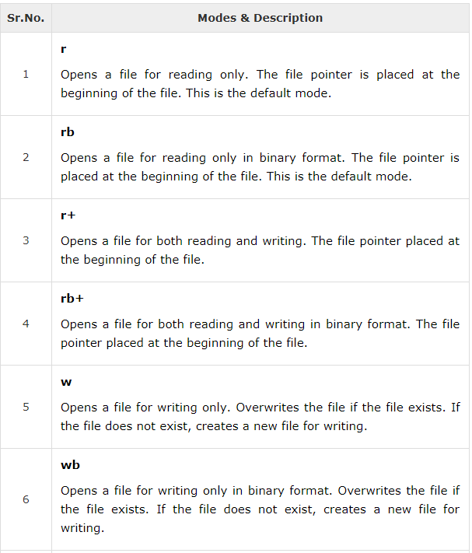
Python File Modes
Ch .Venkata RamiReddy Department Of Computer Science and Engineering

Slide 7
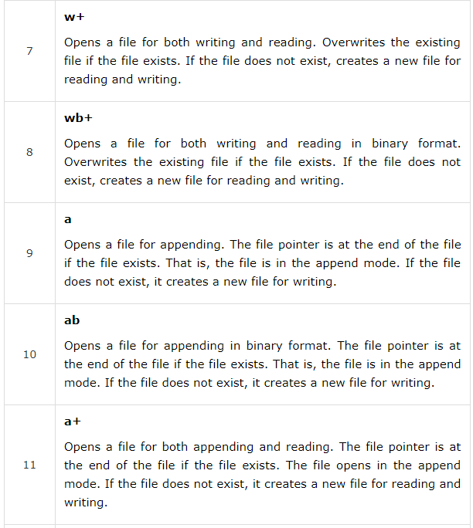
Python File Modes
Ch .Venkata RamiReddy Department Of Computer Science and Engineering

Slide 8
Python File Operations
open()
close()
write()
read()
readLine()
readLines()
tell()
seek()
rename()
Ch .Venkata RamiReddy Department Of Computer Science and Engineering

Slide 9
open()
open() function is used to open a file.
open() returns a file object, also called a “file handle” is a variable used to perform operations on the file.
Syntax: handle= open(filename, mode)
It returns a handle used to manipulate the file.
We can specify the mode while opening a file. In mode, we specify whether we want to read 'r', write 'w' or append 'a' to the file.
We also specify if we want to open the file in text mode or binary mode.
The default is reading in text mode. In this mode, we get strings when reading from the file.
On the other hand, binary mode returns bytes and this is the mode to be used when dealing with non-text files like image or exe files
Ch .Venkata RamiReddy Department Of Computer Science and Engineering

Slide 10
Example
Open.py
f= open('one.txt','r')
for l in f:
print(l)
Output:
hi this cse
vignan
One.txt
hi this cse
vignan
Ch .Venkata RamiReddy Department Of Computer Science and Engineering

Slide 11
close()
close() function is used to close the file.
it closes the file object, after which no more writing can be done.
Syntax: fileObject.close();
Ex:
fo = open("foo.txt", "wb")
print("Name of the file: ", fo.name)
fo.close()
with:
It automatically close the file when the cursor reached the end of the file.
Syntax: with open(“filename”) as f:
Ch .Venkata RamiReddy Department Of Computer Science and Engineering

Slide 12
write()
The write() function writes any string to an open file.
It is used to write the data in to a open file.
In order to write string into a file , we need to open it in write 'w', append 'a' or exclusive creation 'x' mode.
The write() method does not add a newline character ('\n') to the end of the string
Syntax : fileObject.write(string);
Here, passed parameter is the content to be written into the opened file.
This method returns the number of characters written to the file.
Ch .Venkata RamiReddy Department Of Computer Science and Engineering

Slide 13
write()
Ex1:
fo = open("foo.txt","w")
fo.write( "Python is a great language.\nYeah its great!!\n");
fo.close()
Ex2:
fo = open("one.txt","a")
c=fo.write( "\nyes");
print(c)
fo.close()
Ch .Venkata RamiReddy Department Of Computer Science and Engineering

Slide 14
read()
The read() method reads a string from an open file.
To read a file in Python, we must open the file in reading mode.
We can use the read(size) method to read in size number of data.
If size parameter is not specified, it reads and returns up to the end of the file.
Syntax: fileObject.read([count]);
Ex:
f= open('one.txt','r')
str=f.read(5)
print(str)
o/p: hi th
Ch .Venkata RamiReddy Department Of Computer Science and Engineering

Slide 15
readline() & readlines()
readline() method is used to read individual lines of a file.
This method reads a file till the newline.
readlines() method returns every line in the file with separator.
Syntax: fileobject.readline() & fileobject.readlines()
Ex:
f= open('one.txt','r')
print(f.readline()) # it display first line of file o/p : hi this is cse
Ex2:
f= open('one.txt','r')
print(f.readlines())
o/p: [‘ hi this is cse\n’,’vignan’]
Ch .Venkata RamiReddy Department Of Computer Science and Engineering

Slide 16
tell()
The method tell() returns the current position of the file read/write pointer within the file.
Syntax: fileObject.tell()
Ex:
f= open('one.txt','r')
print(f.readline())
print(f.tell())
o/p:
Hi this is cse
16
Ch .Venkata RamiReddy Department Of Computer Science and Engineering

Slide 17
seek()
It is used to change the file pointer position.
The method seek() sets the file's current position at the offset.
Syntax: fileObject.seek(offset, [whence])
offset − This is the position of the read/write pointer within the file.
whence − This is optional and defaults to 0 which means absolute file positioning, other values are 1 which means seek relative to the current position and 2 means seek relative to the file's end.
Ex:
f= open('one.txt','r')
print(f.readline()) #o/p: hi this is cse
f.seek(3,0)
print(f.readline()) #o/p: this is cse
Ch .Venkata RamiReddy Department Of Computer Science and Engineering

Slide 18
rename()
rename() method is used to rename a file or directory.
This method is a part of the os module
Syntax:
os.rename(oldname,newname)
Ex:
import os
os.rename("one2.txt","two.txt")
Ch .Venkata RamiReddy Department Of Computer Science and Engineering

Slide 19
Programs
Write a Python program to read first n lines of a file.
from itertools import islice
f=open("one.txt","r");
n=int(input("no of lines required"))
for line in islice(f,n):
print(line)
Write a Python program to read a file line by line and store it into a list.
f=open("one.txt","r");
l=[]
l=f.readlines();
print(l)
Ch .Venkata RamiReddy Department Of Computer Science and Engineering

Slide 20
Program to count the no of lines ,words and characters in a file
f=open("one.txt","r");
num_lines = 0
num_words = 0
num_chars = 0
for line in f:
num_lines += 1
words=line.split()
num_words +=len(words)
num_chars +=len(line)
print(num_lines)
print(num_words)
print(num_chars)
Ch .Venkata RamiReddy Department Of Computer Science and Engineering

