Slide 1

SEARCH ENGINES
16CS401

Slide 2

Chapter-4
QUERIES AND INTERFACES

Slide 3
Contents
Information Needs
Query Transformation and Refinement
Showing the Results
Retrieval Models
Overview of Retrieval
Probabilistic Models
Ranking based on Language
Application based Models.

Slide 4
Query expansion
Query Transformation and Refinement
Stopping and Stemming Revisited
Spell Checking and Suggestions
Query Expansion
Relevance Feedback
Context and Personalization

Slide 5
Query Expansion
Tumble
Drop
Fall

Slide 6
Query Expansion
In the 1960s, an online thesaurus was considered an essential
tool for the users of the system.
The thesaurus had been used for the document collection,
Thesaurus = synonyms + related words or phrases.
The terms in the thesaurus were carefully chosen and subject to quality control, also referred to as a controlled vocabulary.
Using the thesaurus, users could determine what words and phrases could be used in queries, and could expand an initial query using synonyms and related words.

Slide 7
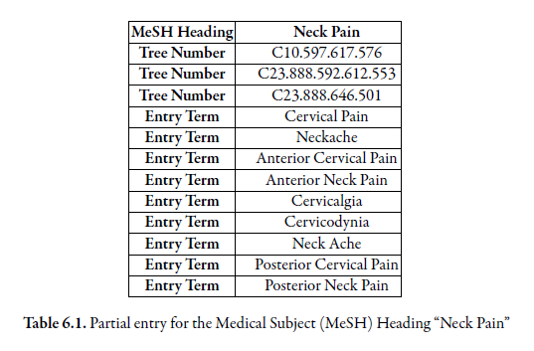
Query Expansion ...
“tree number” entries indicate, using a numbering scheme, where this term is found in the tree of broader and narrow terms.
An “entry term” is a synonym or related phrase for the term.

Slide 8
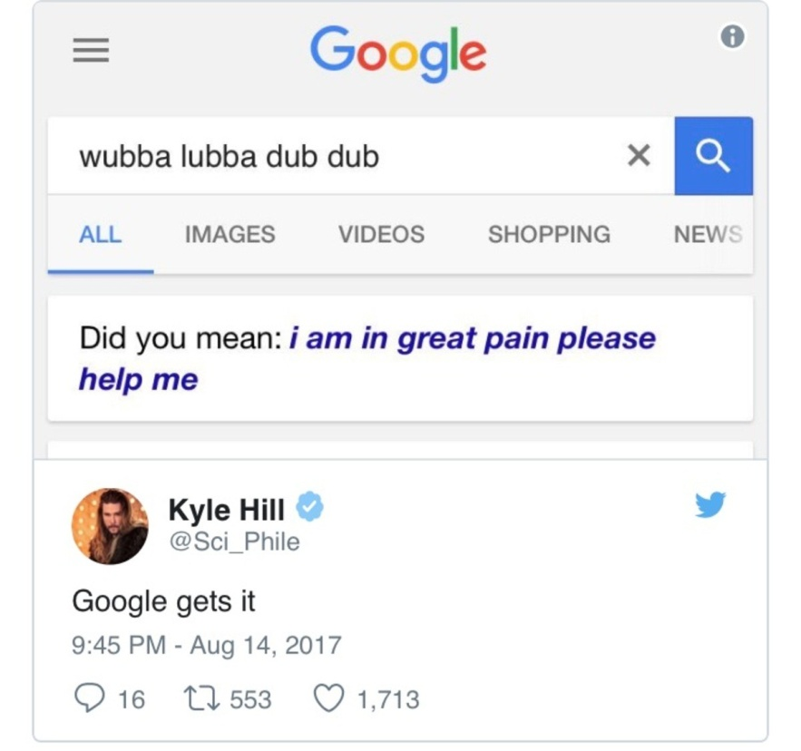
Query Expansion ...
Semi-automatic query
Expansion
A semi-automatic technique requires user interaction such as
selecting the expansion terms from a list suggested by the expansion
Technique, for example, provide query suggestions to the user in the form of the original query words expanded with one or more additional words, or replaced with alternative words.

Slide 9
Query Expansion ...
Query based stemming can also be regarded as a query expansion technique, with the expansion terms limited to word variants.
Automatic expansion techniques that use a general thesaurus, such as Wordnet, have not been shown to be effective.
The key to effective expansion is to choose words that are appropriate for the context, or topic, of the query.
For example, “aquarium” may be a good expansion term for “tank” in the query “tropical fish tanks”, but not appropriate for the query “armor for tanks”.

Slide 10
Approaches for Query Expansion
Term association measures:
Mutual Information
Expected mutual information measure
Pearson’s Chi-squared (χ2) measure
Dice’s coefficient

Slide 11

Query Expansion ...
Dice’s coefficient
na is the number of windows (or documents) containing word a
nb is the number of windows containing word b
nab is the number of windows containing both words a and b
N is the number of text windows in the collection

Slide 12

Query Expansion ...
Mutual Information - used in a number of
studies of word collocation
For two words (or terms) a and b, it is defined as
Measures the extent to which the words occur independently.
P(a) is the probability that word a occurs in a text window of a given size
P(b) is the probability that word b occurs in a text window
P(a, b) is the probability that a and b occur in the same text window.

Slide 13

Query Expansion ...
Mutual Information...
P(a) = na/N, P(b) = nb/N ,P(a, b) = nab/N
where na is the number of windows (or documents) containing
word a, nb is the number of windows containing word b, nab is the number of
windows containing both words a and b, and N is the number of text windows
in the collection.

Slide 14

Query Expansion ...
Expected mutual information measure

Slide 15

Query Expansion ...
Pearson’s Chi-squared (χ2) measure
This measure compares the number of co-occurrences of two words with the expected number of co-occurrences if the two words were independent

Slide 16
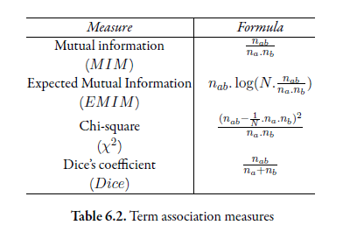
Query Expansion ...

Slide 17
Which is best??
Term association based on single words does not produce good expansion terms, because it does not capture the context of the query.
The best way to capture query context is to use a query log, both to analyze word associations and to find similar queries based on click through data.
If there is no query log available, the best alternative would be to use pseudo-relevance feedback, as described in the next section.

Slide 18
Relevance feedback
Query Transformation and Refinement
Stopping and Stemming Revisited
Spell Checking and Suggestions
Query Expansion
Relevance Feedback
Context and Personalization

Slide 19
Relevance Feedback
- “more like this” feature in some early web search engines
Relevance feedback is a query expansion and refinement technique
with a long history.
First proposed in the 1960s, it relies on user interaction to identify relevant documents in a ranking based on the initial query.
In relevance feedback the user indicates which documents are interesting (i.e., relevant) and possibly which documents are completely off-topic (i.e., non-relevant).
Based on this information, the system automatically reformulates the query by adding terms and reweighting the original terms, and a new ranking is generated using this modified query.

Slide 20
Relevance Feedback ...
Applying machine learning in information retrieval.
training data (the identified relevant and non-relevant documents)
Modifying the query is in fact equivalent to learning a classifier that distinguishes between relevant and non-relevant documents.
Idea : Words occur more frequently in the relevant documents than in the non-relevant documents.
The same idea is used in the technique of pseudo-relevance feedback, where instead of asking the user to identify relevant documents, the system simply assumes that the top-ranked documents are relevant.

Slide 21
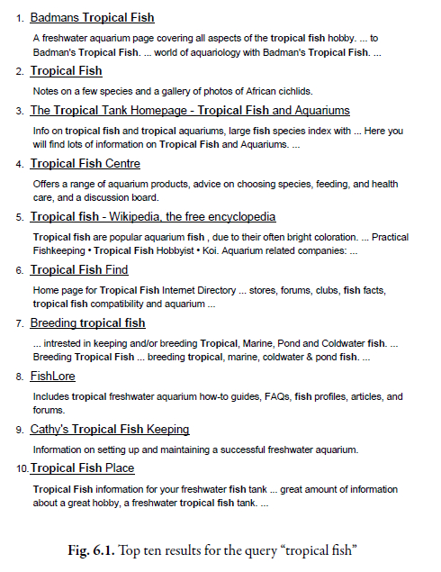
Relevance Feedback ...
a (926)
td (535)
href (495)
http (357)
width (345)
com (343)
nbsp(316)
www (260)
tr (239)
htm (233)
class (225)
jpg (221)

Slide 22
Relevance Feedback ...
These words are not appropriate!!
because they consist of stop words and HTML expressions
In other words, they do not represent the topics covered in the top ranked
documents.
A simple way to refine this process is to count words in the
snippets of the documents and ignore stop words.
This analysis produces the following list of frequent words:
tropical (26), fish (28), aquarium (8), freshwater (5), breeding (4),
information (3), species (3), tank (2), Badman’s (2), page (2), hobby (2),
forums (2)

Slide 23
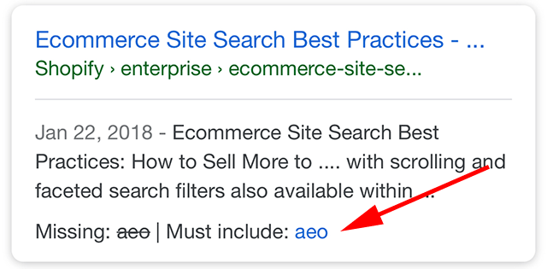
Relevance Feedback ...

Slide 24
Relevance Feedback ...
If the user was, specifically interested in breeding
tropical fish, the expansion terms could be improved using true relevance feedback,
where the document ranked seventh would be explicitly tagged as relevant.
In this case, the most frequent terms are:
breeding (4), fish (4), tropical (4), marine (2), pond (2), coldwater (2),
keeping (1), interested (1)
The major effect of using this list would be to increase the weight of the expansion term “breeding”. The specific weighting, as we have said, depends on the underlying retrieval model.
Although these applications have had some success, the alternative approach
of asking users to choose a different query from a list of suggested queries is currently
more popular

Slide 25
Context & personalization
Query Transformation and Refinement
Stopping and Stemming Revisited
Spell Checking and Suggestions
Query Expansion
Relevance Feedback
Context and Personalization

Slide 26
Context and Personalization
One characteristic of most current search engines is that the results of a query will be the same regardless of
(a) who submitted the query
(b) why the query was submitted,
(c) where the query was submitted
(d) what other queries were submitted in the same session.
All that matters is what words were used to describe the query.
The other factors, known collectively as the query context, will affect the relevance of retrieved documents and could potentially have a significant impact on the ranking algorithm.

Slide 27
Context and Personalization ...
Much research has been done, in particular, on learning user models or profiles to represent a person’s interests so that a search can be personalized.
If the system knew that a person was interested in sports,
for example, the documents
retrieved for the query “vikings” may be different than those retrieved by the same query for a person interested in history.
The most common proposal is to create the profiles based on the
documents that the person looks at, such as web pages visited, email messages, or word processing documents on the desktop.

Slide 28
Context and Personalization ...
Issues with Personalization
Given that documents contain hundreds or even thousands of words, and
the documents visited by the person represent only a snapshot of their
interests, these models are not very specific.
An alternative approach would be to ask the user to describe herself using predefined
categories. In addition to requiring additional (and optional) interactions
that most people tend to avoid.
Another issue that is raised by any approach to personalization based on user
models is privacy.

Slide 29
Context and Personalization ...
Applications of Context
Query logs and clickthrough data to improve web search – Caching
local search, which uses geographic information derived from the query,
or from the location of the device that the query comes from, to modify
the ranking of search results.
Example:
query : “fishing supplies Cape Cod”.

Slide 30
Context and Personalization ...
Local Search
Local search based on queries involves the following steps:
1. Identify the geographic region associated with web pages. This is done either
by using location metadata that has been manually added to the document,
or by automatically identifying locations, such as place names, city names, or
country names, in the document text.
2. Identify the geographic region associated with the query using automatic
techniques. Analysis of query logs has shown that 10–15% of queries contain
some location reference.
3. Rank web pages using a comparison of the query and document location information
in addition to the usual text- and link-based features.

Slide 31
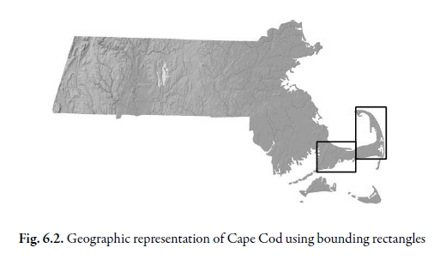
Context and Personalization ...
Local Search

Slide 32

Thank You!!
Stopping and Stemming Revisited
Spell Checking and Suggestions
Query Expansion
Relevance Feedback
Context and Personalization

