Slide 1
UNIT-II
Crawls and Feeds

Slide 2
Crawls and Feeds
Deciding What to Search
Building a search engine, from the mathematics behind ranking to the algorithms of query processing
Great technology can make a good search engine even better
If the right documents are not stored in the search engine, no search technique will be able to find relevant information.
“What should we search?” The simple answer is everything you possibly can.
Every time a search engine adds another document, the number of questions it can answer increases. On the other hand, adding many poor-quality documents increases the burden on the ranking process to find only the best documents to show to the user

Slide 3
Craws and Feeds
Even useful documents can become less useful over time
for example, many people want to know about today’s stock market report, but only a few care about what happened yesterday.
Crawling the Web
To build a search engine that searches web pages, you first need a copy of the pages that you want to search
web pages are particularly easy to copy, since they are meant to be retrieved over the Internet by browsers
How to get the data from the place it is stored to the search engine.
Finding and downloading web pages automatically is called crawling, and a program that downloads pages is called a web crawler
Crawling is also occasionally referred to as spidering, and a crawler is sometimes called a spider

Slide 4
Crawls and Feeds
Challenges to crawling web pages
sheer scale of the Web. There are at least tens of billions of pages on the Internet.
Web pages are usually not under the control of the people building the search engine database
Retrieving Web Pages
Each web page on the Internet has its own unique uniform resource locator, or URL.
Any URL used to describe a web page has three parts: the scheme, the hostname,and the resource name

Slide 5
Crawls and Feeds
Web pages are stored on web servers, which use a protocol called Hypertext Transfer Protocol, or HTTP, to exchange information with client software
The computer’s name is www.cs.umass.edu, which is a computer in the University of Massachusetts Computer Science department. This URL refers to a page on that computer called /csinfo/people.html.
http:// www.cs.umass.edu /csinfo/people.html
scheme hostname resource

Slide 6
Crawls and Feeds
Web browsers and web crawlers are two different kinds of web clients, but both fetch web pages in the same way.
First, the client program connects to a domain name system (DNS) server. The DNS server translates the hostname into an internet protocol (IP) address. This IP address is a number that is typically 32 bits long, but some networks now use 128-bit IP addresses
The program then attempts to connect to a server computer with that IP address.
Once the connection is established, the client program sends an HTTP request to the web server to request a page. The most common HTTP request type is a GET request, for example:
GET /csinfo/people.html HTTP/1.0

Slide 7
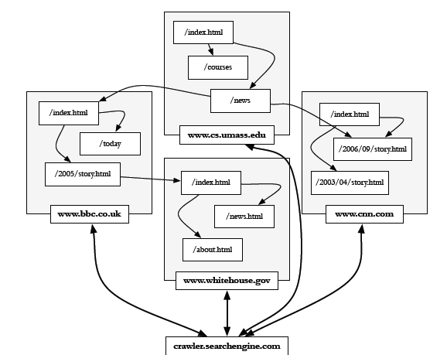
Crawls and Feeds
A client can also fetch web pages using POST requests. A POST request is like a GET request, except that it can send additional request information to the server.

Slide 8
Crawls and Feeds
The Web Crawler
The web crawler has two jobs: downloading pages and finding URLs
The crawler starts with a set of seeds, which are a set of URLs given to it as parameters. These seeds are added to a URL request queue. The crawler starts fetching pages from the request queue
Once a page is downloaded, it is parsed to find link tags that might contain other useful URLs to fetch
If the crawler finds a new URL that it has not seen before, it is added to the crawler’s request queue, or frontier

Slide 9
Crawls and Feeds
Freshness
Web pages are constantly being added, deleted, and modified
To keep an accurate view of the Web, a web crawler must continually revisit pages it has already crawled to see if they have changed in order to maintain the freshness of the document collection
The opposite of a fresh copy is a stale copy, which means a copy that no longer reflects the real content of the web page
The HTTP protocol has a special request type called HEAD that makes it easy to check for page changes. The HEAD request returns only header information about the page, but not the page itself
The Last-Modified value indicates the last time the page content was changed

Slide 10
Crawls and Feeds
Freshness
Web crawler can’t update every page immediately as it changes, the crawler needs to have some metric for measuring crawl freshness
Under the freshness metric, a page is fresh if the crawl has the most recent copy of a web page, but stale otherwise. Freshness is then the fraction of the crawled pages that are currently fresh
Under the age metric, the page has age 0 until it is changed,and then its age grows until the page is crawled again

Slide 11
Crawls and Feeds
Focused Crawling
A search engine that focuses on a specific topic of information.
For instance, at a website about movies, users might want access to a search engine that leads to more information about movies
Vertical search can provide higher accuracy than general search because of the lack of extraneous information in the document collection
The computational cost of running a vertical search will also be much less than a full web search
A less expensive approach is focused, or topical, crawling A focused crawler attempts to download only those pages that are about a particular topic

Slide 12
Crawls and Feeds
Deep Web
Not all parts of the Web are easy for a crawler to navigate. Sites that are difficult for a crawler to find are collectively referred to as the deep Web (also called the hidden Web)
Deep Web is over a hundred times larger than the traditionally indexed Web, although it is very difficult to measure this accurately
Most sites that are a part of the deep Web fall into three broad categories
Private sites are intentionally private
They may have no incoming links, or may require you to log in with a valid account before using the rest of the site

Slide 13
Crawls and Feeds
Form results are sites that can be reached only after entering some data into a
Scripted pages are pages that use JavaScript

Slide 14
Crawls and Feeds
Sitemaps
The biggest problems in crawling arise because site owners cannot adequately tell crawlers about their sites
Site owners sometimes have data that they would like to expose to a search engine, but they can’t because there is no reasonable place to store the links. Sitemaps solve both of these problems
A sitemap contains a list of URLs and data about those URLs, such as modification time and modification frequency

Slide 15
Crawls and Feeds
Distributed Crawling
For crawling individual websites, a single computer is sufficient. However, crawling the entire Web requires many computers devoted to crawling
Three reasons
One reason to use multiple computers is to put the crawler closer to the sites it crawls. Long-distance network connections tend to have lower throughput (fewer bytes copied per second) and higher latency (bytes take longer to cross the network)
Another reason for multiple crawling computers is to reduce the number of sites the crawler has to remember. A crawler has to remember all of the URLs it has already crawled, and all of the URLs that it has queued to crawl

Slide 16
Crawls and Feeds
Distributed Crawling
Yet another reason is that crawling can use a lot of computing resources, including CPU resources for parsing and network bandwidth for crawling pages. Crawling a large portion of the Web is too much work for a single computer to handle
A distributed crawler is much like a crawler on a single computer, except instead of a single queue of URLs, there are many queues. The distributed crawler uses a hash function to assign URLs to crawling computers

Slide 17
Crawls and Feeds
Crawling Documents and Email
Web is a tremendous information resource, a huge amount of digital information is not stored on websites
we will consider information that you might find on a normal desktop computer, such as email, word processing documents, presentations, or spreadsheets. This information can be searched using a desktop search tool
In companies and organizations, enterprise search will make use of documents on file servers, or even on employee desktop computers, in addition to local web pages

Slide 18
Crawls and Feeds
Many of the problems of web crawling change when we look at desktop data. In web crawling, just finding the data can be a struggle. On a desktop Computer, The interesting data is stored in a file system with familiar semantics
Finding all the files on a hard disk is not particularly difficult, since file systems have directories that are easy to discover. In some ways, a file system is like a web server, but with an automatically generated sitemap
There are unique challenges in crawling desktop data, however. The first concerns update speed,Disk space is another concern

Slide 19
Crawls and Feeds
Document Feeds
Web or desktop crawling, we assume that any document can be created or modified at any time
However, many documents are published, meaning that they are created at a fixed time and rarely updated again
News articles, blog posts,press releases, and email are some of the documents that fit this publishing model. Most information that is time-sensitive is published
Each published document has an associated time, published documents from a single source can be ordered in a sequence called a document feed

Slide 20
Crawls and Feeds
A document feed is particularly interesting for crawlers, since the crawler can easily find all the new documents by examining only the end of the feed
We can distinguish two kinds of document feeds, push and pull. A push feed alerts the subscriber to new documents This is like a telephone, which alerts you to an incoming phone call
A pull feed requires the subscriber to check periodically for new documents; this is like checking your mailbox for new mail to arrive.

Slide 21
Crawls and Feeds
The Conversion Problem
Search engines are built to search through text. Unfortunately, text is stored on computers in hundreds of incompatible file formats. Standard text file formats include raw text, RTF, HTML, XML, Microsoft Word, ODF (Open Document Format) and PDF (Portable Document Format)
The most common way to handle a new file format is to use a conversion tool that converts the document content into a tagged text format such as HTML or XML

Slide 22
Crawls and Feeds
Character Encodings
Even HTML files are not necessarily compatible with each other because of character encoding issues. The text that you see on this page is a series of little pictures we call letters or glyphs.
Of course, a computer file is a stream of bits, not a collection of pictures. A character encoding is a mapping between bits and glyphs

Slide 23
Storing the Documents
After documents have been converted to some common format, they need to be stored in preparation for indexing
Document storage is required only for some applications
In desktop search, for example, the documents are already stored in the file system and do not need to be copied elsewhere
As the crawling process runs, it can send converted documents immediately to an indexing process, By not storing the intermediate converted documents
Other kinds of search engines need to store documents somewhere
Fast access to the document text is required in order to build document snippets for each search result. These snippets of text give the user an idea of what is inside the retrieved document without actually needing to click on a link

Slide 24
Requirements for document storage system:
Random access
request the content of a document based on its URL
hash function based on URL is typical
Compression and large files
reducing storage requirements and efficient access
Update
handling large volumes of new and modified documents
adding new anchor text

Slide 25
Using a Database System
Relational database would be a good place to store document data
For many applications, in fact, a database is an excellent place to store documents. A database takes care of the difficult details of storing small pieces of data, such as web pages, and makes it easy to update them later
Major search engines use conventional relational databases to store documents. One problem is the sheer volume of document data, which can overwhelm traditional database systems

Slide 26
Random Access
To retrieve documents quickly in order to compute a snippet for a search result, the document store needs to support random access
We want a data store such that we can request the content of a document based on its URL
Using a hash function on the URL gives us a number we can use to find the data
For small installations, the hash function can tell us which file contains the document. For larger installations, the hash function tells us which server contains the document
Once the document location has been narrowed down to a single file, a B-Tree or sorted data structure can be used

Slide 27
Compression and Large Files
The document storage system should make use of large files and compression
For example, this chapter is approximately 10,000 words, and those words require about 70K of disk space to store. That is far bigger than the average
web page,
But a modern hard disk can transfer 70K of data in about a millisecond.
However, the hard disk might require 10 milliseconds to seek to that file in order to start reading.
This is why storing each document in its own file is not a very good idea

Slide 28
Large Files
Store many documents in large files, rather than each document in a file
avoids overhead in opening and closing files
reduces seek time relative to read time
Compound documents formats
used to store multiple documents in a file
e.g., TREC Web

Slide 29
TREC Web Format

Slide 30
Compression
Text is highly redundant (or predictable)
Compression techniques exploit this redundancy to make files smaller without losing any of the content
Compression of indexes covered later
Popular algorithms can compress HTML and XML text by 80%
e.g., DEFLATE (zip, gzip) and LZW (UNIX compress, PDF)
may compress large files in blocks to make access faster

Slide 31
BigTable
BigTable is a distributed database system originally built for the task of storing web pages.
A BigTable instance really is a big table; it can be over a petabyte in size, but each database contains only one table.
The table is split into small pieces called tablets, which are served by thousands of machines
In relational databases, you will have encountered SQL(Structured Query Language). SQL allows users to write complex and computationally expensive queries
The Big Table approach is quite different. There is no query language, and therefore no complex queries, and it includes only row-level transactions, which would be considered rather simple by relational database standards

Slide 32
BigTable
Google’s document storage system
Customized for storing, finding, and updating web pages
Handles large collection sizes using inexpensive computers

Slide 33
BigTable
No query language, no complex queries to optimize
Only row-level transactions
Tablets are stored in a replicated file system that is accessible by all BigTable servers
Any changes to a BigTable tablet are recorded to a transaction log, which is also stored in a shared file system
If any tablet server crashes, another server can immediately read the tablet data and transaction log from the file system and take over

Slide 34
BigTable
Logically organized into rows
A row stores data for a single web page
Combination of a row key, a column key, and a timestamp point to a single cell in the row

Slide 35
BigTable
BigTable can have a huge number of columns per row
all rows have the same column groups
not all rows have the same columns
important for reducing disk reads to access document data
Rows are partitioned into tablets based on their row keys
simplifies determining which server is appropriate

Slide 36
Detecting Duplicates
Duplicate and near-duplicate documents occur in many situations. Making copies and creating new versions of documents is a constant activity in offices
Keeping track of these is an important part of information management, this situation is more extreme in web
In addition to the normal sources of duplication, plagiarism and spam are common
Multiple URLs to point to the same web page and mirror sites can cause a crawler to generate large numbers of duplicate pages

Slide 37
Detecting Duplicates
Duplicate and near-duplicate documents occur in many situations
Copies, versions, plagiarism, spam, mirror sites
30% of the web pages in a large crawl are exact or near duplicates of pages in the other 70%
Duplicates consume significant resources during crawling, indexing, and search
Little value to most users

Slide 38
Duplicate Detection
Exact duplicate detection is relatively easy
Checksum techniques
A checksum is a value that is computed based on the content of the document
For example, the checksum for a file containing the text “Tropical fish” would be computed as follows (in hex):
e.g., sum of the bytes in the document file
A file containing the same characters in a different order would have the same checksum
Functions such as a cyclic redundancy check (CRC), have been developed that consider the positions of the bytes

Slide 39
Near-Duplicate Detection
More challenging task
Are web pages with same text context but different advertising or format near-duplicates?
A near-duplicate document is defined using a threshold value for some similarity measure between pairs of documents
e.g., document D1 is a near-duplicate of document D2 if more than 90% of the words in the documents are the same

Slide 40
Detecting Near-Duplicates
There are two scenarios for near-duplicate detection. One is the search scenario, where the goal is to find near-duplicates of a given document D.
This, like all search problems, conceptually involves the comparison of the query document to all other documents. For a collection containing N documents
The number of comparisons required will be O(N)
The other scenario, discovery, involves finding all pairs of near-duplicate documents in the collection. This process requires O(N^2) comparisons
word-based representations of documents have been shown to be effective for identifying near-duplicates in the search scenario
The computational requirements of the discovery scenario have meant that new techniques have been developed for deriving compact representations of documents.
These compact representations are known as fingerprints

Slide 41
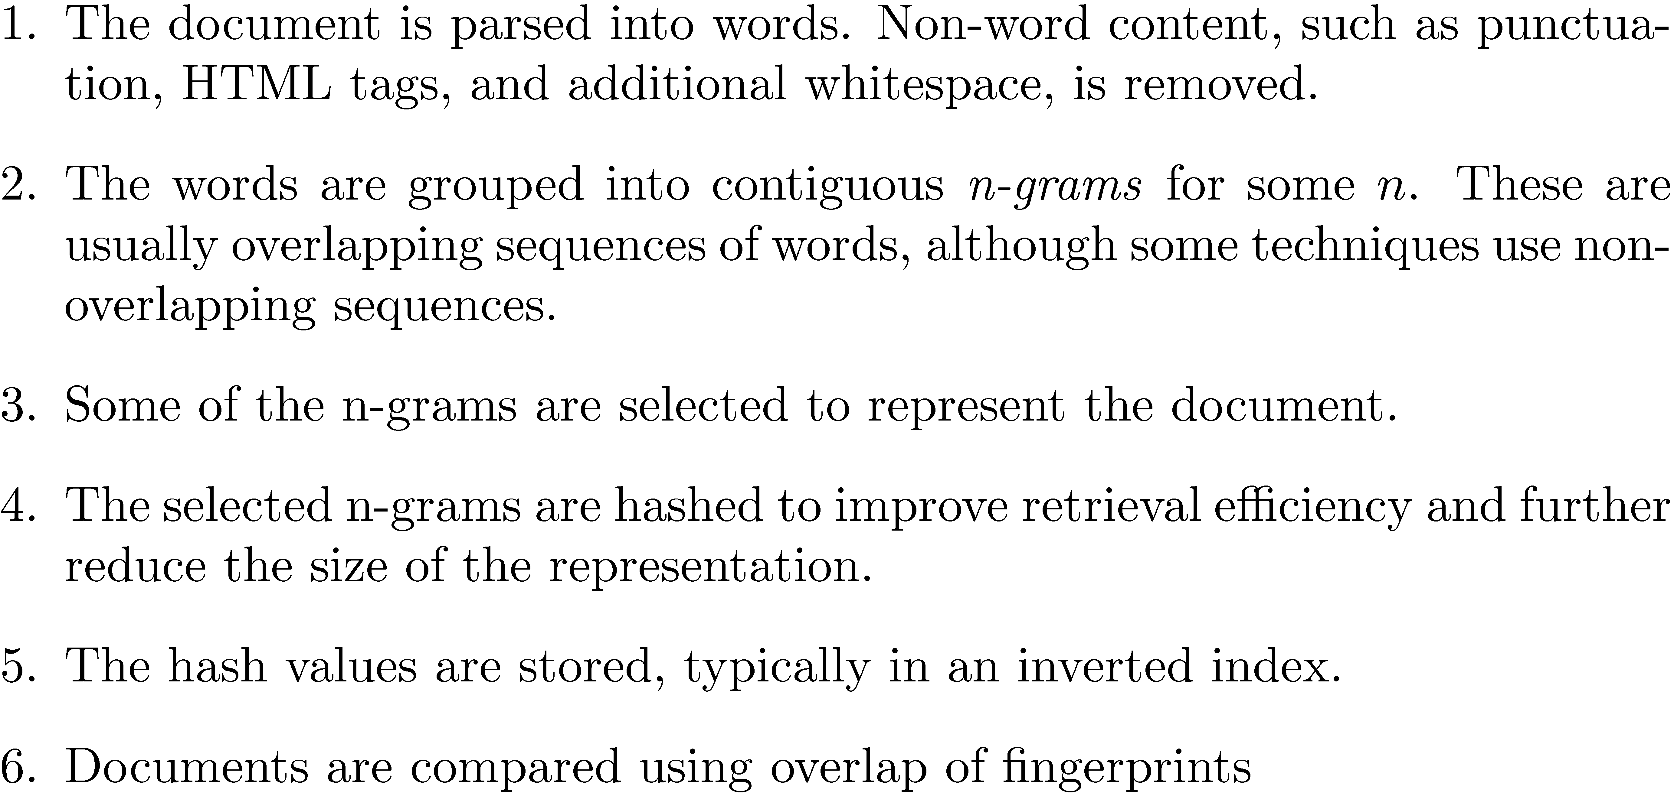
The Basic process of generating fingerprints is as follows

Slide 42
Consider two near-identical documents,D1 andD2. The fingerprints generated from n-grams selected randomly from document D1 are unlikely to have a high overlap with the fingerprints generated from a different
set of n-grams selected randomly from D2. A more effective technique uses pre-specified
combinations of characters, and selects n-grams that begin with those characters. Another popular technique, called 0 mod p, is to select all n-grams
whose hash value modulo p is zero, where p is a parameter

Slide 43
Fingerprint Example

Slide 44
Simhash
Similarity comparisons using word-based representations more effective at finding near-duplicates
Problem is efficiency
Simhash combines the advantages of the word-based similarity measures with the efficiency of fingerprints based on hashing
Similarity of two pages as measured by the cosine correlation measure is proportional to the number of bits that are the same in the simhash fingerprints

Slide 45
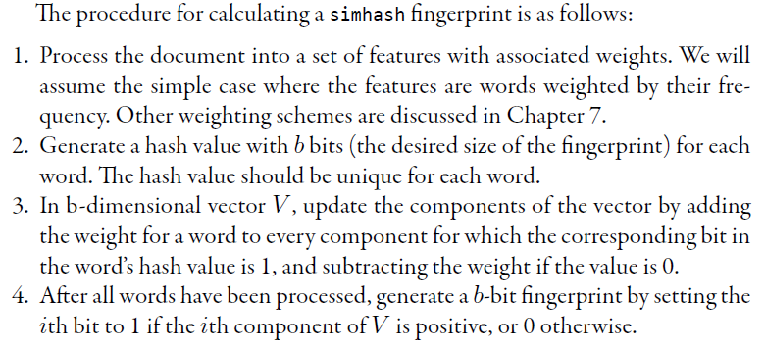

Slide 46
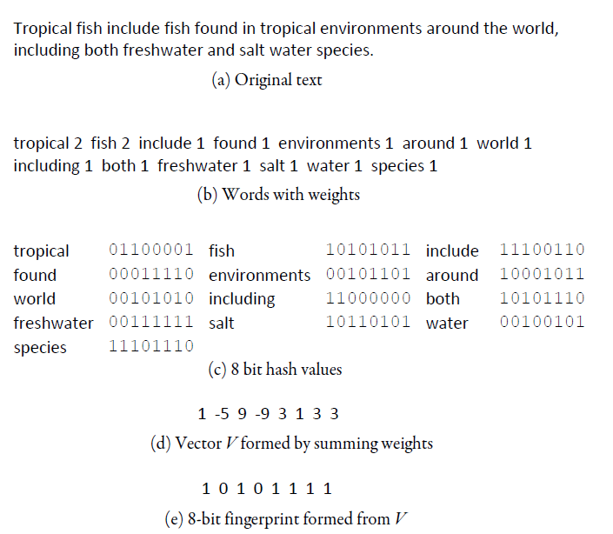

Slide 47
Removing Noise
Many web pages contain text, links, and pictures that are not directly related to the main content of the page
For example The main content of the page (the story) is outlined in black.
This content block takes up less than 20% of the display area of the page, and the rest is made up of banners, advertisements, images, general navigation links, services
This additional material is mostly noise that could negatively affect the ranking of the page
A major component of the representation of a page used in a search engine is based on word counts
Techniques have been developed to detect the content blocks in a web page
Non-content material is either ignored or reduced in importance in the indexing process

Slide 48
Removing Noise
Simple technique based on the observation that there are less HTML tags in the text of the main content of typical web pages than there is in the additional material(also known as a Document slope curve)
Document slope curve shows the cumulative distribution of tags in the example web page from Figure , as a function of the total number of tokens (words or other non-tag strings) in the page
The main text content of the page corresponds to the “plateau” in the middle of the distribution, this flat area is relatively small.

Slide 49
Noise Example

Slide 50
Finding Content Blocks
Cumulative distribution of tags in the example web page
Main text content of the page corresponds to the “plateau” in the middle of the distribution

Slide 51
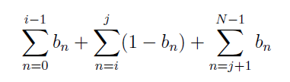
Removing Noise
One way to detect the largest flat area of the distribution is to represent a web page as a sequence of bits, where bn = 1 indicates that the nth token is a tag, and bn = 0 otherwise
The detection of the main content can then be viewed as an optimization problem where we find values of i and j to maximize both the number of tags below i and above j and the number of non-tag tokens between i and j. This corresponds to maximizing the corresponding objective function

Slide 52
Finding Content Blocks
Represent a web page as a sequence of bits, where b_{n} = 1 indicates that the nth token is a tag
Optimization problem where we find values of i and j to maximize both the number of tags below i and above j and the number of non-tag tokens between i and j
i.e., maximize

Slide 53
Removing Noise
The structure of the web page can also be used more directly to identify the content blocks in the page
To display a web page using a browser, an HTML parser interprets the structure of the page specified using the tags, and creates a Document Object Model (DOM) representation
The tree-like structure represented by the DOM can be used to identify the major components of the web page

Slide 54
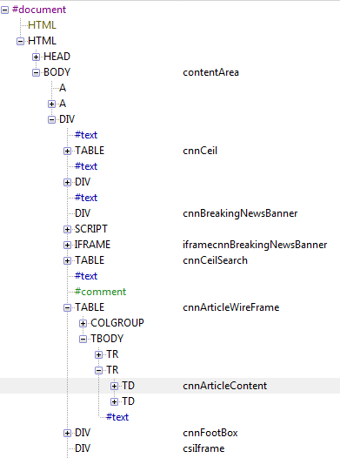
Finding Content Blocks
Other approaches use DOM structure and visual (layout) features

