Slide 1
Processing Text
Converting documents to index terms
Why?
Matching the exact string of characters typed by the user is too restrictive
i.e., it doesn’t work very well in terms of effectiveness
Not all words are of equal value in a search
Sometimes not clear where words begin and end
Not even clear what a word is in some languages
e.g., Chinese, Korean

Slide 2
Text Statistics
Huge variety of words used in text but
Many statistical characteristics of word occurrences are predictable
e.g., distribution of word counts
Retrieval models and ranking algorithms depend heavily on statistical properties of words
e.g., important words occur often in documents but are not high frequency in collection

Slide 3
Zipf’s Law
Distribution of word frequencies is very skewed
a few words occur very often, many words hardly ever occur
e.g., two most common words (“the”, “of”) make up about 10% of all word occurrences in text documents
Zipf’s “law”:
observation that rank (r) of a word times its frequency (f) is approximately a constant (k)
assuming words are ranked in order of decreasing frequency
i.e., r.f ≈ k or r.P_{r} ≈ c, where P_{r} is probability of word occurrence and c ≈ 0.1 for English

Slide 4
Zipf’s Law

Slide 5
News Collection (AP89) Statistics
Total documents 84,678
Total word occurrences 39,749,179
Vocabulary size 198,763
Words occurring > 1000 times 4,169
Words occurring once 70,064
Word Freq. r Pr(%) r.Pr
assistant 5,095 1,021 .013 0.13
sewers 100 17,110 2.56 × 10−4 0.04
toothbrush 10 51,555 2.56 × 10−5 0.01
hazmat 1 166,945 2.56 × 10−6 0.04

Slide 6
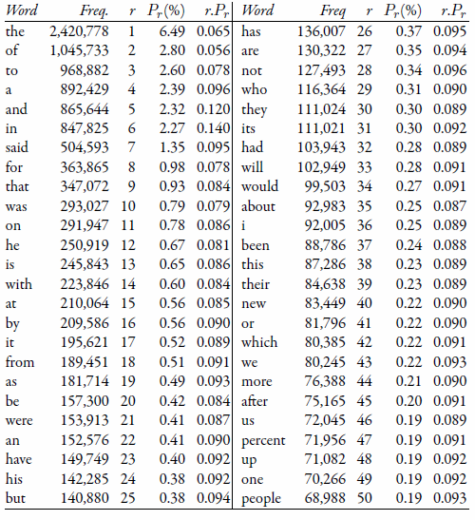
Top 50 Words from AP89

Slide 7
Zipf’s Law for AP89
Note problems at high and low frequencies

Slide 8
Zipf’s Law
What is the proportion of words with a given frequency?
Word that occurs n times has rank rn = k/n
Number of words with frequency n is
r_{n} − r_{n+1} = k/n − k/(n + 1) = k/n(n + 1)
Proportion found by dividing by total number of words = highest rank = k
So, proportion with frequency n is 1/n(n+1)

Slide 9
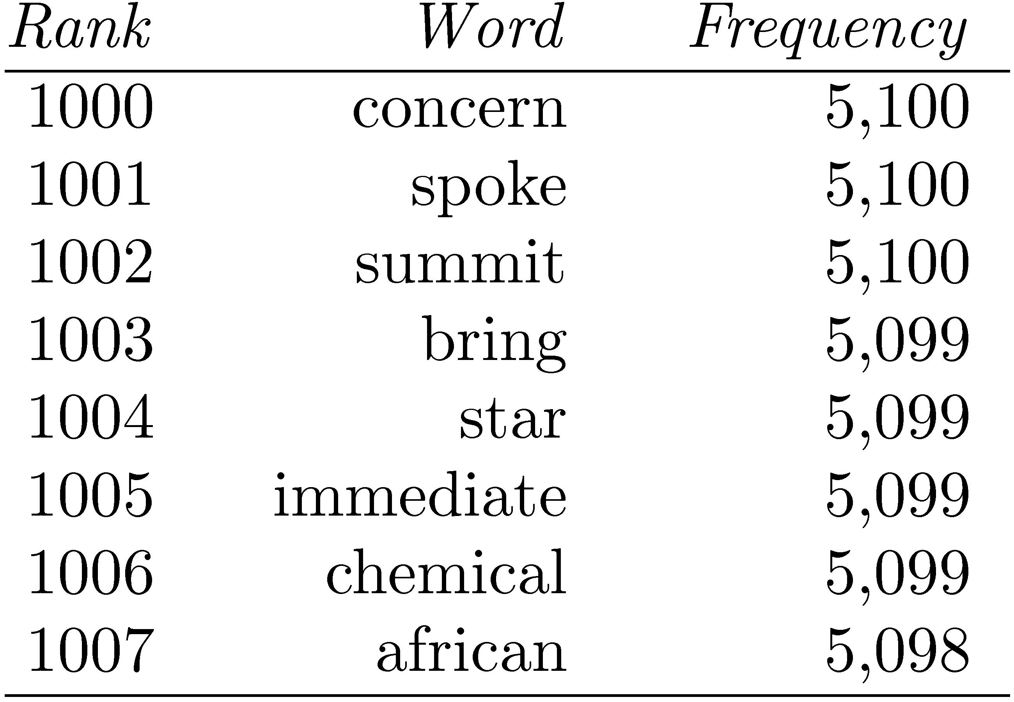
Zipf’s Law
Example word
frequency ranking
To compute number of words with frequency 5,099
rank of “chemical” minus the rank of “summit”
1006 − 1002 = 4

Slide 10
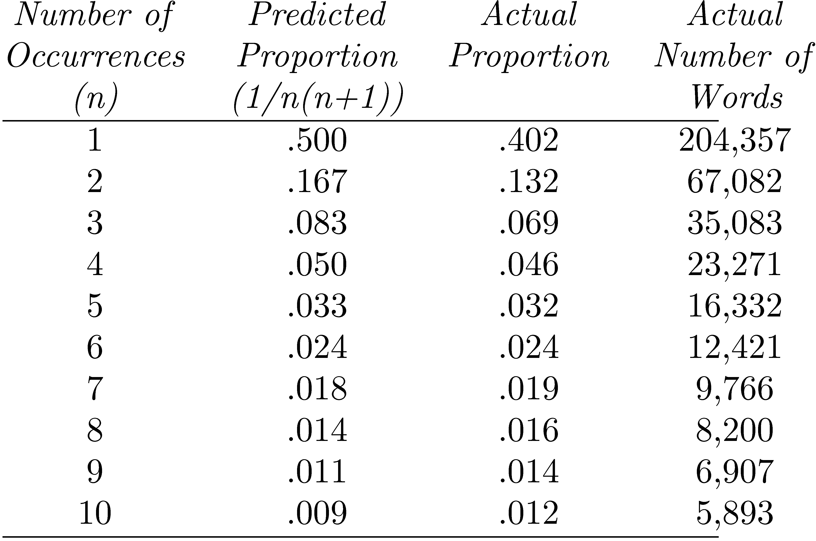
Example
Proportions of words occurring n times in 336,310 TREC documents
Vocabulary size is 508,209

Slide 11
Vocabulary Growth
Prediction related to word occurrence is vocabulary growth, As the size of the corpus grows, new words occur
Assumption of a Zipf distribution for words, we would expect that the number of new words that occur in a given amount of new text would decrease as the size of the corpus increases
The relationship between the size of the corpus and the size of the vocabulary was found empirically by Heaps

Slide 12

where v is the vocabulary size for a corpus of size n words, and k and β are parameters that vary for each collection, referred to as Heaps’ law
Typical values for k and β are often stated to be 10 ≤ k ≤ 100 and β ≈ 0.5
Heaps’ law predicts that the number of new words will increase very rapidly when the corpus is small and will continue to increase indefinitely, but at a slower rate for larger corpora

Slide 13
Vocabulary Growth
Vocabulary growth for the AP89 collection compared to a graph of Heaps’ law with k = 62.95 and β = 0.455.
Clearly, Heaps’ law is a good fit. The parameter values are similar for many of the other TREC news collections
Predictions for TREC collections are accurate for large numbers of words
e.g., first 10,879,522 words of the AP89 collection scanned
prediction is 100,151 unique words
actual number is 100,024
Predictions for small numbers of words (i.e. < 1000) are much worse

Slide 14
AP89 Example
Vocabulary growth for the TREC AP89 collection compared to Heaps’ law

Slide 15
Vocabulary Growth
Web-scale collections are considerably larger than the AP89 collection. The AP89 collection contains about 40 million words, but the TREC Web collection GOV26 contains more than 20 billion words
Figure shows a plot of vocabulary growth for GOV2 together with a graph of Heaps’ law with k = 7.34 and β = 0.648. This data indicates that the number of unique words continues to grow steadily even after reaching 30 million. This has significant implications for the design of search engines

Slide 16
GOV2 (Web) Example
Vocabulary growth for the TREC GOV2 collection compared to Heaps’ law

Slide 17
Estimating Collection and Result Set Sizes
Word occurrence statistics can also be used to estimate the size of the results from a web search
Immediately after the query (“tropical fish aquarium” in this
case) and before the ranked list of results, an estimate of the total number of results is given
To estimate the size of a result set, we first need to define “results.” For the purposes of this estimation, a result is any document (or web page) that contains all of the query words
Some search applications will rank documents that do not contain all the query words, but given the huge size of the Web, this is usually not necessary

Slide 18
Estimating Collection and Result Set Sizes
If we assume that words occur independently of each other, then the probability of a document containing all the words in the query is simply the
product of the probabilities of the individual words occurring in a document. For example, if there are three query words a, b, and c, then
P(a ∩ b ∩ c) = P(a) · P(b) · P(c)
where P(a∩b∩c) is the joint probability, or the probability that all three words occur in a document, and P(a),P(b), and P(c) are the probabilities of each word occurring in a document

Slide 19
Estimating Collection and Result Set Sizes
A search engine will always have access to the number of documents that a word occurs in (fa, fb, and fc),7 and the number of documents in the collection (N), so these probabilities can easily be estimated as P(a) =fa/N, P(b) = fb/N, and P(c) = fc/N
fabc = N · fa/N · fb/N · fc/N = (fa · fb · fc)/N2
where fabc is the estimated size of the result set

Slide 20
Estimating Result Set Size
How many pages contain all of the query terms?
For the query “a b c”:
f_{abc} = N · f_{a}/N · f_{b}/N · f_{c}/N = (f_{a} · f_{b} · f_{c})/N²
Assuming that terms occur independently
f_{abc} is the estimated size of the result set
f_{a}, f_{b}, f_{c} are the number of documents that terms a, b, and c occur in
N is the number of documents in the collection

Slide 21
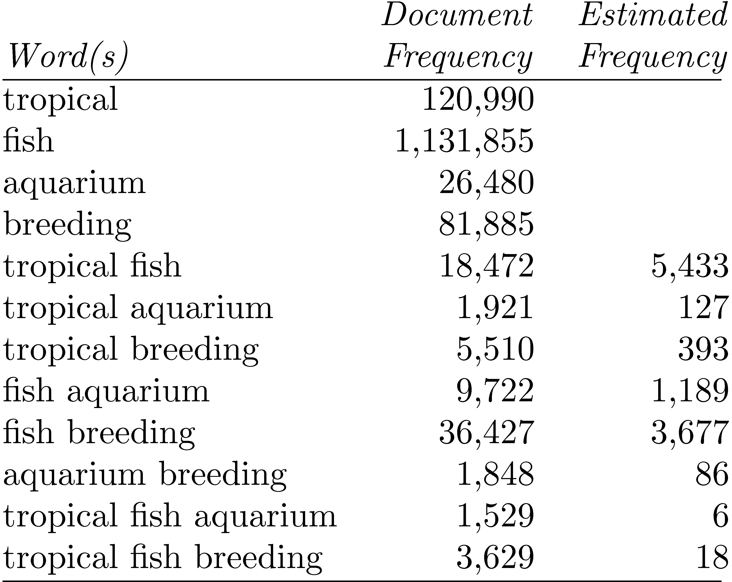
GOV2 Example
Collection size (N) is 25,205,179

Slide 22
Result Set Size Estimation
Better estimates are possible if word co-occurrence information is also available from the search engine.
Obviously, this would give exact answers for two word queries. For longer queries, we can improve the estimate by not assuming independence.
In general, for three words
P(a ∩ b ∩ c) = P(a ∩ b) · P(c|(a ∩ b))
where P(a∩b) is the probability that the words a and b co-occur in a document, and P(c|(a∩b)) is the probability that the word c occurs in a document given that the words a and b occur in the document

Slide 23
Result Set Size Estimation
Poor estimates because words are not independent
Better estimates possible if co-occurrence information available
P(a ∩ b ∩ c) = P(a ∩ b) · P(c|(a ∩ b))
f_{tropical∩fish∩aquarium} = f_{tropical∩aquarium} · f_{fish∩aquarium}/f_{aquarium}
= 1921 · 9722/26480 = 705
f_{tropical∩fish∩breeding} = f_{tropical∩breeding} · f_{fish∩breeeding}/f_{breeding}
= 5510 · 36427/81885 = 2451

Slide 24
Result Set Estimation
Even better estimates using initial result set
Estimate is simply C/s
where s is the proportion of the total documents that have been ranked, and C is the number of documents found that contain all the query words
E.g., “tropical fish aquarium” in GOV2
after processing 3,000 out of the 26,480 documents that contain “aquarium”, C = 258
f_{tropical∩fish∩aquarium} = 258/(3000÷26480) = 2,277
After processing 20% of the documents,
f_{tropical∩fish∩aquarium} = 1,778 (1,529 is real value)

Slide 25
Estimating Collection Size
Important issue for Web search engines
Simple technique: use independence model
Given two words a and b that are independent
f_{ab}/N = f_{a}/N · f_{b}/N
N = (f_{a} · f_{b})/f_{ab}
e.g., for GOV2
f_{lincoln} = 771,326 f_{tropical} = 120,990 f_{lincoln ∩ tropical} = 3,018
N = (120990 · 771326)/3018 = 30,922,045
(actual number is 25,205,179)

Slide 26
Document Parsing
Document parsing involves the recognition of the content and structure of text documents
The primary content of most documents is the words that we were counting and modelling using the Zipf distribution
Recognizing each word occurrence in the sequence of characters in a document is called tokenizing or lexical analysis
Other types of content in a document, such as metadata, images, graphics, code, and tables
Metadata content includes document attributes such as date and author, and, most importantly, the tags that are used by mark up languages to identify document components

Slide 27
Document Parsing
Popular markup languages are HTML (Hypertext Markup Language) and XML (Extensible Markup Language)
The parser uses the tags and other metadata recognized in the document to interpret the document’s structure based on the syntax of the mark up language (syntactic analysis) and to produce a representation of the document that includes both the structure and content
For example, an HTML parser interprets the structure of a web page as specified using HTML tags, and creates a Document Object Model (DOM) representation of the page that is used by a web browser

Slide 28
Tokenizing
Tokenizing is the process of forming words from the sequence of characters in a document
“word” was defined as any sequence of alphanumeric characters of length 3 or more, terminated by a space or other special character
Content and structure that will be used for creating indexes
Example:
“Bigcorp's 2007 bi-annual report showed profits rose 10%.” becomes
“bigcorp 2007 annual report showed profits rose”

Slide 29
Some examples of issues involving tokenizing that can have significant impact on the effectiveness of search are
Small words (one or two characters) can be important in some queries, usually in combinations with other words. For example, xp, ma, pm, ben e king, el paso,master p, gm, j lo, world war II.11
Both hyphenated and non-hyphenated forms of many words are common. In some cases the hyphen is not needed. For example, e-bay, wal-mart, active-x, cd-rom, t-shirts. At other times, hyphens should be considered either as part of the word or a word separator. For example, winston-salem, mazda rx-7, e-cards,pre-diabetes, t-mobile, spanish-speaking.
Special characters are an important part of the tags, URLs, code, and other important parts of documents that must be correctly tokenized
Capitalized words can have different meaning from lowercase words. For example,“Bush” and “Apple”.

Slide 30
Apostrophes can be a part of a word, a part of a possessive, or just a mistake for example, rosie o’donnell, can’t, don’t, 80’s, 1890’s, men’s straw hats, master’s degree, england’s ten largest cities, shriner’s
Numbers can be important, including decimals. For example, nokia 3250, top 10 courses, united 93, quicktime 6.5 pro, 92.3 the beat, 288358 (yes, this was areal query; it’s a patent number).
Periods can occur in numbers, abbreviations (e.g., “I.B.M.”, “Ph.D.”), URLs, ends of sentences, and other situations

Slide 31
Tokenizing Problems
Small words can be important in some queries, usually in combinations
xp, ma, pm, ben e king, el paso, master p, gm, j lo, world war II
Both hyphenated and non-hyphenated forms of many words are common
Sometimes hyphen is not needed
e-bay, wal-mart, active-x, cd-rom, t-shirts
At other times, hyphens should be considered either as part of the word or a word separator
winston-salem, mazda rx-7, e-cards, pre-diabetes, t-mobile, spanish-speaking

Slide 32
Tokenizing Problems
Special characters are an important part of tags, URLs, code in documents
Capitalized words can have different meaning from lower case words
Bush, Apple
Apostrophes can be a part of a word, a part of a possessive, or just a mistake
rosie o'donnell, can't, don't, 80's, 1890's, men's straw hats, master's degree, england's ten largest cities, shriner's

Slide 33
Tokenizing Problems
Numbers can be important, including decimals
nokia 3250, top 10 courses, united 93, quicktime 6.5 pro, 92.3 the beat, 288358
Periods can occur in numbers, abbreviations, URLs, ends of sentences, and other situations
I.B.M., Ph.D., cs.umass.edu, F.E.A.R.
Note: tokenizing steps for queries must be identical to steps for documents

Slide 34
Tokenizing Process
First step is to use parser to identify appropriate parts of document to tokenize
Defer complex decisions to other components
word is any sequence of alphanumeric characters, terminated by a space or special character, with everything converted to lower-case
everything indexed
example: 92.3 → 92 3 but search finds documents with 92 and 3 adjacent
incorporate some rules to reduce dependence on query transformation components

Slide 35
Tokenizing Process
Not that different than simple tokenizing process used in past
Examples of rules used with TREC
Apostrophes in words ignored
o’connor → oconnor bob’s → bobs
Periods in abbreviations ignored
I.B.M. → ibm Ph.D. → ph d

Slide 36
Stopping
Human language is filled with function words: words that have little meaning apart from other words. The most popular—“the,” “a,” “an,” “that,” and “those”—are determiners
Two properties of these function words cause us to want to treat them in a special way in text processing
Keeping track of the quantity of these words in each document requires a lot of disk space
Second, both because of their commonness and
their function, these words rarely indicate anything about document relevance on their own

Slide 37
Stopping
In information retrieval, these function words have a second name: stopwords
We call them stopwords because text processing stops when one is seen, and they are thrown out. Throwing out these words decreases index size, increases retrieval efficiency, and generally improves retrieval effectiveness
Removing too many words will hurt retrieval effectiveness in particularly frustrating ways for the user
A stopword list can be constructed by simply using the top n (e.g., 50) most frequent words in a collection

Slide 38
Stopping
Function words (determiners, prepositions) have little meaning on their own
High occurrence frequencies
Treated as stopwords (i.e. removed)
reduce index space, improve response time, improve effectiveness
Can be important in combinations
e.g., “to be or not to be”

Slide 39
Stopping
Stopword list can be created from high-frequency words or based on a standard list
Lists are customized for applications, domains, and even parts of documents
e.g., “click” is a good stopword for anchor text
Best policy is to index all words in documents, make decisions about which words to use at query time

Slide 40
Stemming
a problem for search engines, which rely on matching words to find relevant documents. Instead of restricting matches to words that are identical, a number of techniques have been developed to allow a search engine to match words that are semantically related
Stemming, also called conflation, is a component of text processing that captures the relationships between different variations of a word
More precisely, stemming reduces the different forms of a word that occur because of inflection (e.g., plurals, tenses) or derivation (e.g., making a verb into a noun by adding the suffix -ation) to a common stem

Slide 41
Stemming
In applications involving highly inflected languages, such as Arabic or Russian, stemming is a crucial part of effective search
There are two basic types of stemmers: algorithmic and dictionary-based
An algorithmic stemmer uses a small program to decide whether two words are related, usually based on knowledge of word suffixes for a particular language.
A dictionary-based stemmer has no logic of its own, but instead relies on pre-created dictionaries of related terms to store term relationships.

Slide 42
Stemming
The simplest kind of English algorithmic stemmer is the suffix-s stemmer. This kind of stemmer assumes that any word ending in the letter “s” is plural, so cakes → cake, dogs → dog
More complicated algorithmic stemmers reduce the number of false negatives by considering more kinds of suffixes, such as -ing or –ed
A dictionary-based stemmer provides a different approach to the problem of stemming errors. Instead of trying to detect word relationships from letter patterns, we can store lists of related words in a large dictionary

Slide 43
Porter Stemmer
The most popular algorithmic stemmer is the Porter stemmer
The stemmer consists of a number of steps, each containing a set of rules for removing suffixes. At each step, the rule for the longest applicable suffix is executed

Slide 44
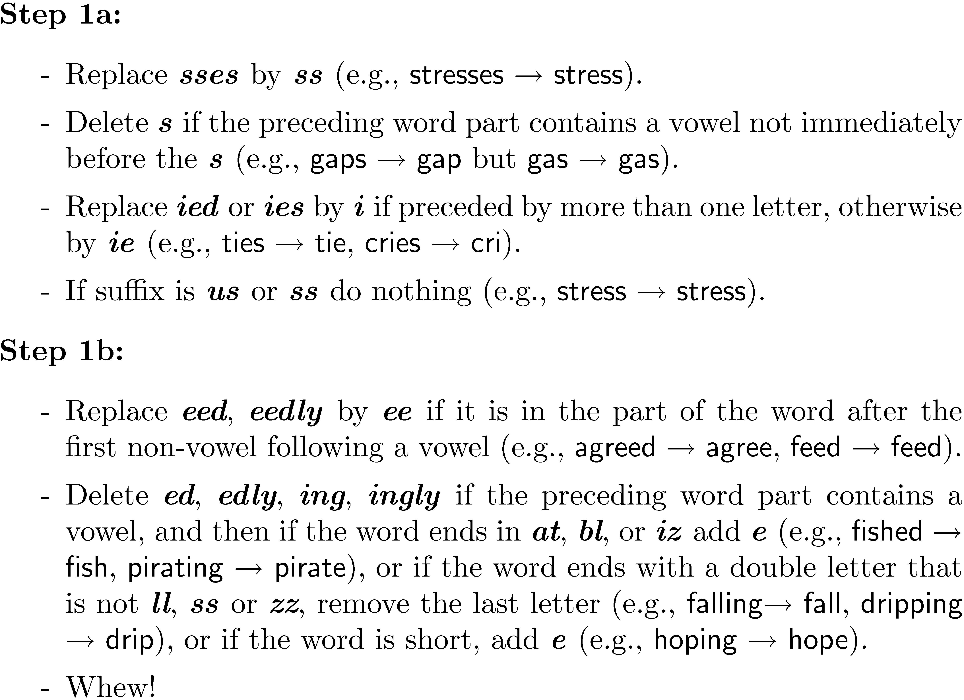
Porter Stemmer
Example step (1 of 5)

Slide 45
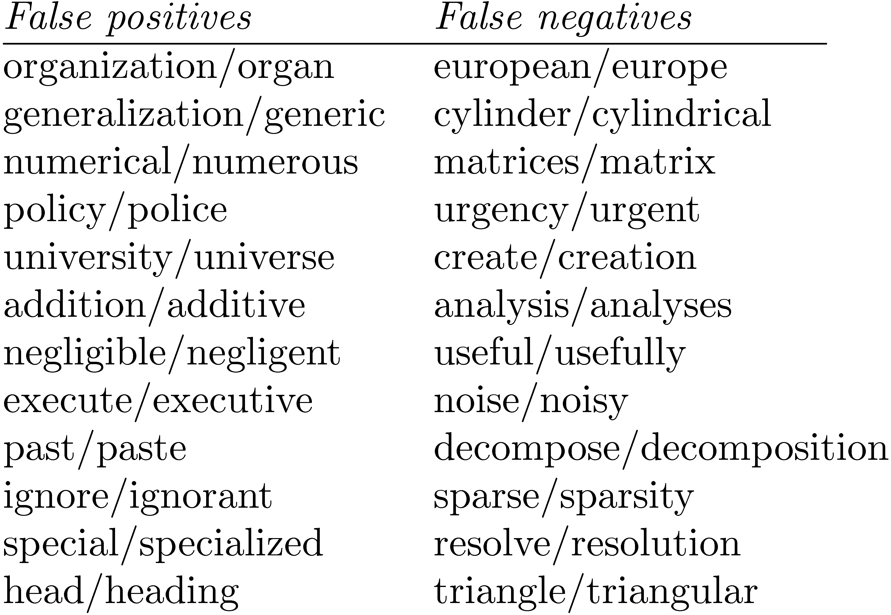
Porter Stemmer
Porter2 stemmer addresses some of these issues
Approach has been used with other languages

Slide 46
Krovetz Stemmer
combine an algorithmic stemmer with a dictionary based stemmer
A dictionary can be used to detect relationships between common words, and the algorithmic stemmer can be used for unrecognized words.
hybrid approach is the Krovetz stemmer (Krovetz,
1993). This stemmer makes constant use of a dictionary to check whether the word is valid. The dictionary in the Krovetz stemmer is based on a general English dictionary but also uses exceptions that are generated manually

Slide 47
Krovetz Stemmer
Hybrid algorithmic-dictionary
Word checked in dictionary
If present, either left alone or replaced with “exception”
If not present, word is checked for suffixes that could be removed
After removal, dictionary is checked again
Produces words not stems
Comparable effectiveness
Lower false positive rate, somewhat higher false negative

Slide 48
Stemmer Comparison

Slide 49
Phrases
Many queries are 2-3 word phrases
Phrases are
More precise than single words
e.g., documents containing “black sea” vs. two words “black” and “sea”
Less ambiguous
e.g., “big apple” vs. “apple”
Can be difficult for ranking
e.g., Given query “fishing supplies”, how do we score documents with
exact phrase many times, exact phrase just once, individual words in same sentence, same paragraph, whole document, variations on words?

Slide 50
Phrases
Text processing issue – how are phrases recognized?
Three possible approaches:
Identify syntactic phrases using a part-of-speech (POS) tagger
Use word n-grams
Store word positions in indexes and use proximity operators in queries

Slide 51
POS Tagging
POS taggers use statistical models of text to predict syntactic tags of words
Example tags:
NN (singular noun), NNS (plural noun), VB (verb), VBD (verb, past tense), VBN (verb, past participle), IN (preposition), JJ (adjective), CC (conjunction, e.g., “and”, “or”), PRP (pronoun), and MD (modal auxiliary, e.g., “can”, “will”).
Phrases can then be defined as simple noun groups, for example

Slide 52
Pos Tagging Example

Slide 53
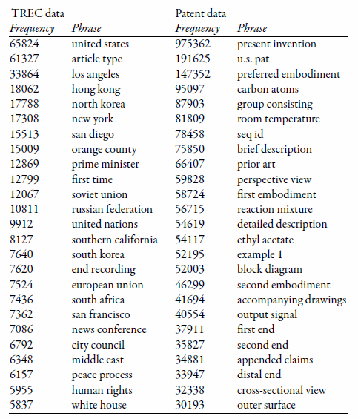
Example Noun Phrases

Slide 54
Word N-Grams
POS tagging too slow for large collections
Simpler definition – phrase is any sequence of n words – known as n-grams
bigram: 2 word sequence, trigram: 3 word sequence, unigram: single words
N-grams also used at character level for applications such as OCR
N-grams typically formed from overlapping sequences of words
i.e. move n-word “window” one word at a time in document

Slide 55
N-Grams
Frequent n-grams are more likely to be meaningful phrases
N-grams form a Zipf distribution
Better fit than words alone
Could index all n-grams up to specified length
Much faster than POS tagging
Uses a lot of storage
e.g., document containing 1,000 words would contain 3,990 instances of word n-grams of length 2 ≤ n ≤ 5

Slide 56
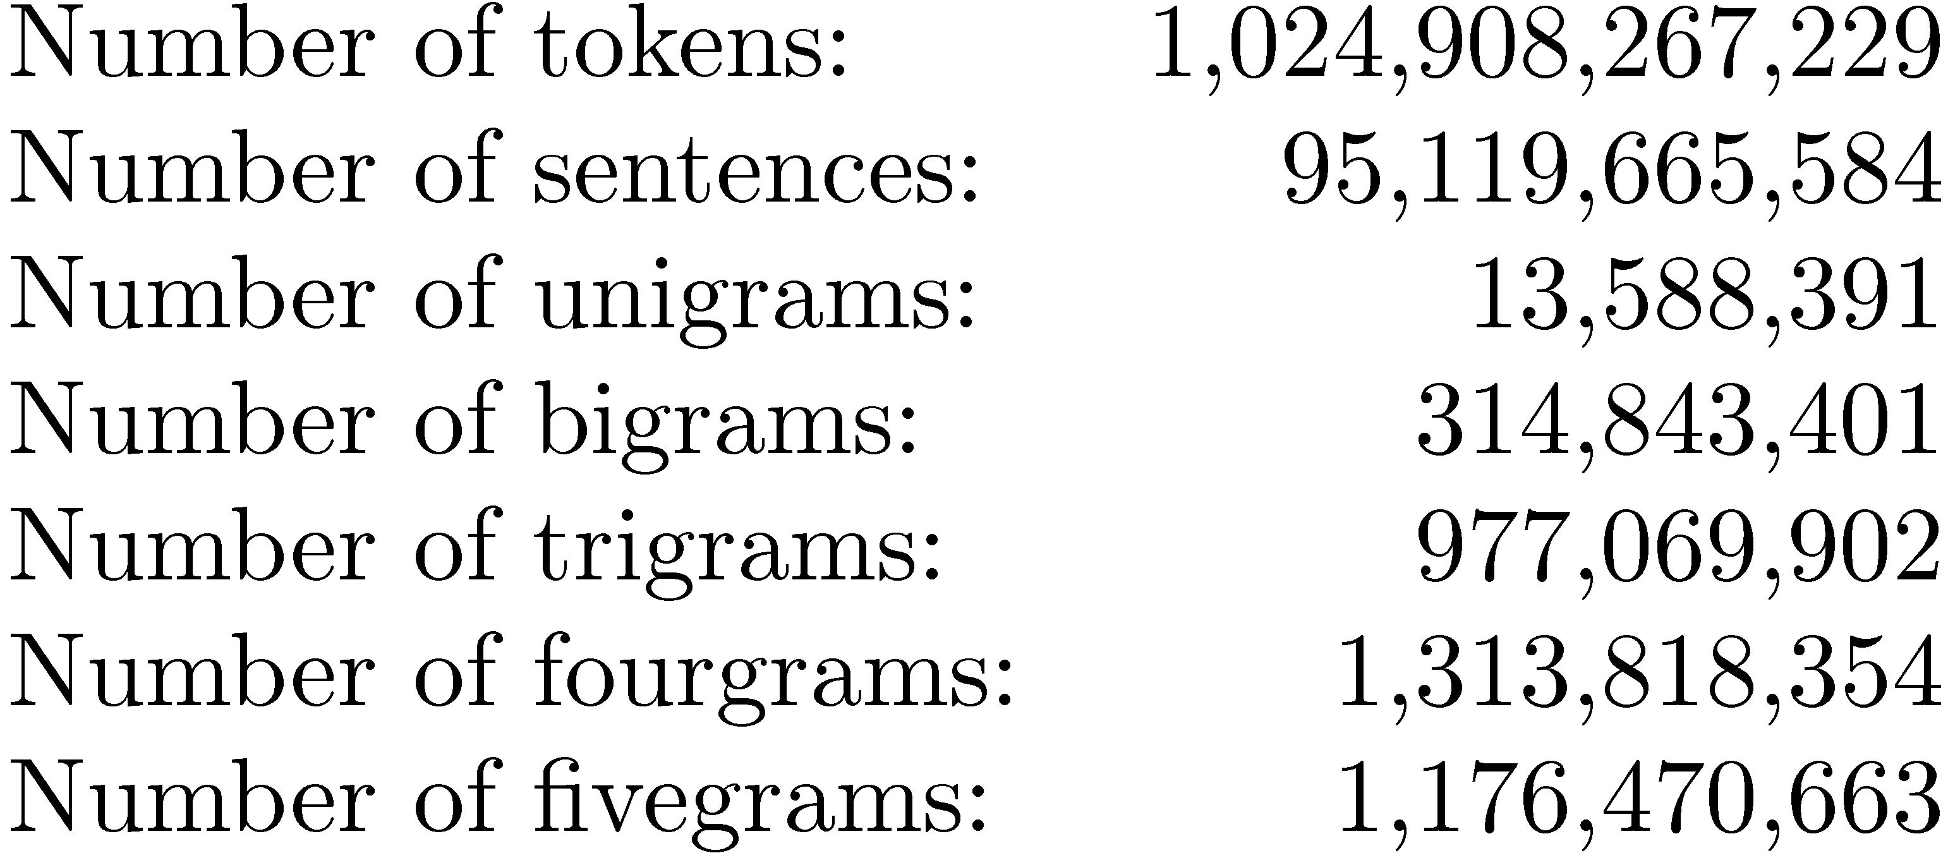
Google N-Grams
Web search engines index n-grams
Google sample:
Most frequent trigram in English is “all rights reserved”
In Chinese, “limited liability corporation”

Slide 57
Document Structure and Markup
Some parts of documents are more important than others
Document parser recognizes structure using markup, such as HTML tags
Headers, anchor text, bolded text all likely to be important
Metadata can also be important
Links used for link analysis

Slide 58
Example Web Page

Slide 59
Example Web Page

Slide 60
Link Analysis
Links are a key component of the Web
Important for navigation, but also for search
e.g., <a href="http://example.com" >Example website</a>
“Example website” is the anchor text
“http://example.com” is the destination link
both are used by search engines

Slide 61
Anchor Text
Used as a description of the content of the destination page
i.e., collection of anchor text in all links pointing to a page used as an additional text field
Anchor text tends to be short, descriptive, and similar to query text
Retrieval experiments have shown that anchor text has significant impact on effectiveness for some types of queries
i.e., more than PageRank

Slide 62
PageRank
Billions of web pages, some more informative than others
Links can be viewed as information about the popularity (authority?) of a web page
can be used by ranking algorithm
Inlink count could be used as simple measure
Link analysis algorithms like PageRank provide more reliable ratings
less susceptible to link spam

Slide 63
Random Surfer Model
Browse the Web using the following algorithm:
Choose a random number r between 0 and 1
If r < λ:
Go to a random page
If r ≥ λ:
Click a link at random on the current page
Start again
PageRank of a page is the probability that the “random surfer” will be looking at that page
links from popular pages will increase PageRank of pages they point to

Slide 64
Dangling Links
Random jump prevents getting stuck on pages that
do not have links
contains only links that no longer point to other pages
have links forming a loop
Links that point to the first two types of pages are called dangling links
may also be links to pages that have not yet been crawled

Slide 65
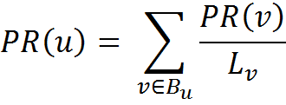
PageRank
PageRank (PR) of page C = PR(A)/2 + PR(B)/1
More generally,
where B_{u} is the set of pages that point to u, and L_{v} is the number of outgoing links from page v (not counting duplicate links)

Slide 66
PageRank
Don’t know PageRank values at start
Assume equal values (1/3 in this case), then iterate:
first iteration: PR(C) = 0.33/2 + 0.33 = 0.5, PR(A) = 0.33, and PR(B) = 0.17
second: PR(C) = 0.33/2 + 0.17 = 0.33, PR(A) = 0.5, PR(B) = 0.17
third: PR(C) = 0.42, PR(A) = 0.33, PR(B) = 0.25
Converges to PR(C) = 0.4, PR(A) = 0.4, and PR(B) = 0.2

Slide 67
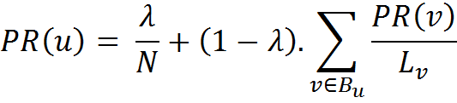
PageRank
Taking random page jump into account, 1/3 chance of going to any page when r < λ
PR(C) = λ/3 + (1 − λ) · (PR(A)/2 + PR(B)/1)
More generally,
where N is the number of pages, λ typically 0.15

Slide 68
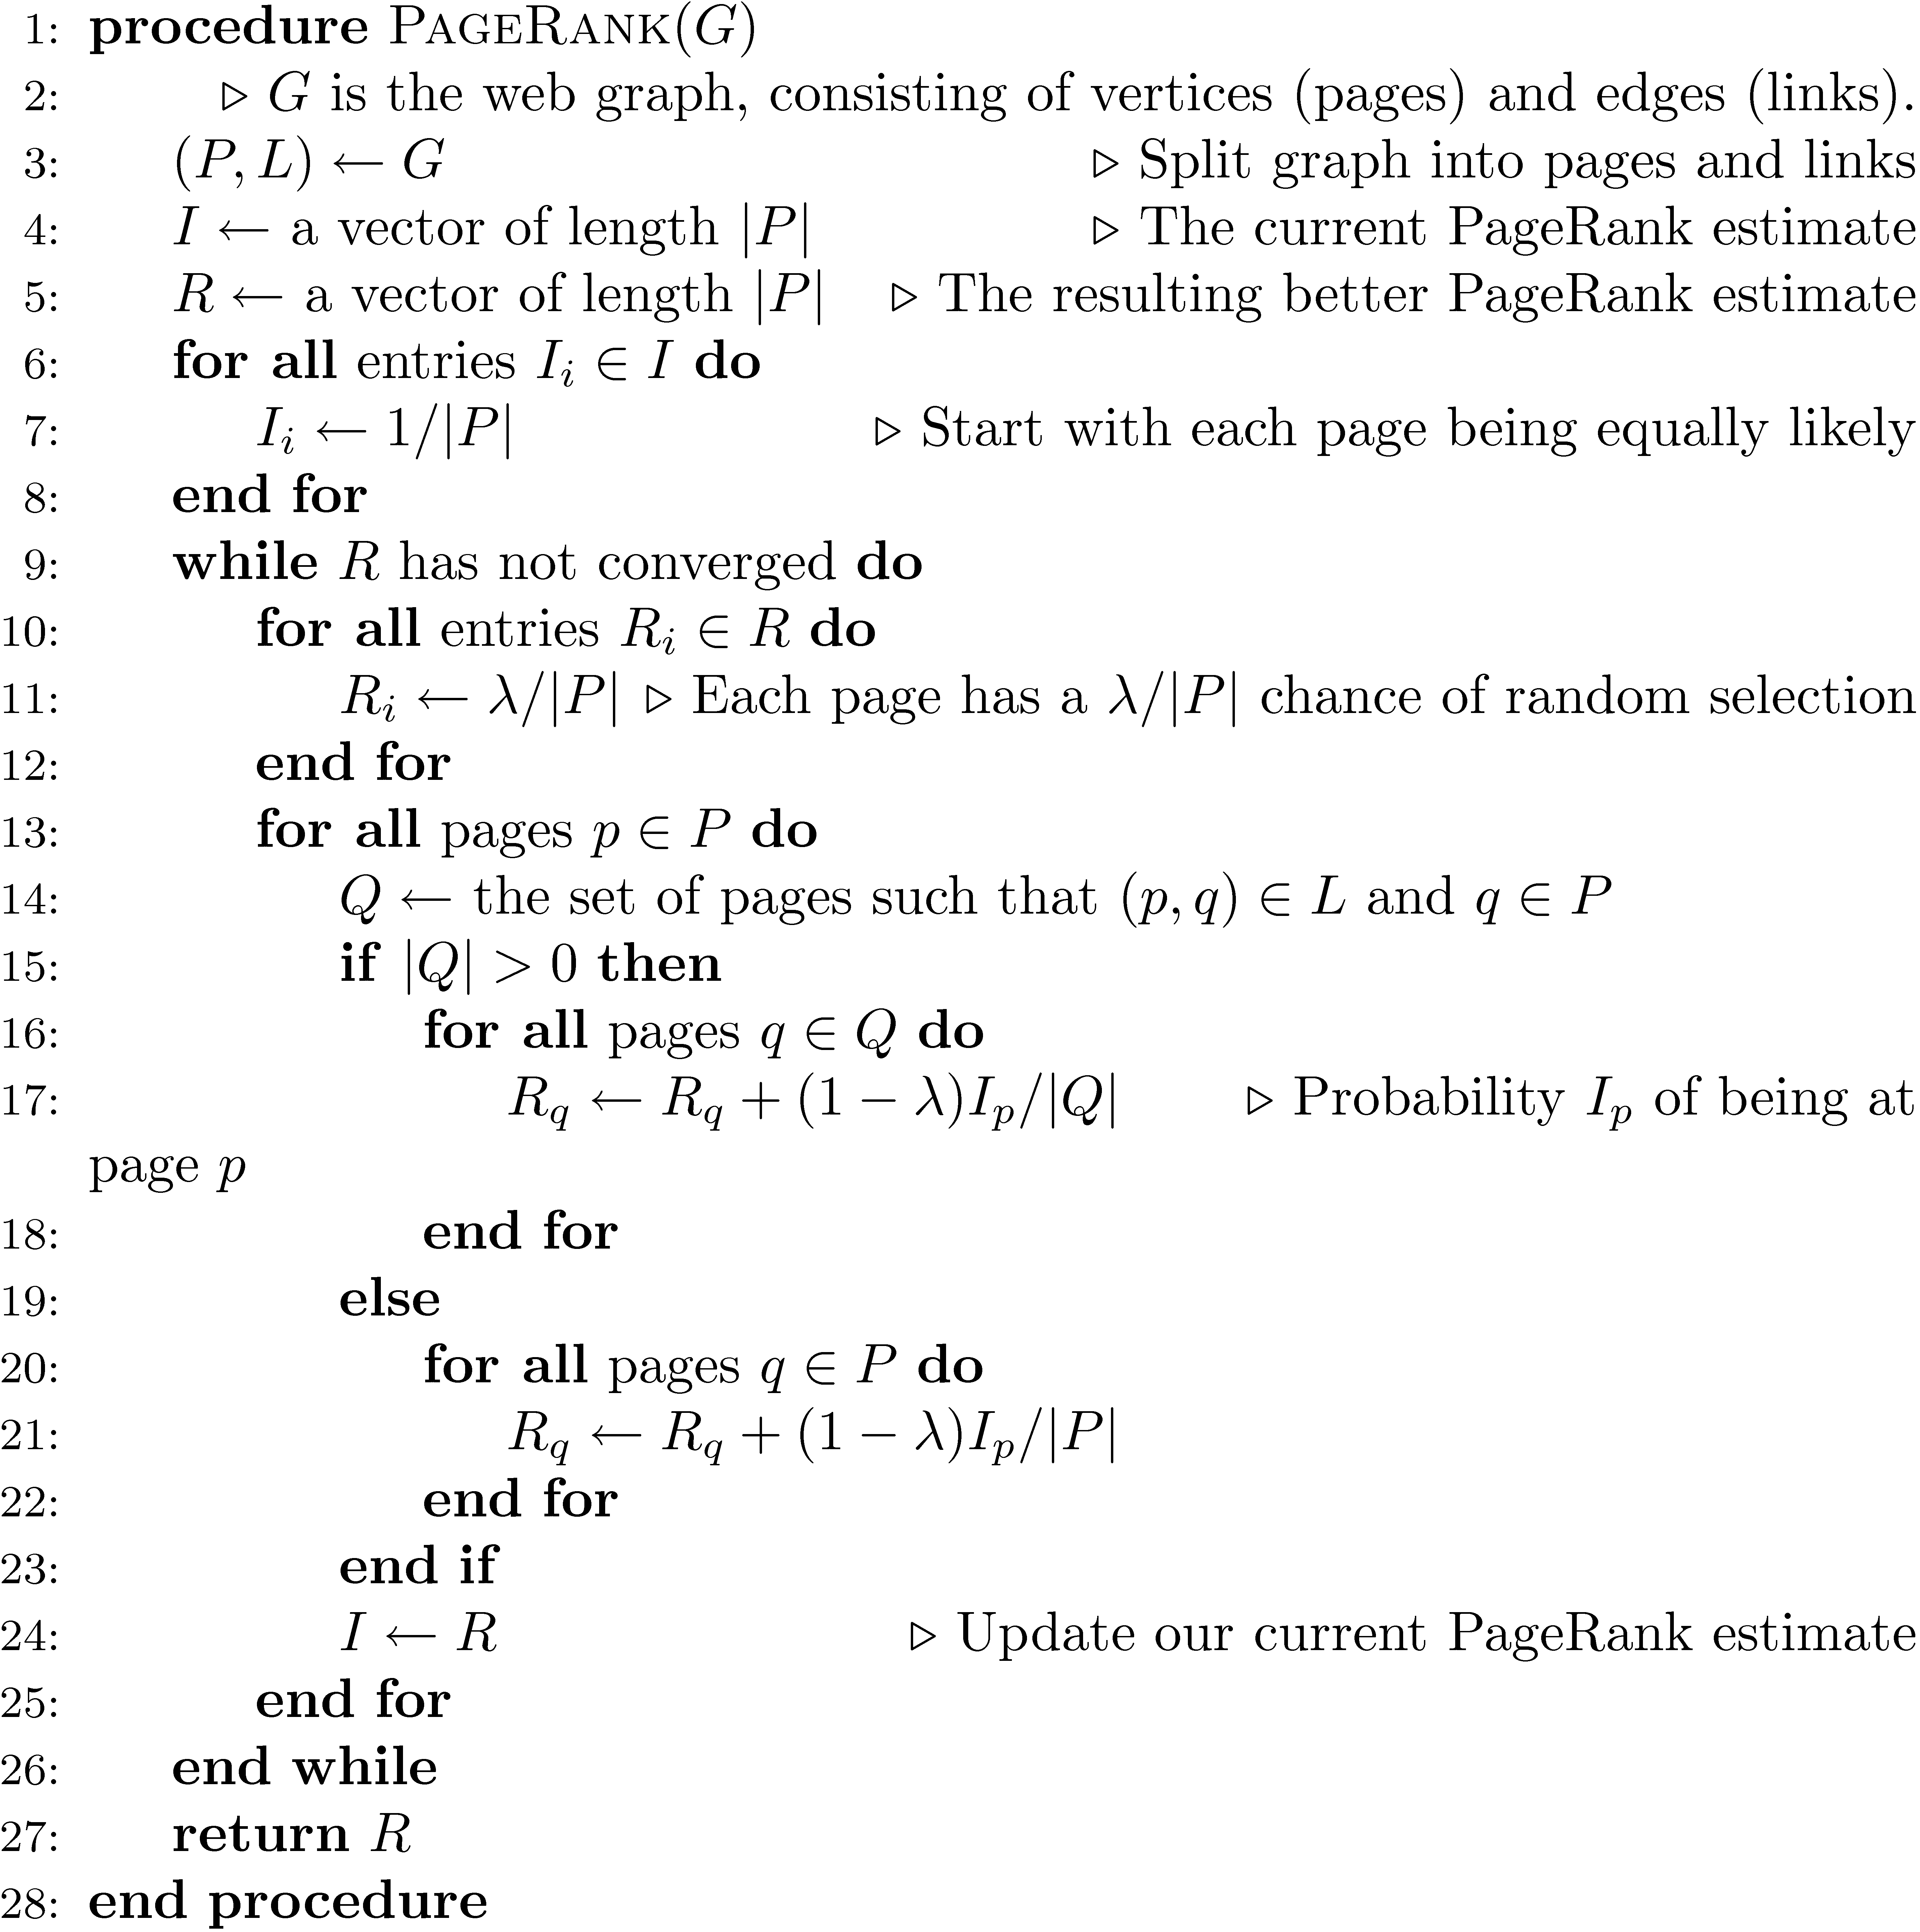

Slide 69
A PageRank Implementation
Preliminaries:
1) Extract links from the source text. You'll also want to extract the URL from each document in a separate file. Now you have all the links (source-destination pairs) and all the source documents
2) Remove all links from the list that do not connect two documents in the corpus. The easiest way to do this is to sort all links by destination, then compare that against the corpus URLs list (also sorted)
3) Create a new file I that contains a (url, pagerank) pair for each URL in the corpus. The initial PageRank value is 1/#D (#D = number of urls)
At this point there are two interesting files:
[L] links (trimmed to contain only corpus links, sorted by source URL)
[I] URL/PageRank pairs, initialized to a constant

Slide 70
A PageRank Implementation
Preliminaries - Link Extraction from .corpus file using Galago
DocumentSplit -> IndexReaderSplitParser -> TagTokenizer
split = new DocumentSplit ( filename, filetype, new byte[0], new byte[0] )
index = new IndexReaderSplitParser ( split )
tokenizer = new.TagTokenizer ( )
tokenizer.setProcessor ( NullProcessor ( Document.class ) )
doc = index.nextDocument ( )
tokenizer.process ( doc )
doc.identifier contains the file’s name
doc.tags now contains all tags
Links can be extracted by finding all tags with name “a”
Links should be processed so that they can be compared with some file name in the corpus

Slide 71
A PageRank Implementation
Iteration:
Steps:
Make a new output file, R.
Read L and I in parallel (since they're all sorted by URL).
For each unique source URL, determine whether it has any outgoing links:
If not, add its current PageRank value to the sum: T (terminals).
If it does have outgoing links, write (source_url, dest_url, Ip/|Q|), where Ip is the current PageRank value, |Q| is the number of outgoing links, and dest_url is a link destination. Do this for all outgoing links. Write this to R.
Sort R by destination URL.
Scan R and I at the same time. The new value of Rp is: (1 - lambda) / #D (a fraction of the sum of all pages) plus: lambda * sum(T) / #D (the total effect from terminal pages), plus: lambda * all incoming mass from step 5. ()
Check for convergence
Write new Rp values to a new I file.

Slide 72
A PageRank Implementation
Convergence check
Stopping criteria for this types of PR algorithm typically is of the form ||new - old|| < tau where new and old are the new and old PageRank vectors, respectively.
Tau is set depending on how much precision you need. Reasonable values include 0.1 or 0.01. If you want really fast, but inaccurate convergence, then you can use something like tau=1.
The setting of tau also depends on N (= number of documents in the collection), since ||new-old|| (for a fixed numerical precision) increases as N increases, so you can alternatively formulate your convergence criteria as ||new – old|| / N < tau.
Either the L1 or L2 norm can be used.

Slide 73
Link Quality
Link quality is affected by spam and other factors
e.g., link farms to increase PageRank
trackback links in blogs can create loops
links from comments section of popular blogs
Blog services modify comment links to contain rel=nofollow attribute
e.g., “Come visit my <a rel=nofollow href="http://www.page.com">web page</a>.”

Slide 74
Trackback Links

Slide 75
Information Extraction
Automatically extract structure from text
annotate document using tags to identify extracted structure
Named entity recognition
identify words that refer to something of interest in a particular application
e.g., people, companies, locations, dates, product names, prices, etc.

Slide 76
Named Entity Recognition
Example showing semantic annotation of text using XML tags
Information extraction also includes document structure and more complex features such as relationships and events

Slide 77
Named Entity Recognition
Rule-based
Uses lexicons (lists of words and phrases) that categorize names
e.g., locations, peoples’ names, organizations, etc.
Rules also used to verify or find new entity names
e.g., “<number> <word> street” for addresses
“<street address>, <city>” or “in <city>” to verify city names
“<street address>, <city>, <state>” to find new cities
“<title> <name>” to find new names

Slide 78
Named Entity Recognition
Rules either developed manually by trial and error or using machine learning techniques
Statistical
uses a probabilistic model of the words in and around an entity
probabilities estimated using training data (manually annotated text)
Hidden Markov Model (HMM) is one approach

Slide 79
HMM for Extraction
Resolve ambiguity in a word using context
e.g., “marathon” is a location or a sporting event, “boston marathon” is a specific sporting event
Model context using a generative model of the sequence of words
Markov property: the next word in a sequence depends only on a small number of the previous words

Slide 80
HMM for Extraction
Markov Model describes a process as a collection of states with transitions between them
each transition has a probability associated with it
next state depends only on current state and transition probabilities
Hidden Markov Model
each state has a set of possible outputs
outputs have probabilities

Slide 81
HMM Sentence Model
Each state is associated with a probability distribution over words (the output)

Slide 82
HMM for Extraction
Could generate sentences with this model
To recognize named entities, find sequence of “labels” that give highest probability for the sentence
only the outputs (words) are visible or observed
states are “hidden”
e.g., <start><name><not-an-entity><location><not-an-entity><end>
Viterbi algorithm used for recognition

Slide 83
Named Entity Recognition
Accurate recognition requires about 1M words of training data (1,500 news stories)
may be more expensive than developing rules for some applications
Both rule-based and statistical can achieve about 90% effectiveness for categories such as names, locations, organizations
others, such as product name, can be much worse

Slide 84
Internationalization
2/3 of the Web is in English
About 50% of Web users do not use English as their primary language
Many (maybe most) search applications have to deal with multiple languages
monolingual search: search in one language, but with many possible languages
cross-language search: search in multiple languages at the same time

Slide 85
Internationalization
Many aspects of search engines are language-neutral
Major differences:
Text encoding (converting to Unicode)
Tokenizing (many languages have no word separators)
Stemming
Cultural differences may also impact interface design and features provided

Slide 86
Chinese “Tokenizing”

