Slide 1
Queries and Interfaces
Information Needs and Queries
Index structures and ranking algorithms are key components of a search engine
User’s point of view the search engine is primarily an interface for specifying queries and examining results

Slide 2
Information Needs
An information need is the underlying cause of the query that a person submits to a search engine
sometimes called information problem to emphasize that information need is generally related to a task
Categorized using variety of dimensions
e.g., number of relevant documents being sought
type of information that is needed
type of task that led to the requirement for information

Slide 3
Information Needs
An information need is the underlying cause of the query that a person submits to a search engine
sometimes called information problem to emphasize that information need is generally related to a task
Categorized using variety of dimensions
e.g., number of relevant documents being sought
type of information that is needed
type of task that led to the requirement for information

Slide 4
Queries and Information Needs
A query can represent very different information needs
May require different search techniques and ranking algorithms to produce the best rankings
A query can be a poor representation of the information need
User may find it difficult to express the information need
User is encouraged to enter short queries both by the search engine interface, and by the fact that long queries don’t work

Slide 5
Interaction
Interaction with the system occurs
during query formulation and reformulation
while browsing the result
Key aspect of effective retrieval
users can’t change ranking algorithm but can change results through interaction
helps refine description of information need
e.g., same initial query, different information needs
how does user describe what they don’t know?

Slide 6
ASK Hypothesis
Belkin et al (1982) proposed a model called Anomalous State of Knowledge
ASK hypothesis:
difficult for people to define exactly what their information need is, because that information is a gap in their knowledge
Search engine should look for information that fills those gaps
Interesting ideas, little practical impact (yet)

Slide 7
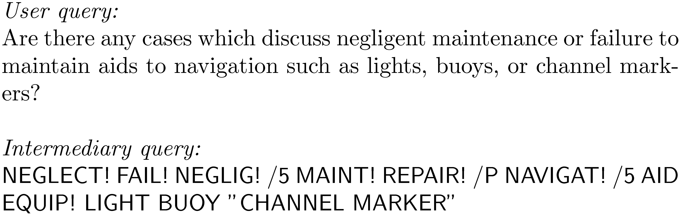
Keyword Queries
Query languages in the past were designed for professional searchers (intermediaries)

Slide 8
This query language uses wildcard operators and various forms of proximity operators to specify the information need
A wildcard operator is used to define the minimum string match required for a word to match the query. For example, NEGLECT! will match “neglected”, “neglects”, or just “neglect”.
A proximity operator is used to define constraints on the distance between words that are required for them to match the query
One type of proximity constraint is adjacency. For example, the quotes around ”CHANNEL MARKER” specify that the two words must occur next to each other

Slide 9
The more general window operator specifies a width (in words) of a text window that is allowed for the match. For example, /5 specifies that the words must occur within five words of each other.
Other typical proximity operators are sentence and paragraph proximity. For example, /P specifies that the words must occur in the same paragraph. In this query language, if no constraint is specified, it is assumed to be a Boolean OR

Slide 10
Query Transformation and Refinement Stopping and Stemming
Simple, natural language queries were designed to enable everyone to search
Current search engines do not perform well (in general) with natural language queries
People trained (in effect) to use keywords
compare average of about 2.3 words/web query to average of 30 words/CQA query
Keyword selection is not always easy
query refinement techniques can help

Slide 11
Query-Based Stemming
Make decision about stemming at query time rather than during indexing
improved flexibility, effectiveness
Query is expanded using word variants
documents are not stemmed
e.g., “rock climbing” expanded with “climb”, not stemmed to “climb”

Slide 12
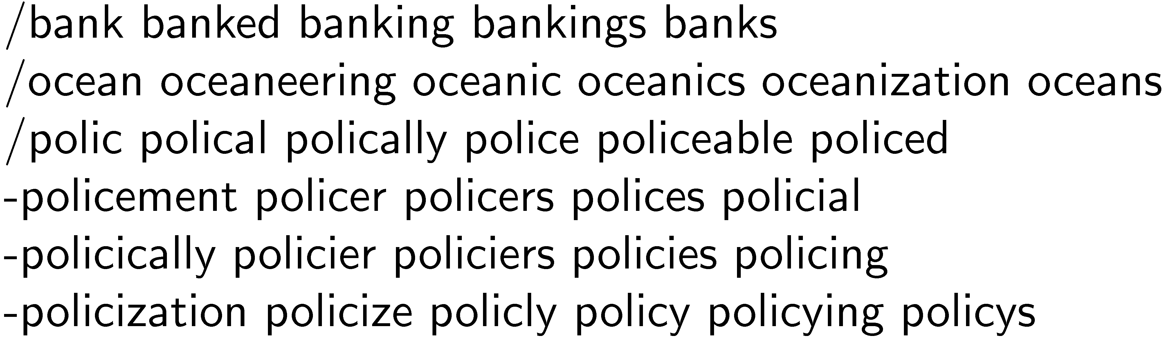
Stem Classes
A stem class is the group of words that will be transformed into the same stem by the stemming algorithm
generated by running stemmer on large corpus
e.g., Porter stemmer on TREC News

Slide 13
Stem Classes
Stem classes are often too big and inaccurate
Modify using analysis of word co-occurrence
Assumption:
Word variants that could substitute for each other should co-occur often in documents

Slide 14
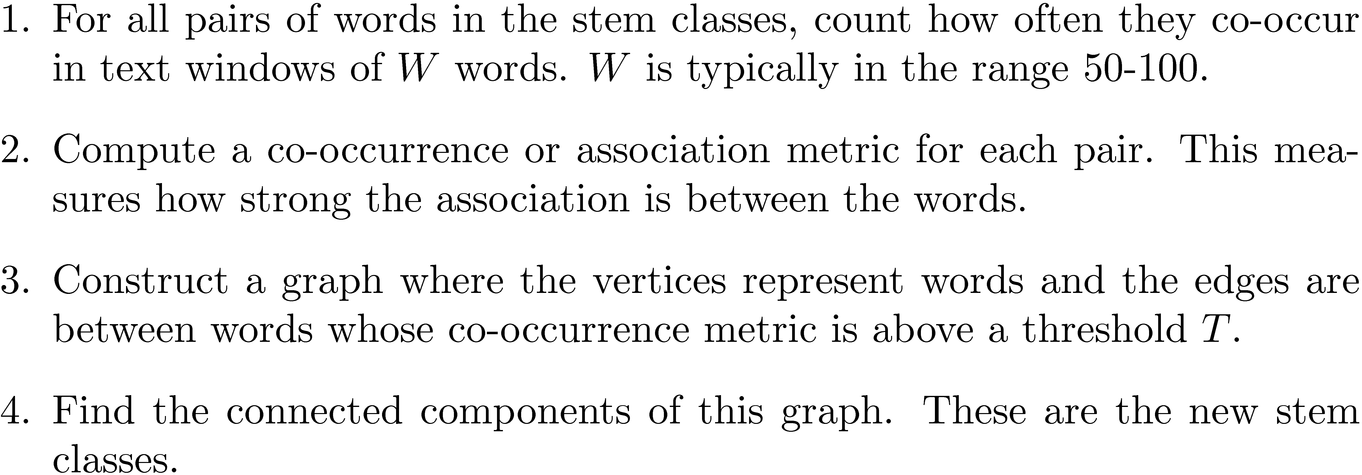
Modifying Stem Classes

Slide 15
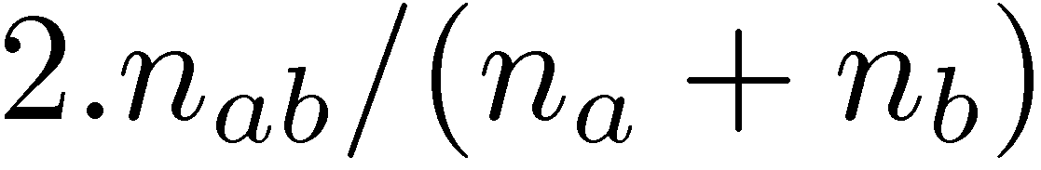
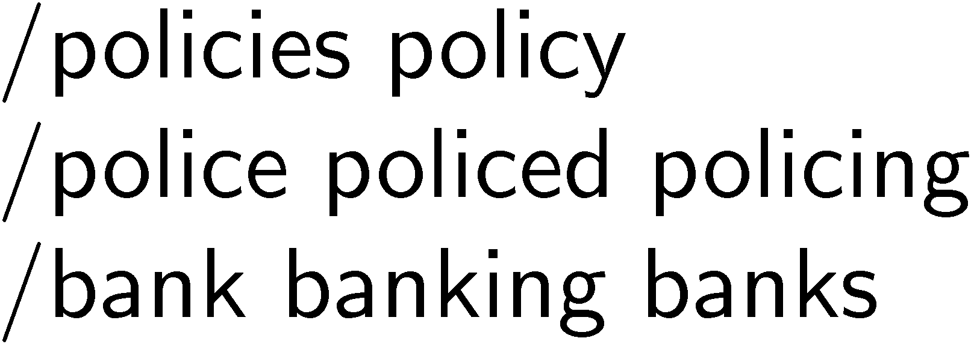
Modifying Stem Classes
Dices’ Coefficient is an example of a term association measure
where n_{x} is the number of windows containing x
Two vertices are in the same connected component of a graph if there is a path between them
forms word clusters
Example output of modification

Slide 16
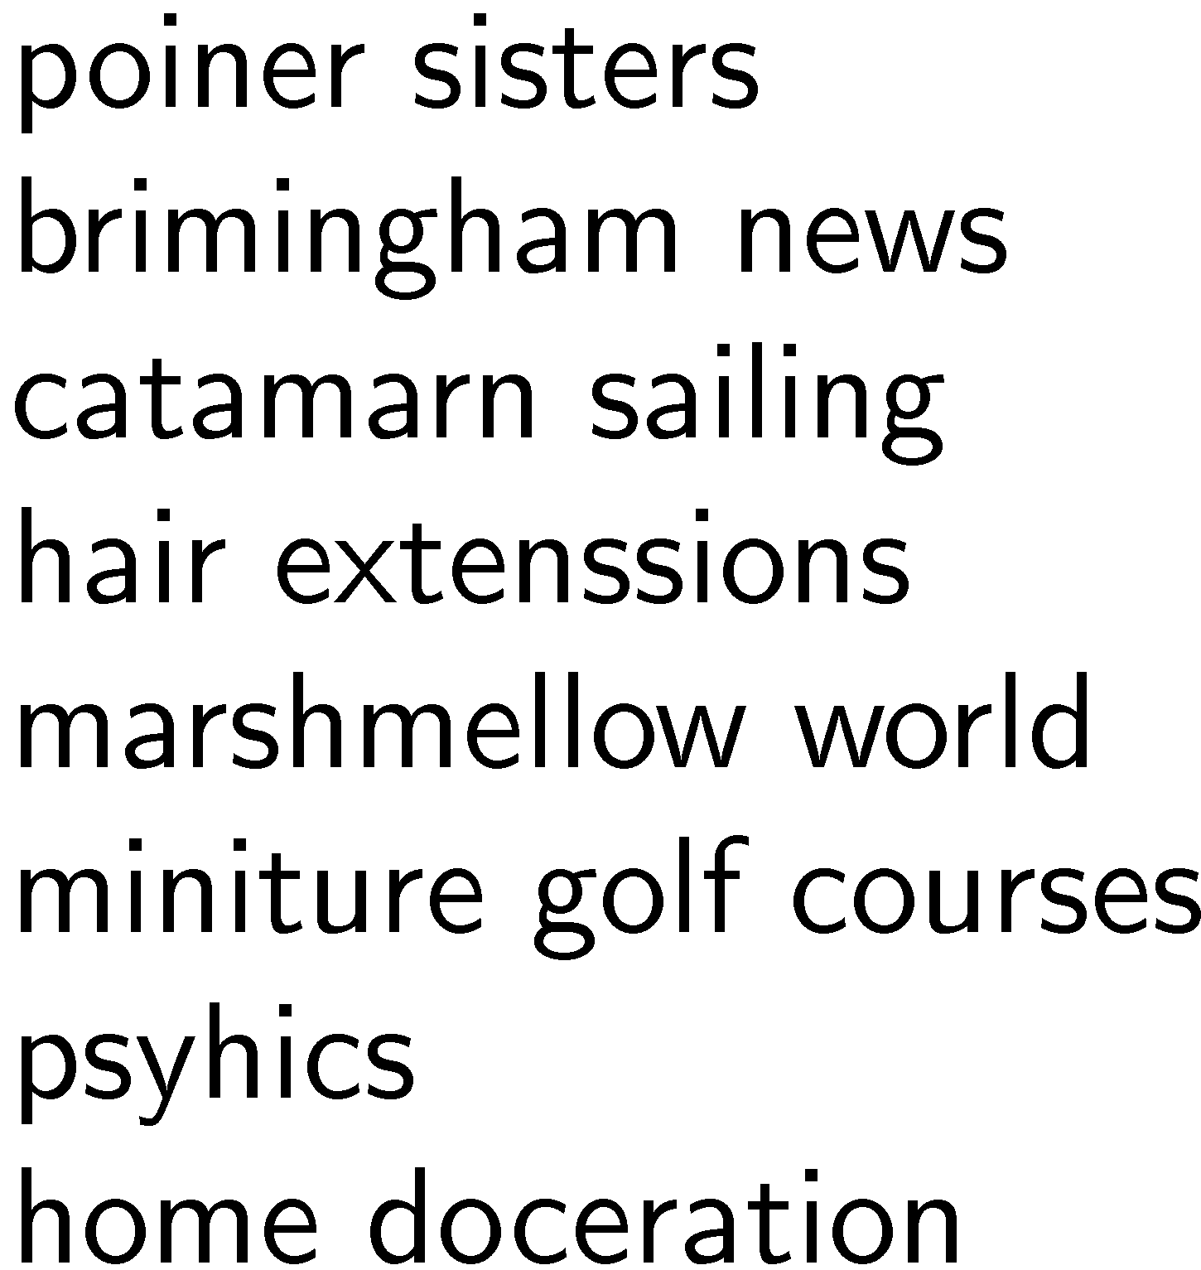
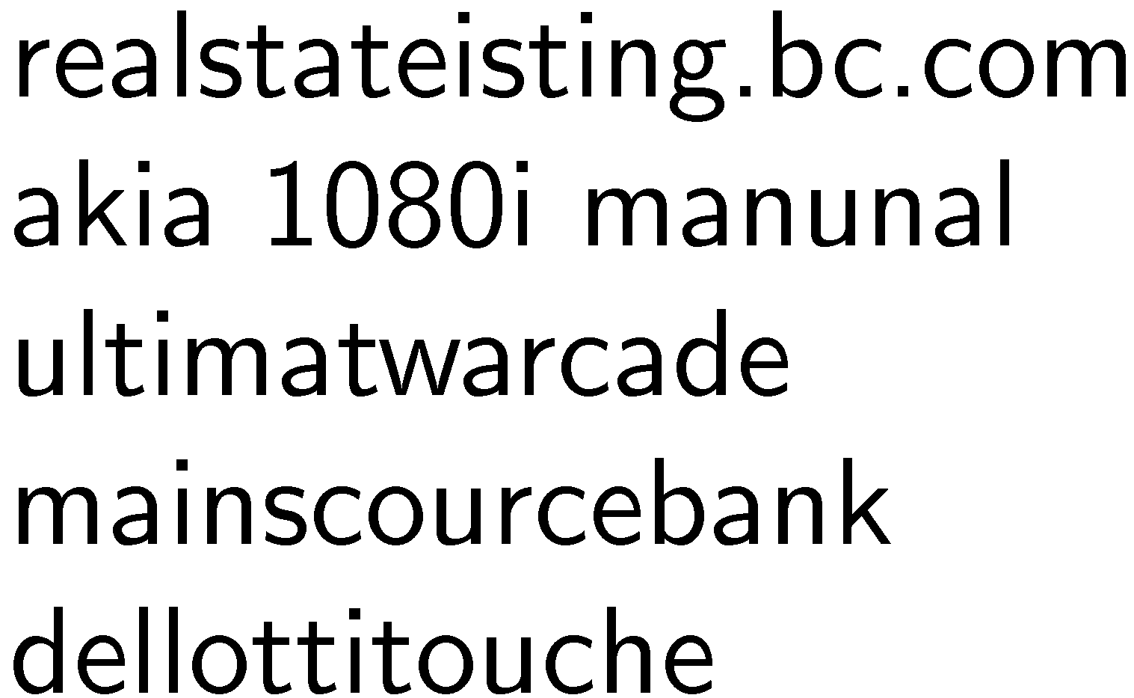
Spell Checking
Important part of query processing
10-15% of all web queries have spelling errors
Errors include typical word processing errors but also many other types, e.g.

Slide 17
Spell Checking
Basic approach: suggest corrections for words not found in spelling dictionary
Suggestions found by comparing word to words in dictionary using similarity measure
Most common similarity measure is edit distance
number of operations required to transform one word into the other

Slide 18
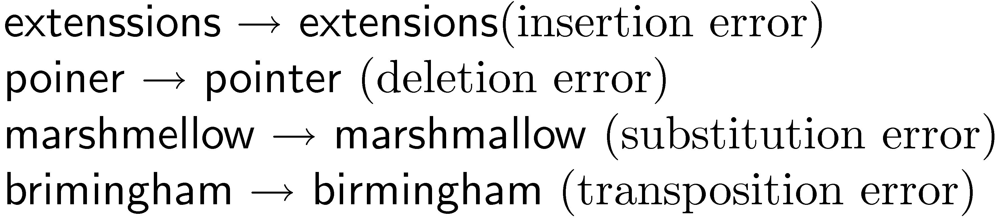

Edit Distance
Damerau-Levenshtein distance
counts the minimum number of insertions, deletions, substitutions, or transpositions of single characters required
e.g., Damerau-Levenshtein distance 1
distance 2

Slide 19
Edit Distance
Number of techniques used to speed up calculation of edit distances
restrict to words starting with same character
restrict to words of same or similar length
restrict to words that sound the same
Last option uses a phonetic code to group words
e.g. Soundex

Slide 20
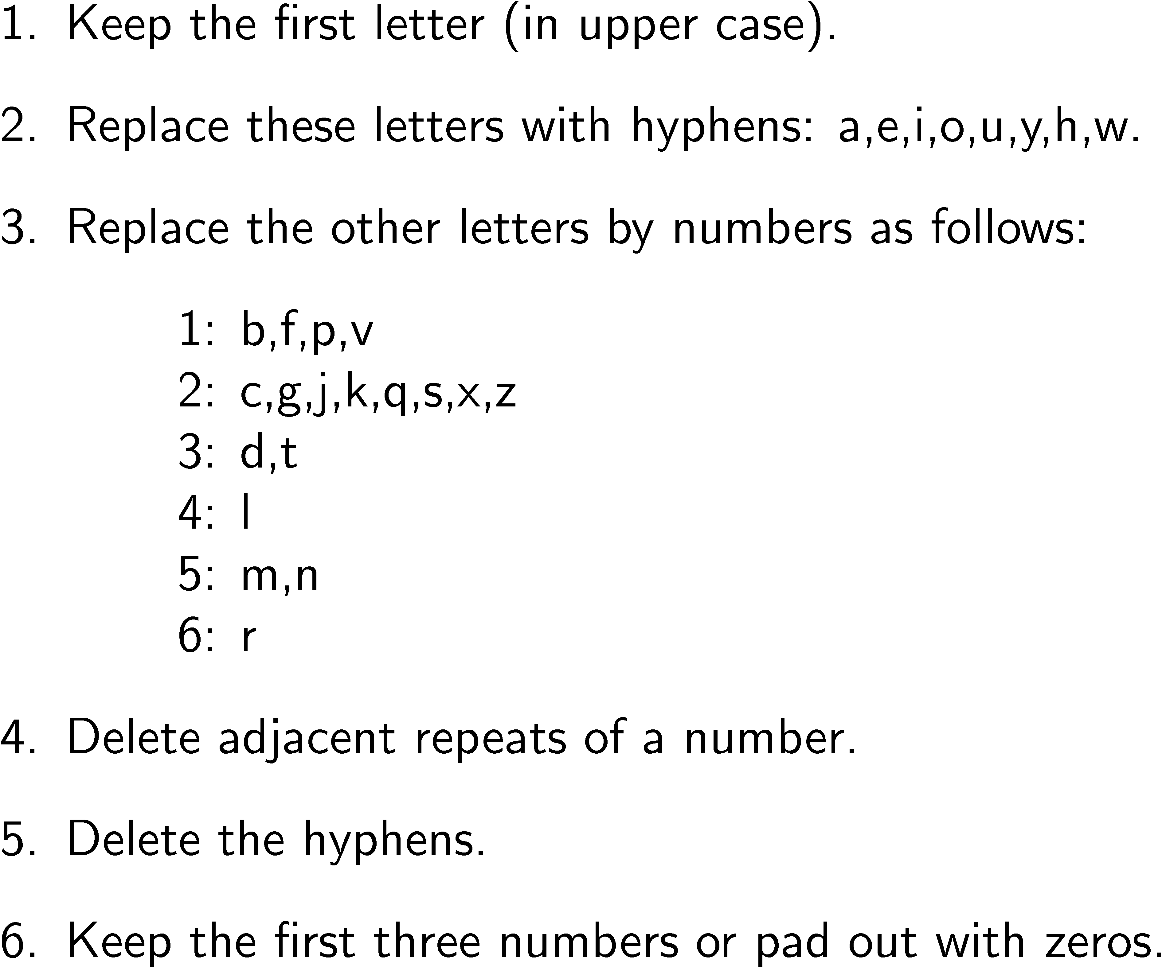
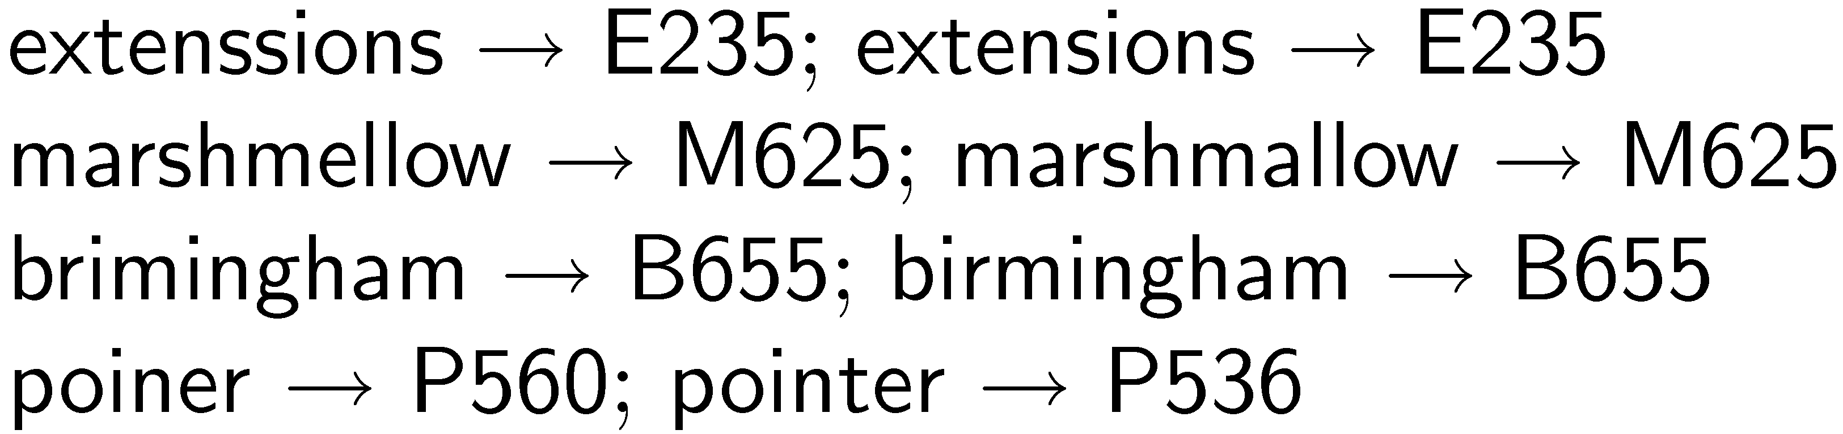
Soundex Code

Slide 21
Spelling Correction Issues
Ranking corrections
“Did you mean...” feature requires accurate ranking of possible corrections
Context
Choosing right suggestion depends on context (other words)
e.g., lawers → lowers, lawyers, layers, lasers, lagers but trial lawers → trial lawyers
Run-on errors
e.g., “mainscourcebank”
missing spaces can be considered another single character error in right framework

Slide 22
Noisy Channel Model
User chooses word w based on probability distribution P(w)
called the language model
can capture context information, e.g. P(w₁|w₂)
User writes word, but noisy channel causes word e to be written instead with probability P(e|w)
called error model
represents information about the frequency of spelling errors

Slide 23
Noisy Channel Model
Need to estimate probability of correction
P(w|e) = P(e|w)P(w)
Estimate language model using context
e.g., P(w) = λP(w) + (1 − λ)P(w|w_{p})
w_{p} is previous word
e.g.,
“fish tink”
“tank” and “think” both likely corrections, but P(tank|fish) > P(think|fish)

Slide 24
Noisy Channel Model
Language model probabilities estimated using corpus and query log
Both simple and complex methods have been used for estimating error model
simple approach: assume all words with same edit distance have same probability, only edit distance 1 and 2 considered
more complex approach: incorporate estimates based on common typing errors

Slide 25
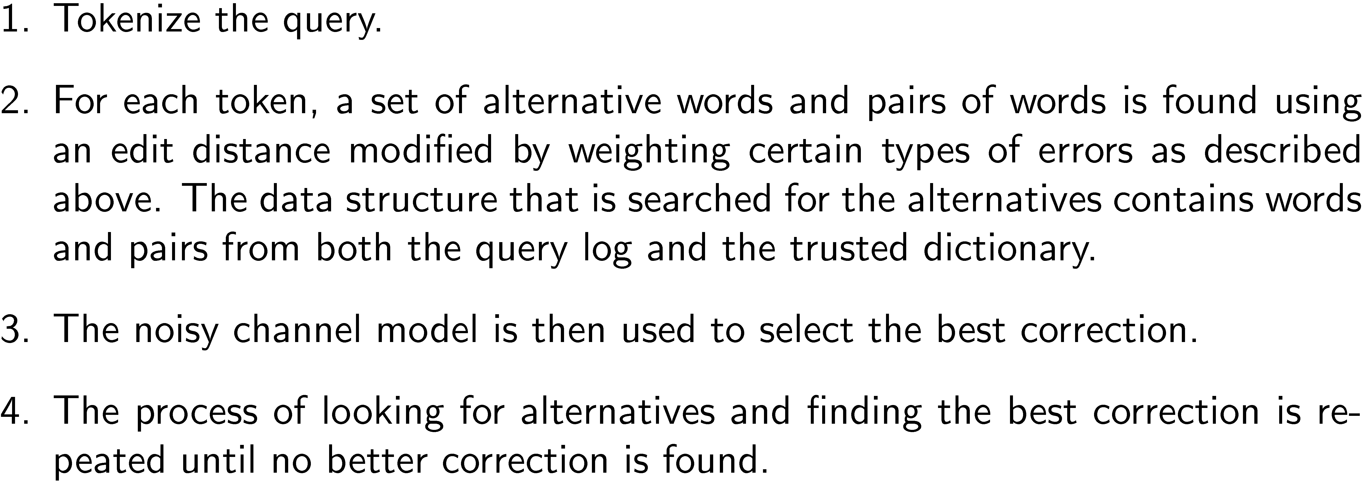
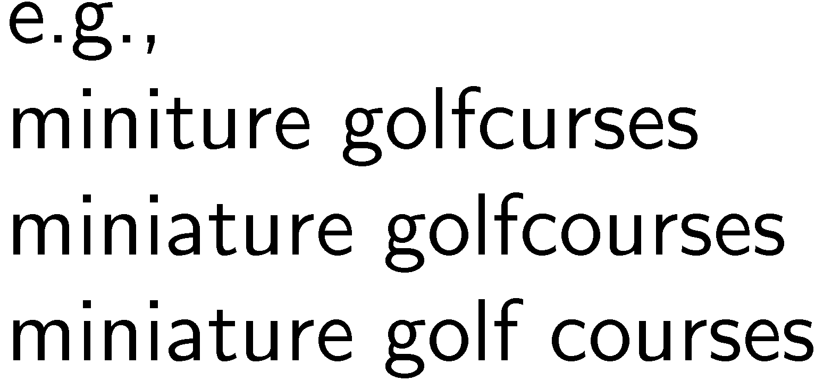
Example Spellcheck Process

Slide 26
The Thesaurus
Used in early search engines as a tool for indexing and query formulation
specified preferred terms and relationships between them
also called controlled vocabulary
Particularly useful for query expansion
adding synonyms or more specific terms using query operators based on thesaurus
improves search effectiveness

Slide 27
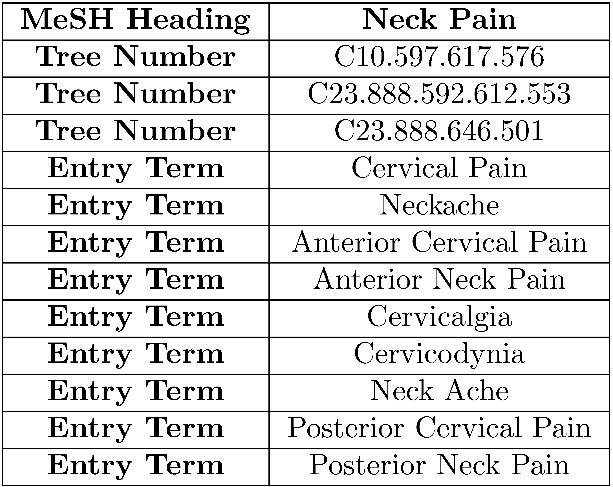
MeSH Thesaurus

Slide 28
Query Expansion
A variety of automatic or semi-automatic query expansion techniques have been developed
goal is to improve effectiveness by matching related terms
semi-automatic techniques require user interaction to select best expansion terms
Query suggestion is a related technique
alternative queries, not necessarily more terms

Slide 29
Query Expansion
Approaches usually based on an analysis of term co-occurrence
either in the entire document collection, a large collection of queries, or the top-ranked documents in a result list
query-based stemming also an expansion technique
Automatic expansion based on general thesaurus not effective
does not take context into account

Slide 30
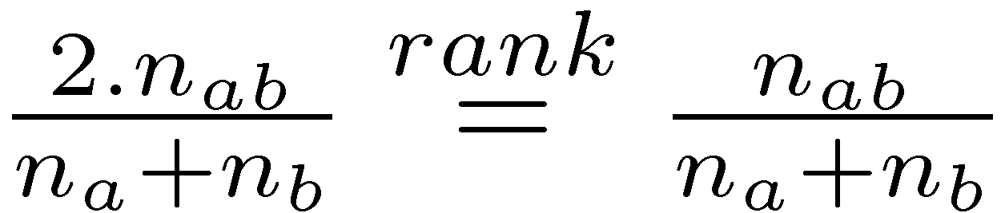
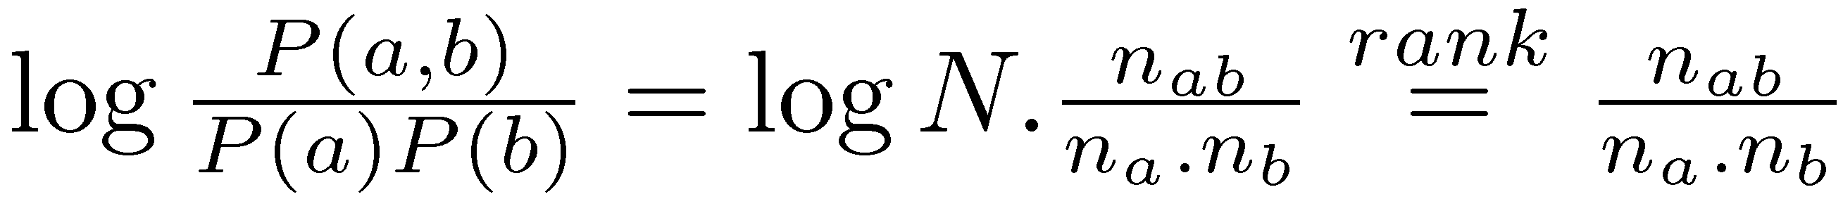
Term Association Measures
Dice’s Coefficient
Mutual Information

Slide 31
Term Association Measures
Mutual Information measure favors low frequency terms
Expected Mutual Information Measure (EMIM)
actually only 1 part of full EMIM, focused on word occurrence

Slide 32
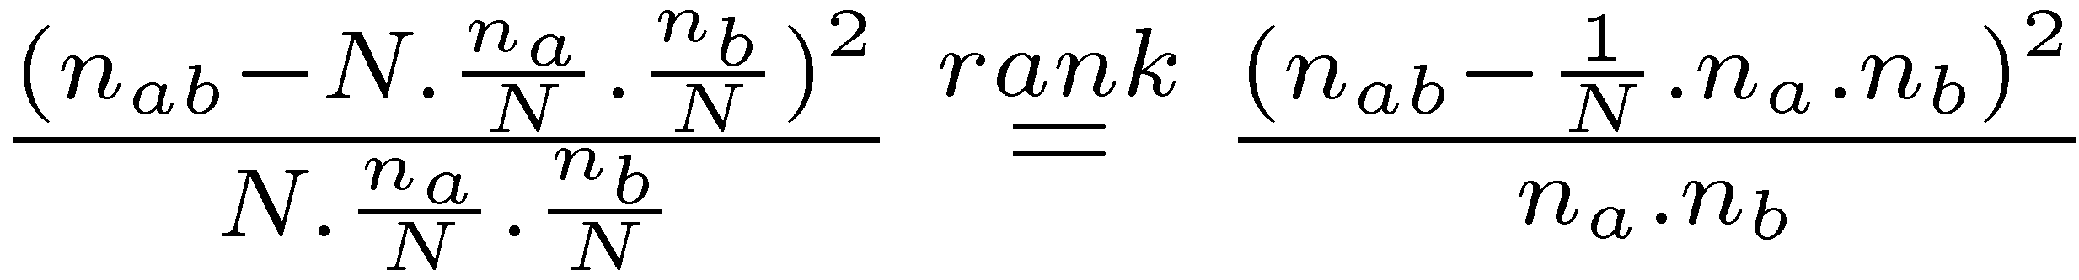
Term Association Measures
Pearson’s Chi-squared (χ²) measure
compares the number of co-occurrences of two words with the expected number of co-occurrences if the two words were independent
normalizes this comparison by the expected number
also limited form focused on word co-occurrence

Slide 33
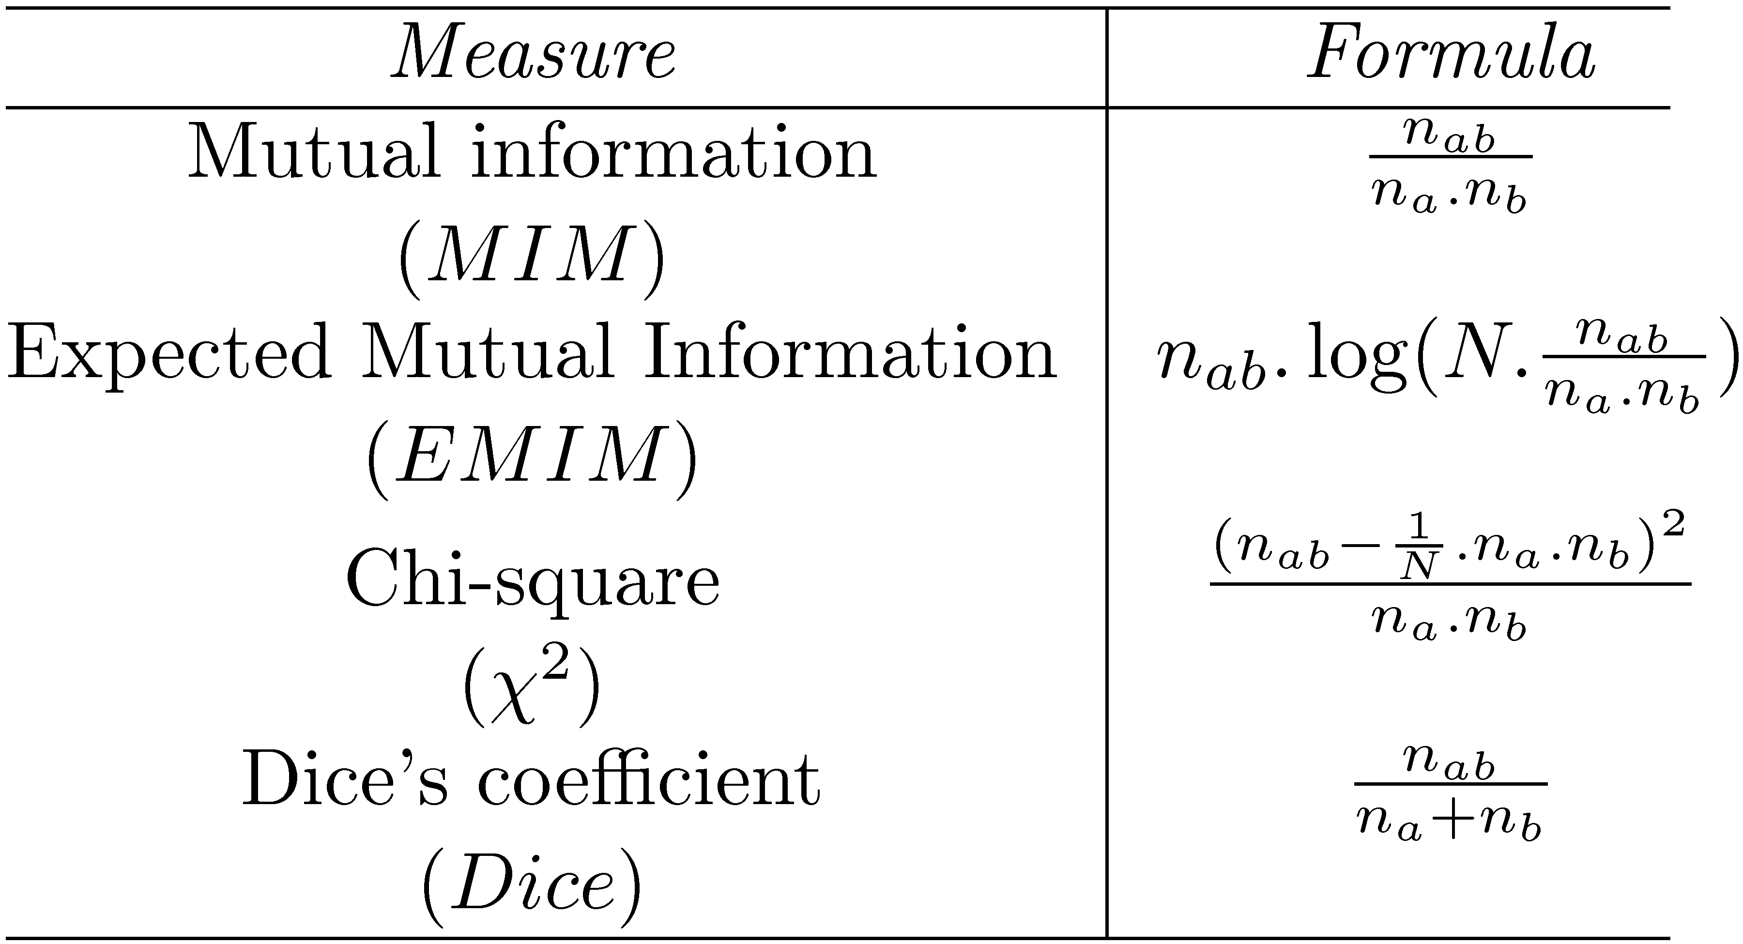
Association Measure Summary

Slide 34
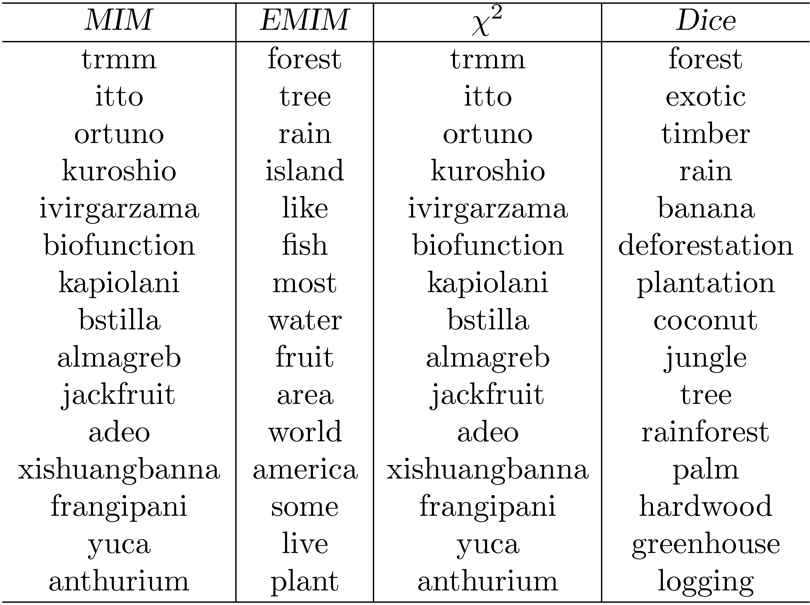
Association Measure Example
Most strongly associated words for “tropical” in a collection of TREC news
stories. Co-occurrence counts are measured at the document level.

Slide 35
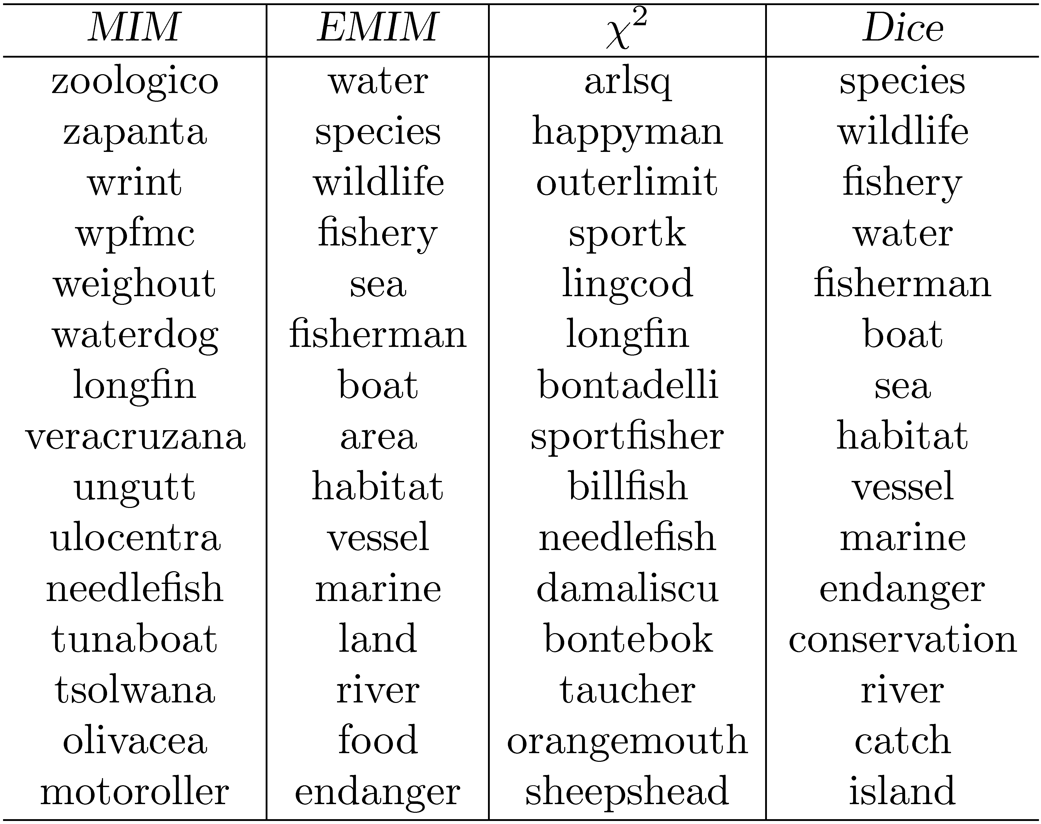
Association Measure Example
Most strongly associated words for “fish” in a collection of TREC news stories.

Slide 36
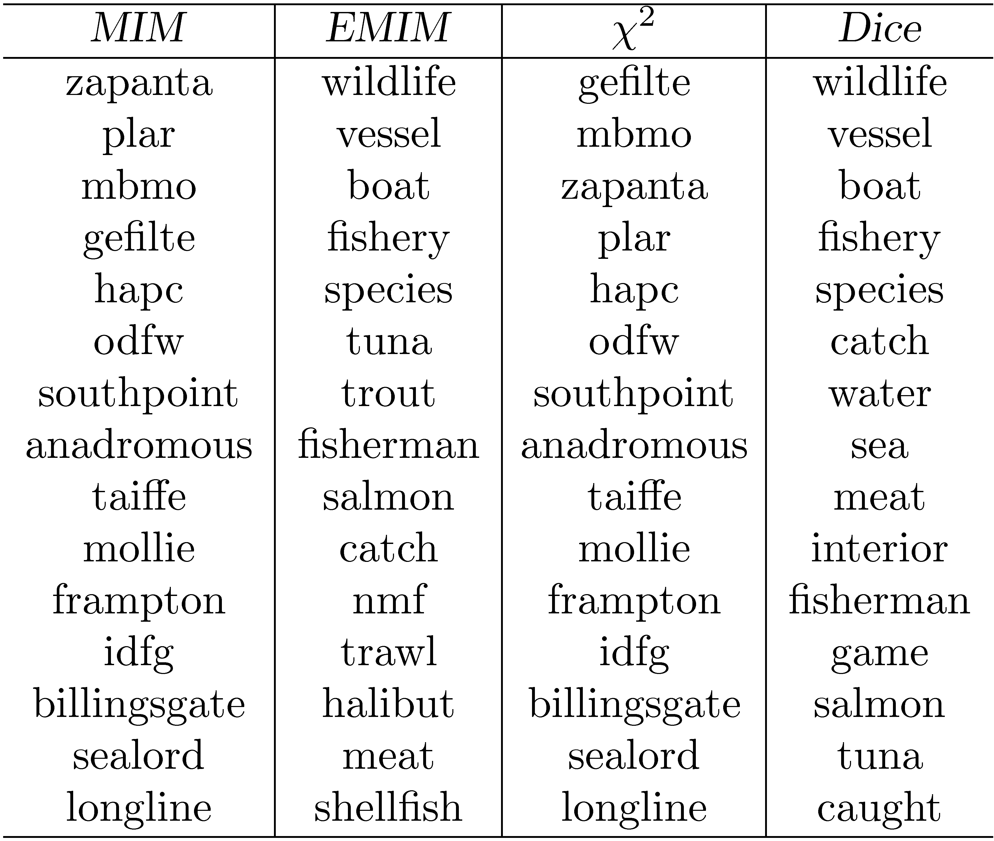
Association Measure Example
Most strongly associated words for “fish” in a collection of TREC news stories. Co-occurrence counts are measured in windows of 5 words.

Slide 37
Association Measures
Associated words are of little use for expanding the query “tropical fish”
Expansion based on whole query takes context into account
e.g., using Dice with term “tropical fish” gives the following highly associated words:
goldfish, reptile, aquarium, coral, frog, exotic, stripe, regent, pet, wet
Impractical for all possible queries, other approaches used to achieve this effect

Slide 38
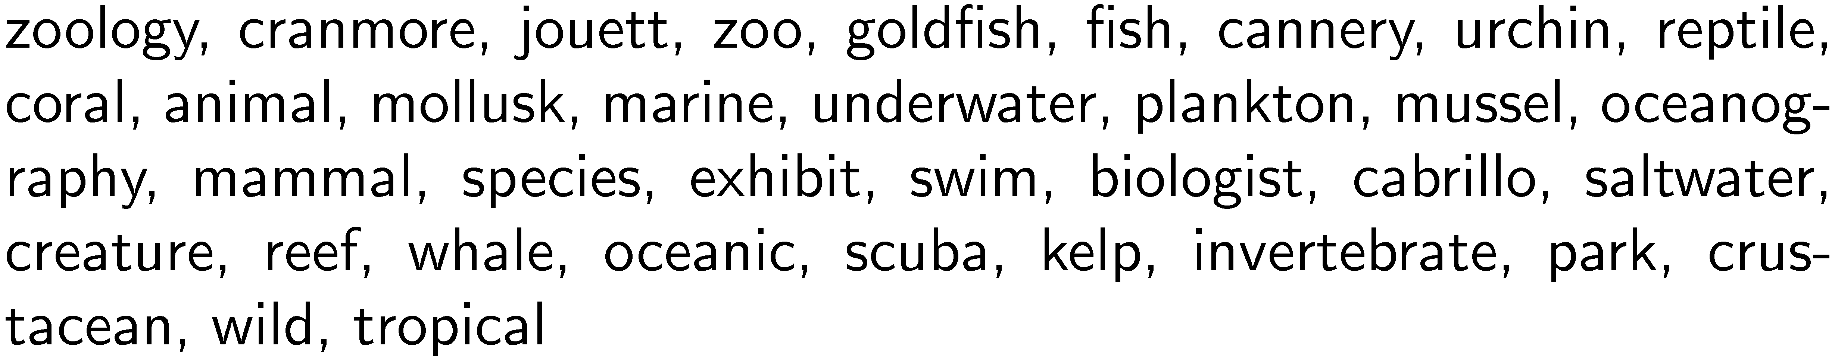
Other Approaches
Pseudo-relevance feedback
expansion terms based on top retrieved documents for initial query
Context vectors
Represent words by the words that co-occur with them
e.g., top 35 most strongly associated words for “aquarium” (using Dice’s coefficient):
Rank words for a query by ranking context vectors

Slide 39
Other Approaches
Query logs
Best source of information about queries and related terms
short pieces of text and click data
e.g., most frequent words in queries containing “tropical fish” from MSN log:
stores, pictures, live, sale, types, clipart, blue, freshwater, aquarium, supplies
query suggestion based on finding similar queries
group based on click data

Slide 40
Relevance Feedback
User identifies relevant (and maybe non-relevant) documents in the initial result list
System modifies query using terms from those documents and reranks documents
example of simple machine learning algorithm using training data
but, very little training data
Pseudo-relevance feedback just assumes top-ranked documents are relevant – no user input

Slide 41
Relevance Feedback Example
Top 10 documents
for “tropical fish”

Slide 42
Relevance Feedback Example
If we assume top 10 are relevant, most frequent terms are (with frequency):
a (926), td (535), href (495), http (357), width (345), com (343), nbsp (316), www (260), tr (239), htm (233), class (225), jpg (221)
too many stopwords and HTML expressions
Use only snippets and remove stopwords
tropical (26), fish (28), aquarium (8), freshwater (5), breeding (4), information (3), species (3), tank (2), Badman’s (2), page (2), hobby (2), forums (2)

Slide 43
Relevance Feedback Example
If document 7 (“Breeding tropical fish”) is explicitly indicated to be relevant, the most frequent terms are:
breeding (4), fish (4), tropical (4), marine (2), pond (2), coldwater (2), keeping (1), interested (1)
Specific weights and scoring methods used for relevance feedback depend on retrieval model

Slide 44
Relevance Feedback
Both relevance feedback and pseudo-relevance feedback are effective, but not used in many applications
pseudo-relevance feedback has reliability issues, especially with queries that don’t retrieve many relevant documents
Some applications use relevance feedback
filtering, “more like this”
Query suggestion more popular
may be less accurate, but can work if initial query fails

Slide 45
Context and Personalization
If a query has the same words as another query, results will be the same regardless of
who submitted the query
why the query was submitted
where the query was submitted
what other queries were submitted in the same session
These other factors (the context) could have a significant impact on relevance
difficult to incorporate into ranking

Slide 46
User Models
Generate user profiles based on documents that the person looks at
such as web pages visited, email messages, or word processing documents on the desktop
Modify queries using words from profile
Generally not effective
imprecise profiles, information needs can change significantly

Slide 47
Query Logs
Query logs provide important contextual information that can be used effectively
Context in this case is
previous queries that are the same
previous queries that are similar
query sessions including the same query
Query history for individuals could be used for caching

Slide 48
Local Search
Location is context
Local search uses geographic information to modify the ranking of search results
location derived from the query text
location of the device where the query originated
e.g.,
“underworld 3 cape cod”
“underworld 3” from mobile device in Hyannis

Slide 49
Local Search
Identify the geographic region associated with web pages
use location metadata that has been manually added to the document,
or identify locations such as place names, city names, or country names in text
Identify the geographic region associated with the query
10-15% of queries contain some location reference
Rank web pages using location information in addition to text and link-based features

Slide 50
Extracting Location Information
Type of information extraction
ambiguity and significance of locations are issues
Location names are mapped to specific regions and coordinates
Matching done by inclusion, distance

Slide 51
Showing the Results
Result Pages and Snippets
Successful interactions with a search engine depend on the user understanding the results
Many different visualization techniques have been proposed for displaying search output
most search engines the result pages consist of a ranked list of document summaries that are linked to the actual documents or web pages

Slide 52
Showing the Results
A document summary for a web search typically contains the title and URL of the web page, links to live and cached versions of the page, and, most importantly, a short text summary, or snippet, that is used to convey the content of the page

Slide 53
Snippet Generation
Query-dependent document summary
Simple summarization approach
rank each sentence in a document using a significance factor
select the top sentences for the summary
first proposed by Luhn in 50’s

Slide 54
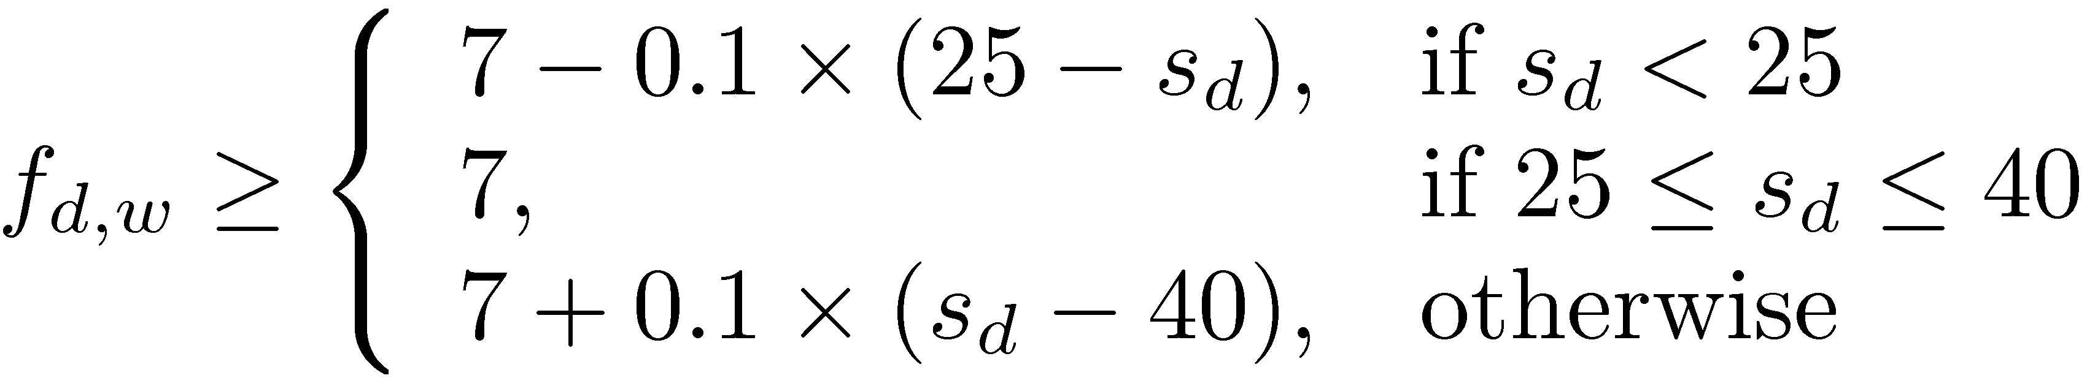
Sentence Selection
Significance factor for a sentence is calculated based on the occurrence of significant words
If f_{d,w} is the frequency of word w in document d, then w is a significant word if it is not a stopword and
where s_{d} is the number of sentences in document d
text is bracketed by significant words (limit on number of non-significant words in bracket)

Slide 55
Sentence Selection
Significance factor for bracketed text spans is computed by dividing the square of the number of significant words in the span by the total number of words
e.g.,
Significance factor = 4²/7 = 2.3

Slide 56
Snippet Generation
Involves more features than just significance factor
e.g. for a news story, could use
whether the sentence is a heading
whether it is the first or second line of the document
the total number of query terms occurring in the sentence
the number of unique query terms in the sentence
the longest contiguous run of query words in the sentence
a density measure of query words (significance factor)
Weighted combination of features used to rank sentences

Slide 57
Snippet Generation
Web pages are less structured than news stories
can be difficult to find good summary sentences
Snippet sentences are often selected from other sources
metadata associated with the web page
e.g., <meta name="description" content= ...>
external sources such as web directories
e.g., Open Directory Project, http://www.dmoz.org
Snippets can be generated from text of pages like Wikipedia

Slide 58
Snippet Guidelines
All query terms should appear in the summary, showing their relationship to the retrieved page
When query terms are present in the title, they need not be repeated
allows snippets that do not contain query terms
Highlight query terms in URLs
Snippets should be readable text, not lists of keywords

Slide 59
Advertising and Search
Advertising is a key component of web search engines since that is how companies generate revenue
Advertising presented with search results (sponsored search). Goal is to find advertisements that are appropriate for the query context
When browsing web pages, advertisements are selected for display based on the contents of pages

Slide 60
Advertising and Search
When browsing web pages, advertisements are selected for display based on the contents of pages. Contextual advertising is thought to lead to more user clicks on advertisements (clickthrough)
Search engine companies maintain a database of advertisements, which is searched to find the most relevant advertisements for a given query or web page
An advertisement in this database usually consists of a short text description and a link to a web page describing the product or service in more detail

Slide 61
Advertising
Sponsored search – advertising presented with search results
Contextual advertising – advertising presented when browsing web pages
Both involve finding the most relevant advertisements in a database
An advertisement usually consists of a short text description and a link to a web page describing the product or service in more detail

Slide 62
Advertisements are not selected solely based on their ranking in a simple text search. Instead, advertisers bid for keywords that describe topics associated with their product.
The amount bid for a keyword that matches a query is an important factor in determining which advertisement is selected.
In addition, some advertisements generate more clickthrough because they are more appealing to the user population. The popularity of an advertisement, as measured by the clickthrough over time that is captured in the
Query log, is another significant factor in the selection process

Slide 63
Searching Advertisements
Factors involved in ranking advertisements
similarity of text content to query
bids for keywords in query
popularity of advertisement
Small amount of text in advertisement
dealing with vocabulary mismatch is important
expansion techniques are effective

Slide 64
When searching the Web, there are usually many pages that contain all of the query terms. This is not the case, however, when queries are compared to advertisements
As an example, a pet supplies company that specializes in tropical fish may place the highest bid for the keywords “aquarium” and “tropical fish”.
Given the query “tropical fish”, this keyword is certainly relevant. The content of the advertisement for that company should also contain words that match the query.
Given that, this company’s advertisement will receive a high score for relevance and a high score based on the bid

Slide 65
Example Advertisements
Advertisements retrieved for query “fish tank”

Slide 66
Searching Advertisements
Pseudo-relevance feedback
expand query and/or document using the Web
use ad text or query for pseudo-relevance feedback
rank exact matches first, followed by stem matches, followed by expansion matches
Query reformulation based on search sessions
learn associations between words and phrases based on co-occurrence in search sessions

Slide 67
Clustering Results
Result lists often contain documents realted to different aspects of the query topic
Clustering is used to group related documents to simplify browsing
Example clusters for
query “tropical fish”

Slide 68
Result List Example
Top 10 documents
for “tropical fish”

Slide 69
Clustering Results
Requirements
Efficiency
must be specific to each query and are based on the top-ranked documents for that query
typically based on snippets
Easy to understand
Can be difficult to assign good labels to groups
Monothetic vs. polythetic classification

Slide 70
Types of Classification
Monothetic
every member of a class has the property that defines the class
typical assumption made by users
easy to understand
Polythetic
members of classes share many properties but there is no single defining property
most clustering algorithms (e.g. K-means) produce this type of output

Slide 71
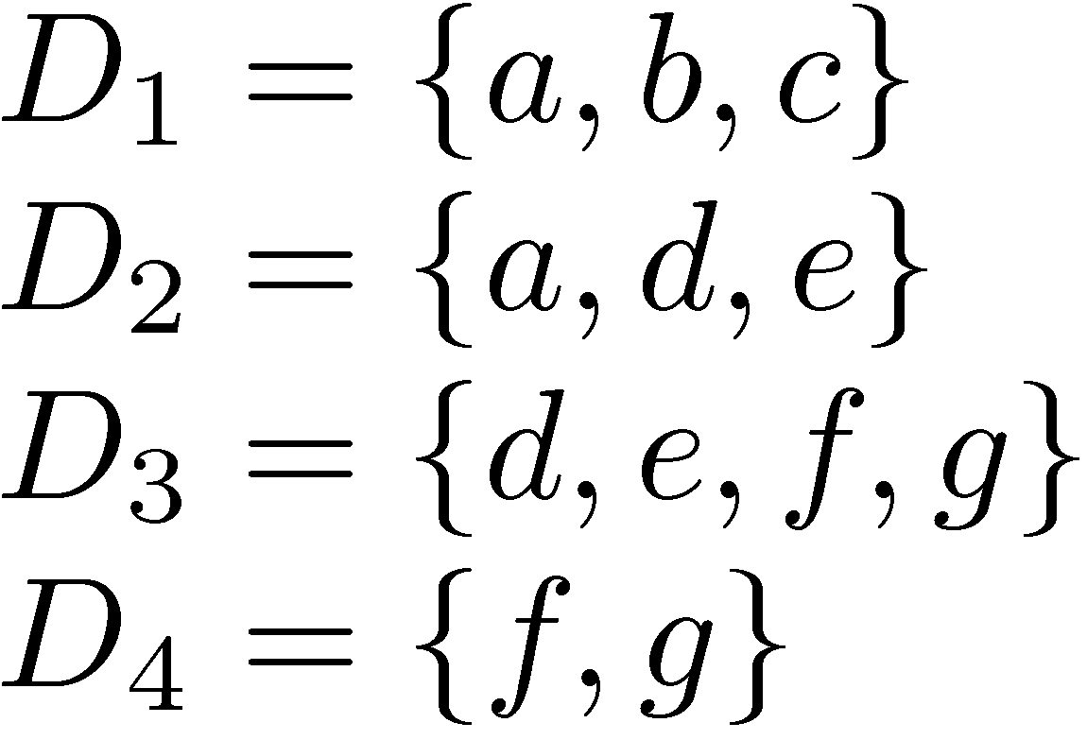
Classification Example
Possible monothetic classification
{D₁,D₂} (labeled using a) and {D₂,D₃} (labeled e)
Possible polythetic classification
{D₂,D₃,D₄}, D₁
labels?

Slide 72
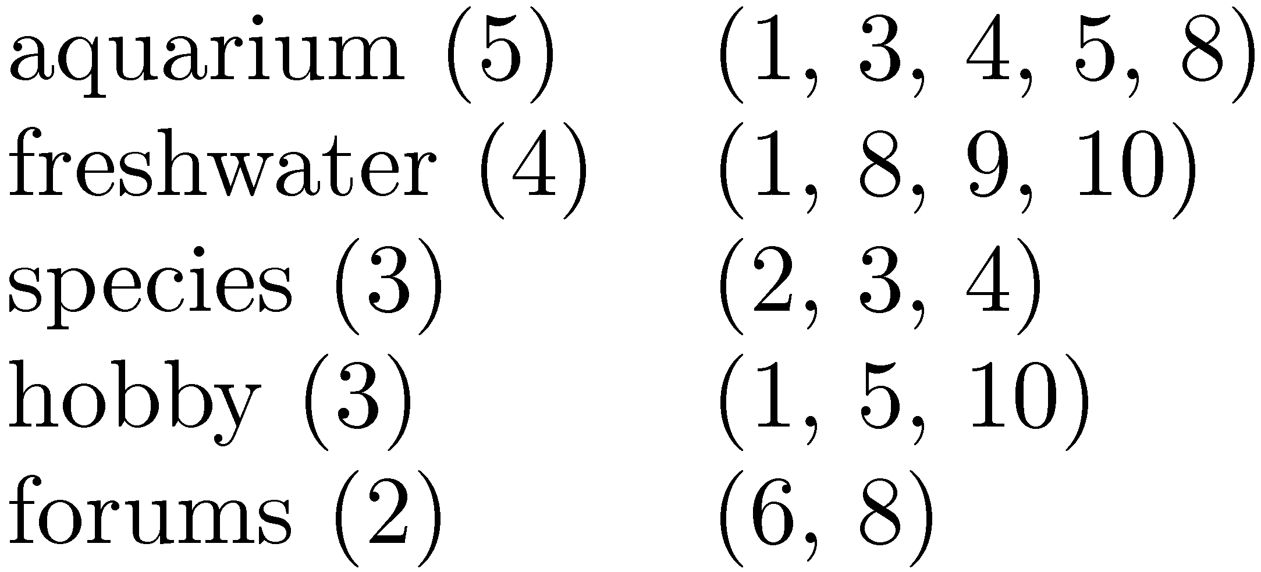
Result Clusters
Simple algorithm
group based on words in snippets
Refinements
use phrases
use more features
whether phrases occurred in titles or snippets
length of the phrase
collection frequency of the phrase
overlap of the resulting clusters,

Slide 73
Faceted Classification
A set of categories, usually organized into a hierarchy, together with a set of facets that describe the important properties associated with the category
Manually defined
potentially less adaptable than dynamic classification
Easy to understand
commonly used in e-commerce

Slide 74
Example Faceted Classification
Categories for “tropical fish”

Slide 75
Example Faceted Classification
Subcategories and facets for “Home & Garden”

