Slide 1
Retrieval Models
A Retrieval model is a formal representation of the process of matching a query and a document
Retrieval model is the basis of the ranking algorithm that is used in a search engine to produce the ranked list of documents
A Good retrieval model will find documents that are likely to be considered relevant by the person who submitted the query

Slide 2
An interesting feature of the retrieval models used in information retrieval is that they typically model the statistical properties of text rather than the linguistic structure
Many different retrieval models and methods of deriving ranking algorithms have been proposed. The basic form of the document score calculated by many of these models is
qi is the query term weight of the ith term, and di is the document term weight

Slide 3
We can, however, propose theories about relevance in the form of mathematical retrieval models and test those theories by comparing them to human actions
Good models should produce outputs that correlate well with human decisions on relevance
Most ranking algorithms calculate a probability of relevance and can represent the uncertainty involved
Many retrieval models have been proposed over the years. Two of the oldest are the Boolean and vector space models

Slide 4
Retrieval Models
Provide a mathematical framework for defining the search process
includes explanation of assumptions
basis of many ranking algorithms
can be implicit
Progress in retrieval models has corresponded with improvements in effectiveness
Theories about relevance

Slide 5
Relevance
Complex concept that has been studied for some time
Many factors to consider
People often disagree when making relevance judgments
Retrieval models make various assumptions about relevance to simplify problem
e.g., topical vs. user relevance
e.g., binary vs. multi-valued relevance

Slide 6
Retrieval Model Overview
Older models
Boolean retrieval
Vector Space model
Probabilistic Models
BM25
Language models

Slide 7
Boolean Retrieval
Two possible outcomes for query processing
TRUE and FALSE
“exact-match” retrieval
simplest form of ranking
Query usually specified using Boolean operators
AND, OR, NOT
proximity operators also used

Slide 8
Boolean Retrieval
Advantages
Results are predictable, relatively easy to explain
Many different features can be incorporated
Efficient processing since many documents can be eliminated from search
Disadvantages
Effectiveness depends entirely on user
Simple queries usually don’t work well
Complex queries are difficult

Slide 9
Searching by Numbers
Sequence of queries driven by number of retrieved documents
e.g. “lincoln” search of news articles
president AND lincoln
president AND lincoln AND NOT (automobile OR car)
president AND lincoln AND biography AND life AND birthplace AND gettysburg AND NOT (automobile OR car)
president AND lincoln AND (biography OR life OR birthplace OR gettysburg) AND NOT (automobile OR car)

Slide 10
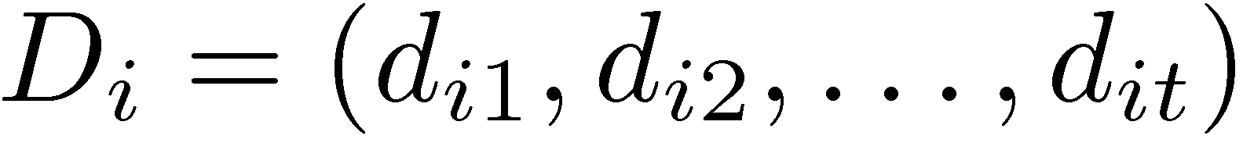
The Vector Space Model
Framework for implementing term weighting, ranking, and relevance feedback
In this model, documents and queries are assumed to be part of a t-dimensional vector space, where t is the number of index terms (words, stems, phrases, etc.). A document Di is represented by a vector of index terms
where dij represents the weight of the jth term. A document collection containing n documents can be represented as a matrix of term weights, where each row represents a document and each column describes weights that were assigned to a term for a particular document

Slide 11
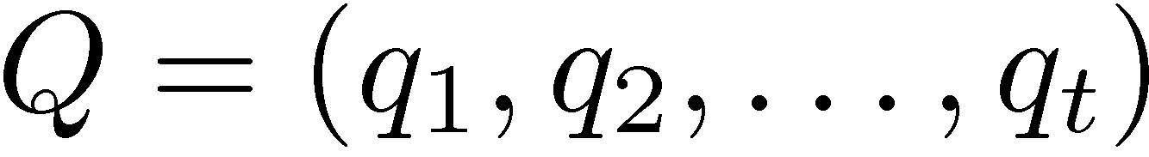
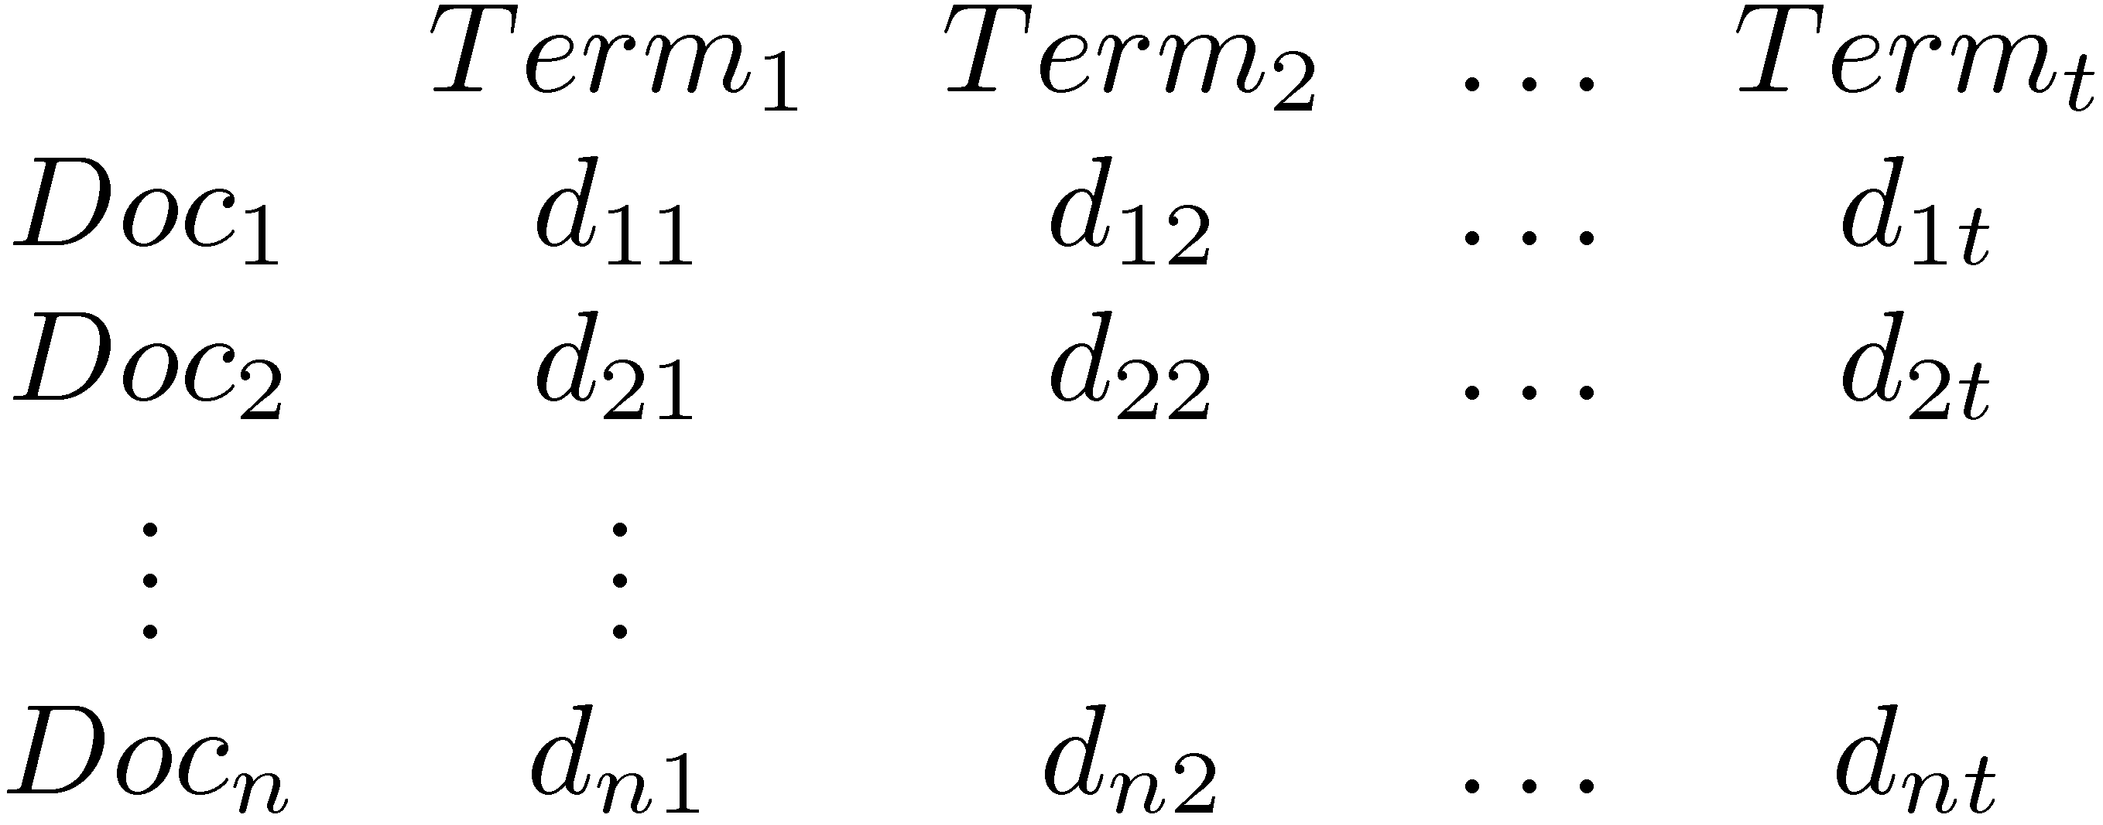
Vector Space Model
Documents and query represented by a vector of term weights
Collection represented by a matrix of term weights

Slide 12
Vector Space Model

Slide 13
Vector Space Model
3-d pictures useful, but can be misleading for high-dimensional space

Slide 14
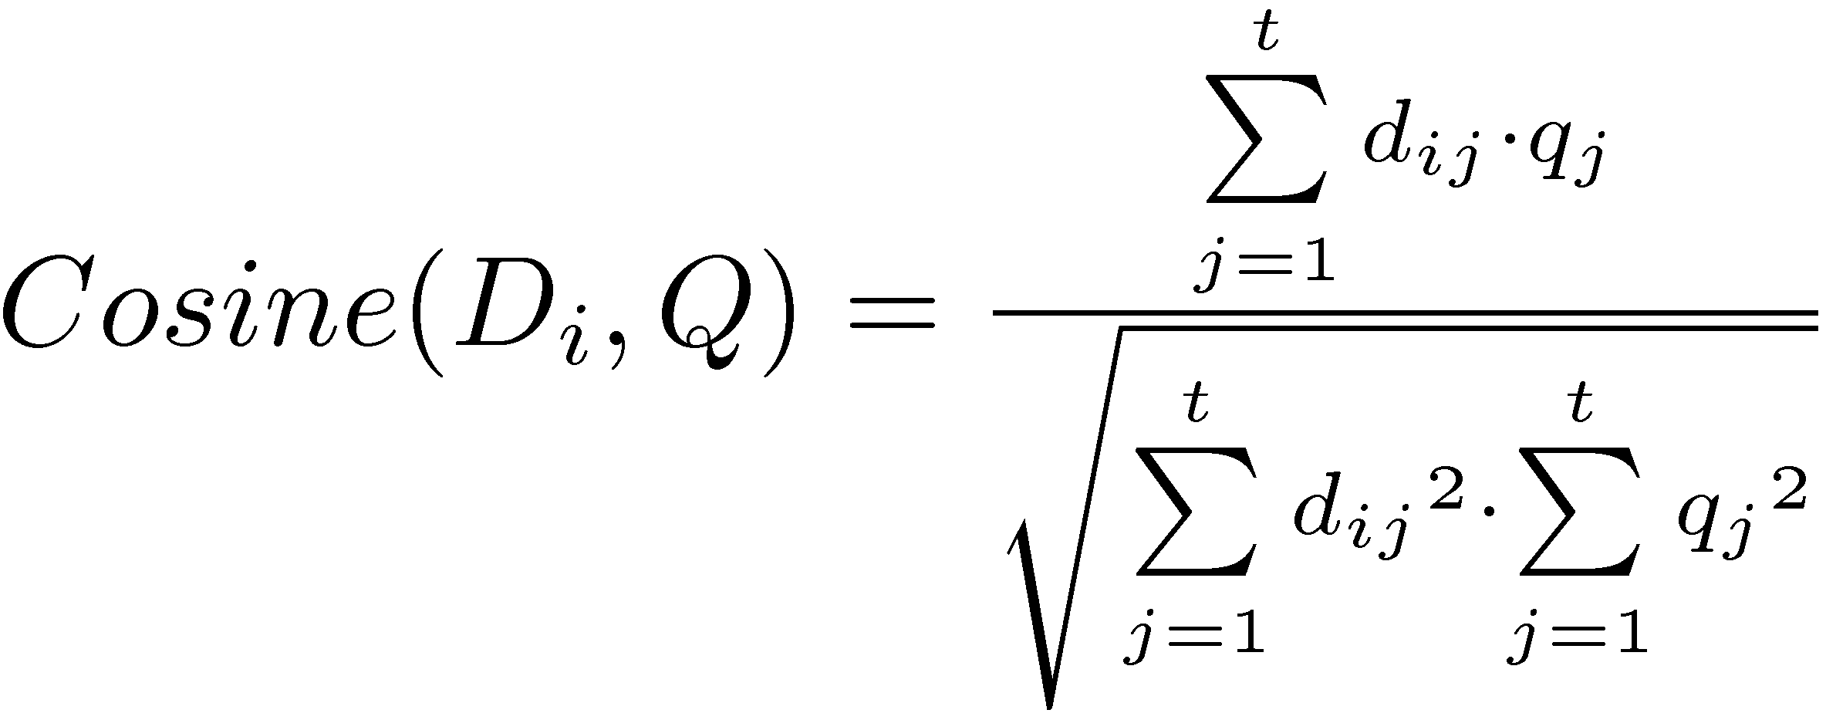
Vector Space Model
Documents ranked by distance between points representing query and documents
Similarity measure more common than a distance or dissimilarity measure
e.g. Cosine correlation

Slide 15
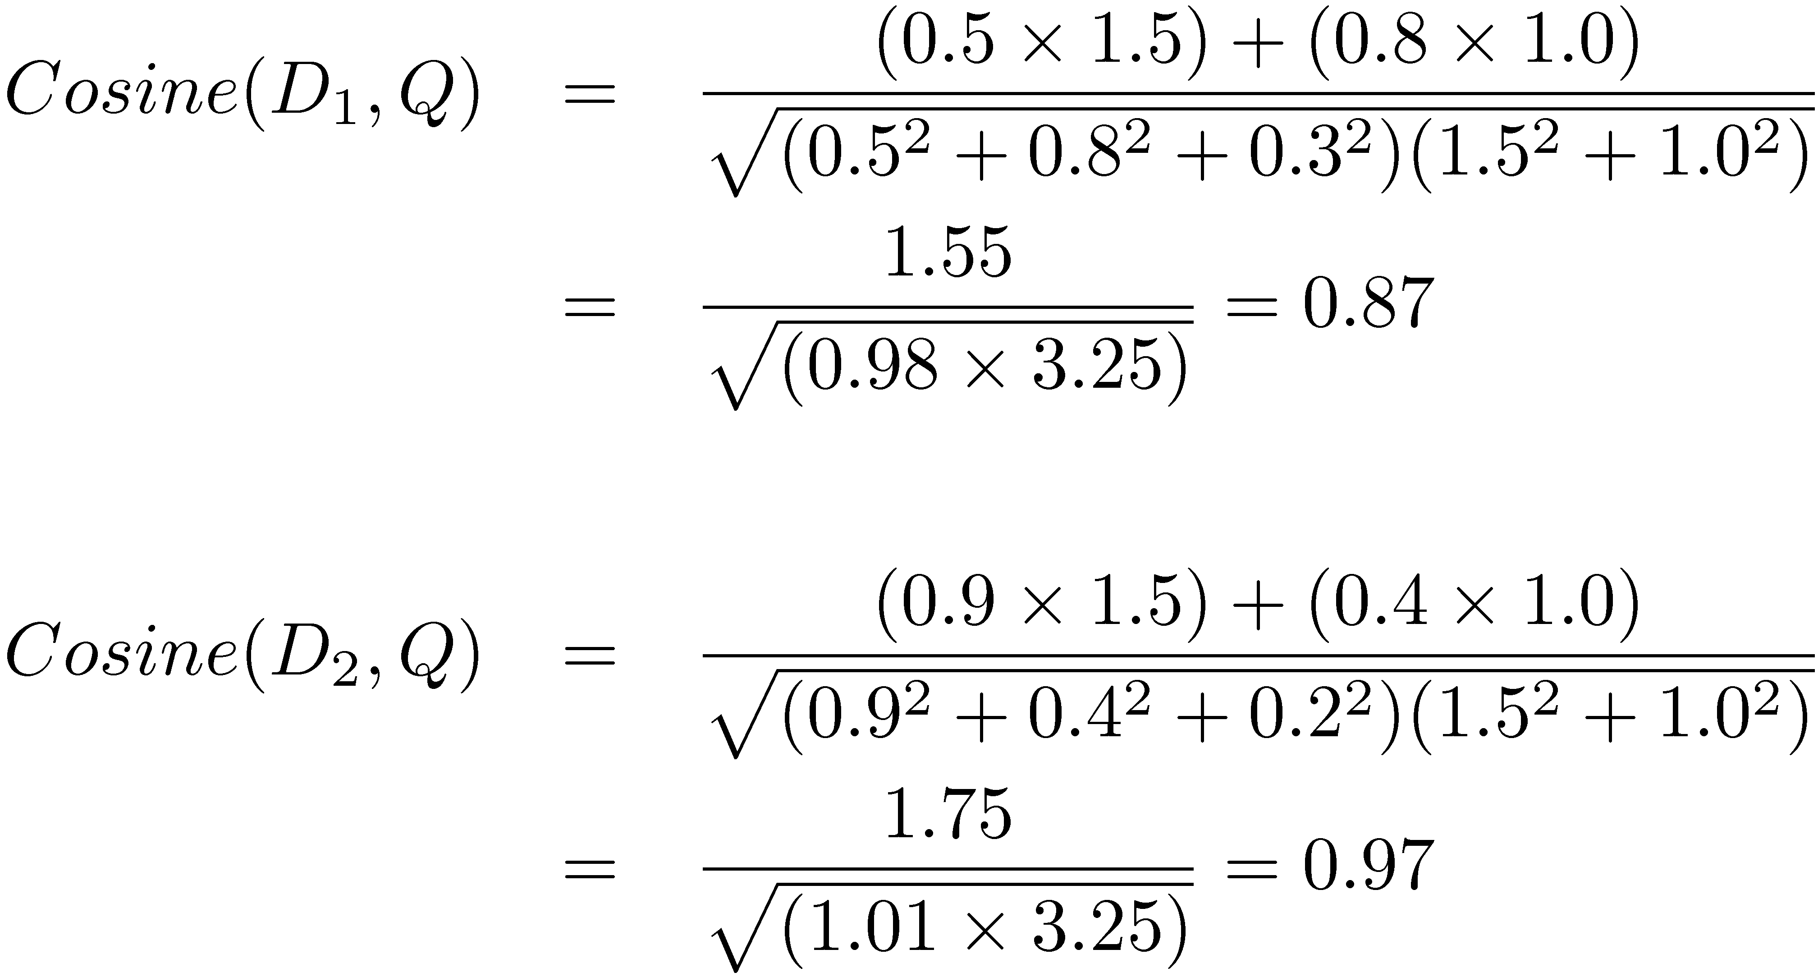
Similarity Calculation
Consider two documents D_{1,} D₂ and a query Q
D₁ = (0.5, 0.8, 0.3), D₂ = (0.9, 0.4, 0.2), Q = (1.5, 1.0, 0)

Slide 16
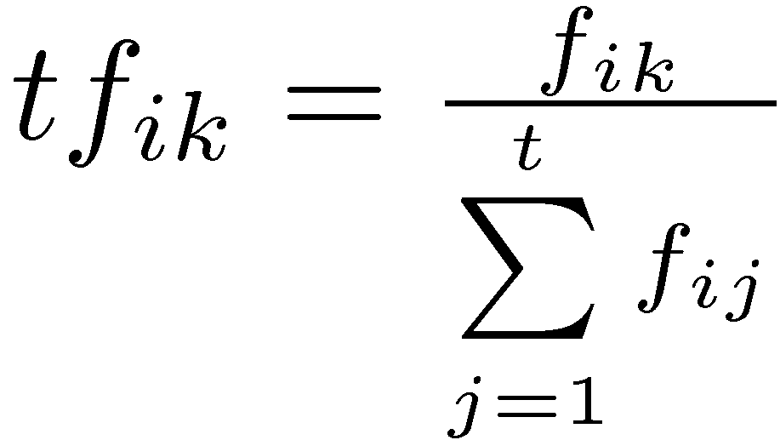
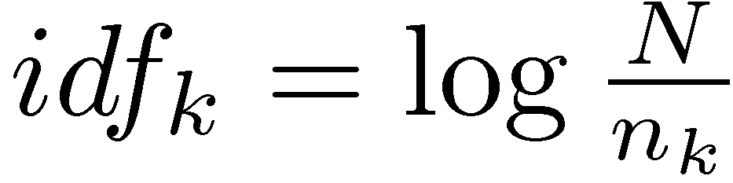
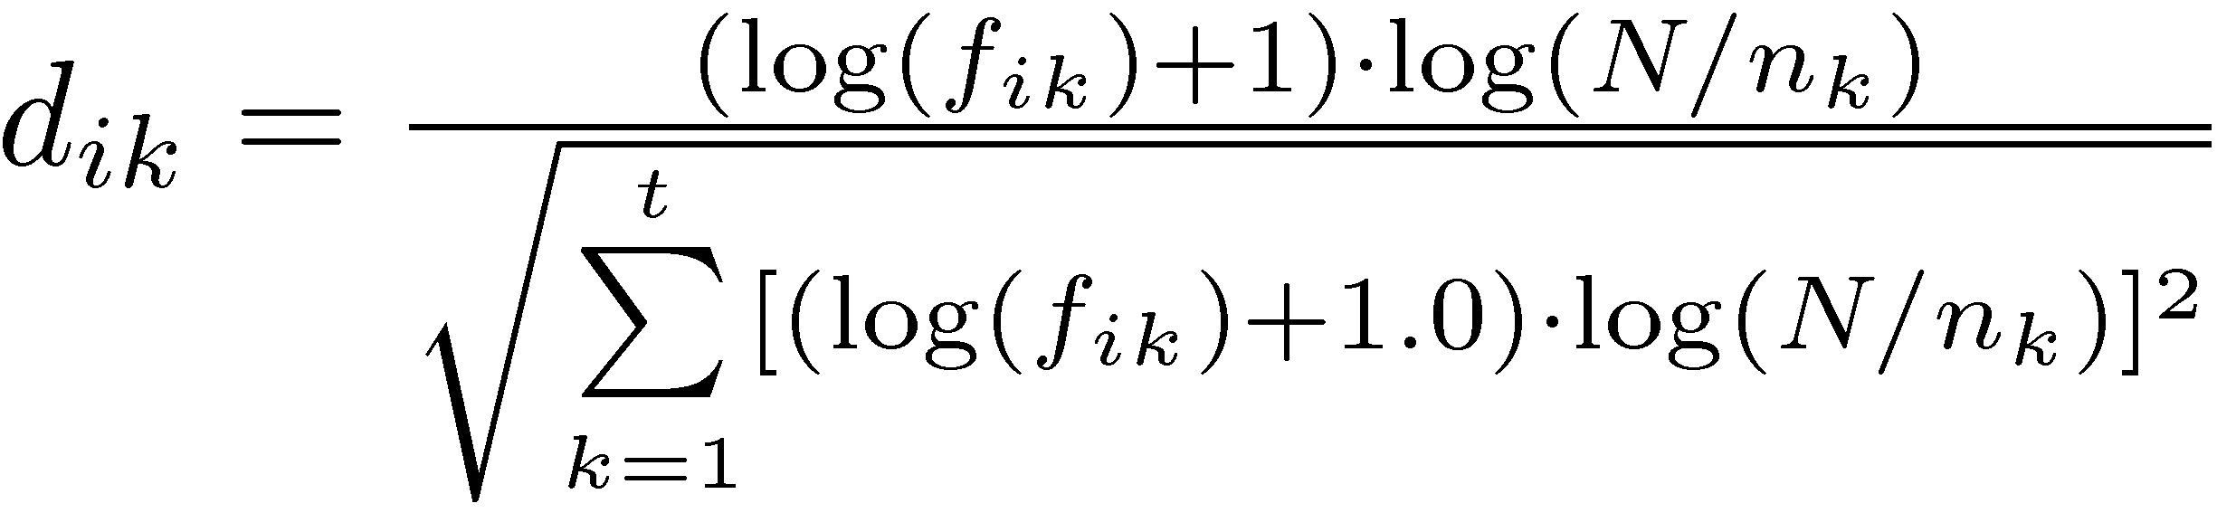
Term Weights
tf.idf weight
Term frequency weight measures importance in document:
Inverse document frequency measures importance in collection:
Some heuristic modifications

Slide 17
Relevance Feedback
Rocchio algorithm
Optimal query
Maximizes the difference between the average vector representing the relevant documents and the average vector representing the non-relevant documents
Modifies query according to
α, β, and γ are parameters
Typical values 8, 16, 4

Slide 18
Vector Space Model
Advantages
Simple computational framework for ranking
Any similarity measure or term weighting scheme could be used
Disadvantages
Assumption of term independence
No predictions about techniques for effective ranking

Slide 19
Probability Ranking Principle
Robertson (1977)
“If a reference retrieval system’s response to each request is a ranking of the documents in the collection in order of decreasing probability of relevance to the user who submitted the request,
where the probabilities are estimated as accurately as possible on the basis of whatever data have been made available to the system for this purpose,
the overall effectiveness of the system to its user will be the best that is obtainable on the basis of those data.”

Slide 20
Probabilistic Models
The Probability Ranking Principle doesn’t tell us how to calculate or estimate the probability of relevance.
There are many probabilistic retrieval models, and each one proposes a different method for estimating this probability
Probabilistic model based on treating information retrieval as a classification problem and then describe a popular and effective ranking algorithm that is based on this model

Slide 21
IR as Classification

Slide 22
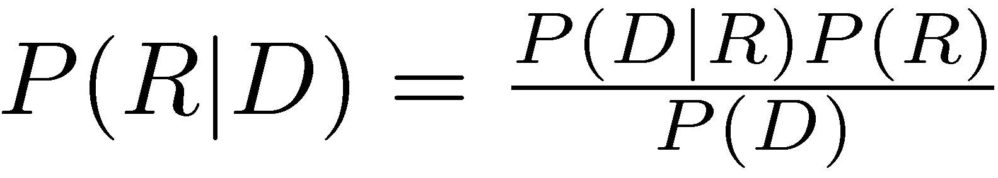
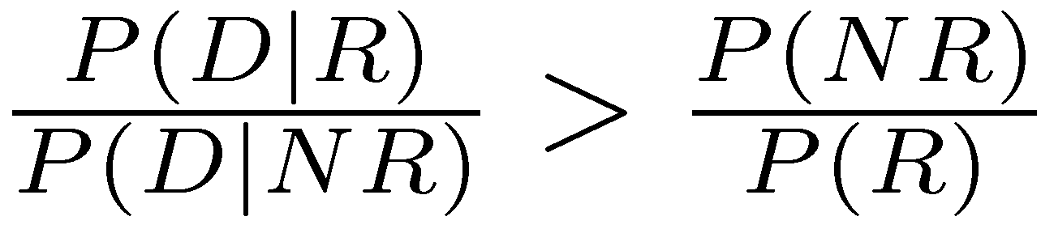
Bayes Classifier
Bayes Decision Rule
A document D is relevant if P(R|D) > P(NR|D)
Estimating probabilities
use Bayes Rule
classify a document as relevant if
lhs is likelihood ratio

Slide 23
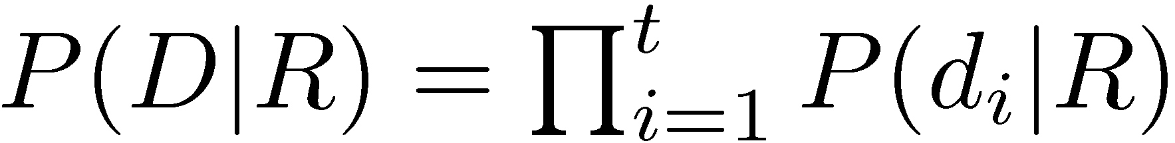
Estimating P(D|R)
Assume independence
Binary independence model
document represented by a vector of binary features indicating term occurrence (or non-occurrence)
p_{i} is probability that term i occurs (i.e., has value 1) in relevant document, s_{i} is probability of occurrence in non-relevant document

Slide 24
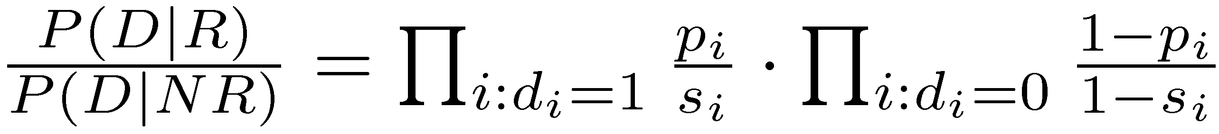
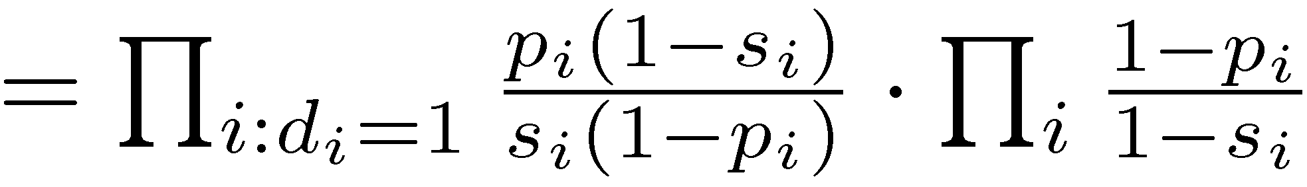
Binary Independence Model

Slide 25
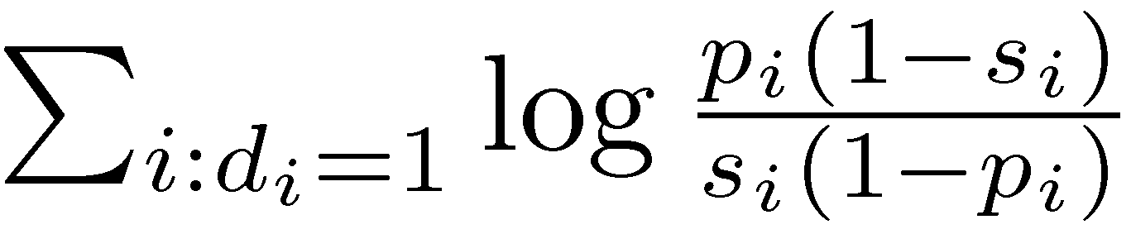
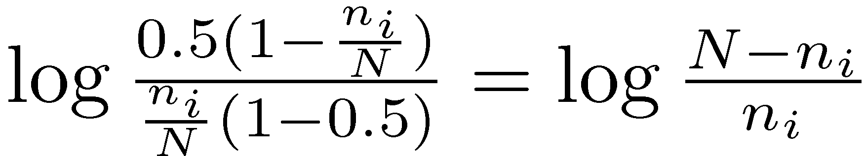
Binary Independence Model
Scoring function is
Query provides information about relevant documents
If we assume p_{i} constant, s_{i} approximated by entire collection, get idf-like weight

Slide 26
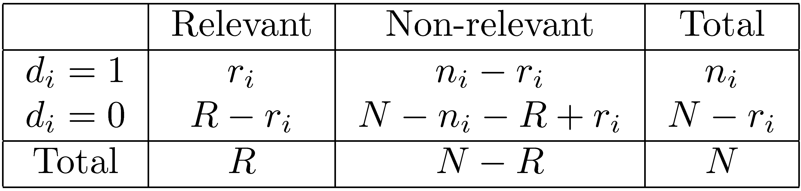
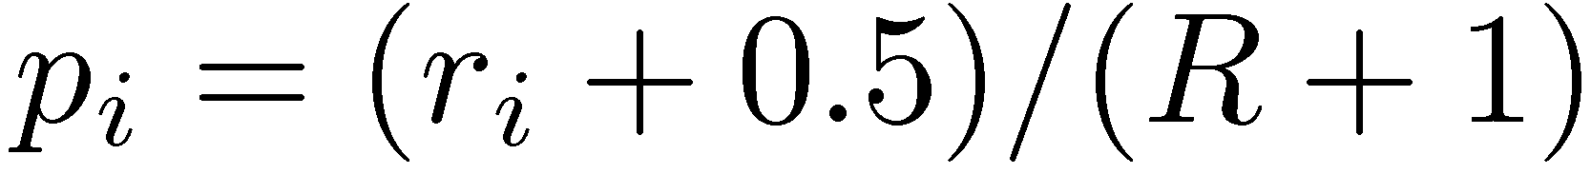
Contingency Table
Gives scoring function:

Slide 27
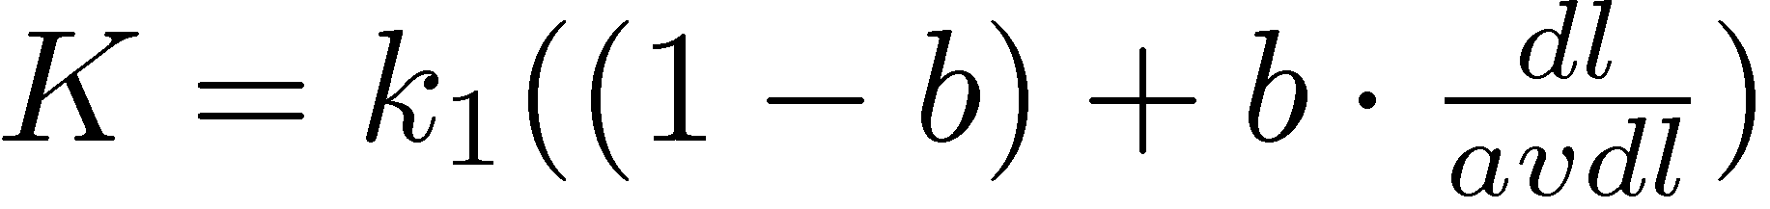
BM25
Popular and effective ranking algorithm based on binary independence model
adds document and query term weights
k1, k2 and K are parameters whose values are set empirically
dl is doc length
Typical TREC value for k1 is 1.2, k2 varies from 0 to 1000, b = 0.75

Slide 28
BM25 Example
Query with two terms, “president lincoln”, (qf = 1)
No relevance information (r and R are zero)
N = 500,000 documents
“president” occurs in 40,000 documents (n₁ = 40, 000)
“lincoln” occurs in 300 documents (n₂ = 300)
“president” occurs 15 times in doc (f₁ = 15)
“lincoln” occurs 25 times (f₂ = 25)
document length is 90% of the average length (dl/avdl = .9)
k₁ = 1.2, b = 0.75, and k₂ = 100
K = 1.2 · (0.25 + 0.75 · 0.9) = 1.11

Slide 29
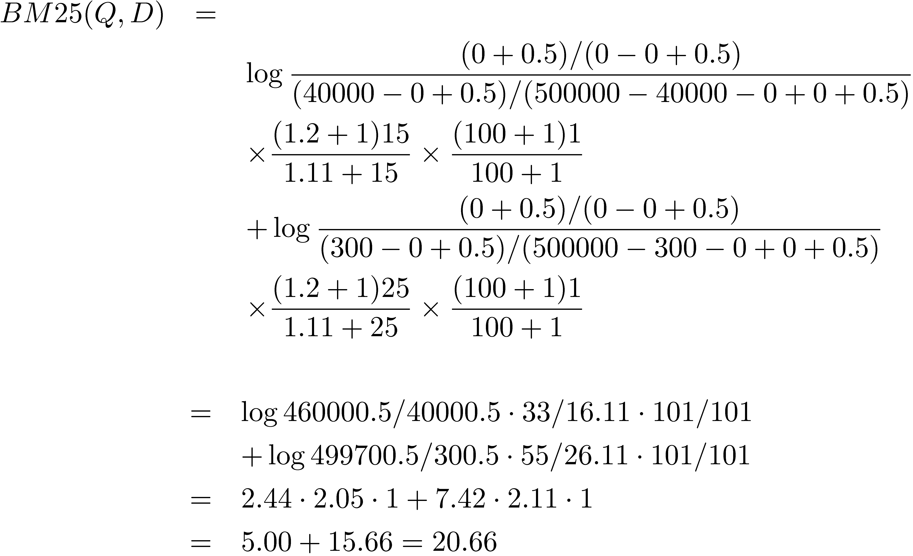
BM25 Example

Slide 30
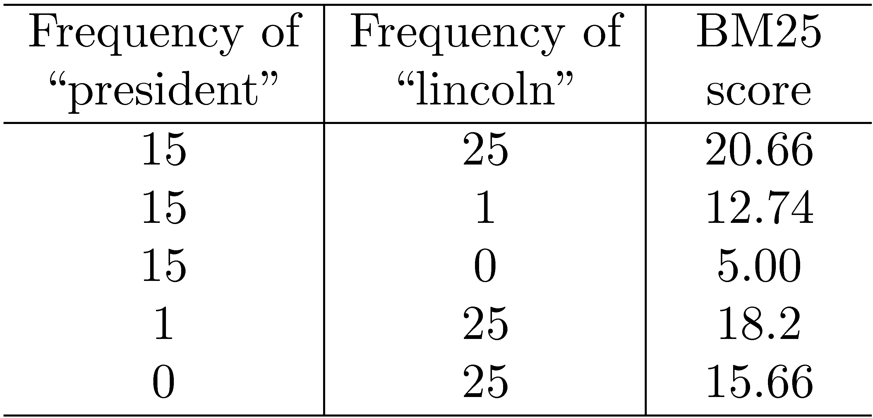
BM25 Example
Effect of term frequencies

Slide 31
Language Model
Unigram language model
probability distribution over the words in a language
generation of text consists of pulling words out of a “bucket” according to the probability distribution and replacing them
N-gram language model
some applications use bigram and trigram language models where probabilities depend on previous words

Slide 32
Language Model
A topic in a document or query can be represented as a language model
i.e., words that tend to occur often when discussing a topic will have high probabilities in the corresponding language model
Multinomial distribution over words
text is modeled as a finite sequence of words, where there are t possible words at each point in the sequence
commonly used, but not only possibility
doesn’t model burstiness

Slide 33
LMs for Retrieval
3 possibilities:
probability of generating the query text from a document language model
probability of generating the document text from a query language model
comparing the language models representing the query and document topics
Models of topical relevance

Slide 34
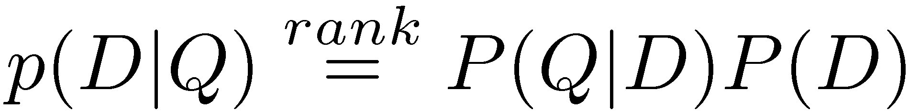
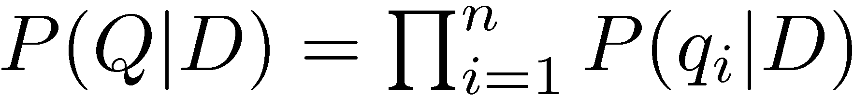
Query-Likelihood Model
Rank documents by the probability that the query could be generated by the document model (i.e. same topic)
Given query, start with P(D|Q)
Using Bayes’ Rule
Assuming prior is uniform, unigram model

Slide 35
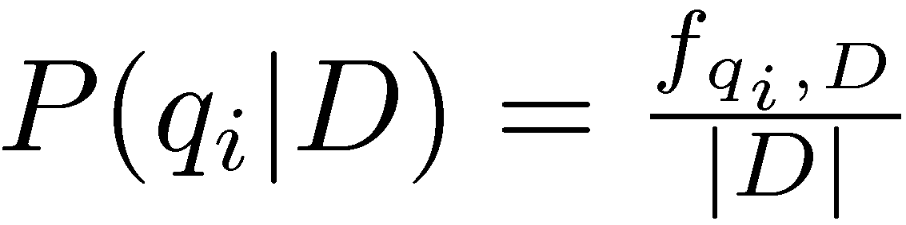
Estimating Probabilities
Obvious estimate for unigram probabilities is
Maximum likelihood estimate
makes the observed value of fqi;D most likely
If query words are missing from document, score will be zero
Missing 1 out of 4 query words same as missing 3 out of 4

Slide 36
Smoothing
Document texts are a sample from the language model
Missing words should not have zero probability of occurring
Smoothing is a technique for estimating probabilities for missing (or unseen) words
lower (or discount) the probability estimates for words that are seen in the document text
assign that “left-over” probability to the estimates for the words that are not seen in the text

Slide 37
Estimating Probabilities
Estimate for unseen words is α_{D}P(q_{i}|C)
P(q_{i}|C) is the probability for query word i in the collection language model for collection C (background probability)
α_{D} is a parameter
Estimate for words that occur is
(1 − α_{D}) P(q_{i}|D) + α_{D} P(q_{i}|C)
Different forms of estimation come from different α_{D}

Slide 38
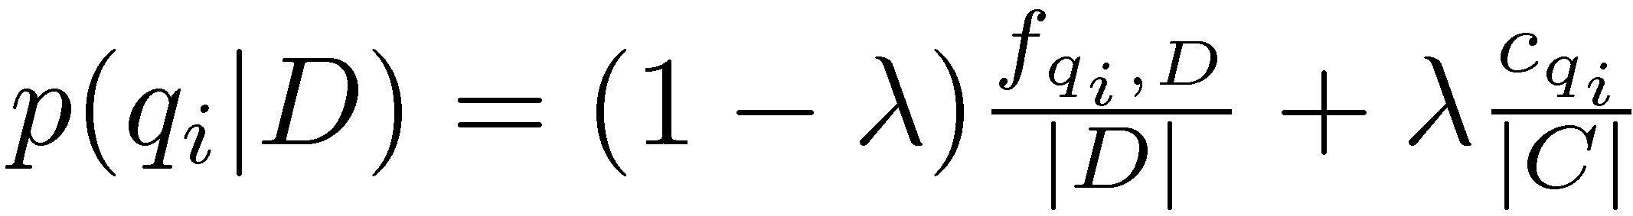
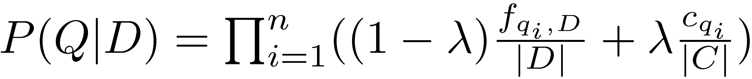
Jelinek-Mercer Smoothing
α_{D} is a constant, λ
Gives estimate of
Ranking score
Use logs for convenience
accuracy problems multiplying small numbers

Slide 39
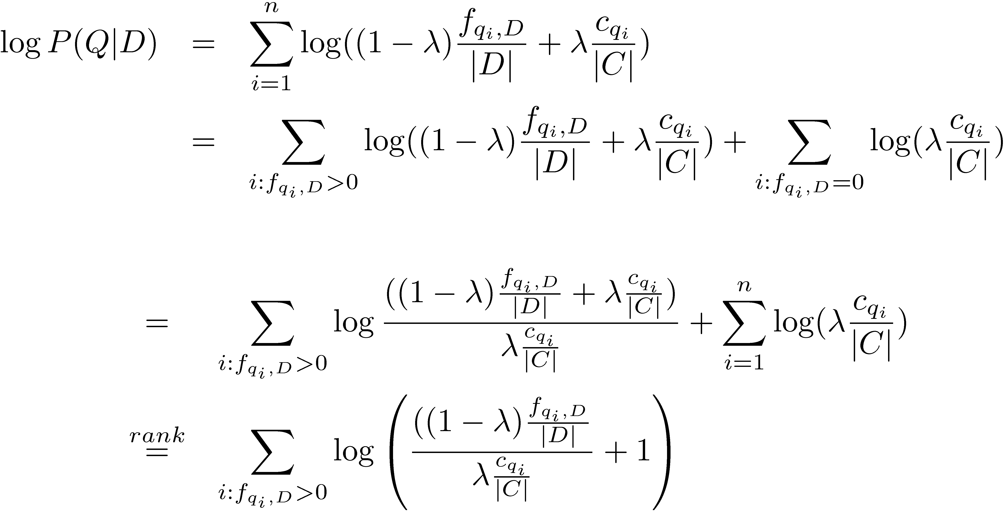
Where is tf.idf Weight?
- proportional to the term frequency, inversely proportional to the collection frequency

Slide 40
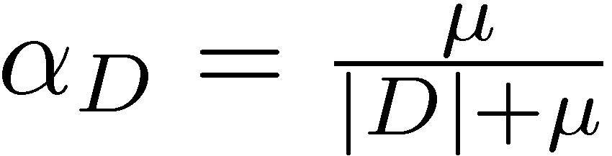
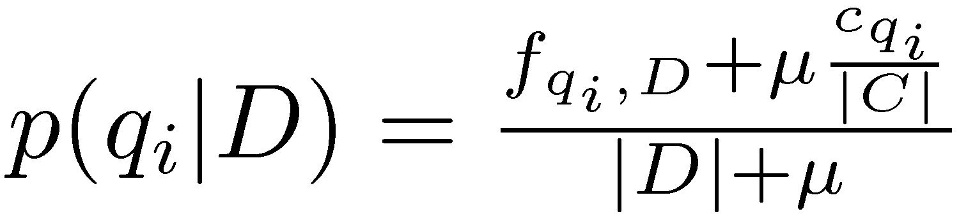
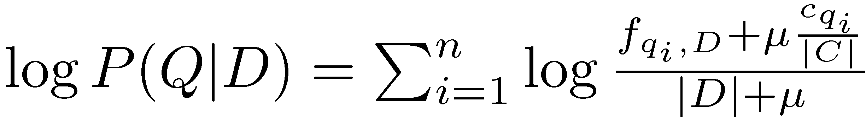
Dirichlet Smoothing
α_{D} depends on document length
Gives probability estimation of
and document score

Slide 41
Query Likelihood Example
For the term “president”
f_{qi,D} = 15, c_{qi} = 160,000
For the term “lincoln”
f_{qi,D} = 25, c_{qi} = 2,400
number of word occurrences in the document |d| is assumed to be 1,800
number of word occurrences in the collection is 10⁹
500,000 documents times an average of 2,000 words
μ = 2,000

Slide 42
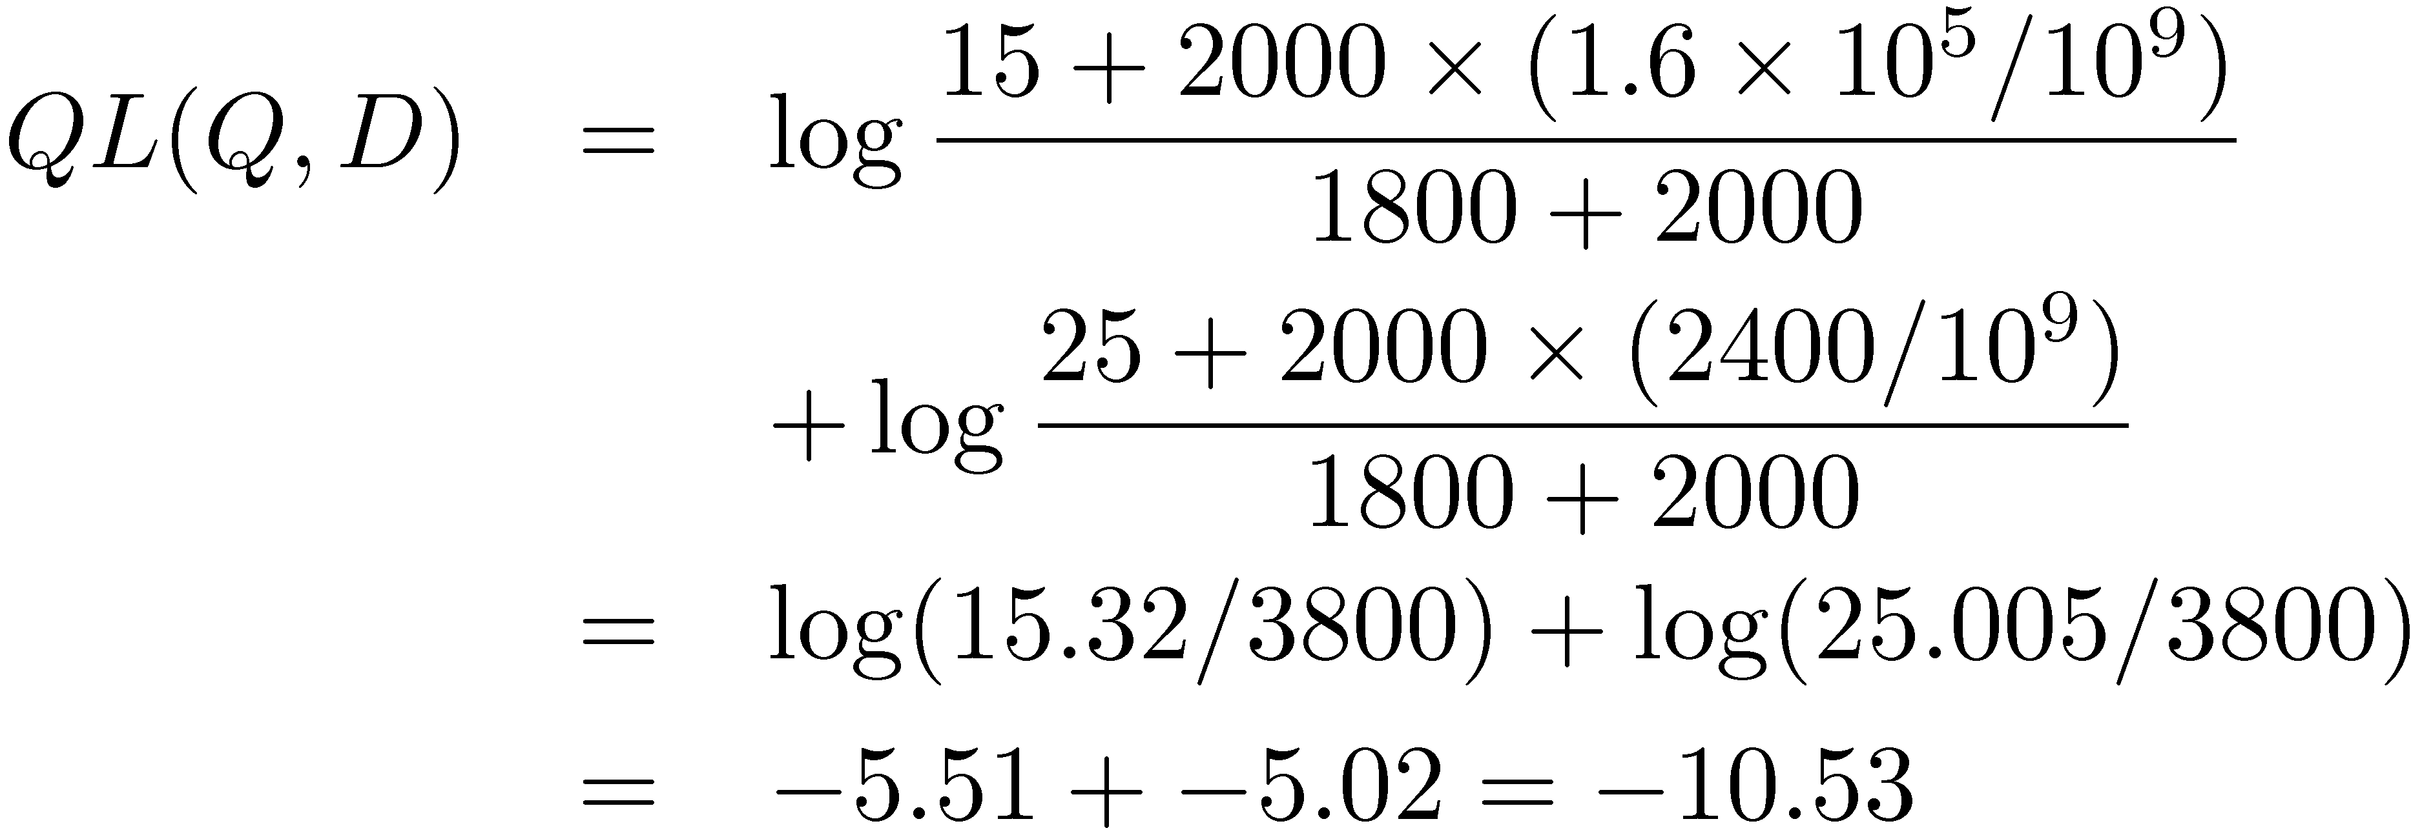
Query Likelihood Example
Negative number because summing logs of small numbers

Slide 43
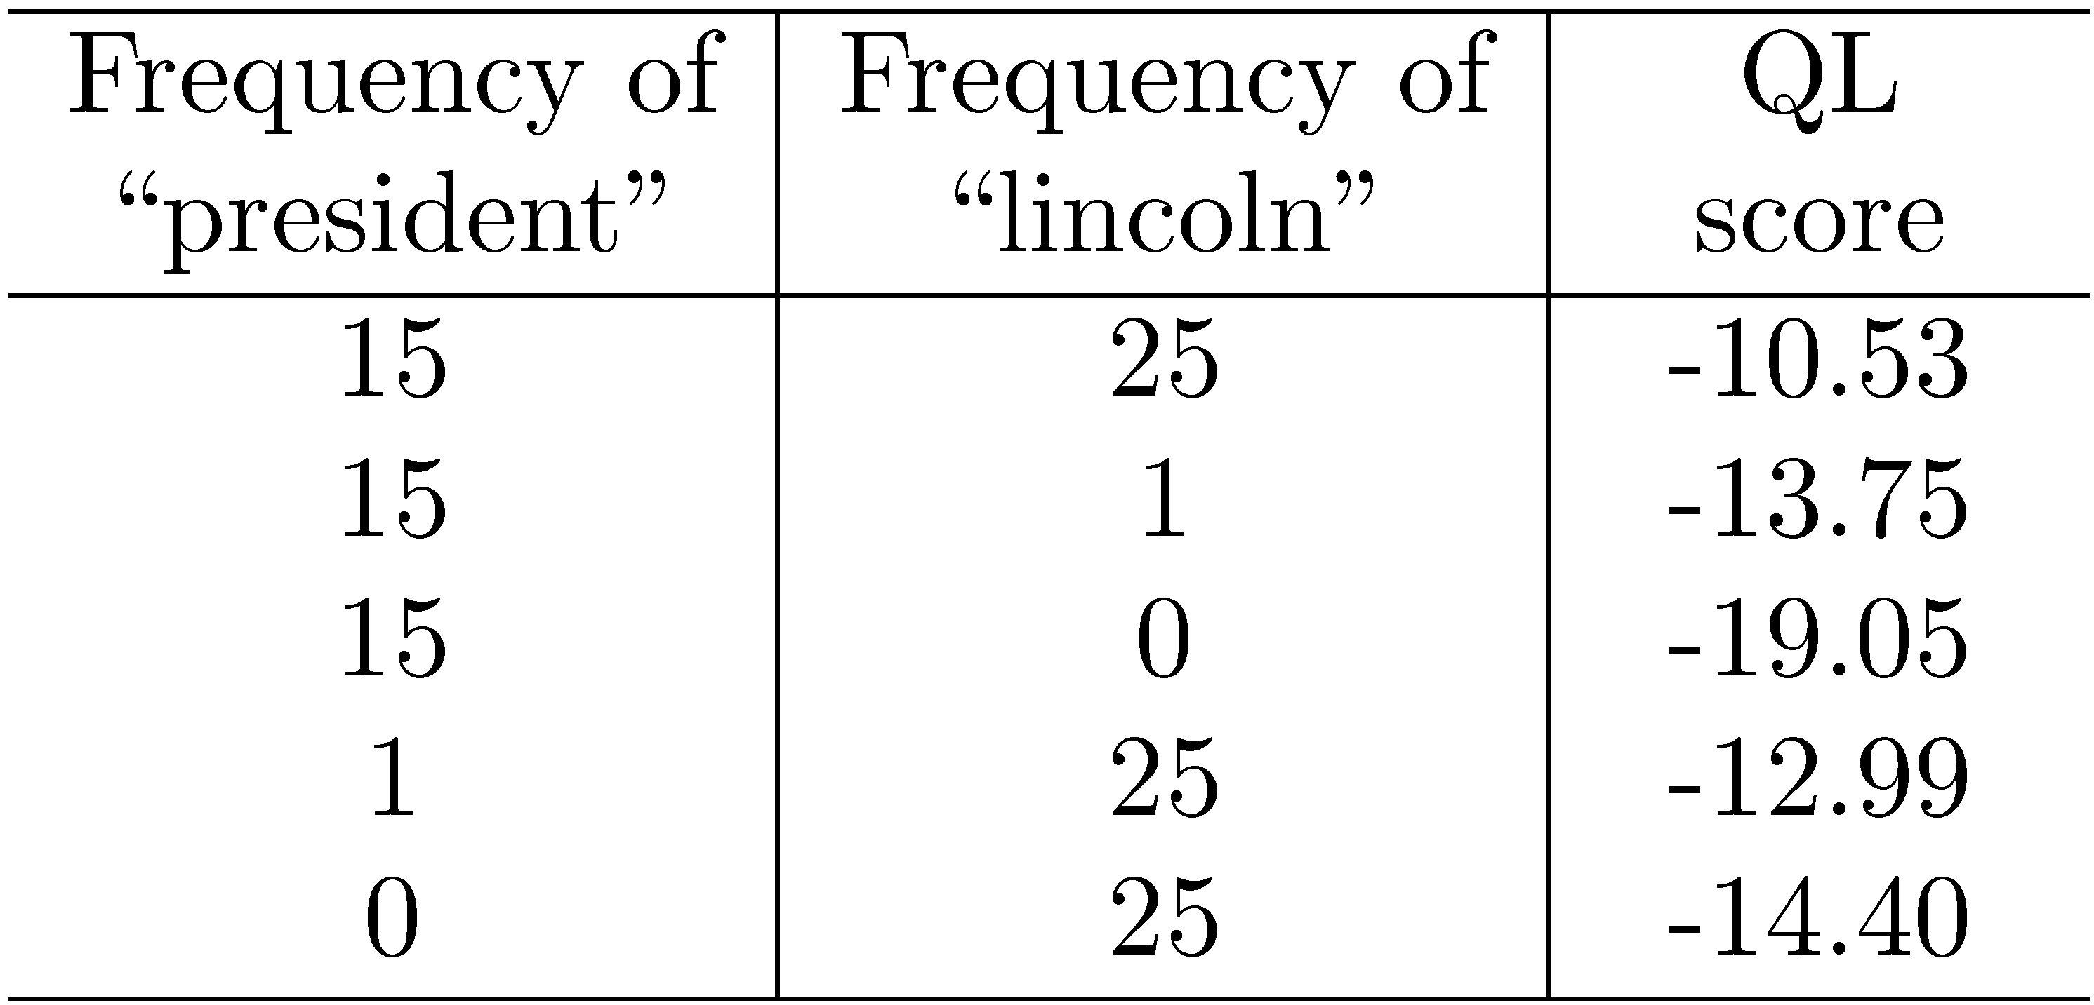
Query Likelihood Example

Slide 44
Relevance Models
Relevance model – language model representing information need
query and relevant documents are samples from this model
P(D|R) - probability of generating the text in a document given a relevance model
document likelihood model
less effective than query likelihood due to difficulties comparing across documents of different lengths

Slide 45
Pseudo-Relevance Feedback
Estimate relevance model from query and top-ranked documents
Rank documents by similarity of document model to relevance model
Kullback-Leibler divergence (KL-divergence) is a well-known measure of the difference between two probability distributions

Slide 46
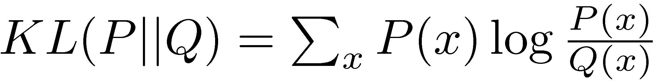
KL-Divergence
Given the true probability distribution P and another distribution Q that is an approximation to P,
Use negative KL-divergence for ranking, and assume relevance model R is the true distribution (not symmetric),

Slide 47
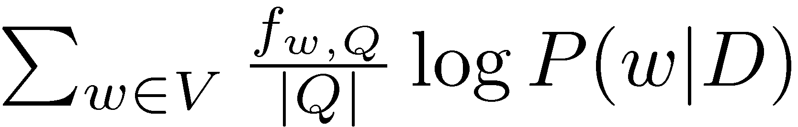
KL-Divergence
Given a simple maximum likelihood estimate for P(w|R), based on the frequency in the query text, ranking score is
rank-equivalent to query likelihood score
Query likelihood model is a special case of retrieval based on relevance model

Slide 48
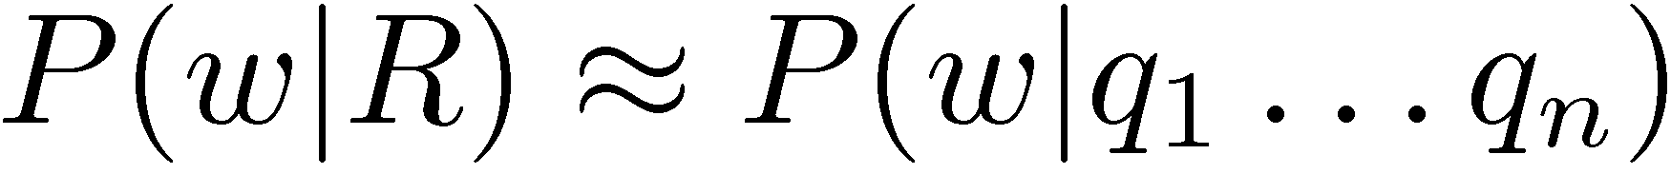
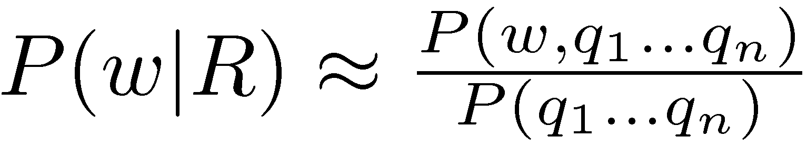
Estimating the Relevance Model
Probability of pulling a word w out of the “bucket” representing the relevance model depends on the n query words we have just pulled out
By definition

Slide 49
Estimating the Relevance Model
Joint probability is
Assume
Gives

Slide 50
Estimating the Relevance Model
P(D) usually assumed to be uniform
P(w, q1 . . . qn) is simply a weighted average of the language model probabilities for w in a set of documents, where the weights are the query likelihood scores for those documents
Formal model for pseudo-relevance feedback
query expansion technique

Slide 51
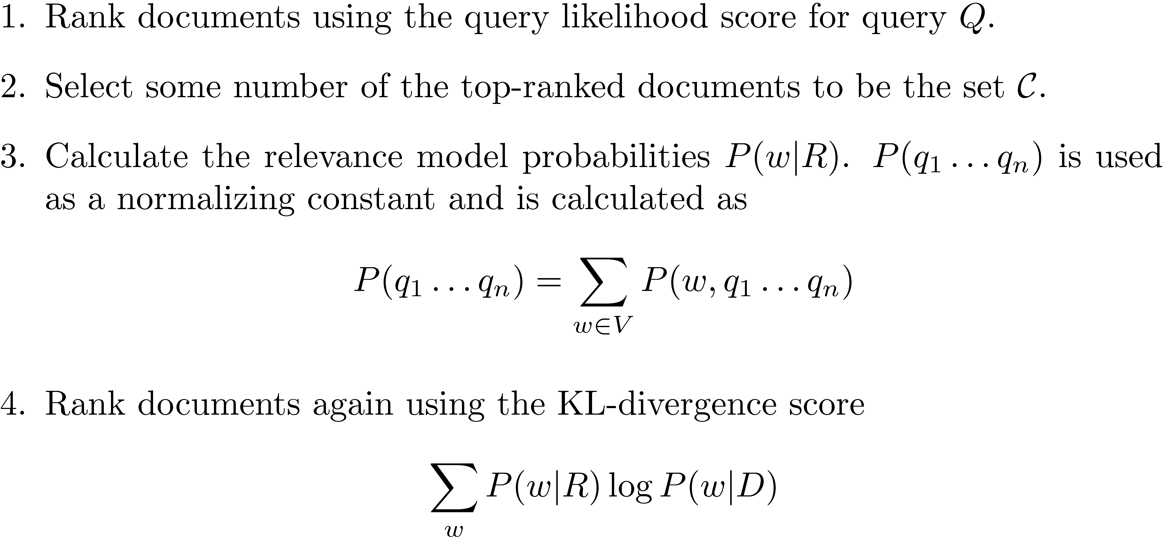
Pseudo-Feedback Algorithm

Slide 52
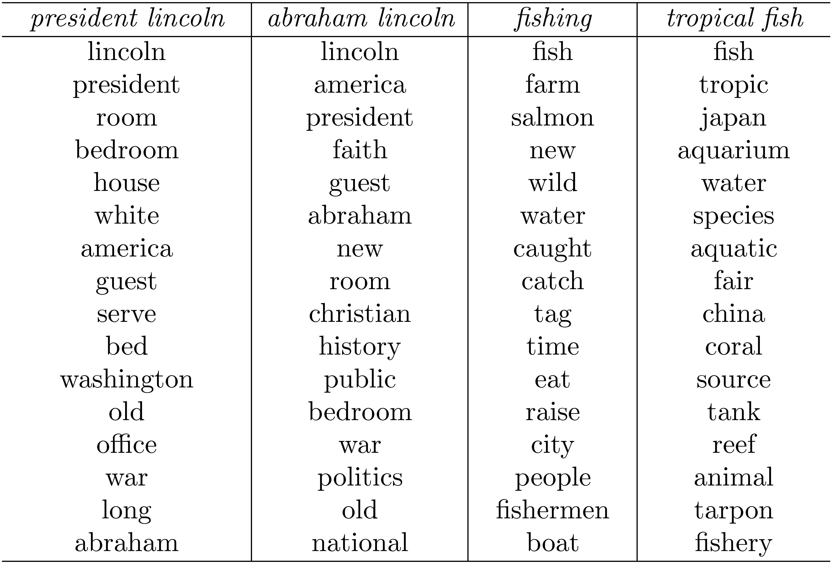
Example from Top 10 Docs

Slide 53
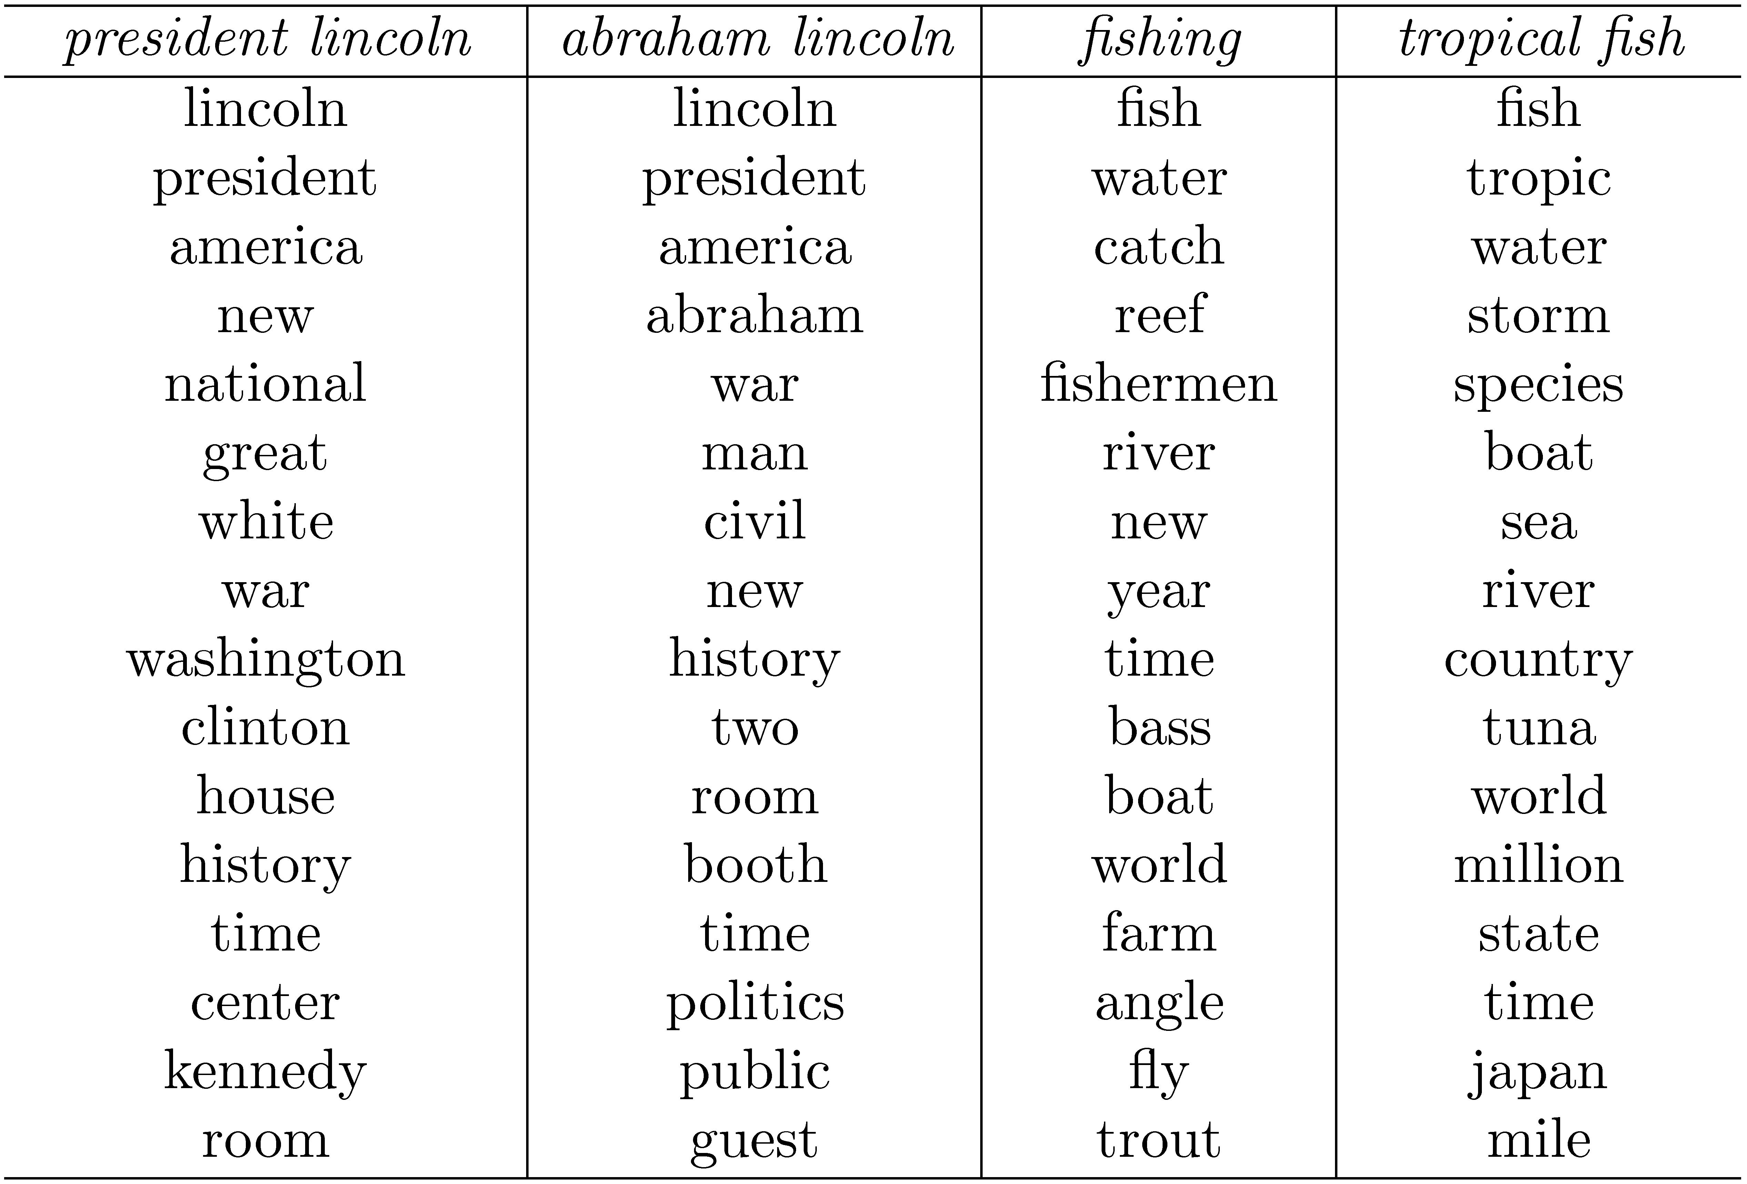
Example from Top 50 Docs

