Slide 1

Unit II
Requirements Engineering & Analysis

Slide 2
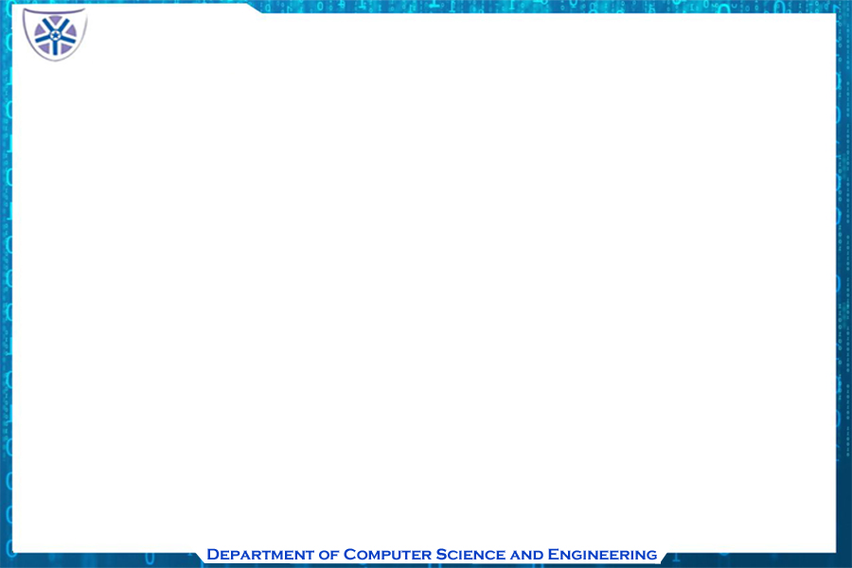
Chapter 1
Requirements Engineering

Slide 3
Introduction
Requirements engineering helps software engineers better understand the problems they are trying to solve.
It is a software engineering action, that begins during the software engineering communication activity and continues into the modeling activity.
Requirements Engineering, must be adapted to the needs of a specific process, project, product, or people doing the work.

Slide 4
REQUIREMENT ENGINEERING
The tasks and techniques that lead to an understanding of requirements is called Requirements Engineering.
Begins during the communication activity and continues into the modeling activity.
Adapted to the needs of the process, the project, and the people doing the project.

Slide 5
Requirements Engineering –
A solution
Allows the requirements engineer to examine
  The context of the software to be performed
  The specific needs of the design must be addressed
  The priorities that guide the order of word is completed
  The information, function, and behavior that have a profound impact on the resultant design

Slide 6
Requirements Engineering Tasks
Seven Task
  Inception
  Elicitation
  Elaboration
  Negotiation
  Specification
  Validation
  Requirements Management

Slide 7
Inception
Elicitation
Elaboration
Negotiation
Specification
Validation
Requirements
Management

Slide 8
Inception Task
During Inception, The requirements Engineer gathers about the
  basic understanding about the problem
  The people who wants a solution
  The nature of the solution described
  The effectiveness of the preliminary communication and collaboration between the customer and the developer.

Slide 9
Inception
Elicitation
Elaboration
Negotiation
Specification
Validation
Requirements
Management

Slide 10
Elicitation Task
Simple enough - ask the customer, the users and others what the objective of the system or the object are.
But, difficult because of
  Problem of scope : The boundary of the system ill defined or the customer / user specifying unnecessary technical data that confuses rather than clarify
  Problem of understanding : The customer / user are not sure of what is needed, don’t have full understanding about the problem
  Problem of volatility : The requirements keeps changing over time.

Slide 11
Inception
Elicitation
Elaboration
Negotiation
Specification
Validation
Requirements
Management

Slide 12
Elaboration Task
The information obtained from the customer during inception and elicitation is explained and refined during this task.
Elaboration is driven by the creation and refinement of user scenario that describes how the end user will interact with the end system.
  It is an analysis modelling task
  Domain classes are identified along with their attributes and relationships
The end result is an analysis model that defines the functional, information and behavioral domain of the problem.

Slide 13
Inception
Elicitation
Elaboration
Negotiation
Specification
Validation
Requirements
Management

Slide 14
Negotiation Task
Customers ask from more than that can be achieved
The software engineer reconciles the conflicts between what the costumer wants to what can be achieved
Requirements are prioritized using iterative approach by the customer, user and other stakeholders
Using iterative approach , requirements are eliminated , combined, added or removed so that each party achieves some measure of satisfaction

Slide 15
Inception
Elicitation
Elaboration
Negotiation
Specification
Validation
Requirements
Management

Slide 16
Specification Task
Specification is the final work product produced by the requirements engineer
It is generally in the form of software requirements specification (SRS)

Slide 17
Software Requirements Specification (SRS)
A software Requirements Specification is a document that is created when a detailed description of all aspects of the software to be build before the commencement of the project
A formal SRS is always not written
SRS may be justified during business issues for the lack of specification
Software Requirements Specification.docx

Slide 18
Inception
Elicitation
Elaboration
Negotiation
Specification
Validation
Requirements
Management

Slide 19
Validation Task
During validation , the work product produced as a result of requirements engineering are assessed for quality
The specification is examined to ensure that
  All software requirements have been stated unambiguously
  Whether inconsistencies, omissions, errors and corrections have been detected and corrected.
A formal technical review serves as a primary requirements validation mechanism

Slide 20
Inception
Elicitation
Elaboration
Negotiation
Specification
Validation
Requirements
Management

Slide 21
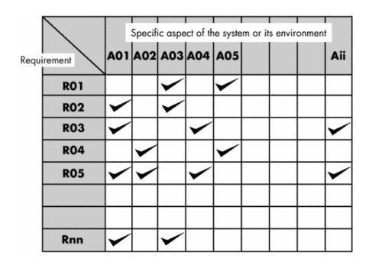
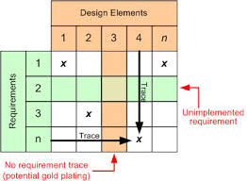
Requirements Management Task
Requirements for computer based systems change
The project manager performs a set of activities to identify, control, and track requirements and changes to the requirements at anytime as the project proceeds
The requirements are then placed into one or more tractability table

Slide 22
Initiation of requirements engineering process
The following steps are required to establish the ground work for understanding software requirements
  Identifying the stakeholder
  Recognizing the existence of multiple stakeholders viewpoints
  Working towards collaboration among stakeholders
  Asking the first question

Slide 23
Video presentation
Four Main Activities Requirements Engineering - Requirements, Stakeholders & Key Activities.mp4

Slide 24

Identifying the stakeholders
A stakeholder is anyone who is benefited in a direct or indirect way from the system which is being developed.
Different stakeholders have different view of the system and achieve different benefits from the system when it is developed.
Thus the list of stakeholders who contribute input as required are made which may also grow in meantime
Business operation managers, product managers, marketing people end – user , product engineers, marketing people etc are all stake holders

Slide 25
Recognizing the existence of multiple stakeholder viewpoints
The requirements of the system are explored from different points of view
As information from multiple viewpoints is collected, emerging requirements may be inconsistent or may conflict with one another.
All the information from the stakeholders should be categorized in a way that the decision makers can choose an set of requirements

Slide 26
Working towards collaboration among stakeholders
The requirement engineer has to identify the areas of commonality , conflicts and inconsistency of requirements of stakeholders
The stakeholders collaborate and provide their views of requirements
The senior of the organization makes the final decision on requirements

Slide 27
Requirement Analysis
Video Presentation
Requirement Analysis phase of Software Engineering - YouTube.MKV

Slide 28
Chapter 2
Building Analysis Model

Slide 29
Introduction
The analysis model is the first representation of a system
Analysis modelling uses a combination of text and diagrams to represent software requirements in a understandable manner
Building analysis model helps to uncover inconsistencies and omissions with ease

Slide 30
Types of analysis modelling
Structured analysis
Object - oriented analysis

Slide 31
Elements of requirement model
Scenario-based elements : Represents the system in the user’s point of view (basic use cases and corresponding use case diagrams)
Flow oriented elements : how data are transformed inside the system by processing function (activity diagram)
Class- based elements : defines objects, attributes, and relationships (class diagram)
Behavior- based elements : uses state transition to show the impact of events on the system (state diagram)

Slide 32
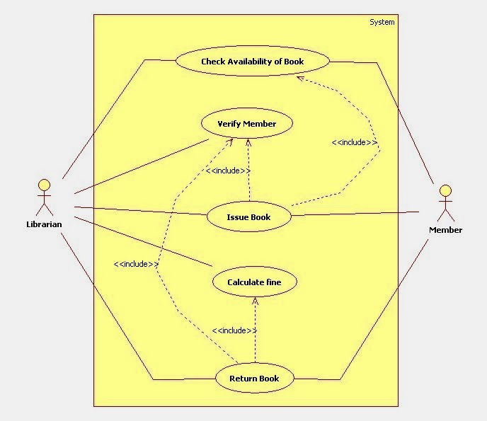
Use case : Library Management

Slide 33
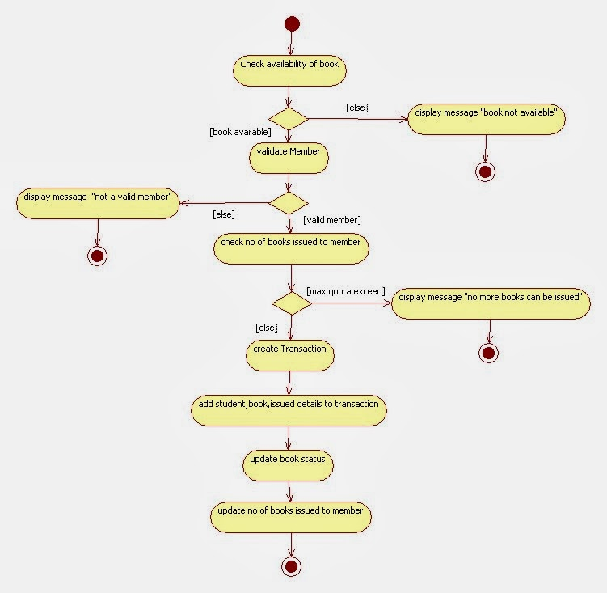
Activity diagram

Slide 34
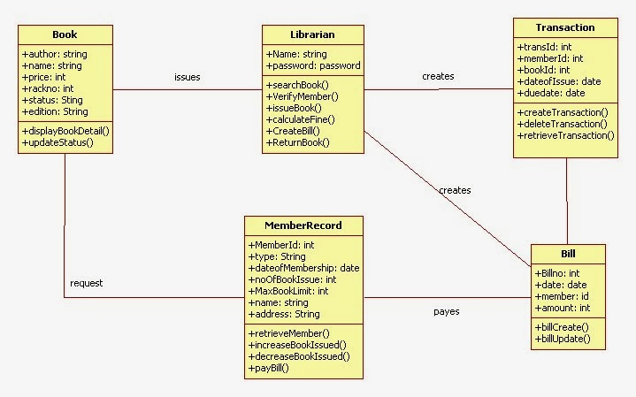
Class diagram

Slide 35
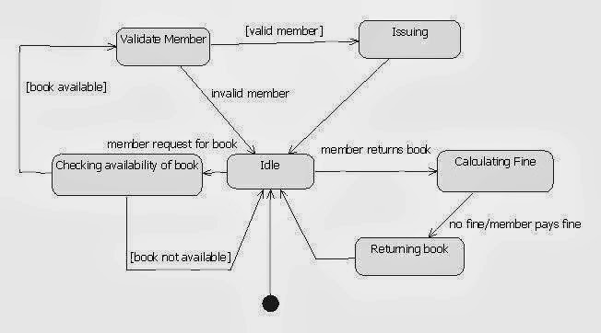
State diagram

Slide 36
Guidelines to build an analysis model
The product of analysis must be highly maintained, especially the software Requirements specification Document(SRS)
Problem must be dealt with using an effective portioning
Graphics must be used wherever possible
The logical and physical consideration must be differentiated

Slide 37
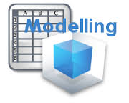
Data Modeling
Data modeling in software engineering is the process of creating a data model for an information system by applying formal data modeling techniques

Slide 38
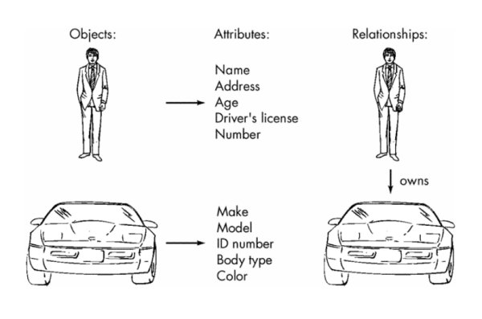
Data modelling concepts
Consists of 3 interrelated data modelling elements
  The data object
  The attribute
  The relationship

Slide 39
Data object
A data object is a representation of any composite information that can be understood by the software
A data object can be
  An external entity (eg: Anything that produces or consumes information)
  A thing (eg: a report or a display)
  An occurrence(eg: a telephone call)
  An event (eg: an alarm)
  A role (eg: a salesperson)
  An organizational unit(eg: accounts department)
  A place(eg: warehouse)
  A structure(eg: A file)
Data objects can be represented in the form of tables

Slide 40
Data Attributes
Data attributes defines the properties of the data object.
It is used to
  Name a data object instance
  Describe its characteristics
  Or make reference to another data object
Example: The attributes for the data object car includes
ID number, body type and color and many other attributes like drive type, transmission type etc.

Slide 41
Relationship
Data objects are connected to one another in different ways.
Relationships indicate the manner in which data objects are connected to one another.
Example: A connection is established between person or car and the 2 objects are related. The relationships are defined below
A person owns a car
A person in insured to drive a car
The terms owns and insures define the relevant connection between the person and car.
The directionality of the relationship reduces the ambiguity and misinterpretations.

Slide 42
Cardinality
The elements of data modelling – data objects, attributes and relationships provides the basic understanding of the information domain.
Cardinality is understanding how many occurrences of object X are related to how many occurrences of object y.
In other words
Cardinality is the specification of the number of occurrences of one [object] that can be related to the number of occurrences of another [object].

Slide 43
Cardinality types
One-to-one (l:l)—An occurrence of [object] 'A' can relate to one and only one occurrence of [object] 'B,' and an occurrence of 'B' can relate to only one occurrence of 'A.‘
One-to-many (l:N)—One occurrence of [object] 'A' can relate to one or many occurrences of [object] 'B,' but an occurrence of 'B' can relate to only one occurrence of 'A.‘
Example : A mother can have many children, but a child can have only one mother.
Many-to-many (M:N)—An occurrence of [object] 'A' can relate to one or more occurrences of 'B,' while an occurrence of 'B' can relate to one or more occurrences of 'A.'
Example : An uncle can have many nephews, while a nephew can have many uncles.

Slide 44
Modality
Modality indicates wheatear particular data object must participate in the relation or not.
The modality of a relationship is 0 if there is no explicit need for the relationship to occur or the relationship is optional.
The modality of a relationship is 1 if an occurrence of the relationship is mandatory.

Slide 45
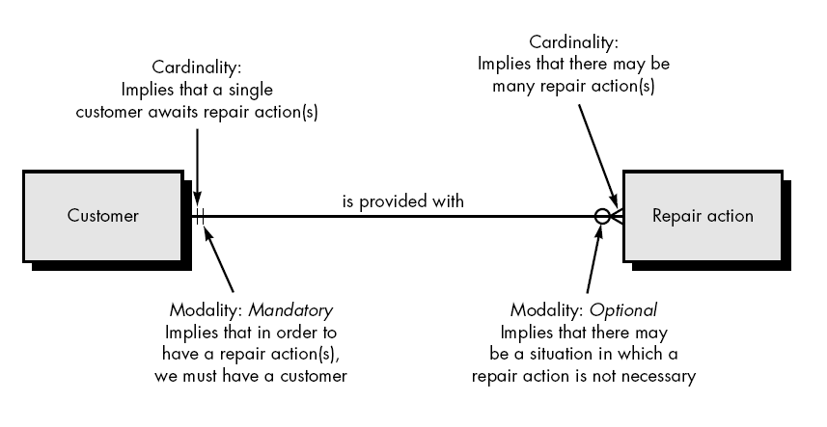
Relationship, cardinality, modality

Slide 46
Class based modeling
The class based elements of an analysis model are objects and classes, attributes, operations, packages, CRC models, collaboration diagrams

Slide 47
Guidelines of identifying these elements for an actual problem
Identifying analysis classes
Specifying class attributes
Defining operations
Class – Responsibility – collaborator (CRC) modeling

Slide 48
Identifying analysis classes
The problem statement is examined and noun are found that fit the following categories(i.e. grammatical phrases)
  External entities (system, people, devices) that produce or consume information to be used by the computer based system
  Things (reports, displays, letters) that are a part of information domain for a problem.
  Occurrences or events ( a robot movement) that occur within the context of system operation
  Roles (manager, engineer, supervisor) played by people who interact with the system
  Organizational unit (division, group, team) that are relevant to an application
  Places (laboratory, control room)that establish the context of the problem and overall function of the system
  Structures ( sensors, vehicles, computers) that define a class of objects or the extreme class of objects

Slide 49
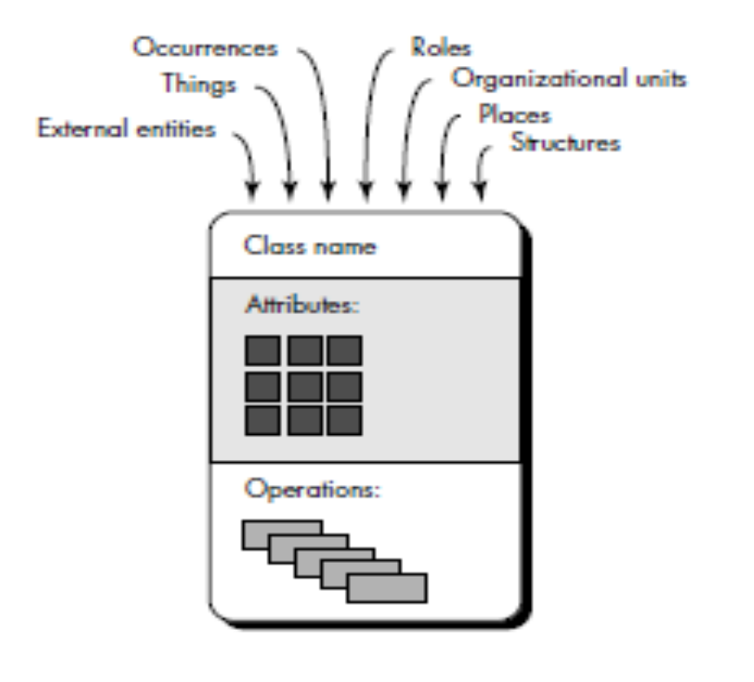
Class manifestation

Slide 50
Extraction of nouns
Potential Object/Class | General Classification
Homeowner | role or external entity
sensor | external entity
control panel | external entity
installation | occurrence
system (alias security system) | thing
number, type | not objects, attributes of sensor
master password | thing
telephone number | thing
sensor event | occurrence
audible alarm | external entity
monitoring service | organizational unit or external entity

Slide 51
Six selection characteristics
Coad and Yourdon suggest six selection characteristics
  Contains information that should be retained
  Provides needed services
  Contains multiples attributes
  Has common set of attributes that apply to all class instances
  Has common set of operations that apply to all the object
  Instances
  Represent external entity that produces or consumes information

Slide 52
Specifying class attributes
Attributes are set of data objects that fully define the class within the context of the problem
To develop a meaningful set of attributes for an object , the processing narrative for the problem must be studied and things that reasonably belong to the object are selected.
In addition, the following question should be answered for each object: “What data items should be answered for each objects (composite and / or elementary) fully define this object in the context of the problem at the hand?”

Slide 53
Defining operations
Operations define the behavior of the object
Operations changes one or more attribute values that are contained within the object
Divided into 3 broad categories
  Operations that manipulate the data in someway (eg: adding, deleting, reformatting)
  Operations that perform a computation
  Operations that monitor an object for the occurrence of an controlling event.

Slide 54
Class – Responsibility- Collaborator (CRC) modeling
CRC provides a simple means of identifying and organizing the classes that are relevant to system or product requirement
According to Ambler, a CRC model is a collection of standard index cards that represent classes
Cards are divided into three sections
  Along the top of card – the name of class is written
  In the body – the class responsibilities in listed on left , the collaborators on the right

Slide 55
Responsibility & Collaborator
Responsibilities : are the attributes and operations that are relevant for the class
Responsibilities are anything that a class knows or does
Collaborators : are those classes that are required to provide a class with the information needed to complete a responsibility
Collaboration implies either a request for information or a request for some action

Slide 56
Index cards
A set of index cards that represent the system classes are developed.
One class per card.
Cards are divided into three sections
  Class name
  Class responsibility
  Class collaborators

Slide 57
Classes
Classes must be identified as follows :
Classes represent things that can be stored to database and persist through out application
Entity classes or model or business statement are extracted from the statement problem
Boundary classes are used to create interfaces that sees and interacts with the software
Controller classes manage unit of work from start to finish.

Slide 58
Responsibilities
The guideline for allocating responsiblities are as follows :
System intelligence should be evenly distributed across classes to best address the needs of the problem
Each responsibility should be stated as generally as possible
Information and the behavior related to it should reside within the same class
Information about one thing should be localized with a single class
Responsiblities should be shared among related classes

Slide 59
Collaborations
Classes fulfill their responsiblities in any of the two ways:
A class can use its own operation to manipulate its own attributes, thereby fulfilling a particular responsiblities
A class can collaborate with other class
Collaborations are identified by determining whether a class can fulfill each responsibility itself

Slide 60
Association and Dependencies
Association defines a relationship between classes
The association may be further defined by indicating multiplicity/cardinality
Multiplicity defines how many of one class are related to how many of another class
Dependency - client/server relationship between two classes i.e. When a class depends on another class\
Dependency relationships are indicated in class diagrams using stereotype names surrounded by angle brackets (e.g., «stereotype»).
Stereotype is an “extensibility mechanism that allows to define a special modeling element whose semantics are custom-defined.

Slide 61
Analysis Packages
Categorization is an important part of analysis modeling.
Various elements of the analysis model are categorized in a manner that packages them as a group called as analysis package , giving a representative name.
Analysis packages are made up of classes having the same categorization
In class diagrams , visibility of class elements can be indicated using a + before a package name in each package indicating the public visibility or private visibility.

