Slide 1

Unit III Software Design

Slide 2
Chapter 1 Design concepts and Principles

Slide 3
DESIGN
Design is an meaningful engineering representation of something that is to be built
It can be traced to a customer’s requirements and at the same time assessed for quality against a set of predefined criteria for “good” design.
In the software engineering context, design focuses on four major areas of concern:
data
architecture
Interfaces and
components

Slide 4
SOFTWARE DESIGN AND SOFTWARE ENGINEERING
Software design sits at the technical kernel of software engineering and is applied regardless of the software process model that is used
Beginning once software requirements have been analyzed and specified, software design is the first of three technical activities—design, code generation, and testing

Slide 5
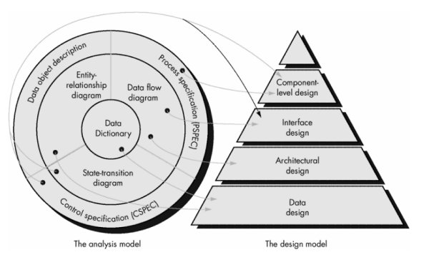
Analysis to design

Slide 6
Analysis to design
Software requirements, manifested by the data, functional, and behavioral models, feed the design task.
Using any one of the design methods, the design task produces a
data design
an architectural design
an interface design
a component design

Slide 7
Data design
The data design transforms the information domain model created during analysis into the data structures that will be required to implement the software.
The data objects and relationships defined in the entity relationship diagram and the detailed data content depicted in the data dictionary provide the basis for the data design activity.
Part of data design may occur in conjunction with the design of software architecture.

Slide 8
Architectural design
The architectural design defines the relationship between major structural elements of the software
The architectural design representation— the framework of a computer-based system can be derived from the system specification, the analysis model, the interaction of subsystems defined within the analysis model.

Slide 9
Interface design
The interface design describes how the software communicates within itself, with systems that inter-operate with it, and with humans who use it.
An interface implies a flow of information (e.g., data and/or control) and a specific type of behavior
Data and control flow diagrams provide much of the information required for interface design.

Slide 10
Component level design
The component-level design transforms structural elements of the software architecture into a procedural description of software components.

Slide 11
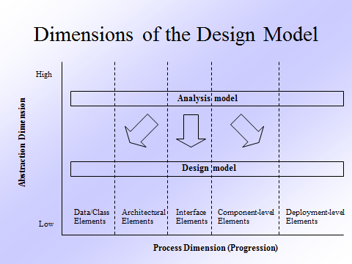
Dimension of design model

Slide 12
Why is design important
Single word statement – quality
Design is the place where quality is fostered in software engineering.
Design provides us with representations of software that can be assessed for quality.
Design is the only way that we can accurately translate a customer's requirements into a finished software product or system.
Without design, we risk building an unstable system—one that will fail when small changes are made; one that may be difficult to test; one whose quality cannot be assessed

Slide 13
Design process
Software design is an iterative process through which requirements are translated into a “blueprint” for constructing the software.
the blueprint depicts a holistic view of software.
the design is represented at a high level of abstraction

Slide 14
Design and Software quality
Throughout the design , the quality of the design is assessed.
3 characteristics for good design
The design must implement all the explicit requirement contained in the analysis model.
The design must be readable, and a understandable guide for those who generate code
The design should provide a complete picture of the software, addressing data and a behavioral domain from an implementation perspective

Slide 15
How to achieve good design
The guidelines are as follows:
A design should exhibit an architectural structure that
Has been created using recognizable design pattern
Is composed of components that exhibit good design characteristics
Can be implemented in an evolutionary fashion, thereby facilitating implementation and testing
A design be modular, that is it should be logically partitioned into elements
A design should contain distinct representation of data
A design lead to data structures that are appropriate for objects to be implemented
A design should lead to components that exhibit independent functional characteristics

Slide 16
DESIGN PRINCIPLES
Software design is both process and model
Design process : The design process is a sequence of steps that enable designers to describe all the aspects of the software to be built
Design Model : The design model is the equivalent of an architects plans for a house

Slide 17
Principles for software design
The design process should not suffer from “tunnel vision”
The design should be traceable to analysis model
The design should not reinvent the wheel

Slide 18
DESIGN CONCEPTS
Abstraction – data , procedural, control
Refinement - elaboration of details for all abstraction
Modularity - compartmentalization of data and function
Architecture – overall structure of data
Procedure - the algorithms that achieve function
Hiding - controlled interfaces

Slide 19
Abstraction
Many levels of abstraction can be posed
At the highest level of abstraction, a solution is stated in broad terms using the language of the problem environment.
At lower levels of abstraction, a more procedural orientation is taken. Problem-oriented terminology is coupled with implementation- oriented terminology in an effort to state a solution.
At the lowest level of abstraction, the solution is stated in a manner that can be directly implemented.

Slide 20
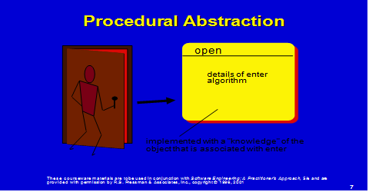
Procedural abstraction
A procedural abstraction is a named sequence of instructions that has a specific and limited function
An example of a procedural abstraction would be the word open for a door. Open implies a long sequence of procedural steps (e.g., walk to the door, reach out and grasp knob, turn knob and pull door, step away from moving door, etc.).

Slide 21
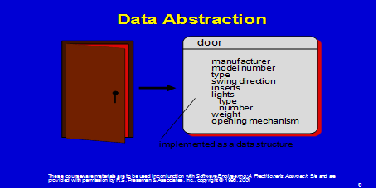
Data Abstraction
A data abstraction is a named collection of data that describes a data object .

Slide 22
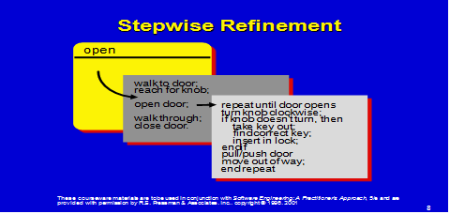
Refinement
Stepwise refinement is a top-down design strategy ,A program is developed by successively refining levels of procedural detail.
Refinement is actually a process of elaboration.
Refinement helps the designer to reveal low-level details as design progresses. Both concepts aid the designer in creating a complete design model as the design evolves.

Slide 23
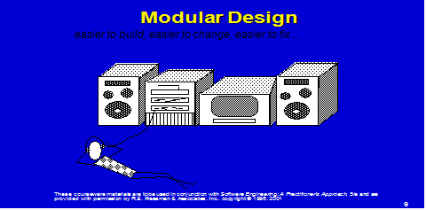
Modularity
Modularity: software is divided into separately named and addressable components, often called modules, that are integrated to satisfy problem requirements.

Slide 24
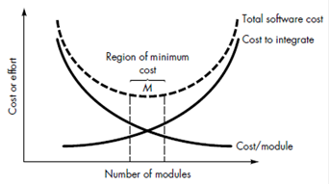
Module and software cost
The effort (cost) to develop an individual software module does decrease as the total number of modules increases.
There is a number, M, of modules that would result in minimum development cost, but we do not have the necessary sophistication to predict M with assurance.

Slide 25
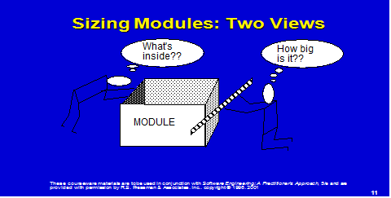
Modularity Tradeoff
2 views – Size and What is inside

Slide 26
5 important criteria
five important criteria that enable us to evaluate a design method with respect to its ability to define an effective modular system:
1.Modular decomposability. If a design method provides a systematic mechanism for decomposing the problem into sub problems, it will reduce the complexity of the overall problem, thereby achieving an effective modular solution.
2.Modular composability. If a design method enables existing (reusable) design components to be assembled into a new system, it will yield a modular solution that does not reinvent the wheel.
3. Modular understandability. If a module can be understood as a standalone unit (without reference to other modules), it will be easier to build and easier to change.
4. Modular continuity. If small changes to the system requirements result in changes to individual modules, rather than system wide changes, the impact of change-induced side effects will be minimized.
5. Modular protection. If an aberrant condition occurs within a module and its effects are constrained within that module, the impact of error-induced side effects will be minimized.

Slide 27
Software Architecture
Software architecture alludes to “the overall structure of the software and the ways in which that structure provides conceptual integrity for a system” .
Architecture is the hierarchical structure of program components

Slide 28
Architectural design properties
Structural properties. This aspect of the architectural design representation defines the components of a system (e.g., modules, objects, filters)
Extra-functional properties. The architectural design description should address how the design architecture achieves requirements for performance, capacity, reliability, security, adaptability, and other system characteristics.

Slide 29
Different models in architecture
Structural models represent architecture as an organized collection of program components.
Framework models increase the level of design abstraction by attempting to identify repeatable architectural design frameworks (patterns) that are encountered in similar types of applications.
Dynamic models address the behavioral aspects of the program architecture, indicating how the structure or system configuration may change as a function of external events.
Process models focus on the design of the business or technical process that the system must accommodate. Finally, functional models can be used to represent the functional hierarchy of a system.

Slide 30
Information hiding
The principle of information hiding suggests that modules be "characterized by design decisions that (each) hides from all others."
Hiding implies that effective modularity can be achieved by defining a set of independent modules that communicate with one another only that information necessary to achieve software function.
Abstraction helps to define the (or informational) entities that make up the software.
Hiding defines and enforces access constraints to both procedural detail within a module and any local data structure used by the module .

Slide 31
Functional independencies
The concept of functional independence is a direct growth of abstraction and information hiding
Functional independence is achieved by developing modules with "single-minded" function and an "aversion" to excessive interaction with other modules.
Independent modules are easy to maintain
Independencies is measures with 2 quantities :
Coupling
Cohesion

Slide 32
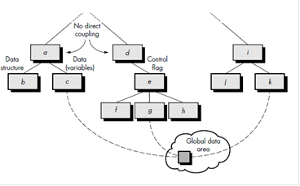
Cohesion
Cohesion is a measure of the relative functional strength of a module.
Coupling is a measure of the relative interdependence among modules.
A cohesive module performs a single task within a software procedure, requiring little interaction with procedures being performed in other parts of a program.

Slide 33
Coupling
Coupling: is a measure of interconnection among modules in a software structure.
Coupling depends on the interface complexity between modules, the point at which entry or reference is made to a module, and what data pass across the interface.
Simple connectivity among modules results in software that is easier to understand and less prone to a "ripple effect", caused when errors occur at one location and propagates through a system.

Slide 34
DESIGN MODEL
The design model is represented in the shape of a pyramid
The symbolism of this shape is important.
A pyramid is an extremely stable object with a wide base and a low center of gravity. Like the pyramid, we want to create a software design that is stable.

Slide 35
Chapter 2 Architectural Design

Slide 36
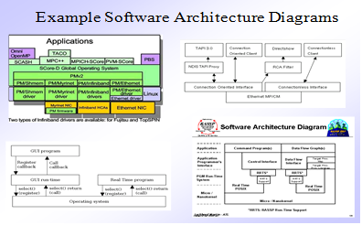
SOFTWARE ARCHITECTURE
The software architecture of a program or computing system is the structure or structures of the system, which comprise software components, the externally visible properties of those components, and the relationships among them

Slide 37
Architecture is a representation
enables a software engineer to
Analyze the effectiveness of the design in meeting its stated requirements
(2) Consider architectural alternatives at a stage when making design changes is still relatively easy, and
(3) Reducing the risks associated with the construction of the software.

Slide 38
Importance of architecture
Three key reasons that software architecture is important:
Representations of software architecture are an enabler for communication between all parties (stakeholders) in the development
The architecture highlights early design decisions that will have a high impact on all software engineering work that follows
Architecture “constitutes a relatively small, intellectually graspable model of how the system is structured and how its components work together” [BAS98].

Slide 39
Two levels of design pyramid
Data design
Architectural design
Data design enables us to represent the data component of the architecture.
Architectural design focuses on the representation of the structure of software components, their properties, and interactions.

Slide 40
DATA DESIGN
Data design (referred as data architecting) creates a model of data and/or information that is represented at a high level of abstraction (the customer/user’s view of data).
The structure of data has always been an important part of software design.
At the program component level : the design of data structures and the associated
At the application level, the translation of a data model (derived as part of requirements engineering) into a database
At the business level, the collection of information stored in disparate databases and reorganized into a “data warehouse”

Slide 41
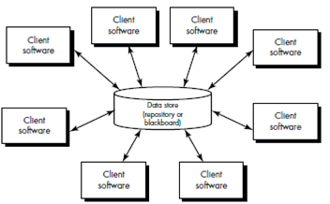
ARCHITECTURAL STYLES
1 .Data-Centered Architectures.
A data store (e.g., a file or database) resides at the center of this architecture and is accessed frequently by other components that update, add, delete, or otherwise modify data within the store.
Data-centered architectures promote integrality. That is, existing components can be changed and new client components can be added to the architecture

Slide 42
ARCHITECTURAL STYLES
2 Data-flow architectures
This architecture is applied when input data are to be transformed through a series of computational or manipulative components into output data.

Slide 43
ARCHITECTURAL STYLES
3 Call and return architectures
This architectural style enables a software designer (system architect) to achieve a program structure that is relatively easy to modify and scale.
Sub styles of this category:
Main program/subprogram architectures.
This classic program structure decomposes function into a control hierarchy where a “main” program invokes a number of program components, which in turn may invoke still other components.
Remote procedure call architectures.
The components of a main program/ subprogram architecture are distributed across multiple computers on a network

Slide 44
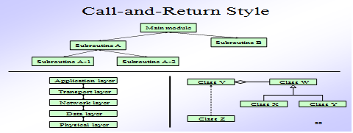
3 Call and return

Slide 45
ARCHITECTURAL STYLES
4. Object-oriented architectures:
The components of a system encapsulate data and the operations that must be applied to manipulate the data.
Communication and coordination between components is accomplished via message passing.

Slide 46
ARCHITECTURAL STYLES
5 Layered architectures:
A number of different layers are defined, each accomplishing operations that progressively become closer to the machine instruction set.
At the outer layer, components service user interface operations.
At the inner layer, components perform operating system interfacing.
Intermediate layers provide utility services and application software functions.

Slide 47
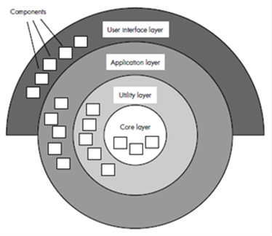
ARCHITECTURAL STYLES
5 Layered architectures:

Slide 48
REFINING THE ARCHITECTURAL DESIGN
Successful application of transform or transaction mapping is supplemented by additional documentation that is required as part of architectural design.

Slide 49
REFINING THE ARCHITECTURAL DESIGN
After the program structure has been developed and refined, the following tasks must be completed:
A processing narrative must be developed for each module.
An interface description is provided for each module.
Local and global data structures are defined.
All design restrictions and limitations are noted.
A set of design reviews are conducted.
Refinement is considered (if required and justified).

Slide 50
PERFORMING USER INTERFACE DESIGN
Interface design focuses on the following
The design of interfaces between software components
The design of interfaces between the software and other nonhuman producers and consumers of information
The design of the interface between a human and the computer
Graphical user interfaces (GUIs) have helped to eliminate many of the most horrific interface problems
However, some are still difficult to learn, hard to use, confusing, counterintuitive, unforgiving, and frustrating
User interface analysis and design has to do with the study of people and how they relate to technology

Slide 51
A spiral process
User interface development follows a spiral process
Interface analysis (user, task, and environment analysis)
Focuses on the profile of the users who will interact with the system
Concentrates on users, tasks, content and work environment
Studies different models of system function (as perceived from the outside)
Delineates the human- and computer-oriented tasks that are required to achieve system function
Interface design
Defines a set of interface objects and actions (and their screen representations) that enable a user to perform all defined tasks in a manner that meets every usability goal defined for the system

Slide 52
A spiral process
Interface construction
Begins with a prototype that enables usage scenarios to be evaluated
Continues with development tools to complete the construction
Interface validation, focuses on
The ability of the interface to implement every user task correctly, to accommodate all task variations, and to achieve all general user requirements
The degree to which the interface is easy to use and easy to learn
The users' acceptance of the interface as a useful tool in their work

Slide 53
THE GOLDEN RULES OF USER INTERFACE DESIGN
Place the User in Control
Reduce the User's Memory Load
Make the Interface Consistent

Slide 54
Place the user in control
Define interaction modes in a way that does not force a user into unnecessary or undesired actions
Provide for flexible interaction
Allow user interaction to be interruptible and "undo"able
Streamline interaction as skill levels advance and allow the interaction to be customized
Hide technical internals from the casual user
Design for direct interaction with objects that appear on the screen

Slide 55
Reduce the User's Memory Load
Reduce demand on short-term memory
Establish meaningful defaults
Define shortcuts that are intuitive
The visual layout of the interface should be based on a real world metaphor
Disclose information in a progressive fashion

Slide 56
Make the Interface Consistent
The interface should present and acquire information in a consistent fashion
Allow the user to put the current task into a meaningful context
Maintain consistency across a family of applications
If past interactive models have created user expectations, do not make changes unless there is a compelling reason to do so
Maintain consistency across a family of applications
If past interactive models have created user expectations

Slide 57
ELEMENTS OF THE USER INTERFACE
To perform user interface analysis, the practitioner needs to study and understand four elements
The users who will interact with the system through the interface
The tasks that end users must perform to do their work
The content that is presented as part of the interface
The work environment in which these tasks will be conducted

Slide 58
User Analysis
The analyst strives to get the end user's mental model and the design model to converge by understanding
The users themselves
How these people use the system
Information can be obtained from
User interviews with the end users
Sales input from the sales people who interact with customers and users on a regular basis
Marketing input based on a market analysis to understand how different population segments might use the software
Support input from the support staff who are aware of what works and what doesn't, what users like and dislike, what features generate questions, and what features are easy to use

Slide 59
Task Analysis and Modeling
Task analysis strives to know and understand
The work the user performs in specific circumstances
The tasks and subtasks that will be performed as the user does the work
The specific problem domain objects that the user manipulates as work is performed
The sequence of work tasks (i.e., the workflow)
The hierarchy of tasks

Slide 60
Content Analysis
The display content may range from character-based reports, to graphical displays, to multimedia information
Display content may be
Generated by components in other parts of the application
Acquired from data stored in a database that is accessible from the application
Transmitted from systems external to the application in question
The format and aesthetics of the content (as it is displayed by the interface) needs to be considered
A set of questions should be answered during content analysis (see next slide)

Slide 61
USER INTERFACE DESIGN
User interface design is an iterative process, where each iteration elaborate and refines the information developed in the preceding step
General steps for user interface design
Using information developed during user interface analysis, define user interface objects and actions (operations)
Define events (user actions) that will cause the state of the user interface to change; model this behavior
Depict each interface state as it will actually look to the end user
Indicate how the user interprets the state of the system from information provided through the interface

Slide 62
Interface Objects and Actions
Interface objects and actions are obtained from a grammatical parse of the use cases and the software problem statement
Interface objects are categorized into types: source, target, and application
A source object is dragged and dropped into a target object such as to create a hardcopy of a report
An application object represents application-specific data that are not directly manipulated as part of screen interaction such as a list
After identifying objects and their actions, an interface designer performs screen layout which involves
Graphical design and placement of icons
Definition of descriptive screen text
Specification and titling for windows
Definition of major and minor menu items
Specification of a real-world metaphor to follow

Slide 63
USER INTERFACE EVALUATION
Before prototyping occurs, a number of evaluation criteria can be applied during design reviews to the design model itself
The amount of learning required by the users
Derived from the length and complexity of the written specification and its interfaces
The interaction time and overall efficiency
Derived from the number of user tasks specified and the average number of actions per task
The memory load on users
Derived from the number of actions, tasks, and system states
The complexity of the interface and the degree to which it will be accepted by the user
Derived from the interface style, help facilities, and error handling procedures

Slide 64
Design and Prototype Evaluation
Prototype evaluation can range from an informal test drive to a formally designed study using statistical methods and questionnaires
The prototype evaluation cycle consists of prototype creation followed by user evaluation and back to prototype modification until all user issues are resolved
The prototype is evaluated for
Satisfaction of user requirements
Conformance to the three golden rules of user interface design
Reconciliation of the four models of a user interface

