Slide 1
Servlets

Slide 2
Contents
Tomcat web server
Introduction to Servlets: Servlets
The Advantage of Servlets over “Traditional” CGI
Basic Servlet Structure
Simple Servlet Generating Plain Text
Compiling and Installing the Servlet
Invoking the Servlet
Lifecycle of a Servlet
The Servlet API
Reading Servlet parameters
Reading Initialization parameters
Context Parameters
Handling Http Request & Responses
Using Cookies-Session Tracking
Servlet with JDBC

Slide 3
Static website
A static website is the simplest kind of website you can build.
Static websites are written in HTML and CSS only
You don't need web programming and database design to create a static website.
A static website is a website without database interaction

Slide 4
Cont ...
Web Server
GET /path/index.html
STATUS …
<file contents>
read
/path/index.html
<file contents>
Filesystem

Slide 5
Dynamic website
Dynamic website is a collection of dynamic web pages whose content changes dynamically.
It accesses content from a database.
Therefore, when you alter or update the content of the database, the content of the website is also altered or updated.
Dynamic website uses client-side scripting or server-side scripting, or both to generate dynamic content.
Client side scripting generates content at the client computer on the basis of user input.
In server side scripting, the software runs on the server and processing is completed in the server then pages are sent to the user.

Slide 6
Cont ...
Web Server
JVM
Servlet/ASP
/PHP
GET /srv/pkg.Servlet?KEY=foo
doGet(req, res)
res <response bar>
STATUS …
<response bar>
Filesystem
Database, etc

Slide 7
Web Server
A computer program that is responsible for accepting HTTP requests from clients, which are known as web browsers, and sending the HTTP responses along with web pages such as HTML documents and linked objects (images, etc.).
In general web server can be used to host the web sites.
The primary function of a web server is to store, process and deliver web pages to clients.
Web server uses server-side scripting to process and deliver web pages to clients.
Some of the server-side scripting languages or technologies are Servlets, JSP,ASP, PHP.
Leading Web servers include ApacheTomcat ,Microsoft's Internet Information Server (IIS) and nginx (pronounced engine X) .
Other Web servers include Novell's NetWare server, Google Web Server (GWS) and IBM's family of Domino servers.

Slide 8
Web Application (Webapp)
A web application (or webapp) runs over the Internet.
Examples of webapps are google, amazon, ebay, facebook and twitter.
A webapp is typically a 3-tier (or multi-tier) client-server database application run over the Internet.
It comprises five components:
HTTP Server: E.g., Apache HTTP Server, Apache Tomcat Server, Microsoft Internet Information Server (IIS), nginx, Google Web Server (GWS), and others.
HTTP Client (or Web Browser): E.g., Internet Explorer (MSIE), FireFox, Chrome, Safari, and others.
Database: E.g., Open-source MySQL, Apache Derby, mSQL, SQLite, PostgreSQL, OpenOffice's Base; Commercial Oracle, IBM DB2, SAP SyBase, MS SQL Server, MS Access; and others.
Client-Side Programs: could be written in HTML , JavaScript, VBScript and others.
Server-Side Programs: could be written in Java Servlet/JSP, ASP, PHP, Perl, Python, CGI, and others.

Slide 9
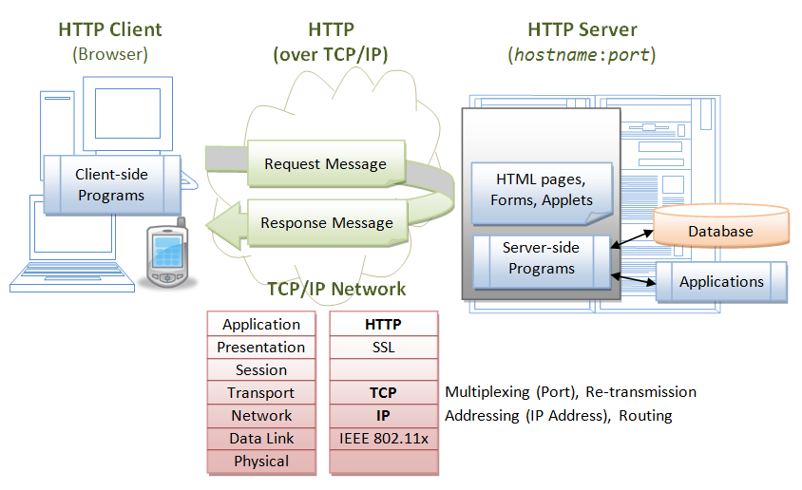
Web Application

Slide 10
Web App Flow
A user, via a web browser (HTTP client), issues a URL request to an HTTP server to start a webapp.
The HTTP server returns an HTML form (client-side program), which is loaded into the client's browser.
The user fills up the query criteria inside the form and submits the form.
The client-side program sends the query parameters to a server-side program.
The server-side program receives the query parameters, queries the database based on these parameters, and returns the query result to the client-side program.
The client-side program displays the query result on the browser.
The process repeats for the next request.

Slide 11
Hypertext Transfer Protocol (HTTP)
Communication protocol between clients and servers
HTTP is an asynchronous request-response application-layer protocol.
A client sends a request message to the server.
The server then returns a response message to the client.
This is the protocol that is used in order to send and receive information from the server.

Slide 12
Apache Tomcat web server
Apache Tomcat, often referred to as Tomcat Server, is an open-source Java Servlet Container developed by the Apache Software Foundation (ASF).
Apache Tomcat is a Java-capable HTTP server, which could execute special Java programs known as "Java Servlet" and "Java Server Pages (JSP)".
Tomcat was originally written by James Duncan Davison in 1998, based on an earlier Sun's server called Java Web Server (JWS).
It began at version 3.0 after JSWDK 2.1 it replaced.
Sun subsequently made Tomcat open-source and gave it to Apache.

Slide 13
Components of Tomcat
Catalina (a Servlet container)
Coyote (an HTTP connector)
Jasper
Cluster
High availability

Slide 14
Components of Tomcat
Catalina:
Catalina is Tomcat's servlet container.
Catalina implements Sun Microsystems's specifications for servlet and JavaServer Pages (JSP)
Coyote:
Coyote is a Connector component for Tomcat that supports the HTTP 1.1 protocol as a web server.
Coyote listens for incoming connections to the server on a specific TCP port and forwards the request to the Tomcat Engine to process the request and send back a response to the requesting client

Slide 15
Components of Tomcat
Jasper:
Jasper is Tomcat's JSP Engine. Jasper parses JSP files to compile them into Java code as servlets (that can be handled by Catalina)
Cluster:
This component has been added to manage large applications. It is used for load balancing that can be achieved through many techniques.
High availability:
A high-availability feature has been added to facilitate the scheduling of system upgrades (e.g. new releases, change requests) without affecting the live environment

Slide 16
Servlets
Basically, a java program that runs on the server
Servlets are java programs which generates dynamic web content.
Servlets acting as a middle layer between a request coming from a Web browser and databases or applications on the HTTP server
A servlet is a server side platform independent, dynamic and multithread java program, which runs in the context of server for extending the functionality of server
A servlet is a java class that dynamically process requests and construct responses.
It Dynamically generate html pages in response to requests
A servlet is mostly implemented for the HTTP protocol and thus the name HTTP Servlet

Slide 17
Servlets
To deploy and run a servlet, a web container must be used.
A web container (also known as a servlet container) is essentially the component of a web server that interacts with the servlets.
The web container is responsible for managing the lifecycle of servlets, mapping a URL to a particular servlet.
The servlet1 specification was created by Pavni Diwanji while she worked at Sun Microsystems, with version 1.0 finalized in June 1997.
As of September 2017, the current version of the Servlet specification is 4.0.

Slide 18
A Servlet’s Job
1. Read any data sent by the user
This data is usually entered in a form on a Web page, but could
also come from a Java applet or a custom HTTP client program.
2. Look up any other information about the request that is
embedded in the HTTP request.
This information includes details about browser capabilities,
cookies, the host name of the requesting client, and so forth.
3. Generate the results
This process may require talking to a database, executing and
Computing the response directly.

Slide 19
Cont ..
4. Format the results inside a document
In most cases, this involves embedding the information inside
an HTML page.
5. Set the appropriate HTTP response parameters
This means telling the browser what type of document is being
returned (e.g., HTML)
6. Send the document back to the client
This document may be sent in text format (HTML).

Slide 20
CGI: Common Gateway Interface
CGI scripts running on a server that generates Dynamic web pages
DISADVANTAGES with CGI
CGI is oldest technique.
For every request CGI creates a new process.
Process creation takes huge amount of time and consumes more resources.
There is limit on number of processes.

Slide 21
The Advantages of Servlets Over “Traditional” CGI
Efficient
In CGI a new process is started for each HTTP request where as with servlets, the Java Virtual Machine stays running and handles each request using a lightweight Java thread
If there are N simultaneous requests to the same CGI program, the code for the CGI program is loaded into memory N times.
With Servlets however, there would be N threads but only a single copy of the servlet class
Convenient
Servlets automatically parsing and decoding HTML form data, reading and setting HTTP headers.

Slide 22
Cont …
Powerful
Multiple Servlets can also share data, making it easy to implement database connection.
Servlets can also maintain information from request to request, simplifying techniques like session tracking and caching of previous computations.
Portable
Java is supported by every major web browser
Inexpensive
Adding servlet support to a server is cheap or free
Secure
Servlets are secure because of its Byte Code.

Slide 23
Basic Servlet Structure
import java.io.*;
import javax.servlet.*;
import javax.servlet.http.*;
public class ServletTemplate extends HttpServlet {
public void doGet(HttpServletRequest request, HttpServletResponse response) throws ServletException, IOException {
// Use "request" to read incoming HTTP headers and HTML form data (e.g. data the user entered and submitted).
// Use "response" to specify the HTTP response status code and headers (e.g. the content type, cookies).
PrintWriter out = response.getWriter();
// Use "out" to send content to browser
} }

Slide 24
Cont …
A browser generates Get request when the user types a URL on the address line or submits an HTML form that specifies a METHOD="GET"
Servlets can also very easily handle POST requests, which are generated when someone submits an HTML form that specifies METHOD="POST“
To be a servlet, a class should extend HttpServlet and override doGet or doPost, depending on whether the data is being sent by GET or by POST
Both of these methods take two arguments: an HttpServletRequest and an HttpServletResponse.
The HttpServletRequest has methods by which you can get the incoming information such as form data, HTTP request headers, and the client’s hostname.

Slide 25
Cont …
The HttpServletResponse is used to send document content and response headers back to the client.
You can get a PrintWriter from the response object.
PrintWriter object used to send the document content back to the client(browser).
doGet and doPost throw two exceptions ,ServletException and IOException you need to include them in method signature.
Finally, you have to import classes in java.io (for PrintWriter, etc.), javax.servlet (for HttpServlet, etc.),and javax.servlet.http (for HttpServletRequest and HttpServlet-Response).

Slide 26
A Simple Servlet that Generating Plain Text
import java.io.*;
import javax.servlet.*;
import javax.servlet.http.*;
public class HelloWorld extends HttpServlet {
public void doGet(HttpServletRequest request, HttpServletResponse response) throws ServletException, IOException {
PrintWriter out = response.getWriter();
out.println("Hello World");
}
}

Slide 27
A Simple Servlet that Generating HTML
import java.io.*;
import javax.servlet.*;
import javax.servlet.http.*;
public class HelloWorld extends HttpServlet {
public void doGet(HttpServletRequest request, HttpServletResponse response)
throws IOException, ServletException
{
response.setContentType("text/html");
PrintWriter out = response.getWriter();
out.println("<html>");
out.println("<head>");
out.println("<title>Hello World!</title>");
out.println("</head>");
out.println("<body bgcolor=pink>");
out.println("<h1>Hello World!</h1>");
out.println("</body>"); out.println("</html>");
} }

Slide 28
Steps to create a Servlet or Compiling and Installing the Servlet
Create a directory structure
Create a Servlet
Compile the Servlet
Create a deployment descriptor
Start the server
Invoke the servlet

Slide 29
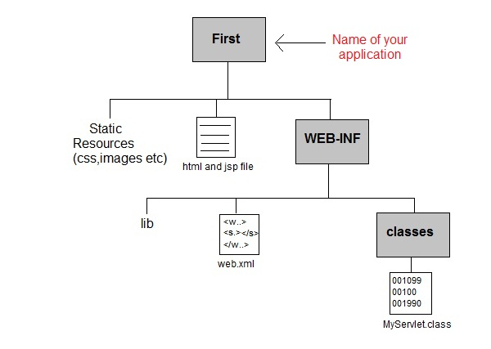
1)Create a directory structures
“First": It is called the context root (or document base directory) of webapp. You should keep all HTML files and resources visible to the web users (e.g., HTMLs, CSSs, images, scripts, JSPs) under this context root.
"First/WEB-INF": This directory, although under the context root, is not visible to the web users. This is where you keep your application's web descriptor file "web.xml".
" First/WEB-INF/classes": This is where you keep all the Java classes such as servlet class-files

Slide 30
Create a Servlet
There are two ways to create the servlet.
By inheriting the GenericServlet class
By inheriting the HttpServlet class
The HttpServlet class is widely used to create the servlet because it provides methods to handle http requests such as doGet(), doPost etc.

Slide 31
Compiling the Servlet
To compile servelts first copy the servlet-api jar file from D:\myproject\tomcat\lib and paste in to bin folder of JDK
i.e C:\Program Files (x86)\Java\jdk1.8.0_144\bin
2. cd \myProject\tomcat\webapps\hello\WEB-INF\classes
3. D: \myProject\tomcat\webapps\hello\WEB-INF\classes>javac HelloWorld.java

Slide 32
Create a deployment descriptor
The deployment descriptor is an xml file, from which Web Container gets the information about the servet to be invoked.
The web container uses the Parser to get the information from the web.xml file.
<web-app>
<servlet>
<servlet-name>HelloWorld</servlet-name>
<servlet-class>HelloWorld</servlet-class>
</servlet>
<servlet-mapping>
<servlet-name>HelloWorld</servlet-name>
<url-pattern>/HelloWorld</url-pattern>
</servlet-mapping> </web-app>

Slide 33
Create a deployment descriptor
<web-app> represents the whole application.
<servlet> is sub element of <web-app> and represents the servlet.
<servlet-name> is sub element of <servlet> represents the name of the servlet.
<servlet-class> is sub element of <servlet> represents the class of the servlet.
<servlet-mapping> is sub element of <web-app>. It is used to map the servlet.
<url-pattern> is sub element of <servlet-mapping>. This pattern is used at client side to invoke the servlet.

Slide 34
Start the server
Move to tomcat bin directory ie "d:\myProject\tomcat\bin" and click startup

Slide 35
Invoke the servlet
http://localhost:8080/hello/Helloworld

Slide 36
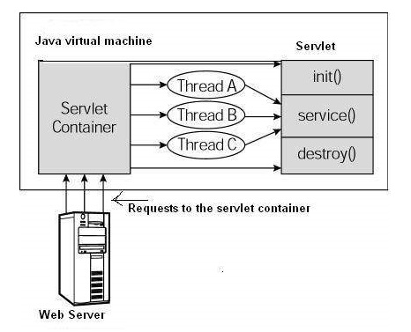
Servlet Life Cycle
Servlet life cycle can be described as a series of steps through which a servlet goes during its life span, starting from loading to till it gets destroyed.
Servlet life cycle contains five steps:
1) Loading of Servlet
2) Creating instance of Servlet
3) Invoke init()
4) Invoke service()
5) Invoke destroy()

Slide 37
Servlet Life Cycle
Step 1: Loading of Servlet
When the web server (e.g. Apache Tomcat) starts up, the servlet container loads all the servlets.
Step 2: Creating instance of Servlet
Once all the Servlet classes loaded, the servlet container creates instances of each servlet class.
Servlet container creates only one instance per servlet class and all the requests to the servlet are executed on the same servlet instance.

Slide 38
Step 3: The init() method
After creating the servlet instance web container calls the servlet’s init method.
This method is used to initialize the servlet before processing first request
The init() method is called only once during the life cycle of servlet
It is called only when the servlet is first created, and not called again for each user request.
The init() method loads some data that will be used throughout the life of the servlet.
Syntax :
public void init() throws ServletException {
// Initialization code…}

Slide 39
Step 4: Invoke service() method
The service() method is the main method to perform the actual task.
The servlet container calls the service() method to process the client requests.
Each time when the web server receives a request for servlet, it spawns a new thread that calls service() method.
Unlike init() and destroy() that are called only once, the service() method can be called any number of times during servlet life cycle.
If the servlet is GenericServlet then the request is served by the service() method itself.

Slide 40
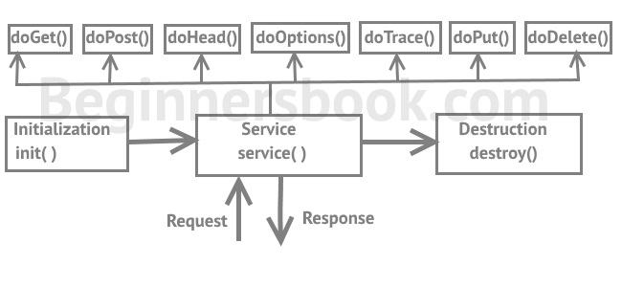
Cont …
If the servlet is HttpServlet then service() method receives the request and dispatches it to the correct handler method based on the type of request.
For example if it is a Get Request the service() method would dispatch the request to the doGet() method by calling the doGet() method with request parameters.
Similarly the requests like Post, Head, Put etc. are dispatched to the corresponding handlers doPost(), doHead(), doPut() etc. by service() method of servlet.

Slide 41
Cont …
Here is the signature of this method:
public void service(ServletRequest request, ServletResponse response) throws
ServletException, IOException{
}

Slide 42
Step 5: Invoke destroy() method
When servlet container shuts down(this usually happens when we stop the web server), it unloads all the servlets and calls destroy() method for each initialized servlets
The destroy() method is called only once at the end of the life cycle of a servlet.
After the destroy() method is called, the servlet object is marked for garbage collection.
public void destroy() {
// Finalization code…}

Slide 43
Example
import java.io.*;
import javax.servlet.*;
public class ExampleGeneric extends GenericServlet{
private String message;
public void init() throws ServletException {
message = "Hello This is CSE-C&G";
}
public void service(ServletRequest req,ServletResponse res)
throws IOException,ServletException{
res.setContentType("text/html");
PrintWriter out = res.getWriter();
out.println("<h1>" + message + "</h1>");
}
public void destroy() {
// do nothing.
} }

Slide 44

The Servlet API
Servlet API is used to create servlets.
Servlet API having two packages to create servlets. These are javax.servlet and javax.servlet.http
The javax.servlet package that contains the classes to support generic servlet (protocol-independent servlet) .
The javax.servlet.http package that contains classes to support http servlet.
The hierarchy of packages:

Slide 45
Cont …
Interfaces in javax.servlet package
Servlet,ServletRequest,ServletResponse,ServletConfig,ServletContext
Classes in javax.servlet package
GenericServle, ServletException, ServletInputStream ServletOutputStream
Interfaces in javax.servlet.http package
HttpServletRequest ,HttpServletResponse ,HttpSession
Classes in javax.servlet.http package
HttpServlet ,Cookie

Slide 46
Generic Servlet
A generic servlet is a protocol independent Servlet that should always override the service() method to handle the client request.
The service() method accepts two arguments ServletRequest object and ServletResponse object.
The request object tells the servlet about the request made by client while the response object is used to return a response back to the client.
GenericServlet is an abstract class and it has only one abstract method, which is service().
That’s why when we create Generic Servlet by extending GenericServlet class, we must override service() method.

Slide 47
Methods of GenericServlet class
public void init(ServletConfig config) is used to initialize the servlet.
public abstract void service(ServletRequest request, ServletResponse response) provides service for the incoming request. It is invoked at each time when user requests for a servlet.
public void destroy() is invoked only once throughout the life cycle and indicates that servlet is being destroyed.
public ServletConfig getServletConfig() returns the object of ServletConfig.
public String getServletInfo() returns information about servlet such as writer, copyright, version etc.
public String getInitParameter(String name) returns the parameter value for the given parameter name.
public String getServletName() returns the name of the servlet object.

Slide 48
Generic Servlet Example
import java.io.*;
import javax.servlet.*;
public class ExampleGeneric extends GenericServlet{
public void service(ServletRequest req,ServletResponse res)
throws IOException,ServletException{
res.setContentType("text/html");
PrintWriter out = res.getWriter();
out.println(getServletName());
out.println(getServletInfo());
}
}

Slide 49
Generic Servlet
Cons of using Generic Servlet:
Working with Generic Servlet is not that easy because we don’t have convenience methods such as doGet(), doPost(), doHead() etc in Generic Servlet that we can use in Http Servlet.
In Http Servlet we need to override particular convenience method for particular request,
However in Generic Servlet we only override service() method for each type of request which is cumbersome.

Slide 50
HttpServlet class
If you creating Http Servlet you must extend HttpServlet class, which is an abstract class.
Instead it overrides the doGet() method or doPost() method or both.
The doGet() method is used for getting the information from server while the doPost() method is used for sending information to the server.
In Http Servlet there is no need to override the service() method because this method dispatches the Http Requests to the correct method handler.
For example if it receives HTTP GET Request it dispatches the request to the doGet() method.

Slide 51
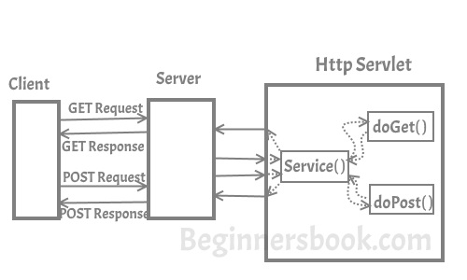
How Http Servlet works?
As you can see in the diagram below that client (user’s browser) make requests.
These requests can be of any type, for example – Get Request, Post Request, Head Request etc.
Server dispatches these requests to the servlet’s service() method, this method dispatches these requests to the correct handler for example if it receives Get requests it dispatches it to the doGet() method.

Slide 52
Methods of HttpServlet class
protected void doGet(HttpServletRequest req, HttpServletResponse resp): When overriding this method, read the request data, and write the response data.
protected void doPost(HttpServletRequest req, HttpServletResponse resp): The HTTP POST method allows the client to send data of unlimited length to the Web server a single time and is useful when posting information to the server.
doPut() – This method is similar to doPost method but unlike doPost method where we send information to the server, this method sends file to the server, this is similar to the FTP operation from client to server
doDelete() – allows a client to delete a document, webpage or information from the server

Slide 53
Methods of HttpServlet class
protected void doHead(HttpServletRequest req, HttpServletResponse resp): The client sends a HEAD request when it wants to see only the headers of a response, such as Content-Type or Content-Length
protected long getLastModified(HttpServletRequest req): Returns a long integer specifying the time the HttpServletRequest object was last modified
protected void service(HttpServletRequest req, HttpServletResponse resp): There is no need to override this method, this method receives the HTTP request from client and forwards them to the corresponding doXXX methods such as doGet(), doPost(), doHEAD() etc.

Slide 54
Example
import java.io.*;
import javax.servlet.*;
import javax.servlet.http.*;
public class HelloWorld extends HttpServlet {
public void doPost(HttpServletRequest req,
HttpServletResponse res)
throws ServletException, IOException {
PrintWriter out = res.getWriter();
out.println("Hello World");
}
}

Slide 55
ServletConfig Interface (or) Reading Initialization parameters
Servlet Container creates ServletConfig object for each Servlet during initialization to pass information to the Servlet.
This object can be used to get configuration information such as parameter name and values from deployment descriptor file(web.xml).
getServletConfig() method of Servlet interface returns the object of ServletConfig.
ServletConfig config=getServletConfig();

Slide 56
Methods of ServletConfig interface:
public String getInitParameter(String name):Returns the parameter value for the specified parameter name.
public Enumeration getInitParameterNames():Returns an enumeration of all the initialization parameter names.
public String getServletName():Returns the name of the servlet.

Slide 57
Syntax to provide the initialization parameter for a servlet
The init-param sub-element of servlet is used to specify the initialization parameter for a servlet.
<web-app>
<servlet>
......
<init-param>
<param-name>parametername</param-name>
<param-value>parametervalue</param-value>
</init-param>
....
</servlet>
</web-app>

Slide 58
Example of ServletConfig to get initialization parameter
import java.io.*;
import javax.servlet.*;
import javax.servlet.http.*;
public class DemoServlet extends HttpServlet {
public void doGet(HttpServletRequest request, HttpServletResponse response)
throws ServletException, IOException {
response.setContentType("text/html");
PrintWriter out = response.getWriter();
ServletConfig config=getServletConfig();
String name=config.getInitParameter("name");
out.println("name is: "+name);
String email=config.getInitParameter("email");
out.println("Email is: "+email);
}
}

Slide 59
Web.xml
<web-app>
<servlet>
<servlet-name>DemoServlet</servlet-name>
<servlet-class>DemoServlet</servlet-class>
<init-param>
<param-name>name</param-name>
<param-value>CHVRR</param-value>
</init-param>
<init-param>
<param-name>email</param-name>
<param-value>chvrr58@gmail.com</param-value>
</init-param>
</servlet>
<servlet-mapping>
<servlet-name>DemoServlet</servlet-name>
<url-pattern>/init</url-pattern>
</servlet-mapping>
</web-app>

Slide 60
ServletContext Interface (or) Context Parameters l
The ServletContext object can be used to get configuration information from the web.xml file.
There is only one ServletContext object per web application.
The main difference between ServletConfig and ServletContext is that unlike ServletConfig, the ServletContext is being created once per web application, i.e. ServletContext object is common to all the servlets in web application.
Context parameters will be accessible to all the servlets in the web application.
getServletContext() method of ServletConfig interface returns the object of ServletContext.
getServletContext() method of GenericServlet class returns the object of ServletContext.
ServletContext context=getServletContext();

Slide 61
Commonly used methods of ServletContext interface:
public String getInitParameter(String name):Returns the parameter value for the specified parameter name.
public Enumeration getInitParameterNames():Returns the names of the context's initialization parameters.

Slide 62
Syntax to provide the context parameters in web.xml
<web-app>
......
<context-param>
<param-name>parametername</param-name>
<param-value>parametervalue</param-value>
</context-param>
......
</web-app>

Slide 63
Example of ServletContext to get the context parameter
import java.io.*;
import javax.servlet.*;
import javax.servlet.http.*;
public class DemoServlet extends HttpServlet{
public void doGet(HttpServletRequest req,HttpServletResponse res)
throws ServletException,IOException
{
res.setContentType("text/html");
PrintWriter out=res.getWriter();
ServletContext context=getServletContext();
String name=context.getInitParameter("name");
out.println("name is: "+name);
String email=context.getInitParameter("email");
out.println("Email is: "+email);
}}

Slide 64
Web.xml
<web-app>
<servlet>
<servlet-name>CHVRR</servlet-name>
<servlet-class>DemoServlet</servlet-class>
</servlet>
<context-param>
<param-name>name</param-name>
<param-value>CHVRR</param-value>
</context-param>
<context-param>
<param-name>email</param-name>
<param-value>chvrr58@gmail.com</param-value>
</context-param>
<servlet-mapping>
<servlet-name>CHVRR</servlet-name>
<url-pattern>/context</url-pattern>
</servlet-mapping>
</web-app>

Slide 65
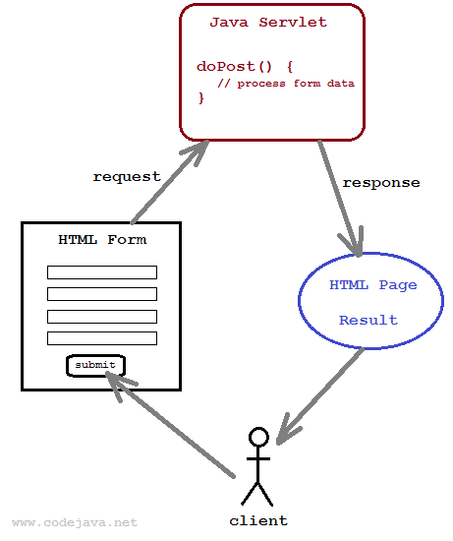
Handling Form Data
The browser uses two methods to pass this information to web server.
These methods are GET Method and POST Method.
GET and POST methods are used to pass information from a form to a Java Servlet
GET Method
While using GET method the form data is
passed in the url as query parameters.
GET method is the default method used.
It looks like,
http://localhost:8080/hello?key1=value1&key2=value2

Slide 66
GET Method
While using GET method the form data is passed in the url as query parameters.
GET method is the default method used.
It looks like,
http://localhost:8080/hello?key1=value1&key2=value2
The GET method is restricted to send up to 1024 characters only.
Never use GET method if you have password or other sensitive information to be sent to the server.
GET can't be used to send binary data, like images or word documents, to the server.
Servlet handles this type of requests using doGet() method.

Slide 67
POST Method
A generally more reliable method of passing information to a backend program is the POST method.
If POST method is used then the form data is passed in the HTTP request message body.
It cannot be seen in the URL as seen in GET method
The POST method does not have any restriction on data size to be sent.
Servlet handles this type of requests using doPost() method.
It is secure

Slide 68
Reading Form Data using Servlet
Servlets handles form data parsing automatically using the following methods depending on the situation −
getParameter() − You call request.getParameter() method to get the value of a form parameter.
getParameterValues() − Call this method if the parameter appears more than once and returns multiple values, for example checkbox.
getParameterNames() − Call this method if you want a complete list of all parameters in the current request.

Slide 69
Login.html loginservlet.java
<html>
<body>
<form method="GET" action="http://localhost:8080/login/login">
FirstName<input type="text" name="fname"/>
Password<input type="password" name="pword"/>
<input type="submit" value="send"/>
</form>
</body>
</html>
import java.io.*;
import javax.servlet.*;
import javax.servlet.http.*;
import java.util.*;
public class LoginServlet extends HttpServlet {
public void doGet(HttpServletRequest request,HttpServletResponse response)
throws IOException,ServletException{
response.setContentType("text/html");
PrintWriter out = response.getWriter();
String fname=request.getParameter("fname");
String pass=request.getParameter("pword");
out.println("user nameis:" +fname);
out.println("password is:" +pass);
}}

Slide 70
Servlets with JDBC
With HTML, Servlets, JDBC, and DBMS, we can easily build Web-based three-tier systems -- client, Web server, and database server.
HTML is used to design the client-side interface that is to be executed on a Web browser such as Netscape and Internet Explore.
Servlets can be employed to do server-side programming and JDBC can be used to interact with a database(s) for the requests from clients.
The database(s) may be located on a remote database server.

Slide 71
signup.html SignupServlet.java
<html><body bgcolor=pink>
<table align=center>
<form method="POST" action="http://localhost:8080/database1/signup">
<tr><td>Name</td><td><input type="text" name="name"/></td>
</tr>
<tr><td>UserName</td><td><input type="text" name="uname"/></td>
</tr>
<tr><td>Password</td><td><input type="password" name="pword"/><td>
</tr>
<tr><td>email</td><td><input type="text" name="email"/><td>
</tr>
<tr><td>mobile</td><td><input type="text" name="mobile"/></td>
</tr>
<tr<td></td><td><input type="submit" value="submit"/></td>
</tr>
</table></form></body></html>
import java.io.*;
import java.util.*;
import javax.servlet.*;
import javax.servlet.http.*;
import java.sql.*;
public class SignupServlet extends HttpServlet {
public void doPost(HttpServletRequest request,HttpServletResponse response)
throws IOException,ServletException{
response.setContentType("text/html");
PrintWriter out = response.getWriter();
String name=request.getParameter("name");
String uname=request.getParameter("uname");
String pass=request.getParameter("pword");
String email=request.getParameter("email");
long mobile=Long.parseLong(request.getParameter("mobile"));
try{
Class.forName("com.mysql.jdbc.Driver");
Connection con=DriverManager.getConnection("jdbc:mysql://localhost/IIICSE","root","root");
Statement stmt=con.createStatement();
int i=stmt.executeUpdate("insert into signup values('"+name+"','"+uname+"','"+pass+"','"+email+"',"+mobile+")");
if(i>0)
out.println("Inserted Successfully");
else
out.println("Insert Unsuccessful");
}
catch (Exception e) {
out.println(e);
}
out.close();
}
}

Slide 72
login.html LoginServlet.java
<html>
<body bgcolor=pink>
<table align=center>
<form method="POST" action="http://localhost:8080/database1/login">
<td>UserName</td><td><input type="text" name="uname"/></td>
</tr>
<tr>
<td>Password</td><td><input type="password" name="pword"/><td>
</tr>
<tr>
<td></td><td><input type="submit" value="Login"/></td>
</tr>
</table>
</form>
</body>
</html>
import java.io.*;
import java.util.*;
import javax.servlet.*;
import javax.servlet.http.*;
import java.sql.*;
public class LoginServlet extends HttpServlet {
public void doPost(HttpServletRequest request,HttpServletResponse response)
throws IOException,ServletException{
response.setContentType("text/html");
PrintWriter out = response.getWriter();
String uname=request.getParameter("uname");
String pass=request.getParameter("pword");
try{
Class.forName("com.mysql.jdbc.Driver");
Connection con=DriverManager.getConnection("jdbc:mysql://localhost/IIICSE","root","root");
PreparedStatement ps= con.prepareStatement("Select uname,password from signup where uname=? and password=?");
ps.setString(1, uname);
ps.setString(2, pass);
ResultSet rs=ps.executeQuery();
if (rs.next()) {
out.println("Correct login credentials");
}
else {
out.print("Sorry UserName or Password Error!");
RequestDispatcher rd=request.getRequestDispatcher("/login.html");
rd.include(request, response);
}
}
catch(Exception e) {
out.println(e);
}
out.close();
}}

Slide 73
Session Tracking
Session simply means a particular interval of time.
Session is a conversional state between client and server and it can consists of multiple request and response between client and server.
Session Tracking is a way to maintain state (data) of an user.
It is also known as session management in servlet.
The HttpSession object is used for session management.
A session contains information specific to a particular user across the whole application.
When a user enters into a website (or an online application) for the first time HttpSession is obtained via request.getSession(), the user is given a unique ID to identify his session.

Slide 74
Session Tracking
Why use Session Tracking?
It is used to recognize the particular user.
How to create HttpSession object:
HttpSession session = req.getSession();
You can store the user information into the session object by using setAttribute() method and later when needed this information can be fetched from the session.

Slide 75
Methods of HttpSession
public void setAttribute(String name, Object value):
Used to store session information as name/value pair. First parameter is the attribute name and second is the attribute value.
session.setAttribute("uName", "ChaitanyaSingh");
public Object getAttribute(String name):
Returns the String object specified in the parameter, from the session object. TO get the value from session .
String userName = (String) session.getAttribute("uName");
public String getId():Returns a string containing the unique identifier value

Slide 76
Cont …
setMaxInactiveInterval(int interval):
Sets the session inactivity time in seconds.
public long getCreationTime():Returns the time when this session was created.
public long getLastAccessedTime():Returns the last time the client sent a request associated with this session.

Slide 77
Cont …
String username=(String) session.getAttribute("uName");
session.setMaxInactiveInterval(5);
PrintWriter out= response.getWriter();
out.println(" <HTML> <HEAD> </HEAD> <BODY>");
out.println("<STRONG> Session ID : </STRONG>" + sessionId);
out.println(" <BR/> ");
out.println("<STRONG> Session Creation Time </STRONG>: " + createDate);
out.println(" <BR/> ");
out.println("<STRONG> Last Accessed Time : </STRONG>" + lastAccessedDate);
out.println(" <BR/> ");
out.println("<STRONG> user name : </STRONG>" + username);
out.println(" </BODY> </HTML> ");
}}
import java.io.*;
import java.util.Date;
import javax.servlet.*;
import javax.servlet.http.*;
public class SessionServlet extends HttpServlet {
public void doGet(HttpServletRequest request, HttpServletResponse response)
throws ServletException, IOException
{
HttpSession session = request.getSession();
long creationTime = session.getCreationTime();
String sessionId = session.getId();
long lastAccessedTime = session.getLastAccessedTime();
Date createDate= new Date(creationTime);
Date lastAccessedDate= new Date(lastAccessedTime);
session.setAttribute("uName", "CHVRR");

