Slide 1
CSS for Styling

Slide 2
Cascading Style Sheets (CSS)
Cascading Style Sheets, fondly referred to as CSS, is a simple design language intended to simplify the process of making web pages presentable.
CSS is a language that describes the style of an HTML document.
CSS describes how HTML elements should be displayed, not what is being displayed.
Describes the appearance, layout, and presentation of information on a web page
Can be embedded in HTML document or placed into separate .css file
A style sheet is a document that contains style information.
It enables us to specify styles such as fonts, colors, size,spacing, margins ,typeface etc..

Slide 3
Why Use CSS?
CSS handles the look and feel part of a web page.
Using CSS, you can control the color of the text, the style of fonts, the spacing between paragraphs, how columns are sized and laid out, what background images or colors are used, layout designs, variations in display for different devices and screen sizes as well as a variety of other effects.
CSS saves a lot of work.

Slide 4
History
CSS was invited by Håkon Wium Lie on October 10, 1994 and maintained through a group of people within the W3C called the CSS Working Group
CSS Versions
Cascading Style Sheets, level 1 (CSS1) was came out of W3C as a recommendation in December 1996. This version describes the CSS language as well as a simple visual formatting model for all the HTML tags.
CSS2 was became a W3C recommendation in May 1998 and builds on CSS1. This version adds support for media-specific style sheets element positioning and tables.
CSS3 was became a W3C recommendation in June 1999 and builds on older versions CSS.

Slide 5
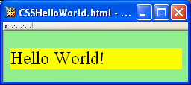
CSS Example:
A styled HTML document produced by the style sheet style1.css:
body { background-color:lime; }
p { font-size: x-large ; background-color : yellow }

Slide 6
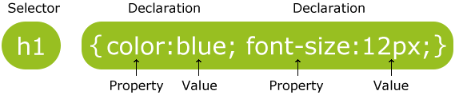
CSS Syntax
A CSS comprises of style rules that are interpreted by the browser and then applied to the corresponding elements in document
selector { property: value }
Ex:

Slide 7
CSS Syntax
Selector − A selector is an HTML tag on which a style will be applied. This could be any tag like <h1> or <table> etc.
Property - A property is a type of attribute of HTML tag. Put simply, all the HTML attributes are converted into CSS properties. They could be color, border etc.
Value - Values are assigned to properties. For example, color property can have value either red or #F1F1F1 etc.

Slide 8
CSS Selectors
CSS selectors are used to "find" (or select) HTML elements based on their element name, id, class, attribute, and more.
Element Type Selector
ID Selector
Universal Selector
Class Selector

Slide 9
element selector
The element selector selects elements based on the element name.
You can select all <p> elements on a page like this :
p { text-align: center; color: red; }

Slide 10
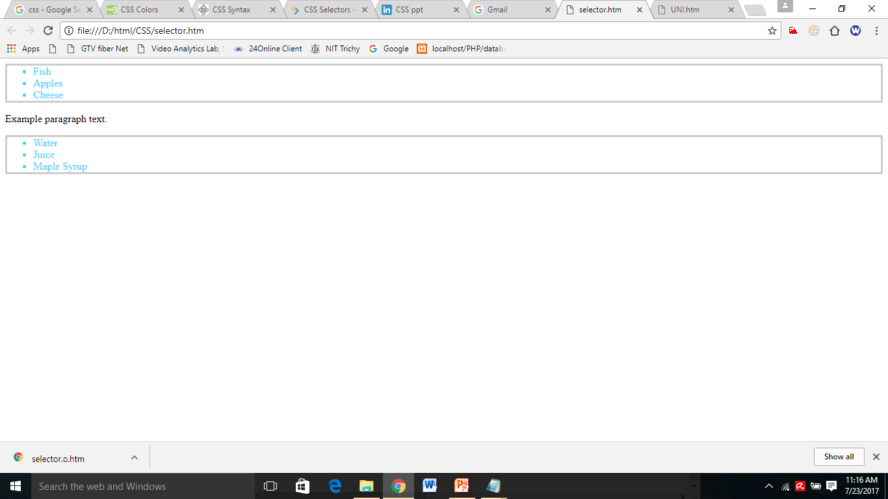
<html>
<body>
<head>
<style>
ul {
color: #36CFFF;
border: solid 3px #ccc;
}
</style>
</head>
<ul>
<li>Fish</li>
<li>Apples</li>
<li>Cheese</li>
</ul>
<p>Example paragraph text.</p>
<ul>
<li>Water</li>
<li>Juice</li>
<li>Maple Syrup</li>
</ul>
</body>
</html>

Slide 11
The id Selector
The id selector uses the id attribute of an HTML element to select a specific element.
The id of an element should be unique within a page, so the id selector is used to select one unique element!
To select an element with a specific id, write a hash (#) character, followed by the id of the element.
#para1 { text-align: center; color: red; }

Slide 12
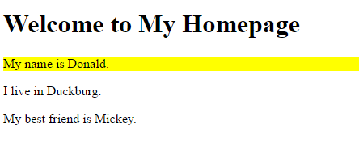
<html>
<head>
<style>
#firstname {
background-color: yellow;
}
</style>
</head>
<body>
<h1>Welcome to My Homepage</h1>
<p id="firstname">My name is Donald.</p>
<p id="hometown">I live in Duckburg.</p>
<p>My best friend is Mickey.</p>
</body>
</html>

Slide 13
The Universal Selectors
Rather than selecting elements of a specific type, the universal selector quite simply matches the name of any element type
The universal selector works like a wild card character, selecting all elements on a page
* { color: green; font-size: 20px; line-height: 25px; }

Slide 14
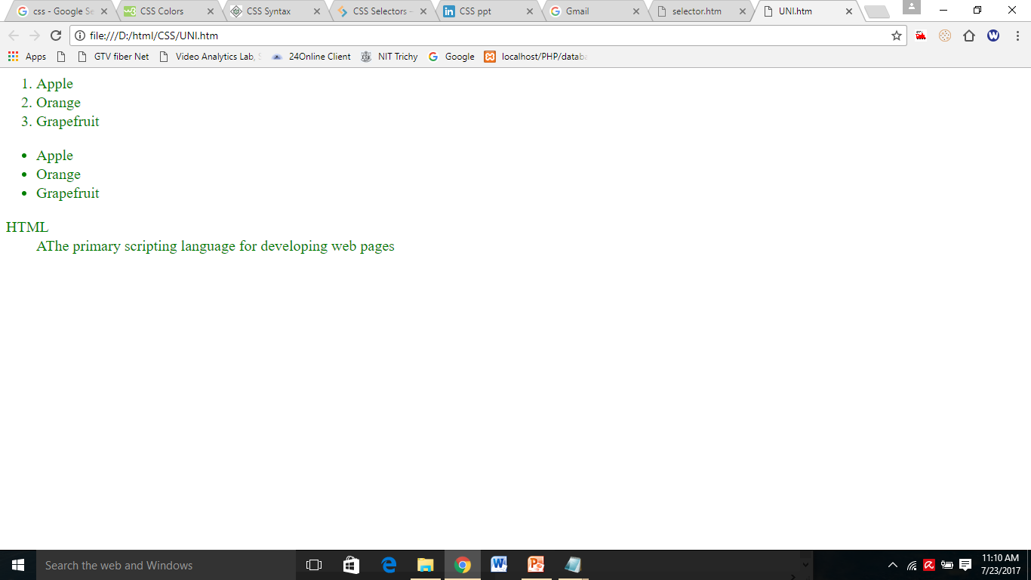
<html> <HEAD>
<style>
* {
color: green;
font-size: 20px;
line-height: 25px;
}
</style>
<body>
<ol type="1">
<li>Apple</li>
<li>Orange</li>
<li>Grapefruit</li>
</ol>
<ul type="disc">
<li>Apple</li>
<li>Orange</li>
<li>Grapefruit</li>
</ul>
<dl>
<dt>HTML</dt>
<dd>AThe primary scripting language for developing web pages </dd>
</dl></body></html>

Slide 15
The class Selector
The class selector selects elements with a specific class attribute.
To select elements with a specific class, write a period (.) character, followed by the name of the class.
In the example below, all HTML elements with class="center" will be red and center-aligned:
.center { text-align: center; color: red; }

Slide 16
<html><HEAD>
<style>
.ex1{
color: green;
font-size: 20px;
line-height: 25px;
}
.ex2{
color: red;
font-size: 30px;
line-height: 25px;
}
</style>
<body>
<ol class="ex1" type="1">
<li>Apple</li>
<li>Orange</li>
<li>Grapefruit</li>
</ol>
<ul class="ex2" type="disc">
<li>Apple</li>
<li>Orange</li>
<li>Grapefruit</li>
</ul>
</body></html>

Slide 17
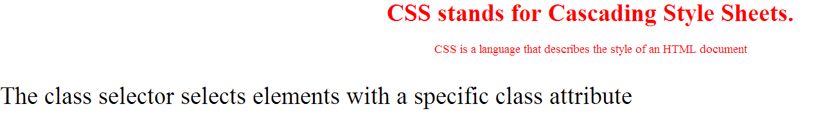
<html>
<head>
<style>
p.center {
text-align: center;
color: red;
}
p.centerlarge {
font-size: 100%;
}
</style>
</head>
<body>
<h1 class="center">CSS stands for Cascading Style Sheets.</h1>
<p class="center"> CSS is a language that describes the style of an HTML document </p>
<p class="centerlarge"> The class selector selects elements with a specific class attribute </p>
</body>

Slide 18
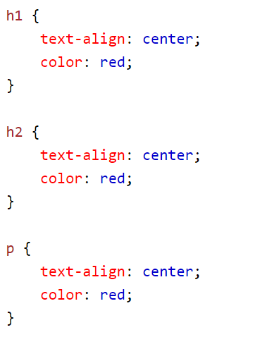
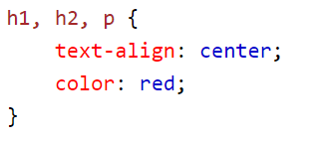
Grouping Selectors
If you have elements with the same style definitions, like this:
It will be better to group the selectors, to minimize the code.
To group selectors, separate each selector with a comma.

Slide 19
Three Ways to Insert CSS
There are three ways of inserting a style sheet:
Internal or embedded style sheet
Inline style
External style sheet

Slide 20
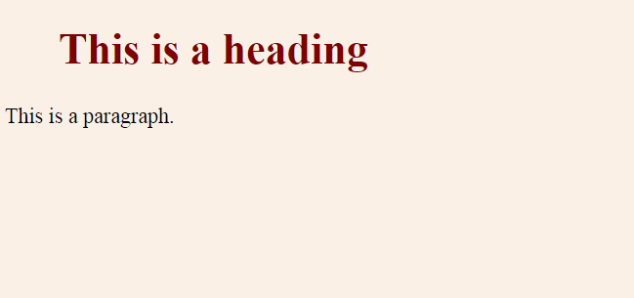
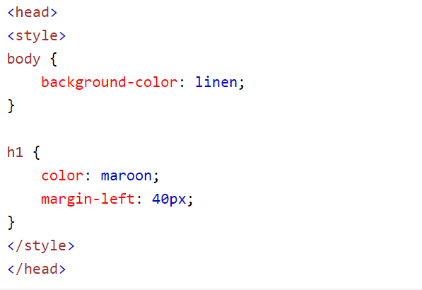
Internal Style Sheet
In this CSS rules are defined with in the document itself using style tag.
Internal styles are defined within the <style> element, inside the <head> section of an HTML page:
An internal style sheet may be used if one single page has a unique style.

Slide 21

Example for Internal Style sheet
<html>
<head>
<title>Cascading Style Sheet</title>
<style>
h2 {
font-family : Tahoma;
color: blue;
text-align: center;
text-transform : uppercase;
}
</style>
</head>
<body>
<h2> Hi guys how r u</h2>
</body>
</html>

Slide 22
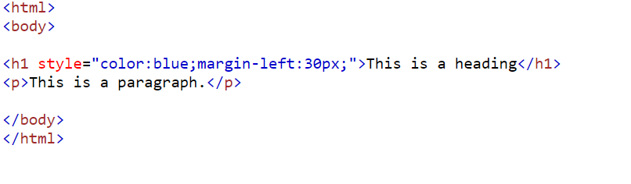
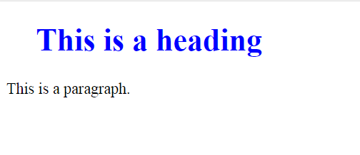
Inline Styles
An inline style may be used to apply a unique style for a single element.
To use inline styles, add the style attribute to the relevant element. The style attribute can contain any CSS property.
The example below shows how to change the color and the left margin of a <h1> element:

Slide 23

<html>
<head>
<title>Cascading Style Sheet</title>
</head>
<body>
<h2 style= "font-family : Tahoma;
color: red; text-align: center;
text-transform : uppercase;">
Hi guys how r u</h2>
</body>
</html>

Slide 24
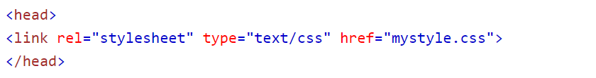
External Style Sheet
An external style sheet is a separate text file with .css extension.
You define all the Style rules within this text file and then you can include this file in any HTML document using <link> element.
The <link> element can be used to include an external stylesheet file in your HTML document.
With an external style sheet, you can change the look of an entire website by changing just one file!

Slide 25
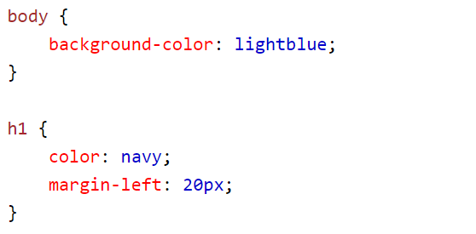
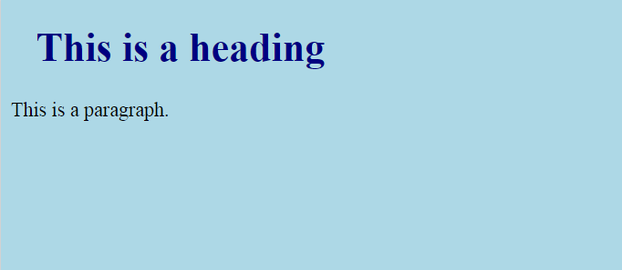
Cont…
An external style sheet can be written in any text editor. The file should not contain any html tags. The style sheet file must be saved with a .css extension.
Here is how the "mystyle.css" looks:

Slide 26
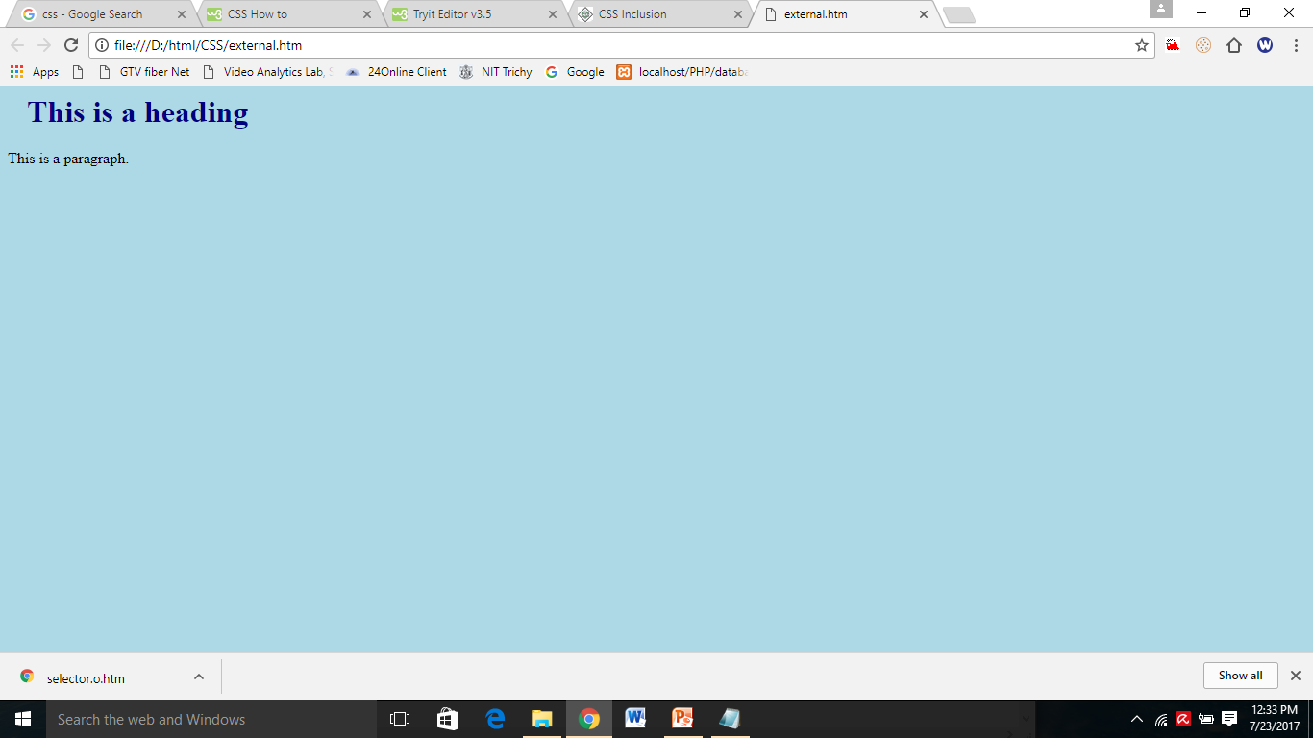
mystyle.css: body { background-color: lightblue; } h1 { color: navy; margin-left: 20px; }
<html>
<head>
<link rel="stylesheet" type="text/css" href="mystyle.css">
</head>
<body>
<h1>This is a heading</h1>
<p>This is a paragraph.</p>
</body>
</html>

Slide 27
CSS Basic Properties
Here are some basic CSS properties to work with.
Text Properties(https://www.w3schools.com/css/css_text.asp)
List Properties(https://www.w3schools.com/css/css_list.asp)
Border Properties(https://www.w3schools.com/css/css_border.asp)
Font Properties(https://www.w3schools.com/css/css_font.asp)
Background properties(https://www.w3schools.com/css/css_background.asp)

Slide 28
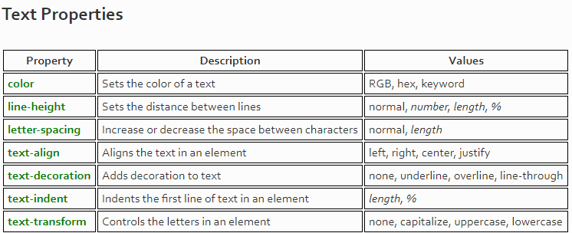

Slide 29
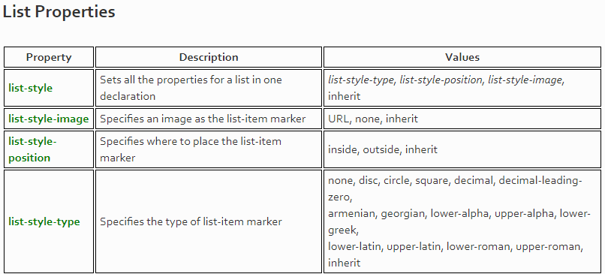

Slide 30
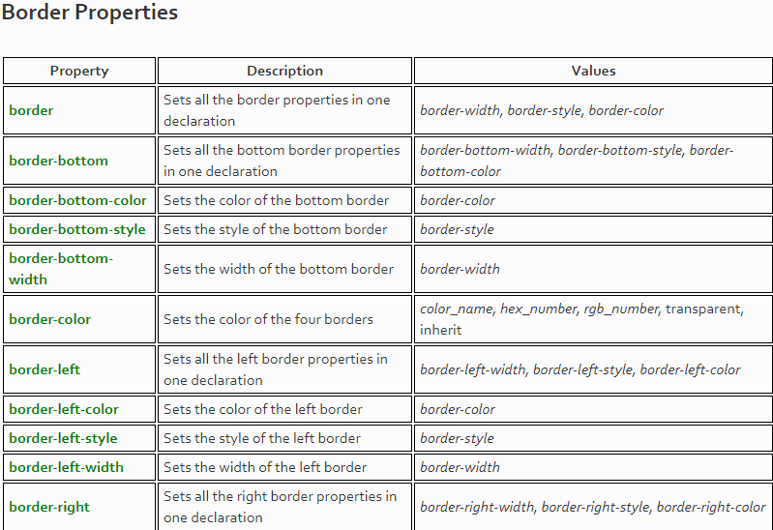

Slide 31
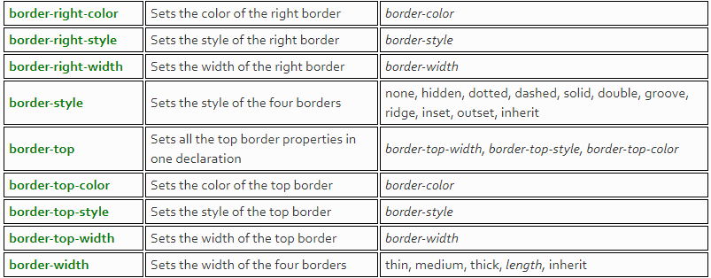

Slide 32
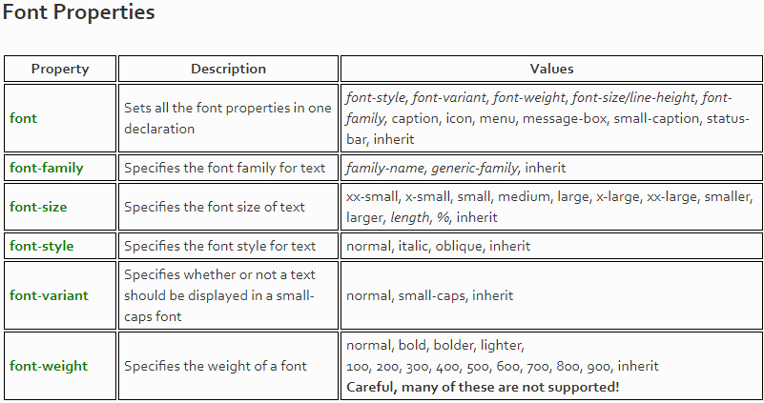

Slide 33
CSS Background Properties
Property | Description
background | Sets all the background properties in one declaration
background-color | Sets the background color of an element | background-color: green;
background-image | Sets the background image for an element | background-image: url(“tree.png");
background-position | Sets the starting position of a background image | background-position: right top;
background-repeat | Sets how a background image will be repeated | background-repeat: no-repeat;

Slide 34
Background Color
The background-color property specifies the background color of an element.
body { background-color: lightblue; }

Slide 35
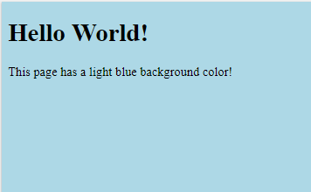
<html>
<head>
<style>
body {
background-color: lightblue;
}
</style>
</head>
<body>
<h1>Hello World!</h1>
<p>This page has a light blue background color!</p>
</body>
</html>

Slide 36
Background Image
The background-image property specifies an image to use as the background of an element.
By default, the image is repeated so it covers the entire element.
The background image for a page can be set like this:
body { background-image: url("paper.gif"); }

Slide 37
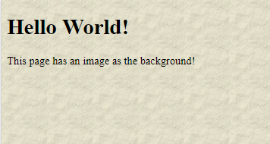
<html>
<head>
<style>
body {
background-image: url("paper.gif");
}
</style>
</head>
<body>
<h1>Hello World!</h1>
<p>This page has an image as the background!</p>
</body>
</html>

Slide 38
Background Image - Set position and no-repeat
Showing the background image only once is also specified by the background-repeat property:
Example
body { background-image: url("img_tree.png"); background-repeat: no-repeat; }

Slide 39
We want to change the position of the image, so that it does not disturb the text too much.
The position of the image is specified by the background-position property:
Example
body { background-image: url("img_tree.png"); background-repeat: no-repeat; background-position: right top; }

Slide 40
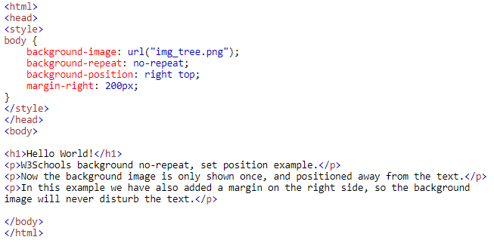
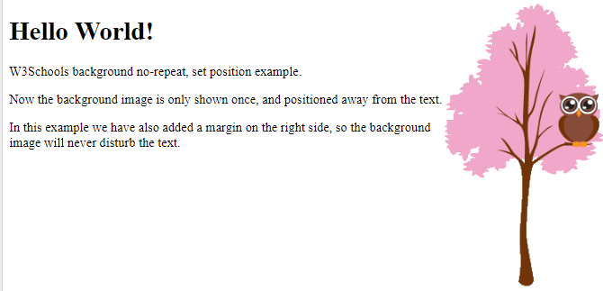

Slide 41
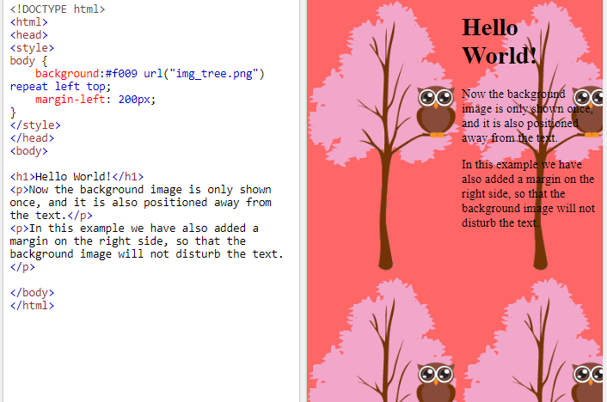

Slide 42
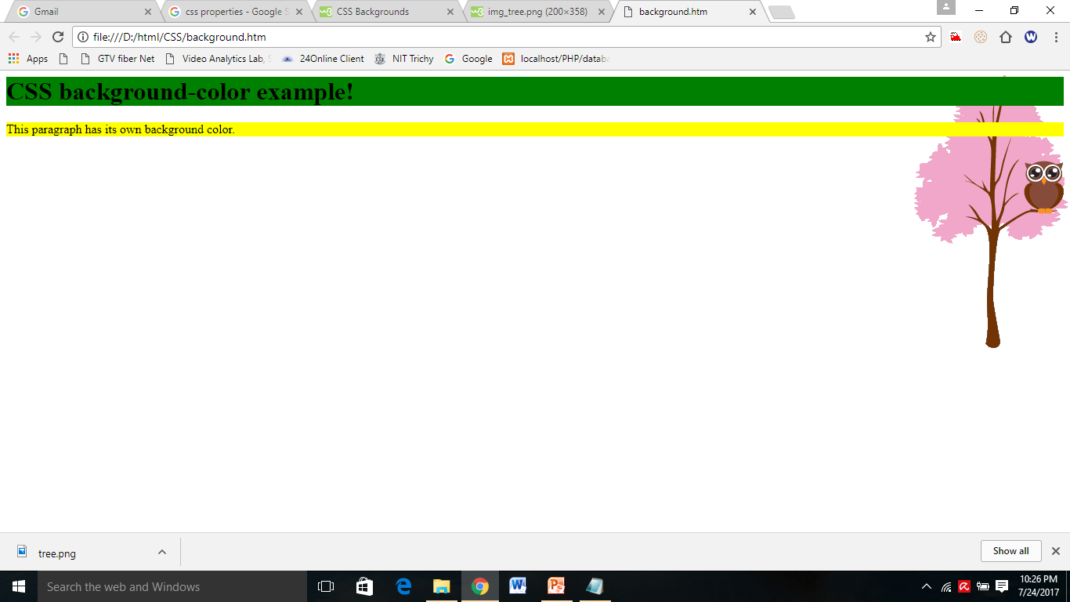
<html>
<head>
<style>
h1 {
background-color: green;
}
body {
background-image: url(“tree.png");
background-repeat: no-repeat;
background-position: right top;
}
p {
background-color: yellow;
}
</style>
</head>
<body>
<h1>CSS background-color example!</h1>
<p>This paragraph has its own background color.</p>
</body></html>

Slide 43
CSS properties for fonts
Property | Description | Example
font | Sets all the font properties in one declaration | font: italic bold 12px/30px Georgia, serif;
font-family | Specifies the font family for text | font-family: "Times New Roman", Times, serif;
font-size | Specifies the font size of text | font-size: 40px;
font-style | Specifies the font style for text | font-style: italic;
font-variant | Specifies whether or not a text should be displayed in a small-caps font | font-variant: small-caps;
font-weight | Specifies the weight of a font | font-weight: bold;

Slide 44
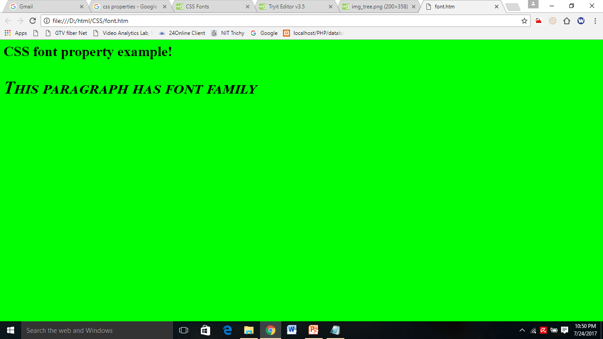
<html>
<head>
<style>
h1 {
font-family: "Times New Roman", Times, serif;
}
p {
font-style: italic;
font-size: 40px;
font-weight: bold;
font-variant: small-caps;
}
</style>
</head>
<body bgcolor="lime">
<h1>CSS font property example!</h1>
<p>This paragraph has font family </p>
</body</html>

Slide 45
CSS properties for Text
Property | Description
color | Sets the color of text | color: red;
letter-spacing | Increases or decreases the space between characters in a text | letter-spacing: 2px;
text-align | Specifies the horizontal alignment of text | text-align: center;
text-decoration | Specifies the decoration added to text | text-decoration: underline;
text-indent | Specifies the indentation of the first line in a text-block | text-indent: 50px;
text-shadow | Specifies the shadow effect added to text | text-shadow: 2px 2px #FF0000;
text-transform | Controls the capitalization of text | text-transform: uppercase;

Slide 46
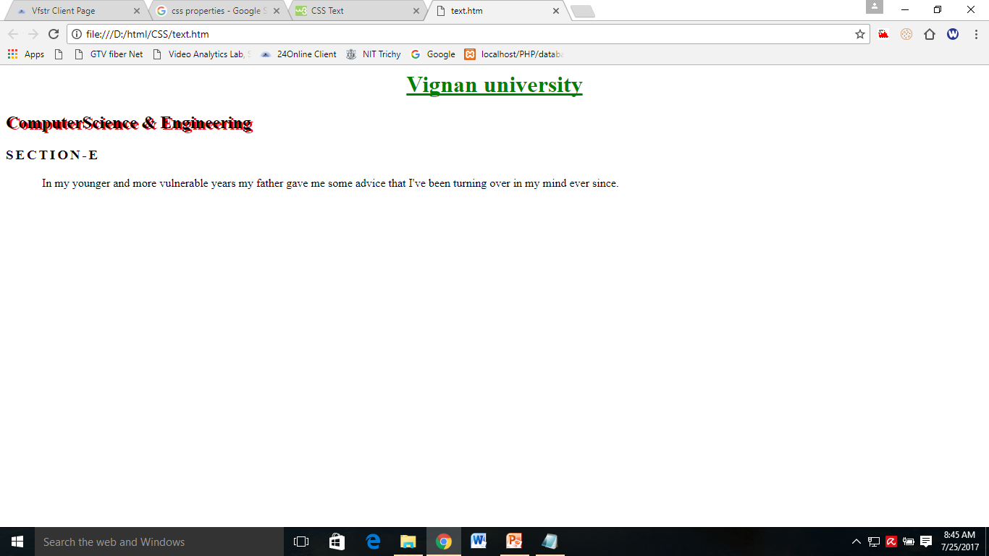
<html><head><style>
h1 {
color: green;
text-align: center;
text-decoration: underline;
}
h2{
text-shadow: 3px 2px red;
}
h3 {
text-transform: uppercase;
letter-spacing: 3px;
}
p {
text-indent: 50px;
}
</style>
<body>
<h1>Vignan university</h1> <h2>ComputerScience & Engineering</h2> <h3>section-e</h3>
<p>In my younger and more vulnerable years my father gave me some advice that I've been turning over in my mind ever since.</p> </body></html>

Slide 47
Border Style
The border-style property specifies what kind of border to display.
The following values are allowed:
dotted - Defines a dotted border
dashed - Defines a dashed border
solid - Defines a solid border
double - Defines a double border
none - Defines no border

Slide 48
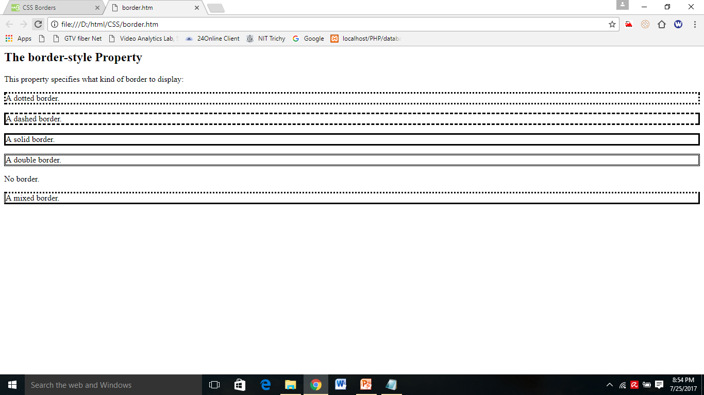
<html><head><style>
p.dotted {border-style: dotted;}
p.dashed {border-style: dashed;}
p.solid {border-style: solid;}
p.double {border-style: double;}
p.none {border-style: none;}
p.mix {border-style: dotted dashed solid double;}
</style></head>
<body>
<h2>The border-style Property</h2>
<p>This property specifies what kind of border to display:</p>
<p class="dotted">A dotted border.</p>
<p class="dashed">A dashed border.</p>
<p class="solid">A solid border.</p>
<p class="double">A double border.</p>
<p class="none">No border.</p>
<p class="mix">A mixed border.</p>
</body></html>

Slide 49
Table Properties
<html>
<head>
<style>
table {
border-collapse: collapse;
width: 100%;
}
th, td {
text-align: left;
padding: 8px;
height: 30%;
width: 5%;
vertical-align: top;
border: 1px solid red;
}
th {
background-color: #4CAF50;
color: white;
}
</style>
</head>
<body>

Slide 50
<body>
<h2>Colored Table Header</h2>
<table>
<tr>
<th>Firstname</th>
<th>Lastname</th>
<th>Savings</th> </tr>
<tr>
<td>Peter</td>
<td>Griffin</td>
<td>$100</td> </tr>
<tr>
<td>Lois</td>
<td>Griffin</td>
<td>$150</td> </tr>
</table>
</body>
</html>

