Slide 1
UNIT-5
Semantic web the future of the Internet

Slide 2
Introduction
In the beginning of the Internet days, software programmers developed all Web pages.
Today, the Web provides perhaps the simplest way to share information, and literally everyone writes Web pages, with the help of authoring tools, and a large number of organizations disseminate data coded in Web pages.
The Hypertext Markup Language (HTML) is typically the language used to code information about renderization (font size, color, position on screen, etc.) and hyperlinks to other Webpages or resources on the Web (multimedia files, text, e-mail addresses, etc.).

Slide 3
Introduction
The net result is that the Web keeps growing at an astounding pace, now having over eight billion Web pages.
Computers are used only to display the information, that is, to decode the color schema, headers, and links encoded in Web pages.

Slide 4
Introduction
Furthermore, Web search engines, the most popular tools to help retrieve Web pages, do not offer support to interpret the results. For that, human intervention is still required.
This situation is progressively getting worse as the size of search results is becoming too large. Most users only browse through the top results, discarding the remaining ones.
Some search engines are resorting to artifice to help control the situation, such as indexing the search result, or limiting the search space to a relevant subset of the Web (such as in Google Scholar).

Slide 5
Introduction
The conclusion is that the size of search results is often just too big for humans to interpret, and finding relevant information on the Web is not as easy as we would desire.

Slide 6
The Syntactic Web
Today’s Web may be defined as the Syntactic Web, where information presentation is carried out by computers, and the interpretation and identification of relevant information is delegated to human beings.
Of course, the interpretation process is very demanding and requires great effort to evaluate, classify, and select relevant information.

Slide 7
The Syntactic Web
The conclusion is that the Web has evolved as a medium for information exchange among people, rather than machines.
As a consequence, the semantic content, that is, the meaning of the information in a Web page, is coded in a way that is accessible to human beings alone.

Slide 8
The semantic web: some definitions
The Semantic Web is not a separate Web but an extension of the current one, in which information is given well-defined meaning, better enabling computers and people to work in cooperation
(Berners-Lee, Hendlers, J. & Lassila, O., 2001)
“The Semantic Web is a vision: the idea of having data on the Web defined and linked in a way that it can be used by machines not just for display purposes, but for automation, integration and reuse of data across various applications (W3C, 2003)
“Soon it will be possible to access the Web resources by content rather than just by keywords (Anutariya et al, 2001)

Slide 9
Semantic Web
The content of the present Word Wide Web is nowadays only accessible and can be elaborated only by people
The Semantic Web is an enlargement of the WWW with semantic information that can be used by computers
With the help of semantic information the content of pages could be processed automatically and computers could make inferences about a search

Slide 10
The semantic web: characteristics
The semantic web is not different from the www, is actually a developing part of it.
The infrastructures and characteristics should be common
Use URI (Uniform resource Identifiers) addressing
Use protocols that a have a small and universally understood set of commands (like HTTP: Hypertext Transfer Protocol)
Be decentralized (like the www)
Function on a large scale

Slide 11
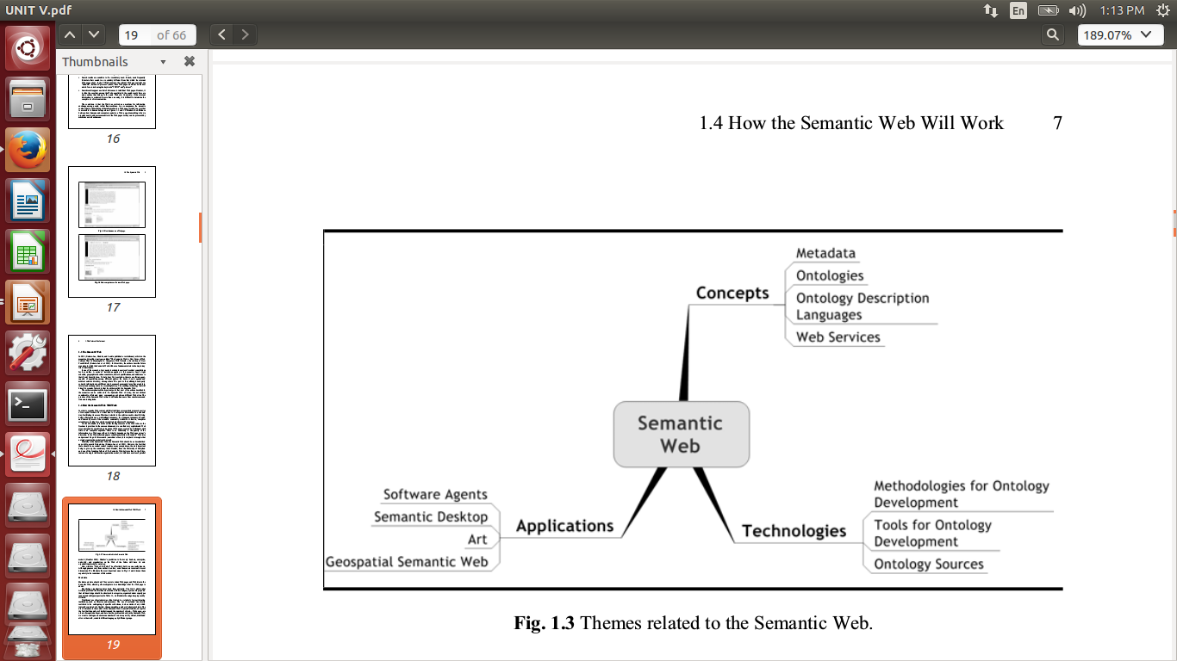

Slide 12
Applications of Semantic Web Technologies
(1)In Search Engines
(2) Semantic desktop applications provide a second example from the area of software engineering.
Such applications use ontologies to integrate desktop applications and the Web, facilitating personal information management, information distribution, and collaboration on the Web, beyond the mere sending of e-mails.

Slide 13
(3)Today, almost all major museums make their collections available over the Web, often with remarkable quality, such as the Hermitage Museum Web site.
In parallel, many organizations have been working toward the development of metadata standards and controlled thesauri(collection of synonyms) for describing cultural objects that facilitate their dissemination(spreading info) over the Web. Such efforts therefore contribute to and benefit from Semantic Web technologies.

Slide 14
(4)A similar phenomenon occurs in the geospatial application area.

Slide 15
What the Semantic Web Is Not
The Semantic Web Is Not Artificial Intelligence
The ultimate goal of AI is to build an intelligent agent exhibiting human-level intelligence (and higher), the goal of the Semantic Web is to assist human users in their day to day online activities.

Slide 16
The Semantic Web Is Not a Separate Web
The Semantic Web is not a separate Web, but rather an extension of the current Syntactic Web.
In this new Web, information will have well-defined meaning as a result of the use of semantic markup languages.
Such languages, essentially ontology description languages, will be added to existing Web pages, in an architecture called The Semantic Web Wedding Cake Architecture

Slide 17
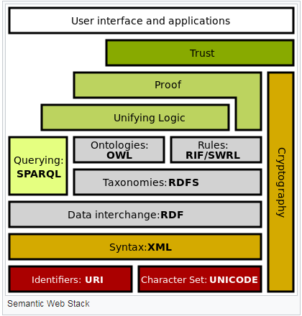

Slide 18
The Semantic Web Will Not Demand the Use of Complex Expressions
Although the Semantic Web language standard, OWL, supports very sophisticated constructs, it will not be mandatory that every Semantic Web application shows this level of complexity.
It is believed by the World Wide Web Consortium (W3C) that, for most Semantic Web Applications, the lighter species of OWL will be sufficient.

Slide 19
How Semantic Web Works:
The World Wide Web is an interesting paradox -- it's made with computers but for people.
the computers themselves really can't make sense of all this information. They can't read, see relationships or make decisions like you can.
The Semantic Web proposes to help computers "read" and use the Web. The big idea is pretty simple -- metadata added to Web pages can make the existing World Wide Web machine readable.

Slide 20
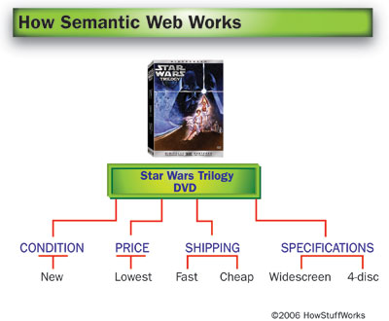
Example
Suppose you want to buy a "Star Wars Trilogy" boxed set online, and you have some basic criteria for your purchase. First, you want widescreen, not full-screen, DVDs, and you want the set that has the extra disc of bonus materials. Second, you want the lowest available price, but you'd prefer to buy a new set, not a used one. Finally, you don't want to pay too much for shipping and handling, but you also don't want to wait too long for delivery.

Slide 21
You could also look for a site that will compare prices and shipping options from several retailers all at once. Either way, you have to do most of the virtual legwork, then make your buying decision and place your order yourself.
With the Semantic Web, you'd have another option. You could enter your preferences into a computerized agent, which would search the Web, find the best option for you, and place your order. The agent could then open personal finance software­ on your computer and record the amount you spent, and it could mark the date your DVDs should arrive on your calendar. Your agent would also learn your habits and preferences, so if you had a bad experience buying from one particular site it would know not to use that site again.

Slide 22
What Will Be the Side Effects of the Semantic Web
The goal of the Semantic Web is to create a Web that is more adequate for the users’ needs. Emerging technologies will allow semantics to be added to existing Web pages and applications so as to make the Semantic Web vision come true.

Slide 23
What Will Be the Side Effects of the Semantic Web-(CONS & PROS) CONS:
Still, there’s a large amount of website owners who are unaware of the semantic web’s importance, and, since it requires for them to add the metadata manually into OWL (Ontology Web Language) semantic markups, they will feel unmotivated to do it.
The use and management of personal data could become a problem because it will be more important than ever to establish solid privacy policies. Basically, everything you post online could be exposed because the capability of content generators (or basically everyone) will be reduced since it would be the website where they post the content which is going to decide whether to share indiscriminately the information or not.

Slide 24
There’s also another heavy reason content creators are concerned about regarding the semantic web, especially the owners of those websites which depend on advertising since the user will just search anything on the browser and the results, like important dates, regular statistical information, or factual data may appear right away, making regular link-like search results outdated, removing the need to opening websites at all. That way, it is very unlikely that website owners support this.

Slide 25
PROS
The end users will be the ones benefiting the most from this since they will see an improvement in the way they interact with machines, search for information and navigate the Internet.
People will be able to talk to the machine the same way one does with a person. We won’t need to learn different expressions or to say unconnected words in order for a device to perform and action, but instead we’ll use those expressions we use regularly
It will answer you in a way that seems the machine is chatting with you. If you ask for something, it will not return a list of results, but instead, it will answer you in common expressions (the way a human could do) providing information taken from many sites.
the key of the semantic web: if you ask for something, a list of links won’t work because you didn’t need links, you needed to get a simple answer.

