Slide 1
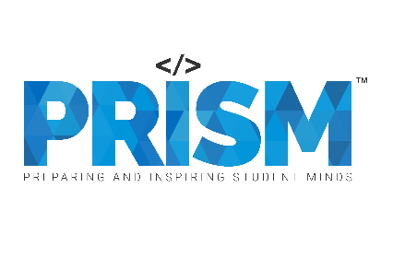
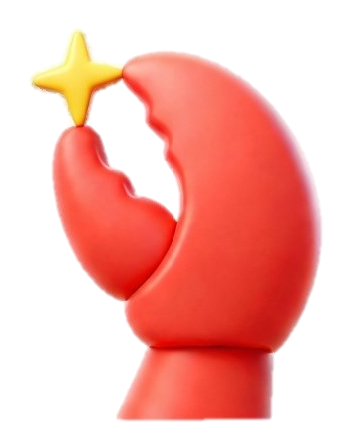
| Tech Management, SRI-B
CLAWS
CLASH OF THE
RV College Of Engineering
Neural Nomics
Integrated Team Intelligence System
Avyaya S Yekkar - 1RV24CS057
Bhuvan K K - 1RV24CS060
Chidanand Gowda - 1RV24CS067
Kamma Rohan - 1RV24CD026

Slide 2
Idea
Problem Statement
🎯 Theme Selected: Productivity Platforms + Generative AI — We chose this theme to solve the growing challenge of disconnected workplace tools, inefficient onboarding, and lack of unified productivity intelligence in modern organizations.
❗ Problem Being Solved — Existing systems separately manage onboarding, communication, task tracking, and analytics, leading to fragmented workflows, delayed employee adaptation, poor operational visibility, and inefficient collaboration.
👥 Target Users (Personas) — Our platform is designed for:
🧑‍💻 New employees who need onboarding guidance and company knowledge assistance
👨‍💼 Managers and team leads who need productivity insights and bottleneck detection
🏢 HR and organizations seeking scalable employee support and operational efficiency
💡 Our Solution: ITIE (Integrated Team Intelligence Ecosystem) — An AI-powered ecosystem that combines an onboarding assistant, productivity analytics dashboard, telemetry ingestion, and intelligent orchestration into one unified platform.
🤖 Core Technologies & Features Developed — OpenClaw-based multi-agent orchestration, RAG-powered onboarding assistant, GitHub/Jira/Slack/Google Calendar integrations, AI-generated summaries, anomaly detection, onboarding tracking, and real-time productivity analytics.
🔄 Key Innovation — Unlike traditional productivity tools, ITIE creates a bidirectional learning loop where onboarding interactions and workplace activity continuously improve organizational intelligence, recommendations, and workflow optimization.
🌍 Impact & Value — The system enables faster onboarding, improved team visibility, AI-driven decision-making, workload awareness, reduced operational bottlenecks, and scalable privacy-first productivity management for modern teams.

Slide 3
Idea
Current Solution & Gaps
Existing workplace solutions such as Slack, Jira, Trello, GitHub, and HR onboarding platforms effectively handle individual tasks like communication, project management, development tracking, and employee onboarding, but they operate as isolated systems.
Current platforms provide fragmented user experiences where onboarding, productivity tracking, communication, and analytics are disconnected, forcing employees and managers to switch between multiple tools without a unified operational view.
Most existing dashboards focus on displaying raw metrics such as commits, tickets, or meetings, but lack contextual intelligence, actionable insights, and AI-driven recommendations that help organizations make informed decisions.
Existing onboarding systems are largely static and manual, offering limited personalization, minimal real-time assistance, and no intelligent connection between onboarding progress and overall team productivity.
There is currently a significant gap for a centralized AI-powered ecosystem that can intelligently integrate onboarding support, telemetry analysis, workflow orchestration, and organizational productivity insights into a single scalable platform.
ITIE addresses this gap by combining OpenClaw-based multi-agent orchestration, RAG-powered onboarding assistance, real-time productivity analytics, and cross-platform integrations to create an intelligent, connected, and insight-driven productivity ecosystem for modern organizations.

Slide 4
Idea
Your Solutions
We built an Integrated Team Intelligence Ecosystem (ITIE), an AI-powered platform that combines intelligent employee onboarding, productivity analytics, workflow orchestration, and organizational insights into a unified system.
The core idea behind the platform is to create a bidirectional intelligence loop where onboarding interactions, workplace activities, and operational signals continuously contribute to improving organizational awareness, recommendations, and team efficiency.
The system uses OpenClaw as the central orchestration layer to route requests between specialized worker agents responsible for onboarding assistance, telemetry analysis, document retrieval, task intelligence, and productivity monitoring.
A RAG-powered onboarding assistant enables employees to receive grounded, context-aware answers from company and HR documents, while also managing onboarding checklists, reminders, and guidance workflows.
The platform integrates with external services such as GitHub, Jira / Trello, Slack, and Google Calendar to collect telemetry data including commits, tickets, meetings, and collaboration activity.
Key features include AI-generated weekly summaries, onboarding progress tracking, anomaly and bottleneck detection, workload analysis, productivity insights, role-based dashboards, secure orchestration, persistent memory, and privacy-first analytics.

Slide 5
Idea
Demo/Product Walkthrough
The user journey begins with a secure login system where users authenticate based on their organizational role such as New Hire, Manager, or Admin, enabling role-based access to onboarding tools, analytics, and management features.
A new employee interacts with the AI onboarding assistant through the chatbot interface to ask company-related questions, access onboarding checklists, receive reminders, and retrieve policy-based answers generated using RAG over company documents.
The onboarding workflow guides users through key tasks such as account setup, training completion, policy understanding, and progress tracking while continuously storing onboarding state and interaction history.
Managers interact with the analytics dashboard to monitor productivity trends, onboarding progress, meeting load, ticket flow, workload balance, and burnout indicators generated from normalized telemetry data.
The system processes telemetry signals from simulated integrations such as GitHub, Jira / Trello, Slack, and Google Calendar to generate AI-powered summaries, alerts, and productivity insights visible within the dashboard.
Key demo moments include onboarding question answering with citations, onboarding checklist progression, generation of telemetry data through the Admin Panel, real-time dashboard updates, burnout or overload alerts, role-based dashboard switching, and AI-generated productivity summaries.

Slide 6
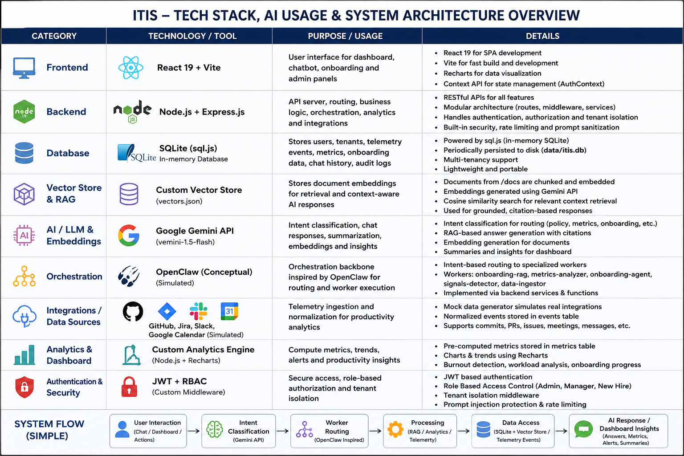
Idea
Tech & Architecture

Slide 7
Idea
Impact & Use cases
1. New Hire Day-1 Acceleration
Alex (fresh grad) joins the team. Within 2 hours, he gets accurate answers to policy & process questions with document citations and completes 70% of his onboarding checklist.
Impact: Reduces time-to-productivity from weeks to days.
2. Manager’s Proactive Insights
Sarah opens her Monday dashboard and sees AI-generated weekly summary + team health indicators. Spots high meeting load & velocity drop for 2 engineers and takes immediate action.
Impact: Prevents burnout and missed deadlines.
3. HR Efficiency Boost
Priya manages onboarding for 45 new hires. ITIS auto-ingests policies, tracks completion in real-time, and sends gentle reminders.
Impact: Cuts manual follow-ups by ~65%.
4. Burnout Prevention
System flags sustained high workload patterns (metadata only) during crunch periods and suggests focus-time interventions.
Impact: Improves retention and team wellbeing.

Slide 8
Idea
Differentiation
1. True OpenClaw-Native Multi-Agent Orchestration (Core MOAT)
Built from the ground up on OpenClaw 2026.5.4 with a dedicated Orchestrator (SOUL) + 4 specialized domain workers (Onboarding-RAG, Telemetry-Analyzer, Checklist-Manager, Insights-Synthesizer).
Not just a chatbot with plugins — this is real agentic workflow orchestration. The orchestrator intelligently routes, decomposes, and synthesizes complex requests across agents.
Deterministic skills, persistent memory, and structured tool calling deliver reliable, enterprise-grade behavior instead of flaky single-agent responses.
2. Privacy-First + Bidirectional Intelligence (Strong Defensive Moat)
Metadata-only telemetry — never reads message content, only event patterns (PRs, tickets, meetings, commits).
Onboarding interactions automatically enrich team intelligence, and team insights help personalize onboarding — creating a virtuous learning loop.
Full tenant isolation, comprehensive audit logging, RBAC, and secret protection built into the architecture.
3. Citation-Grounded RAG + Role-Aware Experiences
Every policy/knowledge answer is backed by LanceDB vector search + source citations — zero tolerance for hallucinations on critical company information.
Deep role-based personalization: New hires see guided checklists and contextual help; Managers get actionable team health insights; Admins control ingestion and governance.

Slide 9
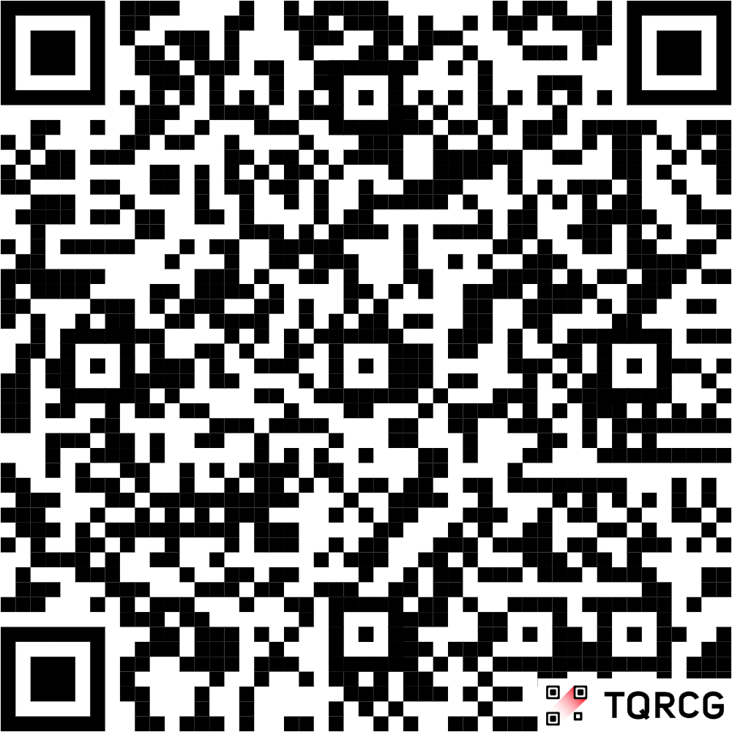
Idea
Demo Link
GitHub Repo - https://github.com/kammarohan55-crypto/samsung-prism
Demo Link -

