Slide 1
Quality-Energy Aware System Design
Application
System-Level Synthesis
Programming models with quality specifications
Static/dynamic task mapping (system compiler/OS)
Quality-/accuracy-configurable hardware
Fabric
High-level synthesis/compiler approximations
Hardware/Software Synthesis

Slide 2
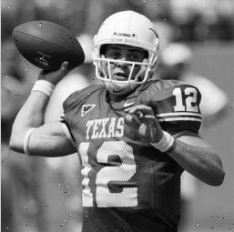
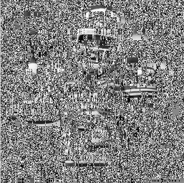
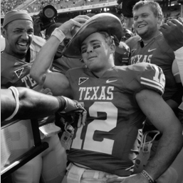

Voltage Overscaling
Traditional design aims to ensure correctness
Guaranteeing worst-case operation is suboptimal
Critical path not always triggered depending on input / environment
Can reduce energy by accepting some timing errors
Satisfy timing on average
Prevent signal quality from severe degradation
Statistical error treatment
Quality-energy profile shaping
E.g. allow for more aggressive V_{DD} scaling
Direct V_{DD} reduction
Controlled Timing-Error Acceptance
(same V_{DD} reduction as above)
Notes:
2
2

Slide 3


Approximate HW/SW Synthesis
Application
45dB PSNR
Approximate HW/SW Synthesis
Compiler Frontend
High-Level Synthesis
46% energy savings
SW Approximations
HW Approximations
Compiler Backend
RTL & Logic Synthesis
30dB PSNR
Binary
Gate Netlist

