Slide 1
Jmeter
Introduction and How to use with Selenium Webdriver Support

Slide 2
Why Jmeter?
The Apache JMeterTM is pure Java open source software, which was first developed by Stefano Mazzocchi of theApache Software Foundation, designed to load test functional behavior and measure performance.
JMeter to analyze and measure the performance of web application or a variety of services.
Performance Testing means testing a web application against heavy load, multiple and concurrent user traffic.
Let say you have to do performance testing of www.google.com for 100 users. What would you do?
Hence you need a software tool like JMeter that will simulate real-user behaviors and performance/load test your site.

Slide 3
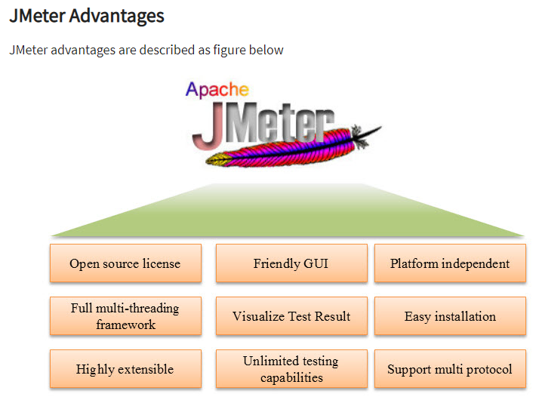
Advantages:

Slide 4
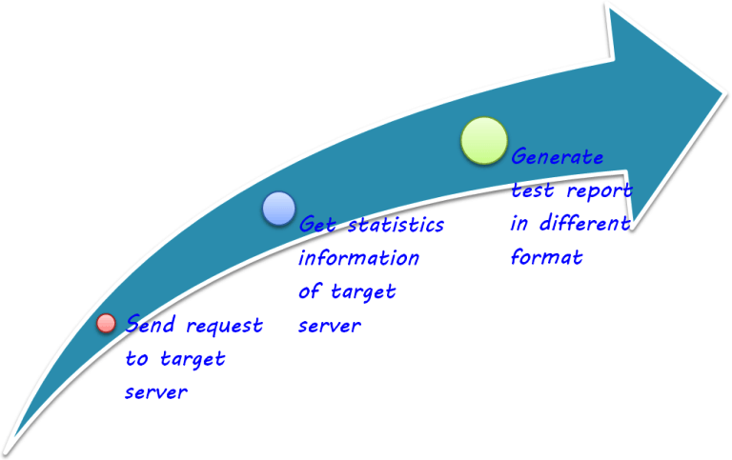
How does JMeter work?

Slide 5

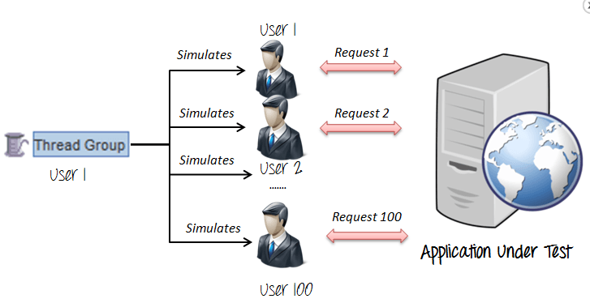
JMeter Elements: Thread Group, Samplers, Listeners, Configuration
Thread :
Thread Groups is a collection of Threads. Each thread represents one user using the application under test. For example, if you set the number of threads as 100; JMeter will create and simulate 100 user requests to the server under test

Slide 6
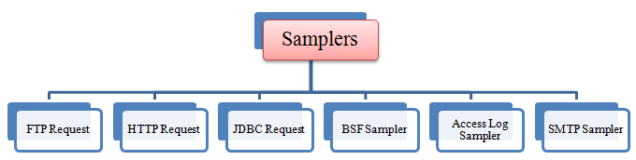
Jmeter Elements: Sampler
JMeter supports testing HTTP, FTP, JDBC and many other protocols.
How does a Thread Group know which type of requests (HTTP, FTP etc.) it needs to make?
The answer is Samplers
The user request could be FTP Request, HTTP Request, JDBC Request...Etc.

Slide 7
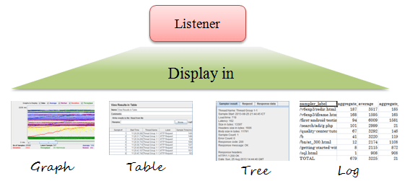
Jmeter Elements: Listener
Listeners: shows the results of the test execution. They can show results in a different format such as a tree, table, graph or log file

Slide 8
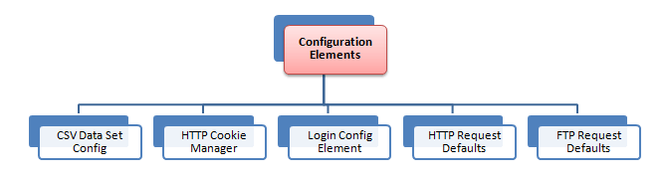
Jmeter Elements: Configuration Elements
Setting up defaults and variables for later use by samplers.
The figure below shows some commonly used configuration elements in Jmeter

Slide 9
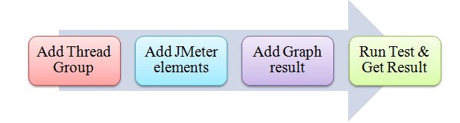
Road Map of Performance Testing: Example
Step 1) Add Thread Group
Start JMeter
Select Test Plan on the tree
Add Thread Group
Step 2) Adding JMeter elements
HTTP request Default
Right Click ThreadGroup -> Add -> Config Element -> HTTP Request Defaults.
HTTP Request
Right-click on Thread Group and select: Add -> Sampler -> HTTP Request.
Step 3) Adding Graph result
Right click Test Plan, Add -> Listener -> Graph Results
Step 4) Run Test and get the test result

Slide 10
How to use Assertions in JMeter (Response Example)
What is an Assertion?
Assertion help verifies that your server under test returns the expected results.
Types of Assertions
Following are some commonly used Assertion in JMeter:
Response Assertion
Duration Assertion
Size Assertion
XML Assertion
HTML Assertion

Slide 11
Jmeter – Plugin Manager
The idea of JMeter Plugins Manager is simple: instead of installing various plugins manually, it will do it for you through nice UI. No need to mess with JARs anymore. Install Plugins Manager once and it will do it all for you: installing, upgrading, uninstalling.
Installation and Usage
Download the Plugins Manager JAR file and put it into JMeter's lib/ext directory. Then start JMeter and go to "Options" menu to access the Plugins Manager.

Slide 12
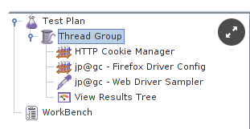
Using Selenium with JMeter's WebDriver Sampler
Install Selenium Webdriver Sampler using Plugin Manager.
Then write your WebDriver script as usual, then add "Thread Group" to your "Test Plan.“
Add Config Element -> HTTP Cookie Manager, Config Element -> jp@gc - Firefox Driver Config, Sampler -> jp@gc - Web Driver Sampler, Listener -> View Results Tree.
The Result is as shown:

Slide 13
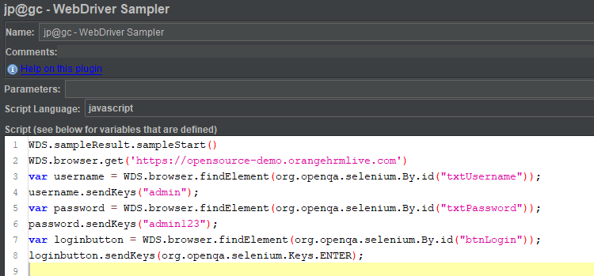
Continued…
You do not need to configure two config elements – you may omit that step. Open the "Web Driver Sampler" and add the code as shown below:

Slide 14
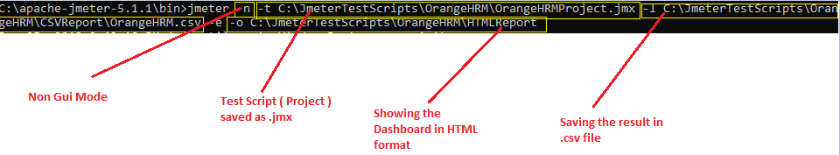
Test Plan Execution in Non – GUI mode
Open cmd Prompt
Goto the local directory where Jmeter.bat is present
Cd C:\apache-jmeter-5.1.1\bin
Run below command:
C:\apache-jmeter-5.1.1\bin>jmeter -n -t C:\JmeterTestScripts\OrangeHRM\OrangeHRMProject.jmx -l C:\JmeterTestScripts\OrangeHRM\CSVReport\OrangeHRM.csv -e o C:\JmeterTestScripts\OrangeHRM\HTMLReport

Slide 15
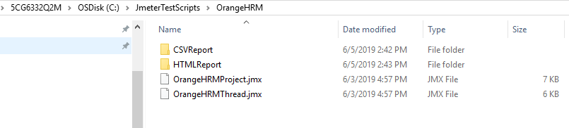

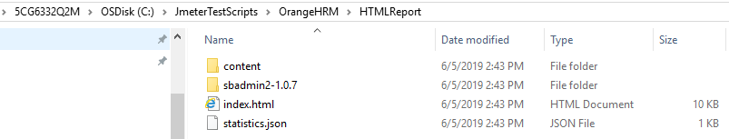
Results:

Slide 16
References:
https://www.guru99.com/introduction-to-jmeter.html
https://www.youtube.com/watch?v=tTgyrSWlj5s

