Slide 1
DoorStep
QuadSquad
Ashwani Chahal
Astha Tiwari
Kamna Yadav
Sravan Kumar

Slide 2
Initial problem statement
A major problem faced by most of the students is to find out time to go out and locate the exact service providers on the basis of budget, skill and experience
DoorStep is an app that helps students hire local professionals at the convenience of their home. Thus saving their time and efforts, helping them find the best professional based on their user ratings, reviews, etc.
Our application is mainly targeted around students

Slide 3
User Study
Answers sought from user study:
Feasibility of the application and its need.
Services to be provided in the beta release.
Features to be implemented
6 students from varied backgrounds were interviewed so that collected data was not biased
A mix of Undergraduate, Graduate and PhD students
A mix of Indians, Americans and Chinese students
A mix of people from difference courses: MIS, CS, Food Sciences
A mix of male and female students

Slide 4
User Study…
The data requirement was of exploratory nature to identify the types of services and interface requirements, so we adapted to a semi-structured interview format
13 fixed questions were asked from every interviewee, after briefing them about the background of the study and taking their consent
The questions were divided into four categories:
Demographic questions
Background information
Information specific to the project
Feedback

Slide 5
User Study…
Interview information:
Duration: Approximately 40 minutes
Location: Taggart Student Center
Tools used: Notes taken on the interview guide printouts

Slide 6
Description of Interviewees
Name of interviewee | Brief description about the interviewee | Team members Interviewing
Nathan | Undergraduate CS student in his junior year, living in student housing | Astha, Sravan
Julie Adams | Undergraduate CS student in her freshman year, living in dorm room | Kamna, Ashwani
Chris Proser | CS PhD student in his second year, living in apartment | Ashwani, Astha
Ravi Duddukuru | Graduate MIS student in his first semester, living in student housing | Sravan, Kamna
Hedieh Ghoreyshi | Undergraduate Computer Sciences student in her first semester, living in apartment | Ashwani, Sravan
Pranav Sharma | Graduate CS student in his first semester, renting a house | Kamna, Astha

Slide 7
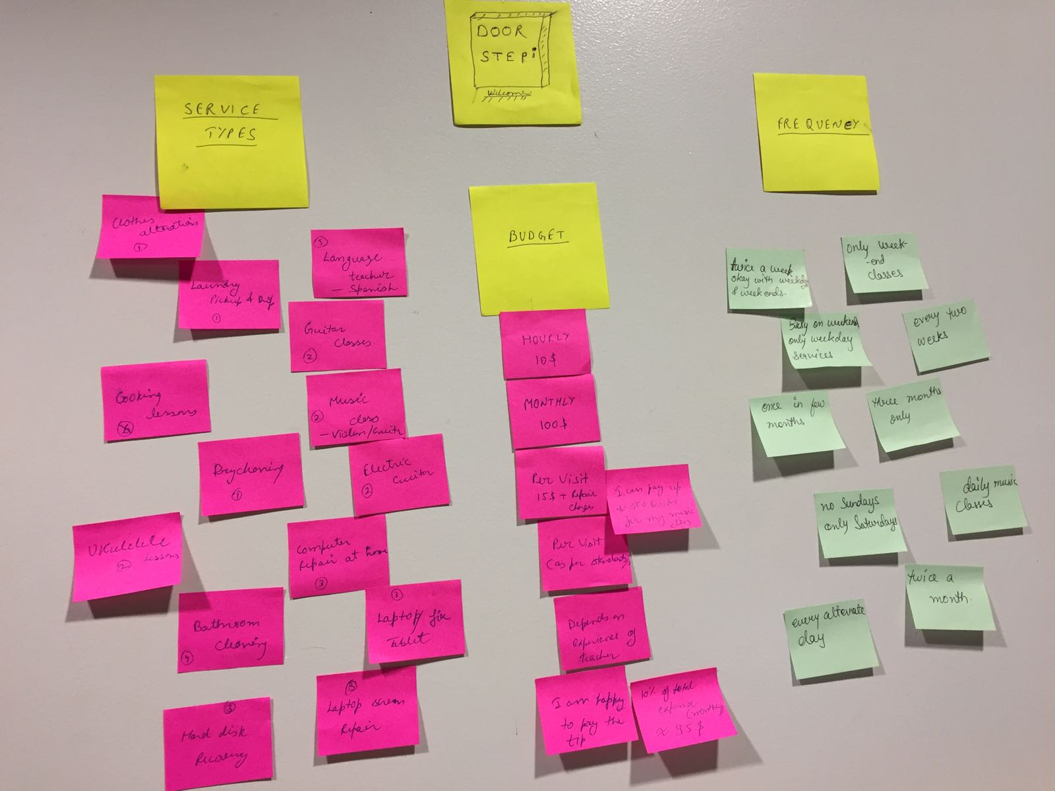
Affinity Diagram

Slide 8
Affinity Diagram…
Location: Created at the place of interviews (TSC cafeteria) after finishing with the interviews and going through the transcripts
Tools used:
Transcripts for interviews
Pens
Sticky notes
TSC cafeteria wall as the background for the diagram
3 personas were created using the information from affinity diagram and user studies

Slide 9
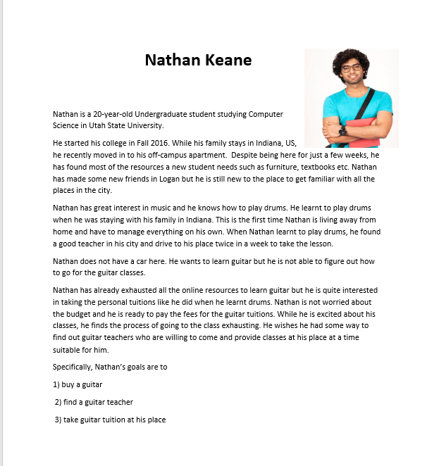
Persona: Nathan

Slide 10
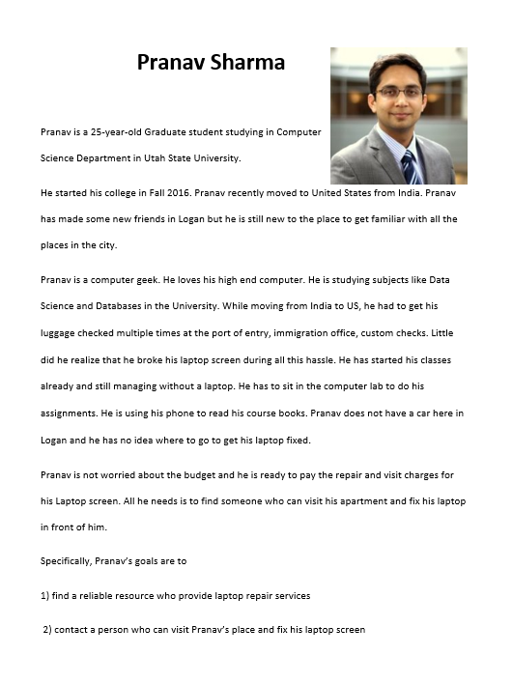
Persona: Pranav

Slide 11
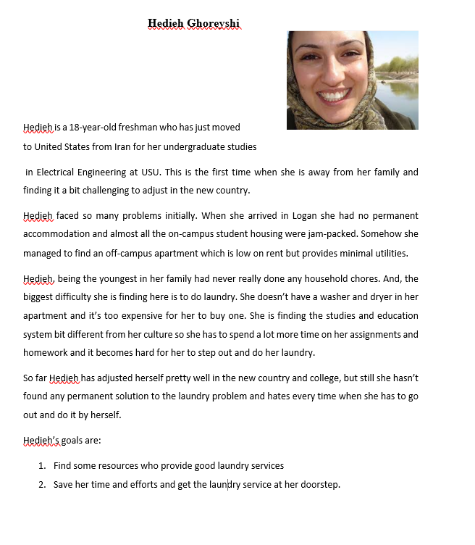
Persona: Hedieh

Slide 12
Findings from the research
Bar chart showing services requested

Slide 13
Findings from the research…
Service related findings:
The 3 most desirable services are: computer repair, laundry and musical instruments
Interface related findings:
Most of the interviewees wanted it to be a mobile application so that they it is more accessible. So, we plan to go with creating a mobile application as the solution
Frequency of service requirement related findings:
As is evident from the above information and the affinity diagrams, the frequency of service requirements cannot be generalized, so we plan to keep it as a search criteria and get it entered by the service provider and the student as well

Slide 14
Post research problem statement
Based on the research findings, we now have the following problem statement for the project
Need to design a prototype for the mobile application for the following three services
Laundry services
Computer / laptop repair services
Music learning classes
Need to design the interface for students to search for services and place requests
Need to design the interface for the service providers to register themselves as service provider on our application
Need to find out service providers for these services
Contact the service providers and encourage them to register their services on our app

Slide 15
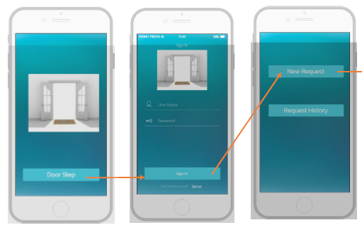
Initial Prototype

Slide 16
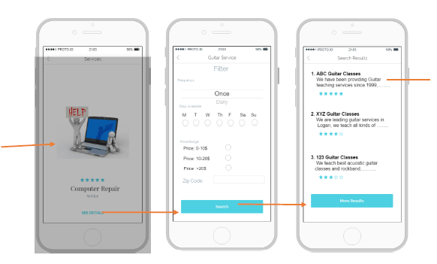
Initial Prototype…

Slide 17
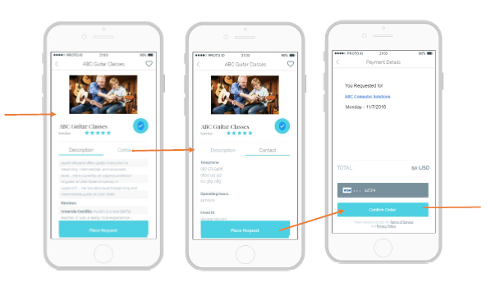
Initial Prototype…

Slide 18
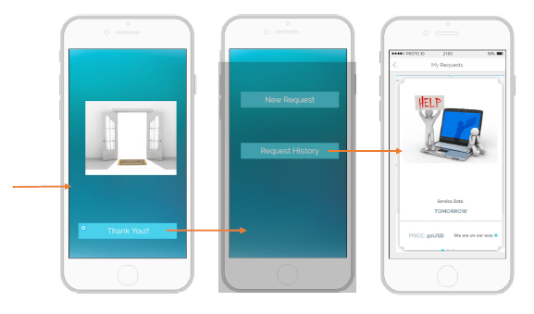
Initial Prototype…

Slide 19
Usability Testing
For the usability testing, we performed tests using 5 of the initial 6 interviewees.
Usability testing information:
Devices used: Touch screen laptops and mobile phones
Other tools used: Notepads to note down findings of the users
Duration: approximately 30 minutes each
Location: TSC cafeteria, Library and Old Main 4th floor Lounge
The user findings were categorized as per their severities: Low, medium and high.
Changes have been incorporated into our final prototype as per these findings and then we had one person test the final prototype for usability.

Slide 20
Usability Testing…
The main medium and high-level findings from the 4 think-aloud sessions held were as follows
No sign-in with Gmail, Facebook or Twitter on the Sign-in screen, however there were options at the signup screen
Continued with just the signup with email and then signin using those details, to remove any confusion in the final prototype
Full-screen scroll-view for every available service
Modified the prototype to include small thumbnails instead of full-screen for each service.

Slide 21
Final Prototype

Slide 22
Questions?

