Slide 1
PROJECT 1:
AN ANALYSIS OF
5 NASDAQ STOCks
And media sentiment
Team calabar
April 10, 2018
Notes:
Kettyl

Slide 2
OUR TEAM
CALABAR PYTHON
kettyl
amoakon
ALEXA
CAVENAS
AURA
johnson
ROBIN
vasudevan
BETH
YODER
Notes:
Say own name

Slide 3
Guiding questions
1
Is it possible to predict stock market behavior?
2
What factors influence share cost fluctuations?
3
Does news media coverage influence trading?
4
How can we measure news media sentiment?
Notes:
Alexa

Slide 4
HYPOTHESIS
A RELATIONSHIP EXISTS
BETWEEN STOCK PRICES
AND MEDIA COVERAGE OF THAT STOCK
OUR INITIAL RESEARCH FOCUSES ON ONLY
5 NASDAQ STOCK EXCHANGE COMPANIES (CHOSEN ANECDOTALLY BASED ON POPULARITY)
AND 4 VARIABLES, DUE TO TIME CONSTRAINTS
Notes:
Aura

Slide 5
PROGRESSION of project
Saturday
tuesday
thursday
saturday
Dissatisfied with results of tweepy
Researched new data sources
Obtained institutional
License for
Data sets
Began to research first hypothesis using Instagram and geolocation
Realized Instagram api end points were not sufficient
New hypothesis
Decided to use tweepy for sentiment analysis
DECIDED TO USE FIRST QUARTER 2018 data
Notes:
Beth

Slide 6
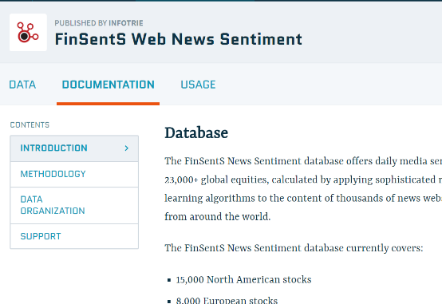
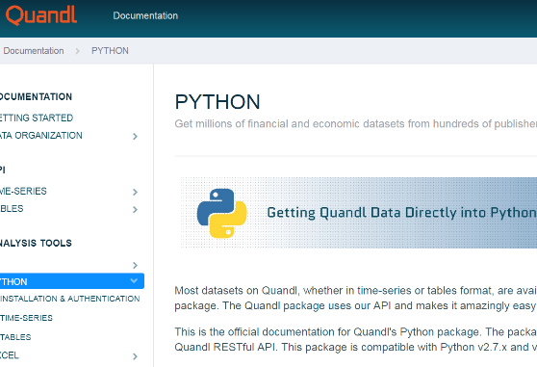
DATA sources
FINSENTS
QUANDL API (PYTHON MODULE)
.financial data company
Source of financial data
Notes:
Beth

Slide 7
variables
01
Closing price:
Adjusted closing price accounts for
Effects of stock price (end of day)
That are caused by corporate actions
Quandl module (quandl api for python)
Compiles this data daily
Reliable real-time data source for analysis of stock prices
Notes:
Kettyl

Slide 8
variables
02
Sentiment Score:
A measure of the bullishness / bearishness of the language used in media coverage
of a given stock on a given day
Ranges from -5 (extremely negative coverage) to +5 (extremely positive coverage);
a score of 0 indicates an absence of
articles for that day
Finsents algorithm determines this number
Notes:
Alexa

Slide 9



Bull vs. bear market
Bear market language
is related to falling
price trends, pessimism,
and overall negative
indicators (stock
markets, unemployment, etc) while bullish
sentiment ratings
would mean that
language used implied
Upward price trends,
optimism, and growth
Notes:
Beth

Slide 10
variables
03
News volume:
The number of news articles about this
Stock published on a given day
Company news excluded
Finsents metric
Notes:
Robin

Slide 11
variables
04
News buzz:
A measure of the rate of change in
News coverage of a given stock
On a given day
Normalized on a scale of 1 to 10
measures the change in the standard
deviation of periodic news Volume
Calculated by finsents
serves as a ‘risk alert’ indicator
Notes:
Aura

Slide 12
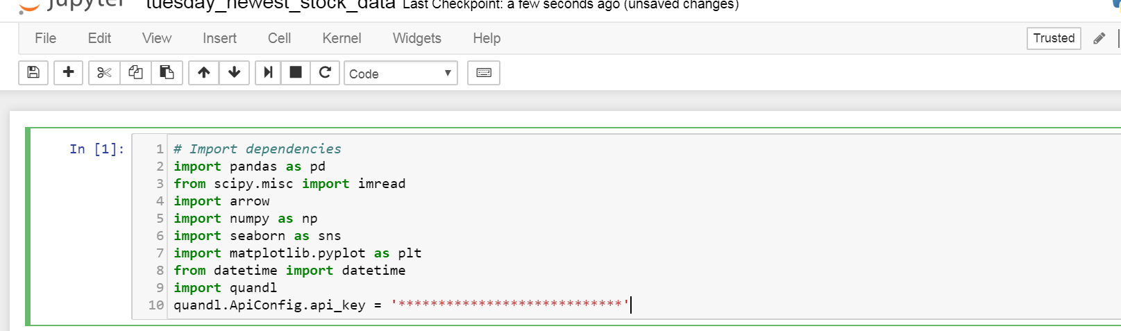
JUPYTER NOTEBOOK 1
Notes:
Aura

Slide 13
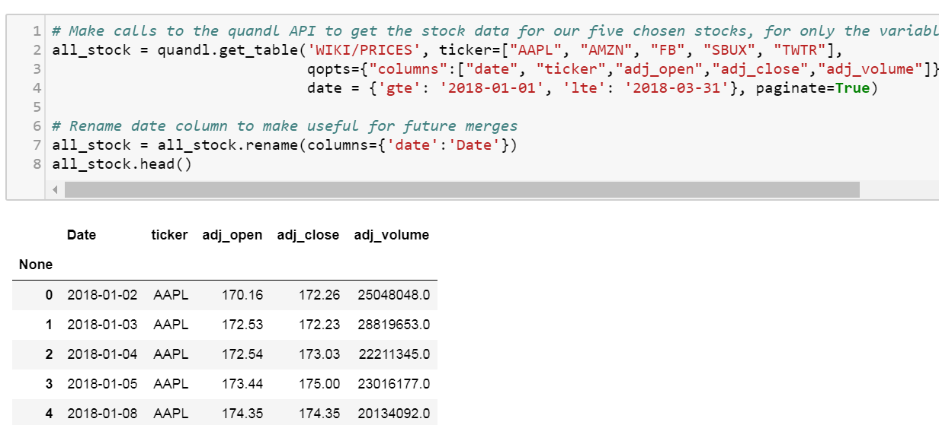
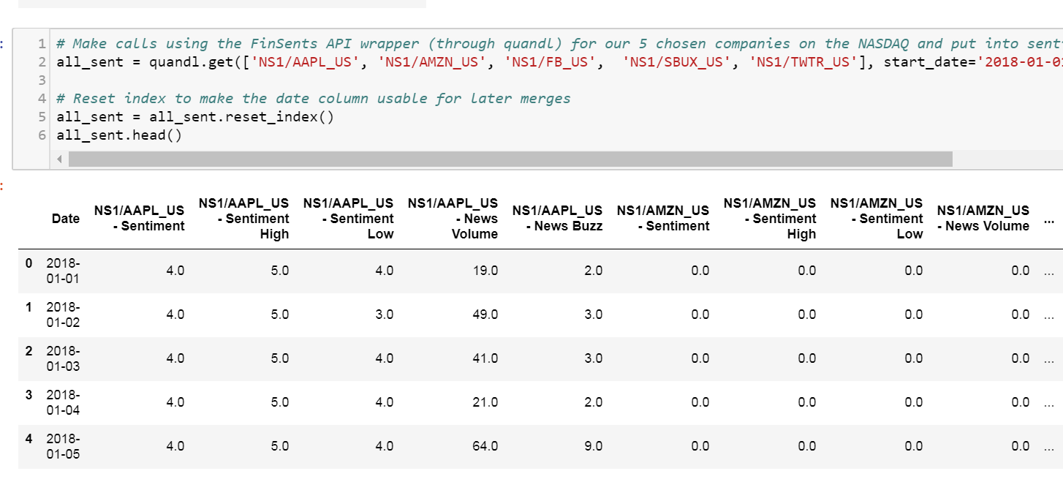
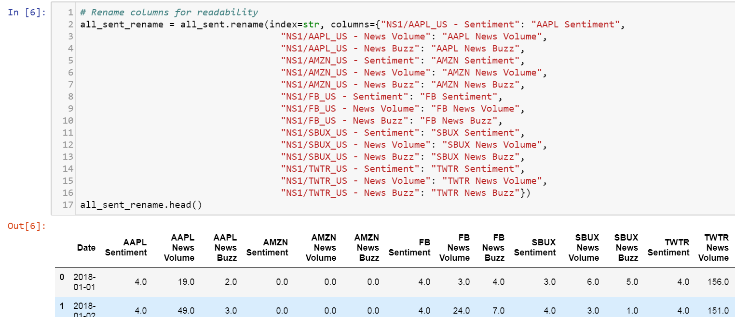
Data organization
Initial dataframes were created from calls to each api/module
Data was organized and cleaned
Notes:
Alexa

Slide 14
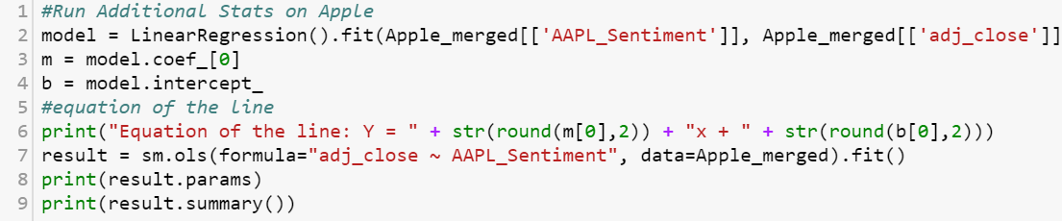
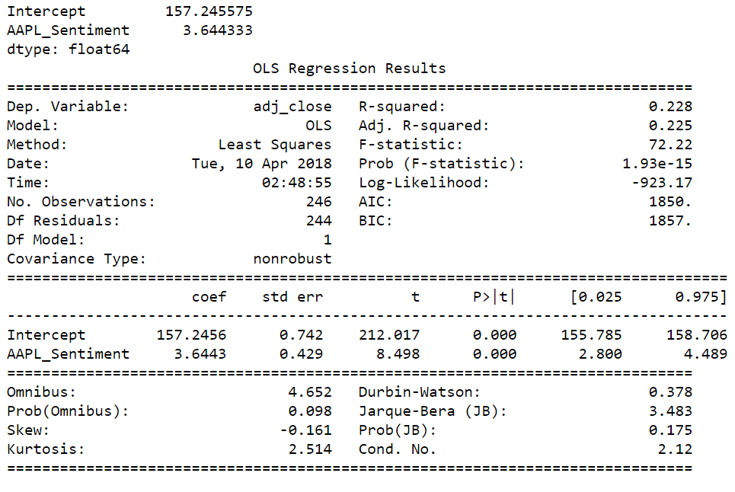
Data analysis
Notes:
Robin

Slide 15
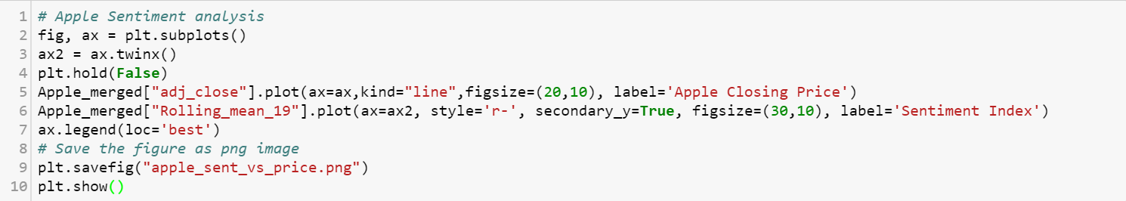
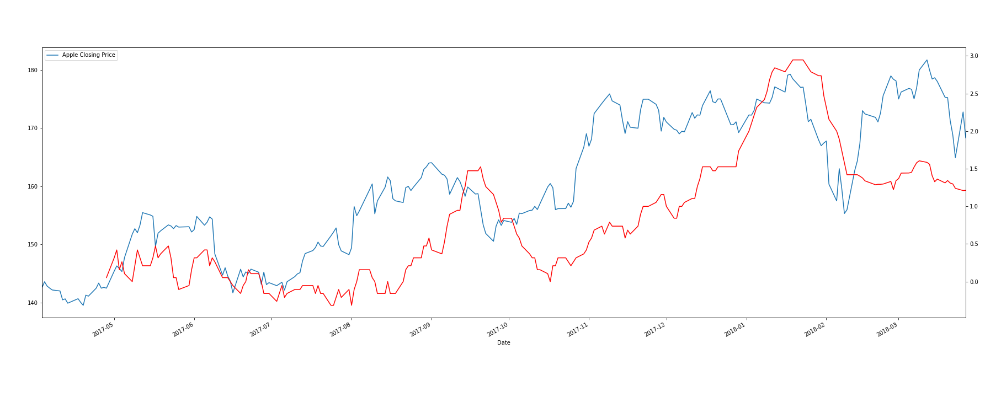
Data analysis ii
Notes:
Robin

Slide 16
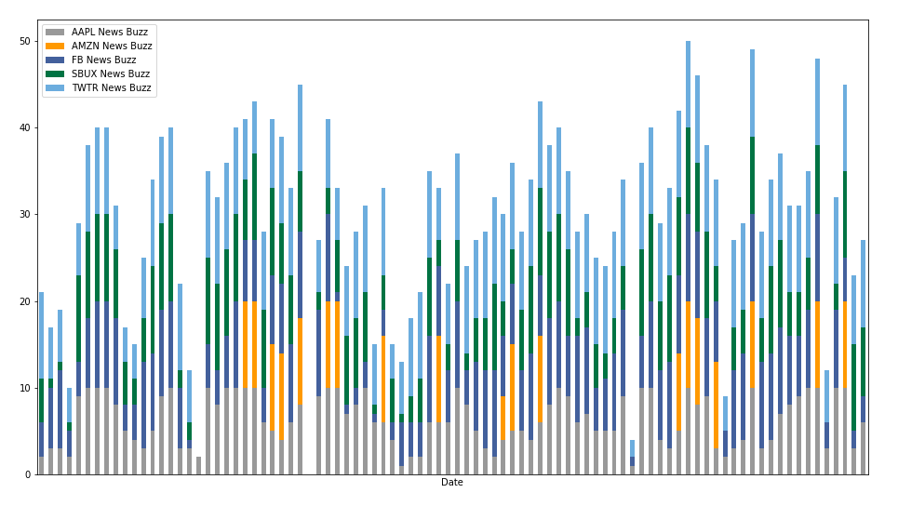
Visualization 1
First quarter 2018 news buzz
Notes:
Aura

Slide 17
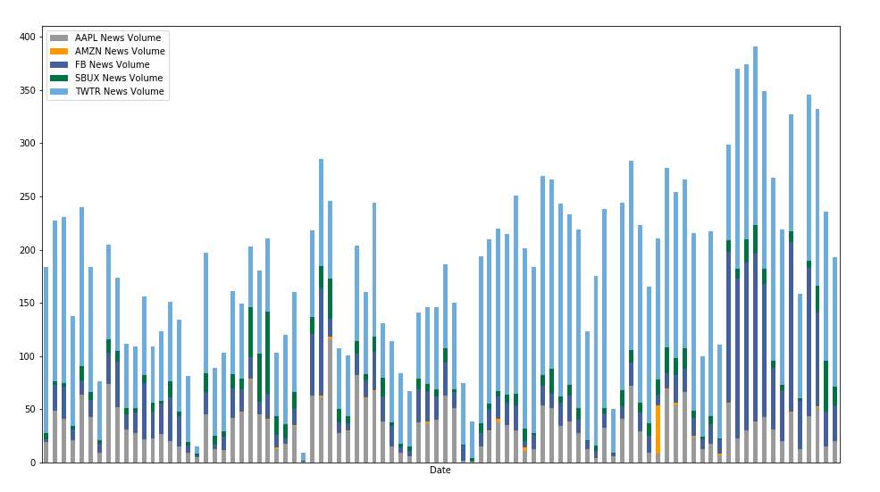
Visualization 1i
First quarter 2018 news volume
Notes:
Beth

Slide 18
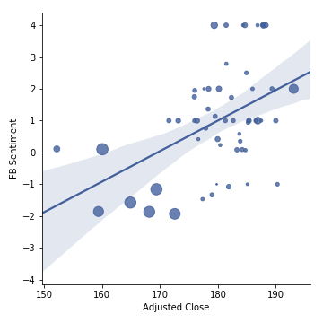

Visualizations
First quarter 2018: FACEbook closing price vs stock sentiment, as a function of news volume
Notes:
Kettyl

Slide 19
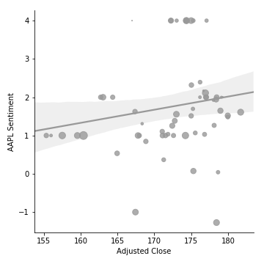

Visualizations continued
First quarter 2018: apple closing price vs stock sentiment, as a function of news volume
Notes:
Kettyl

Slide 20
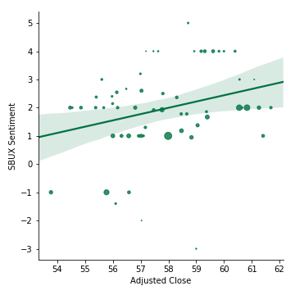

Visualizations continued
First quarter 2018: STARBUCKS closing price vs stock sentiment, as a function of news volume
Notes:
Kettyl

Slide 21
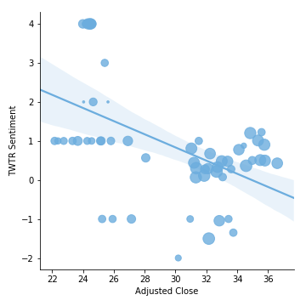

Visualizations continued
First quarter 2018: Twitter closing price vs stock sentiment, as a function of news volume
Notes:
Kettyl

Slide 22
Results
Apple had the highest r square value (.23),
Indicating the highest predictive relationship
Between adjusted closing price and media
sentiment
However, our hypothesis is not confirmed
Because news sentiment is not the best indicator
Of price fluctuations
News volume in conjunction with sentiment is a better indicator, but most fluctuations are due to factors other than our chosen variables
Notes:
alexa

Slide 23
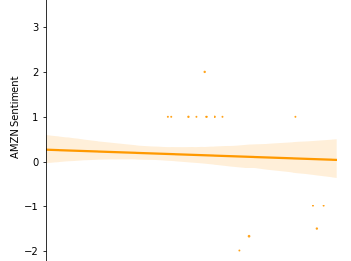
Limitations
TIME: overall project time too short
SCOPE creep: project grew before final focus was agreed upon
Group work: difficult to divide work efficiently; some work duplicated needlessly
Sample data: set too small, data missing for amazon
Statistics: understanding was insufficient to confidently use statistical tools
Notes:
Beth

Slide 24
SUGGESTIONS FOR
FUTURE RESEARCH
Run the same analysis on additional stocks, like the Nasdaq 100
Look into how to compare the previous day’s sentiment (or recent past sentiment) with price, as there would be some intra-day trading based on news, but same day closing price might not be the best indicator
research specific high volume news days to extract meaning
Notes:
Kettyl

Slide 25
references
http://finsents.com/NewsHome/Help
https://docs.quandl.com/docs/python
https://www.investopedia.com/terms/m/marketsentiment.asp
http://blogs.lse.ac.uk/usappblog/2017/10/14/can-twitter-sentiment-predict-stock-market-behaviour/
Notes:
Alexa

Slide 26

Questions?
Hi dzmitry

