Slide 1
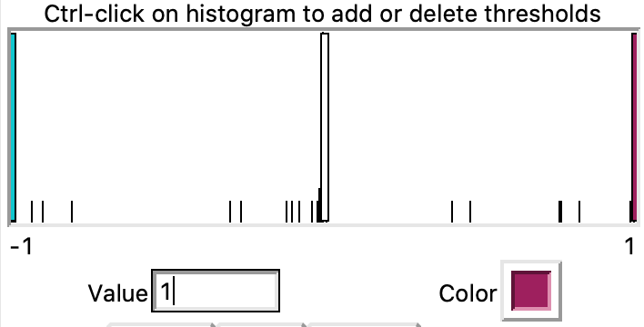
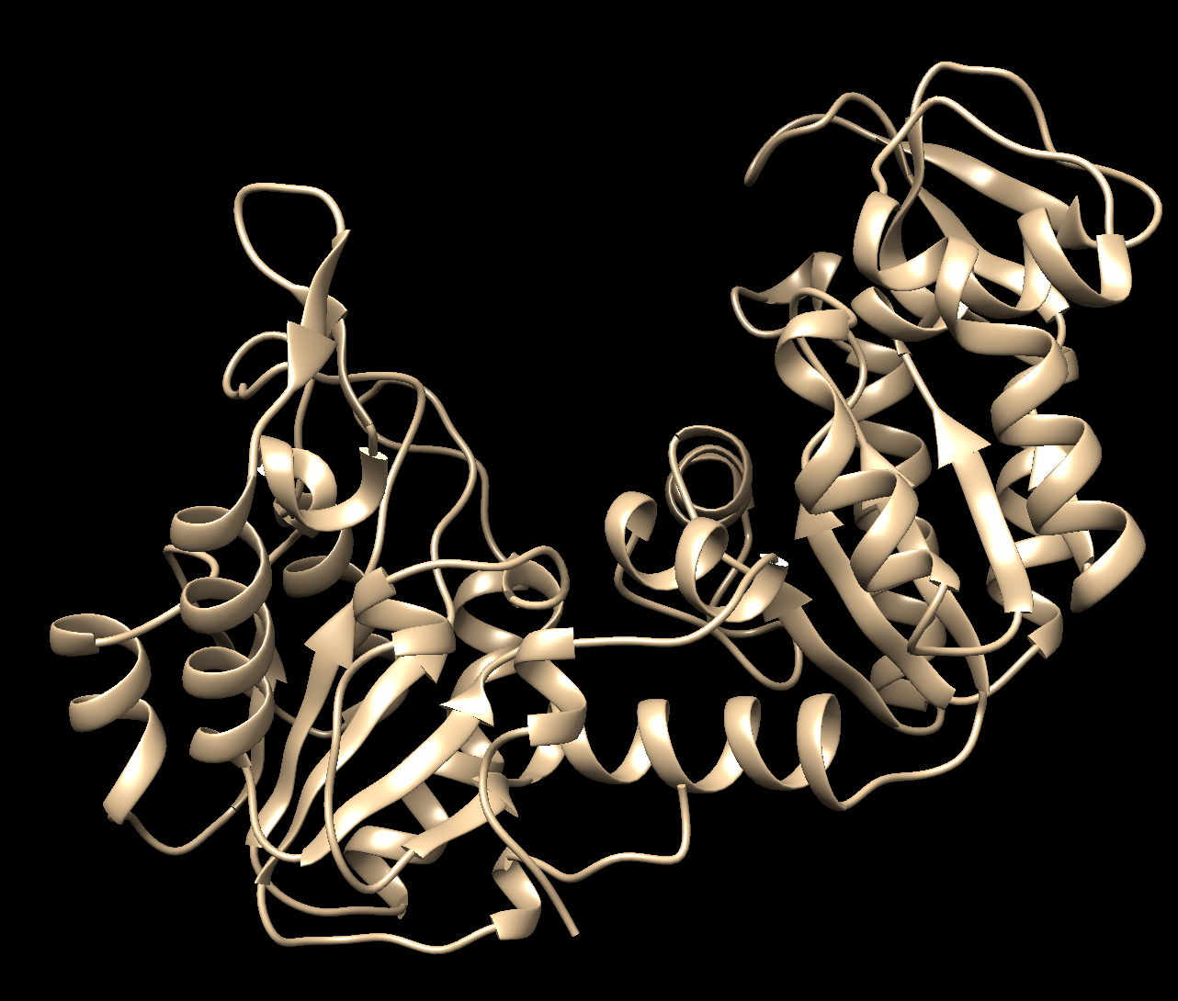
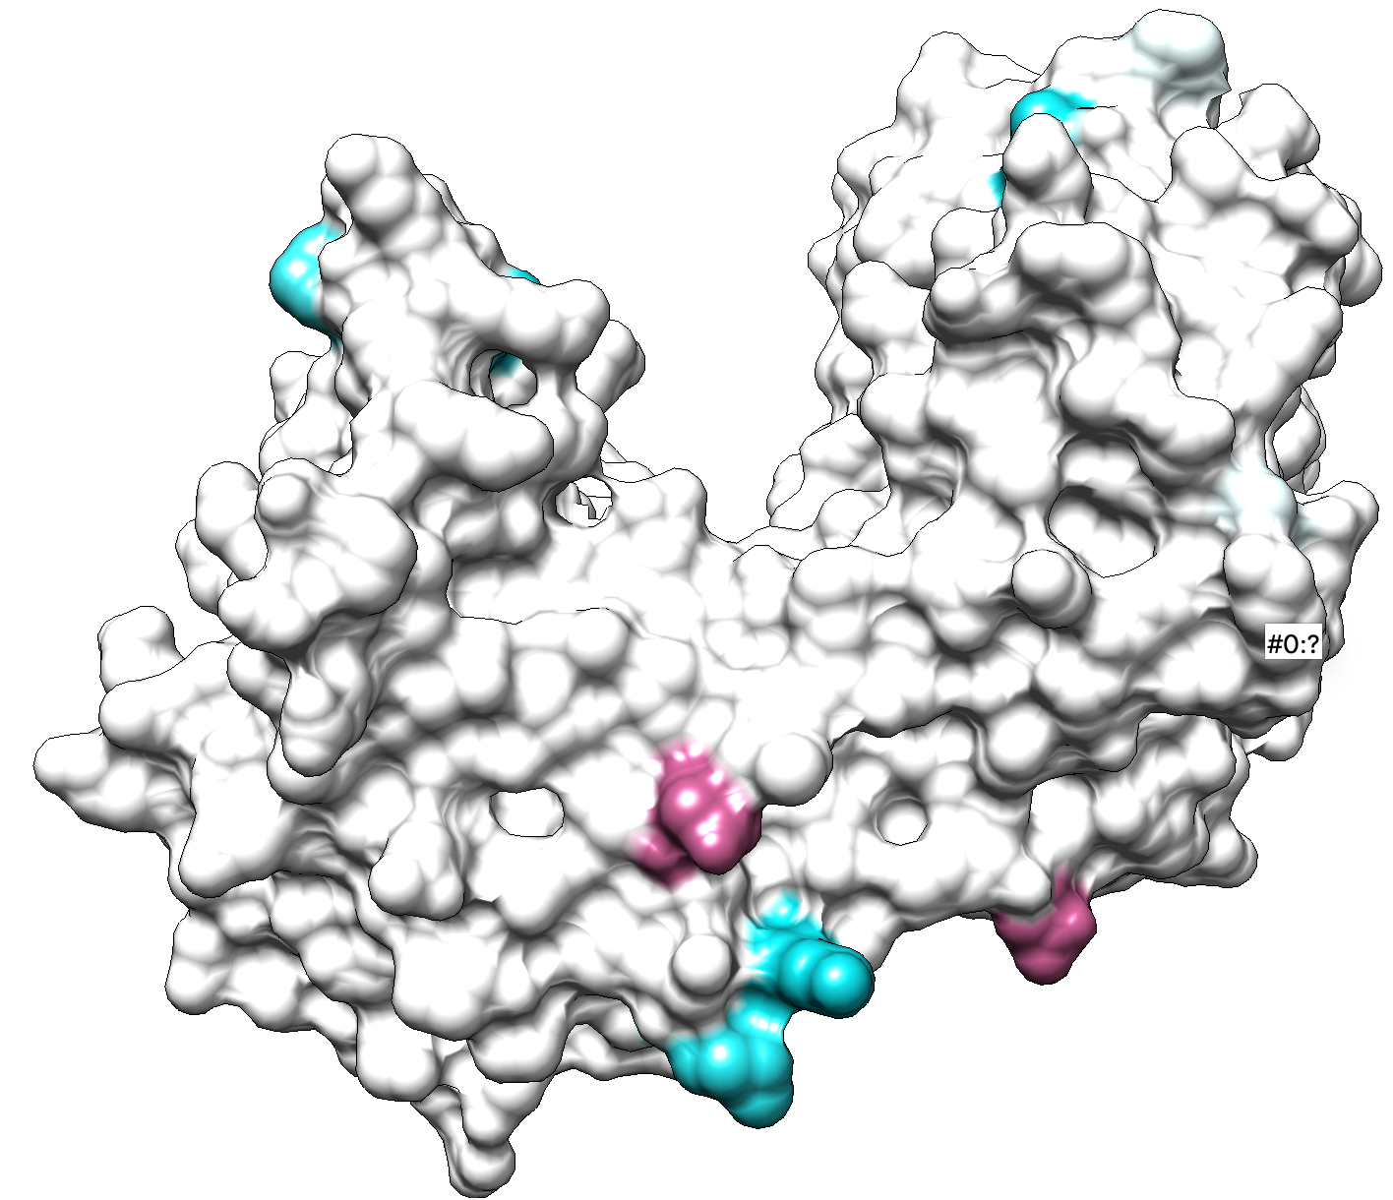
Adjust to 1 if not
Adjust to -1 if not
Cyan: Divergent substitution probabilities
Maroon: Convergent substitution probabilities

