Slide 1
Play and Akka, under the hood
(with Kamon, of course!)
Presented by Ivan Topolnjak

Slide 2
Today’s Agenda
- Get to know Kamon
  What is it?
  How does it look like?
- A word on Akka and Play
- See it in Action (with common problems):
Blocking code in actions.
Forget about compartmentalization.
The lagging actor.
Excessive logging.
Use of `blocking` code blocks.
Long garbage collection pauses.
Questions and
(hopefully) Answers

Slide 3

Kamon, what is it?
Open Source
More than 3 years of effort
Core with Metrics and Tracing
A lot of Integrations (17 + external)
Docs and info at http://kamon.io/

Slide 4
Why does it exist?
Raise your hand honestly.

Slide 5
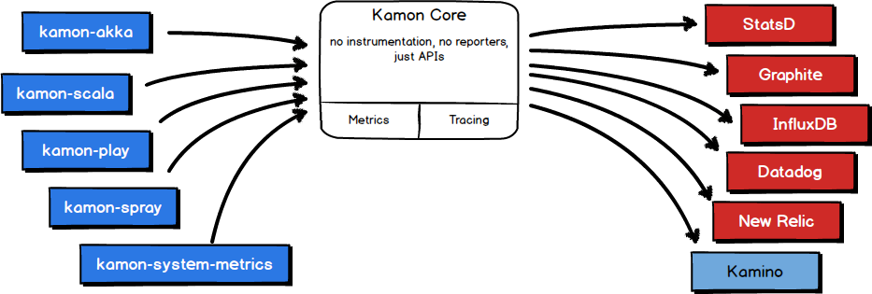
How does it look like?

Slide 6
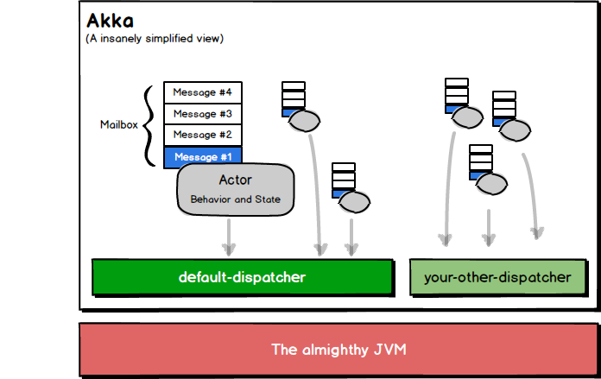

Slide 7
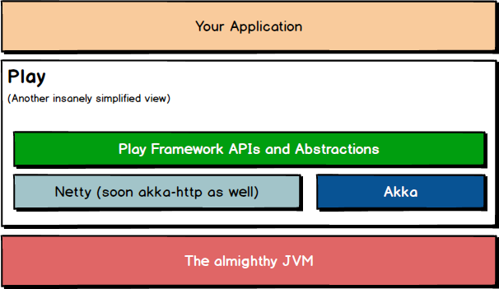

Slide 8
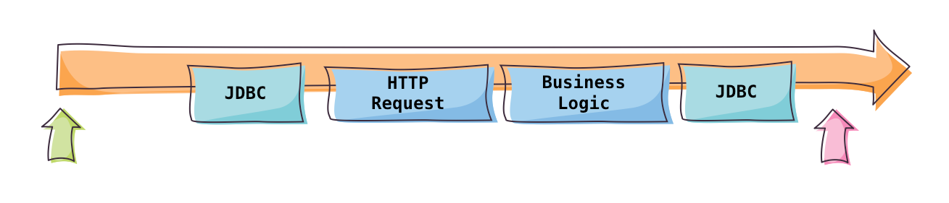
Traditional Thread Model

Slide 9
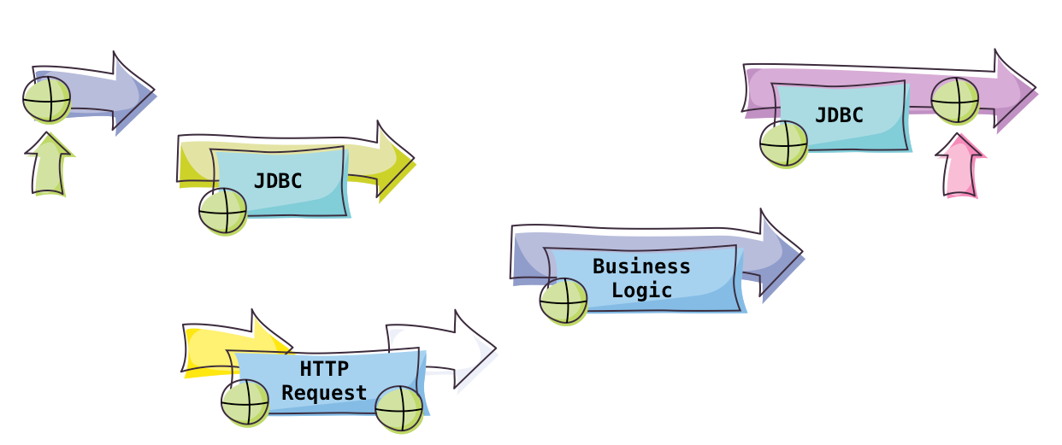
“Reactive” Thread Model

Slide 10
Let’s see it in action

Slide 11
And, now that we are here...
(shameless plug alert)

Slide 12

Sign up for
https://kamino.io

Slide 13
Thanks for Coming!
Questions?

