Slide 1
AI-Powered Collections Strategy
Leveraging Agentic AI for Scalable, Fair, and Effective Debt Management at Geldium

Slide 2
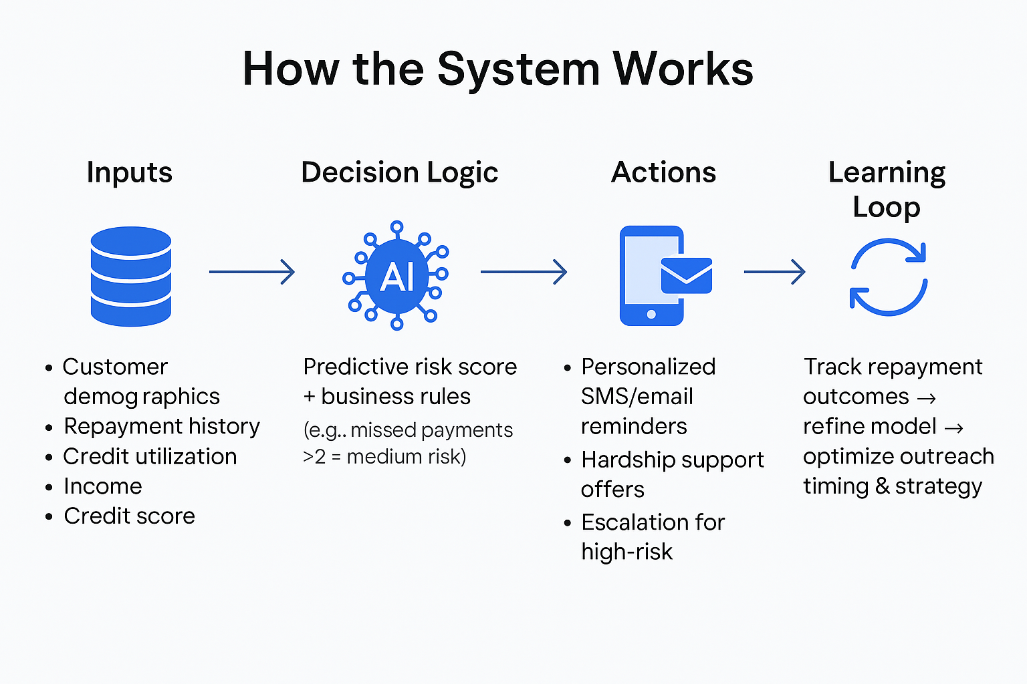
How the System Works
Inputs: Customer demographics, repayment history, credit utilization, income, credit score.
Decision Logic: Predictive risk score + business rules (e.g., missed payments >2 = medium risk).
Actions: Personalized SMS/email reminders, hardship support offers, escalation for high-risk.
Learning Loop: Track repayment outcomes → refine model → optimize outreach timing & strategy.
Notes:
Inputs (Data Sources):
Age & Demographics – helps identify younger/older customers with distinct repayment patterns.
Repayment History – strongest predictor of future delinquency (missed payments).
Credit Utilization – over-reliance on available credit signals financial stress.
Income Level – affects repayment capacity.
Credit Score – overall risk indicator.
Decision Logic:
Combine model outputs (probability of delinquency) with business rules (e.g., “if 3+ missed payments in last 6 months, escalate”).
Segment customers into Low / Medium / High Risk.
Actions (by Risk Level):
Low Risk: Gentle reminders via SMS/email.
Medium Risk: Personalized repayment plan offers.
High Risk: Proactive hardship support or case escalation to collections team.
Learning Loop:
Monitor repayment results after each outreach.
Feed back into the system to refine thresholds, message timing, and preferred channels.

Slide 3
Role of Agentic AI
Autonomous (AI-driven) | Human Oversight
Sending SMS/email reminders | Reviewing hardship or restructuring cases
Adjusting outreach timing & frequency | Handling disputes/complaints
Prioritizing customer risk segments | Approving high-impact decisions (e.g., write-offs)
Updating model with new data | Monitoring compliance and fairness
Notes:
Autonomous Actions (AI-driven):
Routine, low-risk, and scalable tasks like sending reminders, adjusting timing, and segmenting customers.
AI can adapt quickly based on repayment patterns and customer engagement.
Human Oversight Actions:
Complex, sensitive, or high-impact cases (e.g., hardship assistance, disputes, or large debt write-offs).
Ensures fairness, empathy, and compliance with regulations.
Protects against over-automation risks.
Balance: Agentic AI handles repetitive decisions at scale, while humans provide oversight where ethical, legal, or customer experience considerations are critical.

Slide 4
Responsible AI Guardrails
Fairness: Run bias audits across age, income, and region to prevent discriminatory outcomes.
Explainability: Provide plain-language reasons for risk flags; use model interpretability tools (e.g., SHAP).
Compliance: Align decisions with ECOA, GDPR, FCA, and local financial regulations; maintain audit trails.
Human-in-the-loop: Require manual approval for high-stakes or sensitive customer cases.
Notes:
Fairness: AI must be continuously checked to ensure no group is unfairly targeted or excluded. Regular monitoring across demographics is essential.
Explainability: Customers and regulators must understand why an action was taken. Transparency builds trust and meets legal standards like GDPR’s “right to explanation.”
Compliance: Embed regulatory alignment from day one. Keep logs of training data, features, and decision-making processes for audits.
Human Oversight: AI supports, not replaces, critical human judgment. Escalation protocols ensure complex cases are handled empathetically and responsibly.
Monitoring Practices:
Periodic bias audits and fairness reviews.
Regular performance validation (accuracy, precision, recall).
Governance reviews with compliance and legal teams.

Slide 5
Expected Business Impact
Customer Outcomes (Qualitative Benefits):
Fairer, more transparent treatment across customer segments.
Personalized repayment support → improved trust & loyalty.
Faster response times and proactive engagement.
Scalable system that adapts to customer needs in real time.
Business KPIs (Quantitative Outcomes):
10–15% reduction in delinquency rates.
Higher repayment recovery through targeted outreach.
Lower operational costs via automation of routine tasks.
Improved resource allocation — collections staff focus on complex cases.
Notes:
Operational Efficiency: By automating low-risk outreach, Geldium reduces staff workload and costs while improving recovery rates.
Customer Experience: Customers receive timely, tailored support instead of one-size-fits-all interventions. This builds goodwill and reduces customer churn.
Risk Management: Proactive interventions minimize defaults and stabilize cash flows.
Strategic Advantage: A scalable, AI-driven system positions Geldium as a leader in responsible and customer-centric collections.

Slide 6
Implementation Roadmap
Phase 1 (0–3 months): Pilot with a small customer segment, test AI-driven reminders.
Phase 2 (3–6 months): Scale to more regions, integrate hardship support pathways.
Phase 3 (6–12 months): Full integration with CRM & payment systems, continuous monitoring.
Ongoing: Bias audits, compliance reviews, model retraining.

Slide 7
Success Metrics & Monitoring
Key Metrics:
Delinquency reduction rate
Repayment recovery %
Cost per collected account
Customer satisfaction (survey or NPS)
Monitoring Practices:
Quarterly fairness audits
Explainability reports for regulators
Human-in-the-loop review thresholds

Slide 8
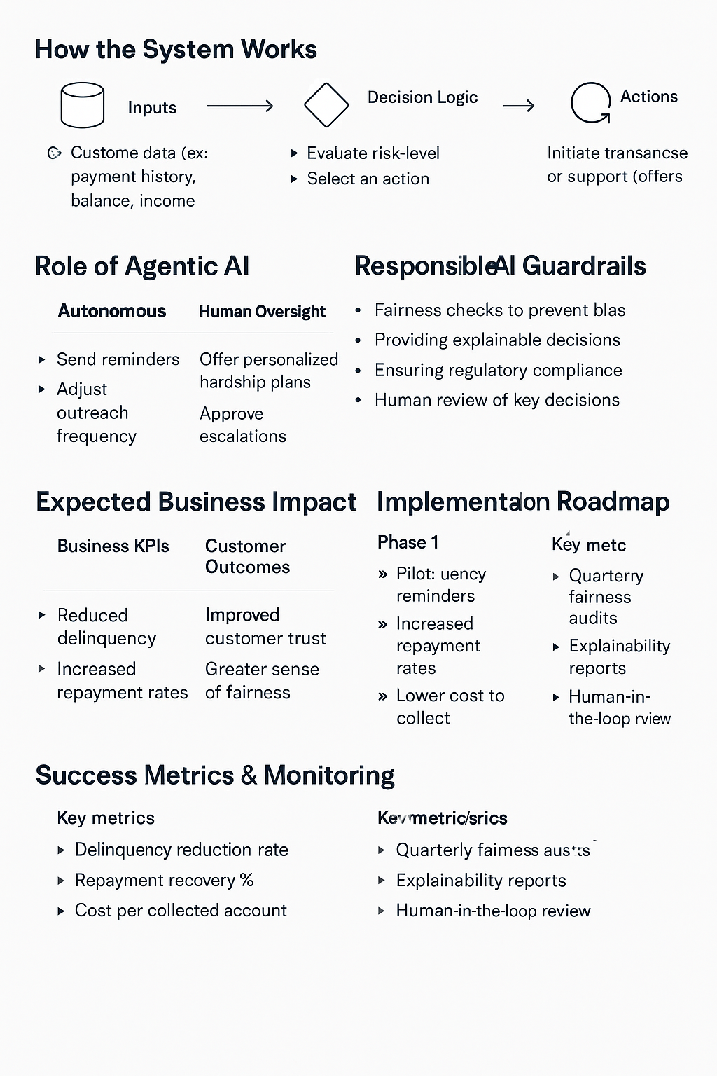
Flow Chat

