Slide 1


LOOPS
+
PLOTS
Keene Morrow
#tidytuesday @UCSB
2021-04-13

Slide 2
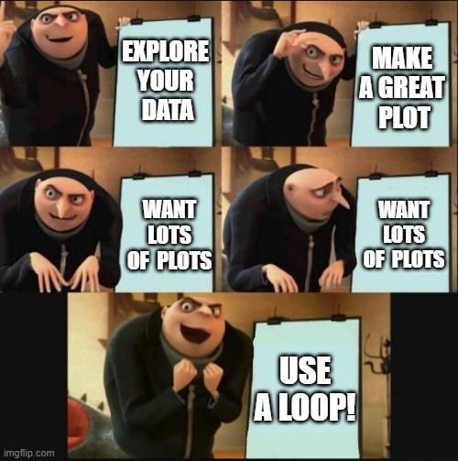
WHY BOTHER MAKING PLOTS WITH A LOOP?

Slide 3
START WITH THE PLOT
ESTABLISH WHAT YOU WANT YOUR FINAL PLOT TO LOOK LIKE FIRST
Keep in mind that your subsets will more than likely have different extents!

Slide 4

EXAMPLE DATA
Rainfall and temperature data for five cities in Australia:
Brisbane, Canberra, Melbourne, Perth, & Sydney
#tidytuesday data from 2020-01-07

Slide 5
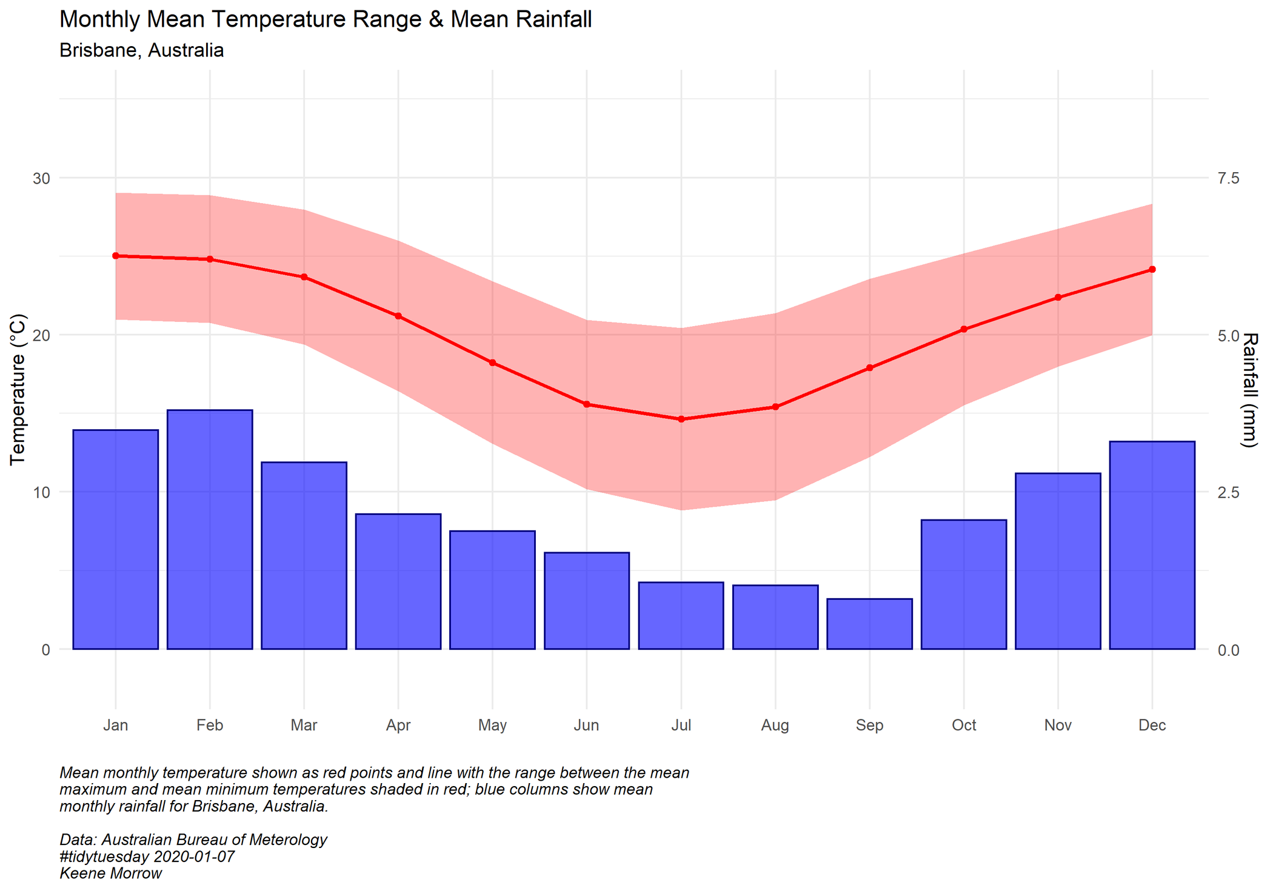

Slide 6
LOOPS IN R
01
FOR
Executes the loop command a set number of times
02
WHILE
Executes the loop command when a condition is true
03
REPEAT
Executes the loop command when a condition is true but at least once

Slide 7
LOOPS IN R
01
FOR
Executes the loop command a set number of times
02
WHILE
Executes the loop command when a condition is true
03
REPEAT
Executes the loop command when a condition is true but at least once

Slide 8
FOR LOOP STRUCTURE
for(value in sequence){
statement
}

Slide 9
BASIC FOR LOOPS
list <- c(0,1,1,3,1)
count <- 0
for(i in list){
count = count + 1)
}
print(count)
___________________________________________________________________________________________________________________________________________

Slide 10
BASIC FOR LOOPS
list <- c(0,1,1,3,1)
count <- 0
for(i in list){
count = count + 1)
}
print(count)
[1] 5
___________________________________________________________________________________________________________________________________________

Slide 11
PLANNING YOUR LOOP
01
WHAT VARIABLE DO YOU WANT TO CHANGE ACROSS YOUR PLOTS?
This will form your sequence.
02
WHERE DO YOU WANT TO USE THE INFORMATION FROM THE SEQUENCE?
The subset, a title, a caption...?
03
WHAT DO YOU WANT TO DO WITH THE OUTPUT?
Save them as images? Store them for later use?

Slide 12
PLANNING YOUR LOOP
01
WHAT VARIABLE DO YOU WANT TO CHANGE ACROSS YOUR PLOTS?
CITY
This will form your sequence.
02
WHERE DO YOU WANT TO USE THE INFORMATION FROM THE SEQUENCE?
The subset, a title, a caption...?
03
WHAT DO YOU WANT TO DO WITH THE OUTPUT?
Save them as images? Store them for later use?

Slide 13
PLANNING YOUR LOOP
01
WHAT VARIABLE DO YOU WANT TO CHANGE ACROSS YOUR PLOTS?
CITY
This will form your sequence.
SUBTITLE,
CAPTION, & FILENAME
02
WHERE DO YOU WANT TO USE THE INFORMATION FROM THE SEQUENCE?
The subset, a title, a caption...?
03
WHAT DO YOU WANT TO DO WITH THE OUTPUT?
Save them as images? Store them for later use?

Slide 14
PLANNING YOUR LOOP
01
WHAT VARIABLE DO YOU WANT TO CHANGE ACROSS YOUR PLOTS?
CITY
This will form your sequence.
SUBTITLE,
CAPTION, & FILENAME
02
WHERE DO YOU WANT TO USE THE INFORMATION FROM THE SEQUENCE?
The subset, a title, a caption...?
03
WHAT DO YOU WANT TO DO WITH THE OUTPUT?
SAVE WITH
GGSAVE
Save them as images? Store them for later use?

Slide 15
BUILDING THE LOOP
01
ESTABLISH THE SEQUENCE USING THE VARIABLE YOU WANT TO CHANGE
cities <- unique(data$city)
> print(cities)
[1] "Brisbane" "Canberra" "Melbourne" "Perth" "Sydney"

Slide 16
BUILDING THE LOOP
02
SET UP THE LOOP TO PROGRESS ALONG THE SEQUENCE
for(i in seq_along(cities)){
...
}

Slide 17
BUILDING THE LOOP
03
GET THE RIGHT DATA
for(i in seq_along(cities)){
ggplot(data =
subset(data,
data$city ==
cities[i])) + ...
}

Slide 18
BUILDING THE LOOP
03
GET THE RIGHT DATA
for(i in seq_along(cities)){
ggplot(data =
subset(data,
data$city ==
cities[i])) + ...
}

Slide 19
BUILDING THE LOOP
04
USE THE RIGHT LABELS
for(i in seq_along(cities)){
...
labs(subtitle =
paste(cities[i],",
Australia", sep = "")
}

Slide 20
BUILDING THE LOOP
04
USE THE RIGHT LABELS
for(i in seq_along(cities)){
...
labs(subtitle =
paste(cities[i],",
Australia", sep = "")
}

Slide 21
BUILDING THE LOOP
04
USE THE RIGHT LABELS
ggsave(here::here("figures",
paste(cities[i],
"_climate.png", sep = "")),
height = 7, width = 7)

Slide 22
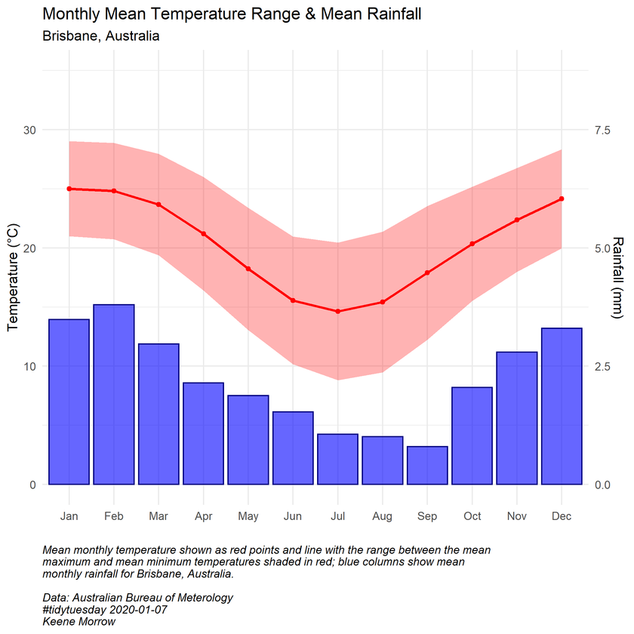
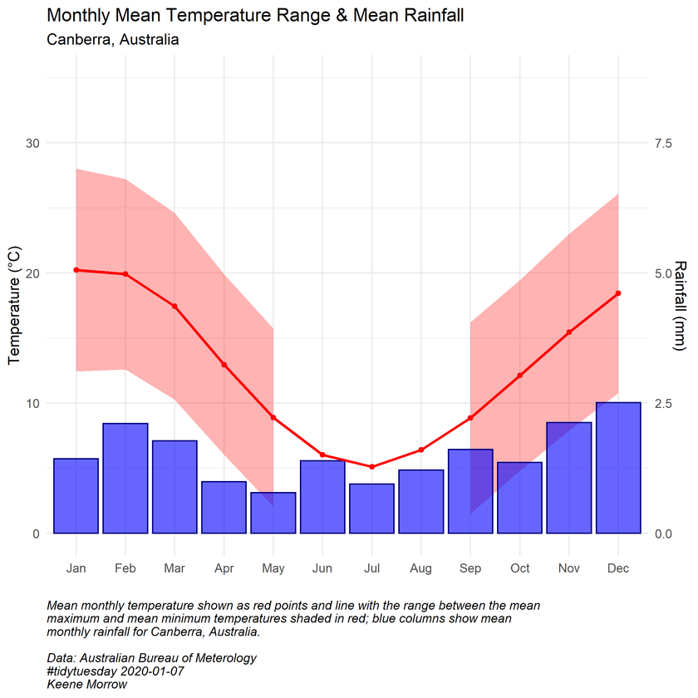
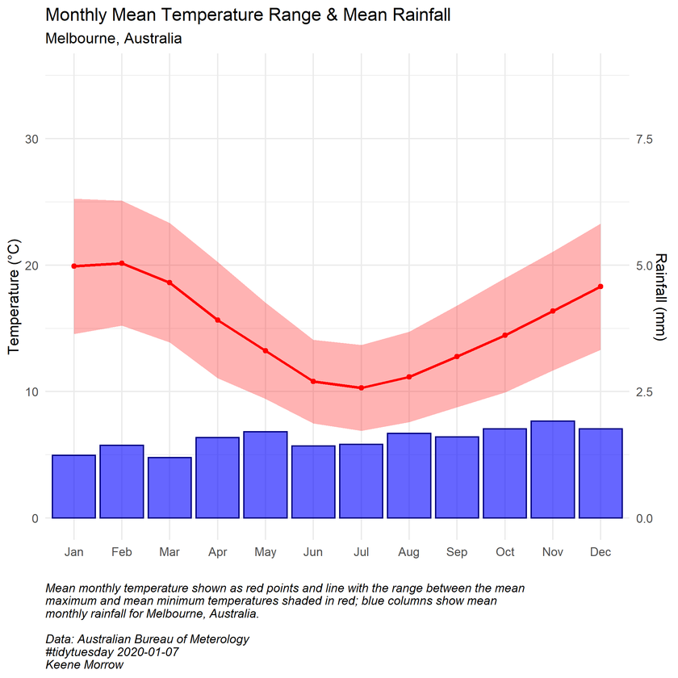
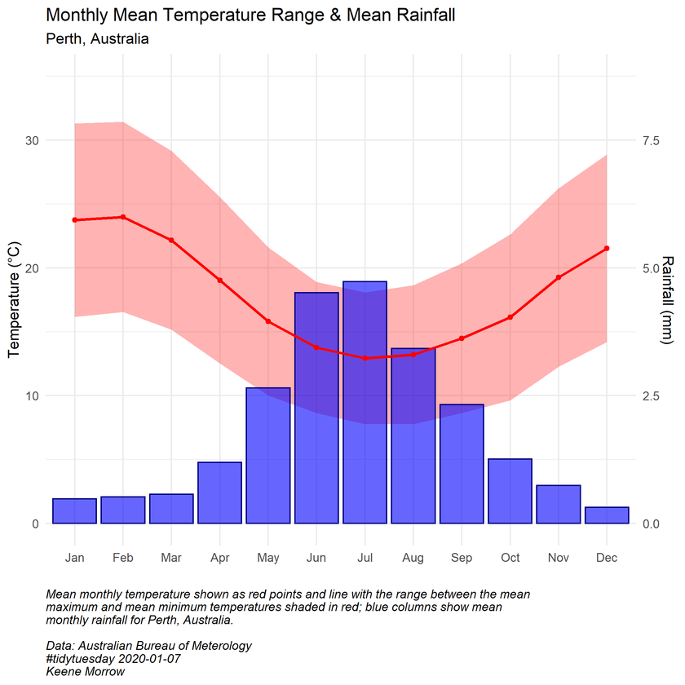
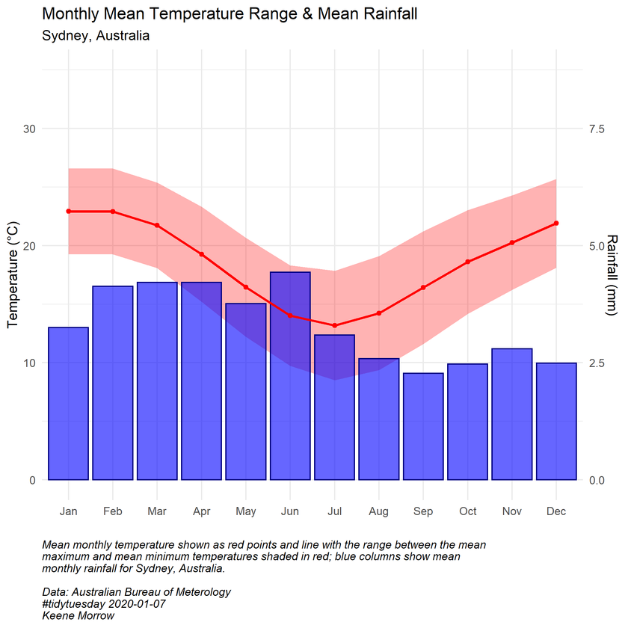
BUILDING THE LOOP
05
TEST IT OUT

Slide 23
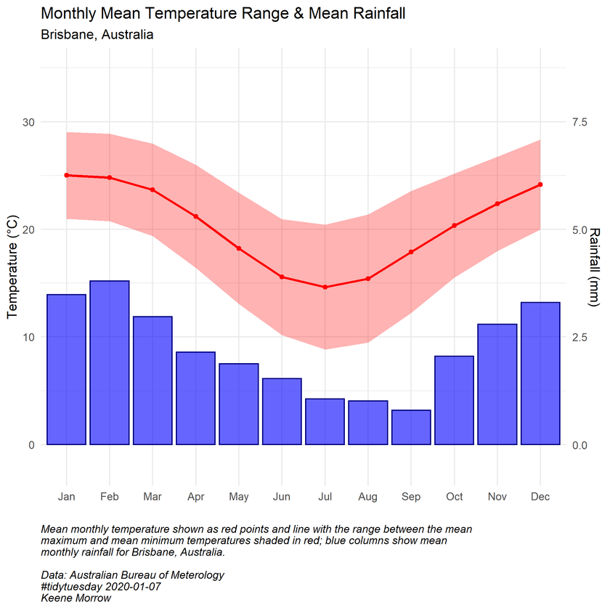
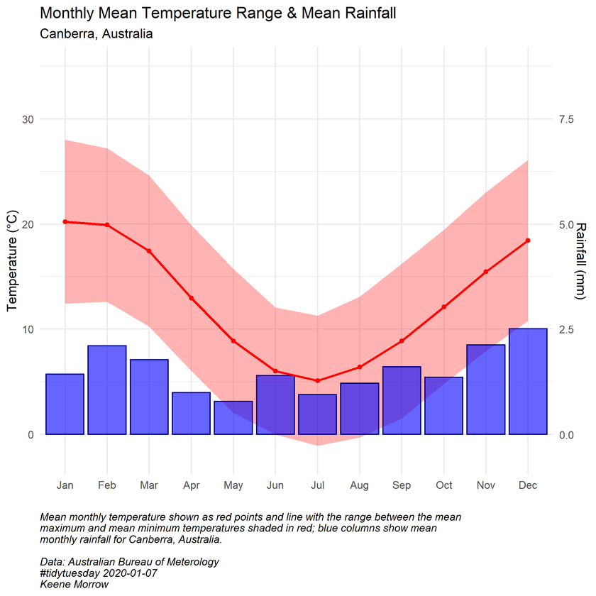
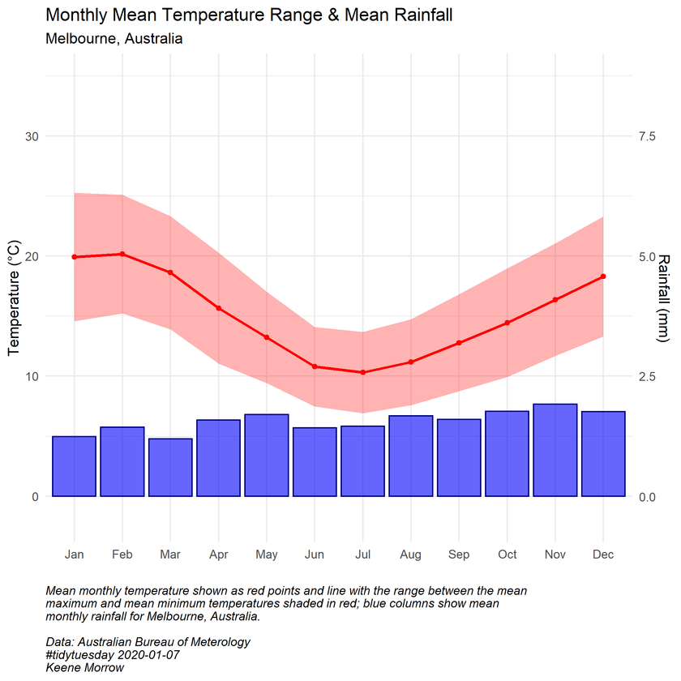
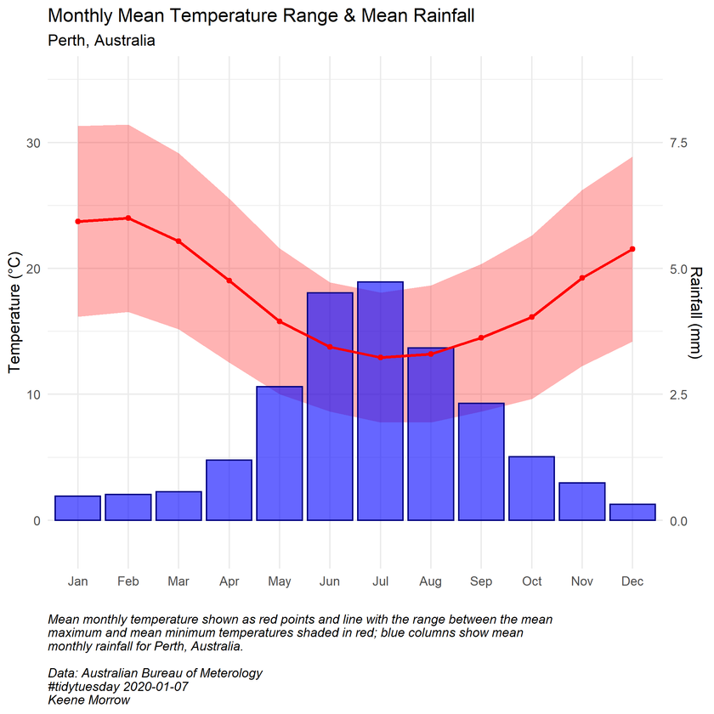
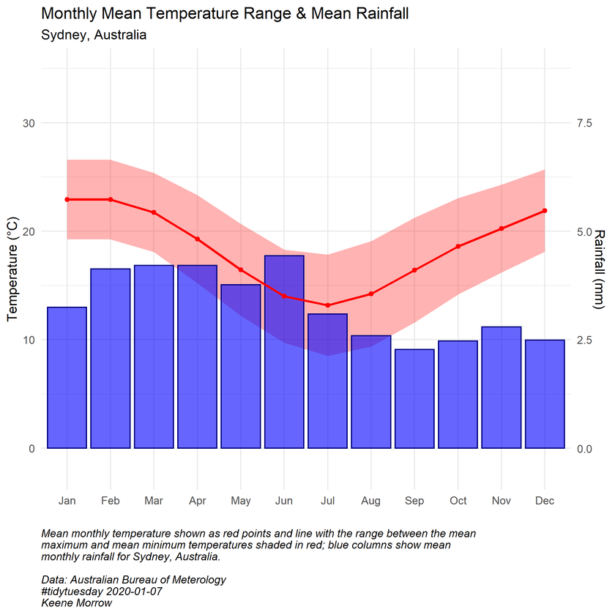
BUILDING THE LOOP
06
TROUBLESHOOT

Slide 24
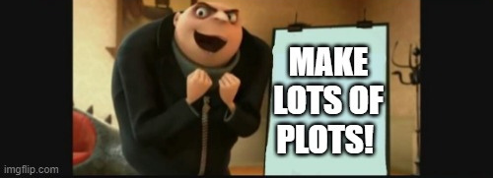
BUILDING THE LOOP
07

Slide 26
KEY FUNCTIONS
01
UNIQUE()
We easily made a sequence of cities using:
unique(data$city)
02
FOR LOOP
We looped through the list of cities using:
for(i in seq_along(cities){...}
03
SUBSET()
We plotted just the data for the city using:
subset(data, data$city == cities[i]))
04
PASTE() + cities[i]
We referenced the name of the city using:
paste(cities[i], ", Australia", sep = " ")

Slide 27


FIND THE FULL THING ON
GITHUB.COM/KAMORROW/TIDYTUESDAY_2020-01-07

