Slide 1
Training Materials
Gmail https://mail.google.com/
Alexa Developer https://developer.amazon.com/alexa/console/ask
GitHub https://github.com/

Slide 2
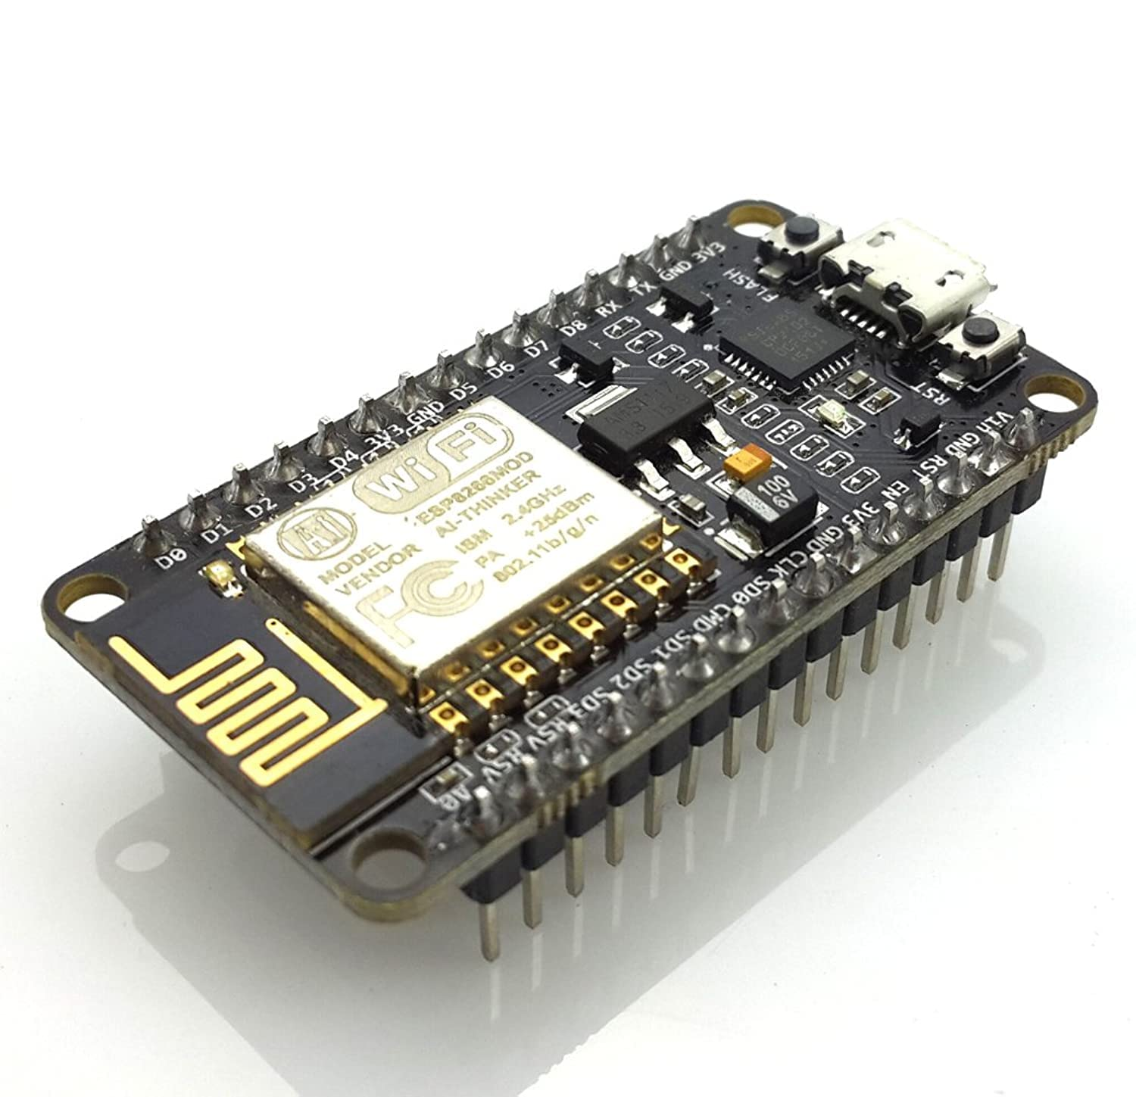
ESP8266 NodeMCU

Slide 3
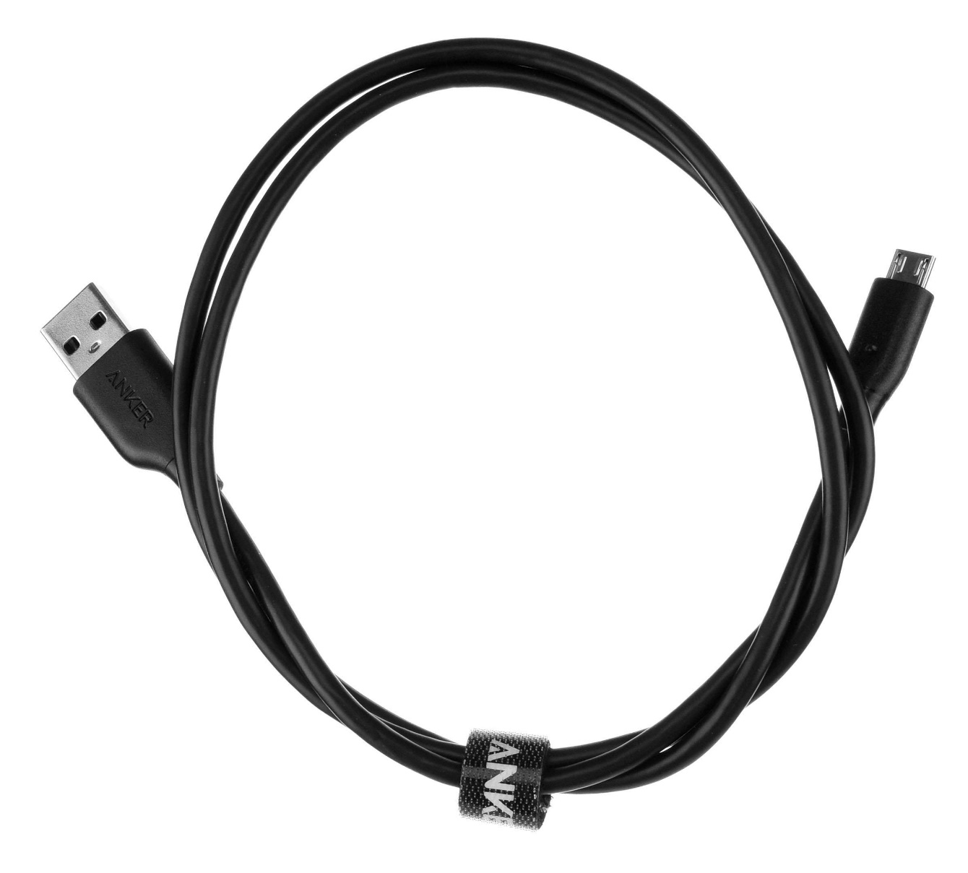
Micro USB Cable

Slide 4
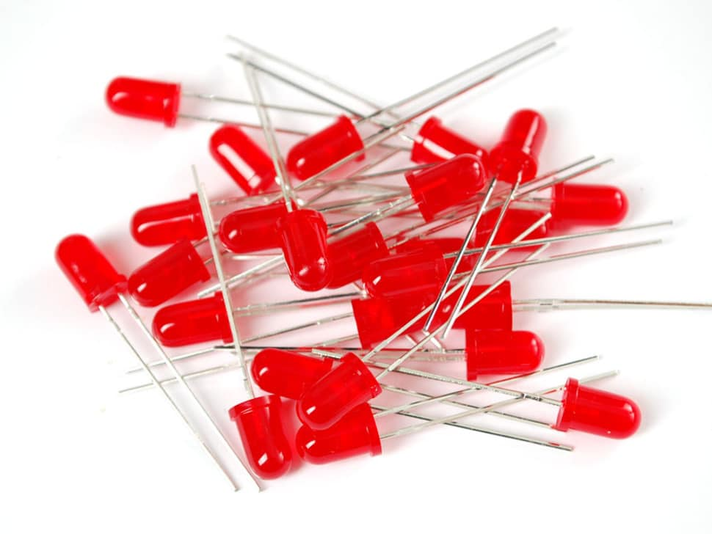
ESP8266 NodeMCU

Slide 5
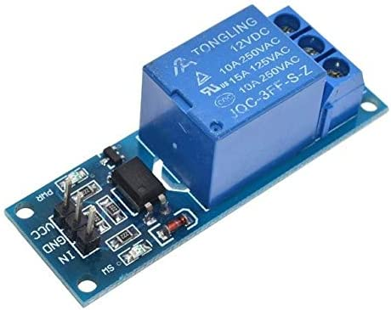
Single Channel Switch Relay

Slide 6
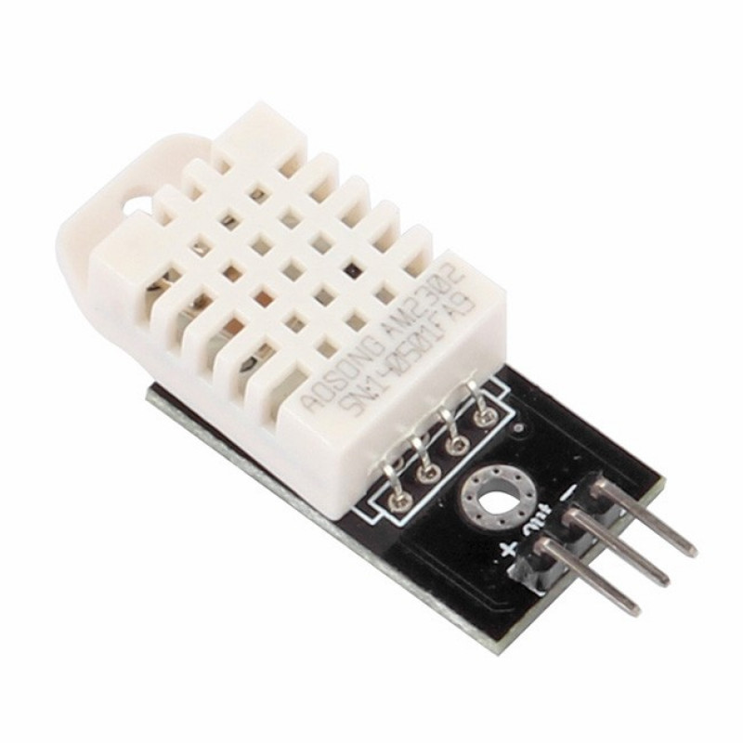
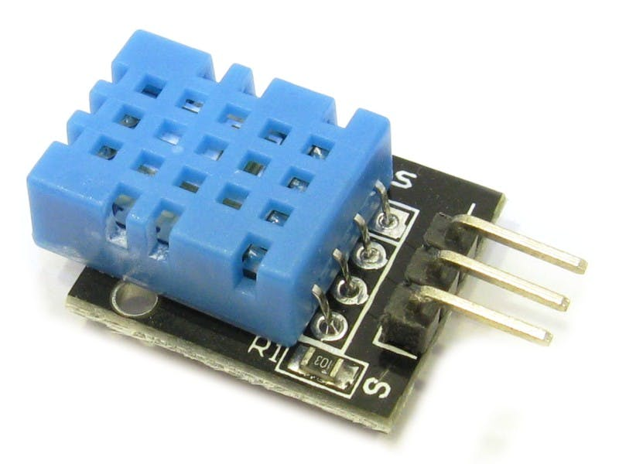
DHT 11
DHT 22
DHT Sensors

Slide 7
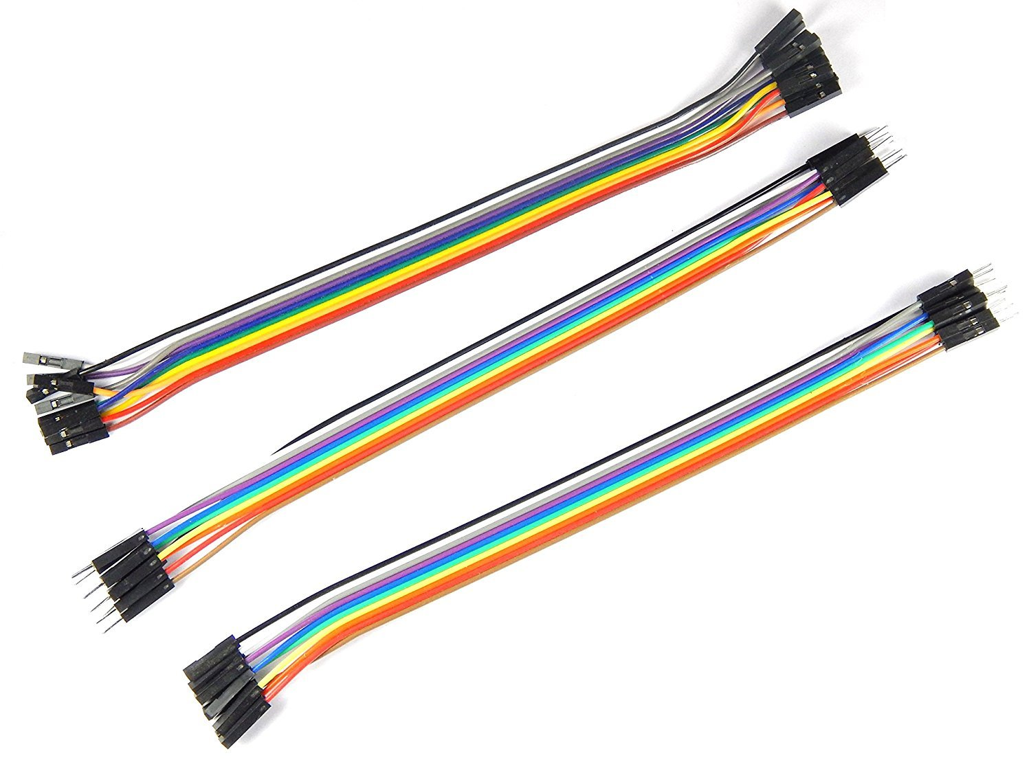
Jumper Wires

Slide 8
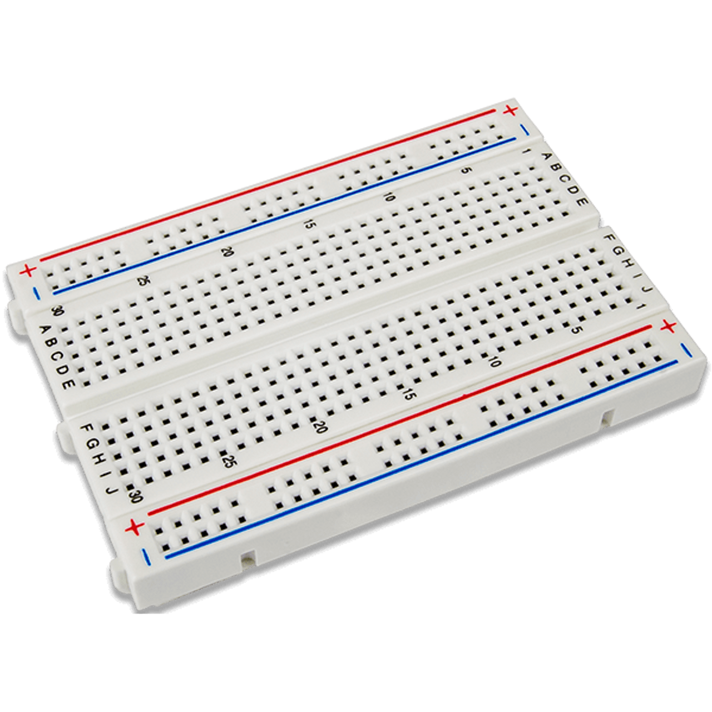
Breadboard

Slide 9
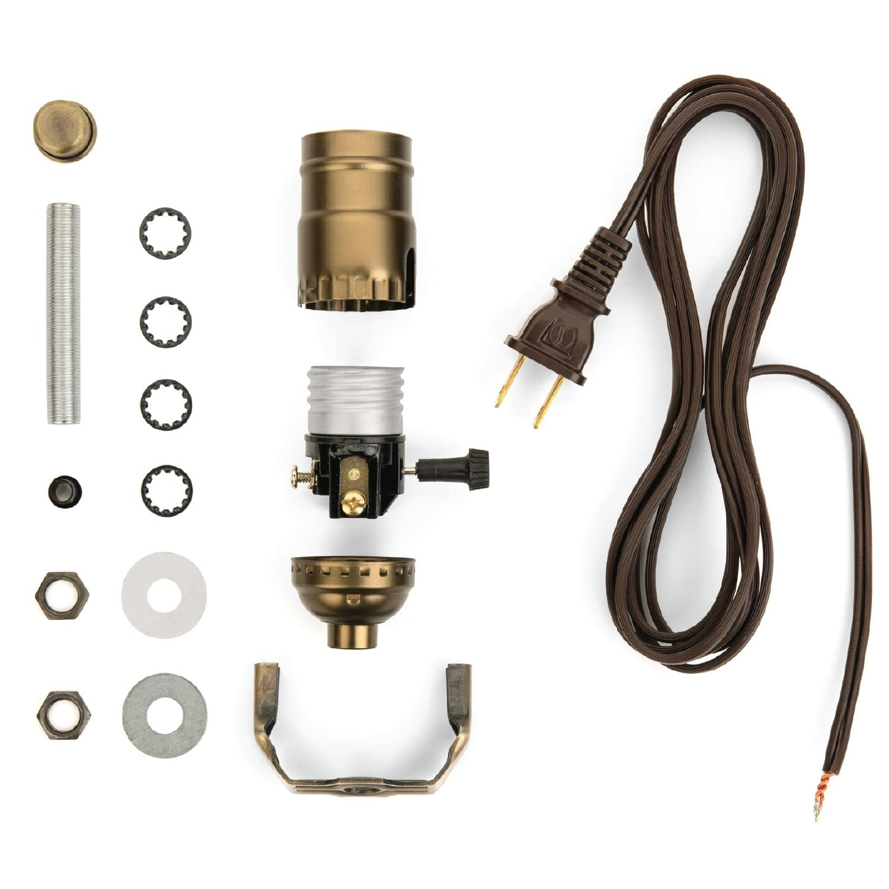

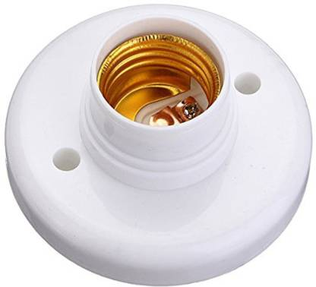
Light Bulb 220VAC
AC Wire W/ Plug
Bulb Socket

Slide 10
