Slide 1
Training Materials

Slide 2
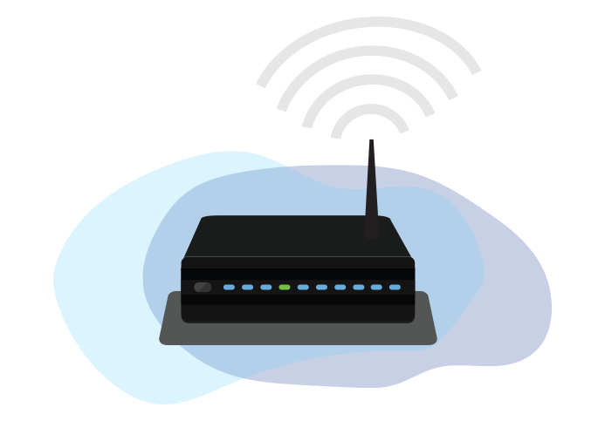
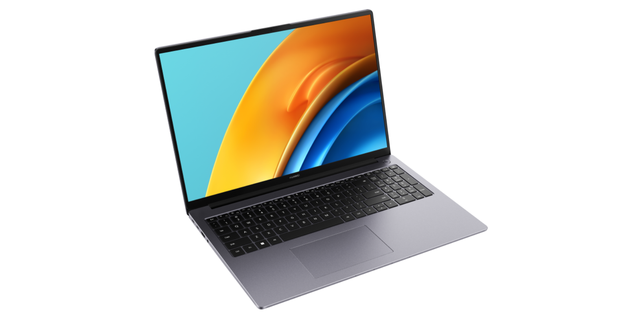
LAPTOP &
WIRELESS ROUTER W/INTERNET

Slide 3
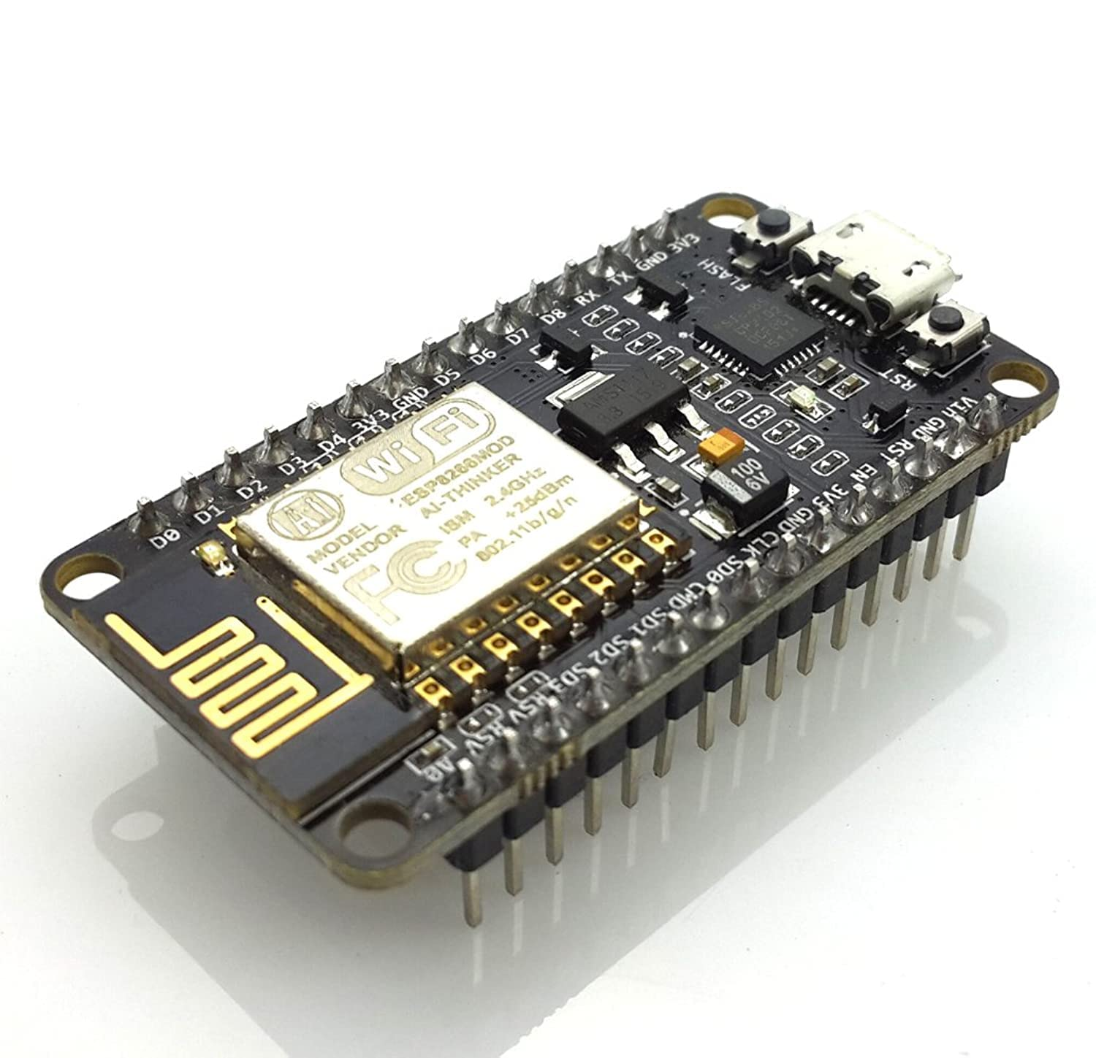
ESP8266 NodeMCU

Slide 4
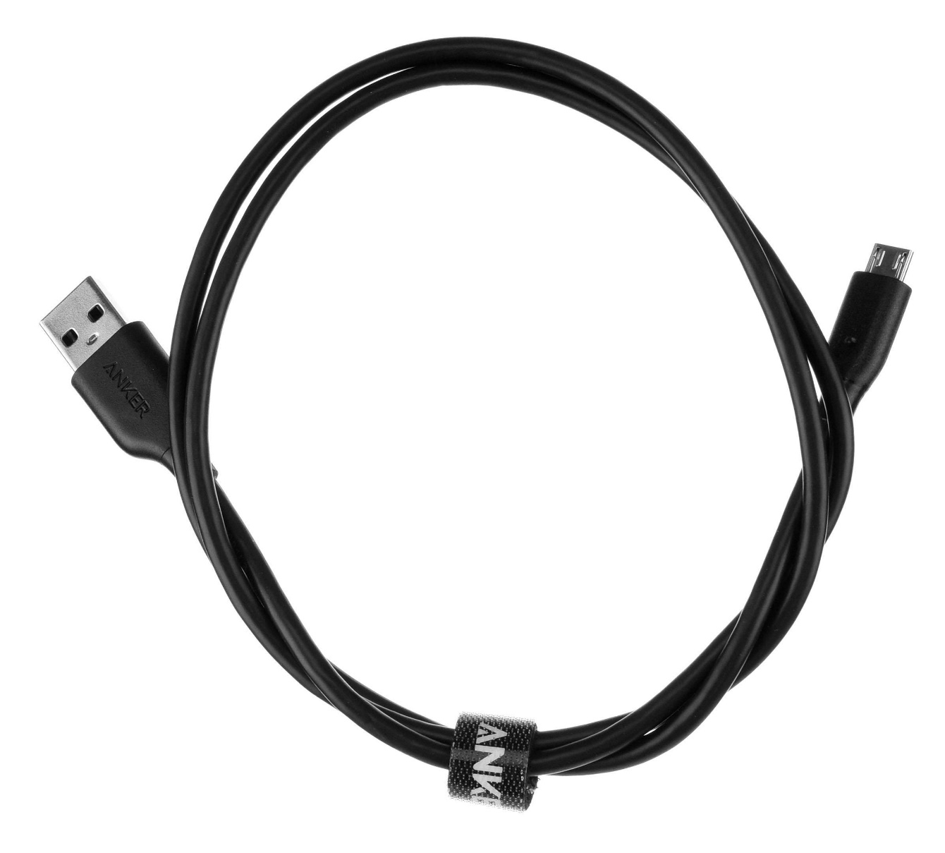
Micro USB Cable

Slide 5
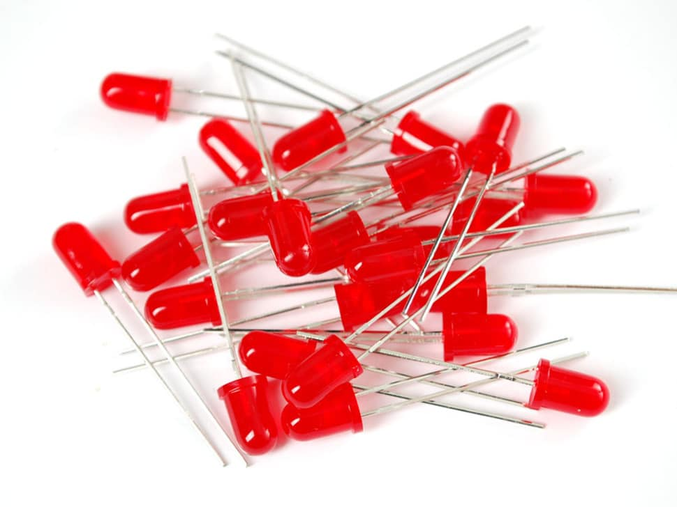
LEDs

Slide 6
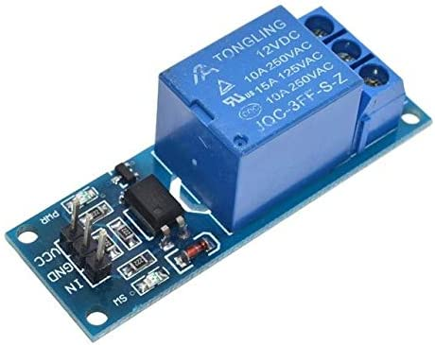
Single Channel Switch Relay

Slide 7
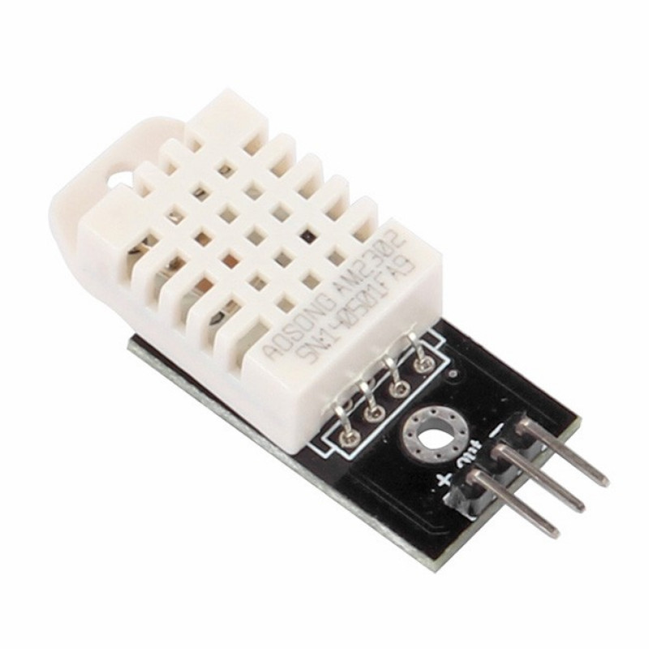
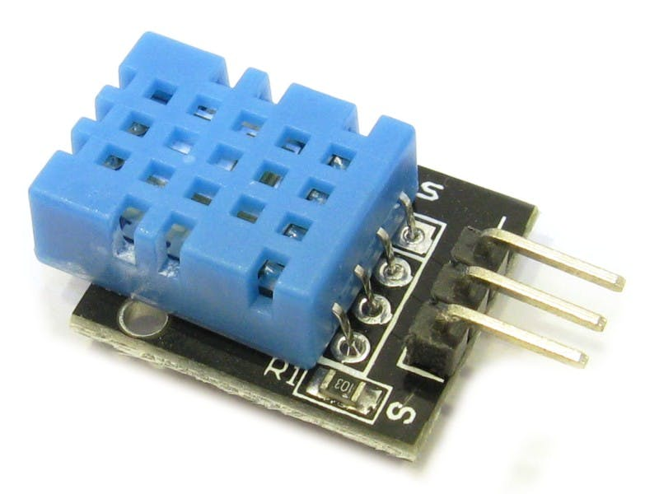
DHT 11
DHT 22
DHT Sensors

Slide 8
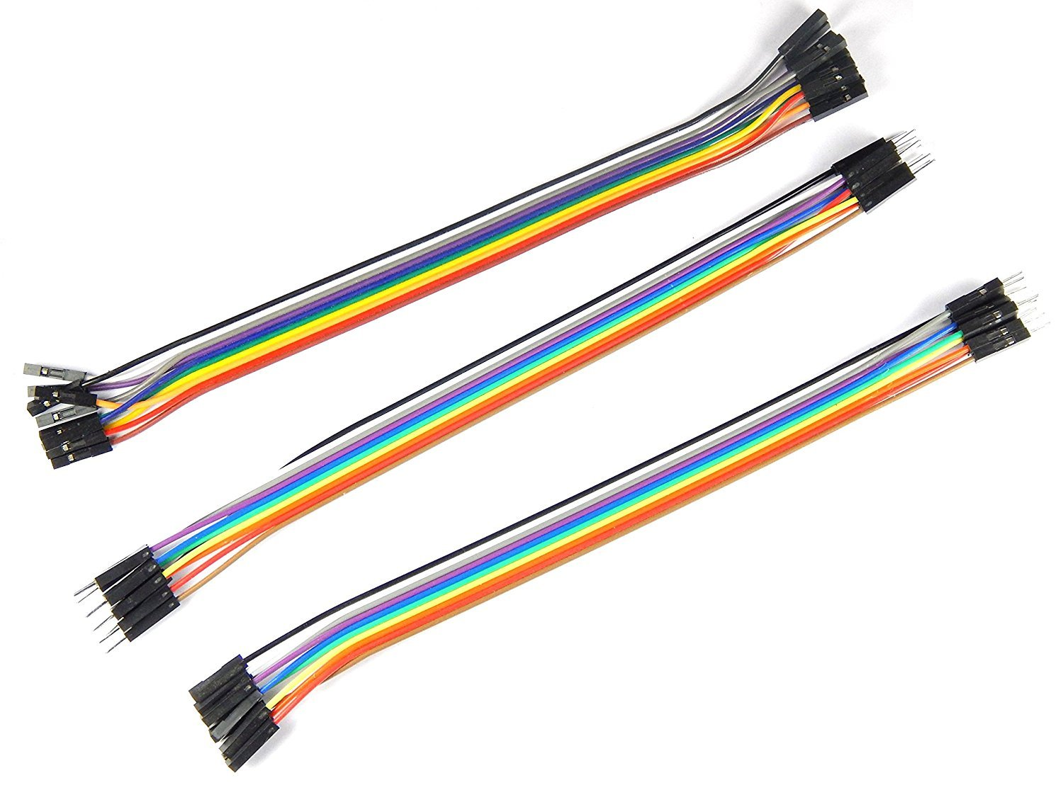
Jumper Wires

Slide 9
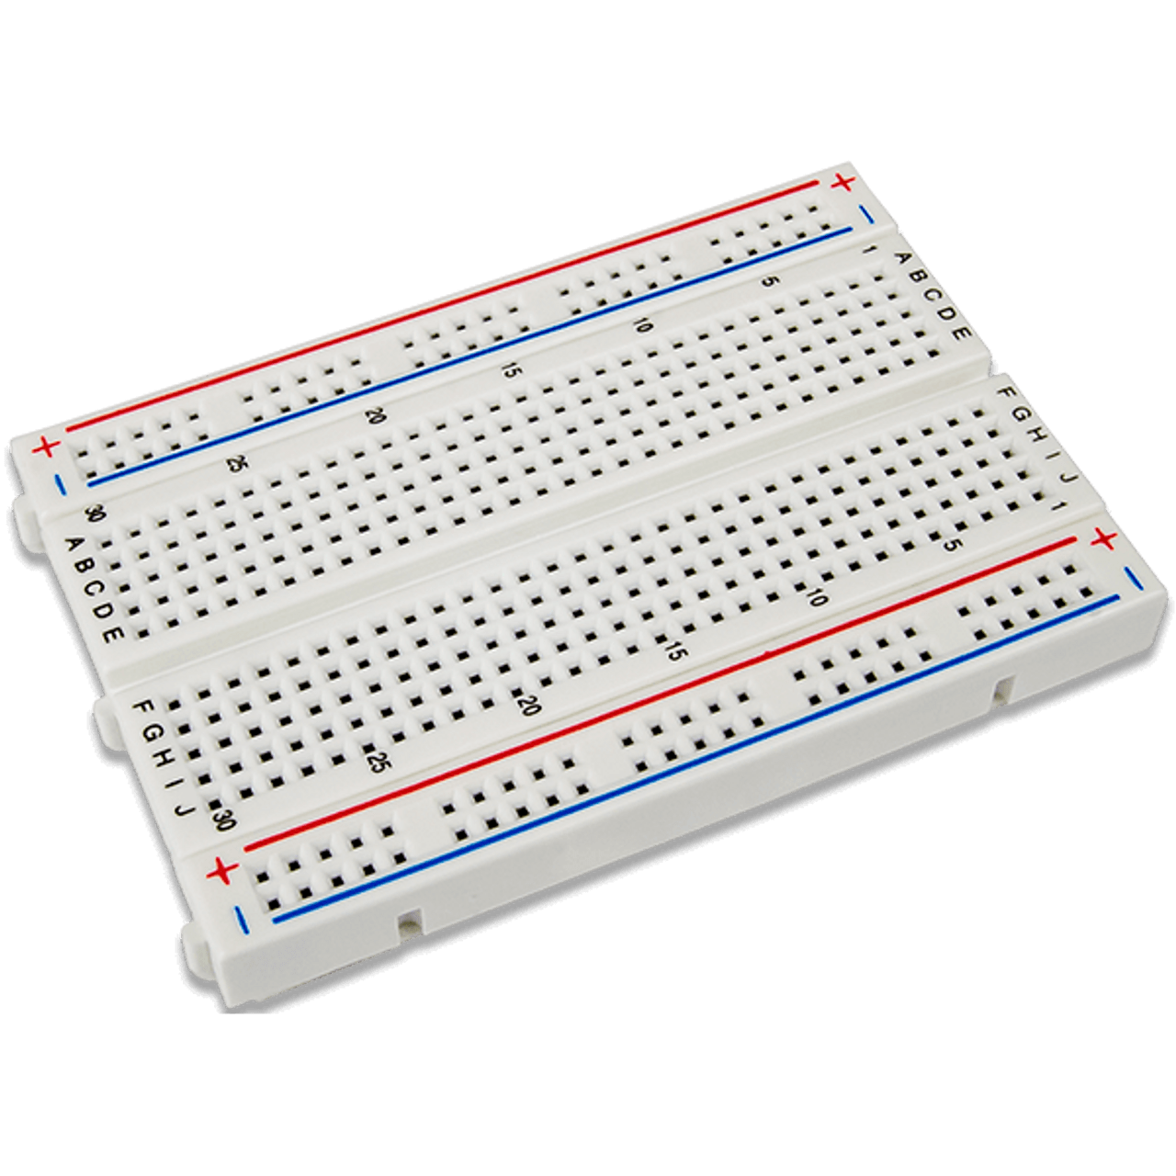
Breadboard

Slide 10
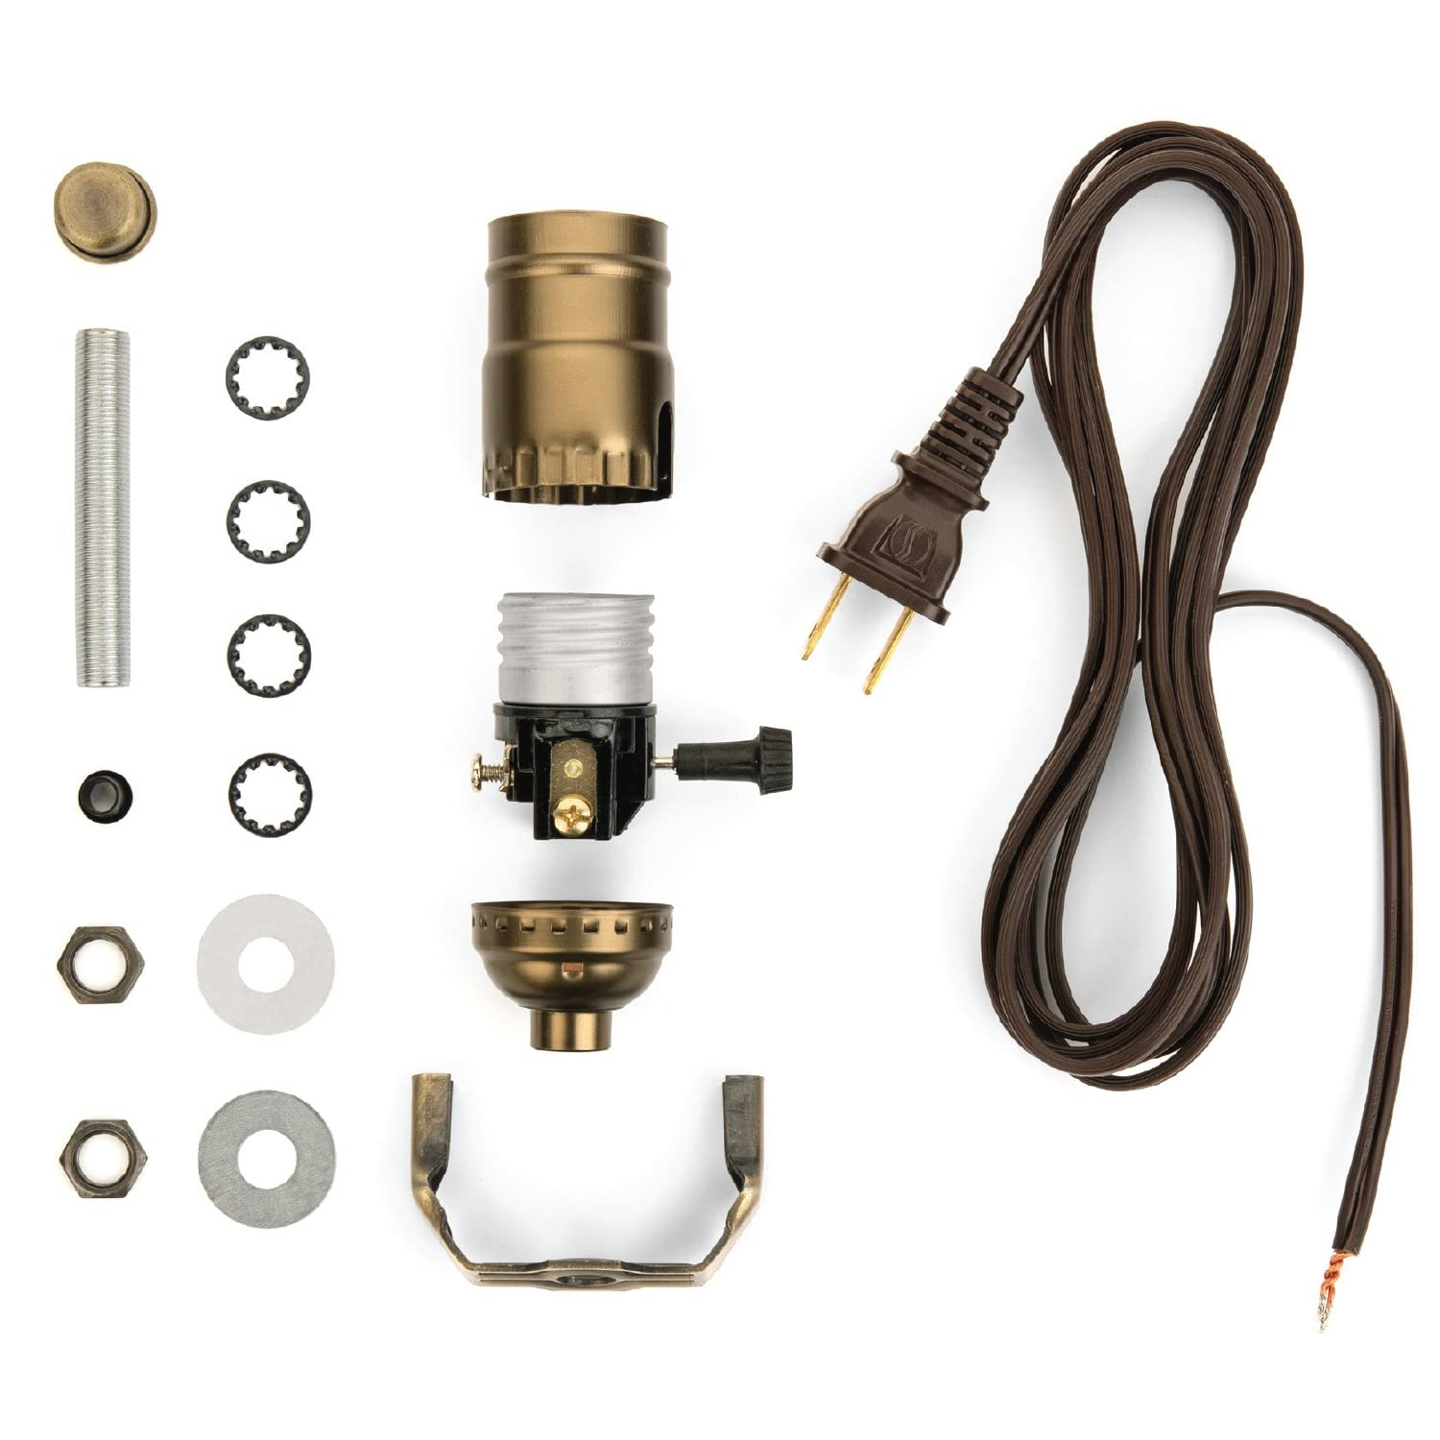

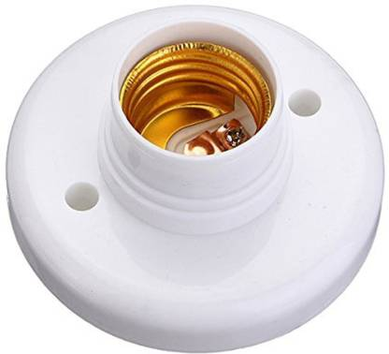
Light Bulb 220VAC
AC Wire W/ Plug
Bulb Socket

Slide 11
