Slide 1
Deep Learning
CNN
Gerardo Caracas
Boise State University

Slide 2
What will I learn today?
What can I do with CNN
Classify an animal via CNN

Slide 3
CNN is used mostly in
Computer vision
Natural language text

Slide 4
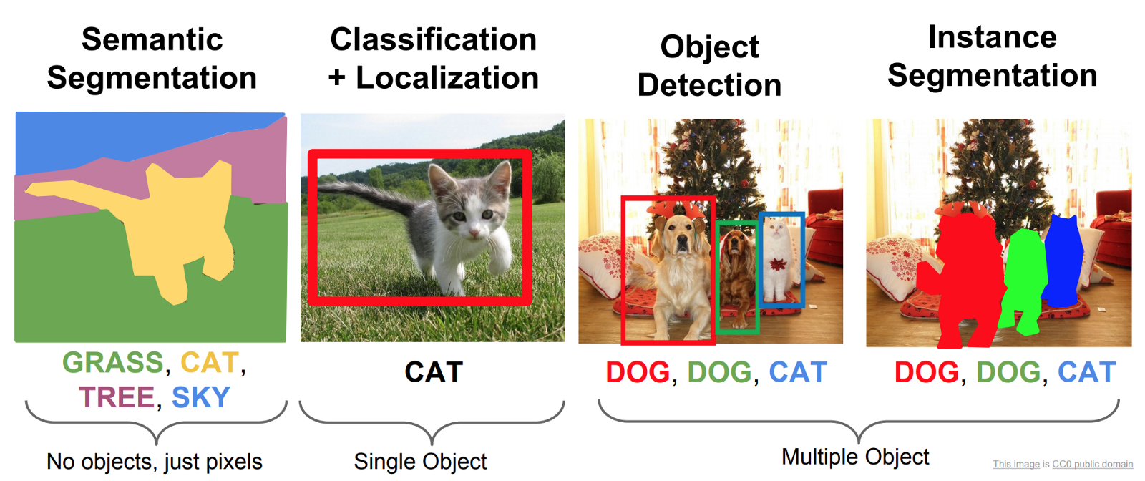
Usages

Slide 5
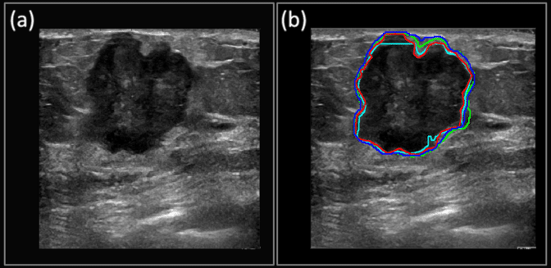
Usages

Slide 6
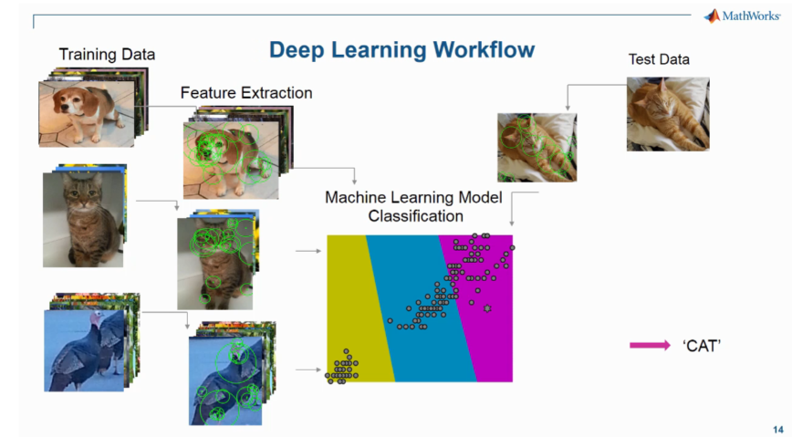
TRAINING
Source: MathWorks

Slide 7
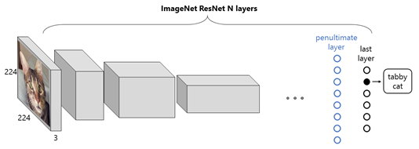
Knowledge transfer

Slide 8
What is a kernel?

Slide 9
Thank You

