Slide 1
Regular Expressions
/^wtf\?+/ig

Slide 2
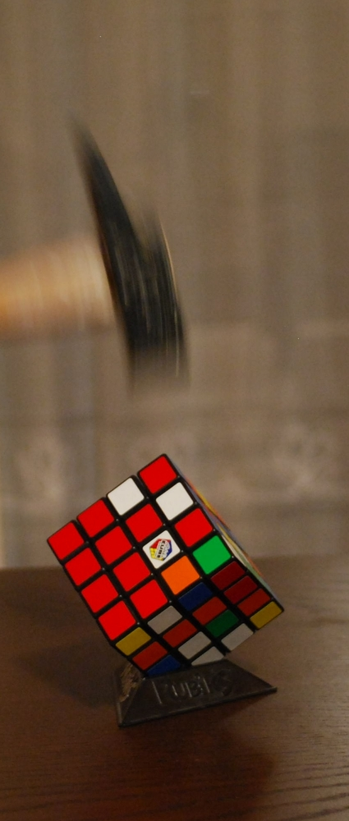
Regular Expressions
At the end of this talk, I hope you love them, but remember the saying:
”If all you have is a hammer,
Everything looks like a nail.”
by Somebody
Do not overuse them, neither try to put them everywhere:
”Some people, when confronted with a problem, think "I know, I'll use regular expressions." Now they have two problems.”
by Jamie Zawinski
http://www.flickr.com/photos/kiusap/7932290836

Slide 3
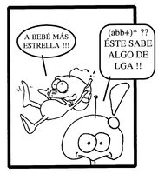
You already know (some) theory
Based on regular grammars
Historically, a big mindfuck for new students
This slide is just a poor excuse to include the following image
Let's put some links
  Wikipedia
  The true power of regex (amazing)
LGA = Languages, Grammars and Automatas
(taken from l'Oasi,any VI, número 16, desembre 2000)

Slide 4
Basics I
A letter (or number) or fixed expression matches itself in the same order
  So the regex abc123 just matches the text abc123 but not cba312 nor 123abc
Spaces also count!
  Regex 'a c' matches the text 'a c' but not 'ac' (quotes included for readability only)
A dot is a special character: matches any character
  So regex . matches either a, b, c, 3 or even a space

Slide 5
Basics II
You can mix them
regex | matches | NOT matches
a.c | Abc, aac, a c, a9c, a.c | Ac
a.b.c | Axbyc, a b c, aabcc | Abc, abcbc
123...abc | 123fooabc | 123foooabc

Slide 6
Quantifiers I
Quantifiers affect the number of times the expression on the left can occur
  Do not confuse them with shell wildcards!
Quantifier | Number of repetitions
* | From 0 to infinite
+ | From 1 to infinite
? | Either 0 or 1
{3} | Exactly 3 times (any number works)
{3,6} | Between 3 and 6 (included)
{3,} | At least 3
{,3} | Up to 3

Slide 7
Quantifiers II
Regex | Means | Good example | NOT means | Bad example
a* | A series of 0 a's, 1 a, 2 a's, ... | (empty), a, aa, aaa, aaaa, ... | An 'a' followed by anything | Abc, abracadabra
a? | 0 or 1 a | (empty), a | An 'a' follow by another character | Aa, ab
ab* | An 'a' followed by any number (0 included) number of b's | A, ab, abb, abbb, ... | The text 'ab' followed by anything | Abc, abracadabra
a*.jpg | Any number of 'a' followed by a character followed by the text jpg | Xjpg, aaaa jpg, a.jpg | Jpg images that start with 'a' | abc.jpg
.* | Any character any times (not necessarily the same character) | Abcdef, (empty), xxx, foo, 123 abc, ... | Something that starts with a dot (hidden files maybe?) | .bashrc
a.*\.jpg | An a, any combination of characters, a literal dot and the text jpg | abc.jpg | I don't know... | b.jpg, abc.gif

Slide 8
Basics III - escaping
If we want to match a dot, asterisk or any other character that have a special meaning, we need to escape it with a backslash \ (see last example from previous slide)

Slide 9
Basics IV - position
Sometimes you may want to match an expression only in certain positions. The following may help:
^ => start of line
^bar matches in 'bar manolo' but not in 'foobar'.
$ => end of line
bar$ matches in 'foobar' but not in 'bar manolo'
^bar$ only matches when the full line just contains 'bar'

Slide 10
Basics V – more positions
\b => word boundary
\bbar\b matches the word bar in any position, like 'bar Manolo', 'come to the bar, Manolo' or 'I don't remember what happened in that bar.', but not foobar
bar\b matches the text 'bar' when it is ending a word. So it will match 'bar' or 'foobar', but neither 'barista' nor 'cabaret'

Slide 11
Groups I
A group means match this or this or this (or this or ...) character
[abc] => either 'a' or 'b' or 'c', but just one of them
[abc]+ => A series of 'a's, 'b's and/or 'c's, in any order, at least one (a, b, c, aa, ab, ac, ba, bc, ca, abcbabbbcba)
[abc]{4} a combination of four letters, only 'a's, 'b's or 'c's. Equivalent to [abc][abc][abc][abc] (aaaa, abbb, abcc, abcb, caca, ...)

Slide 12
Groups II
It's possible to have ranges of characters in groups:
[a-f] => a char from a to f, just one. Equivalent to [abcdef]
[0-9] => one digit number
[69][0-9]{8} => A mobile or landline phone number (numbers of 9 digits either starting by 6 or 9)

Slide 13
Groups III - Negating
You can also match a character NOT in a group:
[^abc] => not an 'a' nor a 'b' nor a 'c' (x, y, z, 1, 2, (space), …)
[^abc]+ => One or more characters, neither of them being an 'a' nor a 'b' nor a 'c' (xyz, 123, x, %&_)

