Slide 1
Blood Brain Barrier Predictions
Kamran Haider
11/21/2017

Slide 2
Summary
Two different representations of the data set were generated:
Molecular Descriptors
Morgan Fingerprints
Two classifiers were chosen:
A logistic regression model
An artificial neural network
Performance was evaluated based on a training(70%)/test(30) split where test set was unseen by the model.
ROC area under curve (AUC) score was used as a performance metric.

Slide 3
Representation 1
As a starting point, the SMILES data were used to generate molecular descriptors.
The choice of descriptors was based on the list of RDKit molecular descriptors and cover features such size, molecular weight, number of aromatic rings, logP.

Slide 4
Model
A Logistic Regression classifier was chosen as a starting model.
In short, the model works by calculating a weighted sum of input features and a bias term and using the sigmoid ‘squishing’ to obtain the probability of an instance belonging to the positive class.

Slide 5
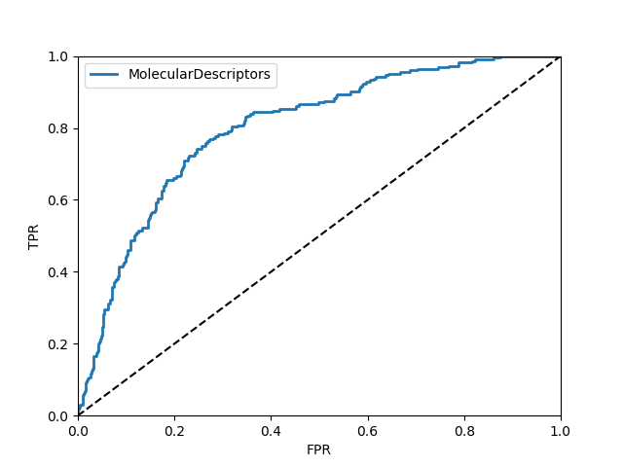
Model performance
Model performance was evaluated with 100 iterations over the dataset, each time with 70/30 training/test split to calculate average performance of the model.
ROC AUC score: 0.68 ± 0.02
Statistically significant performance relative to the Null Model (where category labels are randomly assigned).

Slide 6
Model Diagnosis
The learning curve shows that model is essentially ‘under fitting’ the data.
Performance quickly flattens out, adding more data wouldn't help here.
Perhaps more complex model or addition of features will help?

Slide 7
Some Additional Model Building
Intrigued by this dataset and the results so far, I tried Artificial Neural Networks.
I also added an additional data representation, namely Fingerprints.
It is better to systematically approach the improvement in an ML project.
Started with a single layer architecture, 1 RELU hidden layer with 64 units and on output Sigmoid activation layer.

Slide 8
Artificial Neural Networks Performance
Molecular Descriptors
Morgan Fingerprints
ROC AUC: 0.93% (+/- 0.02)
ROC AUC: 0.84% (+/- 0.05%)

Slide 9
Summary
Logistic Regression provided a reasonable starting point.
The under-fitting suggested that more complex model or more features might perform better.
A single-layer artificial Neural Network was chosen as the next model.
An additional data representation was used: Morgan(ECFP) fingerprints that resulted in the best performance relative to other models.

Slide 10
Outlook
It is intriguing that the Fingerprints, which are essentially bit vectors worked well.
The next question: Can we used 2-D images of chemical structure?
I have written the code to generate 2-D images for the datasets.
Next steps:
I created a toy implementation of Deep Layer Neural Networks (based on a programming assignment from Coursera deep learning course) to diver deeper and develop a simple image recognition approach for blood brain barrier challenge.
I would love to improve and discuss this as an example of building, simple, testable prototypes for machine learning code.

Slide 11
Thanks …
For giving me an opportunity to work on this exciting problem.
As an aspiring machine (deep) learning expert, I would be thrilled to get a chance to explain in more detail, how I approached this problem.

