Slide 1
Presentation on
Garment Management System

Slide 2
Scenario
Consider a Garment system where foreign buyer gives some order to the garment. The garment management receives the order and distributes the work to its employees. After the completion of work Tester (QC) checks the work and finally shipment (delivery) has been done by the management. (All the users need to register into the system).
Now prepare Logical design for the system and then develop the software for this system (according to the logical design).

Slide 3
Row Requirement
We have to make a Garment Management System.
All user must register into this system.
Foreign Buyer gives order.
Garment management can receive this order.
Management distributes the work to its employee.
Work Tester (QC) checks the work according to order.
Satisfied product are delivered by the management.

Slide 4
Software Requirement Specification
SRS id | SRS Name | Description | SRS Type | Priority
SRS-01 | Garment System | We have to make a Garment System. | FR | HIGH
SRS-02 | User Registration | All user must register into this system to use. | FR | HIGH
SRS-03 | Order giving | Foreign Buyer gives order. | FR | HIGH
SRS-04 | Order receiving | Garment management receives this order. | FR | HIGH
SRS-05 | Work distribution | Management distributes the work to its employee. | FR | MODERITE
SRS-06 | Product checking | Work Tester (QC) checks the work according to order. | NFR | HIGH
SRS-07 | Product delivery | Satisfied product are delivered by the management | FR | HIGH

Slide 5
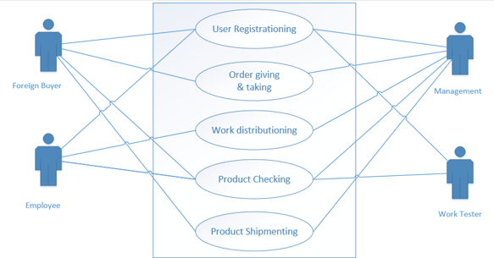
Use Case Diagram

Slide 6
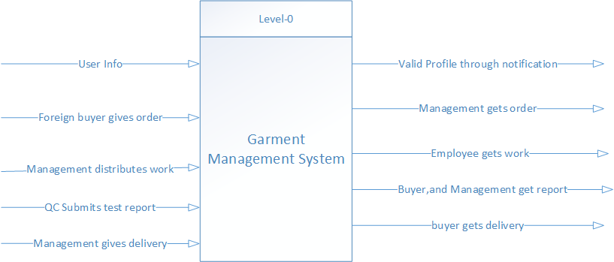
Context Diagram

Slide 7
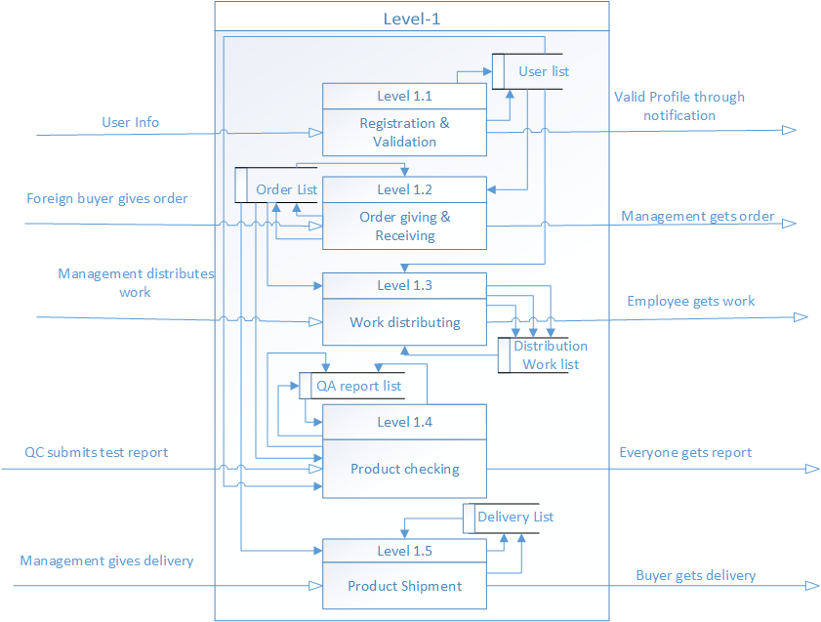
Level 1 DFD

Slide 8
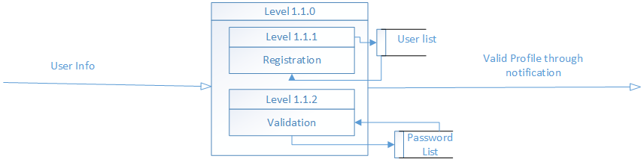
For further understanding process no 1.1 is divided into two processes in Level 2

Slide 9
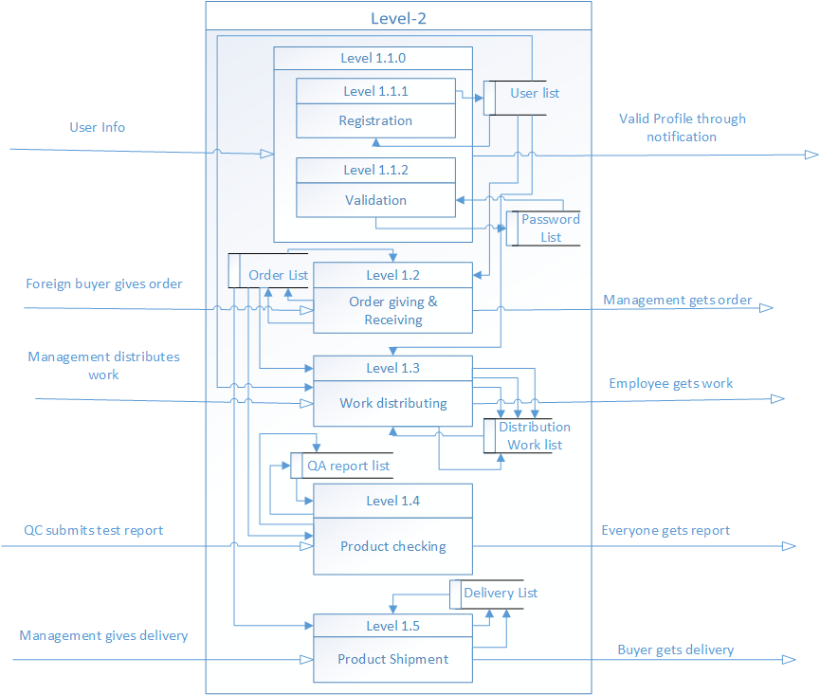
Level 2 DFD

Slide 10
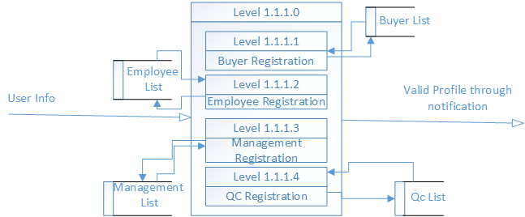
For further understanding process no 1.1.1 is divided into four processes in Level 3

Slide 11
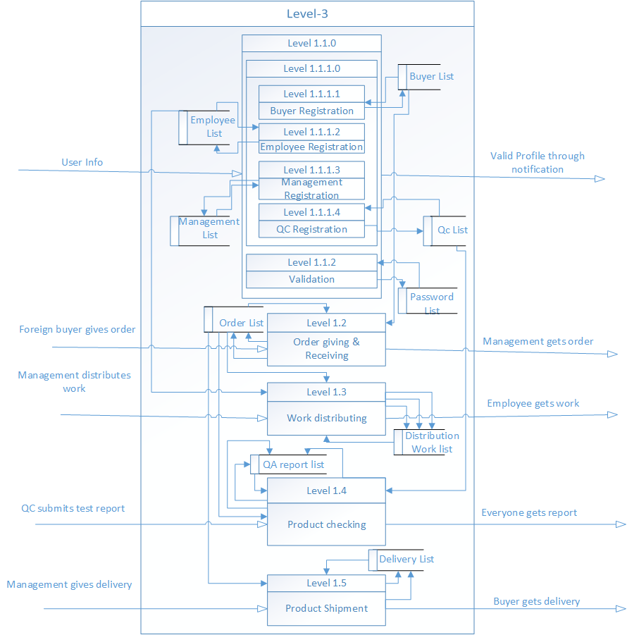
Level 3 DFD

Slide 12
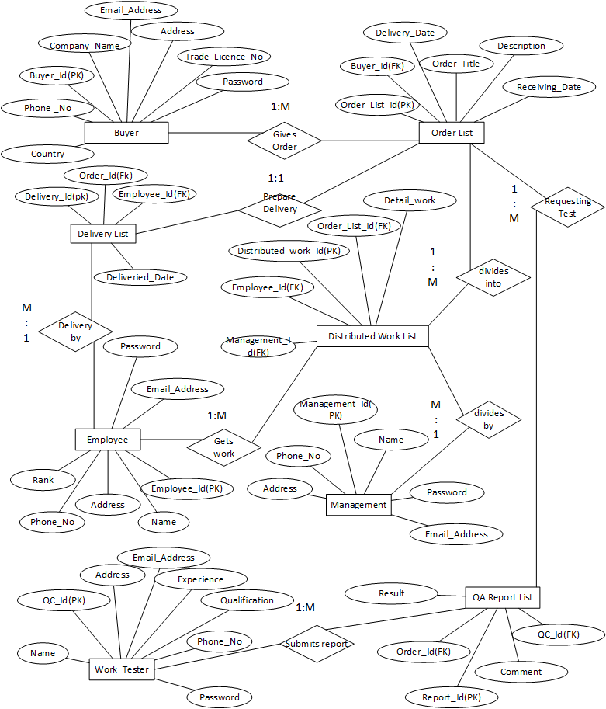
Entity Relationship Diagram

Slide 13
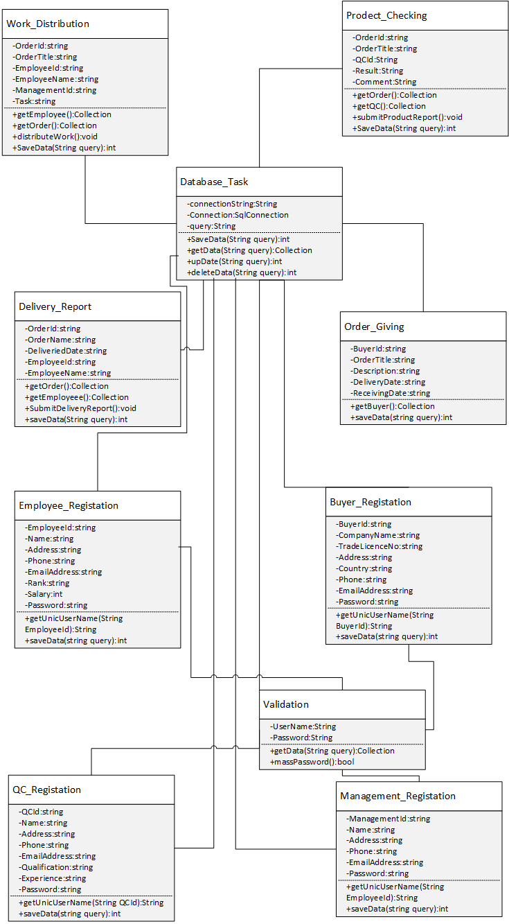
Class Diagram

