Slide 1
git
Presenter: kamraN

Slide 2
What is git?

Slide 3
Version Control
What is a Version Control System?
Types of Version Control Systems
Local
Centralized
Distributed
Popular Version Controls
Mercurial
SVN
git

Slide 4
So why git?
GitHub
Linux Source!
Distributed
Branching and Merging
Complexity
Easily usable everywhere

Slide 5
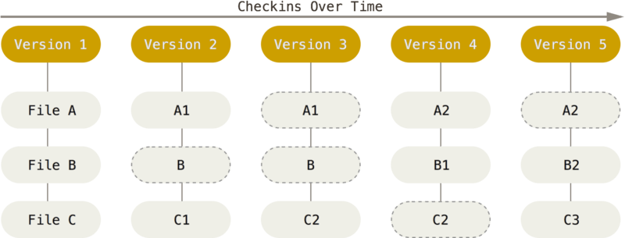
Introduction to git
Git stores and thinks about information a different way
Streams of Snapshots

Slide 6
Introduction to git cont.
Nearly all operations are local
It’s impossible to change files without git knowing it ☺
It’s very difficult to lose data ☺
Let’s get started by knowing states
Commited
Modified
Staged

Slide 7
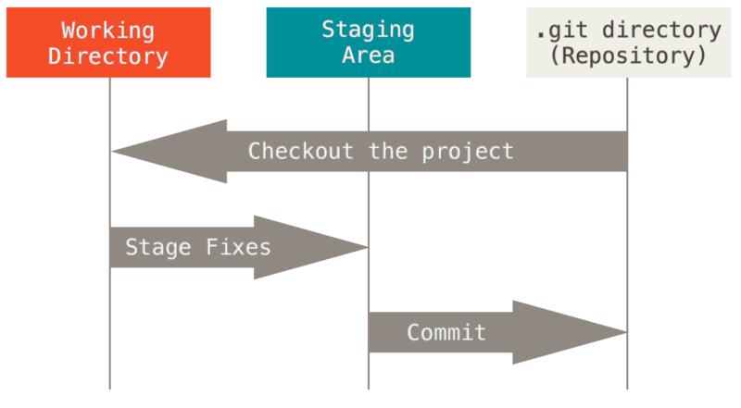
Three States

Slide 8
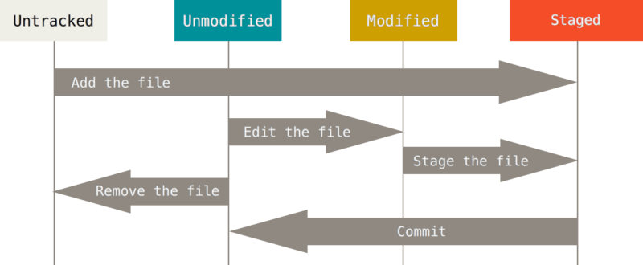
Git Basics
Having a git repository
Initialization
Cloning
Status

Slide 9
Git Basics cont.
Tracking a file
Staging modified files
Ignoring Files
Commiting Changes
Skipping Staging area
Removing Files
Moving Files
Logging

Slide 10
Git Remote
Working with remote repositories
Fetching
Pulling
Pushing

