Slide 1
JEJU Global SNS Content Event!
Team:
Kamran Javed (Pakistan)
Sumaira Kamran (Pakistan)
Topic:
Difference of Dressing between Jeju and Pakistan

Slide 2
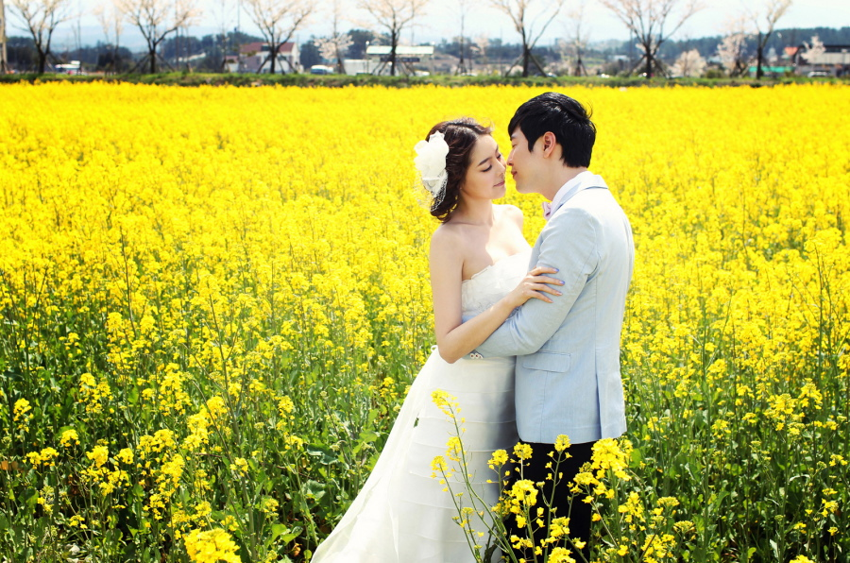
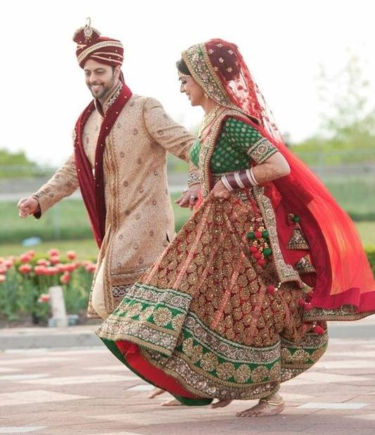

Wedding Dresses

Slide 3
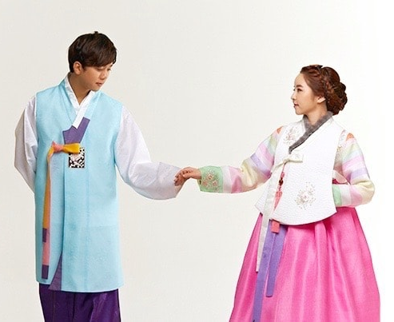
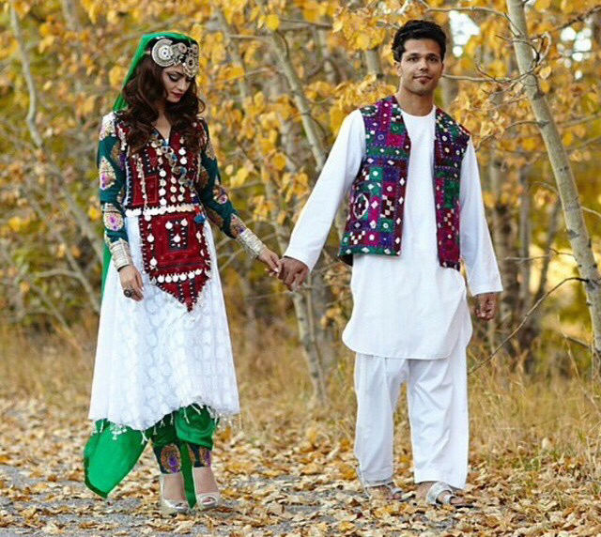
Cultural Dresses

Slide 4
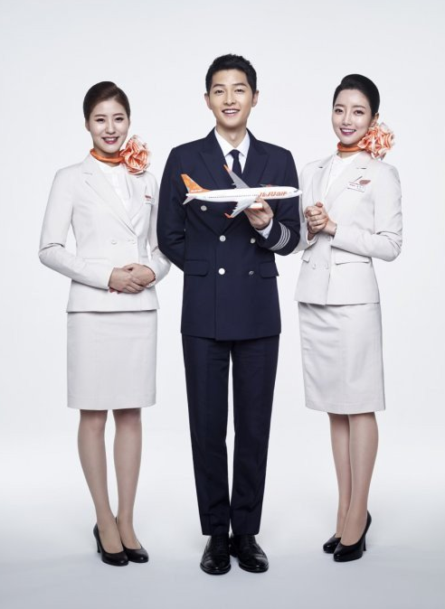
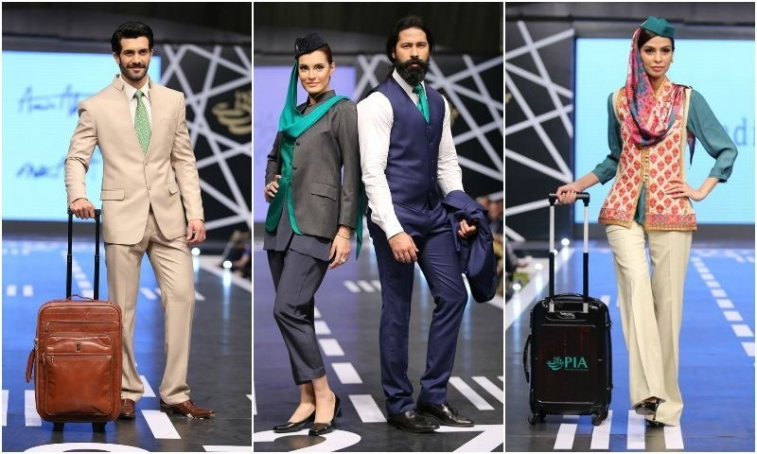
Cabin Crew Dresses

