Slide 1
How to Choose the Stack for Products?
Kamran Khalid

Slide 2
Project vs Product
What is the difference between a project and a product?

Slide 3
Project vs Product
Project: temporary, fixed deliverables, set timeline
Product: long-lived, user-driven, continuously improved

Slide 4
Product — High-Level Tech View
Frontend (what users interact with)
Backend (APIs, business logic)
Database (persistent storage)

Slide 5
Frontend — Languages & Frameworks
Languages: HTML, CSS, JavaScript / TypeScript
Frameworks: React, Vue, Angular, Next.js

Slide 6
Backend — Languages & Frameworks
Languages: Node.js, Python, Java, Go, C#, PHP, Ruby
Frameworks: Express/NestJS, Django/Flask, Spring Boot, Laravel

Slide 7
Database — Relational vs NoSQL
Relational (ACID): PostgreSQL, MySQL, SQL Server
NoSQL (flexible / distributed): MongoDB, Redis, Cassandra

Slide 8
Frameworks — Why They Matter
Reduce boilerplate & enforce patterns
Popular frameworks: Django, Express, Spring Boot, Laravel, Next.js

Slide 9
Full-Stack Developer — Definition & Context
Works across frontend & backend
Startups value full-stack for flexibility
Large product teams often prefer specialized roles

Slide 10
Factors When Choosing a Stack
Product stage: MVP vs scale
Team skills & hiring market
Non-functional needs: performance, security, cost
Ecosystem & library maturity

Slide 11
Trade-offs You Will Face
Speed (time-to-market) vs maintainability
Cutting-edge vs proven tech
Monolith vs microservices
Vendor lock-in vs control

Slide 12
Approaches to Picking a Stack
MVP-first: validate quickly
Future-proofing: build for scale (risk: overengineering)
Balanced: start simple with migration paths

Slide 13
Practical Scenario 1 — Informational Website (Solicitor)
Need: pages (About, Services), contact form, basic SEO
Best fit: CMS (WordPress, Drupal, Joomla)
Benefits: fast setup, plugins, admin UI
Trade-offs: custom features, plugin conflicts

Slide 14
Practical Scenario 2 — E-commerce / Shopping
Needs: product catalog, cart, checkout, payments, order mgmt
Options by scale: WooCommerce (small), Shopify (hosted), Magento (enterprise)
Consider headless commerce for flexible frontends

Slide 15
Practical Scenario 3 — SaaS Product
Needs: user accounts, APIs, multi-tenancy, billing, scaling
Typical stack: React/Vue + Node/Python/Java + PostgreSQL/NoSQL + Cloud/Docker/Kubernetes
Use third-party services for auth, email, billing to speed up

Slide 16
Decision Checklist — 5 Steps
1. Define product goals & constraints
2. Assess team skills
3. Map scalability & non-functional needs
4. Evaluate ecosystem & hiring market
5. Prototype / POC

Slide 17
Starter Stacks for Students
MERN: MongoDB, Express, React, Node (JS end-to-end)
Django + React: Python backend + modern frontend
LAMP: classic stack for fundamentals
Serverless / Firebase: fast MVPs

Slide 18
Summary — Key Takeaways
No perfect stack — choose best-fit for context
Use scenario-driven decisions (site, shop, SaaS)
Full-stack is useful early; specialization grows with product

Slide 19
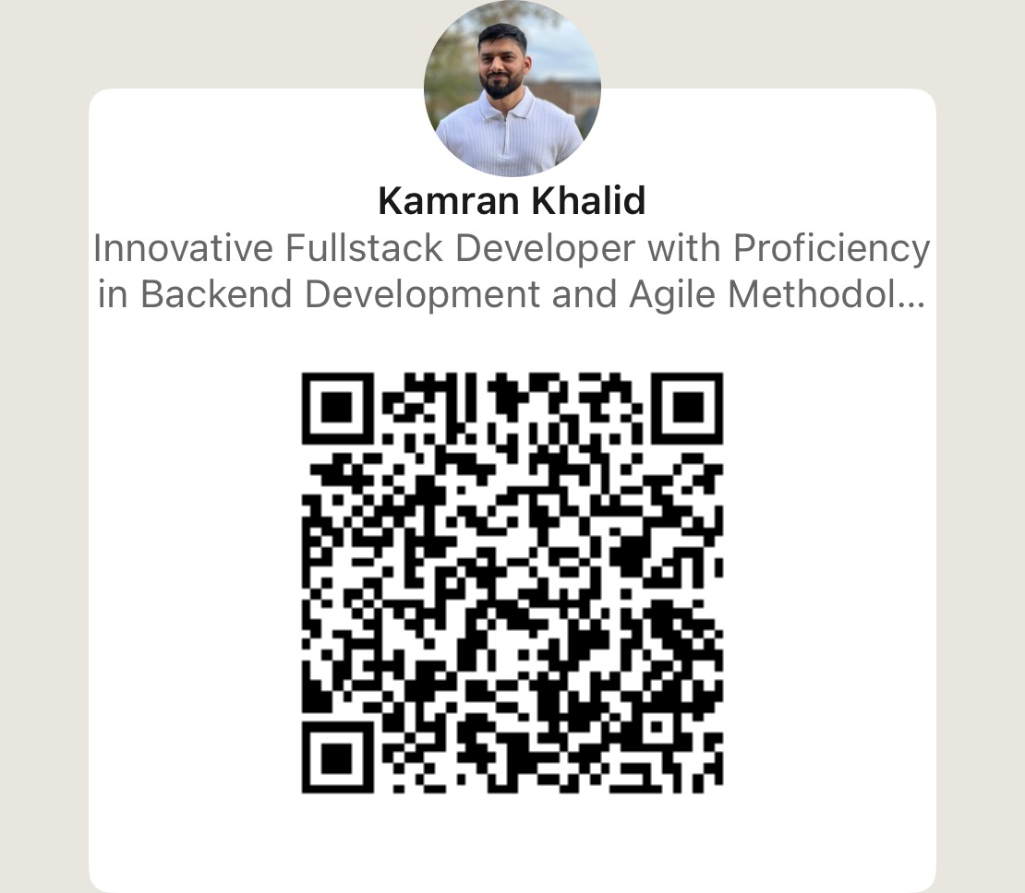

Thank You!
Medium

