Slide 1
Toll Management System
Business Process Model and Notation (BPMN)
Presented by
Asif Ahmed Utsa
ID: 1705084

Slide 2
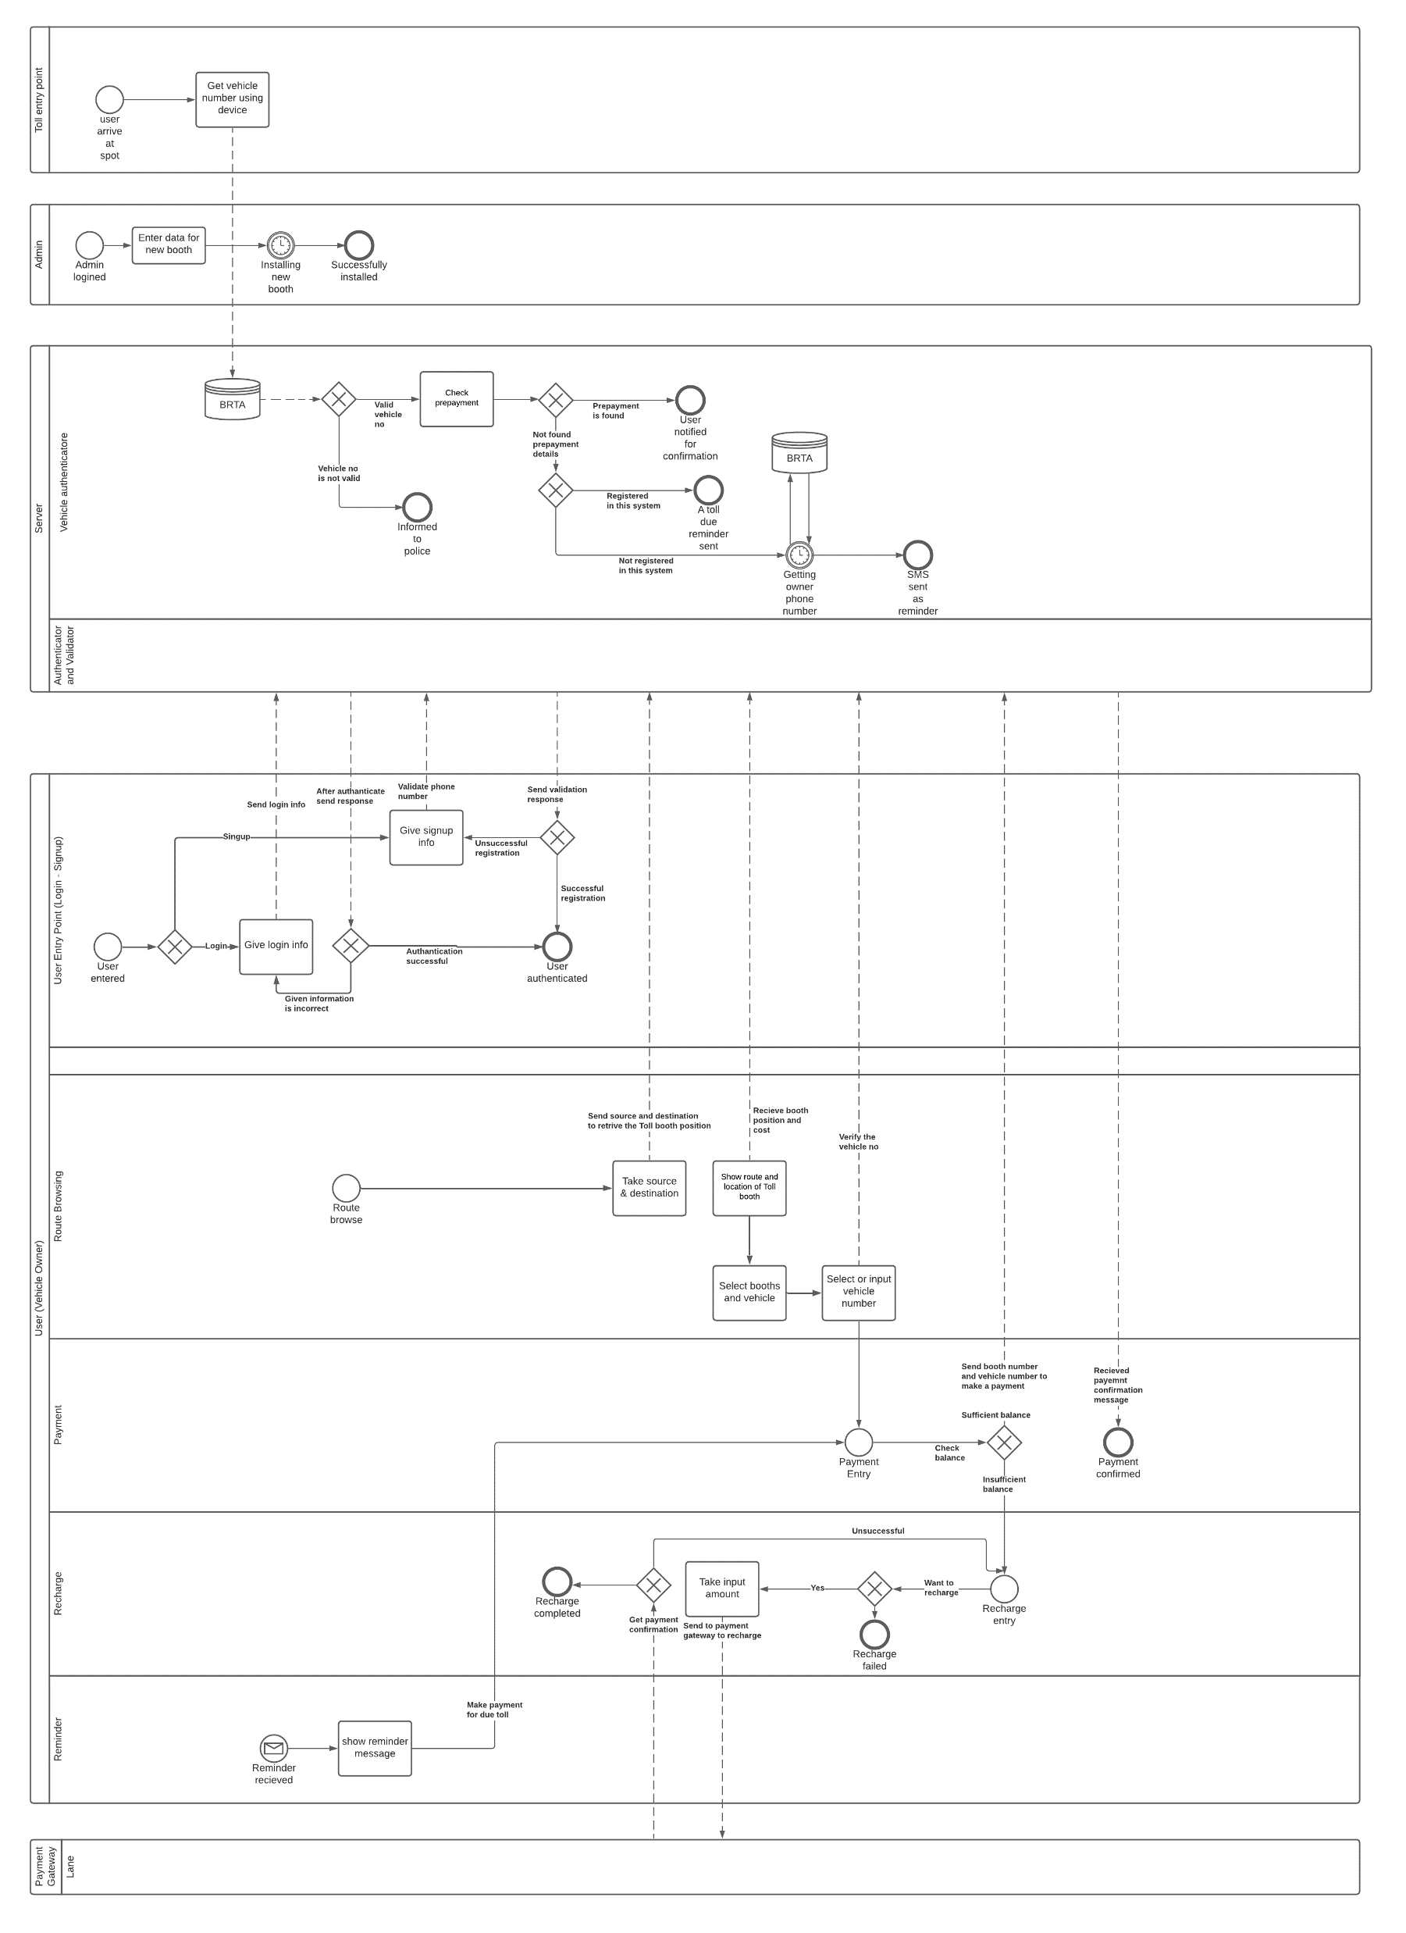
Full Diagram

Slide 3
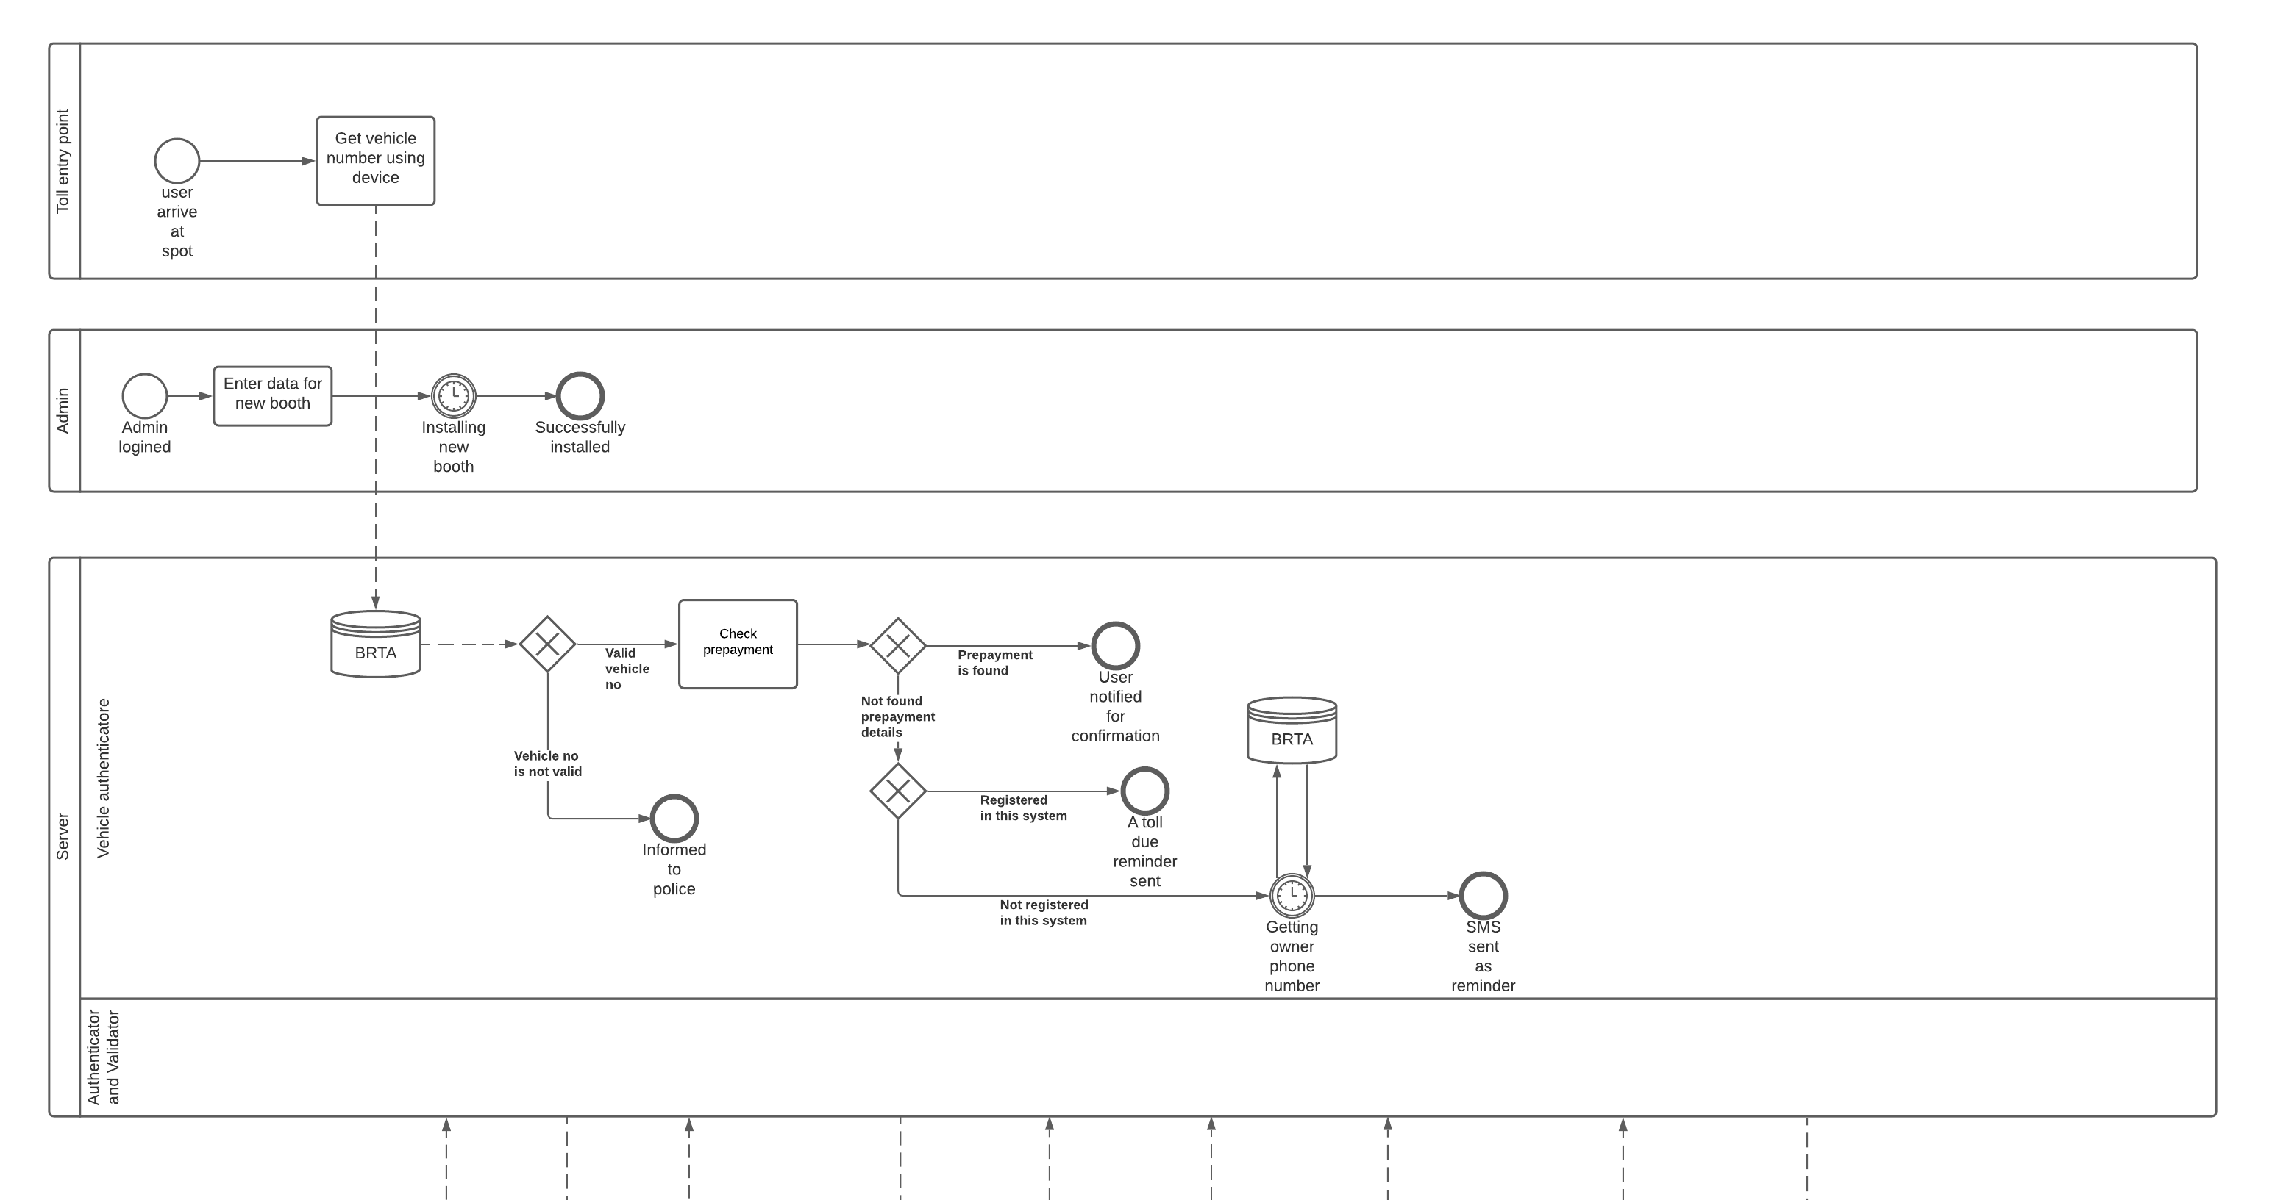
Control Point

Slide 4
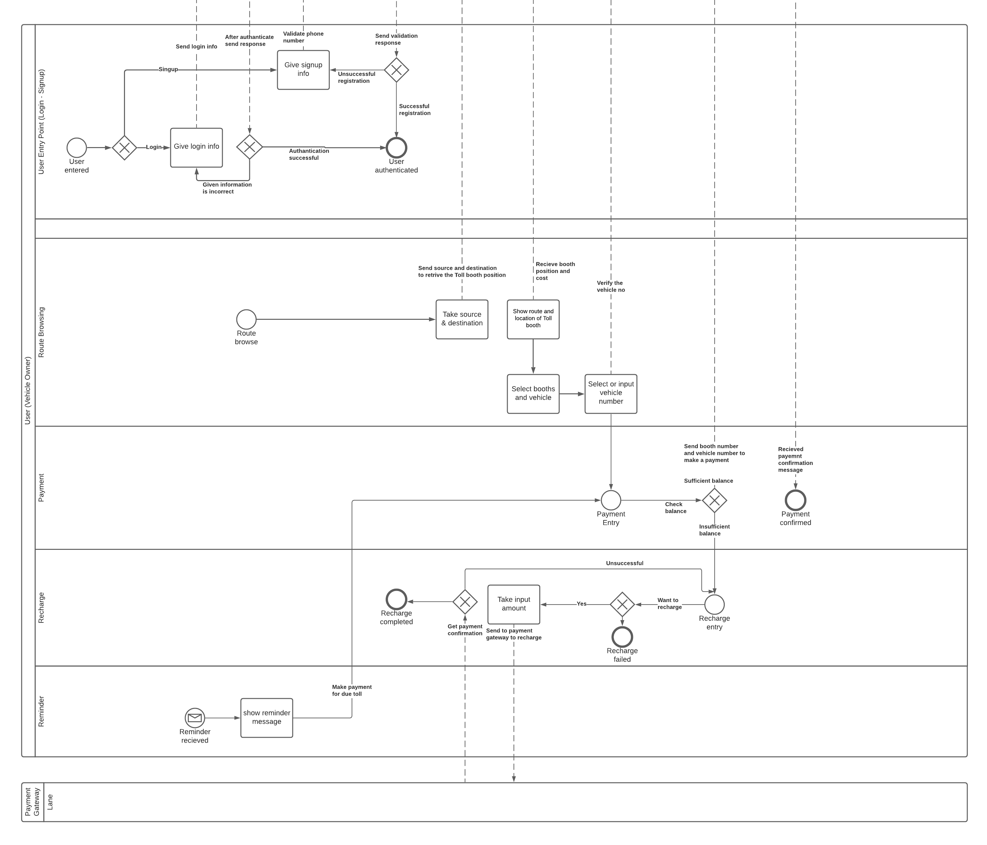
User

Slide 5
Admin

Slide 6
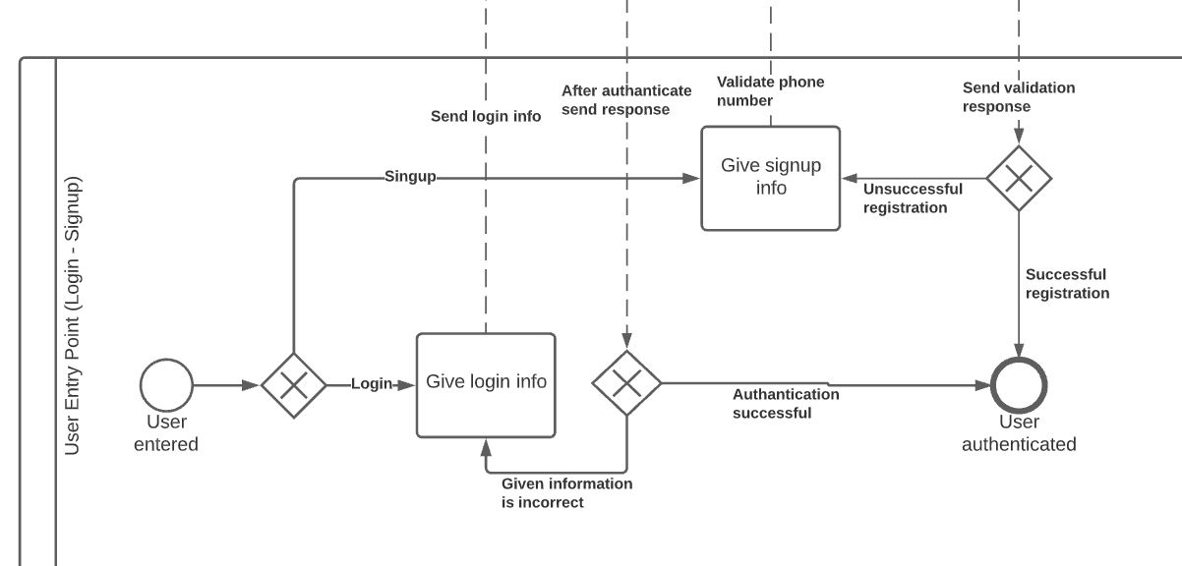
User – Entry Point
Sign up

Slide 7
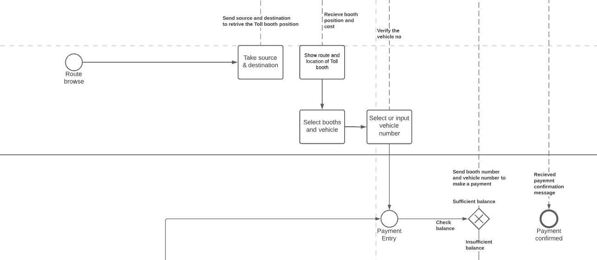
User – Route Browse

Slide 8
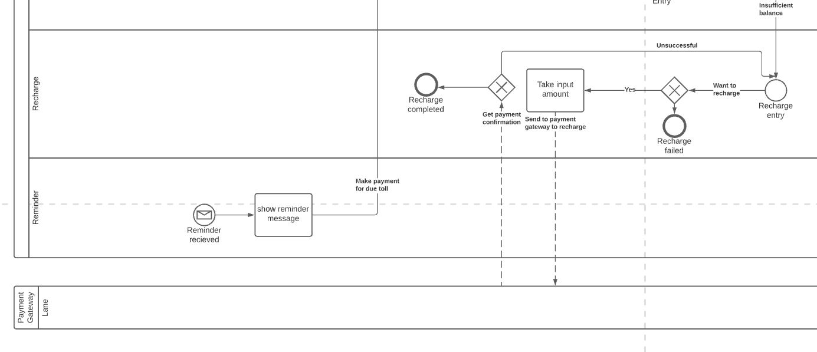
User – Recharge

Slide 9
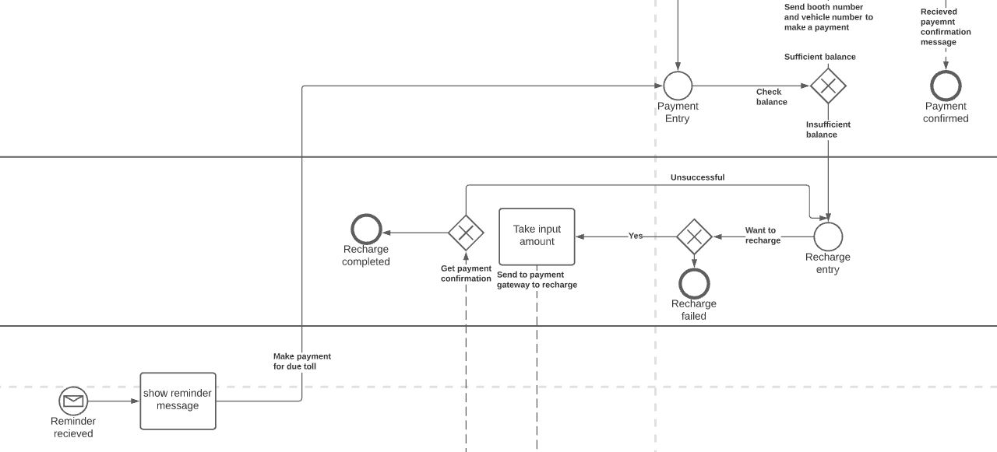
User – Reminder

Slide 10
Toll Entry Point

Slide 11


