Slide 1
CSE326
Toll Management System
Topic: Interaction Diagram
Presented by: Shammo(1705079) and Mehedi(1705082)
Group : 2
1705072 - Sourov
1705079 - Shammo
1705080 - Shafayat
1705081 - Kamrul
1705082 - Mehedi
1705084 - Utsa

Slide 2
Introduction
Generic Color Convention
Project Idea : Toll Management System
Architecture : Model View Controller (MVC)
Diagram Convention : Unified Modelling Language (UML)
Diagrams Generated:
Collaboration Diagram
Sequence Diagram
Model
View
Controller

Slide 3
Module Hierarchy
>Profile management
>Financial management
>Route management
>User History
4
User
Toll Management System
Admin
>Profile management
>Offer management
>Toll Booth management
>Gateway management
>History
5
TollBooth
1
>Finance management
3 Modules
10 Submodules

Slide 4
User Module
1.1 Profile Management

Slide 5
Use Case : User Profile Management
User profile management sub module has the following tasks:
Log in
Sign Up
Profile Info View
Profile Info Edit
Homepage navigation
Model | View | Controller
User Vehicle | UserLoginUI UserSignupUI UserHomepageUI ProfileUI | UserController

Slide 6
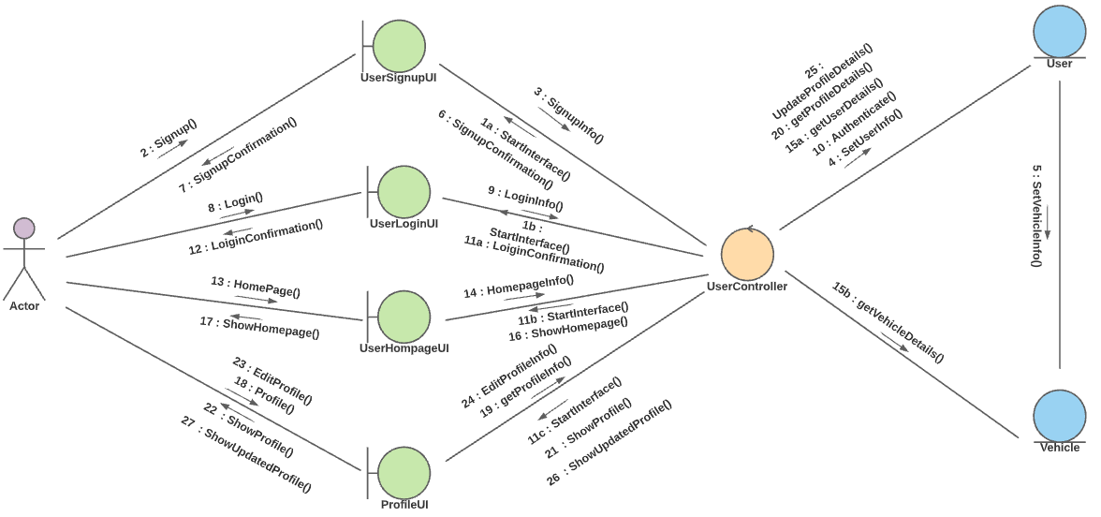
Collaboration Diagram: User Profile Management

Slide 7
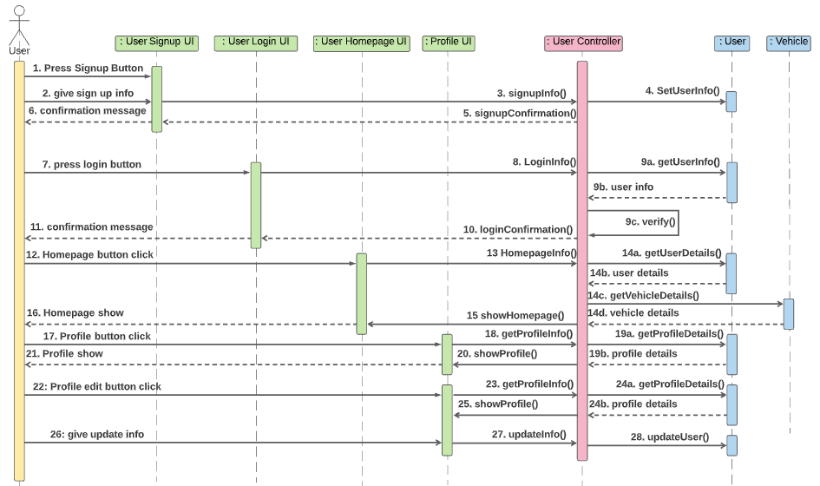
Sequence Diagram: User Profile Management

Slide 8
User Module
1.2 Financial Management

Slide 9
Use Case : User Financial Management
User financial management sub module has the following tasks:
Recharge User wallet
Pay for selected toll booths
Recharging using various gateways
View list of dues
Pay pending dues
Select and add offers
Model | View | Controller
Recharge Due Payment Offer Vehicle PaymentGateway | PaymentUI DuesUI OffersUI RechargeUI | UserController

Slide 10
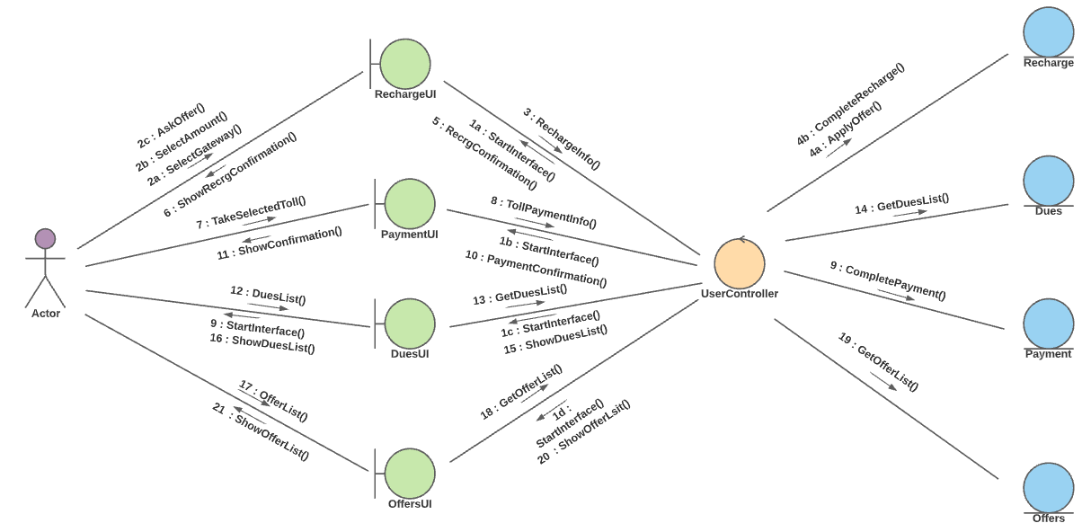
Collaboration Diagram: User Financial Management

Slide 11
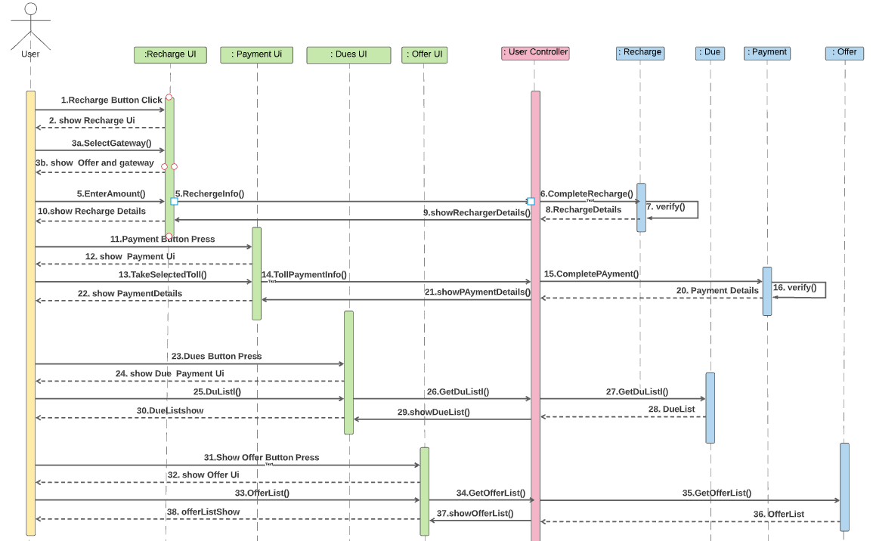
Sequence Diagram: User Financial Management

Slide 12
User Module
1.3 Route Management

Slide 13
Use Case : Route Management
User route management sub module has the following tasks:
Browse routes in map
See available toll booths
Selectively or generally select tollbooths for payment
Model | View | Controller
Route TollBooth Payment Vehicle | BrowseRouteUI | UserController

Slide 14
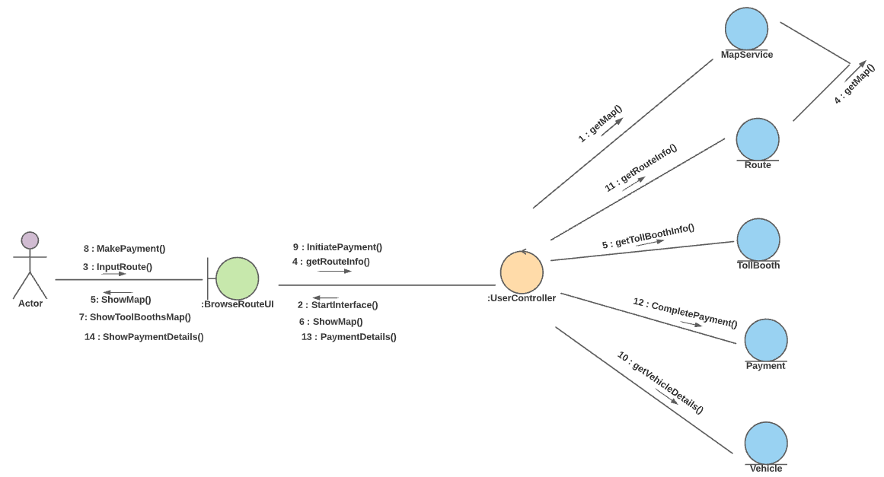
Collaboration Diagram: Route Management

Slide 15
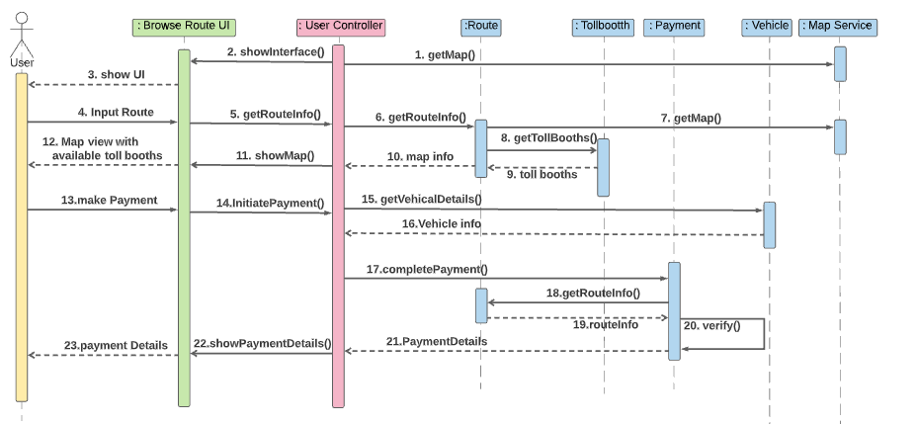
Sequence Diagram: Route Management

Slide 16
User Module
1.4 User History

Slide 17
Use Case : User History Management
User History sub module has the following tasks:
View Recharge History
View dues history
View Route history
View Transaction History
View statistics
Model | View | Controller
Recharge Due Payment Route | UserHistoryUI | UserController

Slide 18
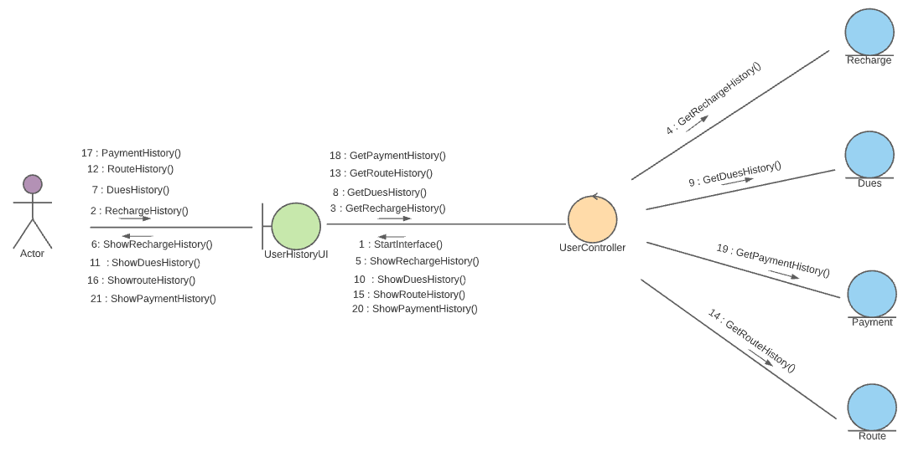
Collaboration Diagram: User History Management

Slide 19
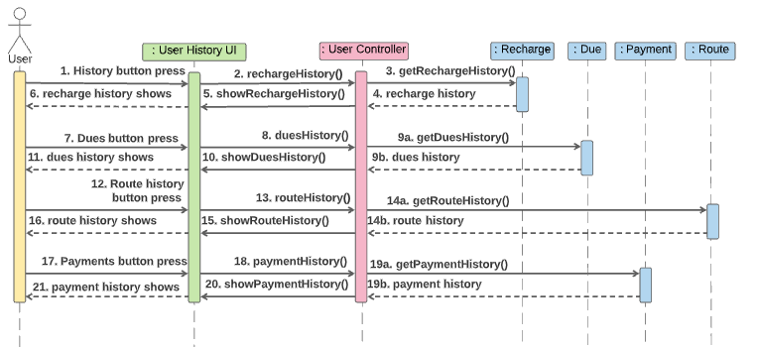
Sequence Diagram: User History Management

Slide 20
2. Admin Module
2.1 Profile Management

Slide 21
Use Case : Admin Profile Management
Admin profile management sub module has the following tasks:
Log in
Sign Up
Profile Info View
Profile Info Edit
Homepage navigation
Model | View | Controller
Admin | AdminLoginUI AdminHomeUI AdminInfoUI | Admin Controller

Slide 22
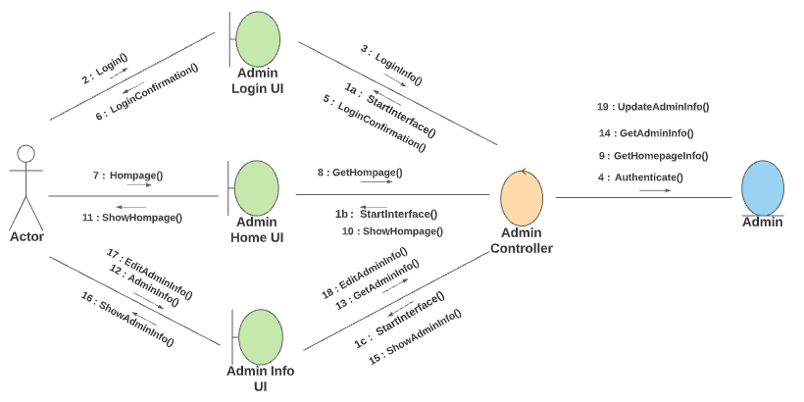
Collaboration Diagram: Admin Profile Management

Slide 23
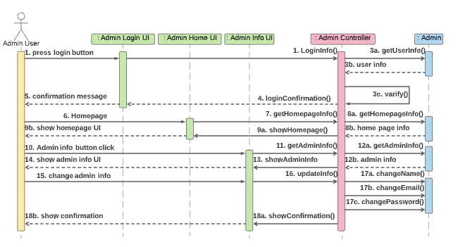
Sequence Diagram: Admin Profile Management

Slide 24
2. Admin Module
2.2 Offer Management

Slide 25
Use Case : Offer Management
Admin offer management sub module has the following tasks:
Add new Offer
Update existing Offer
Show all offers
Model | View | Controller
Admin Offer | AddOfferUI offersShowUI | Admin Controller

Slide 26
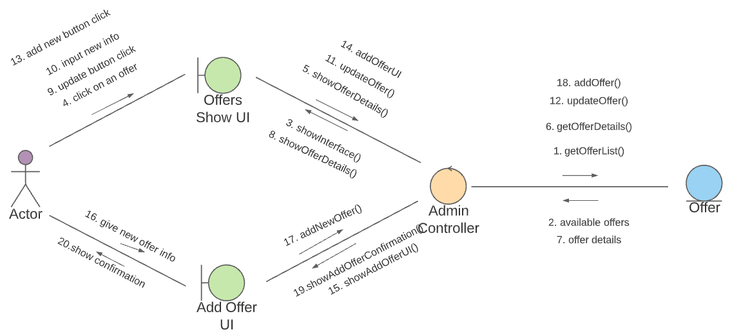
Collaboration Diagram: Offer Management

Slide 27
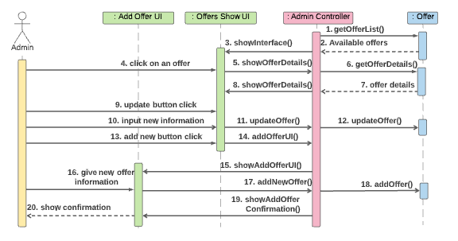
Sequence Diagram: Offer Management

Slide 28
2. Admin Module
2.3 Toll Booth Management

Slide 29
Use Case : Toll Booth Management
Admin toll booth management sub module has the following tasks:
Install new toll booth
Update existing toll booth
Show toll booth info view
Model | View | Controller
TollBooth | TollInfoShowUI InstallTollUI | Admin Controller

Slide 30
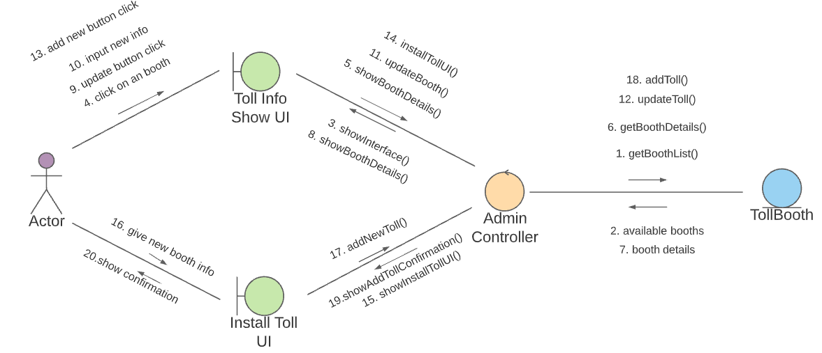
Collaboration Diagram: Toll Booth Management

Slide 31
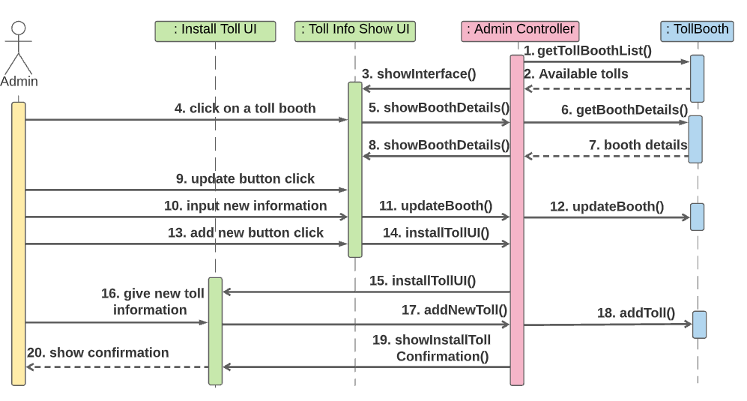
Sequence Diagram: Tool Booth Management

Slide 32
2. Admin Module
2.4 Gateway Management

Slide 33
Use Case : Gateway Management
Admin gateway management sub module has the following tasks:
Add a new gateway
Update gateway
Get gateway info view
Model | View | Controller
Gateway | addGatewayUI showGatewayUI | Admin Controller

Slide 34
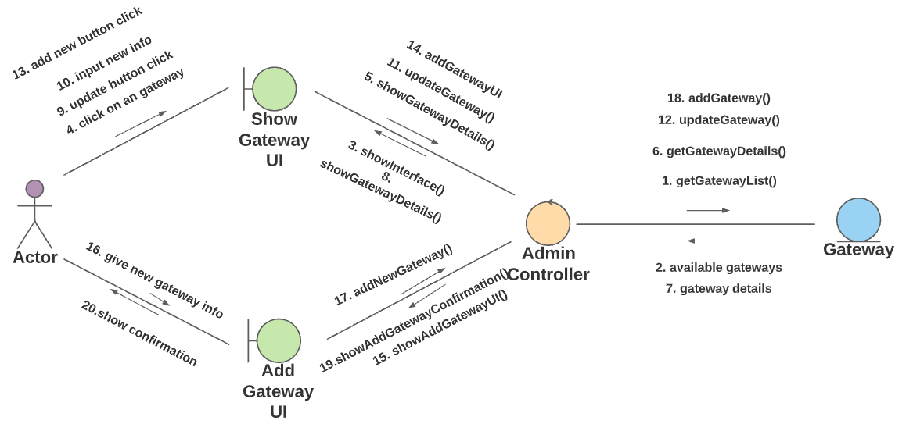
Collaboration Diagram: Gateway Management

Slide 35
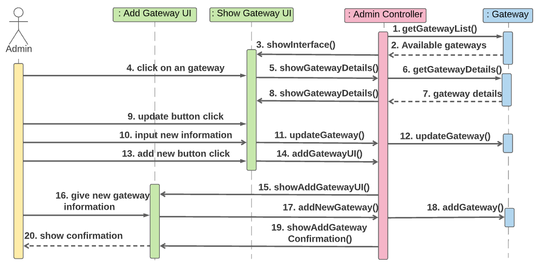
Sequence Diagram: Gateway Management

Slide 36
2. Admin Module
2.5 Financial Management

Slide 37
Admin: financial management
Description
Admin financial management sub module has the following tasks:
See Payment history
See Dues history
See payment or due history for chosen vehicle number
Model | View | Controller
Payment Due Vehicle | showPaymentsUI showDuesUI | Admin Controller

Slide 38
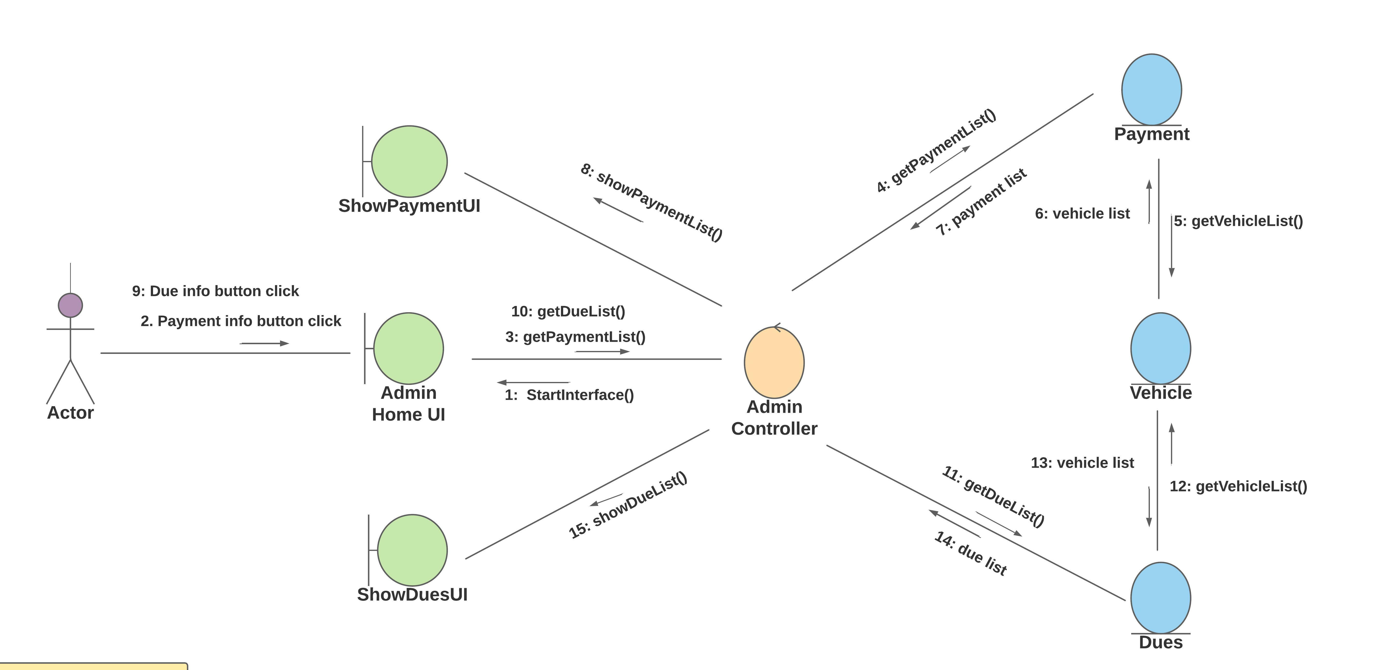
Collaboration Diagram: Financial Management

Slide 39
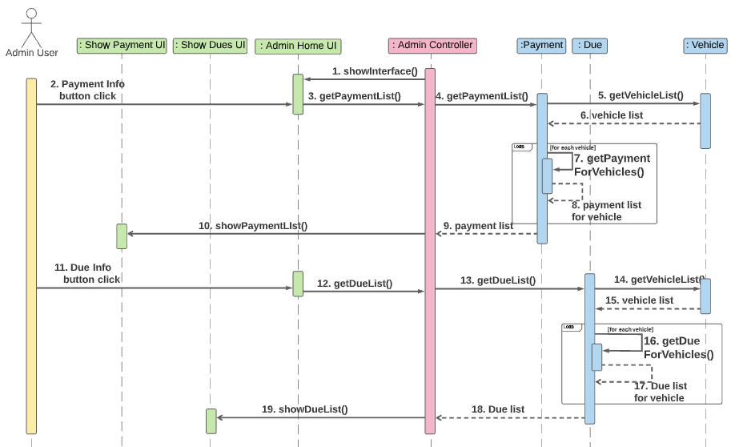
Sequence Diagram: Financial Management

Slide 40
3. Toll scanning Module
3.1 Cash Management

Slide 41
Toll Booth: cash management
Description
Admin cash management sub module has the following tasks:
Scan passing vehicles
Update payment for a prepaid vehicle
Create due for a unpaid passed vehicle
Model | View | Controller
Due Payment TollBooth | TollBoothUi | TollBooth Controller

Slide 42
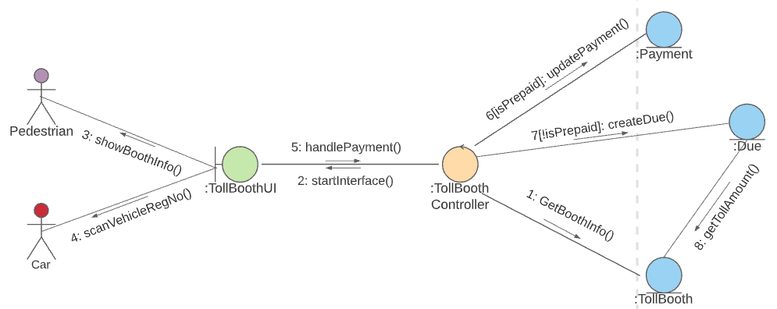
Collaboration Diagram: Cash Management

Slide 43
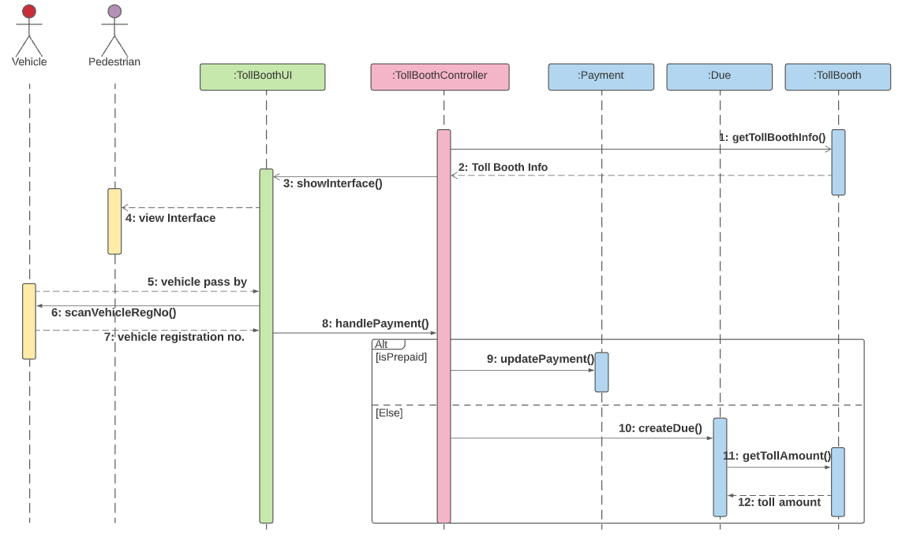
Sequence Diagram: Cash Management

Slide 44
Thank You

