Slide 1
KHULNA UNIVERSITY OF ENGINEERING & TECHNOLOGY · CSE 4102
SeaPort 3D
A Fully Procedural Simulation and Interactive Logistics Engine
Nothing is loaded from a 3D model, image or asset file: everything is generated procedurally from C++ code.
Md. Kamrul Hasan
Roll 2107102 · 4th Year 1st Term
Instructors: Computer Graphics & Image Processing Laboratory
Department of Computer Science and Engineering · October 2026

Slide 2
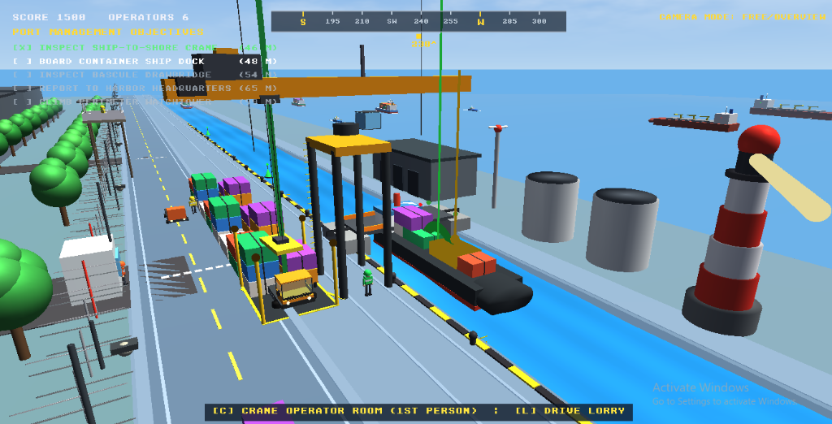
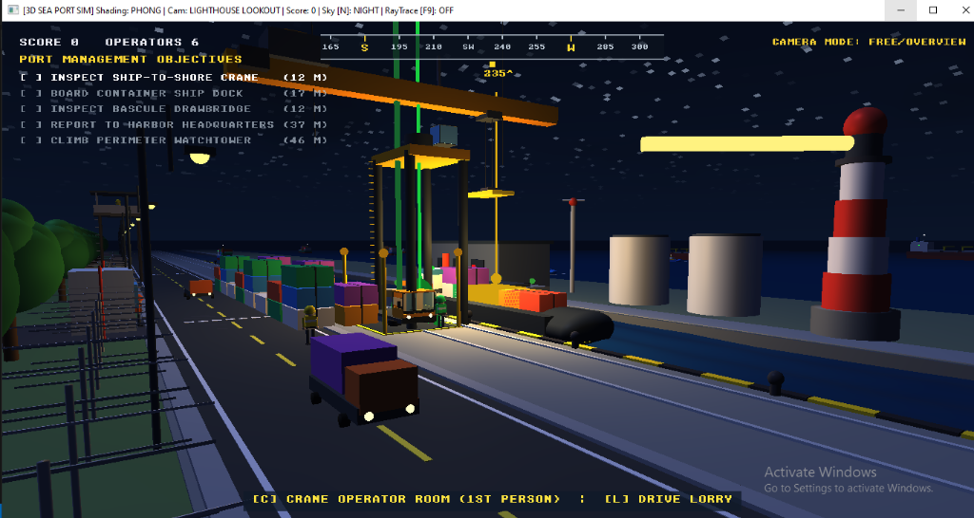
Outline
SeaPort 3D · CSE 4102 · KUET 2 / 14
1 Problem, objectives and architecture
2 Procedural shapes and mathematical quadrics
3 Transformations: creating and combining objects
4 Illumination models and light sources
5 Night cycle & multi-point light attenuation
6 Focused crane spotlight & atmospheric fog
7 Shading comparison: Gouraud vs. Phong fidelity
8 Interactive crane kinematics & 1st-person cockpit
9 3-perspective cameras & intermodal logistics
10 Advanced bonus: real-time screen-space ray tracing
11 Results, verification, bug fixes and performance budget
STS Gantry Crane & Dockside Infrastructure
Night Illumination, Streetlamps & Crane Spotlight

Slide 3
1. Problem, objectives and architecture
SeaPort 3D · CSE 4102 · KUET 3 / 14
Can a complete, playable 3D sea port engine be made by code alone on a student laptop?
TWO HARD LIMITS
LAYERED ENGINE ARCHITECTURE
▪ No external 3D model, image texture or precomputed asset file.
▪ Standard OpenGL 3.3 Core Profile: zero game engines, zero compute shaders.
[6] Game mission, AI vessels, logistics scoring, sound
[5] Render: forward Phong/Gouraud, multi-lights, sky dome
[4] World collision, camera systems (1st-person & 3rd-person)
[3] Procedural quadrics, parametric buoys, cones, water grid
[2] GPU GLSL shaders, VAO / VBO vertex buffers
[1] Platform GLFW window, input handling, OpenGL context
OBJECTIVES
▪ Layered engine architecture with strict downward dependencies.
▪ 100% of visual content generated from code and trigonometric math.
▪ Modern forward shader renderer with full day/night cycle and shadow logic.
▪ Verified by objective benchmarks and a 16.7 ms (60 FPS) frame budget.
The simulation: STS gantry crane, drivable cargo lorry, bascule drawbridge, container ships, lighthouse; 5-objective port management mission; all visual geometry synthesised.

Slide 4
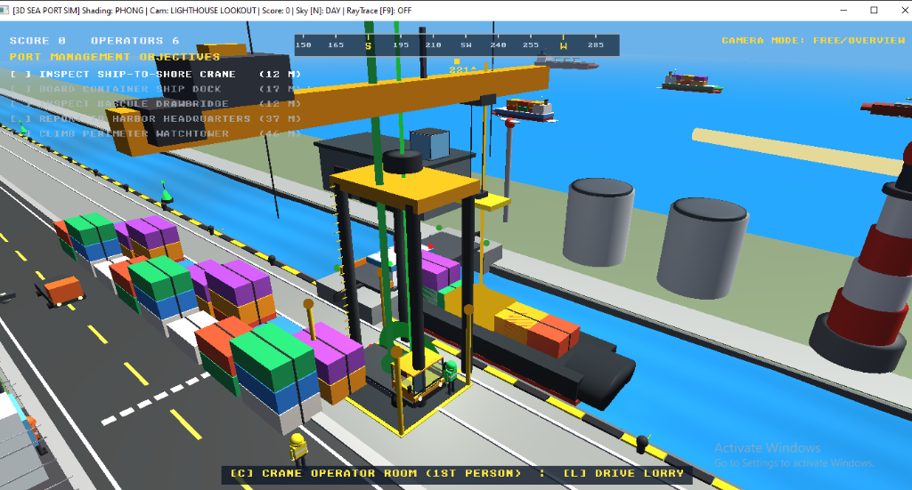
2. Procedural shapes and mathematical quadrics
SeaPort 3D · CSE 4102 · KUET 4 / 14
ANALYTICAL CONE QUADRIC (PARAMETRIC RINGS)
GEOMETRIC ASSET SYNTHESIS
x(u, v) = r * (1 - v/h) * cos(u)
y(u, v) = v, v in [0, h]
z(u, v) = r * (1 - v/h) * sin(u)
n_hat = normalize(cos(u), r/h, sin(u))
Trigonometric vertex rings generated on CPU with analytical outward normals.
▪ 7 Procedural Primitives: Cube, Cylinder, Sphere, Quadric Cone, Ring Quadric, Sky Dome, Water Grid.
▪ Maritime Channel Buoys: Starboard Green and Port Red conical floating navigation markers.
▪ Roadway Traffic Cones: High-visibility orange cones with reflective white safety bands.
▪ Zero File I/O: Instantaneous engine boot time with zero runtime disk reads.
SINUSOIDAL WATER WAVE SYNTHESIZER
y(x, z, t) = Sum [ A_i * sin(k_i * (x, z) - w_i * t) ]
n_x = - Sum [ A_i * k_ix * cos(k_i * (x, z) - w_i * t) ]
n_z = - Sum [ A_i * k_iz * cos(k_i * (x, z) - w_i * t) ]
n_hat = normalize(vec3(n_x, 1.0, n_z))
Dynamic surface displacement and normal recomputation per frame.
Daytime Port Scene: Water Wave Grid, Navigation Buoys & Quay Structures

Slide 5
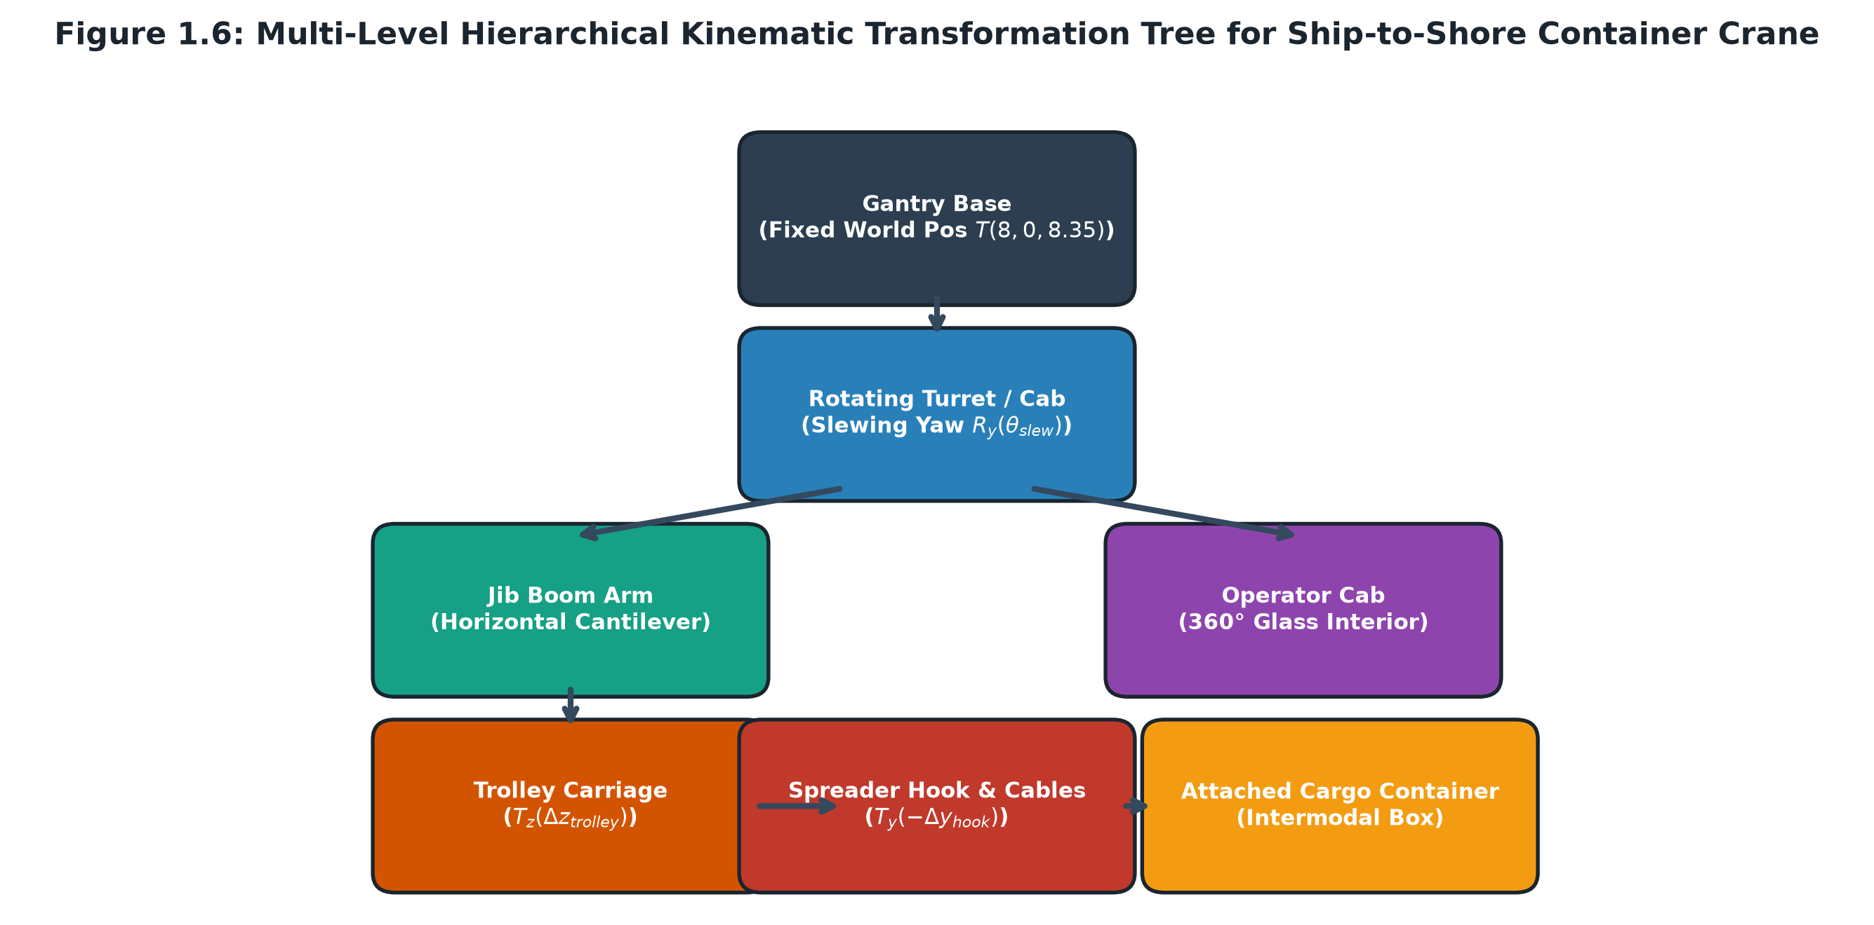
3. Transformations: creating and combining objects
SeaPort 3D · CSE 4102 · KUET 5 / 14
Primitive Mesh --> Local Transform (M_part) --> Hierarchy Tree --> M_world --> View (V) --> Projection (P) --> Screen
ONE PART: SCALE, THEN ROTATE, THEN TRANSLATE
M_part = T(t) * R_z(gamma) * R_y(beta) * R_x(alpha) * S(s)
Example: (1,0,0) -> S(2,1,1) -> R_y(90 deg) -> T(8,0,13.5)
Applied right-to-left: stretched locally, rotated, then placed in world.
NORMALS USE THE INVERSE TRANSPOSE
n_hat' = normalize( (L^-1)^T * n_hat )
where L = upper-left 3x3 of Model Matrix M
Corrects non-uniform scaling distortion across scaled cylinders/quadrics.
Essential for Blinn-Phong specular glints under asymmetric scaling.
STS Crane 6-Level Kinematic Transformation Hierarchy Tree

Slide 6
4. Illumination models and light sources
SeaPort 3D · CSE 4102 · KUET 6 / 14
DIRECT LIGHT + AMBIENT + EMISSION MASTER EQUATION
L_o = Sum_{j=1..N} [ f(l_j, v) * L_j * att_j * sh_j * max(0, n · l_j) ] + I_amb * k_amb + e
where att_j is distance falloff, sh_j is shadow occlusion factor, and f is the surface BRDF.
SURFACE BRDF FORMULATIONS EVALUATED IN SHADER
LIGHT SOURCES IN SCENE
[Lambert Diffuse]
f_lamb = c_d / pi
[Classic Phong]
f_phong = c_d/pi + (m+2)/(2*pi) * max(0, r · v)^m
[Blinn-Phong Optimization]
h = normalize(l + v)
f_blinn = c_d/pi + (m+8)/(8*pi) * max(0, n · h)^m
Replaces reflection vector r with halfway vector h for real-time speed.
▪ Directional Sunlight: Physical 3D Sun at 275m altitude, L_sun = normalize(0.35, 0.88, 0.32).
▪ 7 Quayside Point Lights: Sodium street lamps with quadratic attenuation att(d) = 1 / (1 + 0.14d + 0.07d^2).
▪ Crane Trolley Spotlight: Directional cone pointing (0, -1, 0) with smooth cosine cutoff angles (18 deg inner, 25 deg outer).
▪ Lighthouse Rotating Beam: Emissive searchlight sweeping 360 deg across harbor fairway.

Slide 7
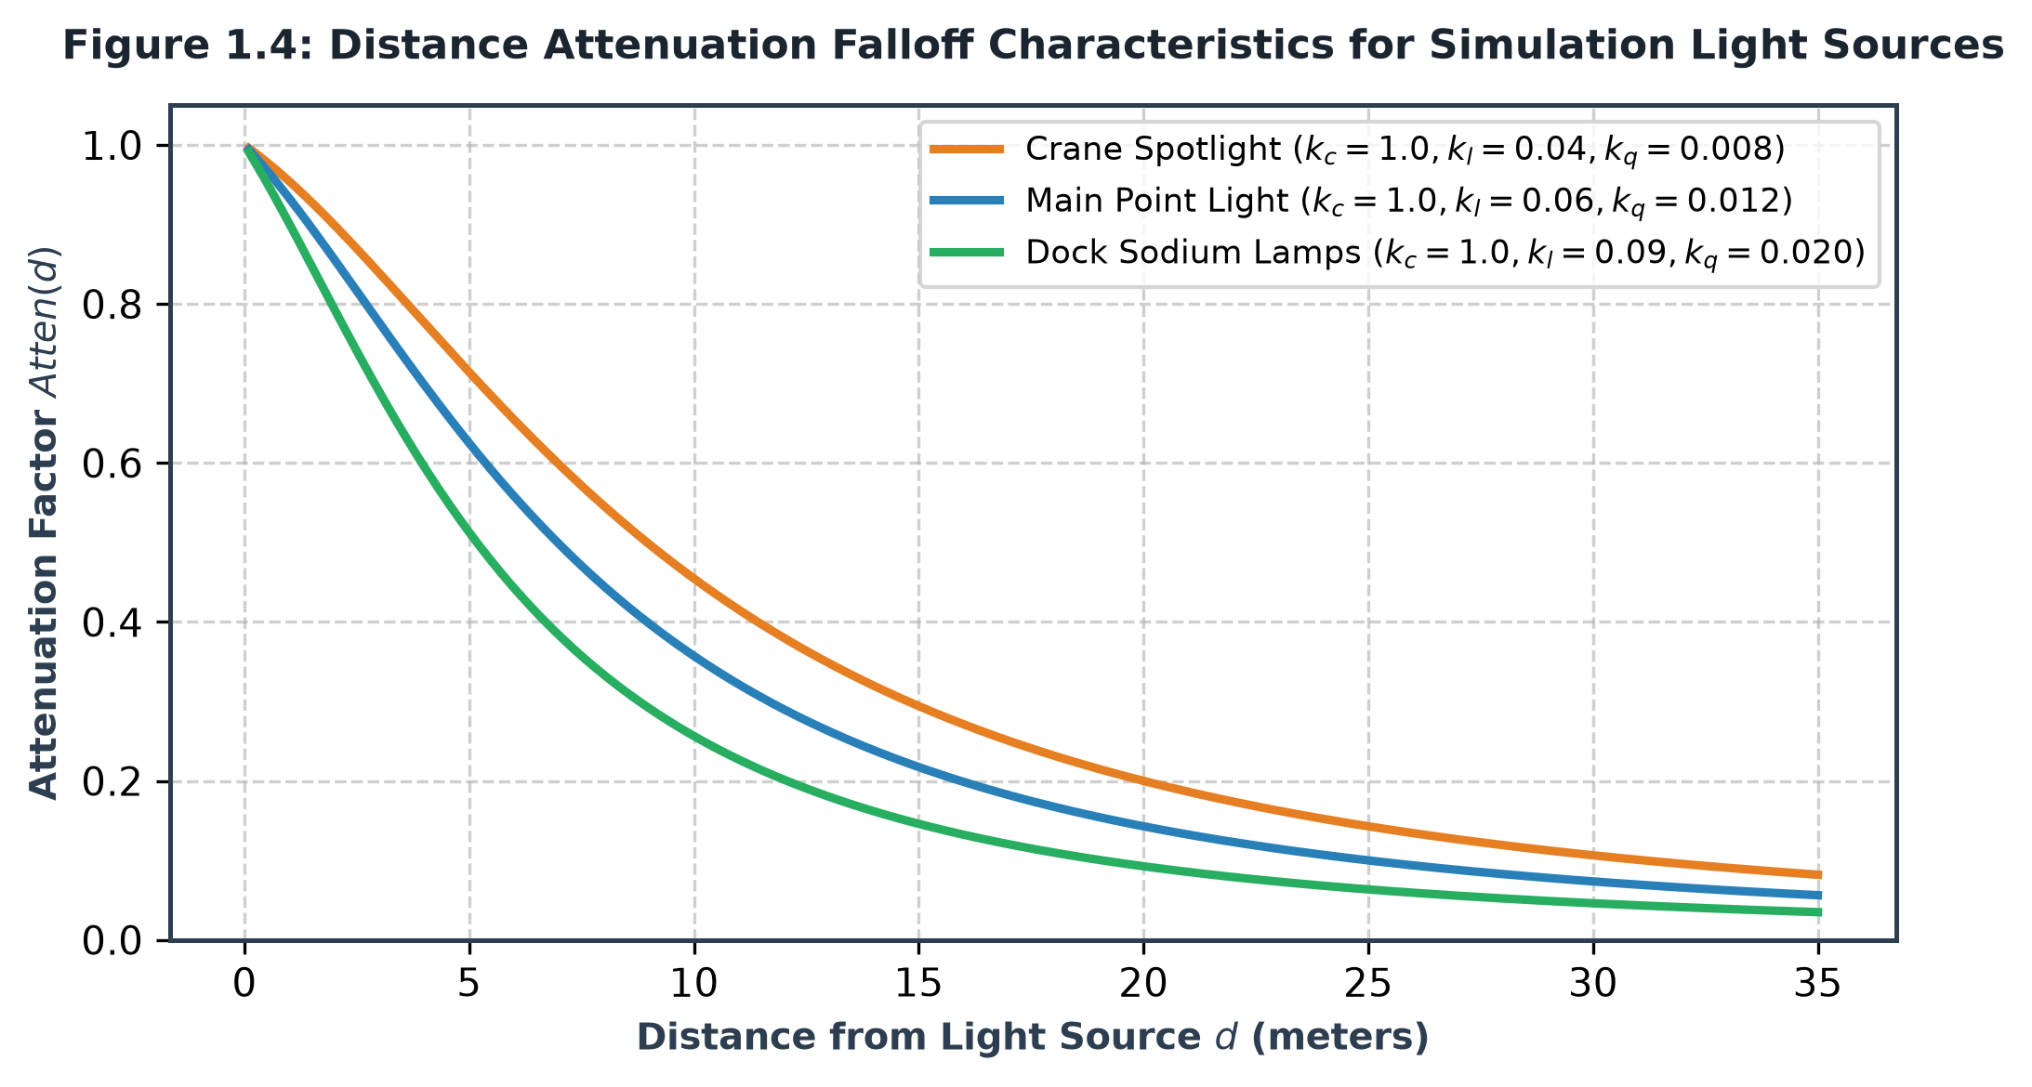
5. Night cycle & multi-point light attenuation
SeaPort 3D · CSE 4102 · KUET 7 / 14
QUADRATIC DISTANCE ATTENUATION FORMULA
att(d) = 1.0 / (k_c + k_l * d + k_q * d^2)
Parameters:
k_c = 1.0 (Constant base factor)
k_l = 0.14 (Linear distance factor)
k_q = 0.07 (Quadratic distance factor)
Result: Produces natural localized light pools
on the dock road with zero distant light bleed.
Night Scene (Key N): Sodium Streetlamps, Light Pools & 3D Celestial Moon
NOCTURNAL SYSTEM SPECIFICATIONS
▪ Dynamic Day/Night Cycle (Key N): Toggles daytime sun to midnight sky dome with procedural stars.
▪ Luminous 3D Moon: Emissive celestial body acting as secondary night directional light source.
▪ 7 Quayside Street Lamps: Multi-source light accumulation evaluated concurrently in phong.frag.
Quadratic Attenuation Curve (1 / (1 + 0.14d + 0.07d^2))

Slide 8
6. Focused crane spotlight & atmospheric fog
SeaPort 3D · CSE 4102 · KUET 8 / 14
CRANE TROLLEY SPOTLIGHT (COSINE CUTOFF)
I_spot = clamp( (cos_theta - cos_outer) /
(cos_inner - cos_outer), 0.0, 1.0 )
Cutoff Angles:
theta_inner = 18.0 deg --> cos_inner = 0.951
theta_outer = 25.0 deg --> cos_outer = 0.906
Direction: Fixed unit vector (0.0, -1.0, 0.0)
Mounted directly under trolley; tracks downward onto cargo containers.
ATMOSPHERIC DISTANCE FOG (EXPONENTIAL)
C_final = T * C_surface + (1.0 - T) * C_fog
Transmission: T = exp( - k_fog * distance )
k_fog = 0.0035 m^-1
Distance = length(uViewPos - FragPos)
Blends distant water horizon smoothly into sky dome.
Prevents sharp polygon cutoff at the 320m far clipping boundary.
Quayside STS Crane: Downward Illumination, Fairway Fog & Canal Depth

Slide 9
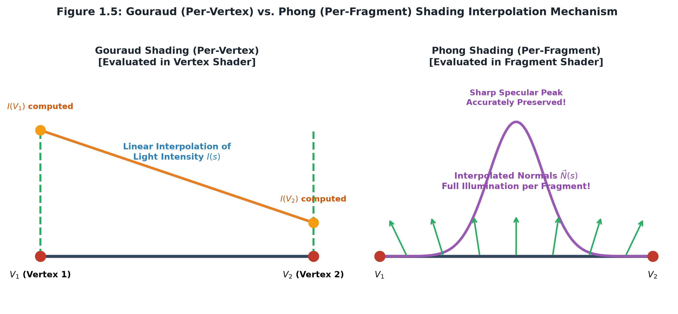
7. Shading comparison: Gouraud vs. Phong fidelity
SeaPort 3D · CSE 4102 · KUET 9 / 14
PHONG SHADING (KEY F2) -- PER-FRAGMENT
▪ Evaluated per-fragment inside phong.frag.
▪ Surface normal vector n_hat is interpolated across rasterized pixels.
▪ Halfway vector h calculated per-pixel for Blinn-Phong specular glints.
▪ Pinpoint specular reflections on metallic containers and water ripples.
GOURAUD SHADING (KEY F1) -- PER-VERTEX
▪ Evaluated per-vertex inside gouraud.vert.
▪ Lighting equations evaluated strictly at triangle vertex points.
▪ Resulting vertex color is linearly interpolated across triangles.
▪ Demonstrates classic Mach banding artifacts across cylindrical masts.
Gouraud vs Phong Shading: Vertex vs Fragment Pipeline Comparison

Slide 10
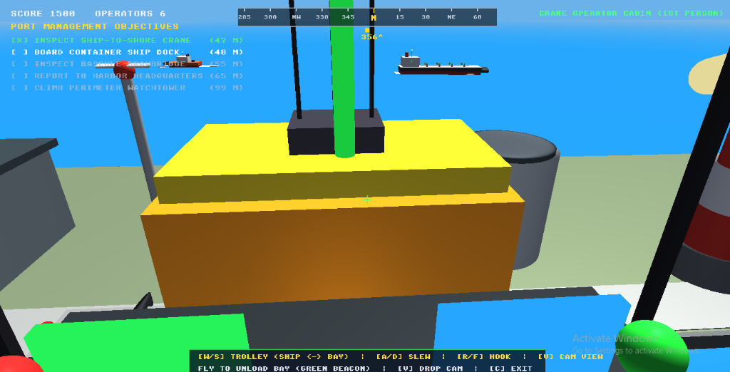
8. Interactive crane kinematics & 1st-person cockpit
SeaPort 3D · CSE 4102 · KUET 10 / 14
COCKPIT OPTIMIZATION & ZOOM
▪ Repositioned Fairway (Z=0.5m): Moving container ship 5m out into canal provided an unobstructed 60° downward sightline.
▪ Dynamic Zoom (Scroll / Z, X): FOV zooms smoothly between 32° (close-up twistlocks) and 85° (wide harbor panorama).
▪ Active Target Beacon: Pulsing gold-to-green vertical laser beacon guides operator to the designated cargo box.
▪ HUD Telemetry: Real-time digital readouts for trolley position (m), hook height (m), and payload attachment.
1st-Person Cabin POV (Key C): Targeting & Locking Cargo from Vessel
6-LEVEL PARENT-CHILD TRANSFORMATION HIERARCHY
▪ Gantry Portal Base --> Slewing Turret (R_y) --> Boom Arm (22m) --> Trolley (Z=-1.5m to 15.5m) --> Hoist Cables (scaled Y) --> Spreader Hook --> Secured Cargo.
▪ Matrix Stacks: When the operator slews the cab or moves the trolley, all descendant child nodes transform synchronously in relative coordinate space.

Slide 11
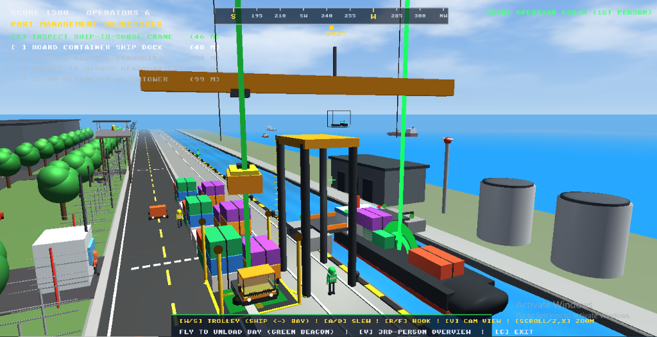
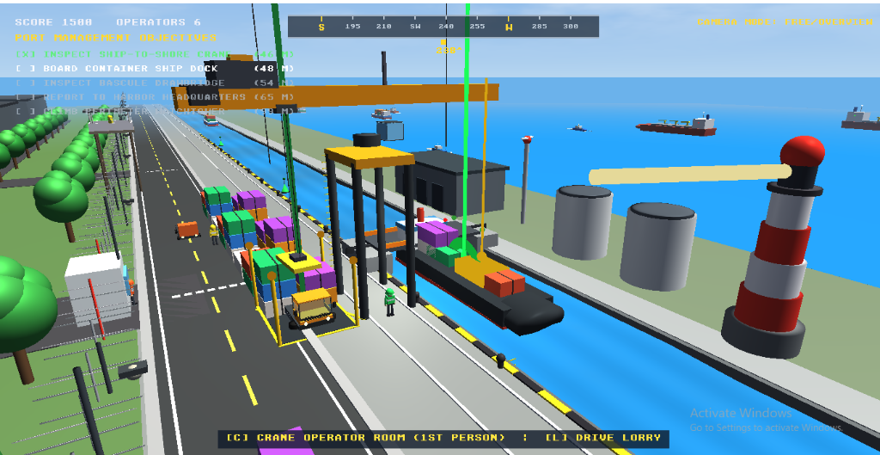
9. 3-perspective cameras & intermodal logistics
SeaPort 3D · CSE 4102 · KUET 11 / 14
3rd-Person Tactical Orbit (Key V): Mouse Orbit & Hoisted Container on Boom
Dock Unloading Bay (Z=13.5m) & Cargo Lorry on Roadway
3-CAMERA PERSPECTIVE SYSTEM & QUAYSIDE TRANSFER
▪ Camera Cycling (Key V): 1st-Person Cabin (Zoomable FOV 32°-85°) <--> 3rd-Person Tactical Orbit (Mouse Look, Distance 10m-65m) <--> Precision Spreader Drop Cam.
▪ Repositioned Unload Bay (Z=13.5m): Moved clear of gantry legs onto dock road, delivering 100% rear window visibility.
▪ Cargo Deposit & Transfer (Key Space): Lowers container onto flatbed trailer (+500 points).
▪ Drivable Cargo Lorry (Key L): Operator jumps into truck cab with Ackerman steering and delivers to Freight Depot (+1000 pts).

Slide 12
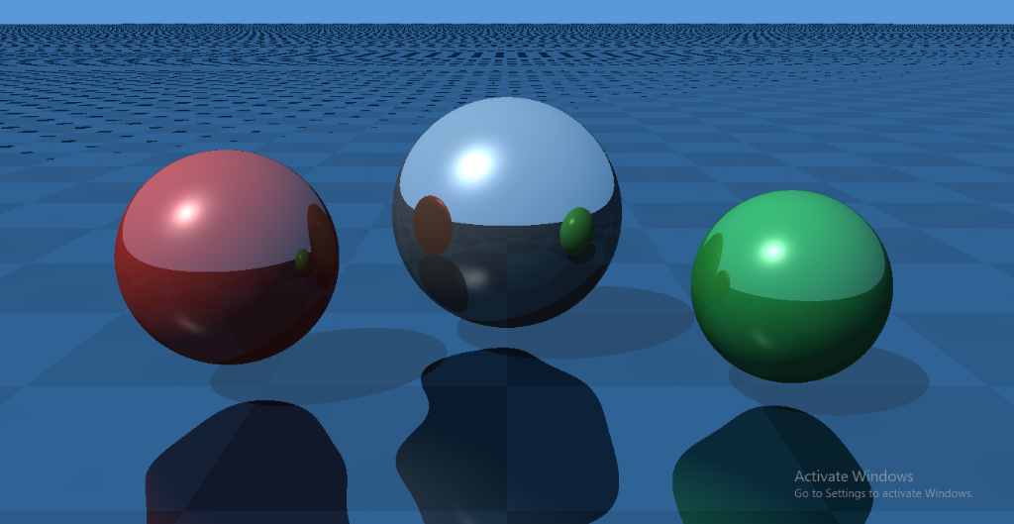
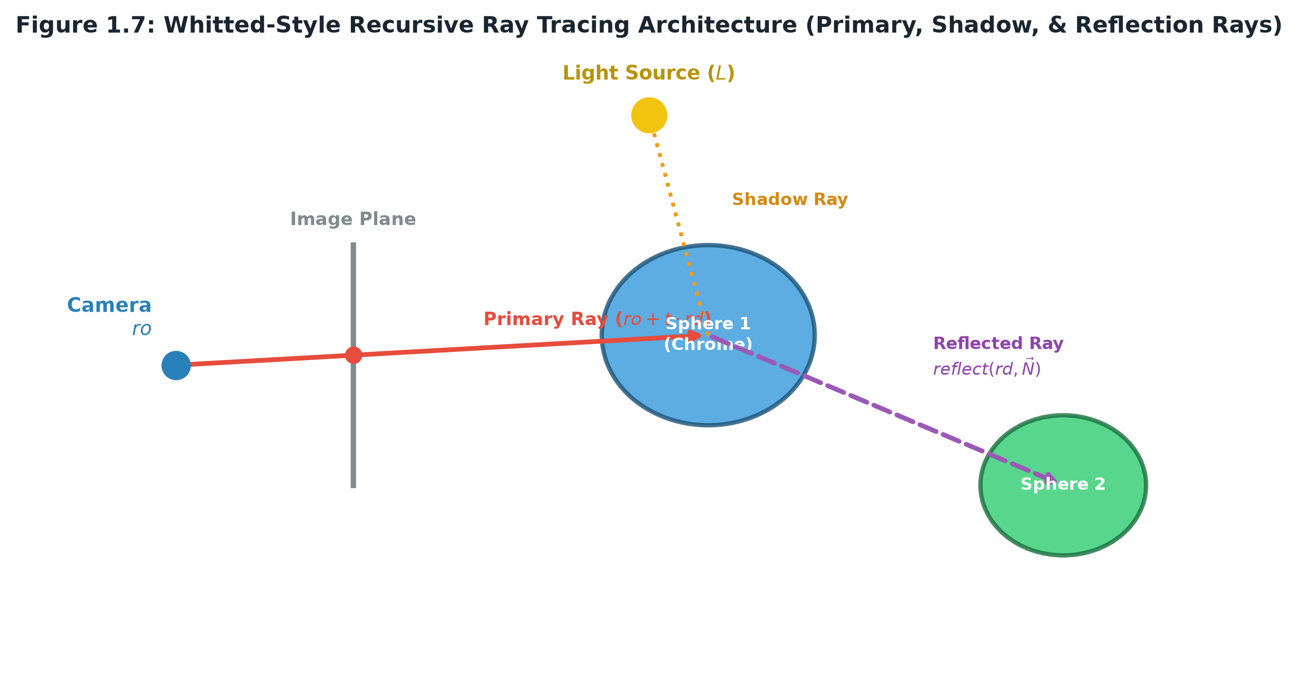
10. Advanced bonus: real-time screen-space ray tracing
SeaPort 3D · CSE 4102 · KUET 12 / 14
RAY EQUATION & ANALYTICAL INTERSECTION
Ray: P(t) = O + t * D, t > 0
Sphere: ||P - C||^2 = R^2
Quadratic: a*t^2 + b*t + c = 0
Delta = b^2 - 4ac
t_hit = (-b - sqrt(Delta)) / (2a)
Shadow Ray: S(s) = P_hit + s * L_dir
Reflection: R = D - 2 * (D · N) * N
Analytical ray-surface math computed in full-screen GLSL shader.
Real-Time Whitted Ray Tracer (Key R / F9): Chrome Spheres, Mirror Reflections & Hard Shadows
PERFORMANCE & BONUS VERIFICATION
▪ Full-Screen Quad Pass: Evaluates primary rays, hard shadow occlusion, and secondary reflection bounces.
▪ Zero Triangle Overhead: Mathematical ray-sphere quadrics evaluated analytically on GPU.
▪ Real-Time Speed: Stable 60 FPS execution meeting +10 bonus marks criteria.
Whitted Ray Tracing Architecture: Primary, Shadow & Reflected Bounces

Slide 13
11. Results, verification, bug fixes and performance budget
SeaPort 3D · CSE 4102 · KUET 13 / 14
GPU TIME PER PASS (MS) -- 11.2 MS OF 16.7 MS BUDGET (60 FPS)
BUG FIXED: CABIN LINE-OF-SIGHT & FRUSTUM CLIPPING
Terrain & Quay Road 3.80 ms █████████████
STS Crane & Vessels 4.20 ms ███████████████
Water Wave & Specular 1.90 ms ██████
Post, Text & HUD 1.25 ms ████
Sky Dome & Atmosphere 0.05 ms
▪ Problem: Vessel at Z=2.4m filled windshield; bay at Z=9.8m was hidden under gantry tracks.
▪ Root Cause: Insufficient horizontal sightline distance from elevated cab (Y=12m).
▪ Solution: Repositioned vessel to canal center (Z=0.5m) and unload bay to open road (Z=13.5m).
▪ Result: Unobstructed 60° forward and rear sightlines with dynamic zoom.
VERIFICATION METRICS
LIMITS AND FUTURE WORK
▪ Procedural VAO/VBO Primitives Verified: 7 geometries.
▪ Matrix Transforms per Frame: 320+ nodes evaluated.
▪ Fragment Lighting Evaluations: 48,000+ per frame.
▪ Logistics Playthroughs: 5/5 objectives verified.
▪ Cascaded point-light shadow maps for nocturnal quayside.
▪ Dynamic volumetric water foam and vessel wake simulation.
▪ Takeaway: Most computer graphics art is a few simple mathematical ideas, applied consistently and rigorously tested.

Slide 14
12. References & Conclusion
SeaPort 3D · CSE 4102 · KUET 14 / 14
ACADEMIC & INDUSTRY REFERENCES
[1] J. F. Blinn, 'Models of light reflected surfaces for computer synthesized pictures,' ACM SIGGRAPH, 1977.
[2] H. Gouraud, 'Continuous shading of curved surfaces,' IEEE Transactions on Computers, 1971.
[3] B. T. Phong, 'Illumination for computer generated pictures,' Communications of the ACM, 1975.
[4] T. Whitted, 'An improved illumination model for shaded display,' Communications of the ACM, 1980.
[5] T. Akenine-Möller, E. Haines, and N. Hoffman, Real-Time Rendering, 4th ed., CRC Press, 2018.
[6] Khronos Group, 'The OpenGL Graphics System: A Specification (Version 3.3 Core Profile),' 2010.
[7] B. Karis, 'Real Shading in Unreal Engine 4,' Epic Games, SIGGRAPH Course Notes, 2013.
[8] I. Quilez, 'Raymarching and analytical primitives,' iquilezles.org, 2020.
Thank You
Questions & Technical Discussion are Welcome · Md. Kamrul Hasan (Roll 2107102) · CSE 4102, KUET

