Slide 1
Explainable-AI Evaluation for
Construction-Safety Vision-Language Models
A two-week feasibility pilot — findings, and the case for scale-up
Research advised by Professor Mustafa Abdallah · Pilot complete

Slide 2
THE QUESTION
Does the six-metric XAI framework transfer to a VLM?
• Professor Abdallah's framework evaluates black-box explanations along six metrics: Descriptive Accuracy, Sparsity, Stability, Efficiency, Robustness, Completeness.
• It was built and validated on tabular network-intrusion-detection DNNs — where a feature is a scalar column.
• This project: does that framework survive the move to a Vision-Language Model making visual safety judgments on construction sites — where the input is an image + text and an explanation is a spatial region?
• A feasibility pilot is the right instrument: it surfaces the adaptations a full study would otherwise hit the hard way.
Construction-VLM XAI · Pilot findings & scale-up
2

Slide 3
HEADLINE ANSWER
Yes — with two real adaptations, not zero changes
6 / 6
9×
~0.5
metrics ran end-to-end and produced interpretable signal
sensitivity gain from the mid-pilot proxy redesign (3.0% → 27.0%)
GPU-hours for the whole pipeline at n=1,000 — compute is not the blocker
The framework's structure transferred. What did not transfer for free was the assumption that the system already produces a discriminating judgment to explain — that had to be checked and repaired.
Construction-VLM XAI · Pilot findings & scale-up
3

Slide 4
EXECUTIVE SUMMARY
The six metrics — headline numbers (163 samples)
Metric | What it measures | Result
Descriptive Accuracy | Masking the top region flips the answer | 36.2%
Visual Sparsity | Top-5-of-576-cell attention mass | 0.108
Stability | 3-run sampled answer agreement | 77.5%
Robustness (L1) | Survives blur / low-light / occlusion / contrast | 80.7%
Bounded Completeness | Top-region masking is load-bearing | 43.6%
Efficiency | Full pipeline @ n=1,000 | ~0.5 GPU-hr
Construction-VLM XAI · Pilot findings & scale-up
4

Slide 5
01
Background & Setup
The framework, the task, the data, and the model
Construction-VLM XAI · Pilot findings & scale-up
5

Slide 6
FRAMEWORK
The six metrics, in one line each
• Descriptive Accuracy — remove the explanation region; a faithful one should change the decision.
• Sparsity — is the attribution concentrated (focused) or spread thin (uninformative)?
• Stability — rerun the same input; do the answer and its region stay put?
• Robustness — do answer and explanation survive small, realistic input perturbations?
• Completeness — is the highlighted region actually necessary to the decision?
• Efficiency — is producing all of this computationally affordable at scale?
Construction-VLM XAI · Pilot findings & scale-up
6

Slide 7
TRANSFER CHALLENGE
From tabular features to image + text
• Tabular setting (original): a feature is a scalar; an explanation is a per-feature importance weight; ground truth is a label.
• VLM setting (here): the input is an image plus a text prompt; an explanation is a spatial region; the model may not even expose an importance signal.
• The question is whether the structure of each metric survives the move — and, where it doesn't transfer for free, what minimal adaptation restores it.
• Two adaptations turned out to be necessary (covered next). Neither was optional or cosmetic.
Construction-VLM XAI · Pilot findings & scale-up
7

Slide 8
DATASET
ConstructionSite — a safety VLM dataset
• 10,013 images (3,004-image test split used); each carries annotator-written violation fields for four safety rules.
• A balanced 163-image subset was drawn: 50 each for three classes; struck_by_risk capped at 13 — later shown to be a labeling artifact, not a dataset property.
• Ground truth comes from the dataset's own annotations. The model is tested on (a) whether it reaches the same judgment, and (b) whether the region it used is a trustworthy explanation.
Construction-VLM XAI · Pilot findings & scale-up
8

Slide 9
TASK
The four safety rules
Rule | Hazard class | What it checks
rule_1 | ppe_violation | Basic PPE present (hard hat / hi-vis vest)
rule_2 | fall_hazard | Fall protection (harness / lanyard) at height
rule_3 | fall_hazard | Edge protection (guardrail) at height / edges
rule_4 | struck_by_risk | Worker inside excavator blind-spot / swing radius
(none) | compliant | Every applicable safety requirement satisfied
rule_2 and rule_3 both map to fall_hazard — two mitigations for one hazard type.
Construction-VLM XAI · Pilot findings & scale-up
9

Slide 10
MODEL CHOICE
Why Florence-2-base-ft
• Lightweight: 231M params, MIT license, runs on a single 8 GB consumer RTX 3070.
• Region-native: produces bounding boxes directly, so a candidate explanation (a box) falls out of the model without a separate localization step.
• The catch: it has no free-form question-answering task token — so a safety question cannot be asked literally. This forces the central adaptation.
• Chosen as a fast first model; a native-VQA model (Qwen2.5-VL) is proposed for the full study.
Construction-VLM XAI · Pilot findings & scale-up
10

Slide 11
02
The Core Adaptation
Turning a detector into a safety-question answerer
Construction-VLM XAI · Pilot findings & scale-up
11

Slide 12
THE PROBLEM
Florence-2 cannot be asked a question
• Florence-2's task vocabulary is a closed set of tokens (caption, detect, ground) — there is no token that means 'answer this question.'
• So 'Is the worker wearing a hard hat?' cannot be posed directly.
• The workaround: convert each safety rule into open-vocabulary detection calls, and derive a yes/no answer from whether and where boxes land.
Construction-VLM XAI · Pilot findings & scale-up
12

Slide 13
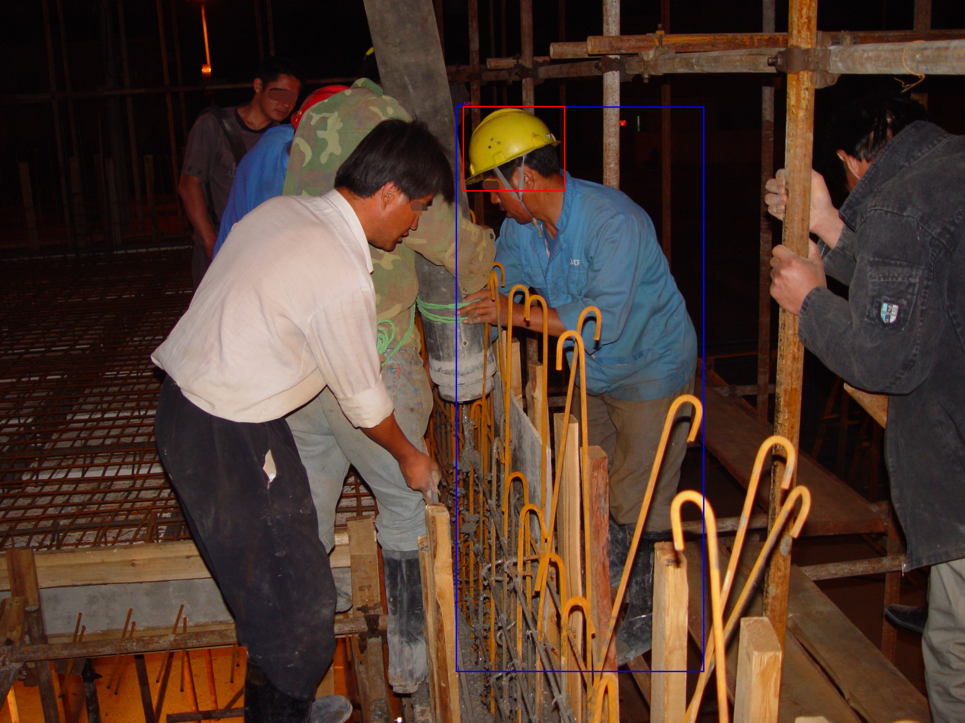
THE SOLUTION
The grounding-proxy: detect, then decide geometrically
• For a PPE rule: detect 'worker' boxes and 'hard hat' boxes separately.
• Mark the scene compliant only if every detected worker has a nearby safety-object box (a per-worker coverage check).
• rule_4 (struck-by) works the same way, checking proximity between 'worker' and 'excavator'.
• The region the model grounded becomes the candidate explanation the six metrics evaluate.
A 'hard hat' query correctly localized on a worker's head.
Construction-VLM XAI · Pilot findings & scale-up
13

Slide 14
REDESIGN
The first proxy barely worked — the redesign fixed it
3.0%
27.0%
9×
sensitivity of v1: 'does a hard hat exist anywhere?' — a near-constant 'compliant' classifier
sensitivity of v2: person-relative per-worker coverage check
improvement — the pilot's most consequential adaptation
v1 failed because multi-worker scenes almost always contain SOME hard hat. The fix mirrors the dataset's own per-worker labeling semantics. This was found only by running a sensitivity check the six metrics do not themselves perform.
Construction-VLM XAI · Pilot findings & scale-up
14

Slide 15
THE DEEPER CAVEAT
Florence-2 does not make the safety judgment
• Florence-2 only returns boxes. The compliant/violation answer is computed by our own hand-written geometric code (per-worker coverage within a fixed pixel-distance threshold).
• Consequence: several metrics partly measure the sensitivity of that geometric proxy, not the model's own reasoning.
• Example: mask the hard-hat box → the object list empties → the coverage check returns 'violation' by construction, regardless of what the model 'thinks.'
• This is the single most important reason to add a native-VQA model in the full study — so the metrics measure the model, not the scaffolding.
Construction-VLM XAI · Pilot findings & scale-up
15

Slide 16
03
System Architecture
How the pieces fit together
Construction-VLM XAI · Pilot findings & scale-up
16

Slide 17
PIPELINE
The evaluation pipeline, end to end
• Setup → sample selection → baseline grounding inference → region standardization → five per-sample metrics + efficiency → bounded completeness → cross-metric summary.
• Region standardization is the hinge: it ranks candidate boxes into an ordered list and provides the masking primitive every later metric consumes.
• Because every masking-based metric consumes this one layer, a single choice made here — how to rank candidate regions — propagates into several metrics at once.
• That fact becomes the pilot's central cross-cutting finding (Section 5).
Construction-VLM XAI · Pilot findings & scale-up
17

Slide 18
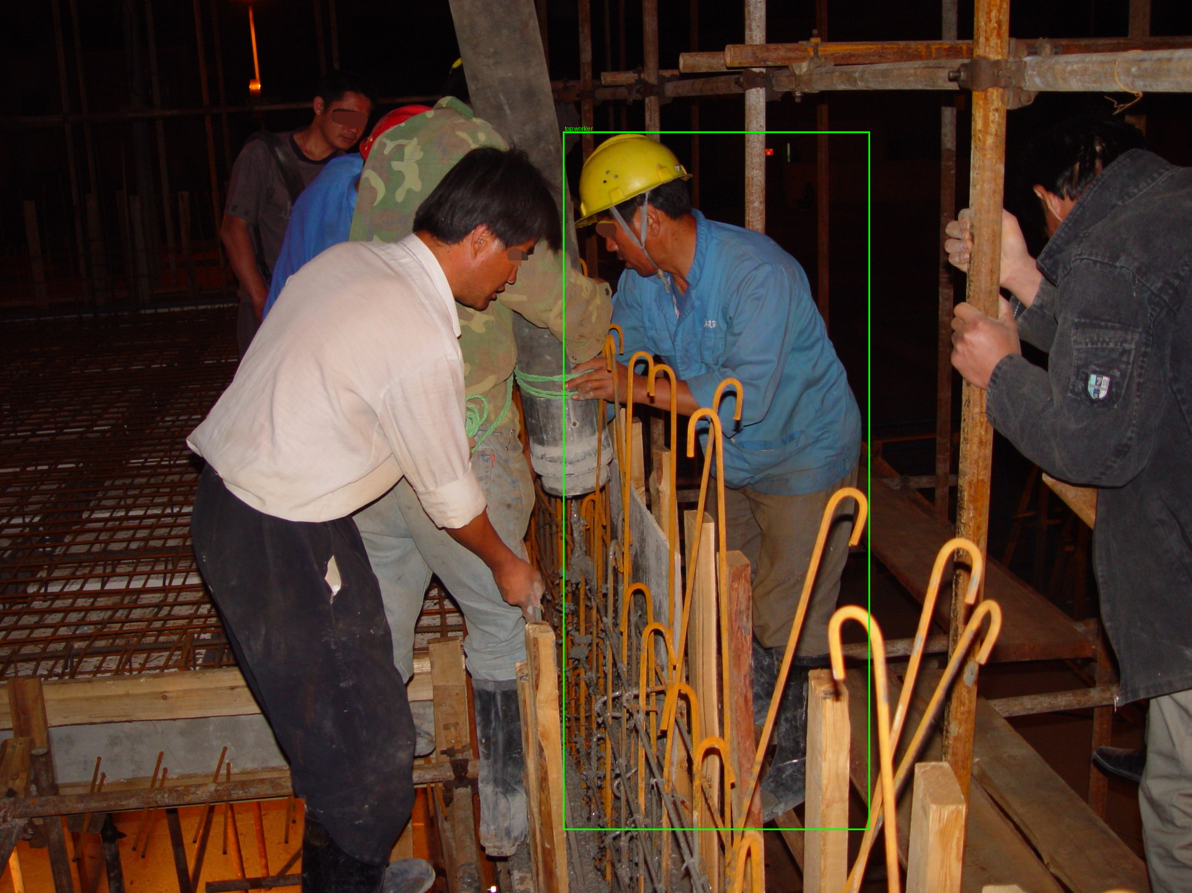
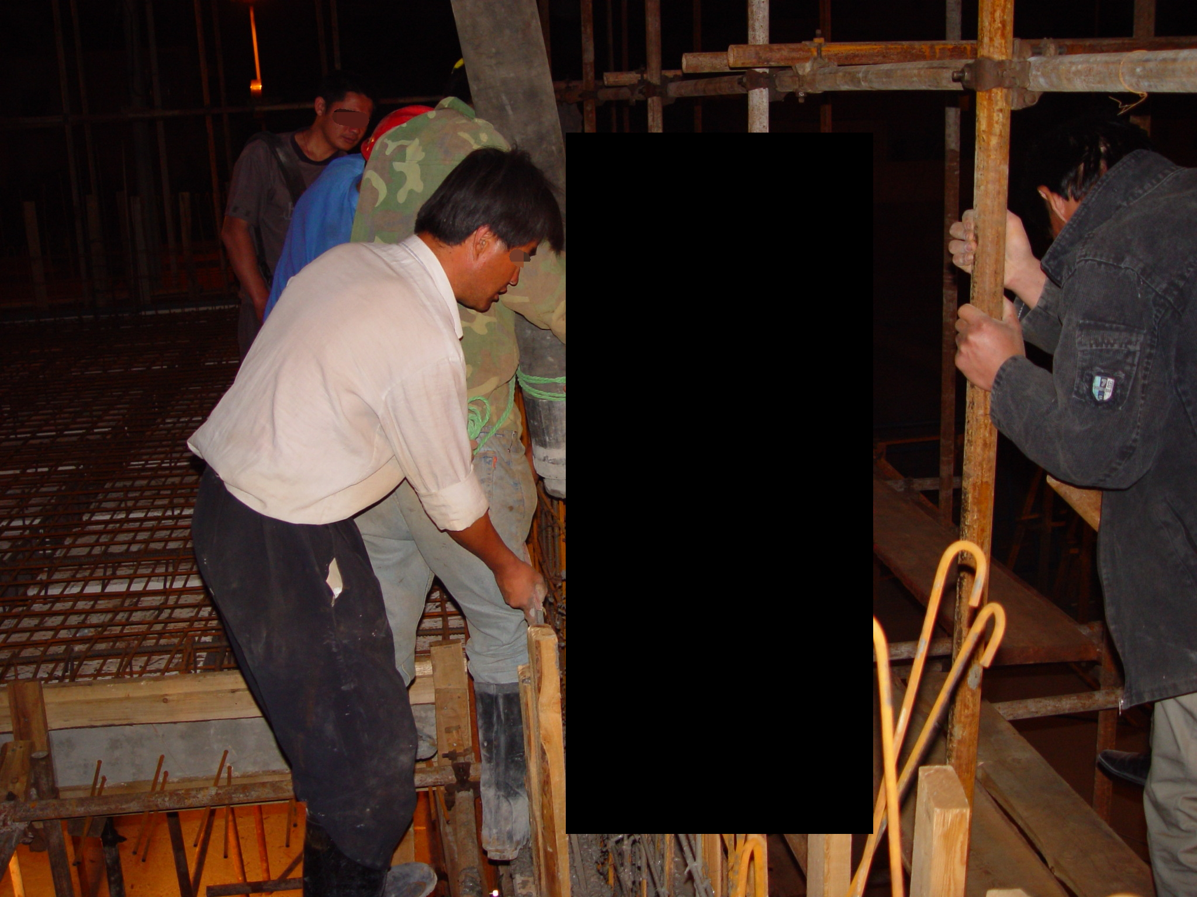
MASKING PRIMITIVE
Region standardization + masking, verified visually
Before: top-ranked region outlined.
After: that region masked (black-fill) for re-inference.
The masking primitive blacks out exactly the ranked region and nothing else — checked before any metric relies on it.
Construction-VLM XAI · Pilot findings & scale-up
18

Slide 19
04
The Six Metrics
Method, results, and what each one revealed
Construction-VLM XAI · Pilot findings & scale-up
19

Slide 20
DESCRIPTIVE ACCURACY
Method — a deletion test
• Mask the top-ranked region, re-run the proxy, and check whether the answer flips.
• A genuinely load-bearing region should be capable of flipping the decision when removed.
• Run twice per sample: mask top-1, then mask top-1 + top-2 cumulatively.
Construction-VLM XAI · Pilot findings & scale-up
20

Slide 21
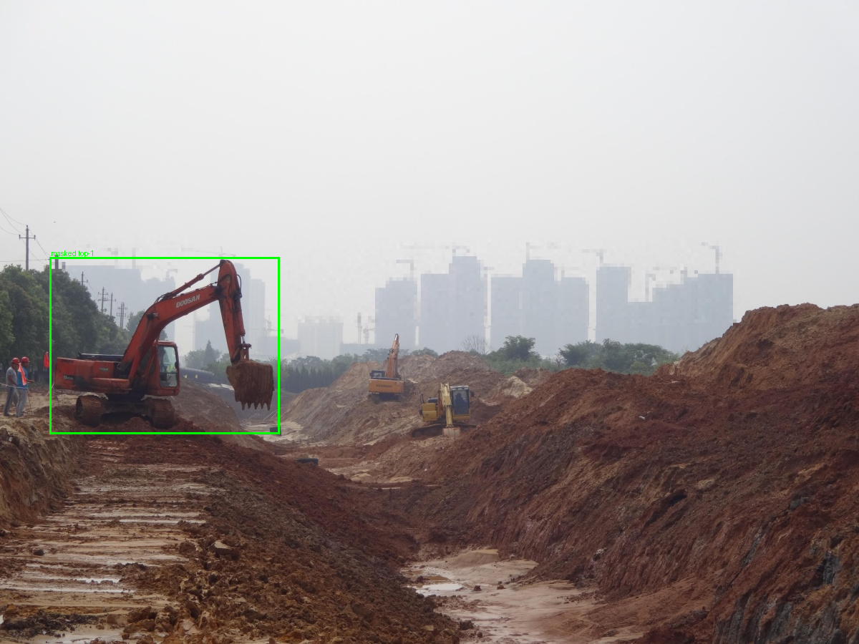
DESCRIPTIVE ACCURACY
Result: 36.2% top-1 flip rate
• 36.2% of samples flip when the top region is masked (35.0% for top-1+2).
• Clean case (right): masking the excavator box removes half of a proximity check and flips hazard → safe — exactly what the metric should detect.
• Weakness: the metric is confounded by the proxy it sits on — rules whose proxy barely discriminates have little for masking to disrupt.
Masking the top region flips the judgment for a reason that tracks the safety concept.
Construction-VLM XAI · Pilot findings & scale-up
21

Slide 22
DESCRIPTIVE ACCURACY
The non-monotonicity anomaly — a diagnostic, not noise
• Masking more (top-1+2 = 35.0%) flipped less than masking top-1 alone (36.2%). This should be impossible for a clean deletion test.
• Traced to a specific mechanism: masking the worker box makes the worker undetectable, which reroutes the proxy into a degenerate scene-level fallback branch.
• The answer then depends only on whether the other box is still visible — a binary, non-monotonic dependency.
• Lesson (generalizable): watch for non-monotonic masking results as a signature of hidden fallback logic.
Construction-VLM XAI · Pilot findings & scale-up
22

Slide 23
VISUAL SPARSITY
Method — and a verified course-correction
• Goal: is the model's attribution concentrated (focused) or spread thin?
• Planned method — attention rollout — assumes a single-modality encoder. Florence-2 fuses image + text tokens in one shared self-attention stack, so rollout's precondition fails.
• Verified against the model's own code before writing wrong code; substituted decoder→encoder cross-attention, which needs no single-modality assumption.
• This kind of architecture-first verification is exactly what a transformer-native XAI method demands.
Construction-VLM XAI · Pilot findings & scale-up
23

Slide 24
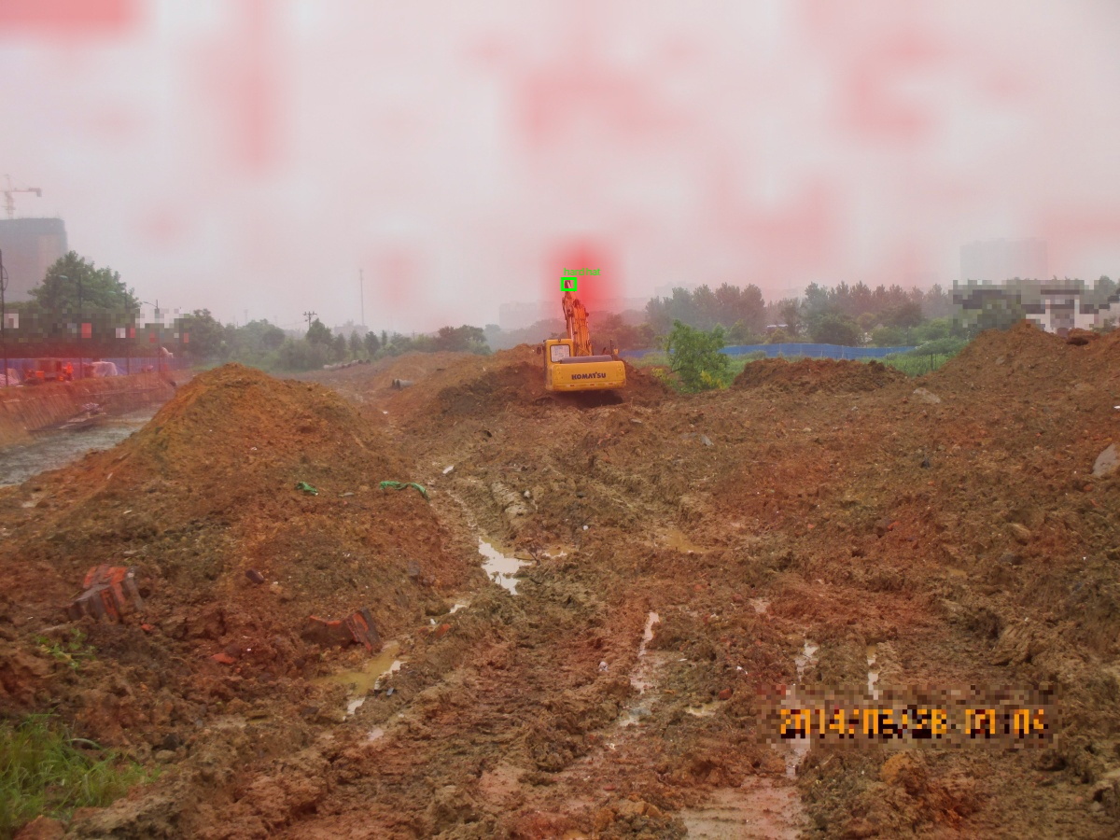
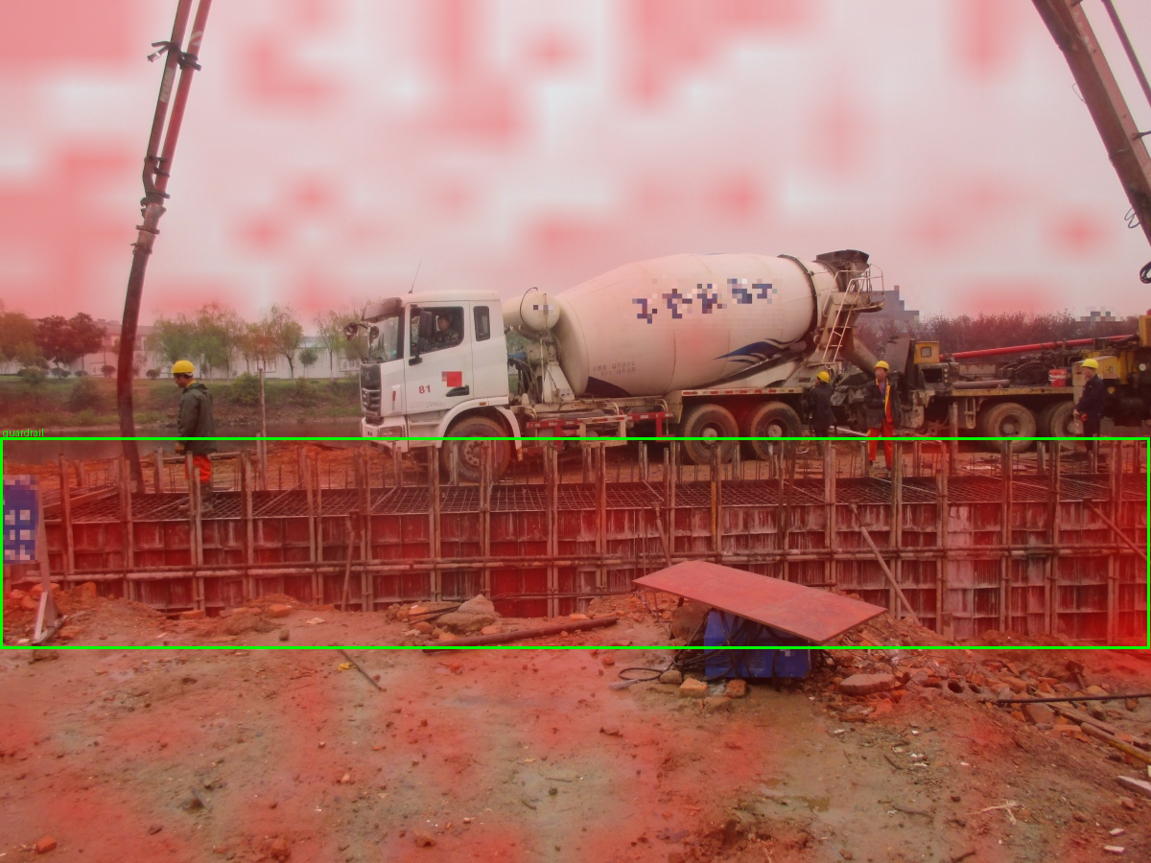
VISUAL SPARSITY
Result 0.108 — but concentration mostly tracks object SIZE
Small hard hat: sharp, concentrated hotspot (looks 'focused').
Large guardrail: attention spread across the frame.
Correlation between object size and concentration is −0.70. A small object looks 'focused' by construction — cross-rule sparsity comparisons are invalid without a size control.
Construction-VLM XAI · Pilot findings & scale-up
24

Slide 25
STABILITY
Method — avoiding a vacuous result
• Florence-2's default decoding is deterministic — literal reruns would be 100% stable by construction (a vacuous result).
• Fix: rerun 3× under stochastic sampling and confirm non-vacuousness (answer agreement 0.775, not 1.0) before trusting any number.
• Measure both answer agreement and region overlap across reruns.
Construction-VLM XAI · Pilot findings & scale-up
25

Slide 26
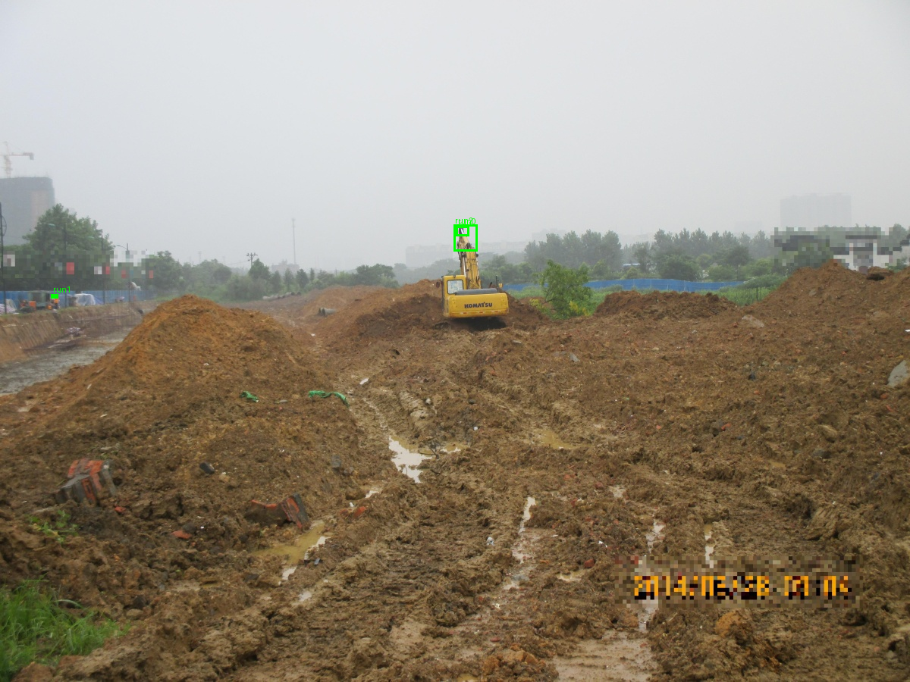
STABILITY
A healthy top-region score hid an unstable safety object
• Headline object-box overlap 0.602. But the top-region overlap (0.667) mostly measured the worker box (area-ranking again).
• The actual safety object is far less stable: hard hat 0.499 vs excavator 0.922 — nearly 2×.
• Right: three reruns' large top boxes overlay almost perfectly; the small hard-hat box underneath moves a lot.
• Partly genuine, partly the IoU size bias — small boxes lose overlap from a few pixels of jitter.
Three stochastic reruns overlaid.
Construction-VLM XAI · Pilot findings & scale-up
26

Slide 27
ROBUSTNESS
Method — isolating perturbation from noise
• Four image perturbations (blur, low-light, occlusion, contrast) + prompt rewording.
• Run under deterministic decoding, so any change is attributable to the perturbation, not to sampling noise.
• Record four signals per rerun: answer changed, confidence drop, evidence-box drift (IoU), and whether the worker detection was lost.
Construction-VLM XAI · Pilot findings & scale-up
27

Slide 28
ROBUSTNESS
Result: answer-change rate by perturbation
Perturbation | Answer changed | Evidence-box IoU | Reading
contrast shift | 10.4% | 0.825 | mild
low light | 11.7% | 0.816 | mild
blur | 27.0% | 0.287 | disruptive
reworded prompt | 27.5% | 0.333 | disruptive
occlude | 28.2% | 0.530 | disruptive (+ fallback)
Level-1 answer survival overall: 80.7%. But 'blur, occlude, reword are equally disruptive' hides three different mechanisms.
Construction-VLM XAI · Pilot findings & scale-up
28

Slide 29
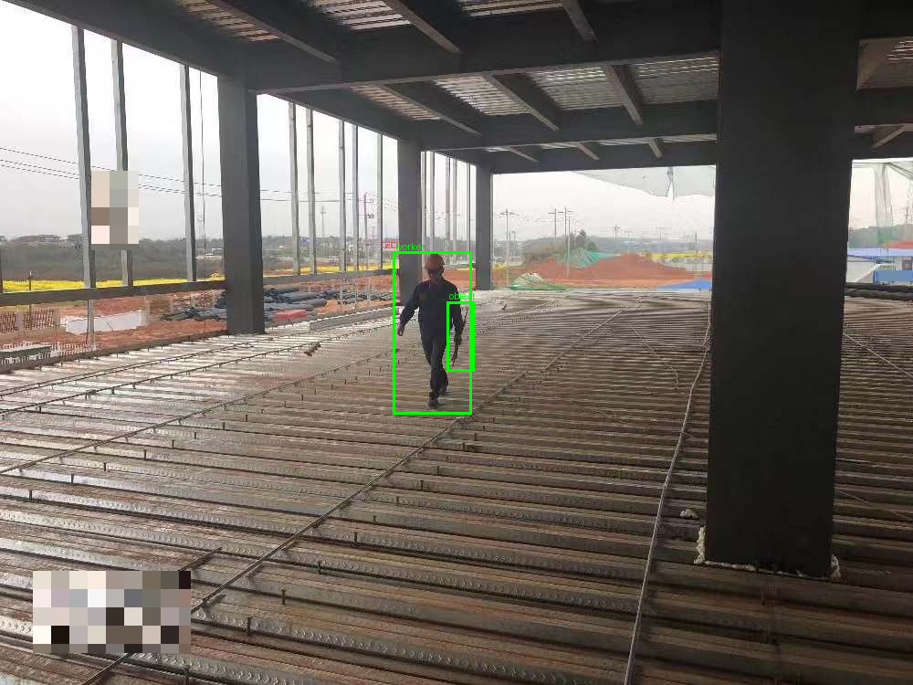
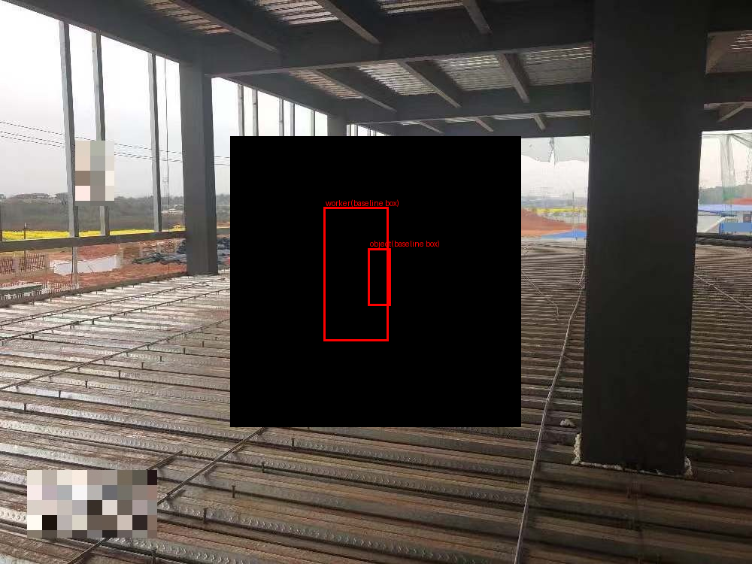
ROBUSTNESS — CENTERPIECE
A stable answer hiding a fully-drifted explanation
Before: the worker's evidence box, fully visible.
After occlusion: answer UNCHANGED, but evidence box relocated (IoU 0.005).
28.3% of stable-answer cases hide this. An answer-level metric alone would certify them as perfectly robust — direct proof that answer-level metrics are necessary but NOT sufficient.
Construction-VLM XAI · Pilot findings & scale-up
29

Slide 30
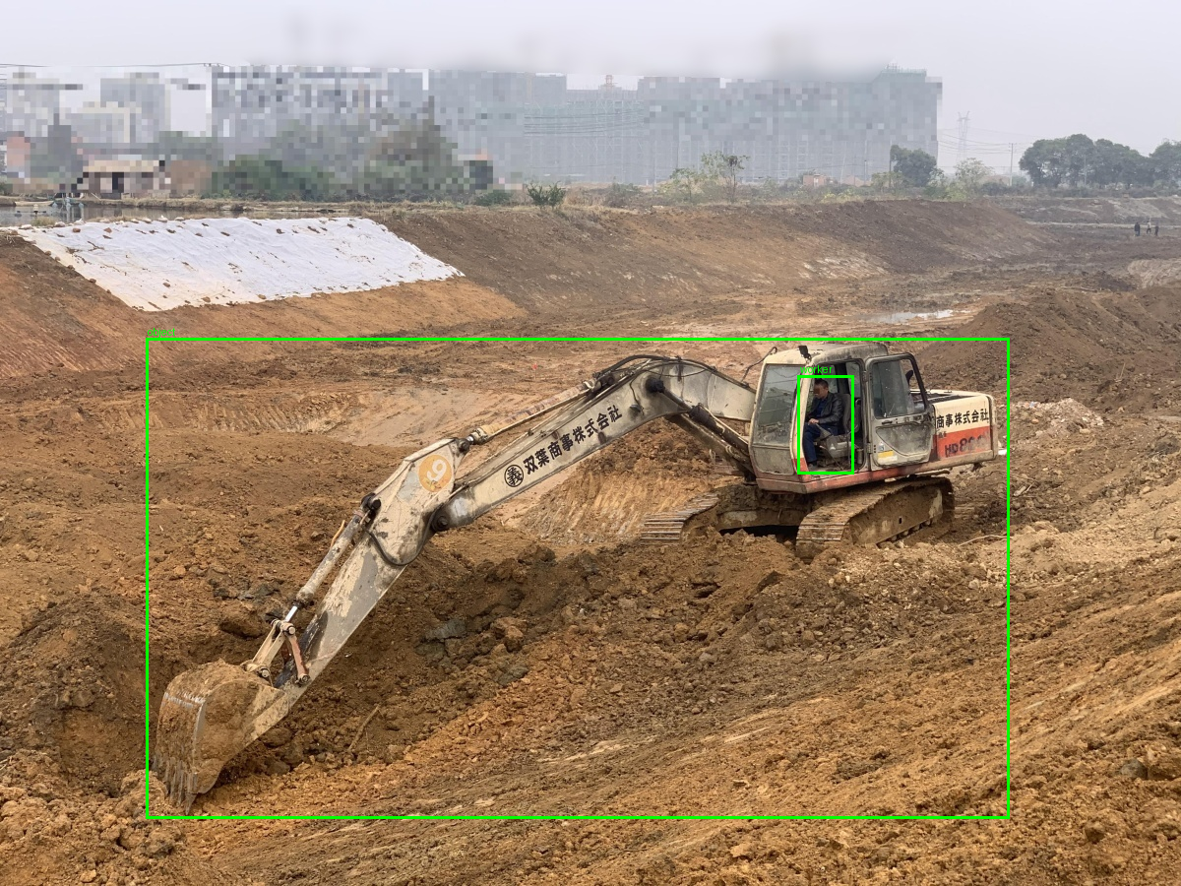
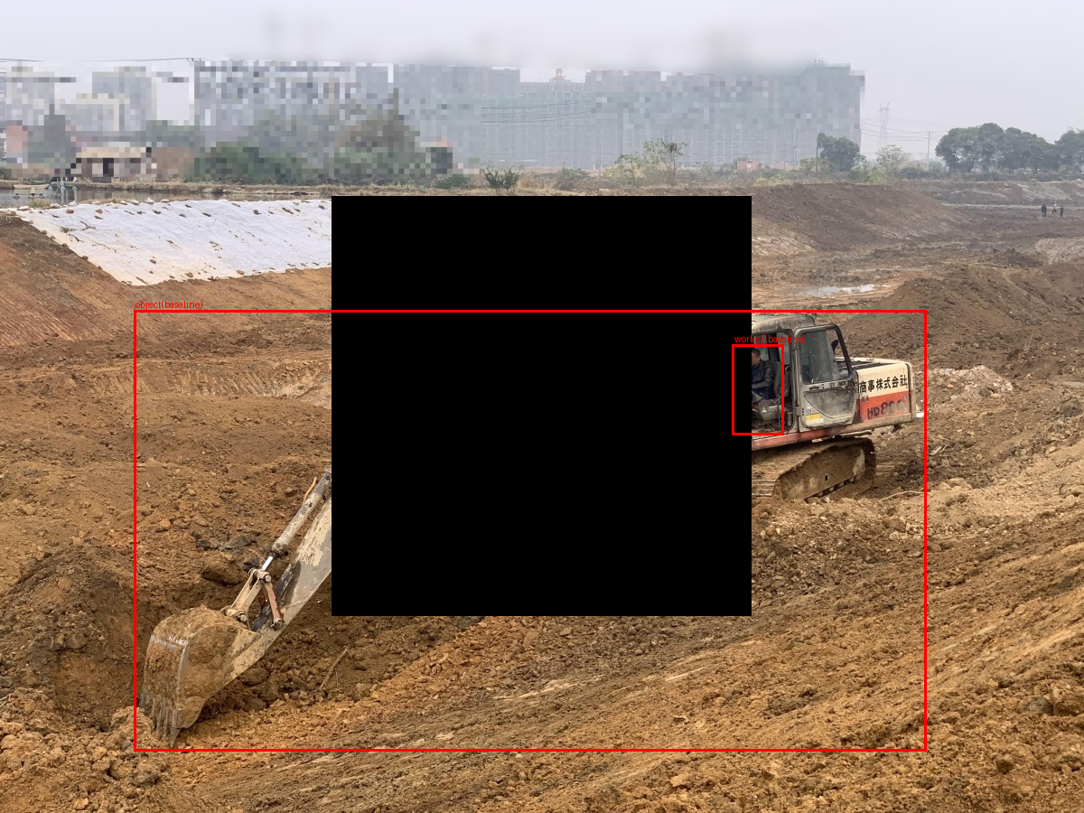
ROBUSTNESS
The fallback artifact — a flip for the wrong reason
Before: both detections already wrong but pass the geometric check.
After occlude: both vanish; answer flips via the fallback branch.
Same mechanism as the descriptive-accuracy anomaly — now triggered by perturbation. Raw robustness over-counts genuine failures unless these are separated out.
Construction-VLM XAI · Pilot findings & scale-up
30

Slide 31
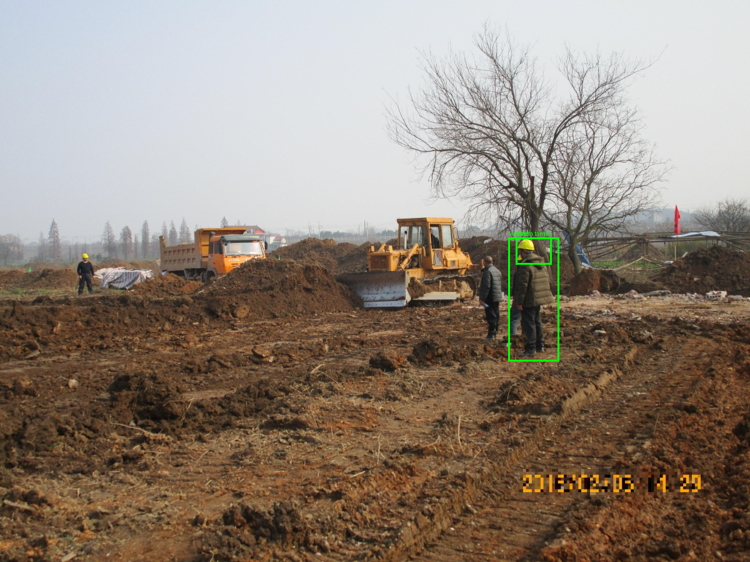
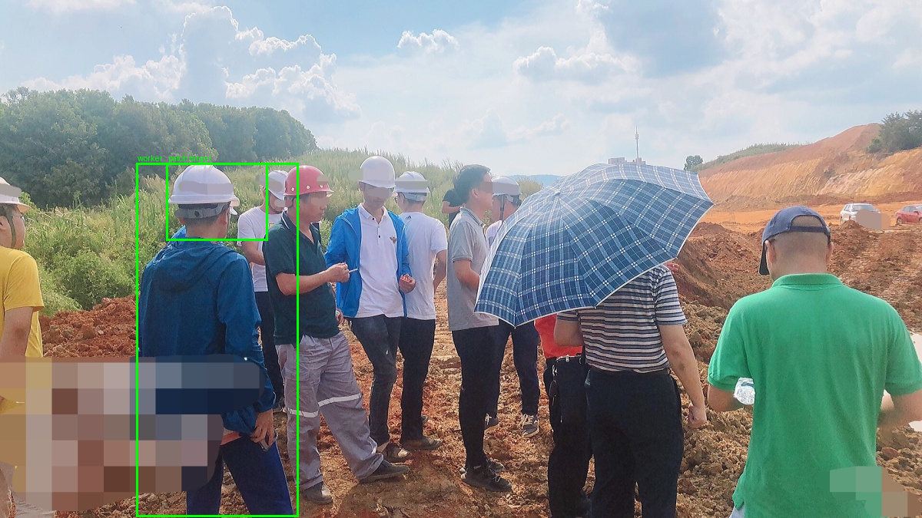
ROBUSTNESS — STRETCH TEST
Adversarial patch: a plausibility probe, not a result
On-target synthetic hard-hat patch → did NOT fool the model.
Off-target patch (torso) → DID flip to 'compliant'.
Denominator corrected from 15% (3/20) to 75% (3/4 meaningful cases). n=4 is too small to claim a vulnerability — flagged for a properly powered study.
Construction-VLM XAI · Pilot findings & scale-up
31

Slide 32
BOUNDED COMPLETENESS
Method — is the top region necessary?
• A necessity test: does removing the top region force the model to change its answer?
• Built as a roll-up over the descriptive-accuracy signal (so the two are not independent confirmations).
• Headline: 43.6% supported, 54.0% weak, 2.5% no-usable region.
Construction-VLM XAI · Pilot findings & scale-up
32

Slide 33
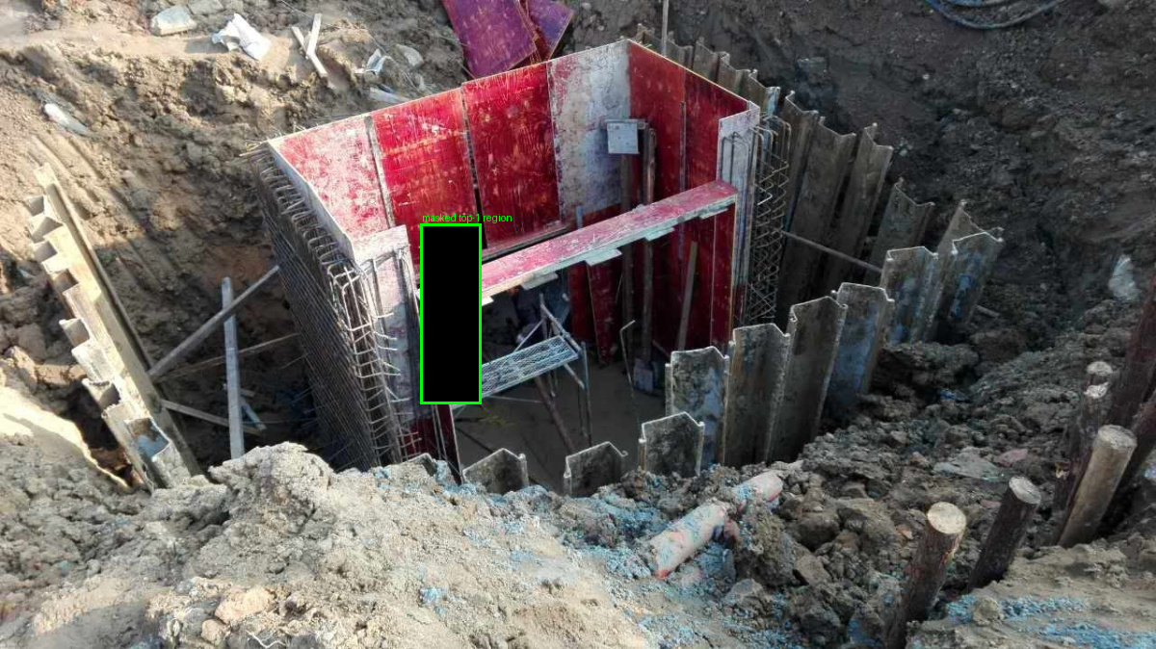
BOUNDED COMPLETENESS
Rigor: an extra 159-rerun check caught an inflation
• The by-rule pattern is the clearest single measurement of the area-ranking confound: PPE rules (small object) score weakest.
• An extra 159-rerun check found a worker-fallback artifact inflating the number, correcting 43.6% → 41.7%.
• Right: 'worker' and 'harness' boxes are nearly identical, so masking one erases both — the flip is a fallback, not genuine necessity.
• This kind of self-correction is what a full study should standardize, not perform ad-hoc.
Masking the top region erases both boxes at once.
Construction-VLM XAI · Pilot findings & scale-up
33

Slide 34
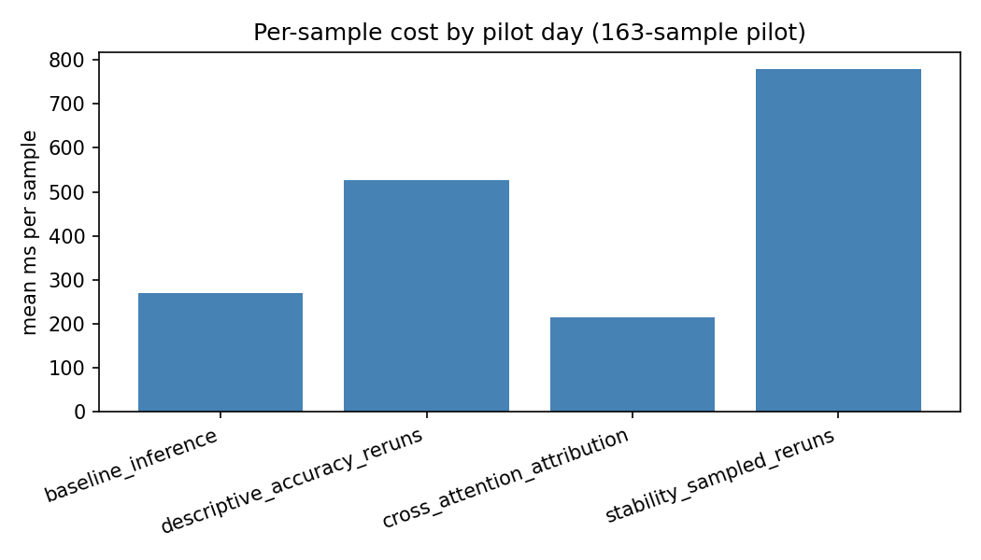
EFFICIENCY
Compute is conclusively not the obstacle
• Full six-metric pipeline: ~0.5 GPU-hours at n=1,000 on a single RTX 3070 (~30 minutes).
• Every other issue in this pilot is about validity, not cost.
• Methodological note: per-sample cost must be normalized by the number of internal model calls before comparing stages.
• Caveat: this budget is for the current pipeline; gradient attribution or dense detection would change it.
Per-sample inference cost by pipeline stage.
Construction-VLM XAI · Pilot findings & scale-up
34

Slide 35
05
Cross-Cutting Findings
Several 'separate' weaknesses are one story
Construction-VLM XAI · Pilot findings & scale-up
35

Slide 36
FINDING 1
One region-ranking choice weakens three metrics at once
• Candidate regions are ranked by box area as a stand-in for importance (no true saliency signal exists).
• A worker's body box is almost always larger than the PPE item, so the worker is ranked first in 96% of PPE samples.
• So descriptive accuracy, stability, and completeness all end up testing the worker, not the hard hat — precisely on the rules the project cares about most.
• This is the single highest-leverage fix: rank by the rule's queried object class before area. No new model calls.
Construction-VLM XAI · Pilot findings & scale-up
36

Slide 37
FINDING 2
A fallback branch recurs across three different tests
• Masking or perturbing the worker can make it undetectable, rerouting the proxy into a degenerate scene-level branch that flips the answer for reasons unrelated to safety.
• The same mechanism appears under deliberate masking (Descriptive Accuracy), under perturbation (Robustness), and inside the Completeness check.
• Found, traced to a specific code branch, and quantified each time — not left as unexplained noise.
• Fix: bake a worker-loss correction into every metric; report genuine vs raw rates.
Construction-VLM XAI · Pilot findings & scale-up
37

Slide 38
FINDING 3
Object size confounds two metrics
• Both sparsity (attention concentration) and stability (IoU overlap) are mathematically size-sensitive.
• Small, body-worn PPE items score worst — partly for geometric reasons, not explanation quality.
• This must be controlled (size-invariant metrics) before comparing PPE rules to large-object rules — and it may even inflate the robustness centerpiece, which also uses IoU.
Construction-VLM XAI · Pilot findings & scale-up
38

Slide 39
FINDING 4
The model does not make the judgment
• Florence-2 only returns boxes; a geometric rule produces the answer.
• So some metrics measure the proxy, not the model — the deepest reason to add a native-VQA model in the full study.
• This reframes the scale-up goal: not 'run more samples,' but 'make the metrics measure the model's reasoning.'
Construction-VLM XAI · Pilot findings & scale-up
39

Slide 40
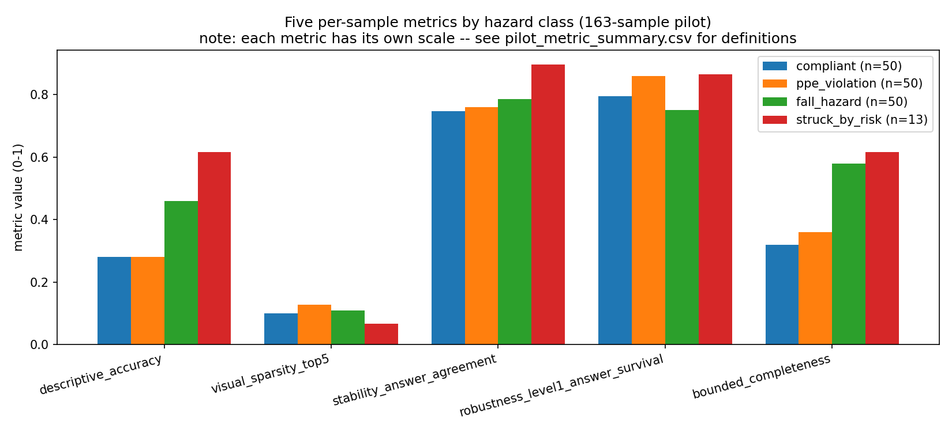
SYNTHESIS
All six metrics, side by side, by hazard class
The single figure that most compactly carries the pilot's quantitative content. struck_by_risk rests on n=13 — directional only.
Construction-VLM XAI · Pilot findings & scale-up
40

Slide 41
REPRODUCIBILITY
The pipeline reproduces from scratch — and testing it found a bug
• Re-run from a clean checkout in a brand-new environment on a fresh 20-sample subset: every step exited cleanly, zero manual intervention.
• Because it ran at a different sample size, it exposed a real bug — chart labels hardcoded to the pilot's sample counts — that every prior run had masked.
• It also hit a transient dataset-streaming error (auto-recovered), which validated moving the full study to a locally cached dataset — now implemented.
Construction-VLM XAI · Pilot findings & scale-up
41

Slide 42
06
Limitations & Scale-Up
Honest constraints, and the plan forward
Construction-VLM XAI · Pilot findings & scale-up
42

Slide 43
LIMITATIONS
Honest limitations (the full list)
• Scale: 163 of 3,004 test images; single model; single GPU.
• struck_by_risk = 13 is a labeling artifact, not a dataset property — the mutually-exclusive priority scheme discarded real struck-by images; the true multi-label pool is ~70.
• The proxy, not the model, makes the judgment — so some metrics partly measure geometric-rule sensitivity.
• Ranking by area; single-worker detection; hardcoded 2D thresholds; bounded (not full) completeness; Level-1 (+partial L2) robustness; uncalibrated confidence proxy; n=4 adversarial probe; fragmented decoding.
Construction-VLM XAI · Pilot findings & scale-up
43

Slide 44
SCALE-UP
The plan is phased — foundations before scale
• Phase 1 — Foundational fixes: rule-aware ranking; multi-label labeling (recovers struck_by_risk); bake in worker-loss correction; split rule_2 concepts; unify decoding. Cheap, high-leverage.
• Phase 2 — Metric validity: size-invariant sparsity & stability; text-token ablation; robustness severity sweeps; multi-hazard completeness.
• Phase 3 — Reproducibility & stats: containerize; multi-seed; minimum-n + significance tests; programmatic report numbers.
• Phase 4 — Attribution: keep cross-attention, add integrated gradients as a corroborating second stream.
• Do NOT scale sample count until Phase 1 is validated — scaling a biased pipeline just yields a larger biased sample.
Construction-VLM XAI · Pilot findings & scale-up
44

Slide 45
SCOPE
Phase 5 — models & datasets (recommended)
• Models (3): Florence-2 (region-native baseline) · Qwen2.5-VL (native-VQA — run both same-proxy AND native-VQA comparisons, so the metrics measure model faithfulness) · one frontier model as a benchmark-only reference.
• Datasets (3): ConstructionSite scaled to the full split · SODA for out-of-distribution robustness · CMA for temporal explanation-stability over video — a genuinely novel contribution.
• This is the difference between 'we scaled the pilot' and 'we fixed the confound a top reviewer will find.'
Construction-VLM XAI · Pilot findings & scale-up
45

Slide 46
DECISIONS
Six decisions we'd value your judgment on
• 1. Attribution method — is decoder→encoder cross-attention an acceptable LRP/DeepLIFT stand-in, or is a transformer-native method required?
• 2. Statistical rigor at small n — minimum-n and which test/interval, especially for struck_by_risk.
• 3. Region-ranking fix — approve replacing area ranking with rule-aware ranking.
• 4. Scaling vs imbalance — full-dataset scaling, or fix the class imbalance first?
• 5. Adversarial study — scope/budget for a properly powered Level-3 patch study.
• 6. rule_2 prompt — treat 'harness' and 'lanyard' as two distinct concepts.
Construction-VLM XAI · Pilot findings & scale-up
46

Slide 47
Thank you
The framework transfers — and the pilot produced an evidence-backed plan
to make the metrics measure the model's reasoning, at scale.
Discussion & the six decisions · Research advised by Professor Mustafa Abdallah

