Slide 1
EXPLAINABLE AI FOR CONSTRUCTION SAFETY
Can a vision-language model explain
a construction hazard?
Transferring a six-metric XAI evaluation framework from tabular intrusion detection to visual safety judgement — across two models, two designs, and 4,045 measured image–rule pairs.
Study 1 · Florence-2-base-ft (231M) Study 2 · Qwen2.5-VL-7B (4-bit)
Project dissertation · 21 August 2026

Slide 2
CONTENTS
What this deck covers
I
Framing
The problem, the framework, the dataset
3–7
II
Study 1 — Florence-2
Pilot design, six metrics, findings
8–20
III
Study 1 — scale-up
Correctness fixes and statistics hardening
21–23
IV
Study 2 — Qwen2.5-VL
Real VQA, seven metrics, 3,882 pairs
24–35
V
Synthesis
Does the framework transfer?
36–39
VI
Close
Conclusion and next steps
40
Every figure is regenerated from committed result files.
2

Slide 3
THE PROBLEM
Accuracy is not trust
A safety system that is right most of the time, for reasons it cannot state, is harder to govern than one that is plainly wrong.
— A wrong system gets switched off. Its errors are visible, so operators stop trusting it.
— A system that is right 91% of the time invites trust. If its stated reasons are unrelated to its decisions, that trust is misplaced and nothing in an accuracy report reveals it.
— Construction is the test case. The industry's “fatal four” — falls, struck-by, caught-in, electrocution — account for the majority of site deaths. An alert that cannot be justified is an alert that gets ignored.
THE RESEARCH QUESTION
Does an XAI evaluation framework built for tabular intrusion-detection networks transfer to a vision-language model making visual safety judgements — and what does it reveal that accuracy hides?
Motivation
3

Slide 4
BACKGROUND
Six metrics — and a seventh this project adds
Metrics 1–6 are Prof. Abdallah's framework, developed for deep intrusion-detection models on tabular data.
Metric | What it asks | Measured in
1 Descriptive accuracy | Remove the evidence the model used — does the answer change? | both
2 Sparsity | Is the explanation concentrated, or smeared over everything? | both
3 Stability | Ask repeatedly — is the answer the same? | both
4 Efficiency | What does one explained decision cost? | both
5 Robustness | Does it survive degraded input? | both
6 Bounded completeness | Was a usable explanation given, and did it matter? | both
7 Explanation correctness | Does the stated reason match the human's reason? | Study 2
WHY THE SEVENTH ONLY APPEARS IN STUDY 2
Metric 7 grades the reason a model gives in words against the reason a human wrote. Florence-2 has no question-answering head — it returns boxes, never a sentence — so there is nothing to grade. Qwen2.5-VL states a reason, which is what makes the metric possible at all.
Framework origin
4

Slide 5
THE DATA
ConstructionSite 10k
10,013 annotated site photographs · gated, CC-BY-NC-4.0
10,013
photographs
test 3,004 · train 7,009
1,278
with a violation
12.8% prevalence
47%
flagged “poor info”
annotation quality
4
safety rules
PPE · fall · edge · plant
— Each violation carries a human-written reason and a bounding box. That reason is the yardstick for metric 7, explanation correctness — without a human-written reason there is nothing to grade the model's reason against.
— Boxes are normalised 0–1; model outputs are absolute pixels. Comparing them without converting puts every annotation in the top-left corner and yields a study-wide null result that looks like a finding.
— “Compliant” means no annotator marked a violation. It does not mean verified safe — which bounds every specificity figure in both studies.
LouisChen15/ConstructionSite
5

Slide 6
THE DATA
The four safety rules
Each rule is put to the model as a question. These are the exact wordings used.
rule_1
PPE
ppe_violation
“Is any worker missing required personal protective equipment — a hard hat, high-visibility clothing, or adequate body covering?”
rule_2
Fall protection
fall_hazard
“Is any worker working at height without fall protection such as a safety harness or lanyard?”
rule_3
Edge protection
fall_hazard
“Is there an unprotected edge, excavation, trench or floor opening that a worker could fall into — one lacking guardrails or barriers?”
rule_4
Machinery proximity
struck_by_risk
“Is any worker inside the danger zone or blind spot of operating heavy machinery, such as an excavator?”
RULE_4 IS ASKED ONLY WHEN MACHINERY IS PRESENT
It is the one rule with a context gate. Asking about excavator proximity in a photograph containing no machinery is a question that cannot be failed — it inflates accuracy while measuring nothing.
src/xai_vlm/rules.py
6

Slide 7
THE DATA
Class imbalance is the design constraint
Violations per rule across the whole corpus.
Rule | Hazard | Test | Train | Total
rule_1 | PPE | 324 | 677 | 1,001
rule_3 | Edge protection | 63 | 109 | 172
rule_2 | Fall protection | 25 | 59 | 84
rule_4 | Machinery proximity | 24 | 46 | 70
WHY BOTH SPLITS
The models are evaluated zero-shot and never trained on this data, so there is nothing to hold out. Using the test split alone would leave rule_2 at n=25 and rule_4 at n=24 — below the n=30 reporting floor, making two of four rules unreportable.
THIS ASYMMETRY DRIVES EVERYTHING DOWNSTREAM
rule_1 has fourteen times the positives of rule_4. Any pooled metric is therefore mostly a statement about PPE — which is exactly how Study 2's sharpest finding stayed hidden until rates were broken out per rule.
Section 5.3
7

Slide 8
APPROACH
Two studies, two different questions
 | Study 1 — Florence-2 | Study 2 — Qwen2.5-VL
Question | Does the framework transfer at all? | What does it measure at scale?
Model | Florence-2-base-ft · 231M | Qwen2.5-VL-7B-Instruct · 4-bit
Task form | Grounding proxy (no VQA head) | Native visual question answering
Sample | 163 images, balanced draw | 3,882 image–rule pairs · 2,556 images
Metrics | 6 | 7 (adds explanation correctness)
Statistics | Bootstrap CIs added in Phase 3.1 | Pre-registered; CIs throughout
THESE ARE NOT A LEAGUE TABLE
Different models, different task forms, different sample sizes, and metric definitions that share names without sharing meaning. Study 1 asks whether the framework can be applied; Study 2 asks what it says. Comparing their headline numbers directly would be a category error.
Design overview
8

Slide 9
PART II
Study 1 — Florence-2
A two-week feasibility pilot: can the framework be applied to a vision-language model at all?
9

Slide 10
STUDY 1 · MODEL
Florence-2-base-ft
A 231M-parameter vision-language model, chosen because it runs comfortably on one consumer GPU.
Property | Value
Parameters | 231 M
Hardware | 1 × RTX 3070, 8 GB
Precision | fp16
transformers | 4.49.0 (pinned)
Native VQA head | none
Attribution | decoder→encoder cross-attention
THE OBSTACLE THAT SHAPED THE PILOT
Florence-2 cannot be asked a question. It grounds phrases. Every safety rule had to be reframed as a detection query, which makes the whole study a measurement of a proxy — a stated adaptation, not literal question answering.
WHY THIS MATTERS LATER
Study 2's model answers questions directly. That single capability difference is what allows metric 7 to exist at all.
Model card
10

Slide 11
STUDY 1 · ADAPTATION
The proxy had to be redesigned mid-pilot
First formulation: ground the safety object, check whether it appears. It barely worked.
3.0%
sensitivity
first formulation
27.0%
sensitivity
person-relative check
9× gain
from changing what the question asks, not from changing the model.
→
WHY IT PRODUCED CONFIDENT NUMBERS ANYWAY
v1 asked: does a hard hat appear anywhere in the image? On a site photo the answer is usually yes, so it returned “compliant” almost regardless of ground truth — 3.0% sensitivity.
None of the six metrics reads the verdict's correctness. They measure flip rates, attention concentration and re-run agreement — all of which compute perfectly well on a model that is ignoring the image. Six plausible numbers, describing nothing.
THE FIX — MAKE THE QUESTION PERSON-RELATIVE
v2 asks: is a hard hat on THIS worker? Detect the worker, detect the safety object, then check whether the object covers the worker's head region.
The hazard now has to be tied to a person, so a helmet elsewhere in frame no longer clears the check. Same model, same weights — only the question changed.
Design decision #1
11

Slide 12
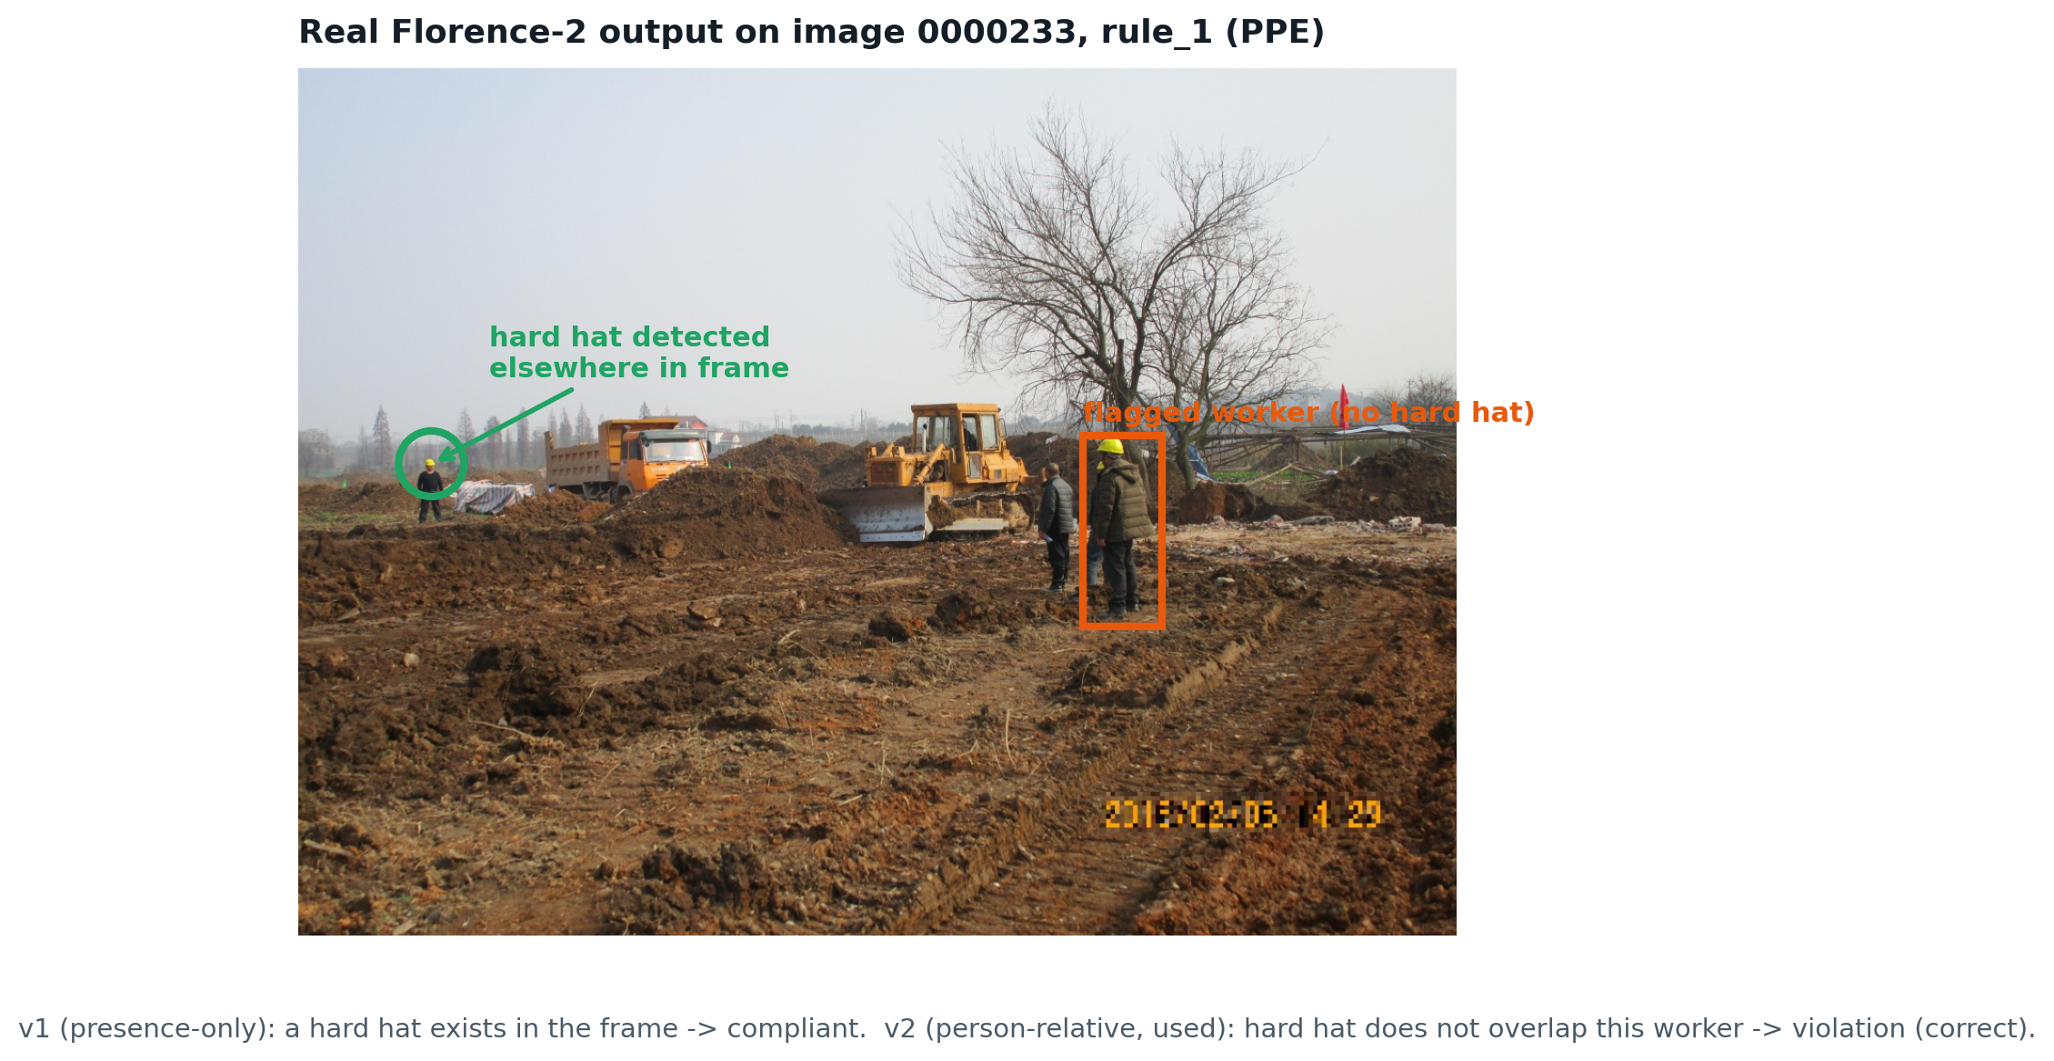
STUDY 1 · ADAPTATION
The mechanism, on a real image
Both boxes below are genuine Florence-2 detections from the pilot run — not a mockup.
WHY V2 IS NOT JUST 'TRY HARDER'
The model detects the hard hat correctly either way — grounding is not the problem. v1 fails because it asks a question with no notion of WHO is wearing WHAT; v2 fixes that by requiring the two boxes to overlap.
Image 0000233, rule_1
12

Slide 13
STUDY 1 · PIPELINE
Eleven stages, run in order
01
Environment
check
02
Balanced
sample
03
Baseline
inference
04
Extract
regions
05
Descriptive
accuracy
06
Visual
sparsity
07
Stability
08
Efficiency
09
Robustness
10
Bounded
completeness
11
Figures &
roll-up
—
Report
— Each stage writes a CSV. Metrics are computed from files, never held in memory across stages, so any stage can be re-run and audited independently.
— Reproducibility was verified end to end. The full pipeline re-runs from a clean virtual environment on a fresh 20-sample subset with no manual intervention.
scripts/01–11
13

Slide 14
STUDY 1 · WORKED EXAMPLE
What one sample actually looks like
INPUT
A site photograph, plus the rule assigned to it
image 0000007 · rule_1 (PPE)
QUERY
The rule, reframed as a grounding phrase Florence-2 can answer
<OPEN_VOCABULARY_DETECTION> “worker” + “hard hat”
MODEL OUTPUT
Boxes for the person and for the safety object
worker [967, 226, 1494, 1427] · object [982, 225, 1199, 406]
DERIVED VERDICT
Person-relative coverage check → compliant / violation
coverage satisfied → “compliant”
EXPLANATION REGION
Standardised, ranked, used by metrics 1, 2, 5, 6
top-ranked region = the worker's body box
READ THE LAST LINE CAREFULLY
The “explanation” is the worker's body box, because regions were ranked by area and a person is larger than a hard hat. That single mechanical choice goes on to explain three of the six metrics' weakest results.
Input, intermediate, output
14

Slide 15
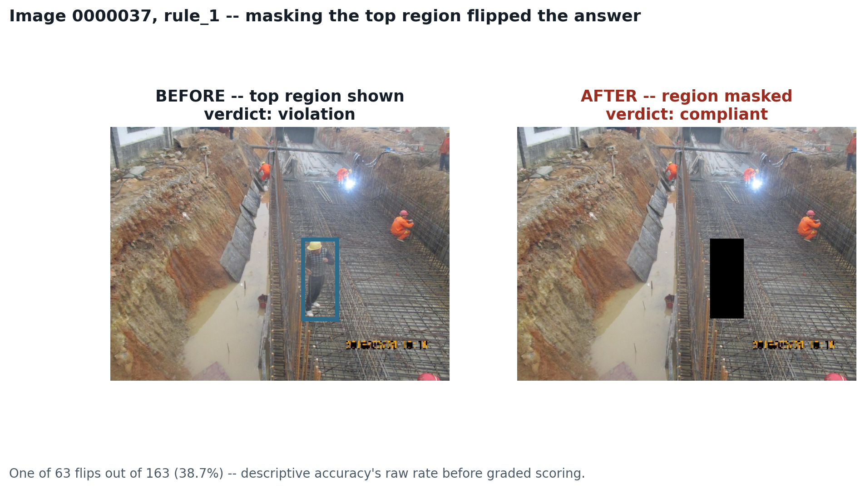
STUDY 1 · METRICS
Metric 1 · Descriptive accuracy
If we delete the region the model pointed to, does its answer change?
Masking the region the model supposedly relied on left its answer unchanged in roughly two cases out of three. The image above is one of the 63 cases (38.7%) where it did flip.
The area-ranking bias is implicated: masking a worker's whole body removes the person, not the missing hard hat — see slide 21.
36.2%
descriptive accuracy
[28.8, 43.6] · n=163
n = 163 · pilot
15

Slide 16
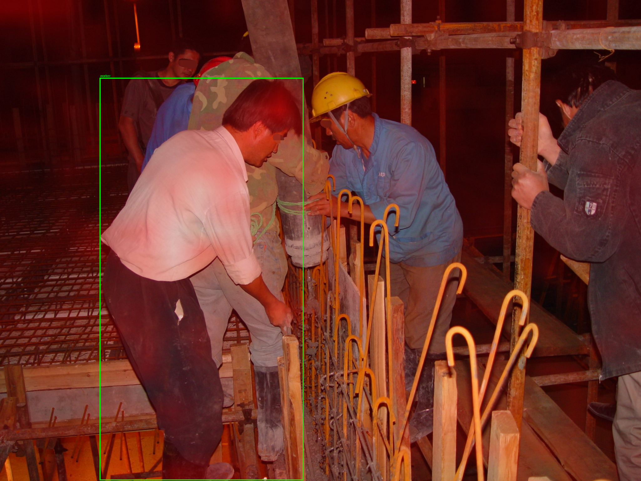
STUDY 1 · METRICS
Metric 2 · Sparsity
Where did the model look while answering — a few places, or everywhere at once?
THE METHOD, PLAINLY
1. As the model writes its answer, it repeatedly “looks back” at the image. That looking is recorded — it is called cross-attention.
2. Divide the image into a 24 × 24 grid — 576 cells — and total up how much attention landed in each one.
3. Rank the cells and ask: what share of all attention fell in the strongest five?
Red = high cross-attention.
Image 0000007, rule_1.
0.87%
if attention were even
5 of 576 cells
10.8%
measured
≈ 12× more focused
HOW TO READ IT
About twelve times more concentrated than an even spread — but the top five cells still hold only a tenth of total attention.
WHY THIS FORMULATION WAS REPLACED
A top-5 measure punishes big hazards for being big: an unguarded edge spanning the frame should attract spread-out attention. Study 2 uses the Gini coefficient, which describes the shape of the distribution regardless of object size.
n = 159 · pilot
16

Slide 17
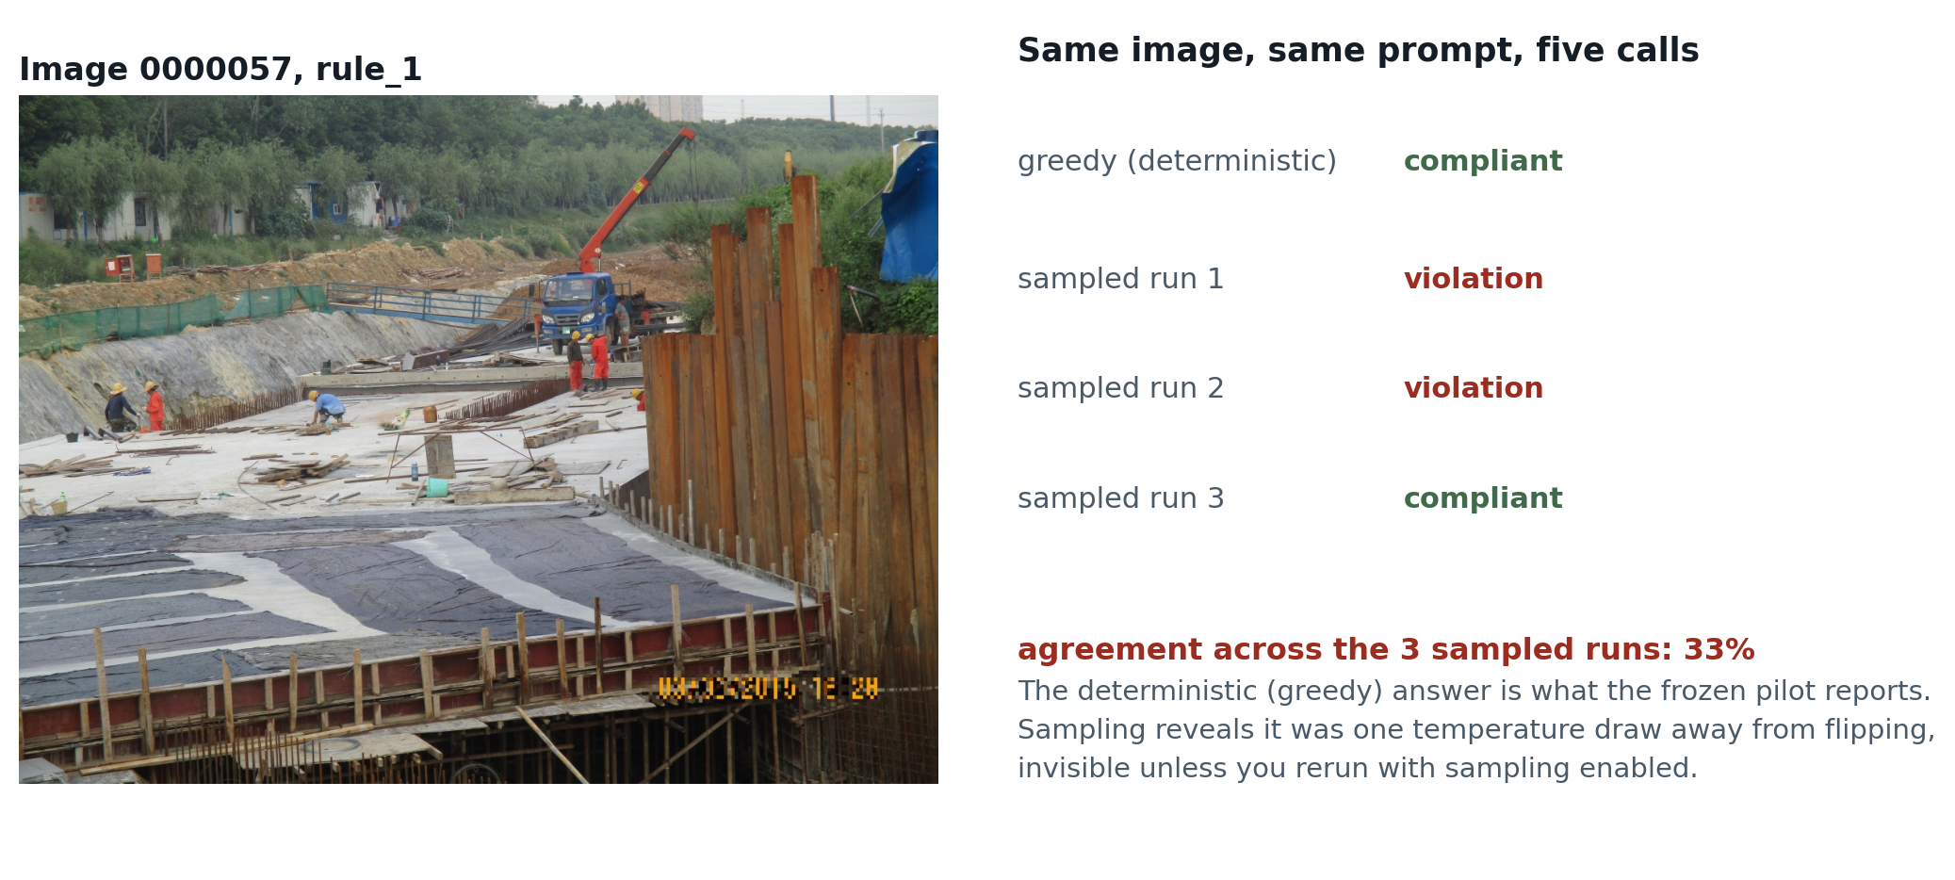
STUDY 1 · METRICS
Metric 3 · Stability
Ask the same question five times — does the model give the same answer?
Sampling is mandatory: under greedy decoding the model is deterministic and would score 100% stable by construction, proving nothing.
A stable answer can hide a drifted explanation: 28.3% of reruns kept the same verdict while the evidence box moved to something unrelated — invisible to answer-level agreement alone.
77.5%
3-run agreement
overall · n=163
n = 163 · pilot
17

Slide 18
STUDY 1 · METRICS
Metric 4 · Efficiency
What does one explained decision cost?
≈0.5 h
result
full pipeline @ n=1,000
— Compute is not the blocker. About thirty minutes of GPU time covers the entire six-metric pipeline at a thousand samples.
— This is the one metric that transferred unchanged. Wall-clock timing means the same thing for tabular and visual models.
METHOD
Per-stage GPU timing, extrapolated to n=1,000.
n = 163 · pilot
18

Slide 19
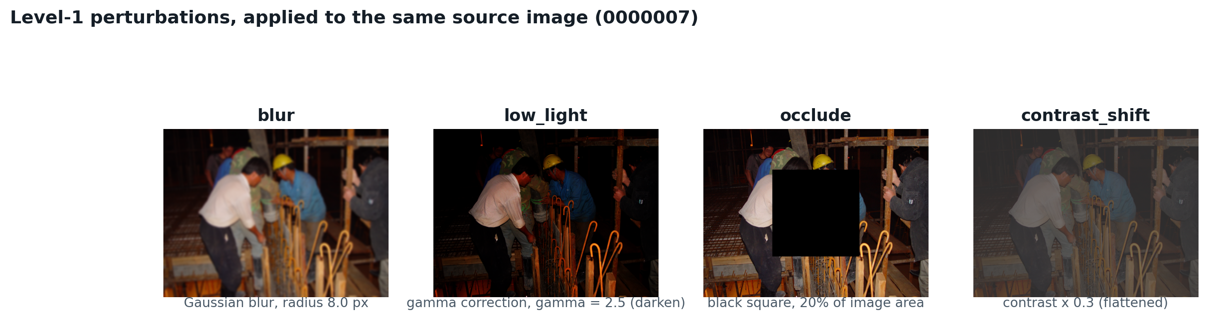
STUDY 1 · METRICS
Metric 5 · Robustness
Does the answer survive a degraded photograph?
— Four perturbations, level 1. Gaussian blur (radius 8), gamma-darkening (γ=2.5), a centred black occlusion square (20% of image area), and contrast × 0.3. No downsampling or resolution change is applied at this level.
— Report per perturbation, never pooled. A single figure hides a model that is perfect under blur and useless in low light — and low light is when site accidents happen.
80.7%
level-1 survival
answer unchanged
TARGETED OCCLUSION DRIFTS THE EXPLANATION MORE THAN RANDOM PLACEMENT
Covering the actual hazard moves the evidence box significantly more than covering a random 20% of the frame — Wilcoxon p = 1.1×10⁻³, confirming the effect is not sampling noise.
n = 652 (163 images × 4 perturbations) · pilot
19

Slide 20
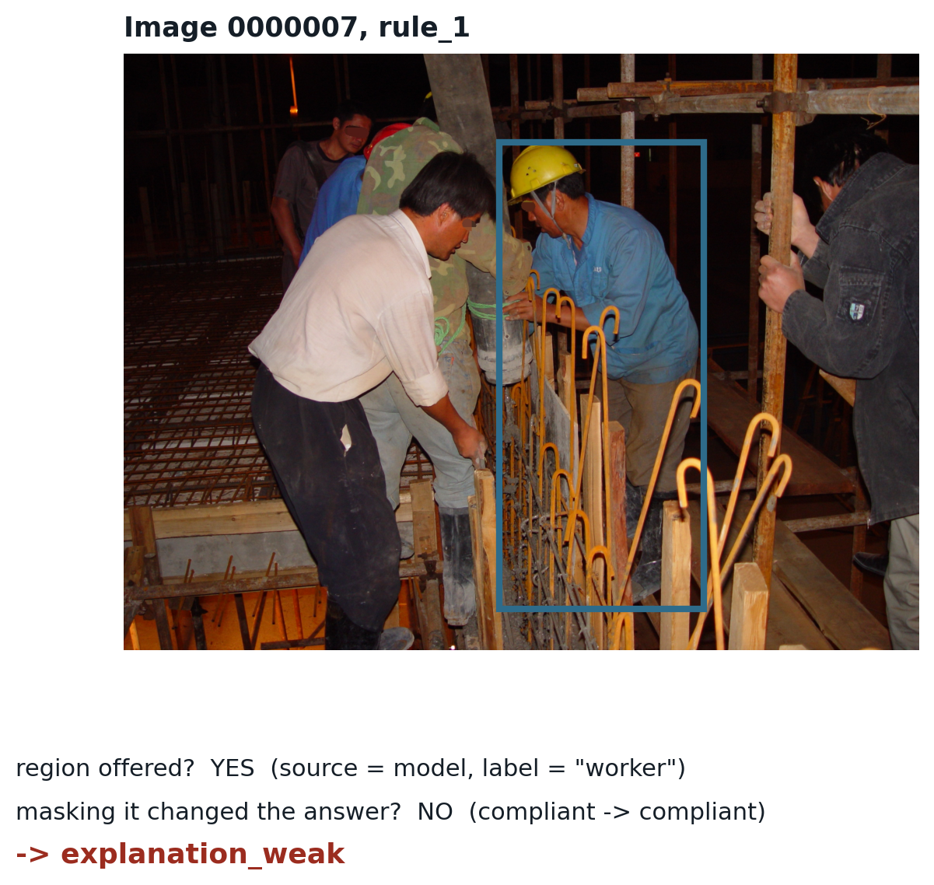
STUDY 1 · METRICS
Metric 6 · Bounded completeness
Was a usable explanation given, and did it actually matter?
THE RULE — A PURE ROLLUP, NO NEW MODEL CALLS
no_usable_explanation — no region was offered at all.
explanation_weak — a region was offered, but masking it did not change the answer.
explanation_supported — a region was offered, and masking it did.
43.6%
supported
54.0%
weak
2.5%
no explanation
“BOUNDED” IS AN HONEST QUALIFIER
This tests whether the single top-ranked region is necessary, not whether the full set of regions is sufficient. Multi-hazard images score far worse — 27.3% [9.1, 45.5] on n=22, flagged below the reporting floor rather than quoted as a result.
n = 163 · pilot
20

Slide 21
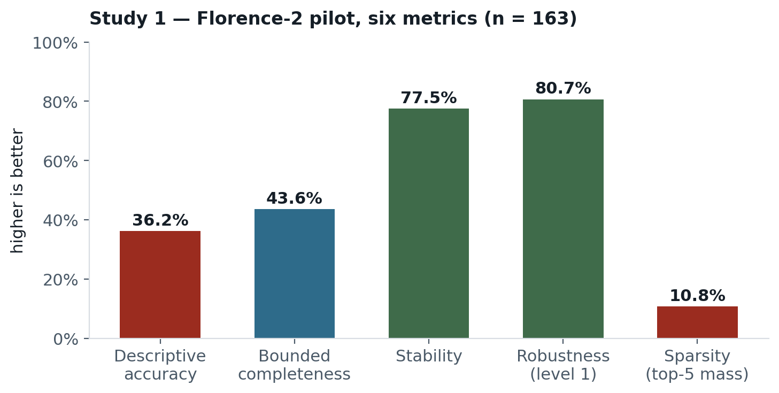
STUDY 1 · RESULTS
Six metrics, one view
THE HEADLINE IS THAT ALL SIX RAN
The pilot's purpose was feasibility: could a framework built for tabular intrusion detection be executed end to end against a vision-language model? It could. The individual values matter less than the two adaptations required and the three defects the process exposed.
results/pilot_metric_summary.csv
21

Slide 22
STUDY 1 · METHODOLOGY
How each number is actually computed
Every metric reduces to a share of samples meeting a per-sample test, applied over n. No metric is estimated or eyeballed.
Metric | Per-sample test | Aggregate | n | Result
Descriptive accuracy | flip(x) = 1 if answer(mask(x, top-1 region)) ≠ answer(x) | mean(flip) | 163 | 36.2%
Sparsity | top5(x) = mass of the 5 highest cells / total mass, on a 24×24 = 576-cell cross-attention grid | mean(top5) | 159* | 10.8%
Stability | agree(x) = share of the 3 pairs among 3 sampled reruns (temp = 0.7) that gave the same answer | mean(agree) | 163 | 77.5%
Robustness | survive(x,p) = 1 if answer(perturb(x,p)) = answer(x), over 4 perturbations p × 163 images | mean(survive) | 652 | 80.7%
Bounded completeness | 3-way rule on (region offered?, did masking flip the answer?) — no new model calls, a pure rollup | share per category | 163 | 43.6% / 54.0% / 2.5%
* SPARSITY'S N IS 159, NOT 163
Four samples had no model-grounded region at all (grid fallback only) — there is no attention map worth scoring in the same way, so they are excluded rather than assigned an arbitrary value.
src/xai_pilot/metrics/*.py
22

Slide 23
STUDY 1 · METHODOLOGY
Descriptive accuracy, worked through
The exact arithmetic behind 36.2%, using the flip you already saw on slide 15.
STEP BY STEP
1. Run the baseline: answer(x) for all 163 images. Image 0000037 → violation.
2. Mask the top-ranked region (worker box) and rerun: answer(mask(x)). Image 0000037 → compliant.
3. Compare: violation ≠ compliant → flip(0000037) = 1.
4. Repeat for all 163 images. 59 return flip = 1; 104 return flip = 0.
5. Average: 59 / 163 = 0.362 → report as 36.2%.
WHY “FLIP” AND NOT “GRADED SCORE”
The frozen pilot's headline (36.2%) uses the boolean flip test above. Scale-up Phase 2.1 later added a continuous graded score — the drop in a confidence-weighted coverage metric, not just yes/no — because a mask can meaningfully reduce the model's confidence without crossing the answer boundary.
Both are reported, behind a flag: the boolean flip rate is what the 163-sample pilot is frozen to and what every number on this deck's Study-1 slides cites; the graded score is a Phase-2 validity check that the boolean version is not hiding a lot of near-misses.
WHAT A HIGH SCORE WOULD MEAN
If most masks flipped the answer, the region would be doing real work. At 36.2%, most did not — consistent with the area-ranking bias masking the worker's body instead of the PPE item in question.
THE FORMULA IS THE SAME SHAPE EVERYWHERE
Sparsity, robustness and stability are also a per-sample 0/1 (or fractional) test, averaged over n. Once you can read this one, you can read all six.
results/descriptive_accuracy.csv
23

Slide 24
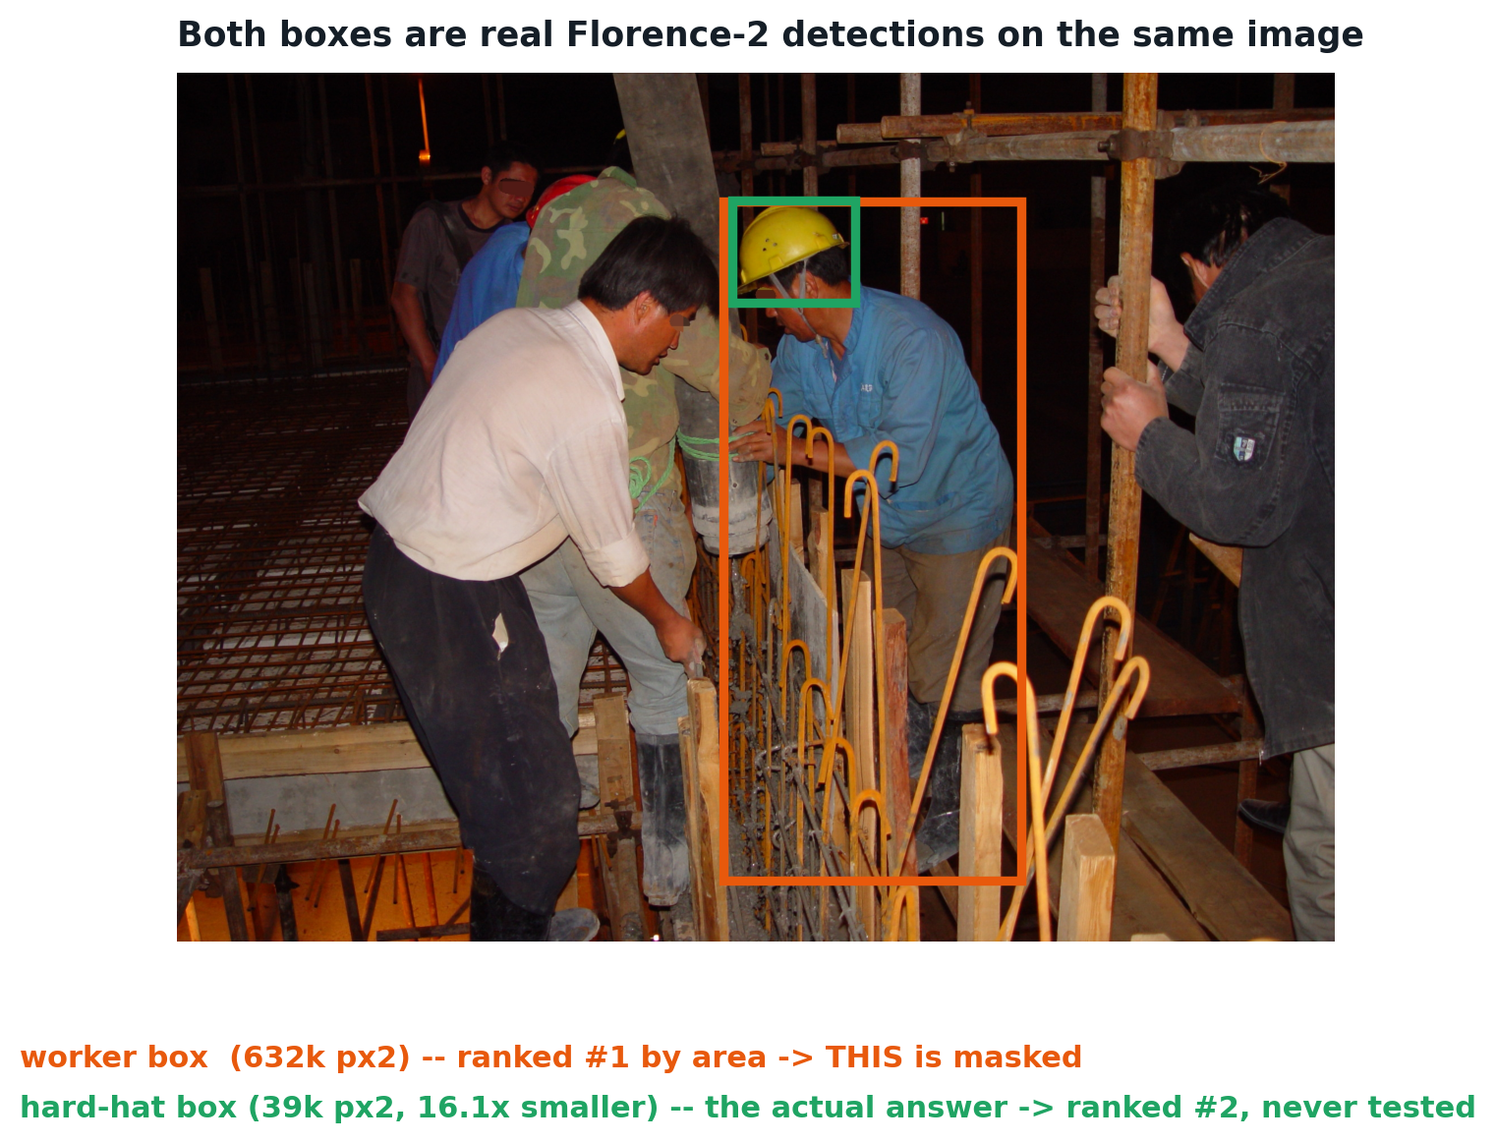
STUDY 1 · FINDINGS
Does Florence only see the largest thing?
No — it detects the small object too. The bias is in how the results are ranked afterwards, not in what the model can see.
WHAT ACTUALLY HAPPENS
1. Florence-2 is asked to ground “worker” and, separately, the safety object (“hard hat”). It returns a box for each — both are real detections.
2. standardize_regions() then picks ONE box to mask, using the policy region_ranking="area": whichever box is largest by pixel area wins.
3. A person's body is reliably bigger than a hard hat, a harness clip, or a guardrail post — so the worker box wins in about 96% of PPE samples.
4. The metric then masks the worker, not the hard hat — measuring whether removing the PERSON changes the answer, which is a different question.
SO THE FIX IS A RANKING FIX, NOT A DETECTION FIX
Phase 1.1 (slide 22) adds a “rule_aware” policy: promote the box matching the rule's queried object above all others, area-descending only within that tier. Wrong-entity top-1 drops from 80 samples to 1.
Answers the area-ranking question directly
24

Slide 25
STUDY 1 · FINDINGS
Three findings that outrank the numbers
— One mechanical choice explains three weak results. Regions were ranked by area, so the “explanation” was almost always the worker's body rather than the missing PPE item. Descriptive accuracy, sparsity and completeness all record their worst values on PPE for this reason — a measurement artefact, not a model property.
— A stable answer can hide a fully drifted explanation. In 28.3% of robustness reruns the verdict held while the evidence box moved to something unrelated. Answer-level robustness alone would have reported this model as reassuringly consistent.
— A fallback code path inflated a slice of every metric that used it. A worker-detection fallback recurred across masking, perturbation and completeness tests. It was traced to a specific branch and quantified each time rather than left as unexplained variance.
THE PATTERN WORTH CARRYING FORWARD
None of these was a crash. Each produced plausible numbers that were wrong for a reason invisible in the output — which is why Study 2 was designed around pre-registration and adversarial checks rather than more metrics.
Pilot conclusions
25

Slide 26
PART III
Study 1 — scale-up
Correcting the pilot before trusting it.
26

Slide 27
STUDY 1 · SCALE-UP
Phases 1 and 2 — correctness before scale
Every fix landed behind a default-off flag, so the frozen pilot still reproduces byte-for-byte.
— Phase 1 — foundational correctness. Defects that made a metric measure the wrong thing, fixed and validated against the frozen record.
— Phase 2 — metric validity. A continuous graded descriptive-accuracy score; a monotonic-masking invariant; mask-mode sensitivity across black fill, blur and inpainting; and a text-ablation proxy reported separately and labelled as not native VQA.
— Non-default runs write mode-suffixed files. A corrected run can never overwrite the frozen pilot result it is being compared against.
WHY FLAGS RATHER THAN EDITS
The pilot's numbers were already circulated. Silently improving them would have made every earlier statement unverifiable. Flags keep both the original and the corrected result addressable at the same time.
Phases 1–2
27

Slide 28
STUDY 1 · SCALE-UP
Phase 1, item by item
Seven correctness fixes. Each is a defect that made a metric measure the wrong thing, not a defect in the model.
Fix | What it corrected | Measured effect
1.1 Region ranking | Masked the rule's object, not the worker body | wrong-entity top-1: 80 → 1
1.2 Multi-label sampling | Recovers hazards hidden behind a higher-priority one on the same image | struck_by_risk: 13 → 24
1.3 Context matching | Compliant images assigned rule_4 only when excavator metadata confirms it applies | 413 vacuous tests removed
1.4 Worker-loss instrumentation | Separates a genuine flip from the worker simply vanishing from the crop | completeness: 159 reruns → 0
1.5 Prompt concept/synonym split | True synonyms now ground the same box; unrelated concepts no longer do | cross-grounding: → 0.000
1.6 Unified greedy decoding | One decoding switch for every stage, removing a silent beam/greedy mismatch | greedy = beam, 93.3% agree
1.7 Literal audit + CI guard | Patch grid computed from the actual input resolution, with a test that blocks new hardcoding | —
THE ONE TO REMEMBER
1.1 is why slide 21's region-ranking bias could later be diagnosed and fixed: rule_aware ranking existed because Phase 1 built it, not because the original pilot got the mechanism right.
commit 68c90da · 110 tests · frozen pilot unchanged
28

Slide 29
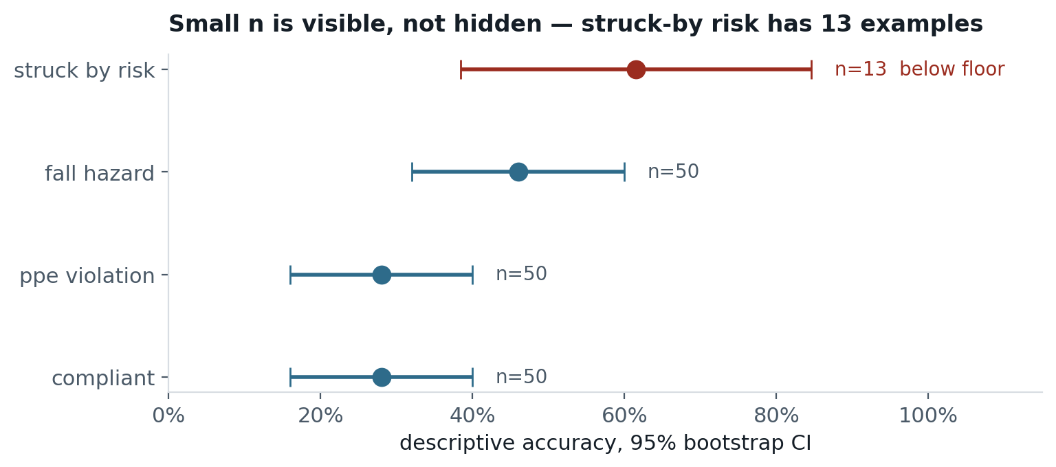
STUDY 1 · SCALE-UP
Phase 3.1 — statistics hardening
Every headline number gains a bootstrap confidence interval, a paired significance test where applicable, and a minimum-n floor.
WHAT CHANGED
Bootstrap 95% CIs
Seeded, reproducible, NaN-dropping.
Wilcoxon signed-rank
Two Phase-2 findings confirmed significant: targeted-vs-random occlusion drift p = 1.1×10⁻³; stability across temperature p = 1.8×10⁻².
Minimum-n floor = 30
Below it, a rate is flagged illustrative rather than suppressed — the subgroup stays visible, but cannot be quoted as solid.
WHY THIS MATTERS FOR STUDY 2
struck-by risk has thirteen examples in the entire test split. That single fact drives Study 2's two-stratum sampling design.
results/statistics_summary.csv
29

Slide 30
PART IV
Study 2 — Qwen2.5-VL
A model that can actually be asked a question — and what that makes measurable.
30

Slide 31
STUDY 2 · RATIONALE
What Study 1 could not answer
Limitation of Study 1 | What Study 2 changes
Grounding proxy, not question answering | Native VQA — the model states a reason in words
No way to grade the stated reason | Metric 7: explanation correctness against the human reason
163 samples; struck-by has 13 | 3,882 image–rule pairs; two-stratum sampling
One violation per image (priority collapse) | Every violated rule is asked
Compliant images assigned rules by rotation | Context-aware negative controls
Statistics added afterwards | Thresholds pre-registered before any value is computed
THE DECISIVE DIFFERENCE
Florence-2 can be asked where something is. Qwen2.5-VL can be asked why it thinks so. Only the second makes “was the stated reason correct?” a question with an answer.
Motivation for a second study
31

Slide 32
STUDY 2 · MODEL
Qwen2.5-VL-7B-Instruct, 4-bit
Thirty times the parameters of Study 1's model, on the same 8 GB card.
Property | Value
Parameters | 7 B (4-bit quantised)
Peak VRAM | 6.97 GB of 8.0
Compute dtype | bfloat16
Attention kernel | sdpa (generation)
Vision budget | 640 blocks · 609 image tokens
Decoding | greedy, 128 max new tokens
FOUR SETTINGS THAT ARE CORRECTNESS, NOT TUNING
bfloat16 — fp16 overflows; output collapses to empty
sdpa — the eager kernel injects spurious tokens
640 blocks — 1280 spills past the card, ~30× slower
ANSWER last — verdict-first contradicts its own reasoning
revision cc594898 · pinned in models.lock
32

Slide 33
STUDY 2 · PIPELINE
Eleven stages, pre-registered in advance
00
Feasibility
gate
01
Frozen
sample
02
Baseline
inference
03
Explanation
regions
04
Descriptive
accuracy
05
Sparsity
06
Stability
08
Robustness
09
Bounded
completeness
07
Efficiency
10
Explanation
correctness
11
Report
+ CIs
— Stage 0 is a stop rule, not a warm-up. Thresholds fixed before any number was seen: if a quantised model cannot detect small hard hats, rule_1 is invalid and so is most of the study.
— Every stage is resumable and coverage-checked. Rows are checkpointed individually; a run that covers part of the sample exits non-zero rather than reporting success.
scripts/00–11
33

Slide 34
STUDY 2 · STAGE 0
The feasibility gate
Run before building anything else. Thresholds pre-registered.
89%
small-object detection
threshold 80% → GO
2.9 s
median latency
budget 6.0 s
100%
parse rate
replies readable
30%
specificity
n=10 · already a warning
READ THE 89% NEXT TO THE 87% YES-SHARE
A model that always answered YES would score 100% on small-object detection and 0% on specificity. This model beat that degenerate baseline by about six points. The gate passed — and simultaneously recorded the YES-bias that became the study's first real finding at n=3,882.
— The gate's value was the stop rule, not the pass. Thresholds written down in advance are what make a GO verdict mean something other than “we decided to continue”.
results/stage0_feasibility.csv
34

Slide 35
STUDY 2 · SAMPLING
Two strata, not one balanced set
— Stratum H — all 1,278 violation images. Every violated rule is asked.
— Stratum C — 1,278 compliant images, matched to H on illumination × camera distance × view. Largest divergence 1.5%, below the 5-point warning threshold.
— Three of seven metrics are undefined on a NO answer. No region to mask, no rationale to grade. Compliant images cannot contribute to them at all — they measure specificity instead.
3,882
image–rule pairs
2,556
distinct images
PREVALENCE REWEIGHTING
Sensitivity 0.80 and specificity 0.90 give precision 0.89 on a balanced set — but 0.54 at the true 12.8% prevalence. Reporting the balanced figure alone overstates deployed precision by 35 points.
VERIFIED AGAINST THE PRE-REGISTERED DESIGN
Per-rule positives match the architecture document exactly: 1,001 / 84 / 172 / 70. That check is what caught an earlier scan reading one split instead of two.
results/sample_manifest.csv · sha af91ed28
35

Slide 36
STUDY 2 · WORKED EXAMPLE
What one sample looks like
THE PROMPT
Look at every worker in this image. Is any worker missing required personal protective equipment — a hard hat, high-visibility clothing, or adequate body covering?
Answer in exactly this format:
REASON: one sentence naming the specific person or location
REGION: (x0, y0, x1, y1) pixel coordinates, or NONE
ANSWER: YES or NO
ANSWER COMES LAST, AND THE ORDER IS LOAD-BEARING
With ANSWER first, the model must commit to a verdict before generating the reasoning that would inform it — and then contradicts itself. Reason-first is chosen for measurability, not accuracy: balanced accuracy is identical either way.
THE REPLY, VERBATIM
REASON: The worker on the left is missing a hard hat.
REGION: (352, 415, 402, 555)
ANSWER: YES
PARSED INTO
verdict YES
region (352.0, 415.0, 402.0, 555.0)
rationale “The worker on the left…”
parse_strict True
latency_ms 10,143
Input, prompt, raw output, parsed fields
36

Slide 37
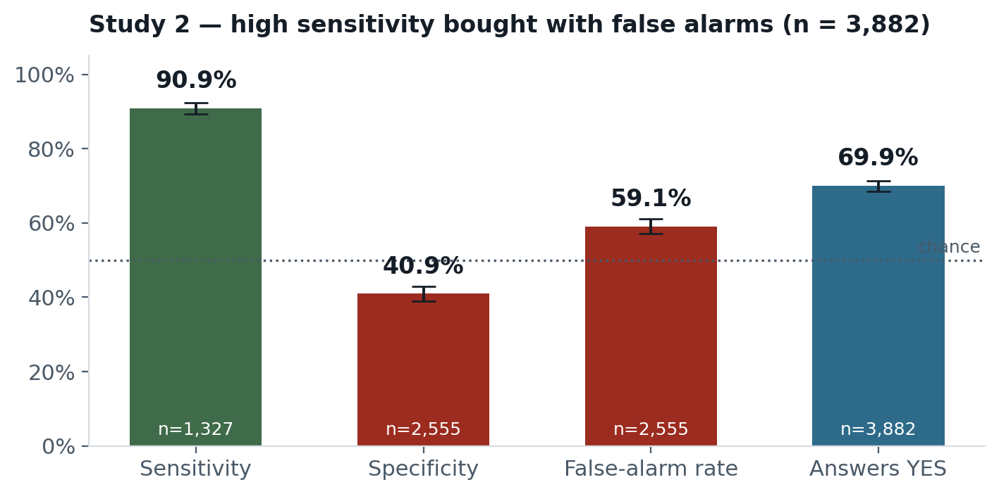
STUDY 2 · RESULTS
Accuracy bought with false alarms
READ THESE TOGETHER
Sensitivity of 91% would pass most deployment reviews. Beside specificity of 41% it collapses.
The model answers YES to 70% of everything, and raises a false alarm on 59% of checks where no hazard exists.
≈ six false alerts for every ten genuine ones.
Balanced accuracy is 66%, against 50% for a model that always says yes.
results/baseline_qwen7b-4bit.csv · n = 3,882
37

Slide 38
STUDY 2 · METHODOLOGY
How the Study 2 numbers are computed
Standard detection-theory ratios for the baseline; a conjunctive rule for metric 7; a flip test for metric 1 — the same shape as Study 1's, over the model's own stated region.
Quantity | Per-row test | Formula | n | Result
Sensitivity | YES answers among rows where expected = YES | TP / (TP+FN) | 1,327 | 90.9%
Specificity | NO answers among rows where expected = NO | TN / (TN+FP) | 2,555 | 40.9%
False-alarm rate | YES answers among the negative-control rows only | FP / (FP+TN)|ctrl | 2,555 | 59.1%
Metric 7 correct | similarity≥0.60 AND hazard_match AND IoU≥0.30, all three required — conjunctive, not weighted or averaged | AND of 3 tests | 1,191 | 2.4%
Metric 1 (Stage 4) | flip(x,m) = 1 if answer(mask(x, region, method=m)) ≠ answer(x), for m in {black, tokens} — same shape as Study 1's test | mean(flip) | in progress | —
WHY METRIC 7 IS AND, NOT A WEIGHTED AVERAGE
A weighted score would let a high text-similarity score outvote a region on the wrong side of the photograph — exactly the failure slide 34 shows. Requiring all three keeps geometry as a hard veto, not a nudge.
src/xai_vlm/metrics/*.py
38

Slide 39
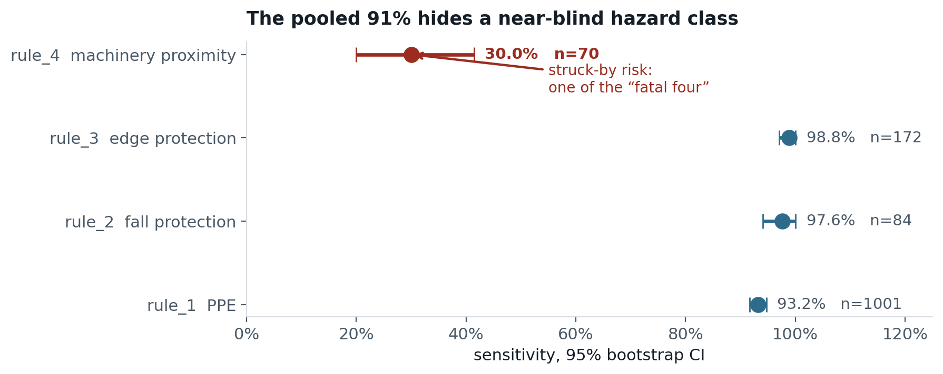
STUDY 2 · RESULTS
The pooled figure hid a near-blind hazard class
RULE_4 IS STRUCK-BY RISK
A worker inside the danger zone of operating machinery — one of construction's “fatal four” causes of death.
Its interval does not approach any other rule's. A model that answers YES to 70% of everything still misses 70% of these.
This was invisible in every figure reported until rates were broken out per rule with intervals attached.
Open question: detection failure, or question wording? rule_4 is the only rule with a context gate. Separating the two needs a prompt ablation, not yet run.
Per-rule sensitivity with 95% bootstrap CIs
39

Slide 40
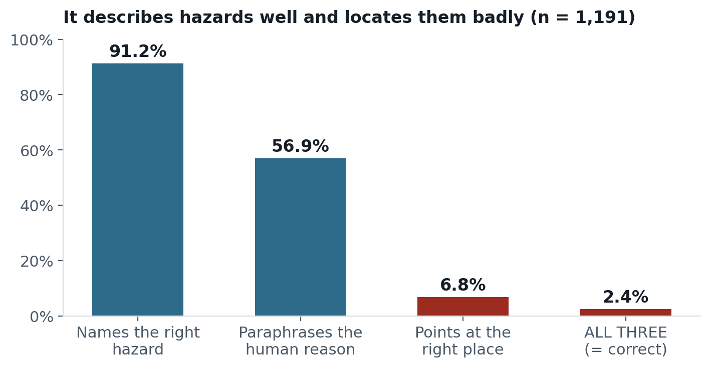
STUDY 2 · METRIC 7
Explanation correctness — three signals
An explanation counts only if it paraphrases the human reason, names the right hazard, and points at the right place.
CONJUNCTIVE, NOT WEIGHTED
The spatial signal is the anchor. Text similarity is fuzzy; box overlap is arithmetic.
A weighted score would let a high text score outvote a region on the wrong side of the photograph — precisely the failure geometry exists to catch.
97.6%
of correct verdicts came with an explanation that failed at least one signal.
Thresholds pre-registered: similarity ≥ 0.60 · IoU ≥ 0.30
40

Slide 41
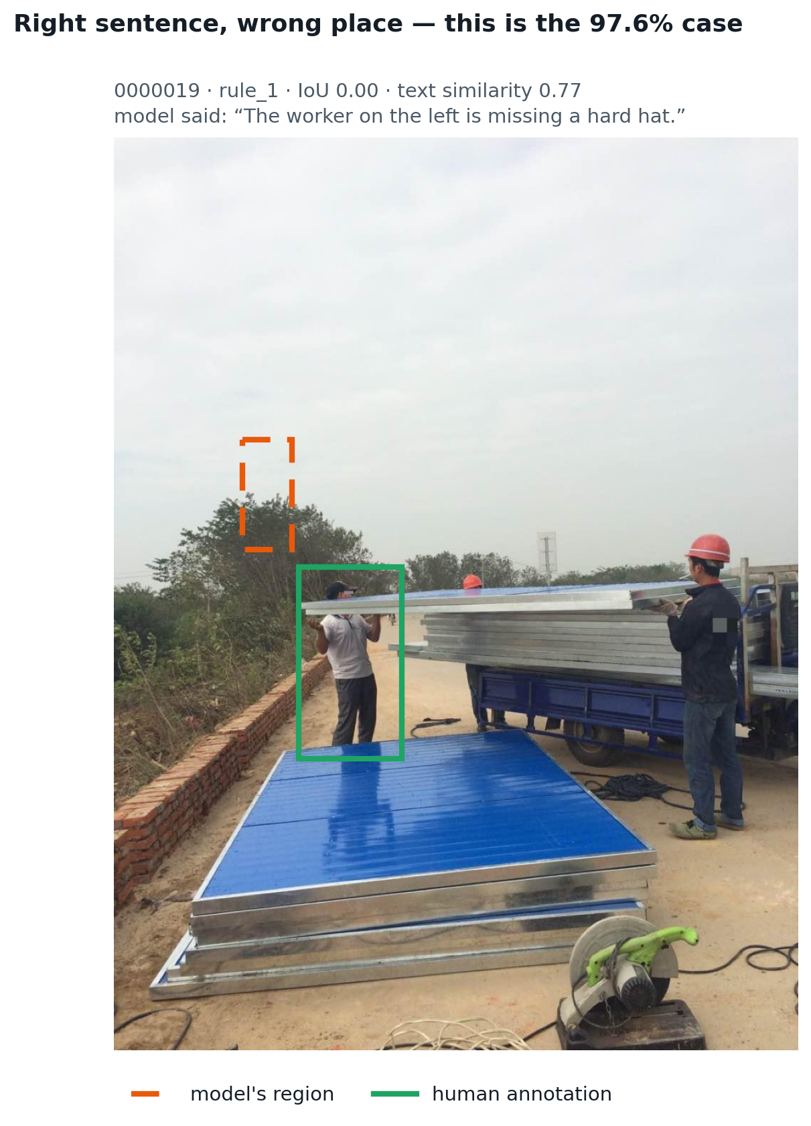
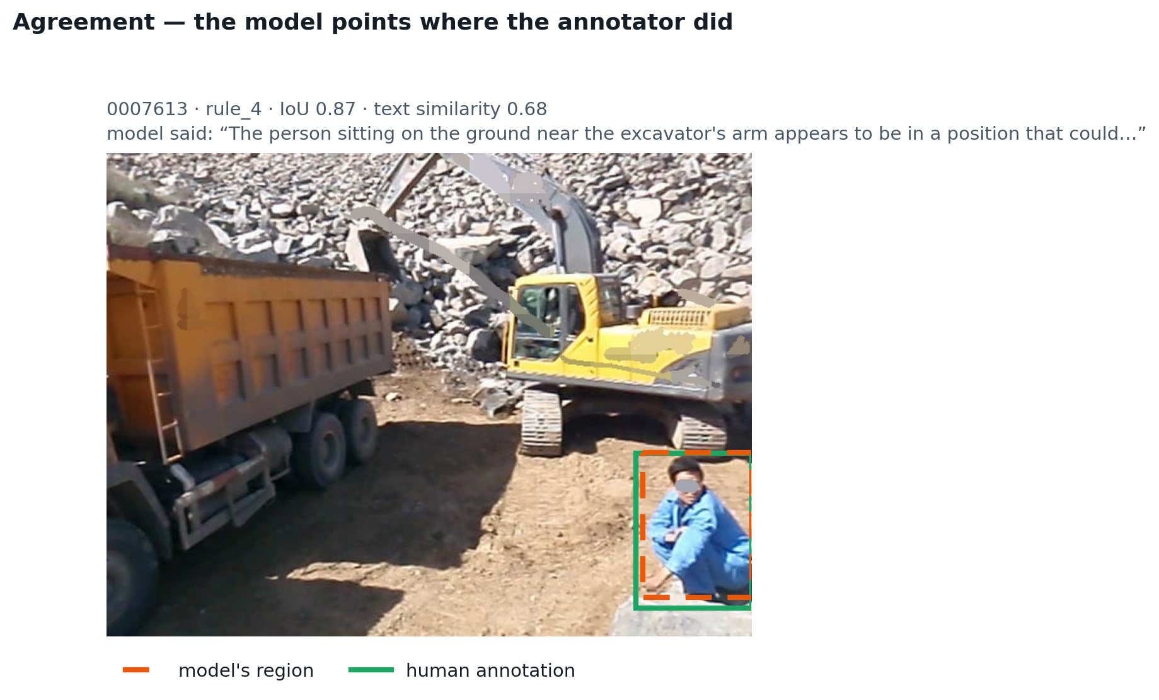
STUDY 2 · METRIC 7
The 97.6% case, made visible
LEFT: THE MODEL IS RIGHT AND POINTS AT SKY
“The worker on the left is missing a hard hat” is true — the annotation marks a bare-headed worker while his colleagues wear helmets. Text similarity 0.77. The model's box is in the trees. IoU 0.00. Right: the same model, agreeing with the annotator to two decimals.
A true sentence anchored to nothing
41

Slide 42
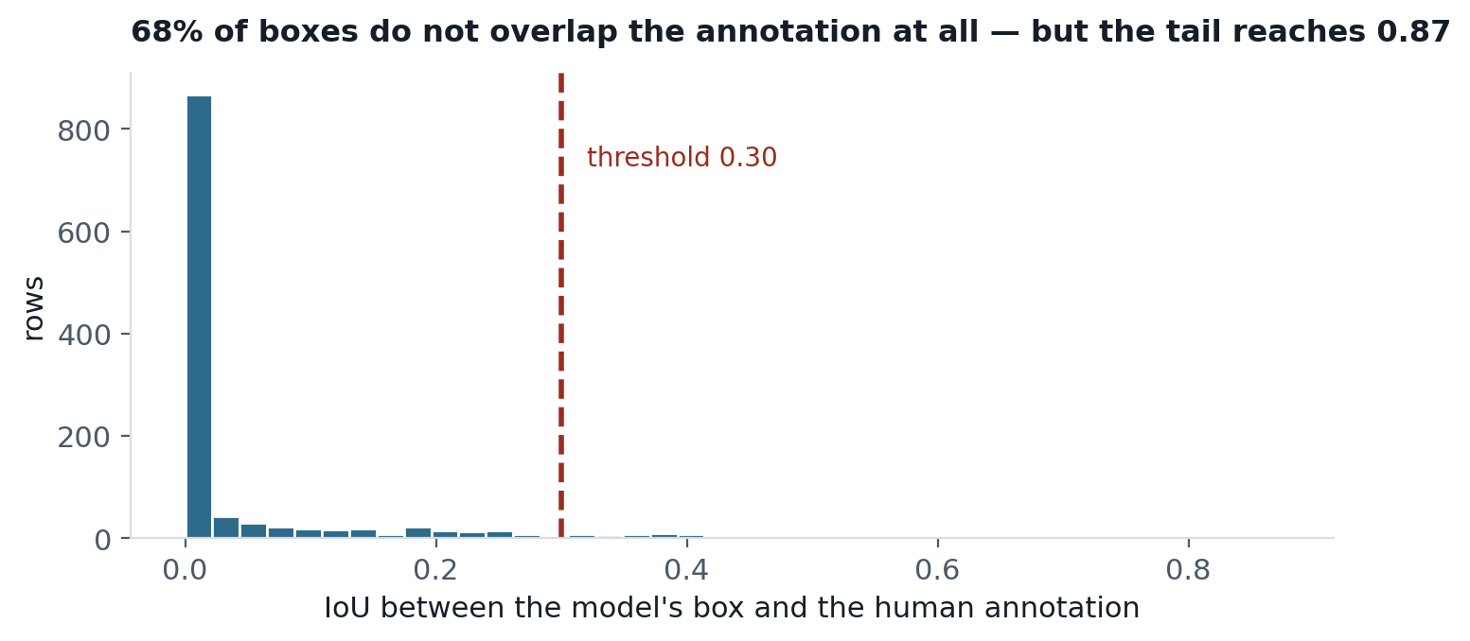
STUDY 2 · METRIC 7
Why 2.4% is not the whole story
VERIFIED, NOT ASSUMED
A 6.8% overlap rate is also the exact signature of a normalised-versus-pixel coordinate bug, so it was hand-checked against raw boxes before being believed.
On high-overlap rows the model's box matches the annotation to three decimals. No broken transform produces that.
— Model regions are tiny — median 0.64% of image area. IoU is severe for small boxes: two hard-hat-sized regions slightly apart score exactly zero.
— 1,430 rows cannot be scored at all. They are YES answers on rules the image does not violate — and a false alarm has no correct explanation. This metric structurally cannot penalise the model's largest failure mode.
— Zero overlap may mean the model found a real violation nobody annotated. 47% of the corpus is self-flagged “poor info”; separating that from a genuine miss needs a human audit.
Caveats that travel with the headline
42

Slide 43
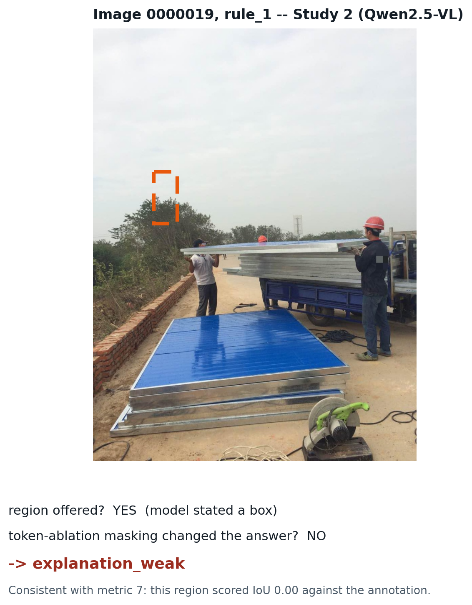
STUDY 2 · METRIC 6
Bounded completeness, on the same example
The same rule that scored Study 1's metric 6, applied to the disagreement case from slide 34 — now with real Stage 4 data.
THE SAME RULE AS STUDY 1
no_usable_explanation — no region stated.
explanation_weak — region stated, masking it did not change the answer.
explanation_supported — region stated, masking it did.
The one difference from Study 1: Study 2's masking is token ablation, not black fill, so the classification is artefact-free by construction.
THREE METRICS, ONE STORY
Metric 7 found this region 0.00 IoU from the annotation. Metric 1 finds removing it changes nothing. Metric 6 therefore calls it explanation_weak — three independent measurements agreeing the stated reason was never load-bearing.
A row already covered by the in-progress Stage 4 run
43

Slide 44
STUDY 2 · METRIC 1
Descriptive accuracy — in progress
The primary faithfulness measurement: remove the region the model named, ask again, see whether the answer changes.
789
rows measured
of 3,031 maskable
2
masking methods
black fill · token ablation
WHY TWO METHODS
Black fill creates a rectangle no photograph contains, so a flip may mean “this image looks broken”. Token ablation deletes the image tokens before the language model runs — no pixels are modified, so no artefact can exist. The gap between them measures the artefact.
THE ARTEFACT FLOOR IS REPORTED FIRST
The 410 rows where the model answered NO are a control, not padding. If masking only removes information, a NO cannot rationally become a YES — so that rate measures how much the intervention perturbs the model by itself. A YES-flip rate that fails to clear it is not evidence of faithfulness.
— This slide is a placeholder. The run is resumable and coverage-checked; regenerating the deck after it completes fills in the flip rates, the artefact floor and the black-versus-tokens gap.
results/descriptive_accuracy_qwen7b-4bit.csv · in progress
44

Slide 45
PART V
Synthesis
What the two studies say together, and what neither can say alone.
45

Slide 46
SYNTHESIS
Two designs, side by side
A contrast of what each design could measure — not a scoreboard.
 | Study 1 · Florence-2 | Study 2 · Qwen2.5-VL
Sample | 163 images | 3,882 pairs · 2,556 images
Task | Grounding proxy | Native question answering
Metric 1 measures | Masking a proxy region | Masking a region the model named
Explanation exists? | Derived from detections | Stated in words by the model
Can grade the reason? | No | Yes — metric 7
Small-class handling | Flagged below n=30 | Two-stratum sampling
Statistics | Added in Phase 3.1 | Pre-registered from the start
THE SAME METRIC NAME DOES NOT MEAN THE SAME MEASUREMENT
Study 1's descriptive accuracy masks a region derived from a detector on a model with no VQA head. Study 2's masks a region the model itself named in words. Both are “Metric 1”. Reading 36.2% against a Study 2 figure as though one model outperformed the other would be a category error.
Different models, tasks, sample sizes and metric definitions
46

Slide 47
SYNTHESIS
Does the framework transfer?
Yes — with two genuine redesigns, not a translation.
— Four metrics transfer almost unchanged. Stability, efficiency, robustness and bounded completeness mean the same thing for a vision model as for a tabular one, once “re-ask” and “degrade the input” are given visual definitions.
— Two required redesign. Sparsity's top-k formulation punishes large objects for being large and was replaced by a size-independent Gini coefficient. Descriptive accuracy needs an intervention that removes evidence without creating an artefact — which is why token ablation exists.
— One is new, and only possible with a model that speaks. Explanation correctness has no tabular analogue: there is no human-written reason to compare a feature attribution against. It is also the metric that produced the study's most consequential finding.
THE FRAMEWORK'S REAL CONTRIBUTION HERE
It forced measurement of things accuracy reporting never surfaces — and in both studies the most important results came from metrics that had nothing to do with whether the answer was right.
The question the project set out to answer
47

Slide 48
SYNTHESIS
Six methodological lessons
Each drawn from a defect that actually occurred in this project.
Silent incompleteness. A run exited zero with 100% parse and a plausible summary while covering 1,231 of 3,882 rows. Guards see only rows that were attempted.
M1
Thresholds from unrepresentative samples. A latency abort calibrated on 39 hand-picked images sat 10% above the real workload and aborted healthy runs.
M2
Configuration drift. A split list defined in two places drifted; one stage sampled both splits while the next read one.
M3
Plausible numbers need adversarial checks. 436 positives and a 6.8% overlap rate were both correct-looking and both indistinguishable from a specific bug.
M4
Undefined is not failure. 2,691 rows are undefined for metric 7 for four distinct reasons. Collapsing them into “incorrect” would invent a much worse and entirely wrong result.
M5
Correct-but-slow evades correctness tests. A missing inference-mode guard retained 16 GB of unused gradient state. Every answer was verifiably identical; the only symptom was a 19.5× cost.
M6
None of these crashed anything
48

Slide 49
LIMITATIONS
Threats to validity, stated plainly
— Annotation quality bounds everything. 47% of the corpus is self-flagged “poor info”. A model penalised for pointing at an unannotated real hazard is being marked wrong for being right.
— One model per study. No comparison arm has been run, so nothing here separates model-specific behaviour from quantisation or scale.
— IoU is severe for small regions. The 2.4% correctness figure is bound by a geometric threshold chosen before the box-size distribution was known.
— Metric 7 cannot see false alarms. A false alarm has no correct explanation, so the model's largest failure mode is structurally outside the metric that grades explanations.
— Three of seven metrics remain unrun. Sparsity, stability and robustness are specified and implemented for Study 2 but not yet executed.
— The efficiency gap is unexplained. Identical work costs 3.1 s standalone and ~10 s in a run. Ruled out: VRAM, system memory, image size, reply length, allocator fragmentation.
What these results cannot support
49

Slide 50
CLOSE
Conclusion
The model is a reliable detector of construction photographs and an unreliable detector of construction hazards.
It answers yes to most things, which buys high sensitivity cheaply. It names hazard categories well, which makes its explanations read plausibly. It locates them poorly, which means the plausible explanation usually is not evidence for the verdict it accompanies.
WHY THAT COMBINATION IS THE DANGEROUS ONE
A system that is plainly wrong gets switched off. A system that is right 91% of the time, for reasons it cannot articulate, while crying wolf on three checks in five, invites exactly the misplaced trust that safety-critical deployment cannot survive.
NEXT
Finish Stage 4 · run sparsity, stability and robustness · add the comparison model arm · human-audit 100 cases to calibrate metric 7 · prompt ablation to resolve the rule_4 question.
Construction-VLM XAI
50

