Slide 1
How the Model Handles Each Safety Class
A Class-by-Class Walkthrough: Results, Working Examples, Failure Cases, and Fixes
Construction-Safety VLM XAI Pilot -- 163-image trial, Florence-2-base-ft

Slide 2
The Four Safety Rules
FOUNDATIONS
Every image is checked against one of four rules. Each rule maps to a hazard class the dataset itself labels.
Rule | Hazard class | What it checks | Logic
rule_1 | ppe_violation | Basic PPE present (hard hat / hi-vis vest) | presence, tight (0.08)
rule_2 | fall_hazard | Fall protection (harness / lanyard) at height | presence, tight (0.08)
rule_3 | fall_hazard | Edge protection (guardrail) at height / excavation edge | presence, loose (0.20)
rule_4 | struck_by_risk | Worker inside an excavator's blind spot / swing radius | proximity, inverted (0.05)
(none) | compliant | Every applicable rule satisfied | n/a -- round-robin tested
• "Presence" rules (1-3): the safety object must be CLOSE to the worker to count as compliant.
• Rule_4 is INVERTED: being close to the excavator is the hazard, not the safe state.
• Thresholds are fractions of the image's largest dimension -- tighter for worn PPE, looser for structural barriers.

Slide 3
How a Class Becomes a Question Florence-2 Can Answer
FOUNDATIONS
• Florence-2 has no yes/no question mode -- it can only be given a phrase and asked to draw boxes.
• So every rule is converted into: detect two things independently -> measure the gap between their boxes -> apply a geometric threshold.
Class / rule | What we ask Florence-2 to find | How the verdict is computed
ppe_violation (rule_1) | "worker", "hard hat" | violation if any worker has no nearby hard hat
fall_hazard (rule_2) | "worker", "safety harness" | violation if any worker has no nearby harness
fall_hazard (rule_3) | "worker", "guardrail" | violation if any worker has no nearby guardrail
struck_by_risk (rule_4) | "worker", "excavator" | hazard if a worker IS near an excavator
compliant | whichever rule it's assigned to | no violation detected by the checks above
Every row is the same mechanism: detect, don't ask. Florence-2 never sees the words "hazard" or "compliant".

Slide 4
Four Ways to Score a Classifier -- and Why We Use Two of Them
FOUNDATIONS
Metric | Formula | Question it answers
Sensitivity (recall) | TP / (TP + FN) | Of all REAL violations, how many did we catch?
Specificity | TN / (TN + FP) | Of all REAL compliant images, how many did we correctly clear?
Precision | TP / (TP + FP) | Of everything we FLAGGED as a violation, how many really were?
Accuracy | (TP + TN) / all | What fraction of all predictions were correct, overall?
Why this deck reports only sensitivity and specificity:
Accuracy hides class imbalance: the v1 proxy scored 97.4% specificity by saying "compliant" almost always. Accuracy alone would have looked deceptively good; sensitivity (3.0%) is what exposed it as broken.
The two error types have different real-world costs: missing a real hazard (low sensitivity) can hurt someone; a false alarm (low specificity) wastes a supervisor's time. Reporting them separately keeps that distinction visible instead of averaging it away.
Sensitivity/specificity do not depend on the sample's class balance; precision and accuracy do. This 163-image pilot is deliberately balanced (roughly 50/50/13/50) -- nowhere close to the real ~3% violation rate in the wild. Precision computed on this sample would not carry over to deployment; sensitivity and specificity would.
Consistency with prior work: this is the same convention Prof. Abdallah's IDS research uses (catching attacks vs. avoiding false alarms).

Slide 5
The Actual Numbers: All Four Metrics, Every Rule
FOUNDATIONS
Computed directly from the 163-sample confusion matrix (TP / FN / TN / FP), per rule.
Rule | TP | FN | TN | FP | n | Sensitivity | Specificity | Precision | Accuracy
rule_1 | 8 | 42 | 9 | 4 | 63 | 16.0% | 69.2% | 66.7% | 27.0%
rule_2 | 4 | 9 | 9 | 4 | 26 | 30.8% | 69.2% | 50.0% | 50.0%
rule_3 | 15 | 22 | 10 | 2 | 49 | 40.5% | 83.3% | 88.2% | 51.0%
rule_4 | 8 | 5 | 5 | 7 | 25 | 61.5% | 41.7% | 53.3% | 52.0%
All rules (pooled) | 35 | 78 | 33 | 17 | 163 | 31.0% | 66.0% | 67.3% | 41.7%
TP = real violation, correctly caught. FN = real violation, missed. TN = real compliant, correctly cleared. FP = real compliant, wrongly flagged.
rule_1 is the clearest demonstration of the Slide-4 argument, with real numbers: specificity looks reasonable (69.2%), but accuracy is only 27.0% -- because this rule's natural sample is 50 violations vs. just 13 compliant images, not balanced, and sensitivity is so low (16.0%) that it drags accuracy down with it. Reporting accuracy alone here would have been actively misleading in either direction depending on which number a reader anchored on.
rule_3 has the best precision (88.2%): when it says "violation," it is usually right -- but that alone does not mean it is catching most real violations (sensitivity is still only 40.5%). Precision and sensitivity answer different questions and neither can substitute for the other.
The pooled "All rules" row is for reference only: the four rules test physically different things (worn PPE vs. structural barriers vs. proximity), so averaging across them is not a meaningful single headline number -- it is included here only to show the total confusion-matrix counts.

Slide 6
The Same Numbers, Rolled Up by Class
FOUNDATIONS
fall_hazard pools rule_2 + rule_3; compliant pools its negative-side counts across all four rules.
Class | Rule(s) | TP | FN | TN | FP | n | Sensitivity | Specificity | Precision | Accuracy
ppe_violation | rule_1 | 8 | 42 | 9 | 4 | 63 | 16.0% | 69.2% | 66.7% | 27.0%
fall_hazard | rule_2 + rule_3 | 19 | 31 | 19 | 6 | 75 | 38.0% | 76.0% | 76.0% | 50.7%
struck_by_risk | rule_4 | 8 | 5 | 5 | 7 | 25 | 61.5% | 41.7% | 53.3% | 52.0%
compliant | all rules, negatives only | -- | -- | 33 | 17 | 50 | n/a | 66.0% | n/a | 66.0%
fall_hazard's own numbers differ from either rule alone: 38.0% sensitivity is between rule_2's 30.8% and rule_3's 40.5%, weighted by each rule's real sample size (13 vs. 37 violations) -- this is the number that actually describes the class, not either rule in isolation.
compliant has no sensitivity or precision: it is never the class being detected -- it only ever supplies the negative ("is this really compliant?") side of every other row's test. Its one meaningful number is how often it was correctly cleared: 66.0%, pooled across all four rules -- identical to the "All rules pooled" specificity on the previous slide, since compliant images are that pooled negative set.
Reading note: the 50 compliant images are counted once per row they were tested against (rule_1, rule_2, rule_3, or rule_4), so the n column is not meant to sum to 163 across classes -- each row is its own independent binary test.

Slide 7
Problems Encountered: Setup and the First Attempt
PROBLEMS ENCOUNTERED
Environment issue, before any results existed: Florence-2's code unconditionally tries to import flash_attn, which has no working Windows build -- loading the model would crash immediately. Fixed with a monkeypatch that strips the import requirement and forces PyTorch's built-in sdpa attention instead. No effect on any number; only on whether the pipeline runs at all.
The first version of the proxy did not work: asking "does a hard hat exist anywhere in the image?" gave 3.0% sensitivity -- effectively a constant "compliant" classifier.
Traced to a concrete case, not just a bad average: image 79 (a real missing-guardrail violation) -- the "guardrail" query matched a piece of wooden formwork that happened to be guardrail-shaped, so the proxy called the scene compliant while the dataset's actual violation was elsewhere in the same photo.
Fix and result: redesigned to a person-relative check (does THIS worker have a nearby safety object) -- sensitivity rose 9x to 27.0%. This is the version all numbers in this deck are built on; the first attempt would not have produced anything worth reporting.

Slide 8
Problems Encountered: Detection Reliability
PROBLEMS ENCOUNTERED
Found by opening individual images behind the numbers, not visible from the summary stats alone:
Hallucination when the object is not in the scene: three separate rules (1, 2, 4), three independent images -- "worker" or "excavator" grounded onto an unrelated vehicle each time, because open-vocabulary detection always returns its best guess, never "not found."
Identity mismatch: the first example picked for rule_1's "works" slide had the hard hat and the worker belonging to two different people standing near each other -- a right answer for the wrong reason, caught and replaced during this review.
Category misidentification: while sourcing clean rule_2 / rule_3 examples, most candidates checked had the detector grounding a real box onto the wrong kind of object -- rigging mistaken for a harness, a dirt slope mistaken for a guardrail.
Common thread: none of these are visible in a sensitivity/specificity table by itself. They only surface by checking what the boxes actually landed on, image by image.

Slide 9
CLASS WALKTHROUGH 1 / 4
Class 1: ppe_violation
rule_1 -- hard hat / hi-vis vest, tight threshold (0.08)

Slide 10
Class 1 Results: ppe_violation (rule_1)
CLASS 1 -- STATS
Version | Sensitivity | Specificity
v1 -- scene-level existence check | 3.0% (3/100, rules 1-3 combined) | 97.4%
v2 -- person-relative check (current) | 27.0% (27/100, rules 1-3 combined) | 73.7%
rule_1 alone (v2) | 16.0% (8/50) | 69.2% (9/13)
Improvement: sensitivity rose 9x (3.0% -> 27.0%) after the person-relative redesign -- see Class-2 slides for the same fix applied to rule_2/rule_3.
Cost: specificity fell from 97.4% to 73.7% -- expected: a detector that never says "violation" scores high specificity for free.
Weakest of the three presence rules: rule_1 improves least (16.0%), even after the redesign -- small object, easiest to miss.

Slide 11
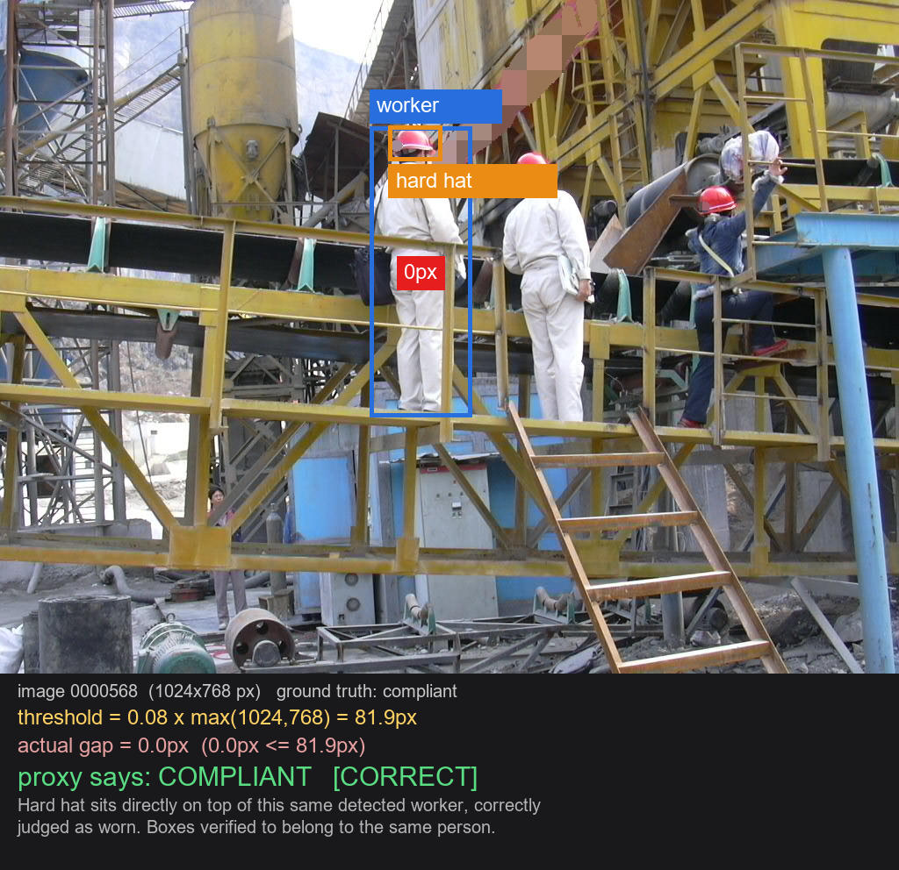
Class 1: Works
CLASS 1 -- EXAMPLE
GROUND TRUTH
compliant
COMPLIANT [CORRECT]
WHY IT WORKED
• Hard hat sits directly on top of THIS same detected worker (0px gap, well inside the 81.9px threshold).
• Verified: both boxes belong to the same person, not two different workers standing near each other.
• This replaces an earlier example we caught where the worker box and hard-hat box belonged to two different people -- see the Problems slide.

Slide 12
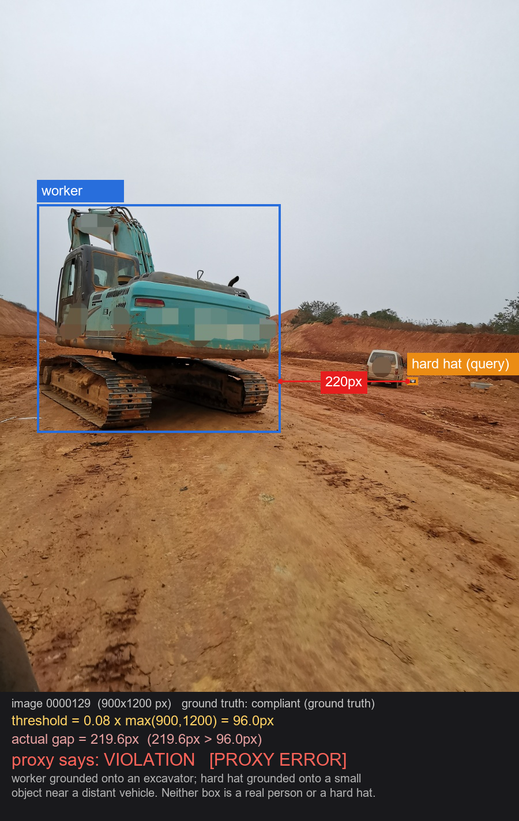
Class 1: Fails
CLASS 1 -- EXAMPLE
GROUND TRUTH
compliant (ground truth)
VIOLATION [PROXY ERROR]
WHAT WENT WRONG
• "worker" grounded onto an excavator.
• "hard hat" grounded onto a small object near a distant vehicle.
• Neither box is a real person or a hard hat -- the distance math ran correctly on nonsense inputs.

Slide 13
Class 1: Other Possible Problems
CLASS 1 -- PROBLEMS
• Identity mismatch (found while reviewing this deck): the proximity check never confirms the worker box and the hard-hat box belong to the SAME person. In a multi-worker scene, a different, nearby person's hard hat can satisfy the check for an undetected worker who has none.
• Single-worker detection ceiling: the "worker" query returns only one box, even in multi-worker scenes -- a real violation on an undetected worker can be missed entirely.
• The 0.08 distance threshold was chosen once and never independently stress-tested against camera distance or image resolution.
• Area-ranking confound: downstream metrics (masking, stability, completeness) tend to test the worker's whole body box instead of the hard hat, because it's larger.
• Worker-loss fallback: perturbing the image can make the worker undetectable, rerouting into a default answer unrelated to the real hazard.

Slide 14
Class 1: Fixes and Limits
CLASS 1 -- FIXES
CAN BE FIXED
CANNOT BE FULLY FIXED
• Identity check: require the hard-hat box to sit within (or just above) the SAME worker's box, not merely within the global distance threshold -- straightforward geometry, not yet implemented.
• Confidence filtering: reject low-confidence detections instead of accepting any box returned.
• Plausibility check: a "worker" box shaped like a vehicle (wide, low) can be rejected by simple geometry.
• Exhaustive detection tokens (<DENSE_REGION_CAPTION>) to recover multiple workers per scene -- needs validation first.
• Rule-aware region ranking so masking tests the hard hat, not the worker's body (already fixed in the scale-up).
• Detect-then-judge architecture means Florence-2 never confirms an object is genuinely absent -- it always returns its best guess.
• A better detector reduces the error rate; it cannot reduce it to zero within this architecture.
• Fully solving this needs a model that can reason "I don't see a worker here" -- i.e. a native-VQA model, not a bigger Florence-2.

Slide 15
CLASS WALKTHROUGH 2 / 4
Class 2: fall_hazard
rule_2 -- harness/lanyard (tight, 0.08) | rule_3 -- guardrail (loose, 0.20)

Slide 16
Class 2 Results: fall_hazard (rule_2 + rule_3)
CLASS 2 -- STATS
Rule | Sensitivity (v2) | Specificity (v2) | Threshold
rule_2 (harness/lanyard) | 30.8% (4/13) | 69.2% (9/13) | tight, 0.08
rule_3 (guardrail) | 40.5% (15/37) | 83.3% (10/12) | loose, 0.20
Two mechanisms, one class: fall_hazard is really two different rules with different thresholds -- worn PPE (rule_2) needs a tight gap; a structural barrier (rule_3) can protect from farther away.
Both improved by the same fix: the v1 -> v2 person-relative redesign (Class 1) applies here too -- part of the combined 3.0% -> 27.0% presence-rule sensitivity gain.
rule_3 is the strongest presence rule overall (40.5% sensitivity, 83.3% specificity) -- its looser threshold is closer in spirit to rule_4's already-working proximity check.

Slide 17
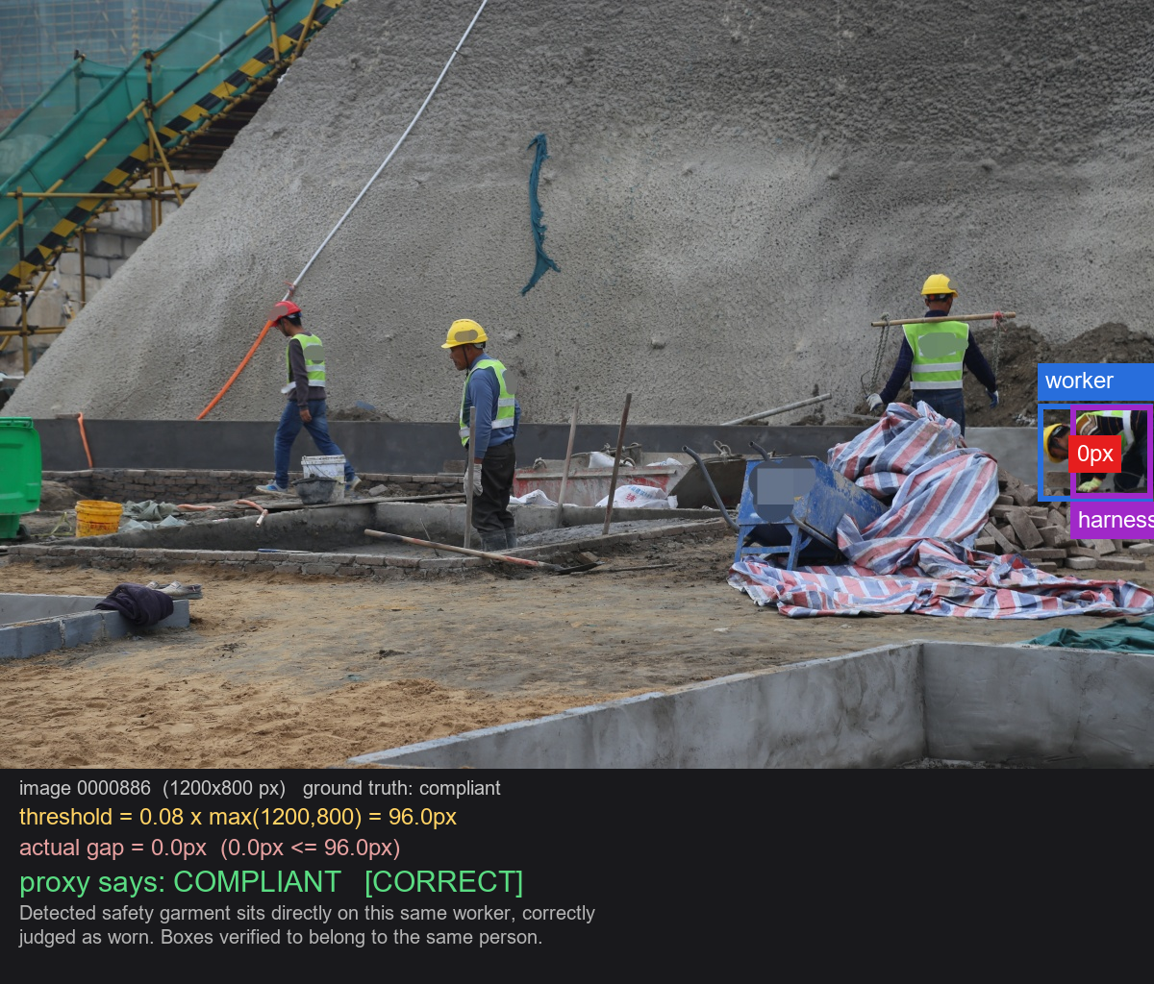
rule_2 (harness): Works
CLASS 2 -- EXAMPLE
GROUND TRUTH
compliant
COMPLIANT [CORRECT]
WHY IT WORKED
• A real safety garment (worn on the torso) sits directly on this same detected worker.
• Boxes verified to belong to the same person, not a nearby different worker.
• Correctly judged as worn -- verdict matches ground truth.

Slide 18
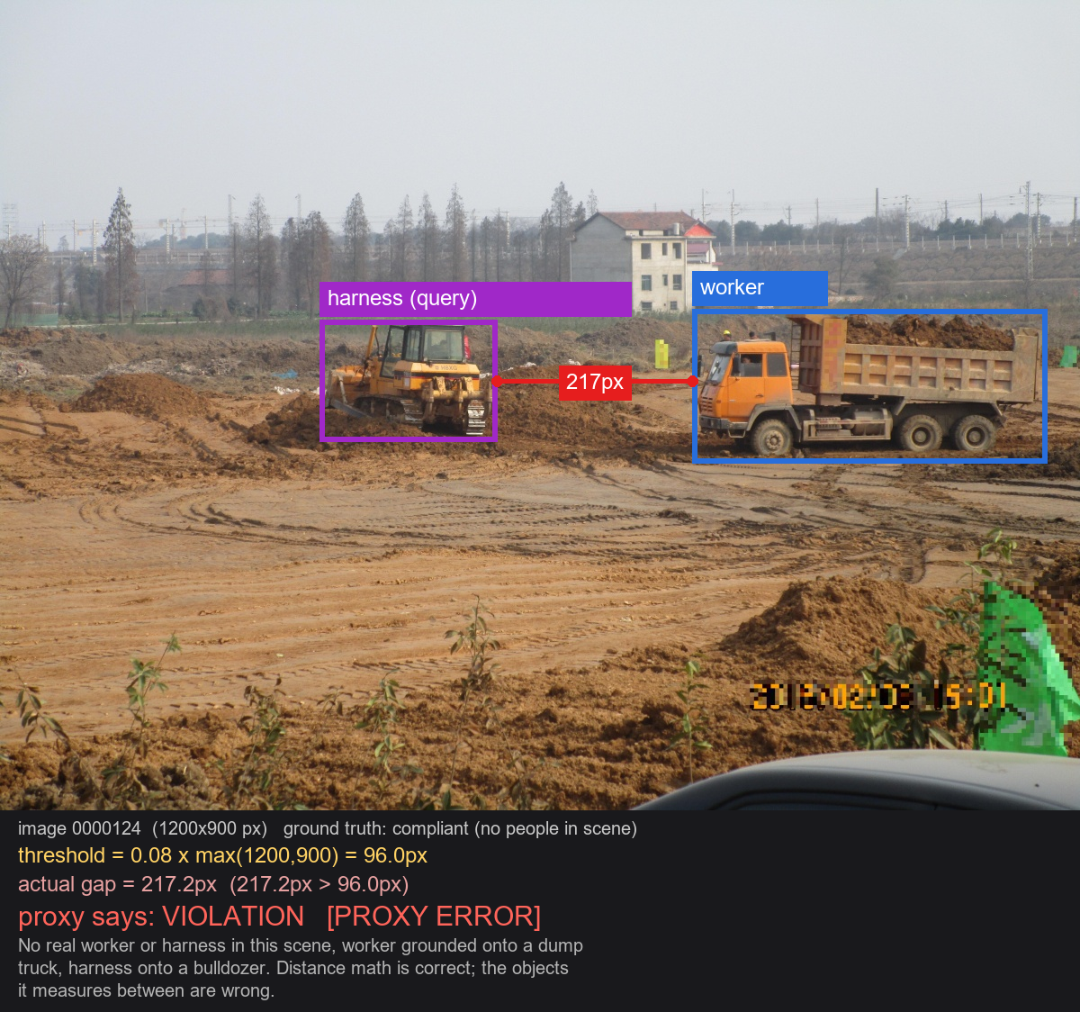
rule_2 (harness): Fails
CLASS 2 -- EXAMPLE
GROUND TRUTH
compliant (no people in scene)
VIOLATION [PROXY ERROR]
WHAT WENT WRONG
• No real worker or harness anywhere in this scene.
• "worker" grounded onto a dump truck; "harness" grounded onto a bulldozer.
• Distance math is correct; the objects it measures between are wrong.

Slide 19
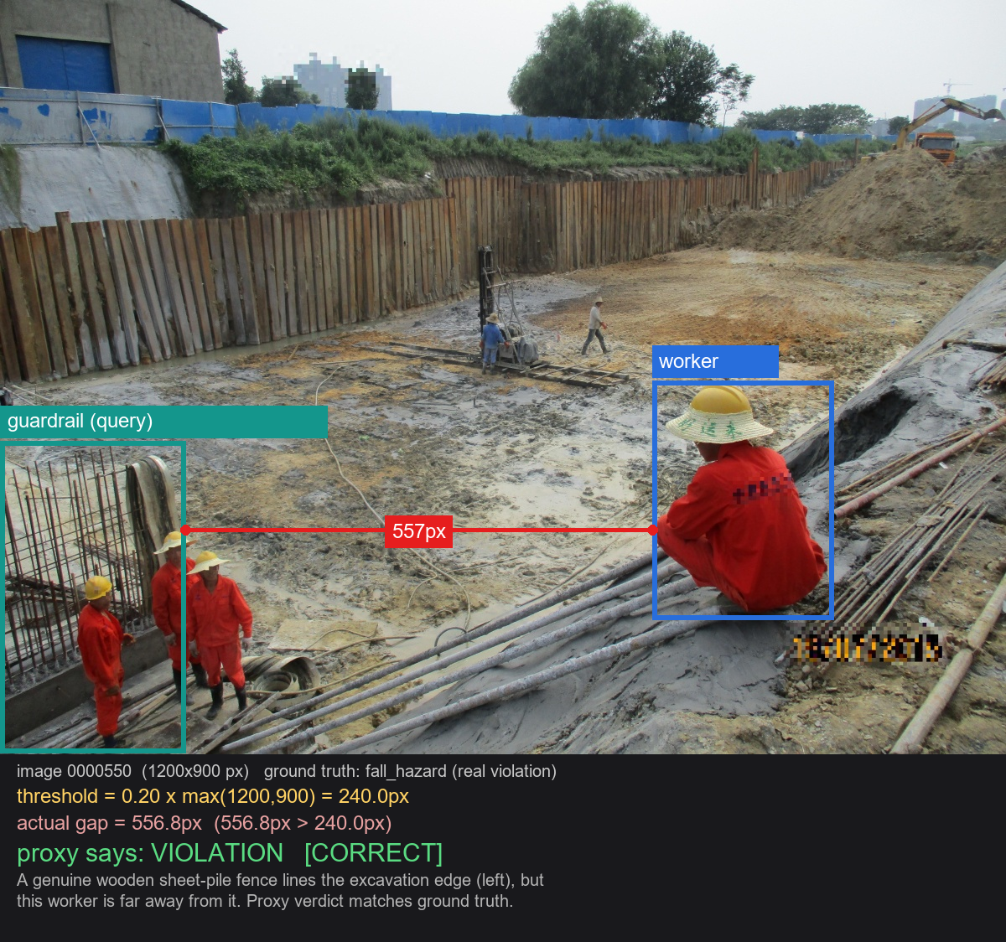
rule_3 (guardrail): Works
CLASS 2 -- EXAMPLE
GROUND TRUTH
fall_hazard (real violation)
VIOLATION [CORRECT]
WHY IT WORKED
• A genuine wooden sheet-pile fence is correctly detected lining the excavation edge.
• This worker is 557px away from it -- well past the 240px threshold.
• Correctly judged as unprotected -- verdict matches ground truth.

Slide 20
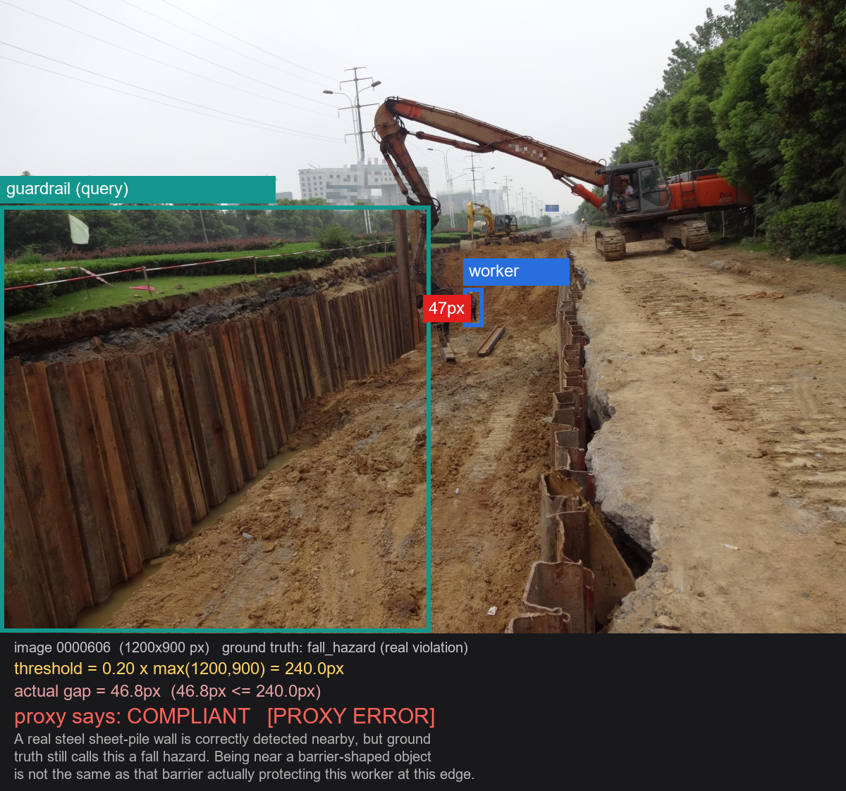
rule_3 (guardrail): Fails
CLASS 2 -- EXAMPLE
GROUND TRUTH
fall_hazard (real violation)
COMPLIANT [PROXY ERROR]
WHAT WENT WRONG
• A real steel sheet-pile wall is correctly detected nearby (46.8px vs 240px).
• But ground truth still calls this a fall hazard.
• Being near a barrier-shaped object isn't the same as that barrier actually protecting this worker at this specific edge.

Slide 21
Class 2: Other Possible Problems
CLASS 2 -- PROBLEMS
• Category misidentification is common, not rare: while sourcing clean examples for this deck, most rule_2/rule_3 candidates had the detector grounding a real box onto the wrong category of object -- rigging mistaken for a harness, a slope edge mistaken for a guardrail. The two examples shown were the exceptions found after checking many candidates, not the typical case.
• Same hallucination risk as Class 1: when no harness or guardrail exists in the scene, Florence-2 still returns a box for it.
• rule_3's error is subtler still: a genuinely real barrier can be nearby without actually protecting the relevant edge -- a semantic gap, not just a detection error.
• The loose 0.20 threshold for rule_3 was chosen once and never independently calibrated against real barrier-to-hazard distances.
• Single-worker detection ceiling and the identity-mismatch risk (Class 1) apply to both rule_2 and rule_3 as well.

Slide 22
Class 2: Fixes and Limits
CLASS 2 -- FIXES
CAN BE FIXED
CANNOT BE FULLY FIXED
• Confidence filtering and plausibility checks, same as Class 1 -- would likely catch a fraction of the category-misidentification cases too.
• For rule_3: verify the barrier sits geometrically BETWEEN the worker and the actual edge, not just "somewhere nearby" -- a real, buildable fix.
• Concept-vs-synonym separation for rule_2 (harness and lanyard are different objects, already fixed in the scale-up) so rewording tests measure phrasing, not object confusion.
• Confirming a barrier functions as protection for THIS worker at THIS edge requires scene understanding beyond box-distance geometry.
• That kind of judgment -- "is this really providing protection" -- is a reasoning task, not a detection task.
• Best addressed by a native-VQA model that can describe the relationship, not just measure it.

Slide 23
CLASS WALKTHROUGH 3 / 4
Class 3: struck_by_risk
rule_4 -- worker-to-excavator proximity, INVERTED logic, threshold 0.05

Slide 24
Class 3 Results: struck_by_risk (rule_4)
CLASS 3 -- STATS
Version | Sensitivity | Specificity
v1 / v2 (unchanged -- no redesign needed) | 61.5% (8/13) | 41.7% (5/12)
No redesign needed: rule_4 was never a scene-level existence check -- it always measured worker-to-excavator distance directly, so it didn't share Class 1/2's v1 failure mode.
Strongest sensitivity of all four rules (61.5%) , but the WEAKEST specificity (41.7%) -- more false hazard alarms than any other rule.
Inverted logic: close = hazard here, not close = compliant. Same geometry as the presence rules, opposite meaning.
Smallest, scarcest class: only 13 images in the 163-sample pilot -- see the Class-4 / scale-up notes on why.

Slide 25
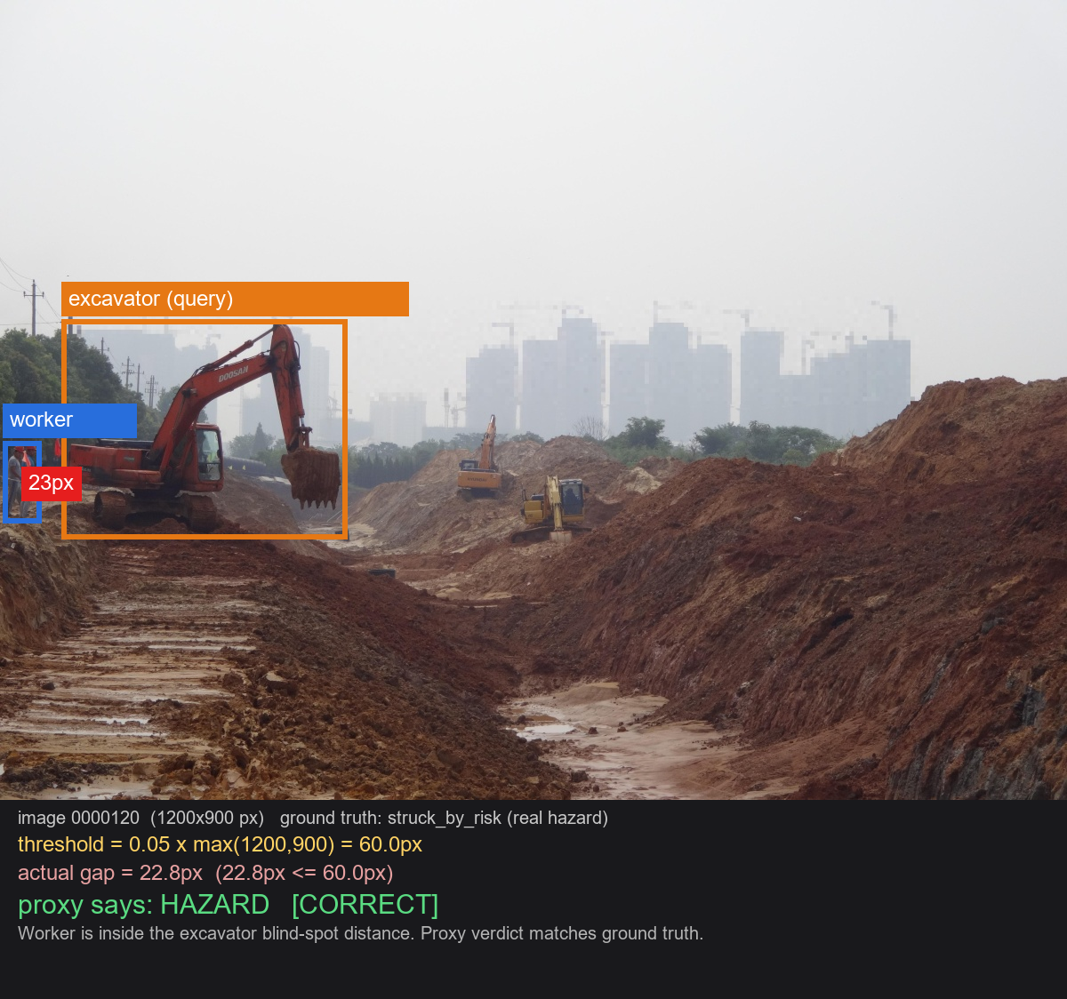
Class 3: Works
CLASS 3 -- EXAMPLE
GROUND TRUTH
struck_by_risk (real hazard)
HAZARD [CORRECT]
WHY IT WORKED
• Worker is inside the excavator's blind-spot distance (22.8px vs a 60px threshold).
• Proxy verdict matches ground truth.

Slide 26
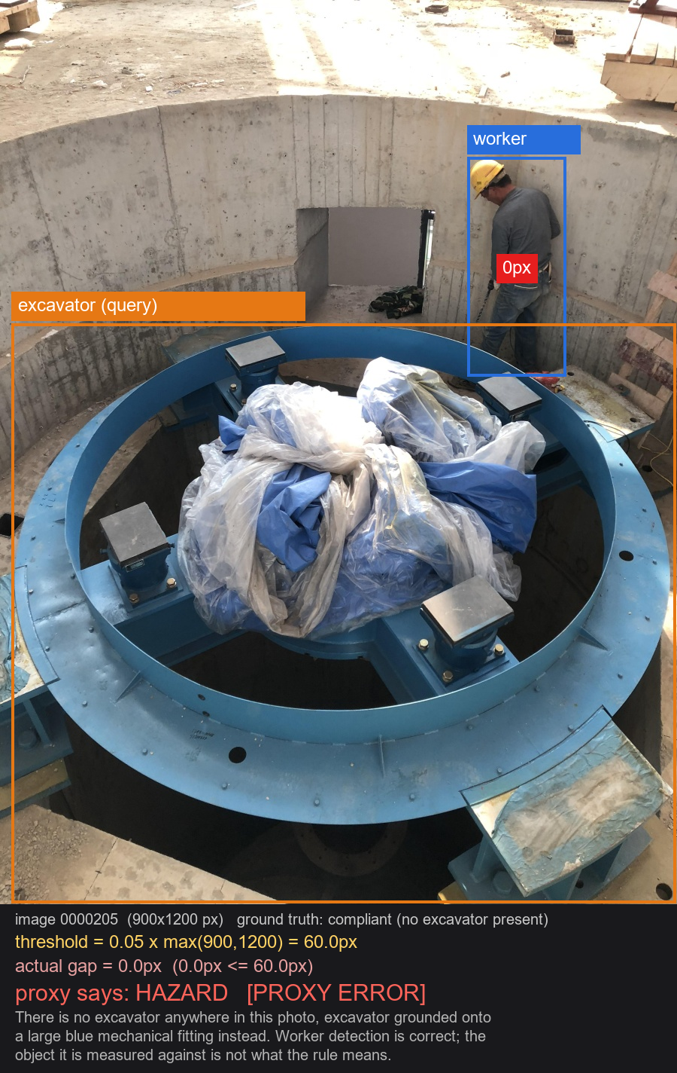
Class 3: Fails
CLASS 3 -- EXAMPLE
GROUND TRUTH
compliant (no excavator present)
HAZARD [PROXY ERROR]
WHAT WENT WRONG
• There is no excavator anywhere in this photo.
• "excavator" grounded onto a large blue mechanical fitting instead.
• Worker detection is correct; the object it's measured against is not what the rule means.

Slide 27
Class 3: Other Possible Problems
CLASS 3 -- PROBLEMS
• Third independent instance of the same hallucination pattern already seen in Class 1 and Class 2 -- this is systematic, not a one-off.
• Box-edge distance is a simplification of a real blind-spot/swing radius, which is arc-shaped and asymmetric, not a uniform ring around the excavator.
• Lowest specificity of any rule (41.7%) -- many compliant scenes get flagged as hazards even before counting hallucination cases.
• No distinction between an operator legitimately INSIDE the machine they're running and a bystander caught in its blind spot.

Slide 28
Class 3: Fixes and Limits
CLASS 3 -- FIXES
CAN BE FIXED
CANNOT BE FULLY FIXED
• Confidence filtering, same as Classes 1 and 2 -- likely the single highest-leverage fix across all three.
• Model the danger zone as an arc/sector instead of a uniform box-distance ring -- real engineering, but buildable.
• Multi-worker enumeration (D4) would also help rule_4's multi-worker scenes.
• Distinguishing "operator of this machine" from "bystander at risk" requires role and context reasoning, not distance measurement.
• A pure geometry check has no way to know who is meant to be near the excavator and who isn't.
• This is a native-VQA-model problem, not a better-detector problem.

Slide 29
CLASS WALKTHROUGH 4 / 4
Class 4: compliant
No detection logic of its own -- tested against whichever rule it is round-robined to

Slide 30
Class 4 Results: compliant (specificity by rule)
CLASS 4 -- STATS
Rule assigned | Specificity (correctly said "no violation")
rule_1 | 69.2% (9/13)
rule_2 | 69.2% (9/13)
rule_3 | 83.3% (10/12)
rule_4 | 41.7% (5/12)
Combined, rules 1-3 | 73.7% (28/38)
How it's tested: a compliant image has no natural rule to test against, so the pilot cycles it evenly across all four rules (round-robin) -- roughly 12-13 images per rule.
Best case: rule_3 (83.3%) -- guardrail's loose threshold rarely misfires on a genuinely clear scene.
Worst case: rule_4 (41.7%) -- the same low-specificity pattern seen in Class 3's stats, now visible from the compliant side too.

Slide 31
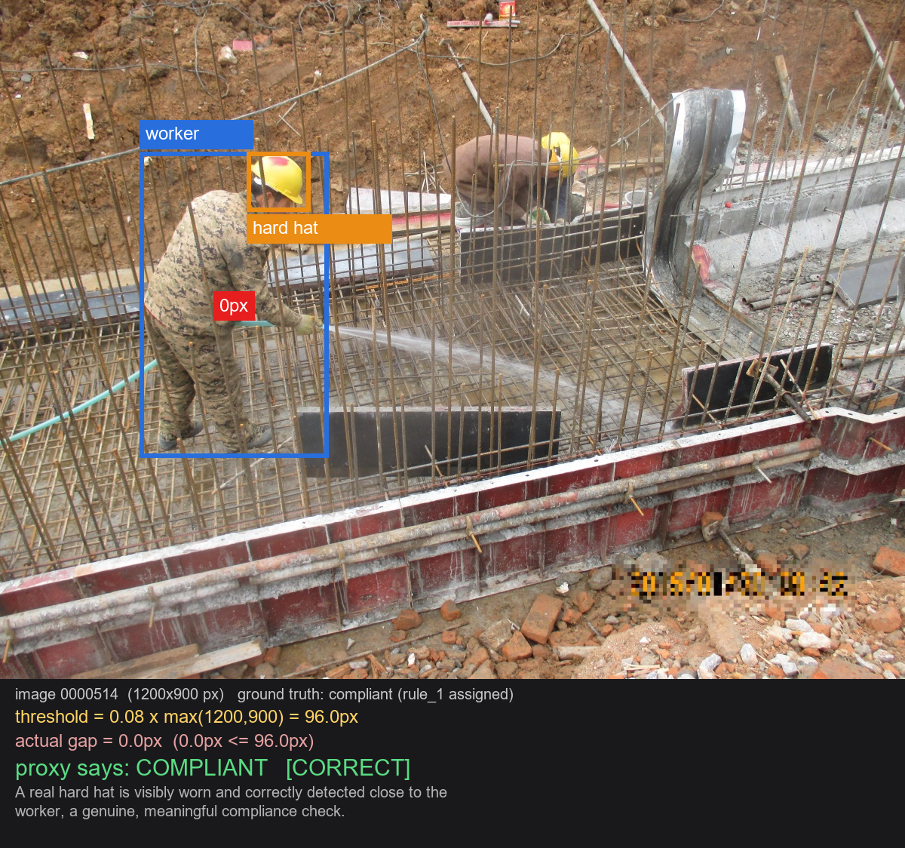
Class 4: Genuine (Works)
CLASS 4 -- EXAMPLE
GROUND TRUTH
compliant (rule_1 assigned)
COMPLIANT [CORRECT]
WHY IT WORKED
• A real hard hat is visibly worn and correctly detected close to the worker.
• A genuine, meaningful compliance check -- the hazard context IS in the picture, and the model verified it correctly.

Slide 32
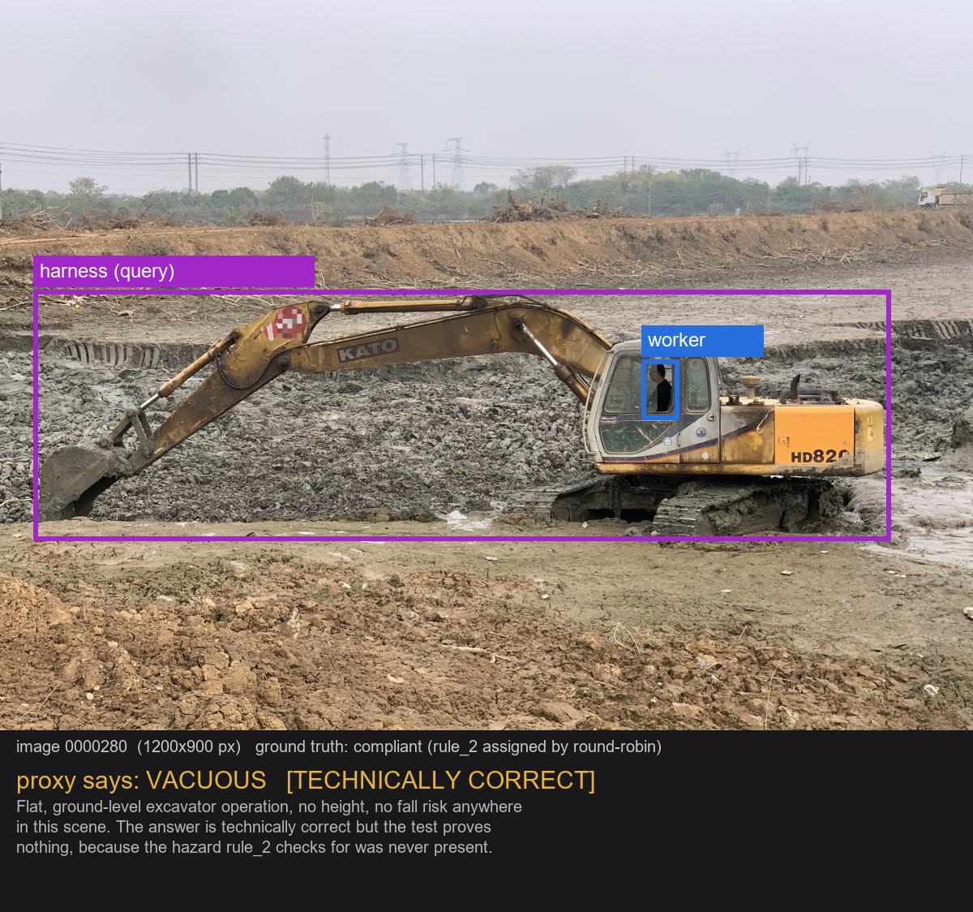
Class 4: Vacuous ("Fails" Differently)
CLASS 4 -- EXAMPLE
GROUND TRUTH
compliant (rule_2 assigned by round-robin)
VACUOUS [TECHNICALLY CORRECT]
WHAT WENT WRONG
• Flat, ground-level excavator operation -- no height, no fall risk anywhere in this scene.
• The answer is technically correct, but the test proves nothing.
• The hazard rule_2 checks for was never present in the picture to begin with.

Slide 33
Class 4: Other Possible Problems
CLASS 4 -- PROBLEMS
• Round-robin assignment can pair a rule with a scene that has zero relevant context -- the vacuous-test problem shown above.
• A "correct" compliant verdict can still ride on a wrong or hallucinated detection (right answer, wrong reasoning) -- the same risk seen in every other class's fail case.
• Nothing in the current reported numbers distinguishes a genuinely-verified compliant result from a vacuously-compliant one -- both count the same toward specificity.

Slide 34
Class 4: Fixes and Limits
CLASS 4 -- FIXES
CAN BE FIXED
CANNOT BE FULLY FIXED
• Context-matched assignment: only assign a rule to a compliant image when its hazard context is actually present in the scene (already built in the scale-up, Phase 1.3).
• Flag "context_absent" cases separately in reporting instead of blending them into the overall specificity number.
• Use the dataset's own scene metadata (illumination, camera distance, quality-of-info fields) to pre-screen ambiguous scenes.
• Some scenes have genuinely ambiguous or partial context (e.g. moderate height) that no simple metadata rule will resolve cleanly.
• A "right answer for the wrong reason" case is invisible unless every intermediate detection is also audited -- expensive at full scale.

Slide 35
One Pattern, Seen Three Times Independently
SYNTHESIS
• Class 1 (rule_1): "worker" grounded onto an excavator when no person was present.
• Class 2 (rule_2): "worker" and "harness" both grounded onto vehicles in an empty scene.
• Class 3 (rule_4): "excavator" grounded onto an unrelated mechanical fitting.
Three different rules, three independent images, the same root cause every time: when the queried object genuinely is not in the scene, Florence-2 still has to return something.
• Confidence filtering and plausibility checks reduce how often this happens -- but cannot reduce it to zero within this architecture.
• This is the central, evidence-backed reason the scale-up plan proposes adding Qwen2.5-VL as a native-VQA comparison (Decision D2) -- a model that can say "I don't see one" instead of being forced to point at something.

Slide 36
Summary: Where Each Class Stands
SUMMARY
Class / rule | Sensitivity | Specificity | Biggest open issue
ppe_violation (rule_1) | 16.0% | 69.2% | Identity mismatch: proximity check does not confirm same person
fall_hazard (rule_2) | 30.8% | 69.2% | Category misidentification common in raw detections
fall_hazard (rule_3) | 40.5% | 83.3% | Barrier proximity is not the same as barrier protection
struck_by_risk (rule_4) | 61.5% | 41.7% | Lowest specificity; danger zone is a box, not a real blind spot
compliant (all rules) | n/a | 73.7% (rules 1-3) | Vacuous tests from round-robin rule assignment
The one finding that matters most:
Across independent rules and independent images, the same failure keeps recurring: when the queried object is not genuinely in the scene (or not on the right person), Florence-2 still returns a box, and the geometry downstream cannot tell the difference.
What to take into the next meeting:
• Near-term, buildable fixes: confidence filtering, same-person identity checks, barrier-between-worker-and-edge geometry.
• Structural fix, already in the scale-up plan: add Qwen2.5-VL as a native-VQA comparison (Decision D2) to measure how much of this a reasoning model actually resolves.

