Slide 1
Performance evaluation of different Biomedical Image Segmentation techniques
AKM Kamrul Islam

Slide 2
Terms to Touch
Introduction
Goal and Contribution
Segmentation Approaches
Demo
Conclusion

Slide 3
Introduction
Image segmentation?
Separating images from background and each other.
Images are partitioned with respect to a chosen property such as brightness, color, reflectivity, texture etc.
Involves partitioning of images into connected regions, each region being homogeneous in some sense.

Slide 4
Basic Image Segmentation
Segmentation examples
unsupervised: background subtraction, recognition
supervised: photo-shop, medical image analysis
Segmentation features and “naïve” methods
intensities, colors ← thresholding, likelihood ratio test
contrast edges ← region growing, watersheds
Clustering techniques and segmentation
parametric methods: K-means, GMM
non-parametric: mean-shift
RGB and RGB+XY spaces
Szeliski, Sec 5.2
Szeliski, Sec 5.3
Other readings: Sonka at.al. Ch. 5
Gonzalez and Woods, Ch. 10

Slide 5
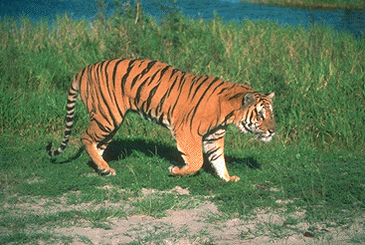
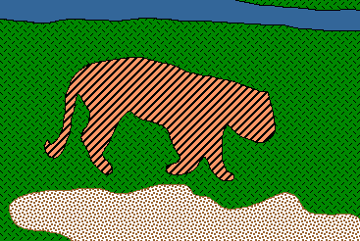
Goal: find coherent “blobs” or specific “objects”
Segmentation
accurate boundary delineation is often required
lower level tasks
(e.g. “superpixels”)
large grey area
in-between
higher level tasks
(e.g. cars, humans, or organs)

Slide 6
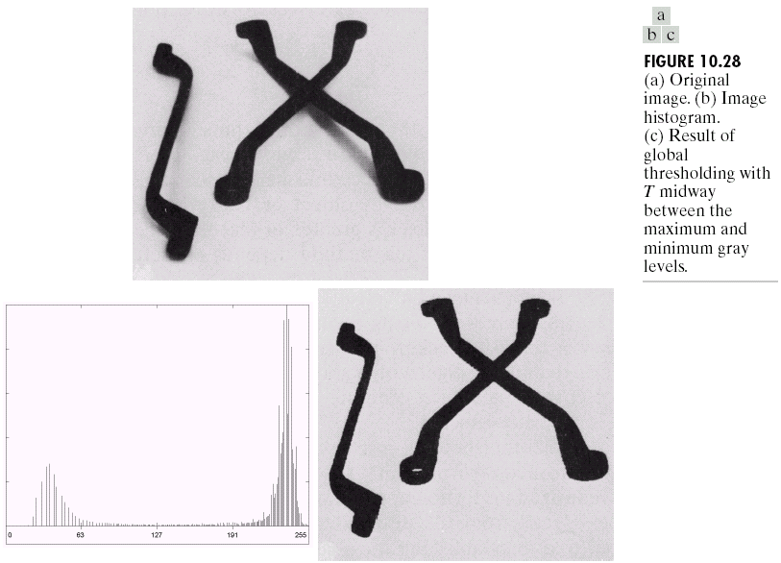
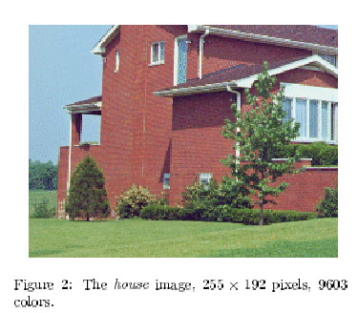
Coherent “blobs”
Simplest way to define blob coherence is as similarity in brightness or color:
The house, grass, and sky make
different blobs
The tools become blobs

Slide 7
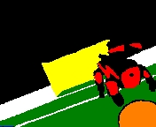
Ideal Segmentation
can
recognize
objects
with
known
simple
color
models
?
?
?

Slide 8
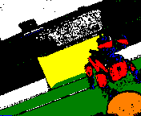
Result of a segmentation method (first learn how to get this, then how to get better results)
even
if
known
simple
color

Slide 9
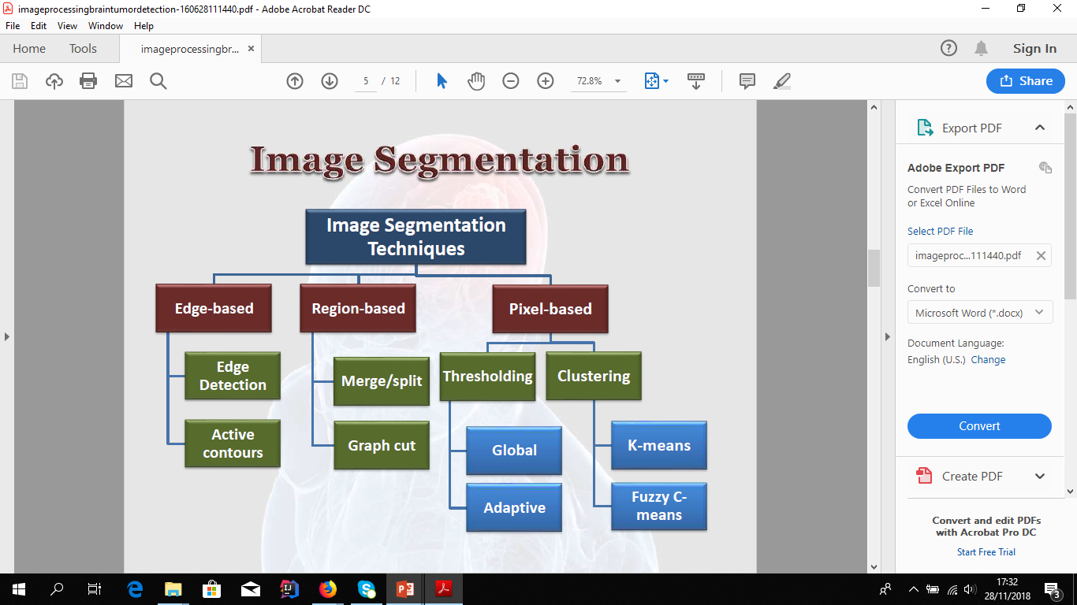

Slide 10
Basic ideas
basic features
basic (naïve) methods
intensities, colors ← thresholding, likelihood ratio test
contrast edges ← region growing, watersheds

Slide 11
Basic ideas
intensities, colors ← thresholding, likelihood ratio test

Slide 12
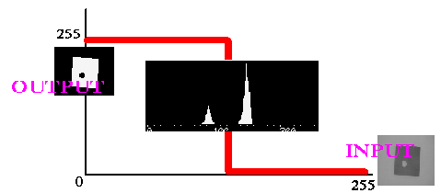
Thresholding
To segment a Gray Scale Image into a binary Black and White Image.
Thresholding Algorithm
Search all the pixels f(i,j) of the image f. An image element g(i,j) of the segmented image is an object pixel if f(i,j) >= T, and is a background pixel otherwise. If there are multiple objects in the image, multiple thresholds can be used.

Slide 13
(segmentation ← intensities/colors) Thresholding
Basic segmentation operation: mask(x,y) = 1 if im(x,y) > T mask(x,y) = 0 if im(x,y) < T
T is threshold
user-defined
or automatic
Same as histogram partitioning:

Slide 14
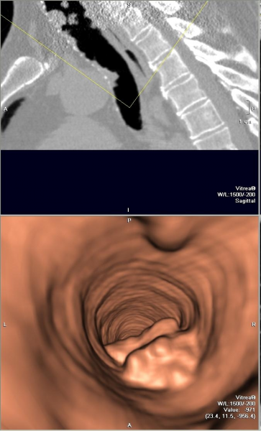
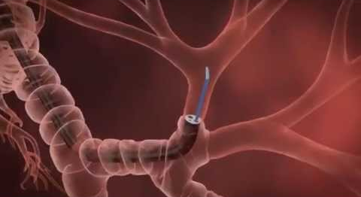
Sometimes works well…
Virtual
colonoscopy,
bronchoscopy,
etc.
a) threshold CT volume -> binary mask
from real device to non-invasive virtual test
b) extract surface mash from binary mask
(fast marching cubes method)

Slide 15
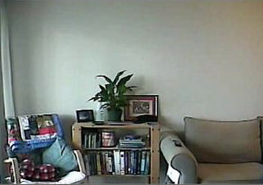
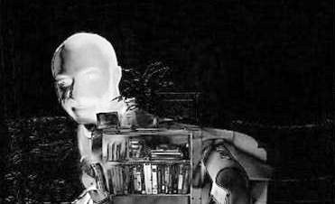
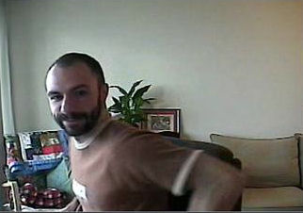
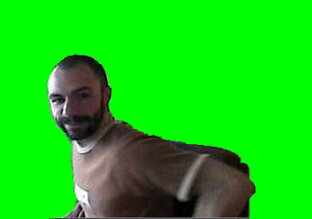
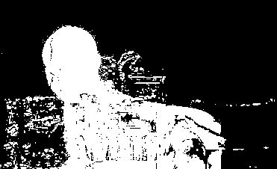
Sometimes works well… ?
I= I_{obj} - I_{bkg}
-
=
background
subtraction
0
T
255
Threshold intensities below T
problems when color models have overlapping support

Slide 16
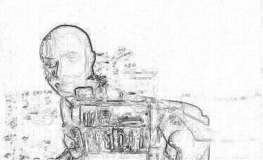
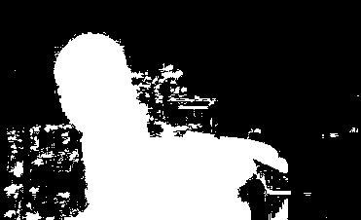
Region growing
seeds
I= I_{obj} - I_{bkg}
-
=
|∇ I_{p}|
Breadth First Search (seeds) :
|∇ I_{p}| < T

Slide 17
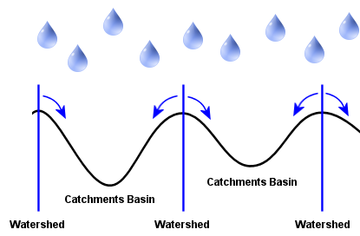
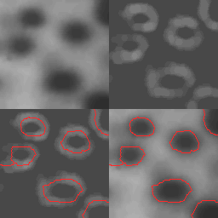
Watersheds
need tricks to build dambs
closing gaps
image
1. gradient
magnitudes
2. find catchment basins
3. copy over original image

Slide 18
General Grouping or Clustering (a.k.a. unsupervised learning)
Have data points (samples, also called feature vectors, examples, etc. ) x₁,…,x_{n}
Cluster similar points into groups
points are not pre-labeled
think of clustering as ‘discovering’ labels
horror movies
sci-fi movies
documentaries
slides from Olga Veksler

Slide 19
How does this Relate to Image Segmentation?
Represent image pixels as feature vectors x₁,…,x_{n}
For example, each pixel can be represented as
intensity, gives one dimensional feature vectors
color, gives three-dimensional feature vectors
color + coordinates, gives five-dimensional feature vectors
Cluster them into k clusters, i.e. k segments
input image
feature vectors for clustering based on color
9
7
8
4
3
6
2
1
8
[9 4 2]
[7 3 1]
[8 6 8]
8
5
3
2
8
7
[8 2 4]
[5 8 5]
[3 7 2]
4
5
2
9
2
1
[9 4 5]
[2 9 3]
[1 4 4]
4
9
4
5
3
4
RGB (or LUV) space clustering

Slide 20
How does this Relate to Image Segmentation?
Represent image pixels as feature vectors x₁,…,x_{n}
For example, each pixel can be represented as
intensity, gives one dimensional feature vectors
color, gives three-dimensional feature vectors
color + coordinates, gives five-dimensional feature vectors
Cluster them into k clusters, i.e. k segments
feature vectors for clustering based on color and image coordinates
input image
9
7
8
4
3
6
2
1
8
[9 4 2 0 0]
[7 3 1 0 1]
[8 6 8 0 2]
8
5
3
2
8
7
[8 2 4 1 0]
[5 8 5 1 1]
[3 7 2 1 2]
4
5
2
9
1
[9 4 5 2 0]
2
[2 9 3 2 1]
[1 4 4 2 2]
4
9
4
5
3
4
RGBXY (or LUVXY) space clustering

Slide 21
K-means Clustering: Algorithm
Initialization step
pick k cluster centers randomly
assign each sample to closest center
Iteration steps
compute means in each cluster
re-assign each sample to the closest mean
Iterate until clusters stop changing
This procedure decreases the value of the objective function
optimization variables
block-coordinate descent: step 1 optimizes µ, step 2 optimizes D

Slide 22

K-means clustering examples: Segmentation
K-means finds
compact clusters
μ₂
T
μ₁
In this case K-means (K=2) automatically finds good threshold (between 2 clusters)

Slide 23
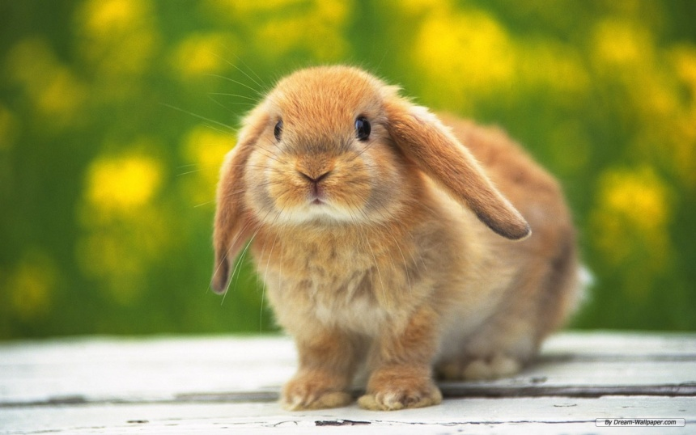
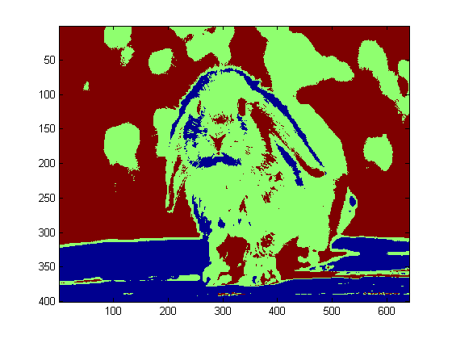
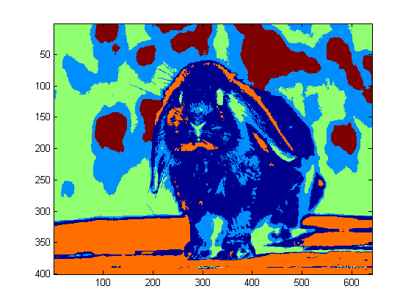
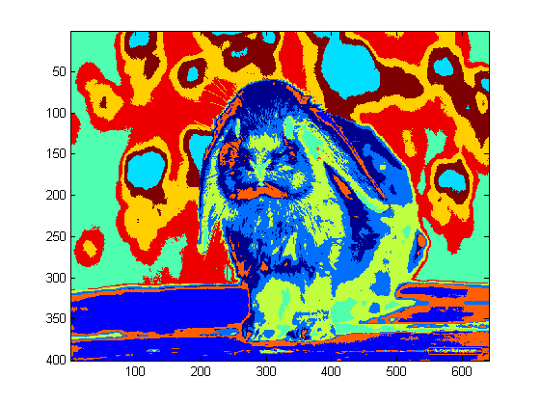
K-means clustering examples: Segmentation?
k = 3
(random colors are used to better show segments/clusters)
k = 5
k = 10

Slide 24
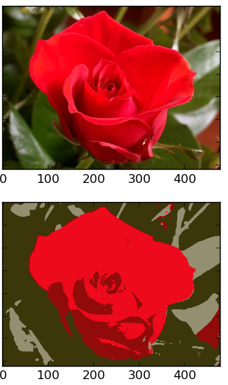
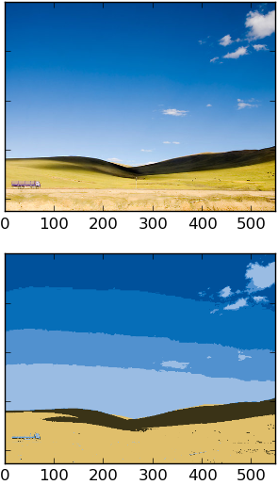
K-means clustering examples: Color Quantization
NOTE
bias to
equal-size
clusters

Slide 25



K-means clustering examples: Adding XY features
color quantization
superpixels
Voronoi cells
RGB features
RGBXY features
XY features only
related to HW 1

Slide 26
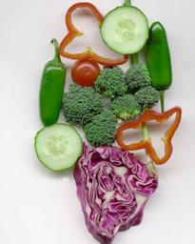
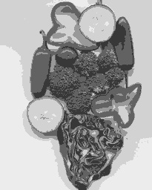
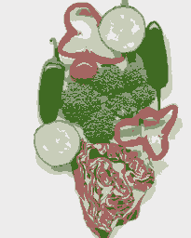
Image
Clusters on intensity
Clusters on color
K-means clustering using intensity alone and color alone
Notes:
I gave each pixel the mean intensity or mean color of its cluster --- this is basically just vector quantizing the image intensities/colors. Notice that there is no requirement that clusters be spatially localized and they’re not.

Slide 27


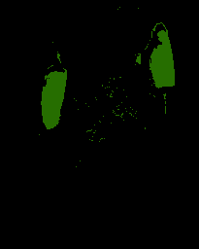
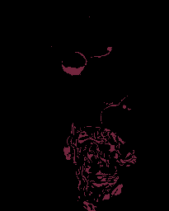
K-means using
color alone,
11 segments.

Slide 28
References
[1] L. Xu, S. Zheng, and J. Jia. Unnatural L0 sparse representation for natural image deblurring. In CVPR, pages 1107–1114, 2013.
[2] C. Yang, L. Zhang, H. Lu, X. Ruan, and M.-H. Yang. Saliency detection via graph-based manifold ranking. In CVPR, pages 3166–3173, 2013
[3] H. Zhang, D. P. Wipf, and Y. Zhang. Multi-image blind deblurring using a coupled adaptive sparse prior. In CVPR, pages 1051–1058, 2013.
[4] H. Zhang, J. Yang, Y. Zhang, and T. S. Huang. Sparse representation based blind image deblurring. In ICME, pages 1–6, 2011.
[5] D. Zhou, J. Weston, A. Gretton, O. Bousquet, and B. Sch¨olkopf. Ranking on data manifolds. In NIPS, pages 169–176, 2003.

