Slide 1
Operating System LAB-06
Prepared By
Md. Mustafizur Rahman
Lecturer, CSE,DCC.

Slide 2
EXPERIMENT NO-06
Dynamic Storage-Allocation Problem
AIM: To Write a C program to simulate the following contiguous memory allocation techniques
a) Worst-fit b) Best-fit c) First-fit

Slide 3
EXPERIMENT NO-06
DESCRIPTION
One of the simplest methods for memory allocation is to divide memory into several fixed-sized partitions. Each partition may contain exactly one process. In this multiple-partition method, when a partition is free, a process is selected from the input queue and is loaded into the free partition. When the process terminates, the partition becomes available for another process. The operating system keeps a table indicating which parts of memory are available and which are occupied. Finally, when a process arrives and needs memory, a memory section large enough for this process is provided.

Slide 4
EXPERIMENT NO-06
DESCRIPTION
When it is time to load or swap a process into main memory, and if there is more than one free block of memory of sufficient size, then the operating system must decide which free block to allocate. Best-fit strategy chooses the block that is closest in size to the request. First-fit chooses the first available block that is large enough. Worst-fit chooses the largest available block.

Slide 5
Dynamic Storage-Allocation Problem
How to satisfy a request of size n from a list of free holes?
First-fit: Allocate the first hole that is big enough
Best-fit: Allocate the smallest hole that is big enough; must search entire list, unless ordered by size
  Produces the smallest leftover hole
Worst-fit: Allocate the largest hole; must also search entire list
  Produces the largest leftover hole
First-fit and best-fit better than worst-fit in terms of speed and storage utilization

Slide 6
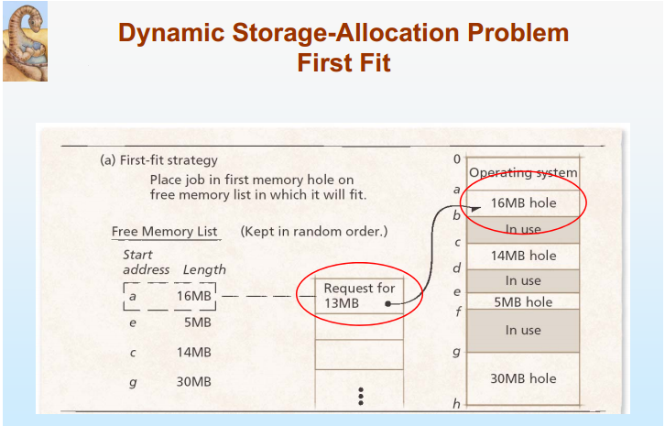
Dynamic Storage-Allocation Problem

Slide 7
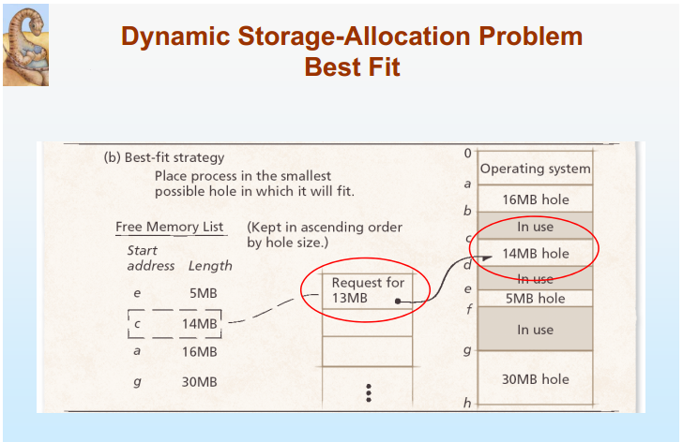
Dynamic Storage-Allocation Problem

Slide 8
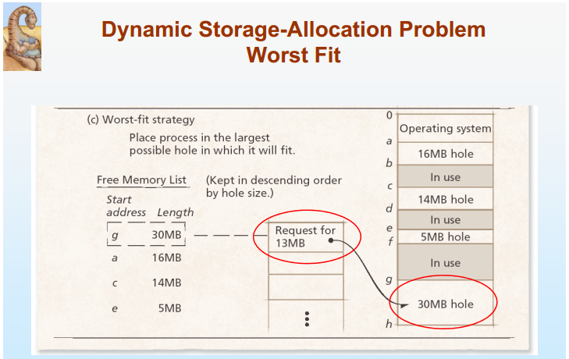
Dynamic Storage-Allocation Problem

Slide 9
EXPERIMENT NO-06: C PROGRAM
#include<stdio.h>
//#include<conio.h>
#define max 25
int main()
{
int frag[max],b[max],f[max],i,j,nb,nf,temp;
static int bf[max],ff[max];
//clrscr();
printf("\n\tMemory Management Scheme - First Fit");
printf("\nEnter the number of blocks:");
scanf("%d",&nb);
printf("Enter the number of files:");
scanf("%d",&nf);
printf("\nEnter the size of the blocks:-\n");
for(i=1;i<=nb;i++)
{
printf("Block %d:",i);

Slide 10
EXPERIMENT NO-06: C PROGRAM
scanf("%d",&b[i]);
}
printf("Enter the size of the files :-\n");
for(i=1;i<=nf;i++)
{
printf("File %d:",i);
scanf("%d",&f[i]);
}
for(i=1;i<=nf;i++)
{
for(j=1;j<=nb;j++)
{
if(bf[j]!=1)
{
temp=b[j]-f[i];
if(temp>=0)
{

Slide 11
EXPERIMENT NO-06: C PROGRAM
ff[i]=j;
break;
}
}
}
frag[i]=temp;
bf[ff[i]]=1;
}
printf("\nFile_no:\tFile_size :\tBlock_no:\tBlock_size:\tFragement");
for(i=1;i<=nf;i++)
printf("\n%d\t\t%d\t\t%d\t\t%d\t\t%d",i,f[i],ff[i],b[ff[i]],frag[i]);
//getch();
return 0;
}

Slide 12
End of Lab 06

