Slide 1
Operating System LAB-07
Prepared By
Md. Mustafizur Rahman
Lecturer, CSE,DCC.

Slide 2
EXPERIMENT NO-07
PAGE REPLACEMENT ALGORITHMS
AIM: To implement FIFO page replacement technique.
a) FIFO b) LRU c) OPTIMAL

Slide 3
EXPERIMENT NO-07
DESCRIPTION
Page replacement algorithms are an important part of virtual memory management and it helps the OS to decide which memory page can be moved out making space for the currently needed page. However, the ultimate objective of all page replacement algorithms is to reduce the number of page faults.
FIFO-This is the simplest page replacement algorithm. In this algorithm, the operating system keeps track of all pages in the memory in a queue, the oldest page is in the front of the queue.

Slide 4
EXPERIMENT NO-07
DESCRIPTION
When a page needs to be replaced page in the front of the queue is selected for removal.
LRU-In this algorithm page will be replaced which is least recently used OPTIMAL- In this algorithm, pages are replaced which would not be used for the longest duration of time in the future. This algorithm will give us less page fault when compared to other page replacement algorithms.

Slide 5
Algorithm
1. Start the process
2. Declare the size with respect to page length
3. Check the need of replacement from the page to memory
4. Check the need of replacement from old page to new page in memory
5. Form a queue to hold all pages
6. Insert the page require memory into the queue
7. Check for bad replacement and page fault
8. Get the number of processes to be inserted
9. Display the values
10. Stop the process

Slide 6
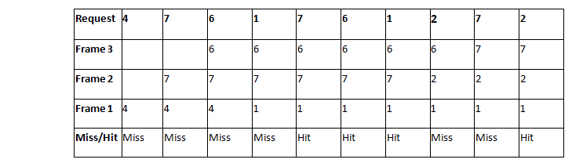
Consider a reference string: 4, 7, 6, 1, 7, 6, 1, 2, 7, 2. the number of frames in the memory is 3. Find out the number of page faults respective to:

Slide 7
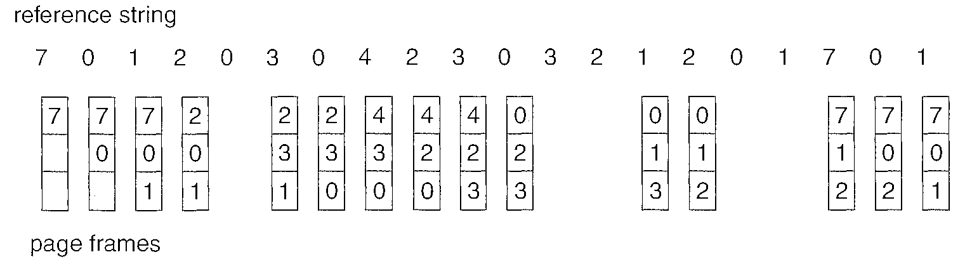
Consider a reference string: the number of frames in the memory is 3. Find out the number of page faults respective to:

Slide 8
EXPERIMENT NO-07: C PROGRAM
#include<stdio.h>
int main()
{
int i,j,n,a[50],frame[10],no,k,avail,count=0;
printf("\nenter the length of the Reference string:\n");
scanf("%d",&n);
printf("\n enter the reference string:\n");
for(i=1;i<=n;i++)
scanf("%d",&a[i]);
printf("\n enter the number of Frames:");
scanf("%d",&no);
for(i=0;i<no;i++)
frame[i]= -1;
j=0;
printf("ref string\t page frames\n");
for(i=1;i<=n;i++)

Slide 9
EXPERIMENT NO-07: C PROGRAM
{
printf("%d\t\t",a[i]);
avail=0;
for(k=0;k<no;k++)
if(frame[k]==a[i])
avail=1;
if (avail==0)
{
frame[j]=a[i];
j=(j+1)%no;
count++;
for(k=0;k<no;k++)
printf("%d\t",frame[k]);
}
printf("\n\n");
}
printf("Page Fault Is %d",count);
return 0;
}

Slide 10
End of Lab 07

