Slide 1
Operating System LAB-08
Prepared By
Md. Mustafizur Rahman
Lecturer, CSE,DCC.

Slide 2
EXPERIMENT NO-08
PAGE REPLACEMENT ALGORITHMS
AIM: To implement OPTIMAL page replacement technique.
a) FIFO b) LRU c) OPTIMAL

Slide 3
EXPERIMENT NO-08
DESCRIPTION
Page replacement algorithms are an important part of virtual memory management and it helps the OS to decide which memory page can be moved out making space for the currently needed page. However, the ultimate objective of all page replacement algorithms is to reduce the number of page faults.
FIFO-This is the simplest page replacement algorithm. In this algorithm, the operating system keeps track of all pages in the memory in a queue, the oldest page is in the front of the queue.

Slide 4
EXPERIMENT NO-08
DESCRIPTION
When a page needs to be replaced page in the front of the queue is selected for removal.
LRU-In this algorithm page will be replaced which is least recently used OPTIMAL- In this algorithm, pages are replaced which would not be used for the longest duration of time in the future. This algorithm will give us less page fault when compared to other page replacement algorithms.

Slide 5
Algorithm of Optimal
1. Start Program
2. Read Number Of Pages And Frames
3.Read Each Page Value
4. Search For Page In The Frames
5.If Not Available Allocate Free Frame
6. If No Frames Is Free Replace The Page With The Page which will not be used for the longest period.
7.Print Page Number Of Page Faults
8.Stop process.

Slide 6
Algorithm of LRU
1. Start the process
2. Declare the size
3. Get the number of pages to be inserted
4. Get the value
5. Declare counter and stack
6. Select the least recently used page by counter value
7. Stack them according the selection.
8. Display the values
9. Stop the process

Slide 7
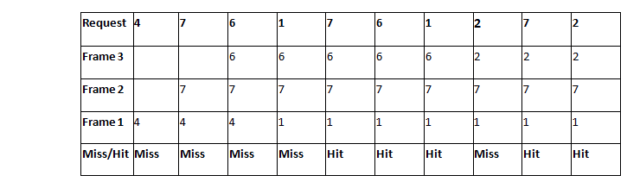
Optimal Example
Consider a reference string: 4, 7, 6, 1, 7, 6, 1, 2, 7, 2. the number of frames in the memory is 3. Find out the number of page faults

Slide 8
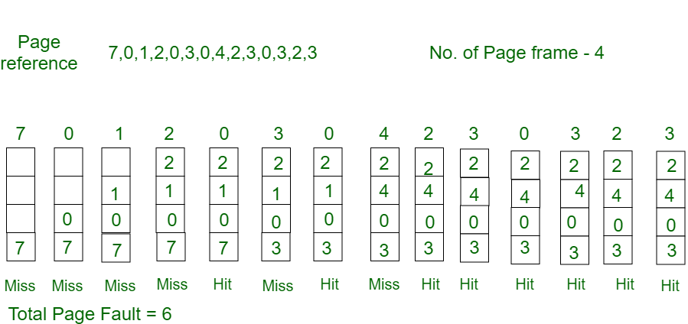
Optimal Example
Consider the page references 7, 0, 1, 2, 0, 3, 0, 4, 2, 3, 0, 3, 2, with 4 page frame. Find number of page fault.

Slide 9
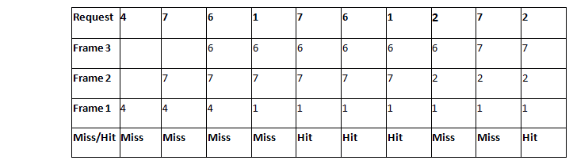
LRU Example
Consider a reference string: 4, 7, 6, 1, 7, 6, 1, 2, 7, 2. the number of frames in the memory is 3. Find out the number of page faults

Slide 10
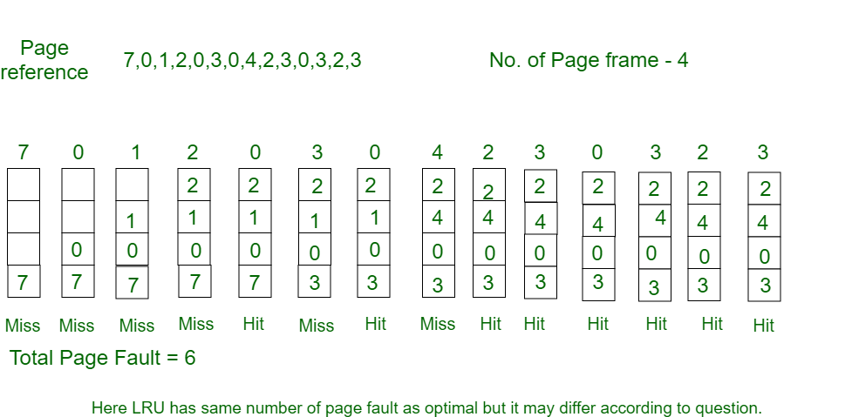
LRU Example
Consider the page reference string 7, 0, 1, 2, 0, 3, 0, 4, 2, 3, 0, 3, 2 with 4 page frames. Find number of page faults.

Slide 11
EXPERIMENT NO-08: C PROGRAM
#include<stdio.h>
int main()
{
int no_of_frames, no_of_pages, frames[10], pages[30], temp[10], flag1, flag2, flag3, i, j, k, pos, max, faults = 0;
printf("Enter number of frames: ");
scanf("%d", &no_of_frames);
printf("Enter number of pages: ");
scanf("%d", &no_of_pages);
printf("Enter page reference string: ");
for(i = 0; i < no_of_pages; ++i){
scanf("%d", &pages[i]);
}

Slide 12
EXPERIMENT NO-08: C PROGRAM
for(i = 0; i < no_of_frames; ++i){
frames[i] = -1;
}
for(i = 0; i < no_of_pages; ++i){
flag1 = flag2 = 0;
for(j = 0; j < no_of_frames; ++j){
if(frames[j] == pages[i]){
flag1 = flag2 = 1;
break;
}
}
if(flag1 == 0){
for(j = 0; j < no_of_frames; ++j){
if(frames[j] == -1){
faults++;

Slide 13
EXPERIMENT NO-08: C PROGRAM
frames[j] = pages[i];
flag2 = 1;
break;
}
}
}
if(flag2 == 0){
flag3 =0;
for(j = 0; j < no_of_frames; ++j){
temp[j] = -1;
for(k = i + 1; k < no_of_pages; ++k){
if(frames[j] == pages[k]){
temp[j] = k;
break;
}

Slide 14
EXPERIMENT NO-08: C PROGRAM
}
}
for(j = 0; j < no_of_frames; ++j){
if(temp[j] == -1){
pos = j;
flag3 = 1;
break;
}
}
if(flag3 ==0){
max = temp[0];
pos = 0;
for(j = 1; j < no_of_frames; ++j){
if(temp[j] > max){
max = temp[j];
pos = j;

Slide 15
EXPERIMENT NO-08: C PROGRAM
}
}
}
frames[pos] = pages[i];
faults++;
}
printf("\n");
for(j = 0; j < no_of_frames; ++j){
printf("%d\t", frames[j]);
}
}
printf("\n\nTotal Page Faults = %d", faults);
return 0;
}

Slide 16
End of Lab 08

