Slide 1
Welcome

Slide 2
PROJECT ON SMART ATTENDANCE SYSTEM USING OPENCV & PYTHON

Slide 3
SUBMITTED TO:
SHUPTA RICHARD PHILIP
SENIOR LECTURER ,CITY UNIVERSITY
DEPARTMENT OF CSE

Slide 4
GROUP MEMBER
Name ID Number
Abidur Rahman 142362004
Saimun Islam 153402316
MD. Hafijul Islam 153402354
Kamrul Islam 153402323
MD.Saddam Hossain 153402318
Sumya Jahan 153402315

Slide 5
The various techniques for marking attendance are:
Signature based System
Fingerprint based System
Iris Recognition
RFID based System
Face Recognition

Slide 6
Daily student attendance in schools, colleges and institutes. It facilitates to access the attendance information of a particular student in a particular class.
Some basic problems:
This method is not flexible.
It’s risk.
Losing the attendance sheet
Unethical problem may be occurring such as cheating in signature.

Slide 7
For example, a student does not attend his class but his attendance form has been signed by other student. This system is proposed to overcome these problems.

Slide 8
Objective
The prime objectives of research are:
To discover, verify and test new and important facts.
To analyses an event or process or phenomenon to identify the cause and effect relationship.
To develop new scientific tools, concepts and theories to understand scientific and nonscientific Problems.
To find solutions to scientific, non-scientific and social problems.

Slide 9
Why we using this
It's take less time.
It’s built for automating the processing of attendance.
It also enhances the speed of performing attendance task easily.
After recognition, it will mark the attendance of the recognized student and update the attendance record.
The admin will be able to print these record details afterward.

Slide 10
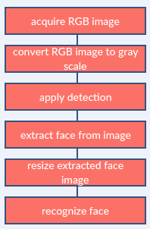
Image processing

Slide 11
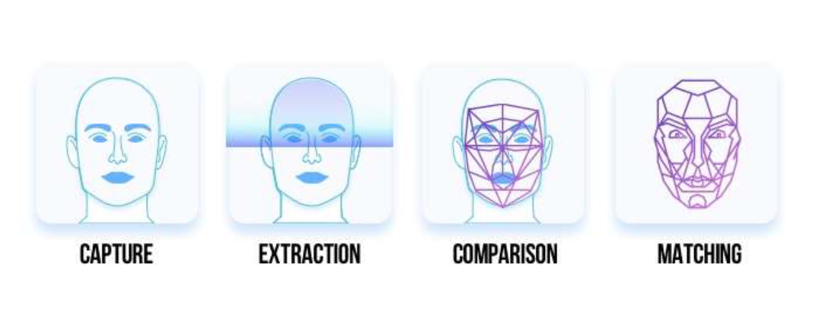

Slide 12
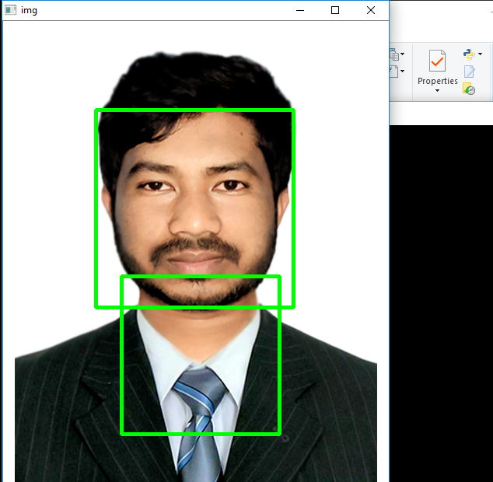
When we applied the openCV python code, the code was able to successfully recognize the faces, it detect the faces and write the names of recognized persons as shown

Slide 13
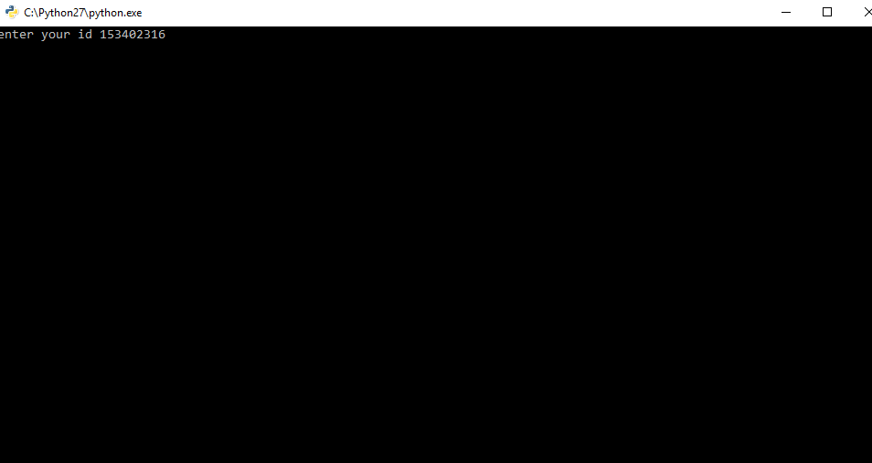
How to add student:

Slide 14
THE PROBLEM THAT WE FACED
In our project we have faced many of problems and we have overcome them:
1- Download Python and library for it on Anaconda and opencv.
2- Version of the Anaconda and Opencv.

Slide 15
Conclusion:
From our experiment, we noticed the face recognition was sensitive to face background, light, and head orientations. This technique described the accurate and efficient method of automatic attendance in the classroom which could replace the traditional method. An automatic attendance has many advantages, most of the existing systems are time consuming and require semi manual interference from lecturers, our system seeks to solve these issues by using face recognition in the process to save the time and labor. And No need for installing complex hardware for taking the attendance in classroom, all we need is a camera and laptop. We used algorithms that can detect and recognize faces in the image.

Slide 16
Future Work:
Automatic attendance system can be improved by increasing the number of features which can be extracted to increase accuracy of face recognition. Once the software is developed and tested properly, it could be improved to cover full institutions such as the faculty of engineering.

Slide 17
Thanks!
To All

