Slide 1

Emergency medicine Service at night
Group:3
Nafisa Sultana ID:20-43072-1
Most.Masnat Marufi ID:20-43122-1
S.M.Kamrul Hasan Koche ID:20-43405-1
Shuvra Deb ID:19-39479-1
American International University-Bangladesh (AIUB)

Slide 2
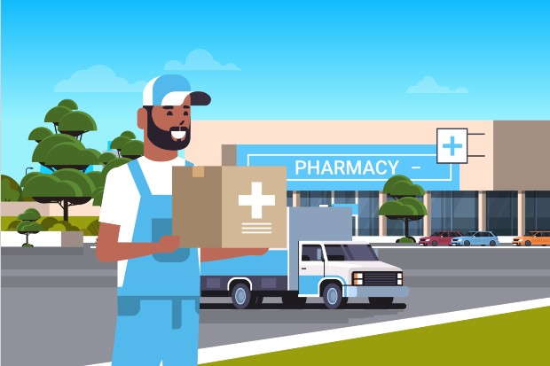

Target for the project :
People who have Scarcity of medicine at night
People who don’t have transportation, apply for online service
Suddenly at night if someone get sick , they will get a immediate help / service

Slide 3
Opportunity of online medicine service
Problem of online
medicine service
Online sale of medicine may lead to regulatory challenges since one can run it from another region or country
Ease of sale and handling of medicine especially controlled drugs may lead to drug abuse and misuse.
Patient's data confidentiality may be lost by unguarded access to the site.
Face to face interaction for proper counseling , BMI and vital sign checks for pharmaceutical care may be lacking.
It is easy and convenient to order medicines online and it solves to emergency patients at mid night problem.
It saves a lot of time.
Busy lifestyle and less travel
It offers a varied range options
It also has verification system to reduce misuse.

Slide 4
objective
Build can easy-to-use web and mobile application for ordering medicine.
Build a web portal usable from devices of all sizes.
Build a web portal that will be easy for general people to navigate.
Build a web portal to verify prescriptions if required.
Build a web portal to keep records for a long period of time as specified by policies.
Build a web portal to provide confidentiality to user records.

Slide 5
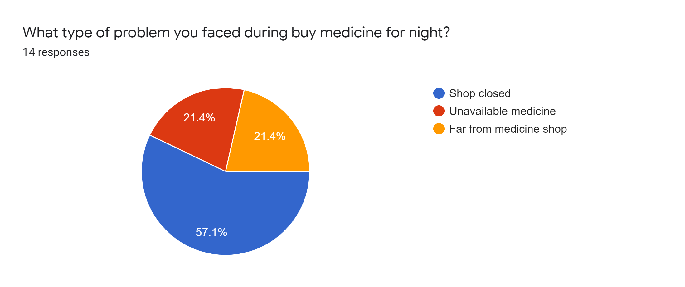
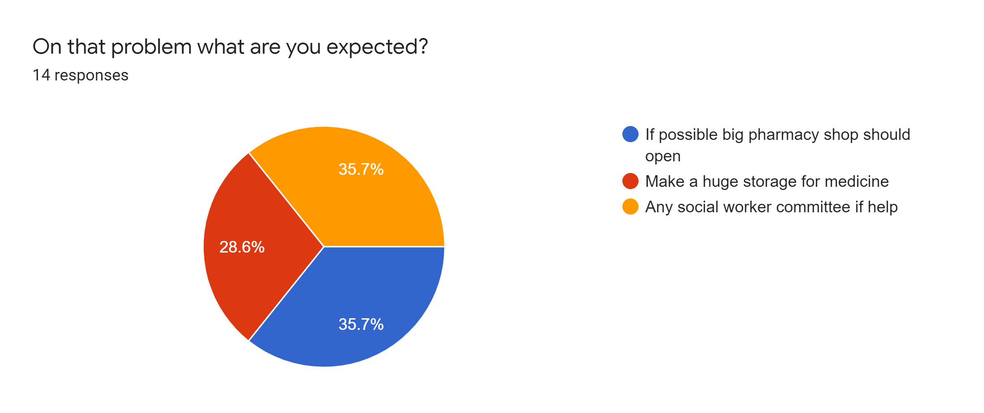
opportunity, including evidence of research into the need, problem or opportunity

Slide 6
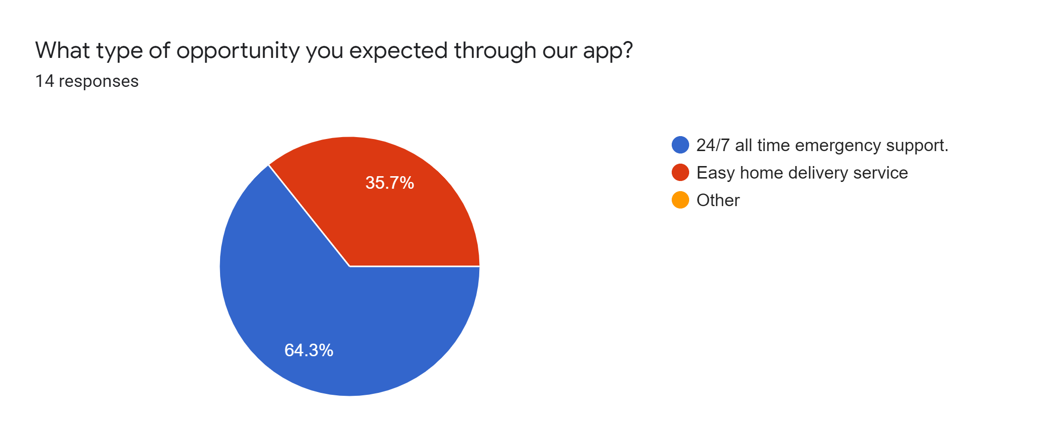
opportunity, including evidence of research into the need, problem or opportunity

Slide 7
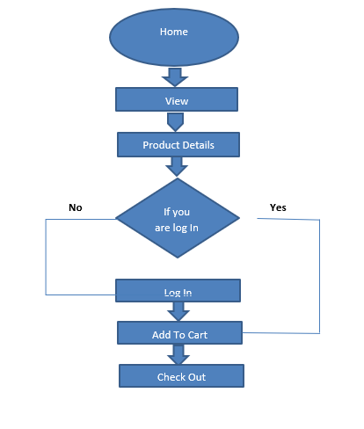
24/7 A reliable online medicine service

Slide 8

Thank You

