Slide 1

Linux ubuntu
2
+
2
+
Server configuration

Slide 2


What will we learn form this tutorial !
2
+
2
+

Slide 3

2
+
2
+
2
+
Why Linux Server
Linux Install virtual on your PC
Basic command show
What is LAMP and How to install
Deploy Normal HTML Project [LAMP]
Deploy Laravel Project [LAMP]
Deploy React Project [LAMP]
What is LEMP and how to install
Deploy Normal HTML Project [LEMP]
Deploy Laravel Project [LEMP]
Deploy React Project [LEMP]

Slide 4
2
+
2
+
2
+
11. Linux Install on VPS server.

Slide 5
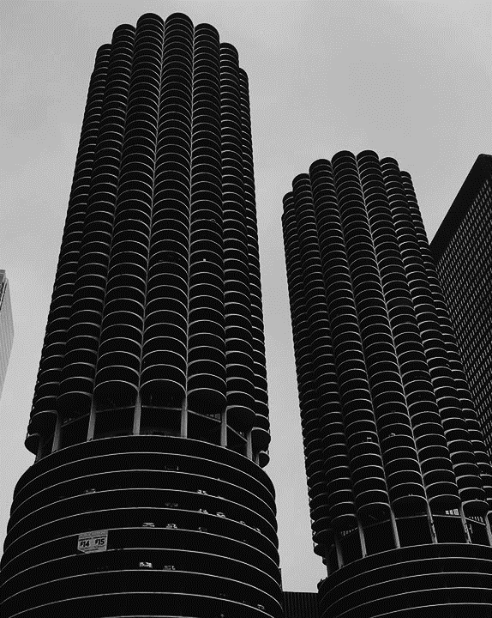
Linux Install virtual on your PC
2
+
Reference Link
https://www.linux.org/pages/download/
https://ubuntu.com/download#download
https://releases.ubuntu.com/
https://www.virtualbox.org/
https://www.putty.org/

Slide 6

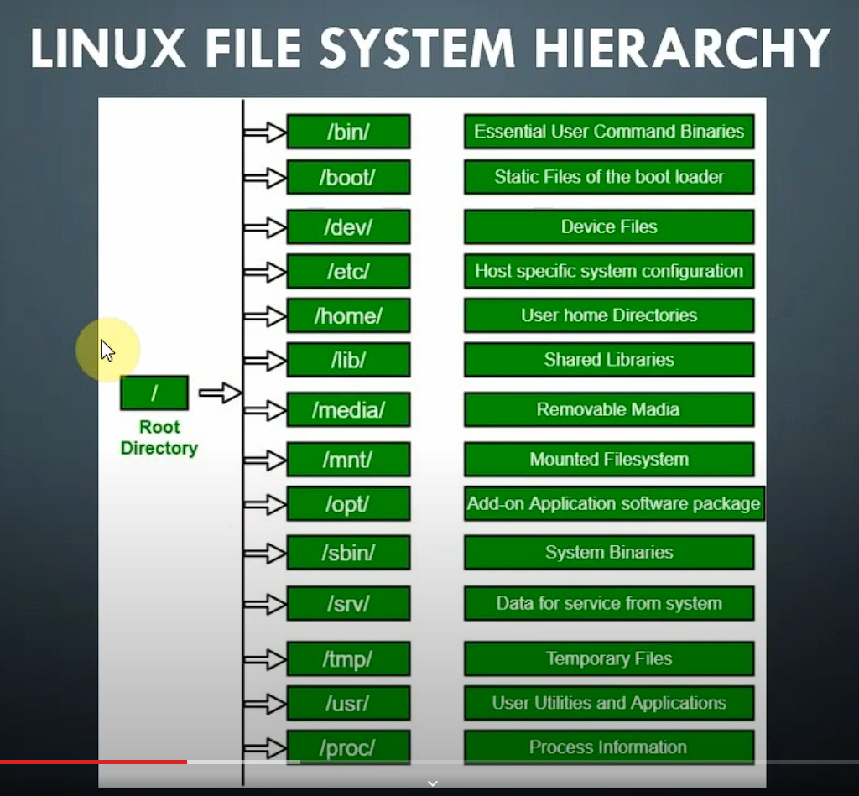
File system hierarchy
2
+

Slide 7

Setup Lamp
if Mysql Error than, do that-
sudo apt update
sudo apt install apache2
sudo ufw app list
sudo ufw allow in "Apache Full“
sudo apt install mysql-server
sudo mysql_secure_installation
sudo apt install php libapache2-mod-php php-mysql
sudo mysql
ALTER USER 'root'@'localhost' IDENTIFIED WITH mysql_native_password by 'Password$123’;
sudo mysql_secure_installation

Slide 8
Setup PHPMyAdmin [lamp]
If any Problem-
sudo dpkg-reconfigure -plow phpMyAdmin
sudo ln -s /etc/phpmyadmin/apache.conf /etc/apache2/sites-available/phpmyadmin.conf
sudo a2enconf phpmyadmin.conf
sudo systemctl restart apache2
sudo apt install phpmyadmin php-mbstring php-zip php-gd php-json php-curl
sudo phpenmod mbstring
sudo ln -s /etc/phpmyadmin/apache.conf /etc/apache2/sites-available/phpmyadmin.conf
sudo systemctl restart apache2

Slide 9
Simple Html site deploy [LAMP]
2
cd /var/www
sudo mkdir myhtml
cd myhtml
sudo nano index.html [past your html code]
cd /etc/apache2/sites-available
sudo cp 000-default.conf myhtml.conf
sudo nano myhtml.conf
sudo a2ensite myhtml.conf
sudo systemctl reload apache2
cd sites-avcd /etc/apache2
sudo a2dissite 000-default.conf
sudo systemctl reload apache2
+
t

Slide 10

COMPOSER INSTALL
2
+
1. sudo apt update 2. sudo apt install php-cli unzip 3. cd ~ 4. curl -sS https://getcomposer.org/installer -o /tmp/composer-setup.php 5. HASH=`curl -sS https://composer.github.io/installer.sig` 6. php -r "if (hash_file('SHA384', '/tmp/composer-setup.php') === '$HASH') { echo 'Installer verified'; } else { echo 'Installer corrupt'; unlink('composer-setup.php'); } echo PHP_EOL;“ 7. sudo php /tmp/composer-setup.php --install-dir=/usr/local/bin --filename=composer 8. sudo apt-get install git composer -y 9. composer

Slide 11
Laravel site deploy [LAMP]
2
+
sudo apt-get update cd /var/www/ sudo git clone https://github.com/laravel/laravel.git cd /var/www/git-clone-folder composer install sudo cp .env.example .env php artisan key:generate sudo chown -R www-data.www-data /var/www/git-clone-folder/storage sudo chown -R www-data.www-data /var/www/git-clone-folder/bootstrap/cache sudo cp /etc/apache2/sites-available/000-default.conf /etc/apache2/sites-available/larvel_app.conf sudo nano /etc/apache2/sites-available/larvel_app.conf sudo service apache2 restart sudo a2ensite larvel_app.conf sudo a2dissite 000-default.conf sudo service apache2 restart

Slide 12
Laravel Not loading inner pages / Not found with 404
2
+
sudo a2enmod rewrite sudo nano /etc/apache2/apache2.conf <Directory /var/www/> Options Indexes FollowSymLinks AllowOverride All Require all granted </Directory> sudo service apache2 restart

Slide 13
Node Install
2
+
sudo apt update curl -fsSL https://deb.nodesource.com/setup_current.x | sudo -E bash – sudo apt-get install -y nodejs

Slide 14
React Site Deploy [LAMP]
2
+
sudo apt update cd /var/www/ git clone https://github.com/kamruzzamanripon/Ecommerce-html-to-react.git cd /var/www/your_react_project_folder npm install npm run build cd /etc/apache2/sites-available sudo cp 000-default.conf reactapp.conf sudo a2dissite 000-default.conf sudo systemctl restart apache2 sudo a2ensite reactapp.conf sudo systemctl restart apache2

Slide 15
Setup LEmp
if Mysql Error than, do that-
sudo apt update
sudo apt install nginx –y
sudo systemctl status nginx
sudo ufw app list
sudo ufw allow 'Nginx FULL’
sudo ufw status
sudo apt install mysql-server
sudo mysql_secure_installation
sudo apt install php libapache2-mod-php php-mysql
sudo mysql
ALTER USER 'root'@'localhost' IDENTIFIED WITH mysql_native_password by 'Password$123’;
sudo mysql_secure_installation

Slide 16
Update php
sudo apt-get install software-properties-common
sudo add-apt-repository ppa:ondrej/php
sudo apt update
sudo apt install php8.0-fpm php8.0-common php8.0-mysql php8.0-gmp php8.0-curl php8.0-intl php8.0-mbstring php8.0-xmlrpc php8.0-gd php8.0-xml php8.0-cli php8.0-zip
php -v

Slide 17
Setup PHPMyAdmin [lEmp]
location /phpmyadmin {
root /usr/share/;
index index.php index.html index.htm;
location ~ ^/phpmyadmin/(.+\.php)$ {
try_files $uri =404;
root /usr/share/;
fastcgi_pass unix:/run/php/php8.0-fpm.sock;
fastcgi_index index.php;
fastcgi_param SCRIPT_FILENAME $document_root$fastcgi_script_name;
include /etc/nginx/fastcgi_params;
}
location ~* ^/phpmyadmin/(.+\.(jpg|jpeg|gif|css|png|js|ico|html|xml|txt))$ {
root /usr/share/;
}
}
sudo apt install phpMyAdmin
sudo phpenmod mbstring
sudo nano /etc/nginx/snippets/phpmyadmin.conf
go to cd /etc/nginx/sites-available/ open conf file which site you want to run and add below line-
include snippets/phpmyadmin.conf;
sudo systemctl restart nginx

Slide 18
Setup PHPMyAdmin [LEMP] If any Problem-
sudo dpkg-reconfigure -plow phpmyadmin
sudo ln -s /etc/phpmyadmin/apache.conf /etc/nginx/ sites-available/
sudo ln -s /etc/sites-available/phpmyadmin.conf /etc/nginx/sites-enabled/
sudo systemctl restart nginx

Slide 19
Simple Html site deploy [LEMP]
2
cd /var/www
sudo mkdir myhtml
cd myhtml
sudo nano index.html [past your html code]
cd /etc/nginx/sites-available
sudo cp default myhtml
sudo nano myhtml [Change root dictory, where is you html ]
sudo ln -s /etc/nginx/sites-available/myhtml /etc/nginx/sites-enabled/
sudo unlink /etc/nginx/sites-enabled/ default
sudo nginx –t
sudo systemctl restart nginx
+
t

Slide 20
Laravel site deploy [LEMP]
2
+
sudo apt-get update cd /var/www/ sudo git clone https://github.com/laravel/laravel.git cd /var/www/git-clone-folder composer install php artisan key:generate sudo cp .env.example .env sudo chown -R www-data.www-data /var/www/git-clone-folder/storage sudo chown -R www-data.www-data /var/www/git-clone-folder/bootstrap/cache sudo nano /etc/nginx/sites-available/app_folder_file

Slide 21
2
+
server { listen 80 default_server; listen [::]:80 default_server; server_name 192.168.0.109; root /var/www/app-one/public; add_header X-Frame-Options "SAMEORIGIN"; add_header X-XSS-Protection "1; mode=block"; add_header X-Content-Type-Options "nosniff"; index index.html index.htm index.php; charset utf-8; location / { try_files $uri $uri/ /index.php?$query_string; } location = /favicon.ico { access_log off; log_not_found off; } location = /robots.txt { access_log off; log_not_found off; } error_page 404 /index.php; location ~ \.php$ { fastcgi_pass unix:/var/run/php/php8.0-fpm.sock; fastcgi_index index.php; fastcgi_param SCRIPT_FILENAME $realpath_root$fastcgi_script_name; include fastcgi_params; } location ~ /\.(?!well-known).* { deny all; } }

Slide 22
Laravel site deploy [LEMP]
2
+
sudo ln -s /etc/nginx/sites-available/app_folder_file /etc/nginx/sites-enabled/ sudo unlink /etc/nginx/sites-enabled/previous_app_foler_file sudo nginx –t sudo systemctl reload nginx

Slide 23
React Site Deploy [LEMP]
2
+
sudo apt update cd /var/www/ git clone https://github.com/kamruzzamanripon/Ecommerce-html-to-react.git cd /var/www/your_react_project_folder npm install npm run build cd /etc/nginx/sites-available sudo ln -s /etc/nginx/sites-available/app_folder_file /etc/nginx/sites-enabled/ sudo unlink /etc/nginx/sites-enabled/previous_app_foler_file sudo nginx –t sudo systemctl reload nginx

Slide 24
THANK YOU
2
+
2
+
Syed Kamruzzaman Ripon

