Slide 1

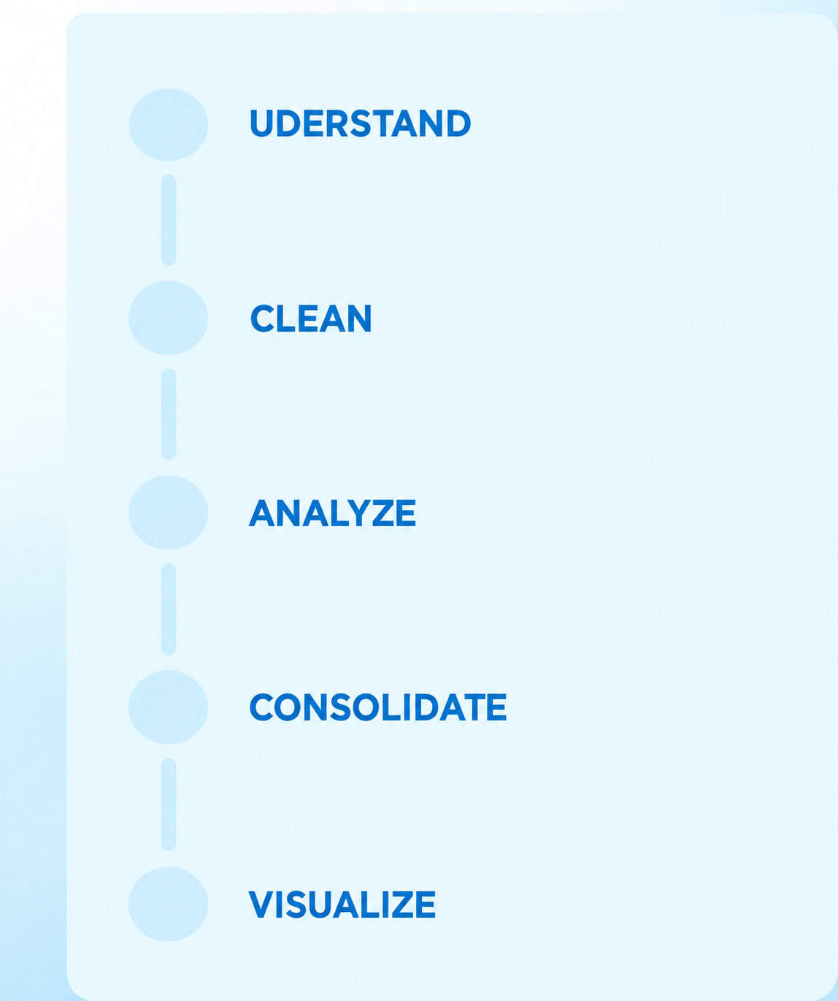
TEAM 7 • CODE AVENGERS . Python Hackthon September 2026
Heart Failure Analysis
UDERSTAND
A One Week Python Hackathon to transform complex heart failure data into meaningful clinical insights using Python-based data analysis and visualization.
CLEAN
7 DATASETS
2,008 PATIENTS
3 ANALYTICS LAYERS
ANALYZE
CONSOLIDATE
Team Members:
Neha Jain
Sandhya Kammarinaga
Sucheta Rai
Suganya Sekhar
Swithisha Saraswat
VISUALIZE
Notes:
0:00–0:18 — “We are Team 7, Code Avengers. Our goal was to turn a multi-table heart-failure dataset into an end-to-end analytics workflow: understand it, clean it, discover patterns, translate those patterns into actions, test predictive models, and finally communicate the results through a dashboard.”

Slide 2
Seven Days. One Connected Analytics Pipeline.
We deliberately built the project in layers, so every later decision was grounded in a clean, understood dataset.
Day 1
1
Mapped 7 clinical tables, keys, variables and outcomes
2
Day 2
Standardized fields, handled missing values and produced reusable clean datasets
Days 3–4
3
Built descriptive, prescriptive and predictive analyses across clinical domains
4
Days 5–6
Consolidated team notebooks; strongest findings into one decision-focused dashboard
Day 7
5
Present the complete hackathon journey, key analytical insights, predictive outcomes, and dashboard
Result: From raw clinical data to meaningful insights — one structured, collaborative journey.
Notes:
0:18–0:52 — “Day 1 was data understanding: we mapped all seven tables and the common inpatient key. Day 2 was cleaning and validation. On Days 3 and 4, the team worked in parallel on descriptive, prescriptive and predictive analysis. During Days 4 and 5, we consolidated everyone’s work, standardized the format and file structure, and prepared the results for the dashboard.”

Slide 3
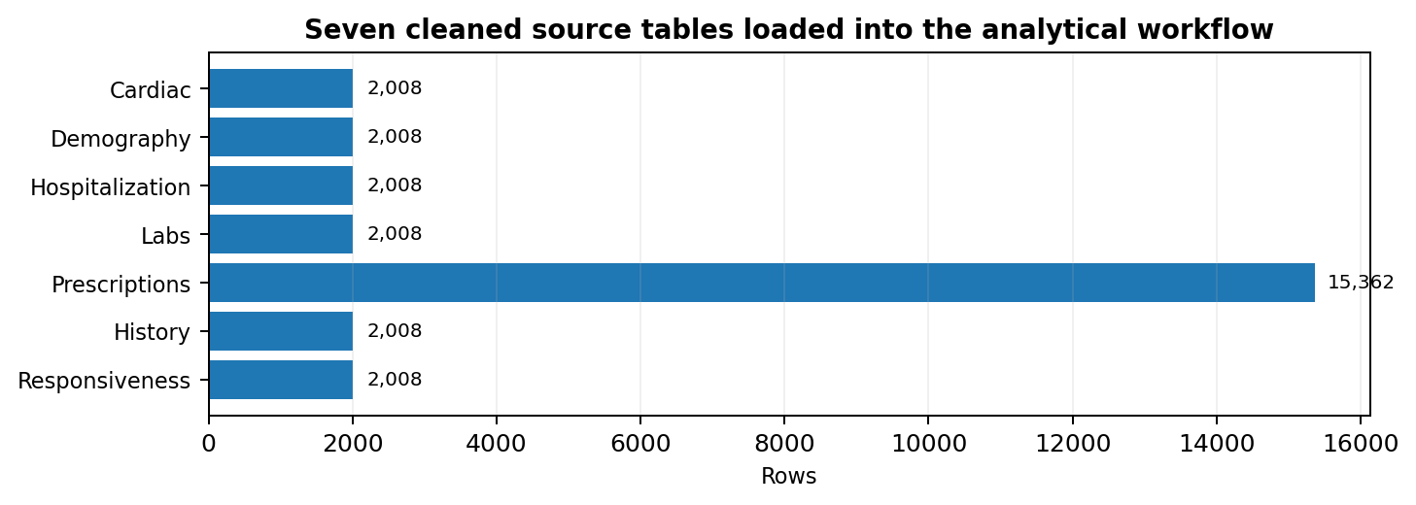
Data Understanding & Data Cleaning — Building a Reliable Foundation
OBJECTIVE • Understand the structure, patient keys and clinical domains first — then standardize and validate the data before any analysis.
1 DATA UNDERSTANDING
2 DATA CLEANING & VALIDATION
✓
Patient key validation
2,008 unique patients; 0 duplicate IDs in Labs and Demography.
✓
Missing-value assessment
Clinical missing values identified explicitly rather than silently treated as normal.
✓
Prescription normalization
15,362 medication records recognized as patient–drug associations before merging.
KEY DATA PROFILE
6 patient-level tables: 2,008 rows each • Labs: 107 columns
Prescriptions: 15,362 patient–drug rows • 25 unique medications
✓
Merge integrity
Patient-level consolidation produced 2,008 unique patients × 116 analytical features.
Outcome: a validated, patient-level analytical foundation ready for descriptive, prescriptive and predictive analysis.
Notes:
We began by understanding all seven clinical tables—their dimensions, patient keys and how each table represented a different clinical domain. Six core patient-level tables contained 2,008 records each, while prescriptions contained 15,362 patient–drug records. During cleaning, we validated patient identifiers, checked missingness and duplicates, standardized the structure, and handled medication data at the correct grain before merging. This resulted in a consolidated analytical dataset with 2,008 unique patients and 116 features, providing a reliable foundation for the remaining analysis.

Slide 4
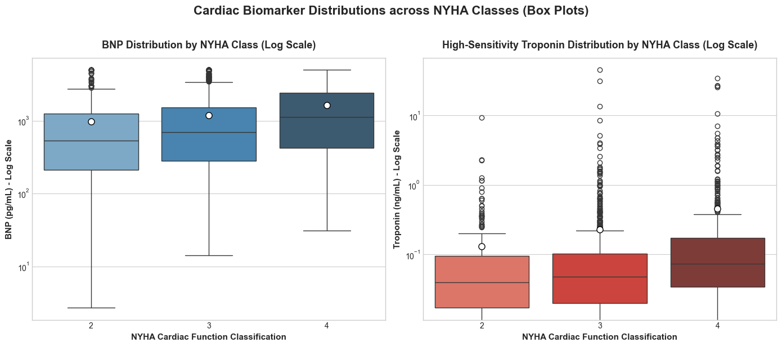
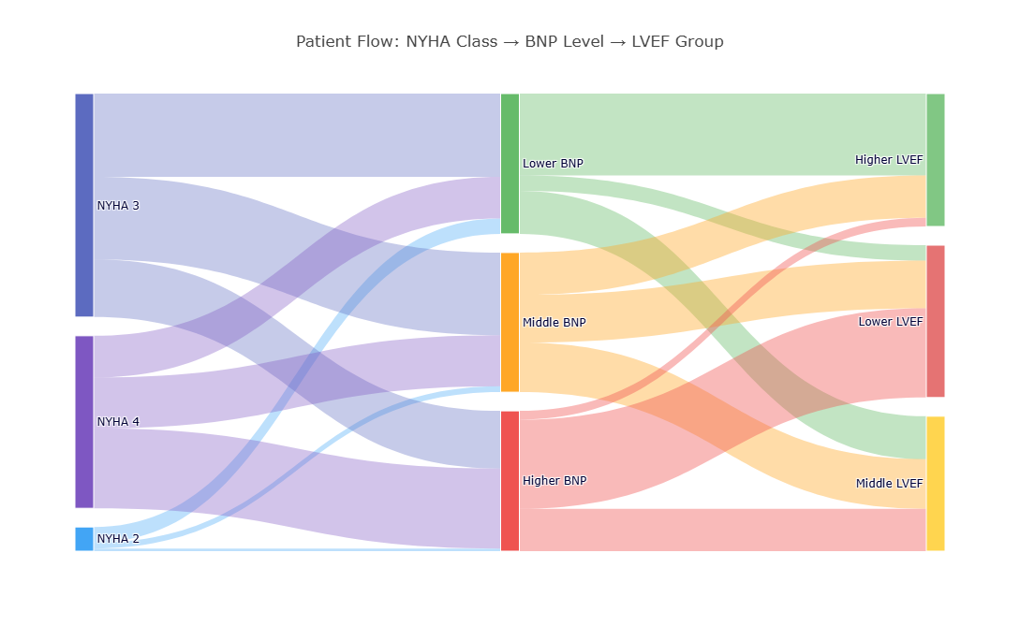
Descriptive Analysis — Understanding Heart-Failure Severity
OBJECTIVE • Describe how functional severity, cardiac biomarkers and ventricular function vary across hospitalized heart-failure patients.
1 NYHA severity ↔ cardiac biomarkers
2 NYHA → BNP → LVEF patient pathways
KEY HEART-FAILURE INSIGHT
As NYHA class increased from 2 → 4, median BNP rose 113% and median Troponin rose 85%, showing a progressively heavier cardiac biomarker burden with functional severity.
KEY HEART-FAILURE INSIGHT
Patients within the same NYHA class followed different BNP and LVEF pathways, showing that heart-failure severity is heterogeneous and should be interpreted using multiple cardiac indicators together.
Descriptive analysis revealed how symptoms, biomarkers and ventricular function combine to characterize heart-failure severity.
Notes:
Our descriptive analysis focused directly on the hospitalized heart-failure cohort. We found that BNP and Troponin increased as NYHA functional severity increased. We also examined how NYHA class flowed into BNP and LVEF groups, which showed that patients with the same symptom class can still have different cardiac profiles. This established a heart-failure-specific clinical picture before moving into recommended actions.

Slide 5
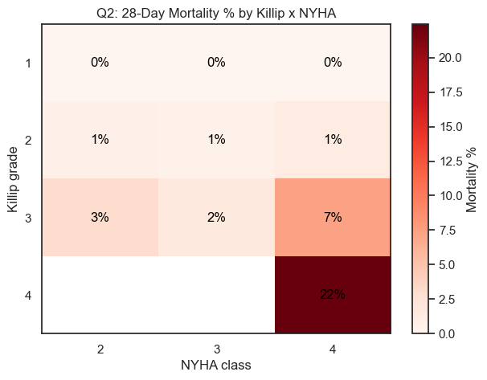
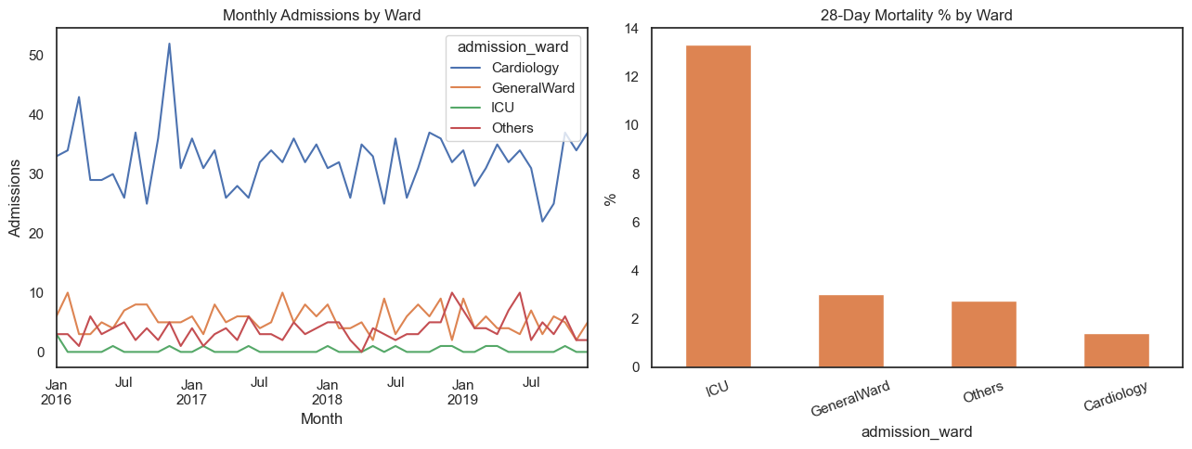
Prescriptive Analysis — Turning Evidence into Action
OBJECTIVE • Move beyond “what happened?” to identify where targeted clinical monitoring, follow-up and resource allocation could be prioritized.
1 Severity-based escalation
2 Risk-based resource allocation
ACTIONABLE INSIGHT
Mortality rises sharply in the most severe Killip/NYHA combinations—exceeding 20% at Killip. The analysis supports prioritizing ICU-level monitoring for high-severity combinations.
ACTIONABLE INSIGHT
ICU 28-day mortality was ~13.3% versus ~3.0% in General Ward and ~1.4% in Cardiology, supporting risk-based staffing rather than volume alone.
Prescriptive analysis converts observed risk patterns into focused, data-supported actions and resource priorities.
Notes:
Prescriptive analysis asks what action the evidence suggests. Two examples stood out. First, mortality rises sharply when Killip and NYHA severity are considered together, with the highest-risk combinations supporting earlier ICU-level monitoring. Second, ICU patients had about 13 percent 28-day mortality—far higher than General Ward or Cardiology—showing why staffing should consider clinical risk, not just patient volume.

Slide 6
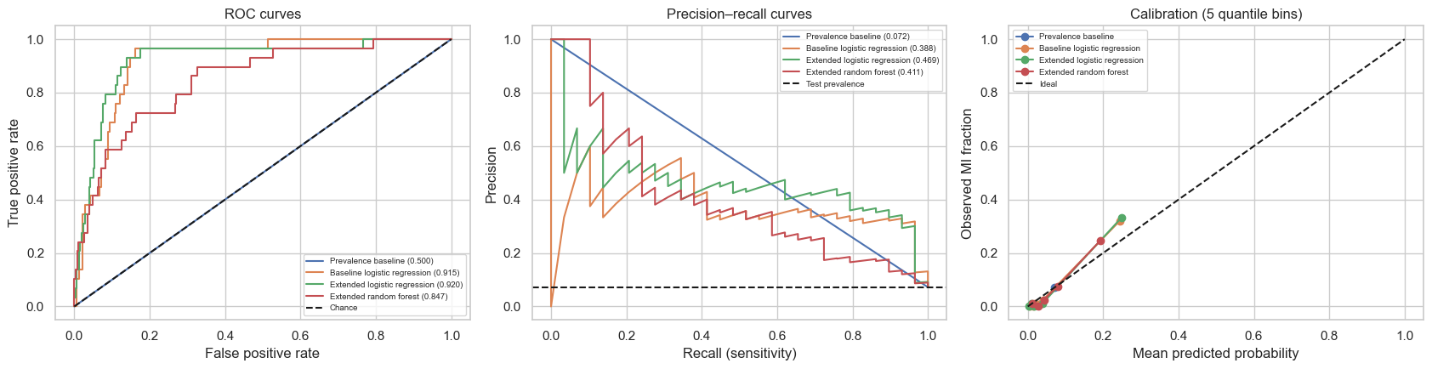
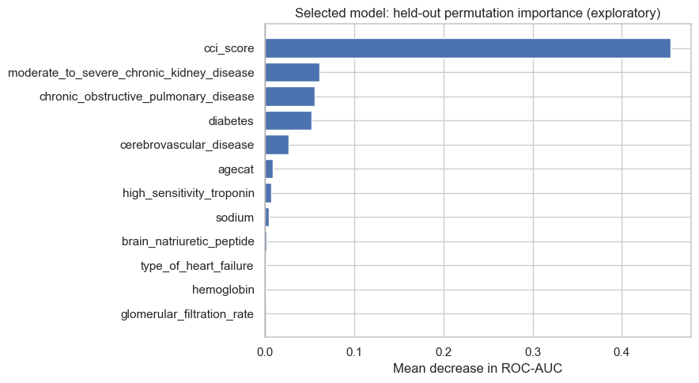
Predictive Analysis — Combining Signals to Identify Clinically Important Patterns
WHY IT MATTERS • Predictive modeling combines demographics, comorbidities, cardiac measures and laboratory markers to detect multivariable patterns that single metrics may miss.
1 Model discrimination & validation
2 What drove the model?
VALIDATED RESULT
The selected extended logistic model achieved held-out ROC-AUC 0.920 (95% bootstrap CI 0.863–0.964) and average precision 0.469 on 402 unseen patients.
KEY MODEL INSIGHT
CCI score produced the largest permutation-importance drop in ROC-AUC, followed by CKD, COPD and diabetes—showing the importance of combined comorbidity burden.
The predictive model identified meaningful patterns across multiple clinical factors, helping distinguish patients with higher-risk profiles.
Notes:
Predictive analysis is important because it combines many clinical signals at once rather than relying on one measurement. For our documented myocardial infarction analysis, the extended logistic model was selected using training-only cross-validation and then evaluated on 402 held-out patients. It achieved a ROC-AUC of 0.920, with a bootstrap confidence interval from 0.863 to 0.964. CCI score was the strongest permutation-importance feature, followed by CKD, COPD and diabetes. Because the dataset does not contain MI-onset timestamps, we describe this as classification of documented MI patterns, not prediction of a future heart attack.

Slide 7
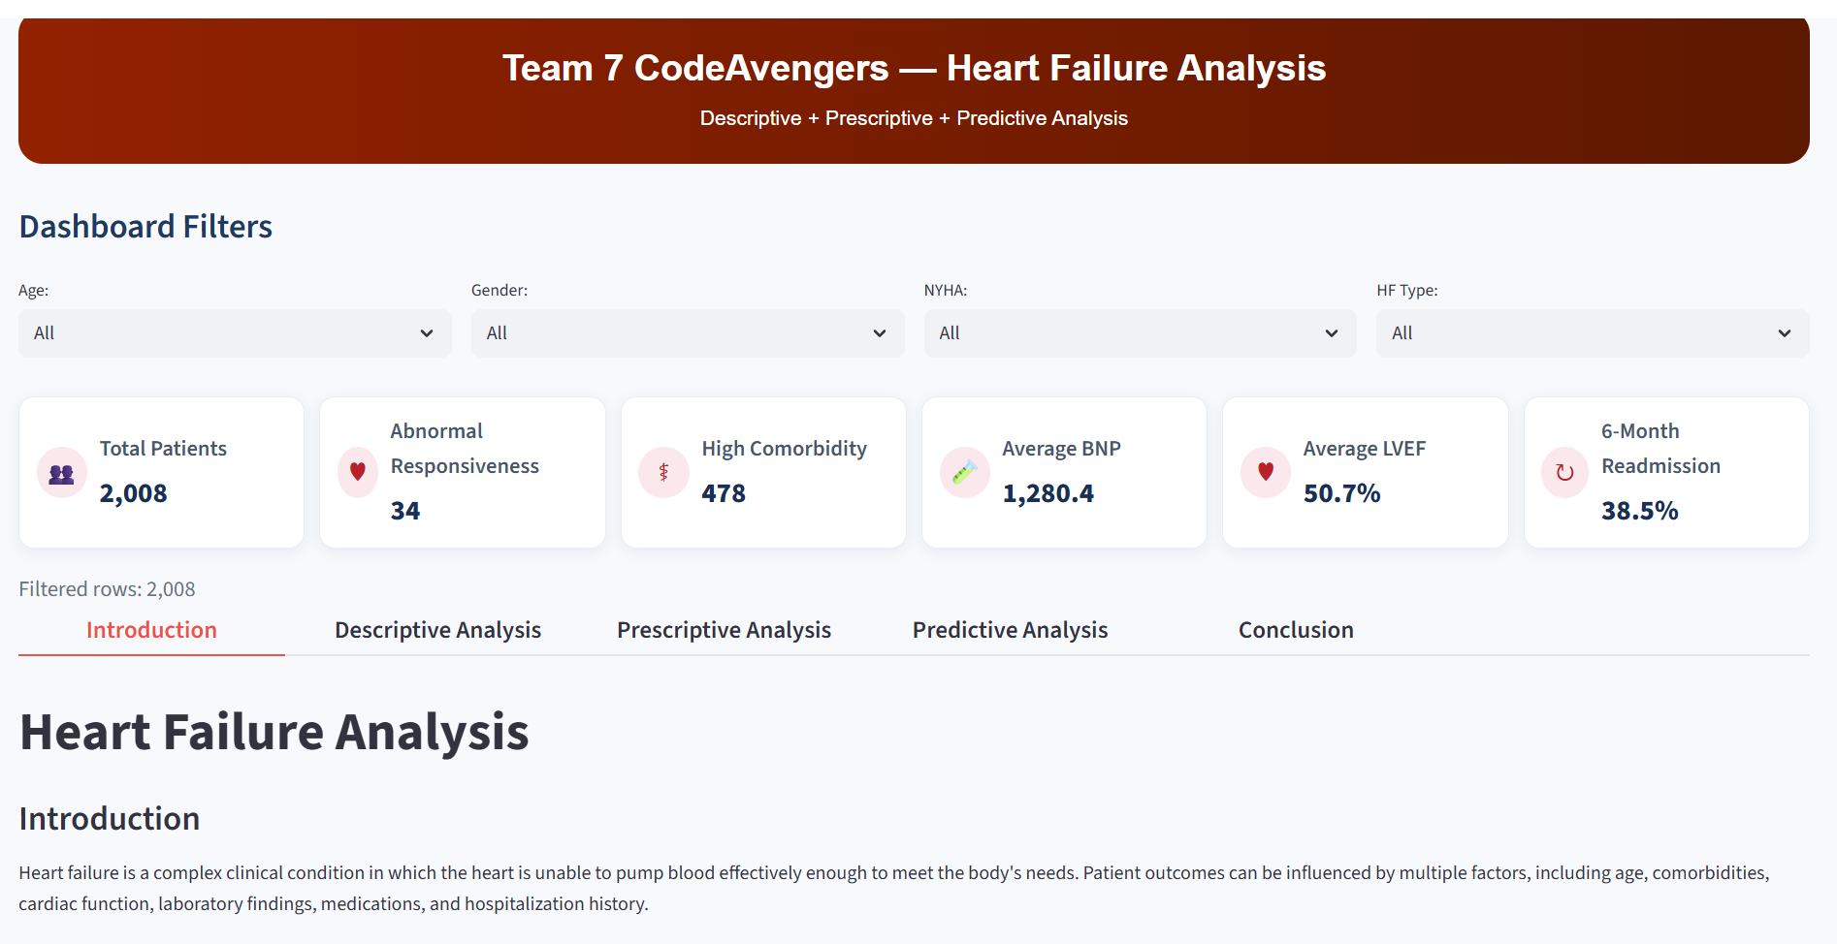
Dashboard - One view for cohort profile, risk signals and outcomes
Dashboard Link : Team7_CodeAvengers_Dashboard_Link
DEMO FLOW
1 Cohort snapshot
DROP FINAL
DASHBOARD SCREENSHOT HERE
2 Key clinical patterns
3 Risk / priority view
4 Outcome & follow-up
Notes:
2:30–4:00 — “Now I’ll show how those layers come together in the dashboard. Start with the cohort snapshot and filters, then point to one or two strongest descriptive patterns, move to the priority/risk view, and finish with outcomes or follow-up indicators. Avoid explaining every chart—use the dashboard to show how a user can move from population overview to a specific high-priority subgroup.”

Slide 8
KEY TAKEAWAYS
What the heart-failure analysis tells us
A connected view of severity, clinical action, and multivariable risk.
1
Severity is multidimensional
2
Risk can guide monitoring
Higher NYHA class aligned with higher BNP and Troponin, while BNP–LVEF pathways showed meaningful variation within the same functional class.
High Killip / NYHA combinations and ICU mortality patterns support focusing monitoring and resources on clinically higher-risk groups.
3
Comorbidity burden matters
4
The dashboard connects the story
The selected logistic model showed strong held-out discrimination; CCI, CKD, COPD and diabetes contributed important multivariable signals.
The final dashboard brings cohort profile, clinical patterns, risk priorities and outcomes into one decision-focused view.
FROM RAW CLINICAL DATA → VALIDATED ANALYSIS → ACTIONABLE INTELLIGENCE

Slide 9

From Clinical Data to Actionable Intelligence
Questions?

