Slide 1

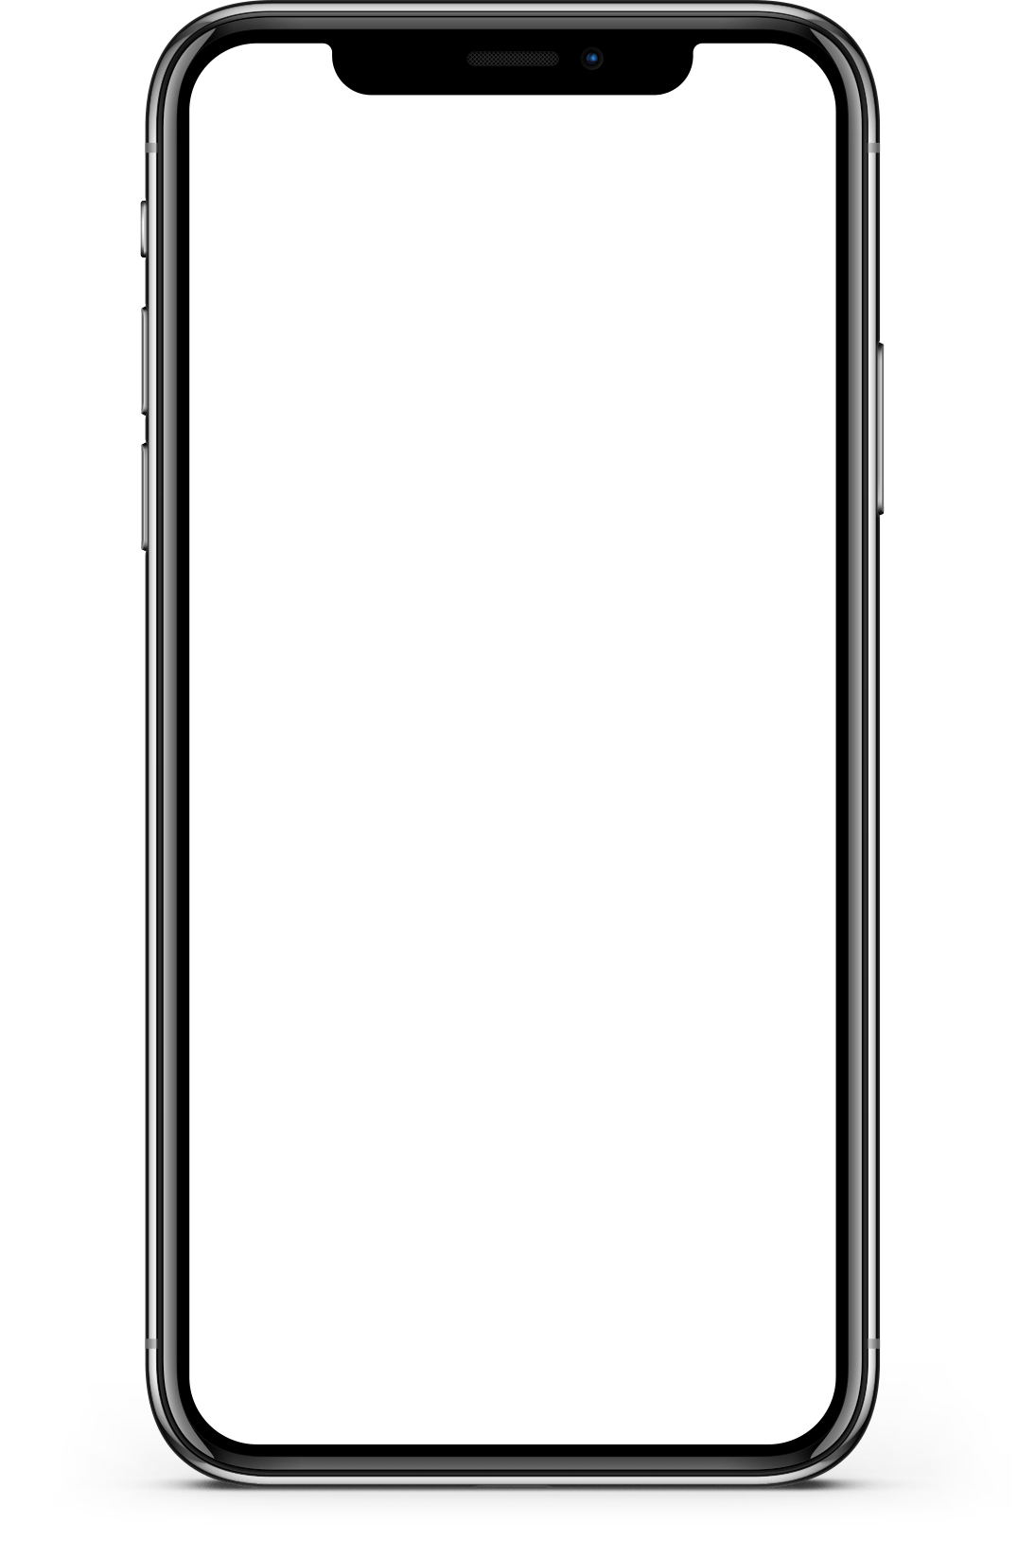
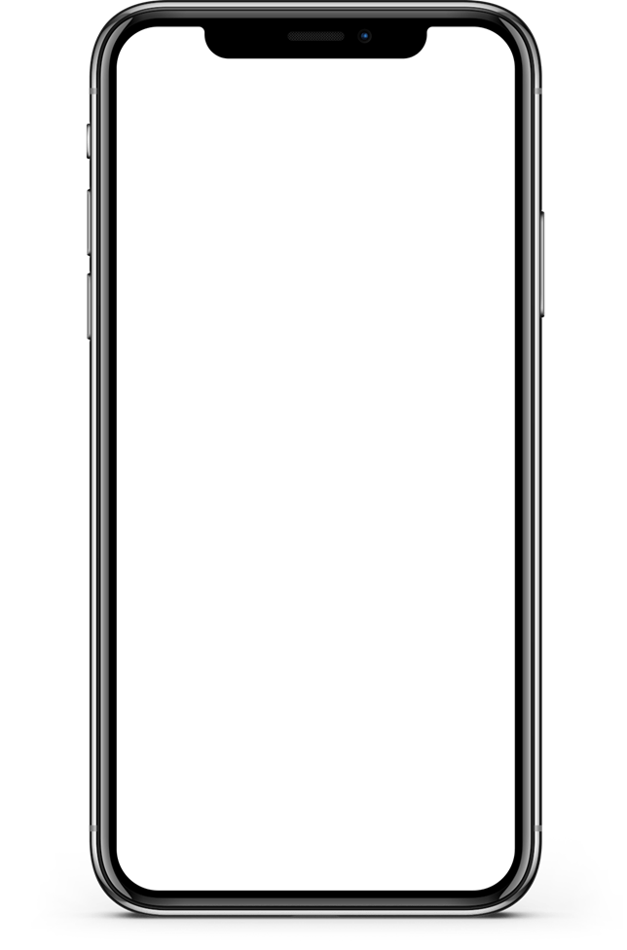
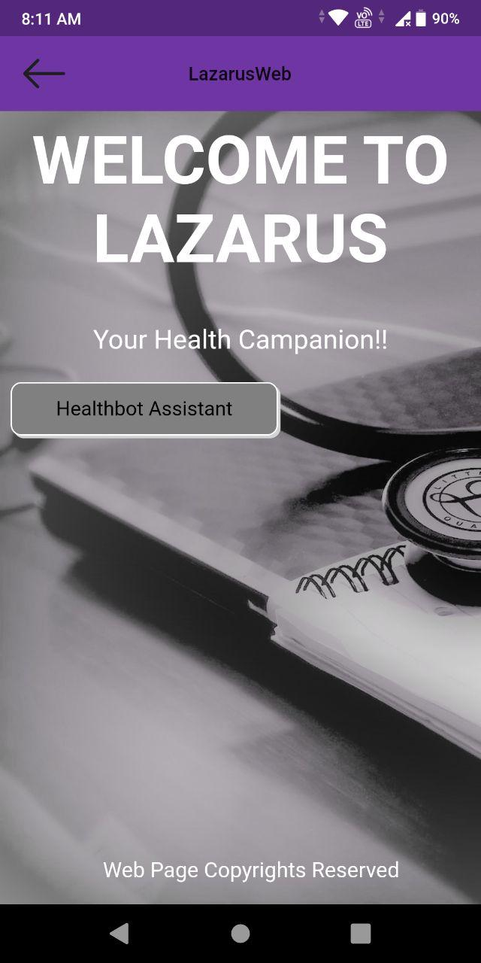
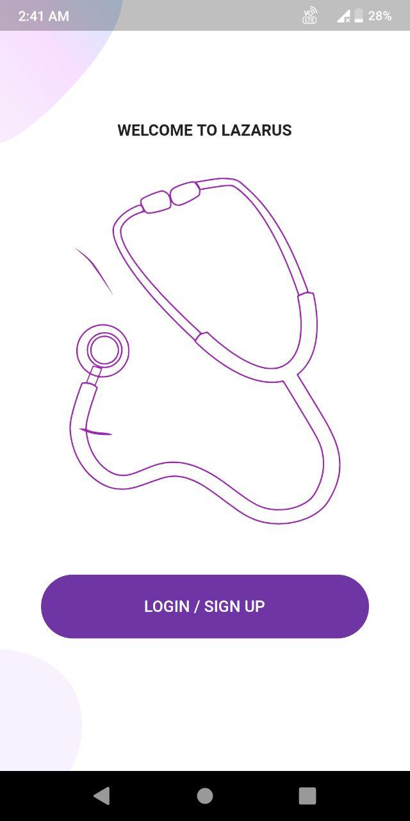
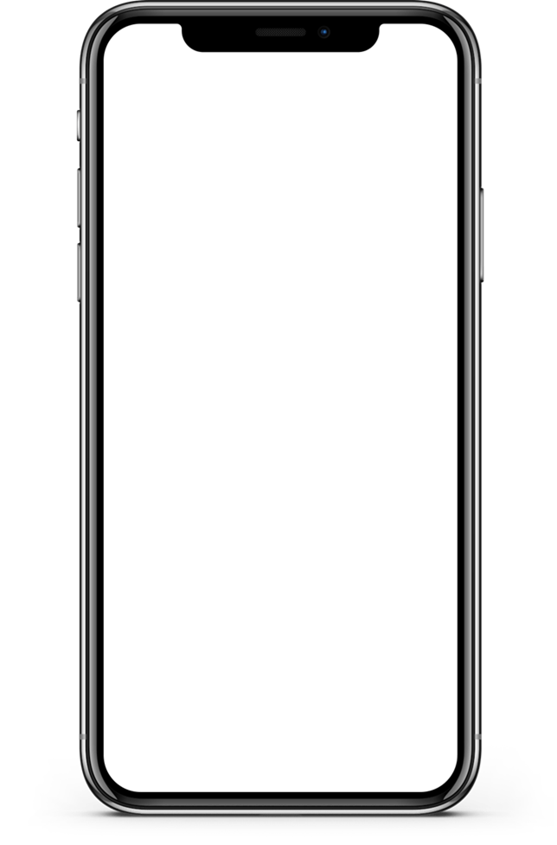
Chhatra Vishwakarma Awards 2020 Team: Lazarus Application Id: VISH202011475
Project: Lazarus
Notes:
<a href='https://www.freepik.com/photos/coffee'>Coffee photo created by jcomp - www.freepik.com</a>

Slide 2

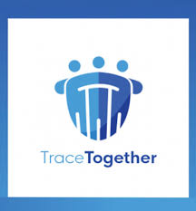
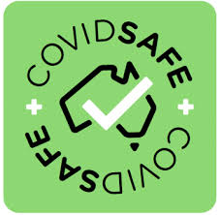
PROBLEM/OPPORTUNITY
Proximity trackers of today like Aarogya Setu (India) or TraceTogether (Singapore) need each of its users to have a Bluetooth Low Energy (BLE) enabled smartphone (for example an Android phone with OS version of KitKat or greater) and the technique is effective for contact tracing only when large chunks of the population are using this smartphone application. But that cannot be the case for countries/regions with large populations and considerable proportions of low income groups. India with a population of almost 1,380,004,385 has only over a 100 million downloads for Aarogya Setu app.
Moreover, such BLE proximity trackers are region specific, restricting contact tracing for an individual within borders, which can prove to be fatal for international flyers.
Limited reach of contact tracing apps
If a person tests positive for Covid19 he/she must be interviewed by healthcare workers to trace contacts which may have been missed by tracking apps (since not everybody is using app and not all users are keeping app active always). But reproducing all interactions accurately from memory is not possible and also healthcare workers have to repeatedly come in close contact with patients. None of the contact tracing apps provide any solution in such a case.
Inefficient alternative
Covid19 contact tracing apps have no utility outside the domain of pandemic control. Users have very low motivation to regularly keep a battery consuming app active. Furthermore, maintaining the services behind an app for a limited phase during onset of pandemic and then discontinuing when user base declines and then again restarting for a future epidemic is not an economical option.
No incentive for using app
Notes:
<a href="https://www.freepik.com/free-photos-vectors/business">Business vector created by freepik - www.freepik.com</a>

Slide 3
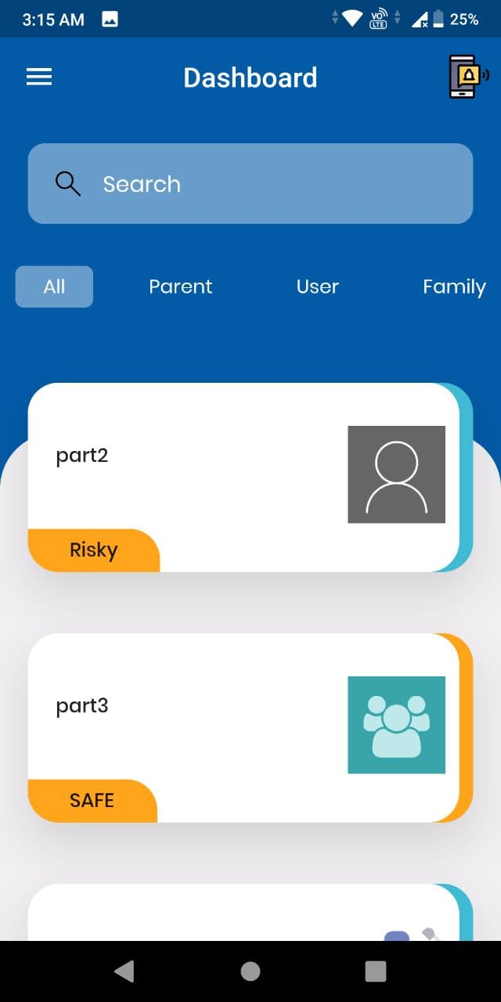
Solution: Lazarus
Not just a mobile application, it is an entire system that, as a pilot project, increases efficiency of pandemic control methods but can benefit general healthcare in the long run.
Since each user does not need a smartphone for contact tracing, the app has multi-user support. Thus, even with one smartphone per family, all the family members can be part of the Lazarus system.
The user remains in control of all data. Minimal server support is required. As the system ensures growth in user base irrespective of geographies or financial status, the volume of data generated is unparalleled and invaluable for healthcare
1
2
3
4
Lazarus system eliminates dependance of proximity tracking solely on BLE technology. It rather trivializes a practice similar to recording attendance at schools/offices, such that one-smartphone-per-user is not necessary, while the accuracy is as good as BLE based solutions.
The app also allows users to maintain a diary. When infected, instead of trying to recall the contacts made in the past few days, users can deliver the same data through this diary. The app filters only enough information to track the contacts, no details of personal life are revealed, and users get one extra utility out of the app.
Notes:
Photo by Anastasiia Ostapovych on Unsplash

Slide 4
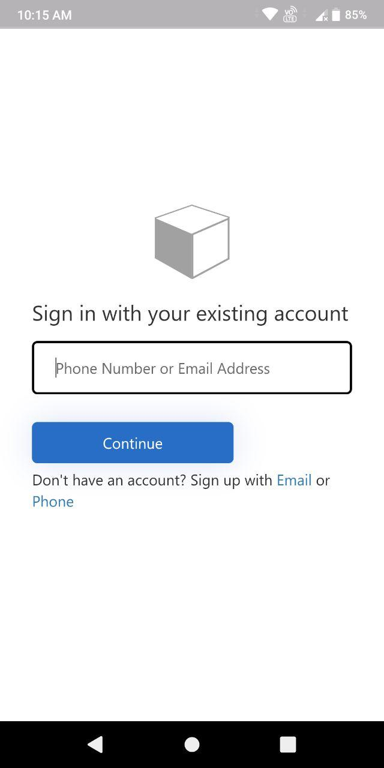
Multi-User support
After installing, first user registers himself/herself on the Lazarus system through Azure AD B2C service. His/her account then shows up as a tile on the dashboard, and is characterized as ‘Parent’ account.
All other users on this smartphone register themselves through the same process and their account tiles add up on the dashboard, and are characterized as ‘User’ account.
Whichever user uses the app, he/she can tap on his/her tile and use all features of the app, seamlessly.
Data generated while one user uses the app (including contact tracing data), is stored and maintained in app database (sqlite3) and a Firestore (cloud) database against the respective user account.
‘Family’ type of account is for people who share home with above users but have their own smartphone. Such accounts are inactive on this smartphone, only for reference, so that Lazarus system can mark them as affected too if any of the above users are infected.
Notes:
<a href='https://www.freepik.com/photos/coffee'>Coffee photo created by jcomp - www.freepik.com</a>

Slide 5
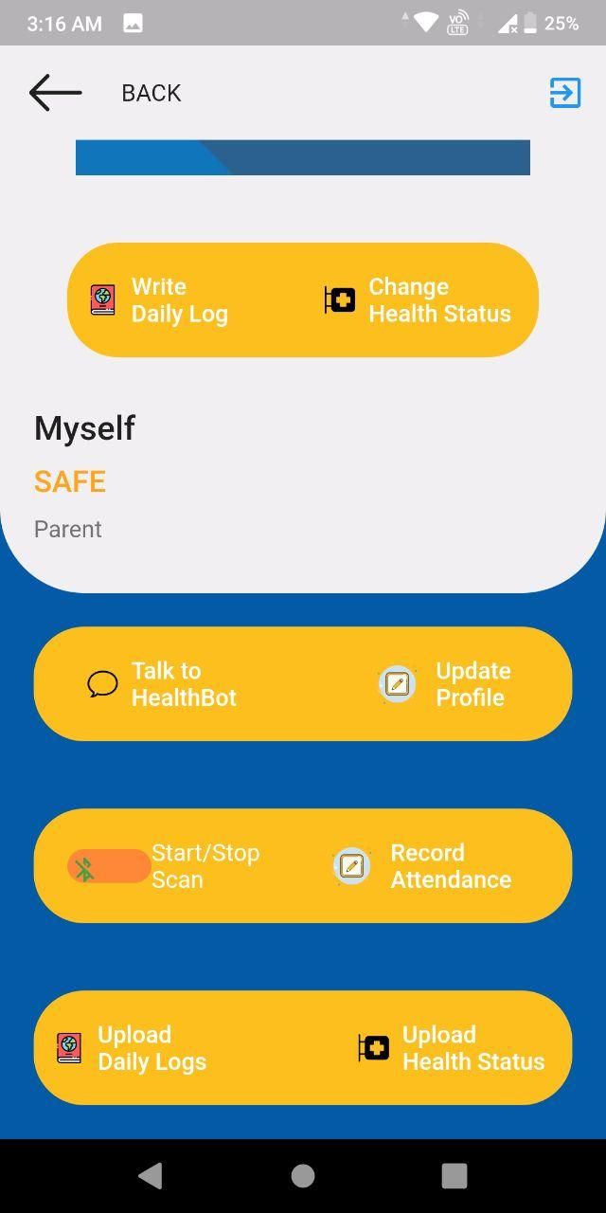
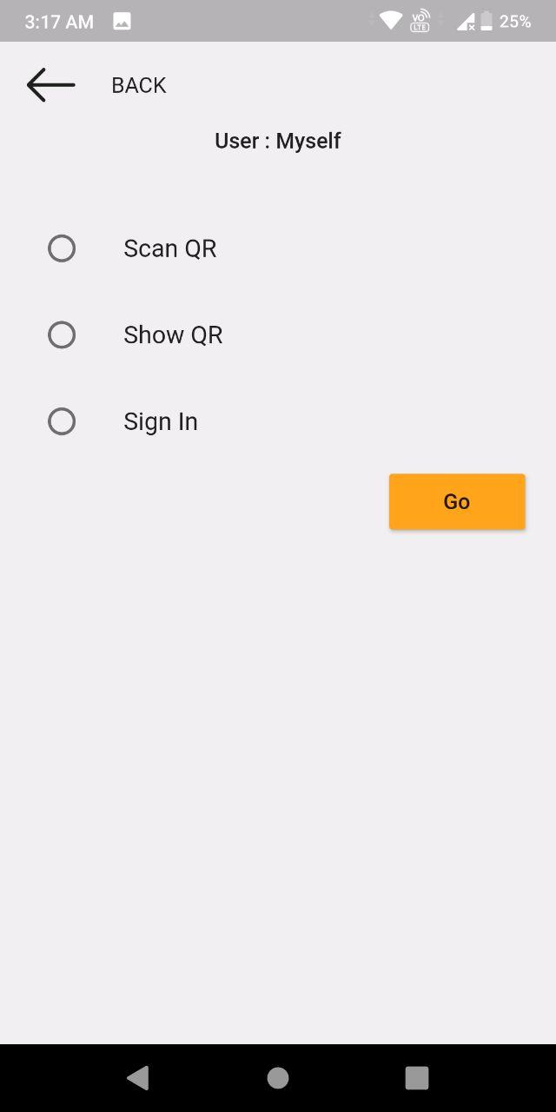


Contact Tracing
When BLE scanning is on, the app generates a unique timestamped code and stores it in database. It then broadcasts this code without the timestamp, while nearby apps scan this code, add the timestamp themselves, and store the resultant code in their database. When one user is infected, he/she uploads all code generated by his/her app. These codes will match with other users only if they were close to the infected and if their apps scanned the codes at the same time as they were generated by infected user’s app. Thus Lazarus system does not periodically require a complex security key generated from a parent server (like Singapore’s TraceTogether app), but still carries out contact tracing free of forged codes.
Suppose user B starts up BLE tracker on his/her interface and leaves. The other users cannot record their contacts when they go outside. And user B cannot record contacts with people without a smartphone having Lazarus, or not registered with Lazarus at all. For this we have a ‘SIGN-IN’ feature. The smartphone carrying app-user(say user D) can ask for the phone number of the person with no smartphone or account (say person E). Just like BLE, a unique time stamped code is stored in D’s app database and a temporary folder in cloud Firestore stores identical code for E. When E opens his account on app this code syncs with his/her app database. So an interaction which could have been missed by BLE, is captured.
Tapping on an account tile on dashboard opens up user-specific interface. The ‘Start/Stop Scan’ option is a BLE proximity tracker just like any other app. The ‘Record Attendance’ feature provides non-BLE solution.
Notes:
<a href='https://www.freepik.com/photos/coffee'>Coffee photo created by jcomp - www.freepik.com</a>

Slide 6
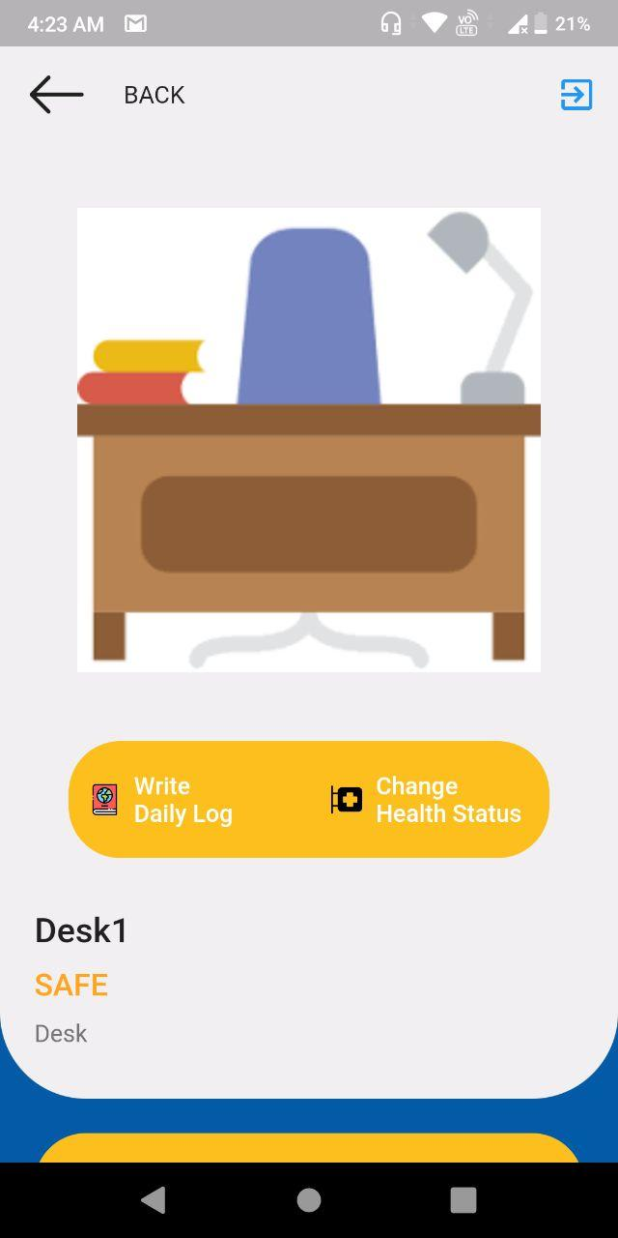
But people don’t even use BLE scanning properly, why will they go around exchanging phone numbers for contact tracing? It doesn’t feel safe even. And what if both people are not carrying smartphones?
Solution: ‘Desk’ account
People will be more comfortable giving out phone numbers while entering a shop or office rather than giving the number to an individual. It is also easier to implement a compulsory registration with Lazarus when entering these places just like how masks are mandatory for entry. Also most places already have a system of recording contact details during entry.
Places of close human gatherings like receptions, customer help desks, shops, classrooms, doctor’s clinics can be registered as ‘Desk’ user in the app by the person-in-charge. This desk operator can keep recording attendances for anybody entering this space, in the same way as individual accounts with ‘Sign-In’ method, and also with BLE and *QR methods.
People who have not registered with Lazarus will be registered on-spot, due to the same ‘Sign-In’ feature, just by giving their phone numbers like regular users, while their contact data will be stored in cloud temporarily. Whenever they do open their account on app, the account will sync with this cloud data. And even if they never open their account, they can always be contacted, if their codes match with an infected individual or with a hotspot ‘Desk’ account.
This Desk account feature also generates readymade data regarding which places behaved as hotspots, without actually tracking down location of each infectious human-to-human transmission.
* ‘Scan QR’ and ‘Show QR’ is also an alternative way of exchanging contact tracing codes by QR, available for both individuals and ‘Desks’.
Thus, ‘Desk’ account exponentially increases user-base of Lazarus. Furthermore, Lazarus extends the same forgery-free, server-independent and simple logic (using timestamped codes) across all the modes of contact tracing (BLE, Sign-In, *QR). And since the timestamps are in UTC, the contact tracing is applicable across time zones, beyond international borders.
Notes:
<a href='https://www.freepik.com/photos/business-card'>Business card photo created by rawpixel.com - www.freepik.com</a>

Slide 7
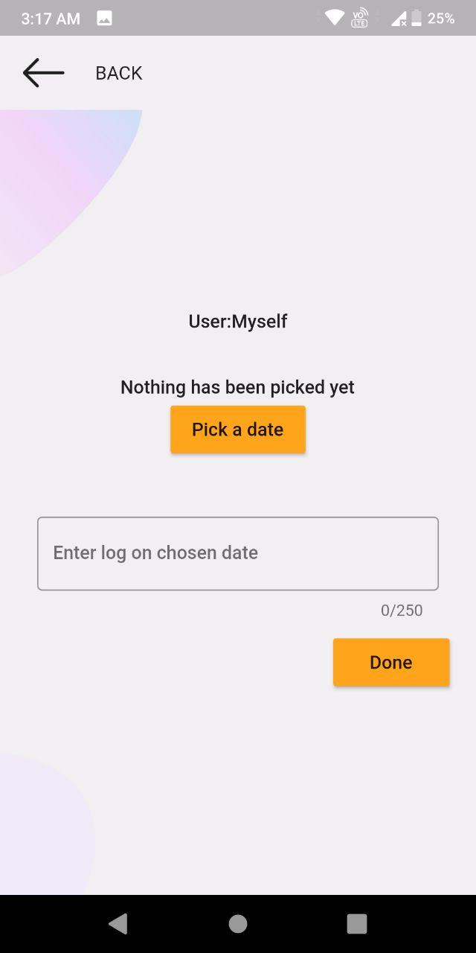
Diary Keeping
To overcome the difficulty in accurately reproducing interaction history from memory, an in-app “Enter Daily Log” option is provided where the user can willfully enter his/her daily whereabouts just like maintaining a diary. All the log entries are then filtered by Microsoft Azure’s natural language understanding LUIS model, to extract key information like location, time and person or number of persons interacted with, which is then stored with date stamp. When infected, user can tap on ‘Upload Daily Logs’, so that authorities can find and warn people who might have come in contact, with maximum accuracy. Also, healthcare workers don’t have to go door to door.
In a production level app, users will be able to edit their logs like a complete diary and can also use voice to record logs in audio format or use speech-to-text.
We propose a social media platform on this app where users get medical advice from doctors who are app users. The Azure LUIS NLP service can have added parameters to assess the diary records and grade the mental and physical health of user. The app will then post the suspicious health condition anonymously and medical practitioners can offer suggestions, which will show up in user’s feed.
The health condition will appear anonymously on doctors’ feed and the social media servers will only act as passage of data app-to-app and nothing will be required to be stored in server. Even the LUIS service currently requires no storage overhead, the app sends in data, LUIS filters it Live, and sends data back. Privacy cannot be compromised at any stage. And the app will serve a purpose all year round. The app currently has “Talk to Healthbot” option, a chatbot for self health assessment.
Notes:
<a href='https://www.freepik.com/photos/coffee'>Coffee photo created by jcomp - www.freepik.com</a>

Slide 8
Impact
BLE, Sign-In and QR contact tracing methods, along with ‘Desk’ account feature, universal time-stamped code logic and multi-user support feature, increase chances of an individual being part of the Lazarus system. He/she would have been otherwise left untraced by ordinary proximity trackers.
During all the proximity tracking processes, none of the users’ confidential account details are revealed, even though phone number and email addresses are exchanged, as Azure Functions handles the exchange of time-stamped codes in backend.
Diary-keeping feature reduces dependence on door-to-door contact tracing by healthcare workers, efficiency of pandemic control efforts increases manifold.
Since the above features increase user base faster than actual app downloads, hotspots and super spreaders can be identified more easily and predictive models can be generated faster. Authorities can then on basis of such models in any country and also go for cross country measures.
With the proposed social media feature, the user receives honest medical advice which is not always guaranteed in paid visits where the doctor’s or hospitals’ vested interests can allow for misguidance and foul play.
The user decides if he/she wants to upload his/her data for analysis. And all uploaded data is maintained with enough anonymity to prevent prejudice in analysis.
This could enable early detection and diagnosis of health issues of user with professional guidance. Researchers can also gather scientifically valuable medical data from this user base.
I have informally approached two of my college professors in 50-70 age bracket, 8 of my batchmates and two of my seniors who are now working professionals in IT and power plant industries, about their views on the practicality of my solution. All of them replied that they could see themselves as using the application and that it had wide scale potentials.
Notes:
Photo by Ferran Fusalba Roselló on Unsplash

Slide 9
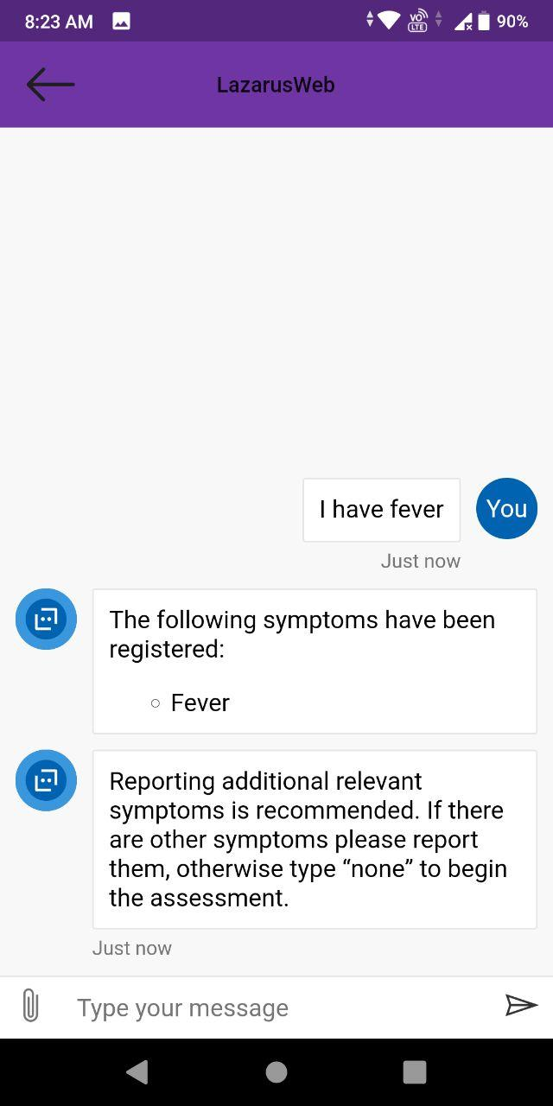
Implementation
A cloud vendor needs to be fixed for services like authentication, serverless functions, NLP, etc. Pay as you go cloud services would be ideal as the user base is not fixed at any time.
Use of ‘Desk’ account at places of gathering like offices, shops, classrooms, etc. needs to be emphasized to give initial boost to user base.
1
2
Integration of the social media platform and testing with ordinary users and actual medical practitioners.
Cloud-based speech services need to be added under Diary-Keeping feature for users to make diary entries easily through voice in multiple languages.
*Chatbot for self health assessments in current prototype stage
4
3
A webapp to be implemented that can pull up all uploaded medical data and create research-friendly visualizations (for example, region-wise numbers of diabetic patients under a certain age group at different times).
Enhancement of app interface for accommodating more and more users having disabilities
5
6
Cost of the app’s cloud-based features would not vary much from user to user and rather depend on size of user base.
The only point of cost variation can arise in the social media platform we intend to implement. But the social media feature can also be monetized in a freemium model, with premium account features and advertisement, while keeping the service free for user.
Notes:
Photo by Etienne Martin on Unsplash

Slide 10
THANK
YOU
Video link for short demo: https://youtu.be/za8qsJncbUw
Long demo link: https://youtu.be/X13k4GPePLo
Google drive link for full resolution pictures: https://drive.google.com/drive/folders/1Hfn0mpAozTuFT7BC10Q-0TcQInDwpVDJ?usp=sharing
Lazarus
Notes:
<a href='https://www.freepik.com/photos/coffee'>Coffee photo created by jcomp - www.freepik.com</a>

