Slide 2













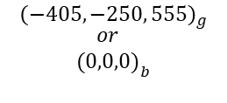



Basiskoordinatensystem
$$\overset{→}{Y_{b}}$$
$$\overset{→}{X_{b}}$$
$$\overset{→}{Z_{g}}$$
$${\left(−405, −250, 555\right)}_{g}$$
$${\begin{aligned}or \\ (0,0,0)\end{aligned}}_{b}$$
$$\overset{→}{P_{tcp}}$$
$$\overset{→}{P_{t}}$$
$$\vec{d_{t2tcp}}$$
d_global2base
$$R_{n}$$
$$\overset{→}{Z_{b}}$$
$$θ$$
$$θ$$
$$\overset{→}{Z_{g}}$$
$$\overset{→}{Y_{g}}$$
$$\overset{→}{X_{g}}$$
$$\overset{→}{Y_{g}}$$
$${\left(0,0,0\right)}_{g}$$
$$\overset{→}{X_{g}}$$
Weltkoordinatensystem

Slide 3






$$\overset{→}{Z_{g}}$$
$$M$$
$$\overset{→}{X_{g}}$$
$$\overset{→}{Y_{g}}$$
$$φ$$
$$O$$
$$b$$
$$a$$

Slide 4
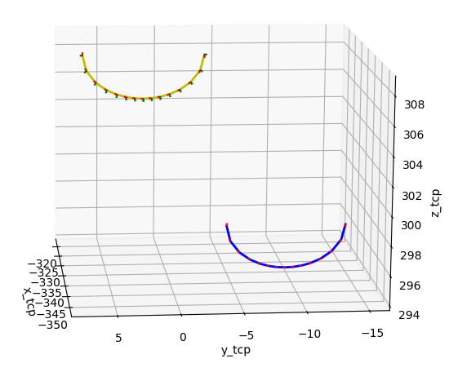

Bahn des TCP
$${\vec{d}}_{tcp2t}$$
Bahn der Nadelspitze

