Slide 1
Acceleration Structures for Ray Tracing
CS 230: Computer Graphics
Nikhil Kamthe

Slide 2
Agenda
Introduction
Concepts
MBR
KD-Tree
Results
Conclusion

Slide 3
Introduction
Ray tracing : Generating an image by tracing the path of light
Use of Acceleration Structures
Why?
General ray tracer too slow
Most expensive task is the intersection test
Costly operation repeated a number of times
Acceleration structures (in form of Spatial Hierarchies) help detect which object is likely to intersect
Reduces ray-object intersection computational overload
Cuts down render time

Slide 4
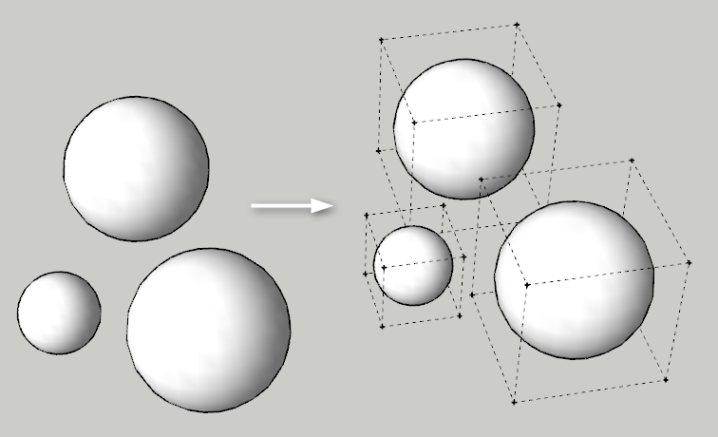
Minimum Bounding Box
Smallest box enclosing one or more object(s)
We create Axis Aligned MBRs
The objects are indexed using a KD-Tree (K=3)
MBRs of the individual objects are used to compute MBRs for every node of the KD-Tree

Slide 5
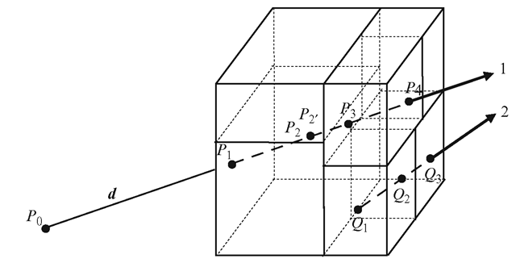
Kd-Tree
Spatial Data structure for storing points in K dimensional space
We use a 3-dimensional KD-Tree
At the node we store
the MBR of the node (contains MBRs of all objects at the node)
The pointers to objects present within the MBR
The pointers to Left and right child
Objects are partitioned along the longest axis

Slide 6
Results
We tested the code on 25 datasets, 5 randomly generated datasets for each of the input sizes mentioned in the table.
The table below contains the average values.
Number of Objects | Time Taken (sec) | Time Taken with KD-Tree (sec) | Time Taken for building KD-Tree (sec)
1024 | 28.65 | 4.21 | 0.007
2048 | 55.17 | 4.80 | 0.014
4096 | 106.84 | 5.02 | 0.028
8192 | 209.99 | 5.51 | 0.058
16384 | 424.29 | 6.25 | 0.134

Slide 7
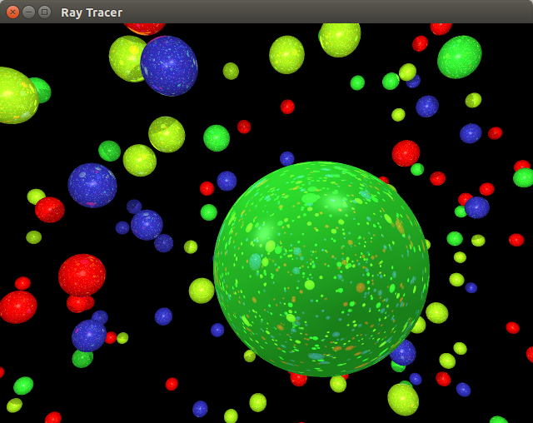
Conclusions & Future Work
The performance of the Ray Tracer improved significantly after using Spatial Indexing Structures.
The Spatial Index could be computed once, stored in memory and used thereafter for rendering static scenes.
In order to use Spatial Data Structures for changing scenes, we need efficient methods to update nodes and still maintain the balance of the Spatial Index.

Slide 8
THANK YOU!

