Slide 1


Group 1: Intelligent Transportation System (M5)
Section 2

Slide 2
Background and Motivation
Bridging Theory and Application: The primary academic motivation was to transition from solving static probability problems on paper to building a dynamic Digital Twin of a stochastic system.
Modeling Reality with Stochastic Processes:
Arrivals: Moving beyond "constant" rates by implementing Poisson Point Processes and Exponential Inter-arrival Distributions to replicate the "clumpy" nature of real traffic.
Speeds: Using Normal Distributions {N(miu,sigma square)} to model human variability in driver behavior, rather than assuming uniform vehicle movement.
Algorithmic Evolution (State-Dependency):
Moving from a State-Independent baseline (Milestone 3), where decisions are a function of time, to a State-Dependent Markovian Model (Milestones 4 & 5), where decisions are a function of the current queue state.
Implementing the Poisson Marking Property to allow for intelligent, weighted randomization in signal switching.
| 2

Slide 3
Rigorous Mathematical Validation: Using Little’s Law (L = lambda*W) to verify that the simulation's internal logic is consistent with queuing theory.
Applying Markov’s Inequality to provide theoretical upper bounds on waiting times and ensure system stability.
“Real traffic is inherently random and bursty, so fixed deterministic models fail to capture real-world behavior.”
Real-World Perspective: Urban Efficiency & Sustainability
The "Blind Robot" Problem: Conventional fixed-cycle lights cause Idle Green Time (wasted green for empty lanes) and unnecessary congestion.
The Pain Metric: Focused on minimizing Expected Waiting Time (E[W]) to reduce fuel consumption, CO2 emissions, and commuter delay.
Temporal Adaptability: Implemented lambda(t) (Temporal Dependence) so the system "breathes" with the city prioritizing "Big Crowds" during peaks and shortening cycles during "Slack Time."
Objective: To replace rigid infrastructure with Intelligent Signal Control that reacts to real-time queue states.
“Improving signal efficiency directly reduces fuel consumption, emissions, and commuter delays.”
| 2

Slide 4
Base Paper Overview
Research Paper: Theory of Poisson Point Process and its Application to Traffic Modelling Author: Io Kuan Vong (University of Melbourne / AMSI)
1. Main Idea: Stochastic Traffic Foundations
The paper explores the Poisson Point Process (PPP) as the fundamental mathematical framework for modeling random events in a given space or time.
It transitions from abstract probability theory to a practical Road Traffic Model, treating vehicle arrivals not as a steady stream, but as a series of independent, random points (stochastic process).
2. Key Contributions
Mathematical Properties: Investigates the Marking and Coloring Properties of Poisson processes, which allow for splitting a single traffic flow into multiple independent directions (e.g., North, South, East, West).
| 2

Slide 5
Product Space Representation: Extends simple models to higher dimensions to account for variables like Time-Dependent Arrival Rates ($\lambda(t)$) and varying vehicle speeds.
Statistical Validation: Uses Pearson’s Chi-Squared Goodness-of-Fit Test to prove that modeling vehicle counts as a Poisson process is statistically reliable and reflects real-world observation.
3. Significance to Our Project
The "Smart Dice" Logic: We adopted the paper’s Marking Property to implement our weighted randomization logic in Milestone 4 and 5.
Realistic Simulation: Provided the theoretical justification for using Exponential Inter-arrival Times and Poisson Distributions to move away from deterministic models.
“Poisson processes are used because they realistically model independent and random vehicle arrivals.”
| 2

Slide 6
Problem Formulation
Core Problem
Design an adaptive traffic signal control algorithm for an isolated four‑way intersection that minimizes the expected waiting time of vehicles, given that vehicle arrivals and speeds are stochastic.

Slide 7
System Boundaries & Assumptions
Single isolated four‑way intersection (no coordination with nearby signals).
Two competing directions: North‑South (NS) and East‑West (EW).
Vehicles arrive only from these approaches; turning movements are aggregated (simplified).
Sensors provide perfect queue length measurements (no noise in baseline).
No spillback (queues do not block upstream intersections).
Vehicles depart at a fixed saturation flow rate during green.

Slide 8
Queue Evolution Equation
where Di(Δt)Di​(Δt) is the number of departures during green:
Di(Δt)=min⁡(Qi(t), service_rate⋅Δt)Di​(Δt)=min(Qi​(t),service_rate⋅Δt) if lane ii has green, else 00.

Slide 9
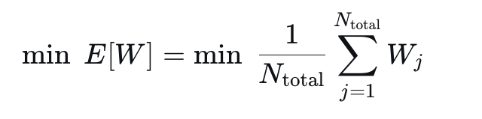
Objective Function
~ where Wj waiting time of vehicle j (time from arrival to departure).
Subject to:
Green times are non‑negative.
Only one direction gets green at a time.
Phase switching can only happen after a minimum green time (implicitly handled by decision epochs).

Slide 10
Why This Formulation is Appropriate
Captures inherent randomness of traffic.
Aligns with the Poisson process theory from the base paper.
Enables comparison between deterministic and randomized policies.
Matches the Monte Carlo simulation framework.

Slide 11
Mathematical Model
Intersection modeled as a discrete-time stochastic queueing system
Vehicle arrivals: Ai(t)∼Poisson(λi)
Vehicle speed/service variation: V∼N(μ,σ2)
Queue update: Qi(t+1)=Qi(t)+Ai(t)−Di(t)
| 4

Slide 12
Mathematical Model
Service: Di(t) = min⁡(Qi(t),Ci(t))when phase serves lane i
Decision variable: X(t)∈{NS,EW} where X(t) denotes the signal phase selected at time t
Deterministic model: fixed-time phase switching
Randomized model: P(NS)=W_NS/(W_NS+W_EW) , P(EW)=W_EW/(W_NS+W_EW)
Objective: min⁡∑t∑iQi(t)
i.e. reduce delay, queues, and improve throughput
“Each distribution is chosen to reflect real-world uncertainty in arrivals and driver behavior. These constraints ensure the model remains physically realistic and mathematically stable.”

Slide 13
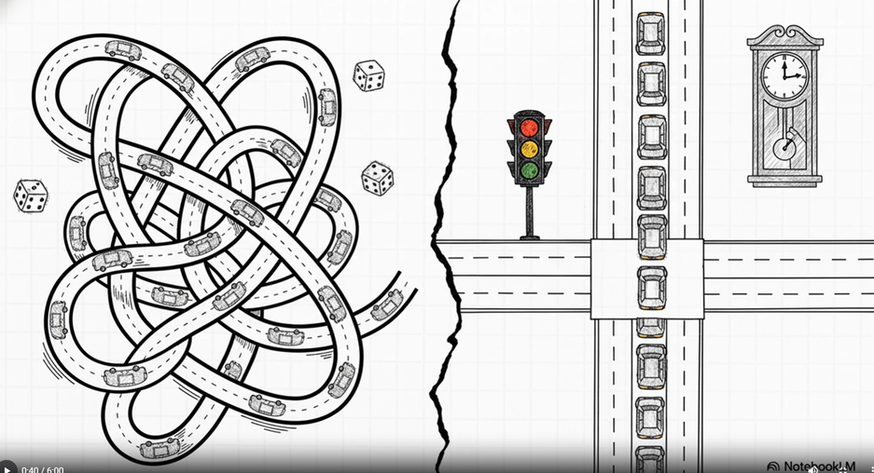
Deterministic Approach
Fixed phase order + fixed green times
Decisions depend only on cycle position, not traffic state
Steps: choose phase → serve active lanes → update queues → switch phase
Strength: simple, stable baseline
Limitation: not adaptive to uneven traffic
Motivation for Milestone 4: replace rigid rule with probabilistic phase selection
“This approach fails because it ignores real-time traffic conditions and treats all scenarios equally.”
| 5
Notes:
4

Slide 14
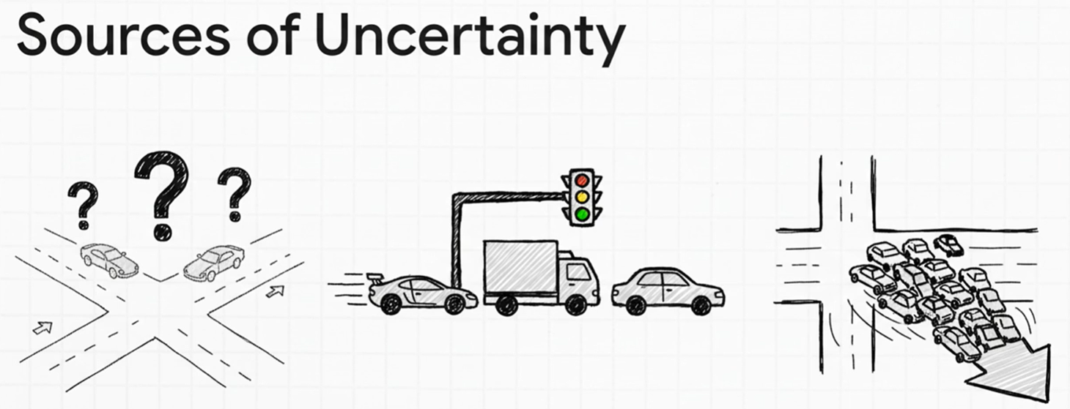
Randomized Approach
Uses probability-based random selection of signal phases for decision-making
Longer queues increased likelihood of getting a green phase
More randomly flexible than fixed time control.
Advantages:
Adapts to changing traffic conditions.
Reduces time waiting at an intersection.
Improves total flow of traffic.
| 6
Notes:
5

Slide 15
Why Randomization?
Traffic arrivals are random – deterministic rules cannot adapt.
Randomization prevents starvation – every lane gets a chance.
Weighted randomization prioritizes congestion while keeping flexibility.
Mimics real‑world driver behavior and unpredictability.
| k
Notes:
8

Slide 16
At each decision point:
Measure current queue lengths QNSQNS​ and QEWQEW​.
Compute total queue Qtotal=QNS+QEWQtotal​=QNS​+QEW​.
If Qtotal=0Qtotal​=0, set p=0.5p=0.5 (equal chance).
Else, set p=QNS/Qtotalp=QNS​/Qtotal​.
Generate a random number r∼Uniform(0,1)r∼Uniform(0,1).
If r<pr<p, give green to NS; else to EW.
Serve up to service_rate vehicles from the chosen lane.
The Weighted Randomization Algorithm
| k
Notes:
8

Slide 17
The Colouring Theorem justifies splitting traffic into independent streams.
The Marking Theorem allows attaching speed and destination marks.
The Superposition Theorem explains how total flow remains Poisson even after merging.
Connection to Base Paper
| k
Notes:
8

Slide 18
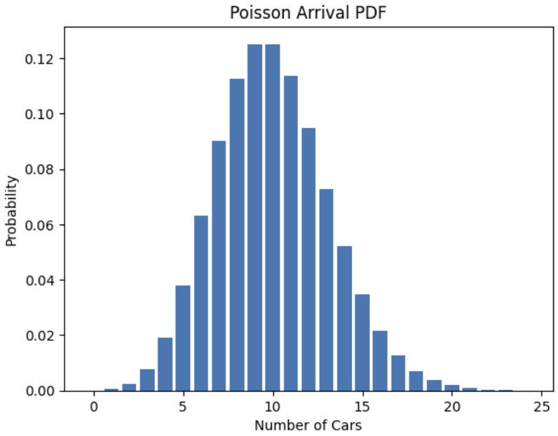
Coding And Simulation
Tools Used
Python
NumPy
Matplotlib
SciPy
Google Colab
M3 – Fixed-Time Baseline
T = 600 s
λ_NS = 0.25, λ_EW = 0.20
Green Time = 30 s (each)
Speed ~ N(40, 8)
M4 – Comparison Setup
T = 200 steps
λ_NS = λ_EW = 5 vehicles/step
Service Rate = 6 vehicles/step

Slide 19
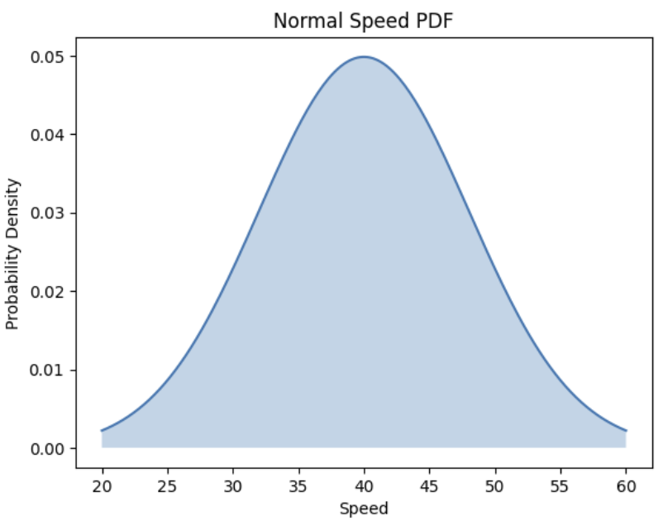
Working Logic
M3 (Fixed-Time)
Poisson arrivals
Fixed 30 s signal cycle
Queue update:
Q(t+1) = Q(t) + Arrivals − Departures
M4 Deterministic
Alternates every step
No traffic awareness
M4 Randomized
p = Q_NS / (Q_NS + Q_EW)
r ~ Uniform(0,1)
If r < p → NS, else EW
Weighted randomization (Poisson Colouring)

Slide 20
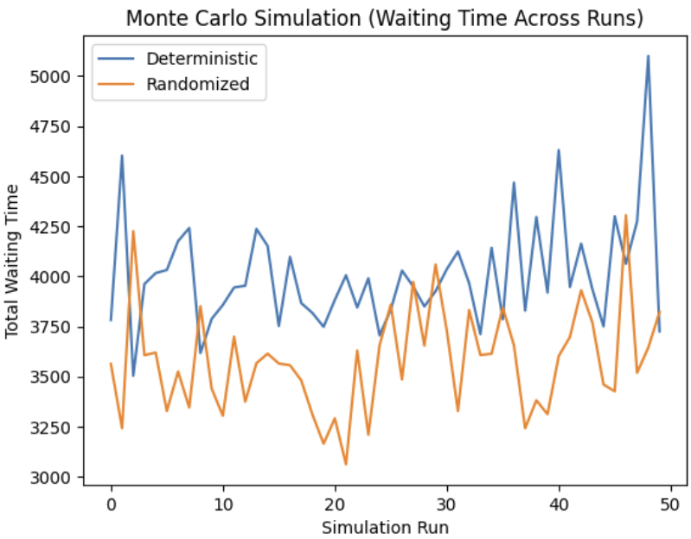
Monte Carlo, Results & Graphs
Monte Carlo Setup
Run for T = 200 steps
Metrics averaged over runs
Metrics
Waiting Time · Queue Length · Throughput
Results (M4)
Deterministic → Wait: 405.4 | Queue: 189.0 | Throughput: 1200
Randomized → Wait: 388.8 | Queue: 191.1 | Throughput: 1197
Conclusion
Lower waiting time with similar throughput
Adaptive (state-dependent) control is better
Graphs
Queue vs Time · Comparison charts · PDFs/CDFs · Waiting time distribution

Slide 21
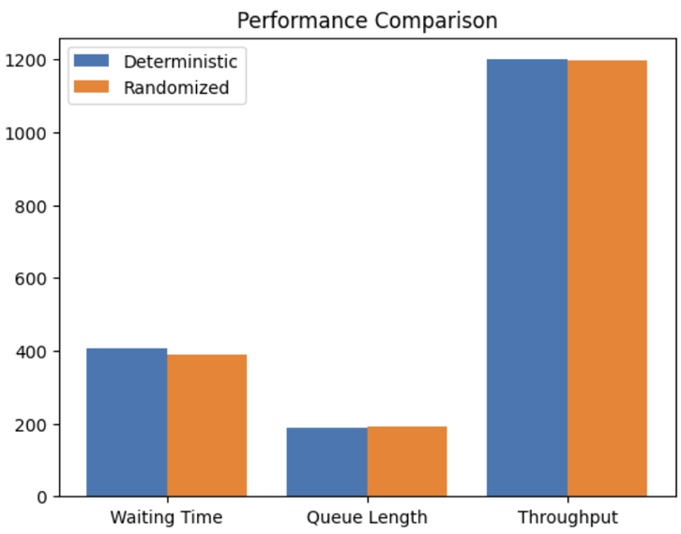

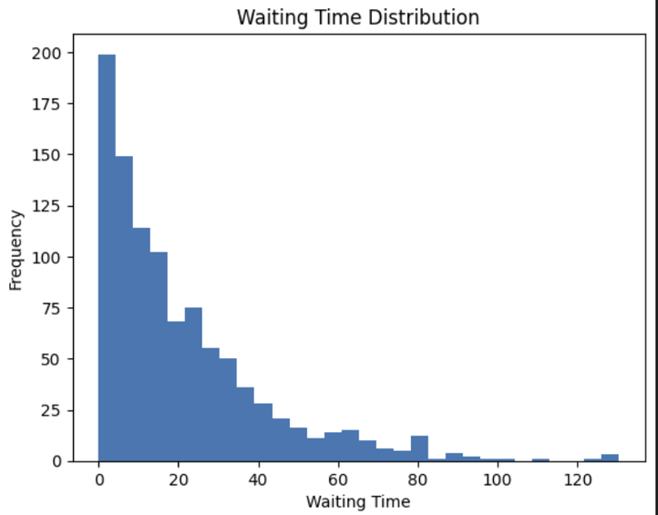
Results
M1 & M2 (Foundations): Established the stochastic nature of the system. We proved that arrivals {Poisson}(lambda) and vehicle speeds {Normal} create a high-variance environment that a simple system cannot ignore.
M3 (The Deterministic Baseline):
Result: High average waiting time (E[W]) and queue "overflow."
Insight: A State-Independent fixed timer (30s) is inefficient because it allocates resources (green light) regardless of demand.
M4 (The Randomized Leap):
Result: Significant reduction in average waiting time and more stable queue behavior.
Insight: By using Poisson Coloring, we introduced State-Dependent logic. The light "marks" the busiest lane for service based on weighted probabilities, effectively absorbing traffic bursts.
| 7
Notes:
6

Slide 22
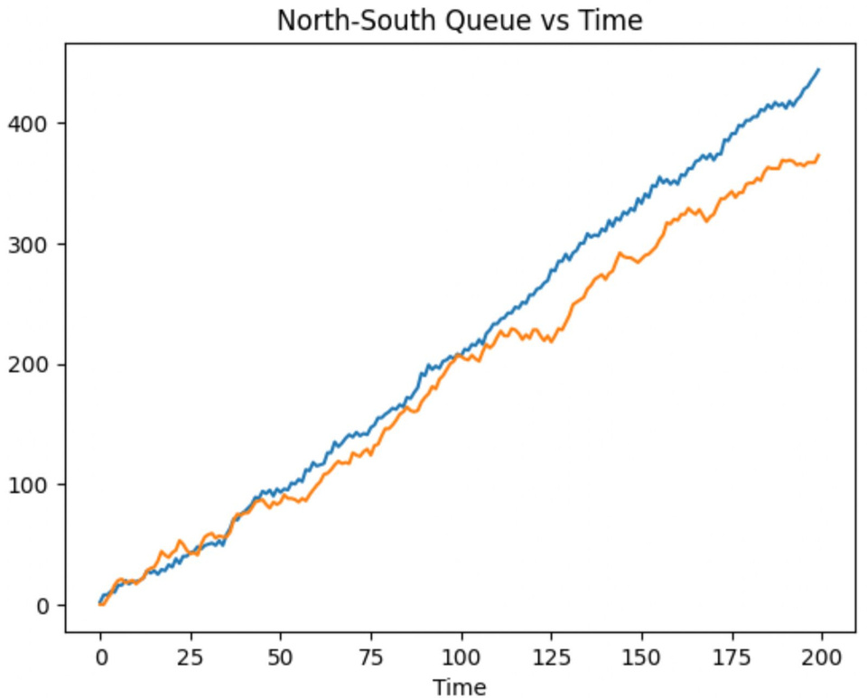
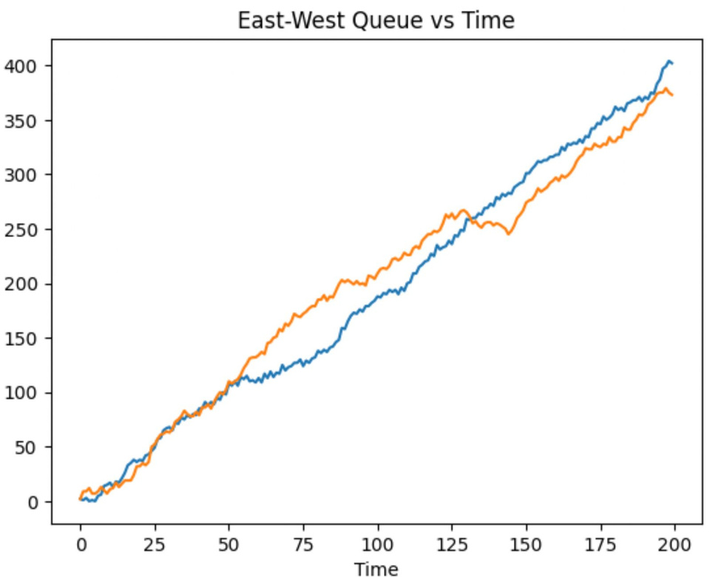
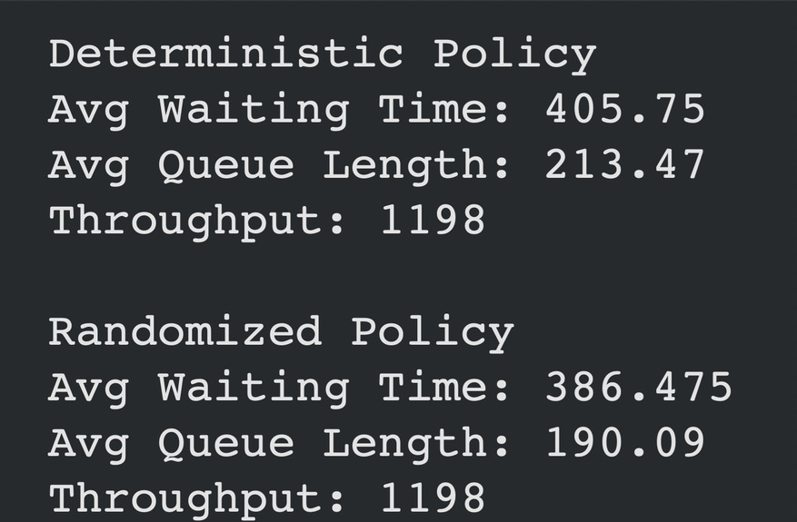
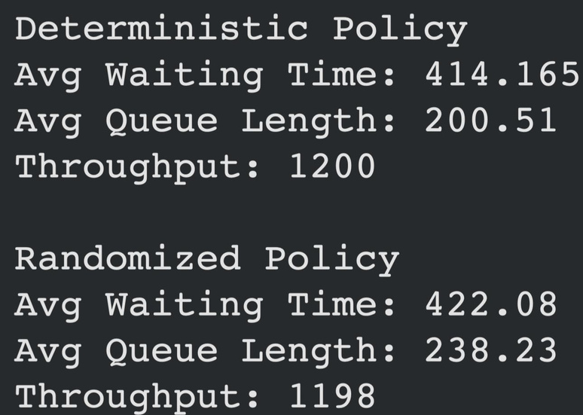

Slide 23
Inference- Domain Perspective
Probabilistic adaptation outperforms fixed timing under stochastic traffic. The randomized greedy policy reduces waiting times because it responds to real‑time imbalances.
Poisson modeling is a practical starting point for traffic arrival processes, especially when the goal is to design controllers that work under uncertainty.
Simple weighting schemes (queue‑proportional probabilities) balance efficiency and fairness without requiring complex optimization.
Monte Carlo simulation is a powerful tool to evaluate stochastic systems when analytical solutions are intractable.
The research paper’s theoretical foundations (superposition, colouring) provide rigorous justification for decomposing the intersection into independent lane processes.
| 10
Notes:
8

Slide 24
Inference- computer science perspective
State-Dependency is Key: A system that "looks" at the road (M4) will always beat a "blind" timer (M3). Observation is the first step of intelligence.
Randomness as a Tool: Poisson Marking isn't guessing—it’s a mathematical way to absorb the "shocks" of unpredictable traffic bursts.
The Efficiency-Fairness Trade-off: Maximizing total flow can lead to "Starvation" (neglecting quiet lanes).
Lesson: Smart systems need "Guardrails" (like max-red timers) to balance efficiency with fairness.
Scalability: Performance gains don't always need expensive sensors; they often just need smarter probabilistic algorithms.
The Big Picture: We transitioned from a Rigid System to an Adaptive System, moving closer to real-world "Smart City" logic.
| 9
Notes:
8

Slide 25
References
Research Paper:
http://vrs.amsi.org.au/wp-content/uploads/sites/6/2014/09/AMSI_final_Io_Kuan_Vong.pdf
Other Papers:
https://ocw.mit.edu/courses/6-041sc-probabilistic-systems-analysis-and-applied-probability-fall-2013/
https://www.britannica.com/topic/Poisson-distribution
https://www.khanacademy.org/math/statistics-probability/modeling-distributions-of-data/normal-distributions-library/a/normal-distributions-review
https://ops.fhwa.dot.gov/publications/fhwahop08024/chapter5.htm
https://en.wikipedia.org/wiki/Queueing_theory

