Slide 1

EcoTrack: Measure, Monitor, Minimize
EcoTrack is a user-friendly web application designed to empower individuals to monitor and reduce their carbon footprints. Measure, monitor, and minimize for a greener future.
By:
BugFinders(Ishika Goel & Kamya Jindal)

Slide 2

What is EcoTrack?
EcoTrack is a user-friendly web application that allows individuals to easily track and reduce their carbon footprints. Through personalized insights and actionable tips, users can make informed choices to lessen their environmental impact.

Slide 3

Features
Inputting Lifestyle Choices
Personalized Insights
EcoTrack allows users to input their lifestyle choices and activities, providing a comprehensive overview of their carbon footprint.
Users receive personalized insights into their individual environmental impact, helping them understand their contributions to climate change.
Actionable Tips
EcoTrack provides actionable tips tailored to users' habits, helping them make sustainable choices and reduce their carbon footprints.

Slide 4

Benefits
1
Informed Decisions
2
Greener Future
EcoTrack empowers users to make informed decisions by providing them with the knowledge they need to understand the environmental impact of their choices.
By tracking and reducing their carbon footprints, users contribute to a greener future by minimizing their impact on the environment.
3
Importance of Tracking
Tracking and reducing carbon footprints is crucial in mitigating climate change and preserving the planet for future generations.

Slide 5

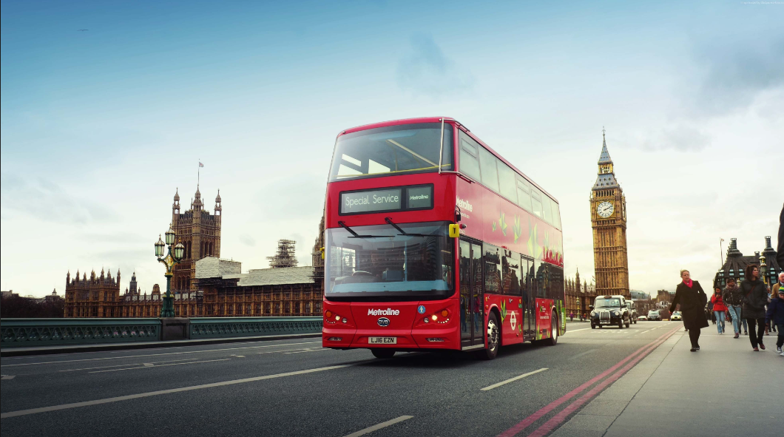

Tips for Sustainable Choices
Eat Locally and Seasonally
Opt for Public Transportation
Bring Your Own Bags
By using reusable shopping bags, you can reduce plastic waste and promote a more sustainable and eco-conscious shopping experience.
Support local farmers and reduce your carbon footprint by consuming locally sourced, seasonal produce. It's a delicious and sustainable choice.
Reduce greenhouse gas emissions by utilizing public transportation whenever possible. It's an eco-friendly choice that helps alleviate traffic congestion.

