Slide 1
Advanced Programming in Python language
Final exam presentation by:
Dias Kamza
Yerasyl Usen
Yerkebulan Zhigerbaev

Slide 2

Main tasks
Authorize the user by checking from database
Display a list of articles and their summary for the desired cryptocurrency
Show result using bootstrap design

Slide 3




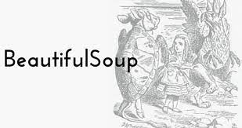


Slide 4
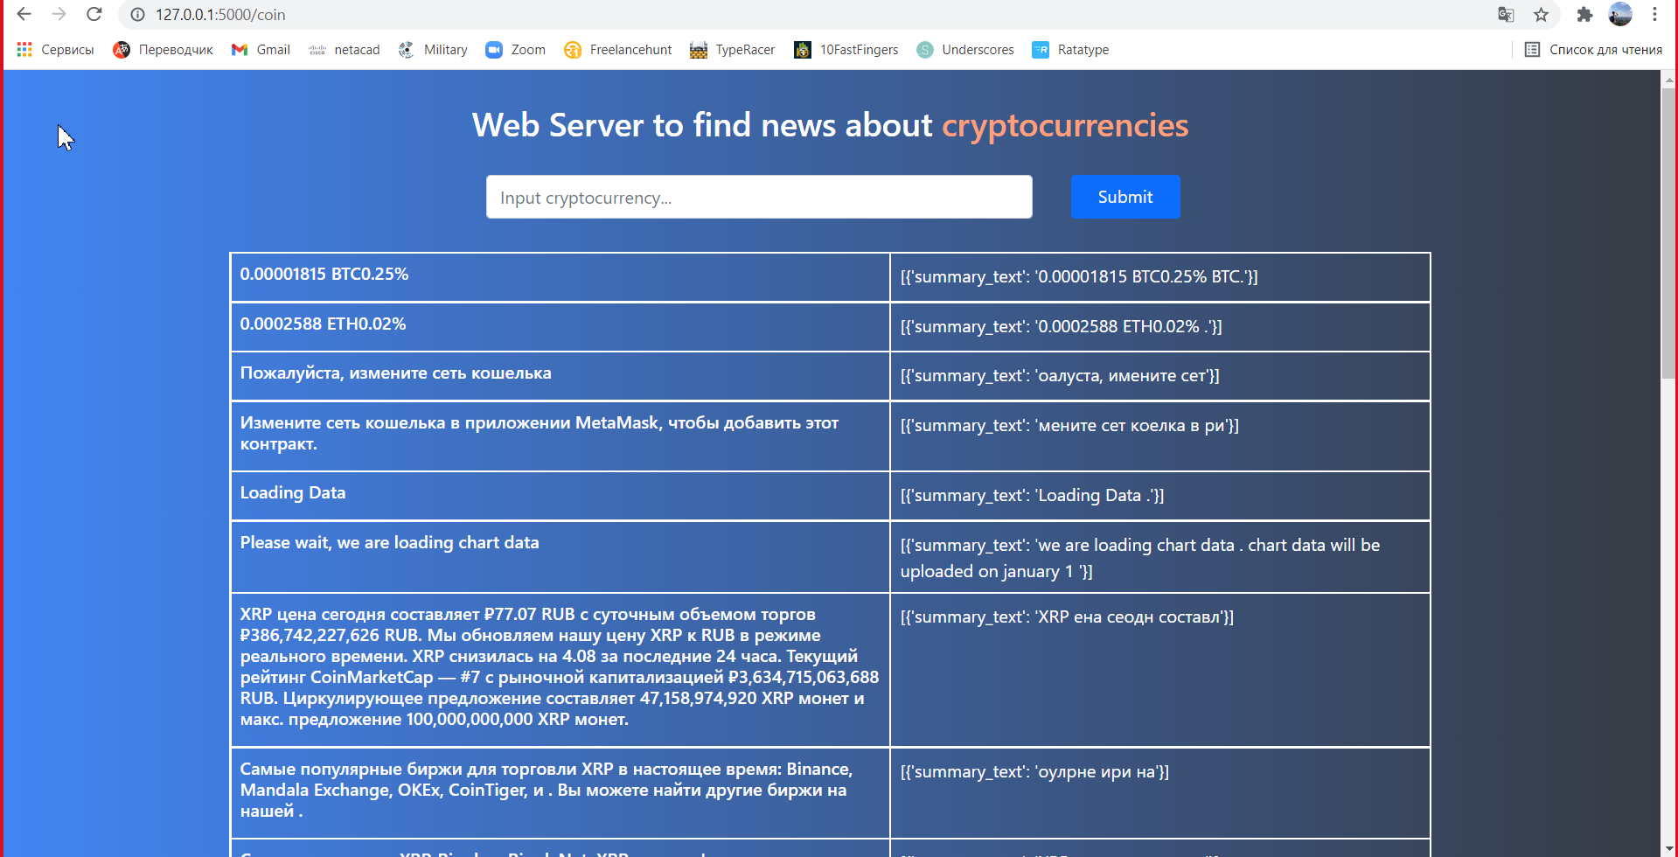
Some screenshots of output result

Slide 5
The end
We hope you enjoyed our presentation

