Slide 1
Locally Linear Classification
Project Presentation: Foundations of Machine Learning

Slide 2
Team and Roles:
Yucong Lei
Kamila Zaman
Zhiye Xie
Theoretical Correctness of the Algorithm
Validity of possible input distributions
Algorithm Development
Experimental Analysis
Comparison to SVM
Theoretical Bound and Generalization Analysis

Slide 3
Discussion
Introducing the Algorithm
Development Approach and Experimental Results
Theoretical Analysis

Slide 4
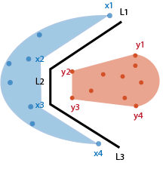
Problem Setting
Binary Classification : -1, 1
Number of samples: m
Decision boundary: Piecewise hyperplane
Non-linearly separable
Dimension of Feature Space: 2D, can be generalized to higher dimension

Slide 5
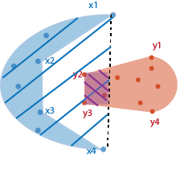
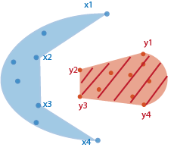
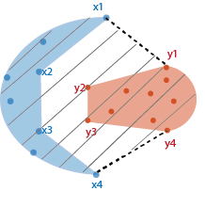
Convex Hulls
Convex Hull of dataset
Convex Hull of Class -1
Convex Hull of Class 1
Purple region highlights mis-classified points

Slide 6
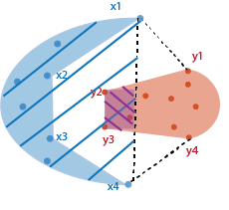
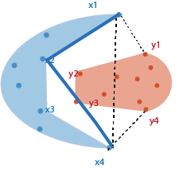
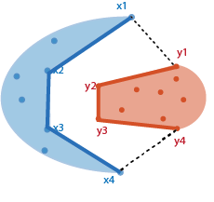
Finding the boundary region

Slide 7
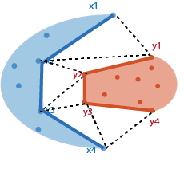
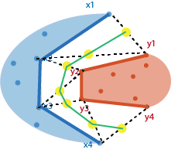
Triangularization

Slide 8
Properties of our Algorithm
Zero Empirical Error
High Dimensionality

Slide 9
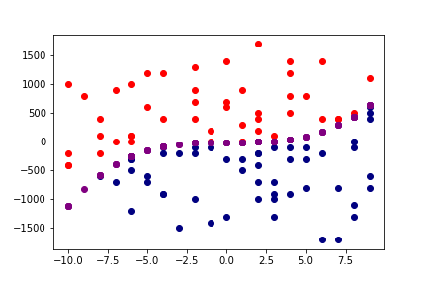
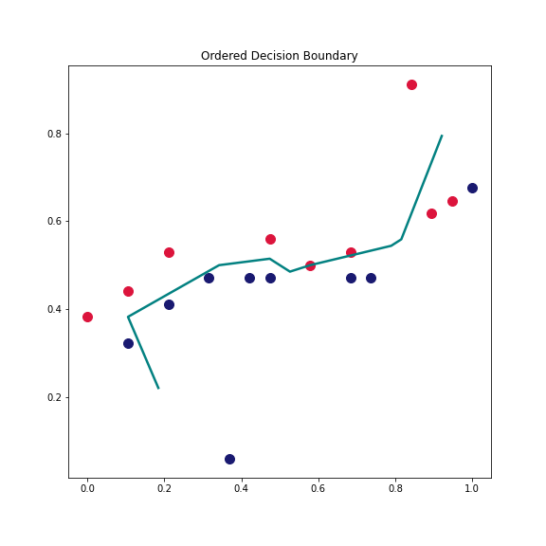
Algorithm - Locally Linear Classifier
above y
below y
y= x³ ,

Slide 10
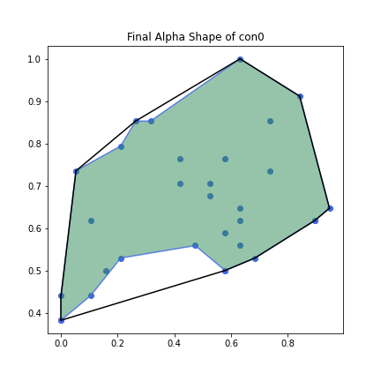
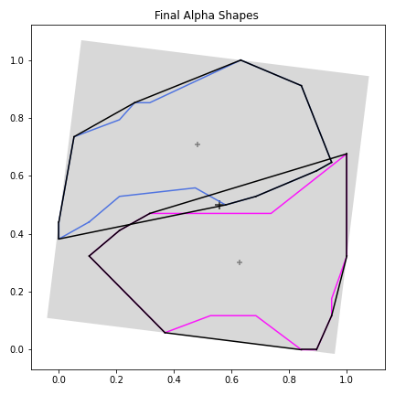
Convex Hull Vs Pseudo-Convex Hull
Convex Hull
Is the smallest convex polygon P for a set Q such that each point in Q is either on the boundary of P or interior of it.
Pseudo-Convex Hull (Alpha Shape):
A tightly bound form of convex hull, which preserves greater geometry of the given data
Black Lines → Convex Hulls
Colored Line → Pseudo Convex Hulls

Slide 11
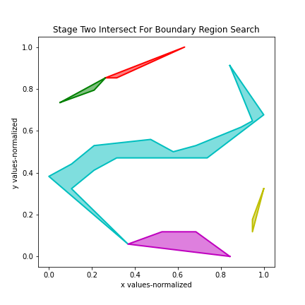
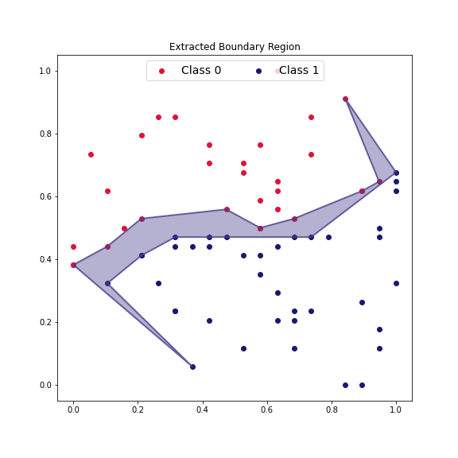
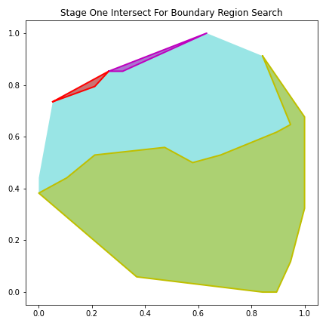
The Boundary Region

Slide 12
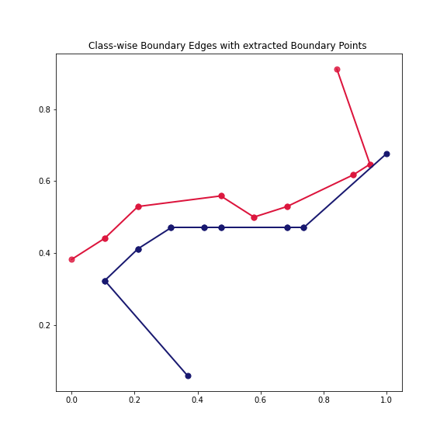
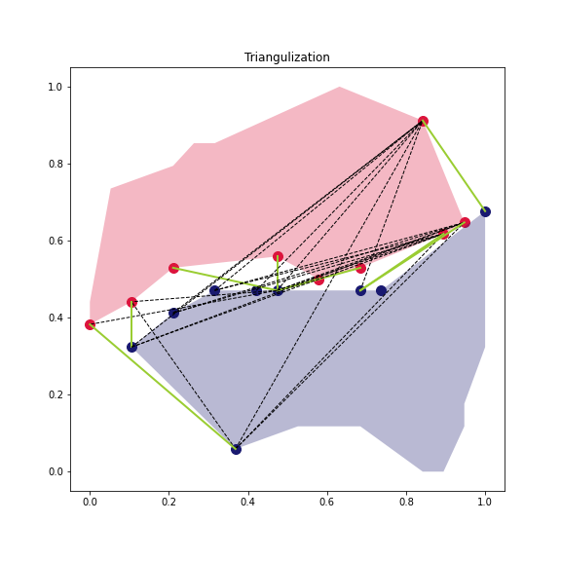
The Boundary Region - Triangulate

Slide 13
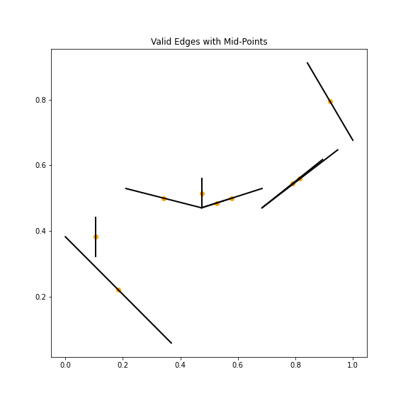
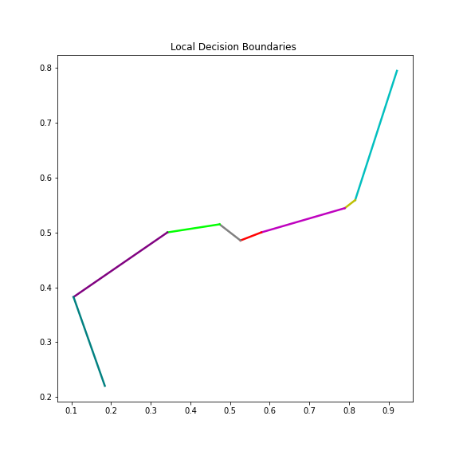
The Decision Boundary - Construction

Slide 14
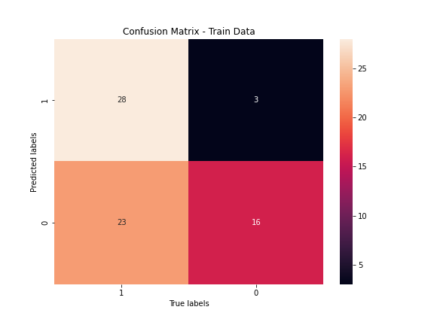
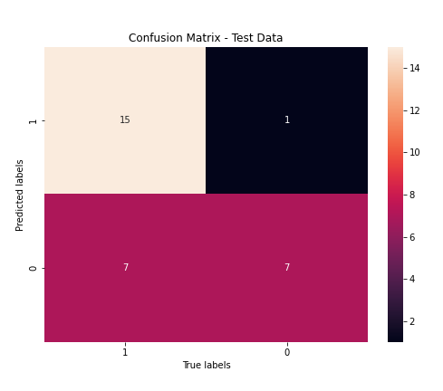
Evaluation Metrics
Metric | Train | Test
Error: | 0.37 | 0.26
Accuracy: | 0.63 | 0.73
F1-Score(macro): | 0.62 | 0.71
F1-Score(micro): | 0.60 | 0.73
F1-Score(weighted): | 0.63 | 0.71

Slide 15
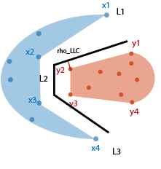
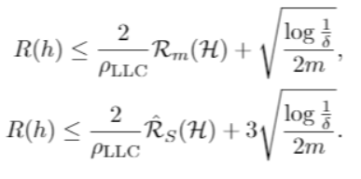
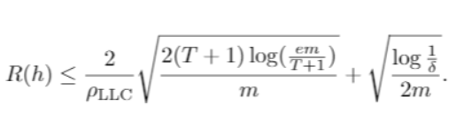
Theoretical Analysis
Zero empirical error
Zero empirical margin loss by setting Ꝭ = Ꝭ_{LLC}
Margin bound for locally linear classification problem:

Slide 16
Thank You!

Slide 17
Algorithm - Locally Linear Classifier
“To find a piece-wise hyperplane as decision boundary constructed from local region classifiers(local hyperplanes) within decision space of two classes for non-linearly separable distribution”
“Combination of local line segments to form the final decision boundary”

Slide 18
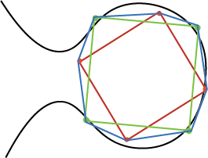
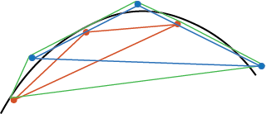
Corner Cases - Exclusion
*Any data distribution that has more than 2 cross-edges over its alpha shapes is a corner case

Slide 19
Presentation Outline:
1. Introducing group members and their main contributions to the project (Yucong: proposing algorithms, Kamila: experiment, Zhiye: theoretical analysis). Schedule of the presentation: introducing algorithm -> experimental results -> theoretical analysis
2. Presenting algorithm:
2.0 basic setting of the algorithm: m samples, 2 classes (-1 and 1), non-linear separable, but can be separated by piecewise linear hyperplanes. Emphasize that for the sake of illustration, we present our algorithm in 2-D feature space. It can be later generalized to high-D space. Use Figure 1
2.1 Briefly explain what is convex hull on sample points. Use Figure 2 to explain the convex hull of data set, class -1, class +1 separately.
2.2 Show how to learn the boundary region from convex hulls by using the back-off trick. Use Figure 3. Emphasis what is our boundary region we want to work on.
2.3 Show how to triangularize the boundary region and create our hypothesis. Use Figure 4
2.4 explain why it has zero empirical error, why it can be generalized to high-D space
3. Experimental results
4. Theoretical analysis

Slide 20
The Model – Testing & Evaluation
Non-Separable Test Cases
Quadratic: y = x² + 3x + 2
Cubic: y = x + 5

Slide 21
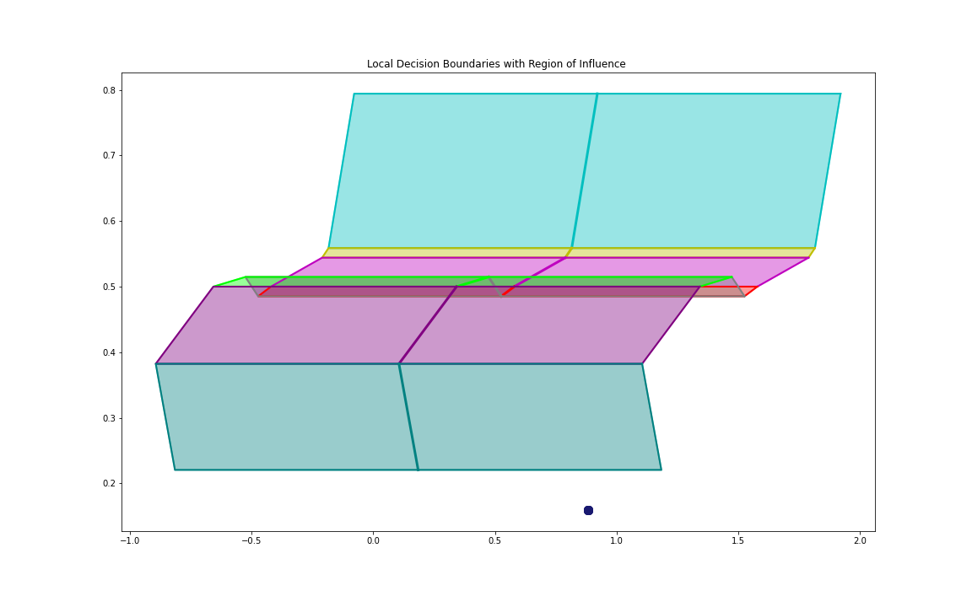
Prediction Strategy- Influence Region
Saved Model Structure:
Local hyperplanes
Corresponding Influence Region
Right and Left class marker
Prediction:
New point
Find region it falls in
Get corresponding line classifier
Map point orientation to line
Mark class accordingly

